Slide 1


Early-arrival waveform inversion for near-surface velocity estimation
Xukai Shen
Mar 3rd 2015

Slide 2
Outline
1. Motivation
2. Data examples
3. Conclusion

Slide 3
Outline
1. Motivation
2. Data examples
3. Conclusion

Slide 4
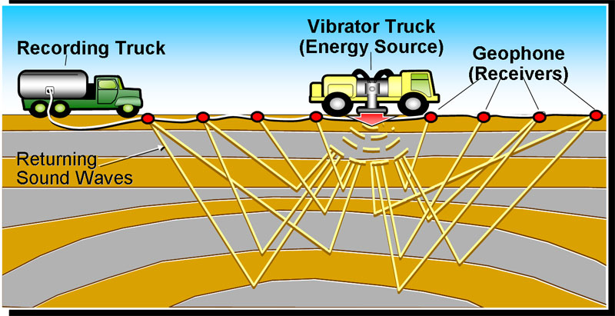
Seismic survey
x
z

Slide 5
Seismic survey
x
t
x
z

Slide 6
Seismic survey
x
t
x
z

Slide 7
Seismic survey
x
t
x
z

Slide 8
Seismic imaging
x
t
x
z
?

Slide 9
Seismic imaging
x
t
x
z
?
Velocity
Image

Slide 10
Seismic imaging
x
t
x
z

Slide 11
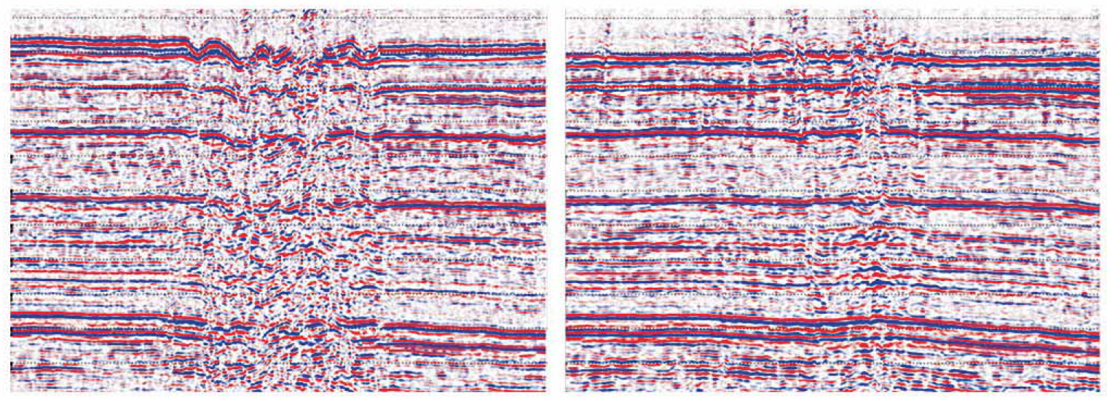
Near-surface impact on imaging
Image with bad near-surface V
Image with good near-surface V
(Keho and Kelamis, 2010)

Slide 12
Near-surface impact on imaging
Image with bad near-surface V
Image with good near-surface V
(Keho and Kelamis, 2010)

Slide 13
Good near-surface velocity model is crucial for subsurface imaging

Slide 14
Early-arrival waveform inversion for near-surface velocity estimation

Slide 15
Early-arrival waveform inversion for near-surface velocity estimation

Slide 16
Early-arrival waveform inversion for near-surface velocity estimation

Slide 17
v=v₀
Waveform Inversion
(WI)
(Tarantola, 1984)
v=v+g(d_{res})
Wave-equation modeling, generate d_{cal}
Subtract d_{cal} from d_{obs}, generate d_{res}
No
d_{res} small enough
Yes
Finish

Slide 18
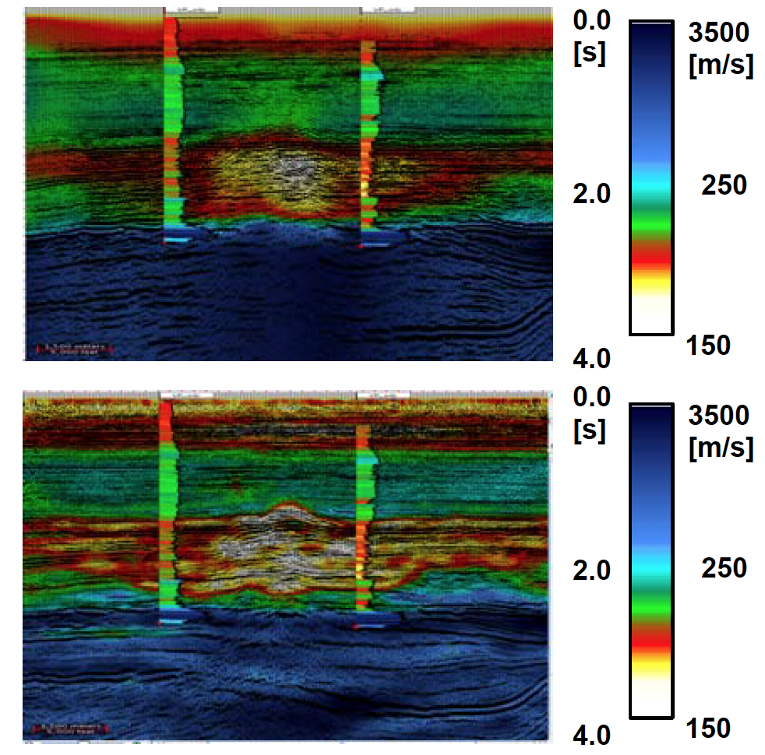
x
3500
(m/s)
2500
1500
Velocity
Before
WI
z
x
3500
(m/s)
2500
1500
Velocity
After
WI
z
(Barkved et al., 2010)

Slide 19
x
3500
(m/s)
2500
1500
Velocity
Before
WI
z
x
3500
(m/s)
2500
1500
Velocity
After
WI
z
(Barkved et al., 2010)

Slide 20
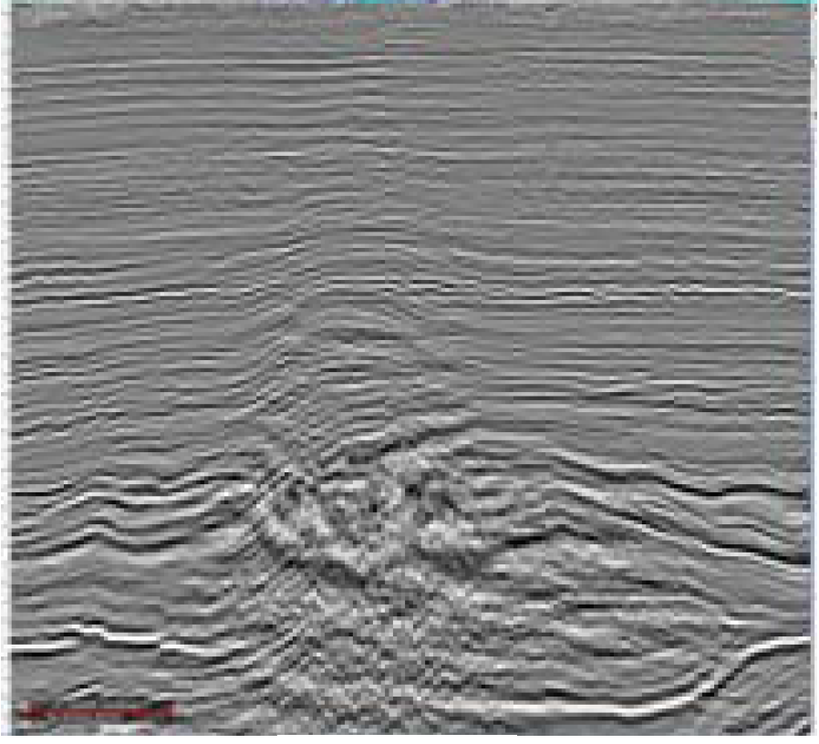
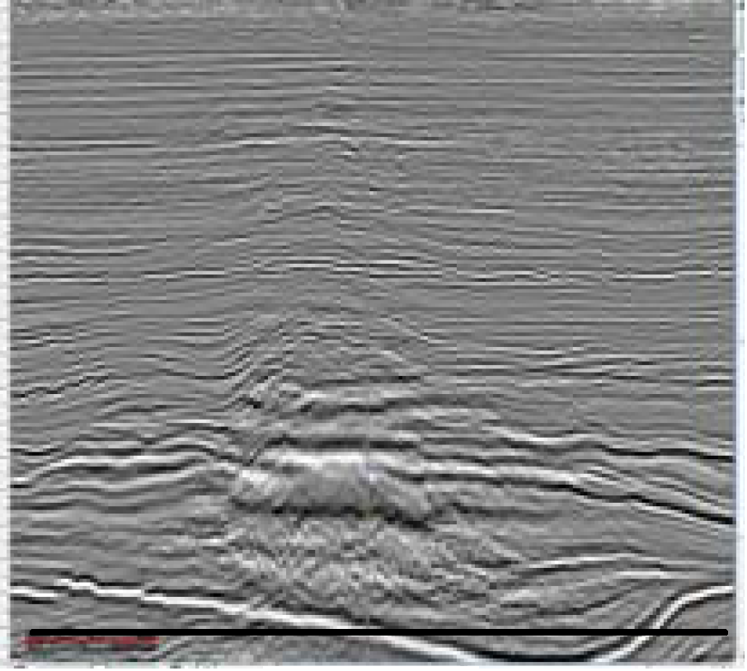
x
Image
Before
WI
z
x
Image
After
WI
z
(Barkved et al., 2010)

Slide 21
x
Image
Before
WI
z
x
Image
After
WI
z
(Barkved et al., 2010)

Slide 22
WI gives high-resolution near-surface velocity model

Slide 23
WI gives high-resolution near-surface velocity model
WI results lead to better images of both near-surface and subsurface

Slide 24
Early-arrival waveform inversion for near-surface velocity estimation

Slide 25
Early-arrival waveform inversion for near-surface velocity estimation

Slide 26
Early-arrivals:

Slide 27
Early-arrivals: mainly refractions, diving waves

Slide 28
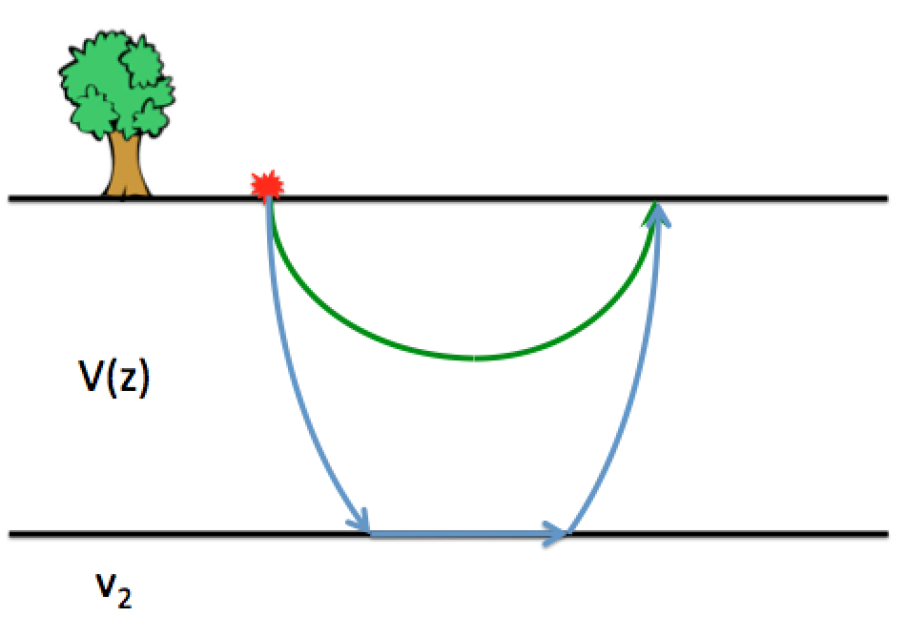
Early-arrivals: mainly refractions, diving waves

Slide 29
Early-arrivals: mainly refractions, diving waves
  Usually exist

Slide 30
Early-arrivals: mainly refractions, diving waves
  Usually exist
  Illuminate near-surface well

Slide 31
Early-arrivals: mainly refraction, diving waves
x
t
Land shot gather

Slide 32
Early-arrivals: mainly refraction, diving waves
x
  Good signal-to-noise ratio
t
Land shot gather

Slide 33
Early-arrival waveform inversion for near-surface velocity estimation

Slide 34
Near-surface velocity estimation:
Important for seismic imaging on land.
Waveform inversion:
Effective for near-surface velocity estimation.
Early-arrival:
Good data for waveform inversion.

Slide 35
v=v₀
Waveform Inversion
(WI)
(Tarantola, 1984)
v=v+g(d_{res})
Wave-equation modeling, generate d_{cal}
Subtract d_{cal} from d_{obs}, generate d_{res}
No
d_{res} small enough
Yes
Finish

Slide 36
v=v₀
Waveform Inversion
(WI)
(Tarantola, 1984)
v=v+g(d_{res})
Wave-equation modeling, generate d_{cal}
Subtract d_{cal} from d_{obs}, generate d_{res}
No
d_{res} small enough
Yes
Finish

Slide 37
Challenge #1: Exact data matching

Slide 38
Seismic survey
x
t
x
z

Slide 39
Seismic survey
x
t
x
z
Source impulse
Source coupling
…

Slide 40
Seismic survey
x
t
x
z
Vp
Vs
Density
…

Slide 41
Seismic survey
x
t
x
z
Receiver response
Receiver coupling
…

Slide 42
Match non-acoustic amplitude with acoustic wave-equation modeled amplitude

Slide 43
Challenge #2: Initial model building for WI

Slide 44
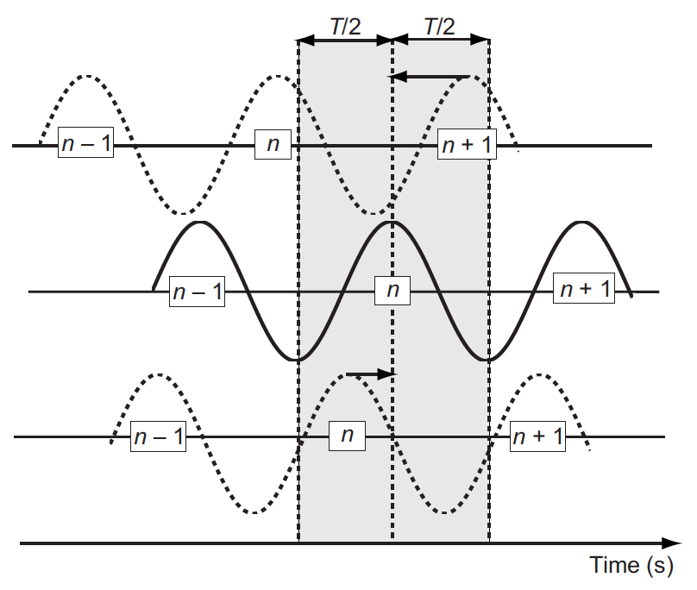
WI initial model requirement
d_{cal}(v₀)
d_{obs}
d_{cal}(v₀)
Initial model
Observed data
Calculated data
(Virieux and Operto, 2009)

Slide 45
WI initial model requirement
d_{cal}(v₀) Bad v₀
d_{obs}
d_{cal}(v₀) Good v₀
Initial model
Observed data
Calculated data
(Virieux and Operto, 2009)

Slide 46
Thesis Structure
Chapter 1
Introduction
Initial model building by WTI
Kinematic WI (KWI) Objective function
Random boundary condition
3D Examples
Chapter 2
Chapter 3
Chapter 4
Chapter 5

Slide 47
Thesis Structure
Chapter 1
3D Examples
Chapter 2
Chapter 3
Chapter 4
Chapter 5

Slide 48
Outline
1. Motivation
2. Data examples
3. Conclusion

Slide 49
3D synthetic blind test, based on onshore data Brazil

Slide 50
3D synthetic blind test, based on onshore data Brazil
Given:
Initial model
Data and source wavelet, low-cut at 5 Hz

Slide 51
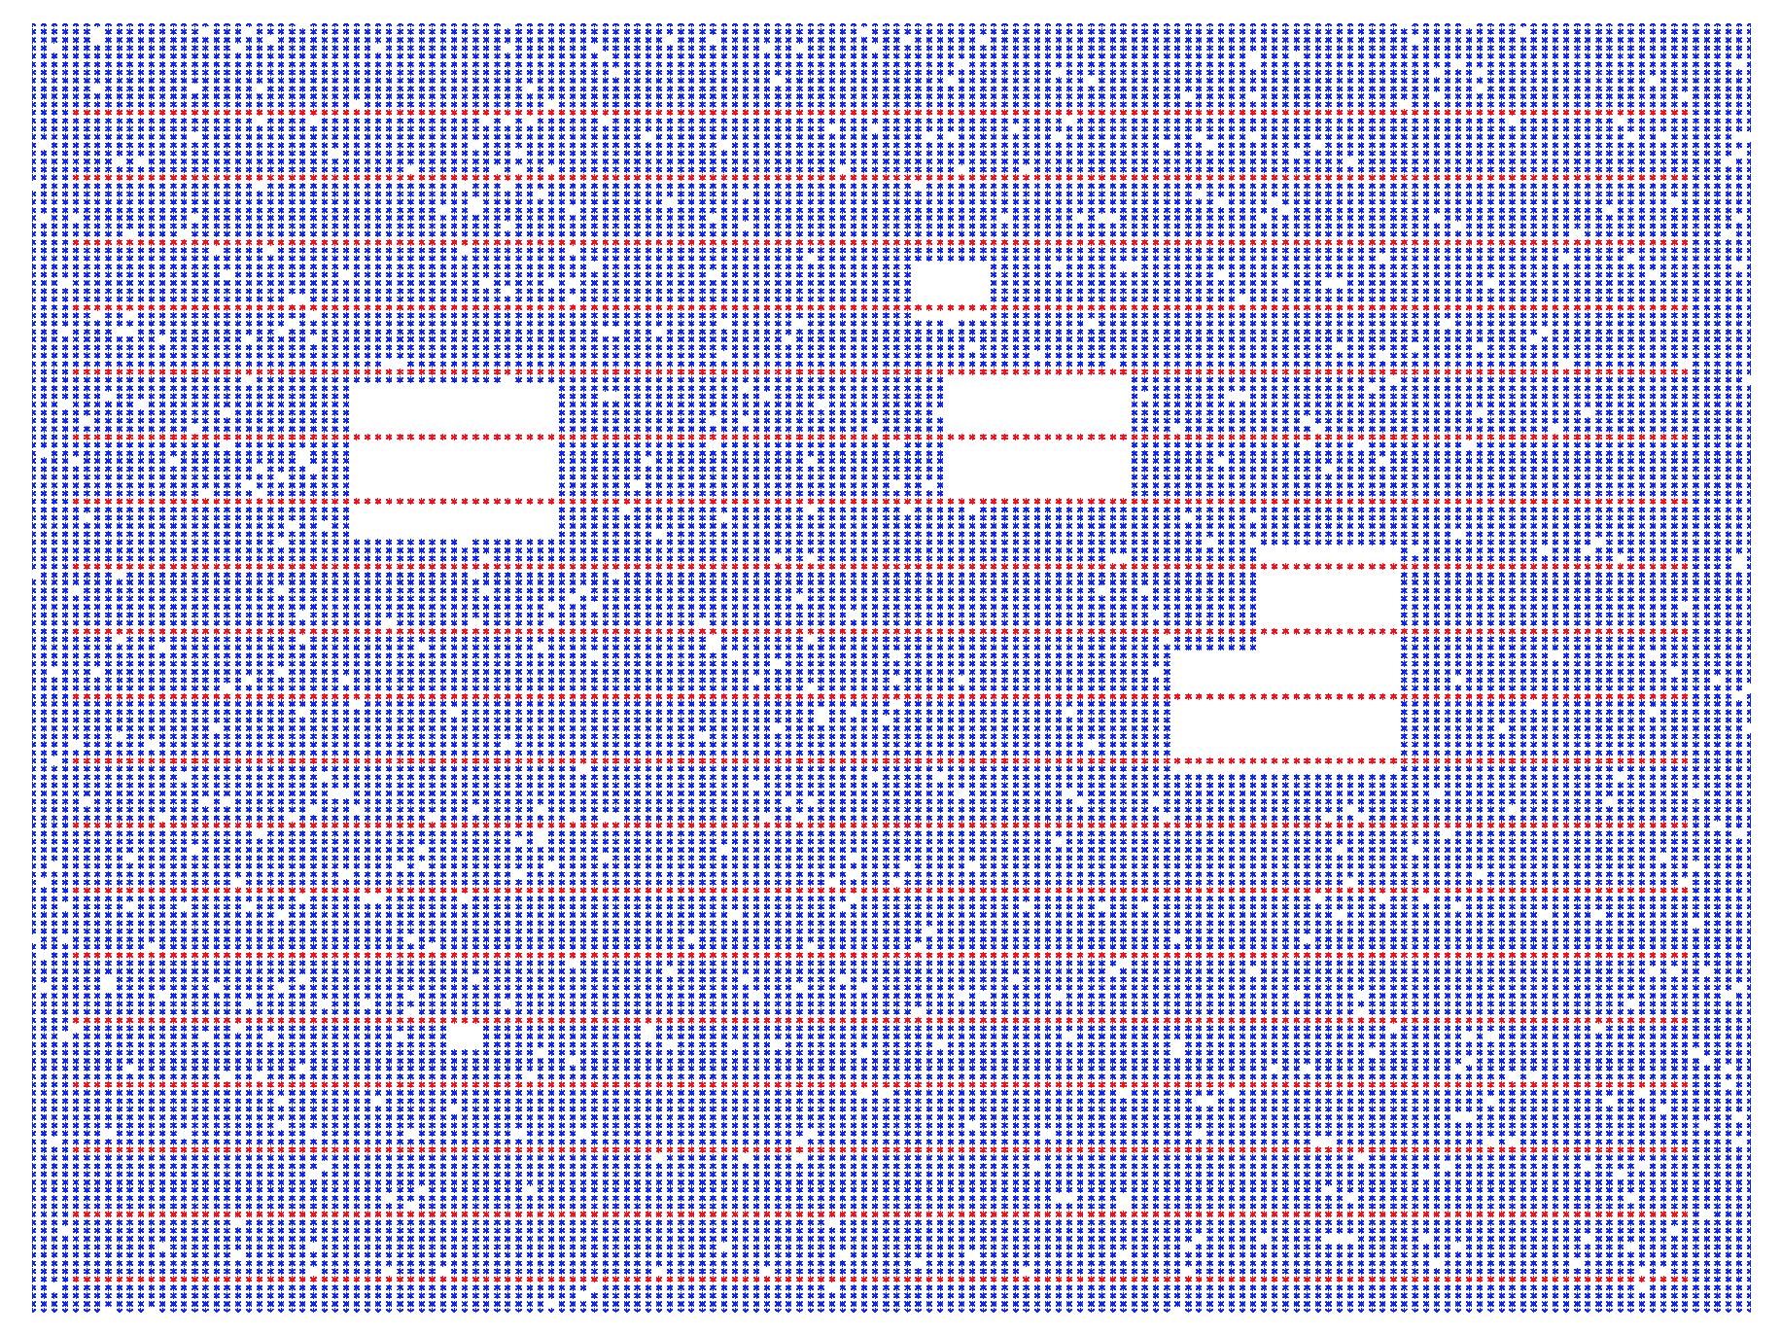
Acquisition
geometry
  source
  receiver

Slide 52
Acquisition
geometry
  source
  receiver
  4 km

Slide 53
Acquisition
geometry
  source
  receiver
  4 km

Slide 54
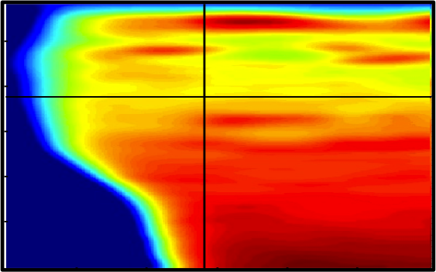
Z
Y
In-line section
X

Slide 55
Z
X-line section
Y
In-line section
X

Slide 56
Depth slice
Z
X-line section
Y
In-line section
X

Slide 57

Depth slice
Z
X-line section
Y
In-line section
X

Slide 58
Depth slice
Y
Z
In-line section
X-line section
X
Y

Slide 59
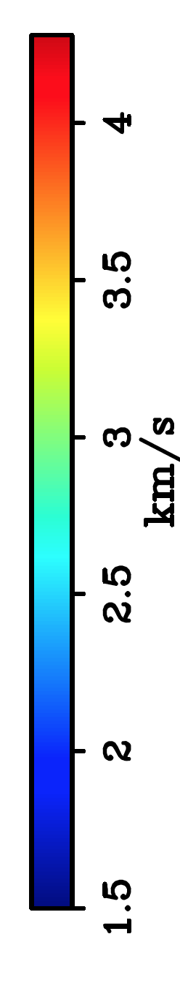
True model

Slide 60
Initial model

Slide 61
Input data
4000 2000 -0.2

Slide 62
Input data
Lowpass filter
4000 2000 -0.2

Slide 63
Input data
Lowpass filter
Time window
4000 2000 -0.2

Slide 64
Input
first-breaks
for WTI
4000 2000 -0.2

Slide 65
Modeled
first-breaks
before WTI
4000 2000 -0.2

Slide 66
Modeled
first-breaks
after WTI
4000 2000 -0.2

Slide 67
Input
first-breaks
for WTI
4000 2000 -0.2

Slide 68
Traveltime error before WTI

Slide 69
Traveltime error after WTI

Slide 70
Initial model

Slide 71
WTI result

Slide 72
Offset
histogram

Slide 73
Single trace WTI gradient

Slide 74
Step 1 : WTI, lowpass 10Hz, first-breaks only (11 iterations)

Slide 75
Step 1 : WTI, lowpass 10Hz, first-breaks only (11 iterations)
Step 2 : KWI, lowpass 10Hz, all data (16 iterations)
Step 3 : KWI, lowpass 17Hz, all data (12 iterations)
Step 4 : KWI, no bandpass, all data (25 iterations)

Slide 76
Step 1 : WTI, lowpass 10Hz, first-breaks only (11 iterations)
Step 2 : KWI, lowpass 10Hz, all data (16 iterations)
Step 3 : KWI, lowpass 17Hz, all data (12 iterations)
Step 4 : KWI, no bandpass, all data (25 iterations)

Slide 77
WTI result

Slide 78
Final KWI result

Slide 79
True model

Slide 80
Final KWI result

Slide 81
Initial model

Slide 82
Observed
early-arrivals
4000 2000 -0.2

Slide 83
Modeled
early-arrivals
after KWI
4000 2000 -0.2

Slide 84
Data residual
after KWI
4000 2000 -0.2

Slide 85
True model

Slide 86
True model
1.5km/s

Slide 87
Final KWI result

Slide 88
First layer velocity in the final KWI result

Slide 89
Outline
1. Introduction
2. Data examples
3. Conclusions

Slide 90
Early Arrival Waveform Inversion can recover high-resolution near-surface velocity model.

Slide 91
Early Arrival Waveform Inversion can recover high-resolution near-surface velocity model.
Amplitude matching is difficult in onshore applications, hence should be de-emphasized.

Slide 92
Early Arrival Waveform Inversion can recover high-resolution near-surface velocity model.
Amplitude matching is difficult in onshore applications, hence should be de-emphasized.
WTI can build good starting models for Early Arrival KWI.

Slide 93
Thank
  Yi Luo for suggesting WTI for the WI initial model building.

Slide 94
Thank
  Yi Luo for suggesting WTI for the WI initial model building.
  Robert Clapp for generating the 3D blind test data.

