Slide 1

JUMPSTARTING
NEURAL NETWORK TRAINING
FOR SEISMIC PROBLEMS
Fantine Huot (Stanford Geophysics)
Advised by Gregory Beroza & Biondo Biondi (Stanford Geophysics & ICME)
SEP 172

Slide 2
LEARNING FROM DATA
Deep learning networks can learn very accurate mappings from inputs to outputs from large amounts of labeled data
NOISE REMOVAL
OBJECT DETECTION
EVENT DETECTION
IMAGE SEGMENTATION
However, these models are immensely data-hungry and rely on huge amounts of labeled data to achieve their performance
Notes:
“As of 2016, a rough rule of thumb is that a supervised deep learning algorithm will generally achieve acceptable performance with around 5,000 labeled examples per category and will match or exceed human performance when trained with a dataset containing at least 10 million labeled examples.”

Slide 3
CHALLENGES & LIMITATIONS
LIMITED LABELED DATA
POOR GENERALIZATION
The earth is intrinsically unlabeled
Absence of ground truth
Uncertain labels
Fuzzy boundaries
Unbalanced data sets with rare events
The real world is messy
Infinite number of novel scenarios
Many sources of noise
Small signal to noise ratio
Incomplete data, drop outs
The ability to transfer knowledge to new conditions is generally known as transfer learning
Notes:
What our models still frightfully lack is the ability to generalize to conditions that are different from the ones encountered during training.
Every time we apply our model not to a carefully constructed dataset but to the real world.
The real world is messy and contains an infinite number of novel scenarios, many of which our model has not encountered during training and for which it is in turn ill-prepared to make predictions.

Slide 4
TRADITIONAL SUPERVISED LEARNING
Source task / Domain
Target task / Domain
Training and evaluation on the same task or domain
LARGE
SMALL
3
Notes:
In the classic supervised learning scenario of machine learning, if we intend to train a model for some task and domain A, we assume that we are provided with labeled data for the same task and domain.
We can now train a model A on this dataset and expect it to perform well on unseen data of the same task and domain.
On another occasion, when given data for some other task or domain B, we require again labeled data of the same task or domain that we can use to train a new model B so that we can expect it to perform well on this data.
The traditional supervised learning paradigm breaks down when we do not have sufficient labeled data for the task or domain we care about to train a reliable model.

Slide 5
TRANSFER LEARNING
Source task / Domain
Target task / Domain
Storing knowledge gained solving one problem and applying it to a different but related problem
LARGE
SMALL
KNOWLEDGE
4
Notes:
In practice, we seek to transfer as much knowledge as we can from the source setting to our target task or domain. This knowledge can take on various forms depending on the data: it can pertain to how objects are composed to allow us to more easily identify novel objects; it can be with regard to the general words people use to express their opinions, etc.

Slide 6
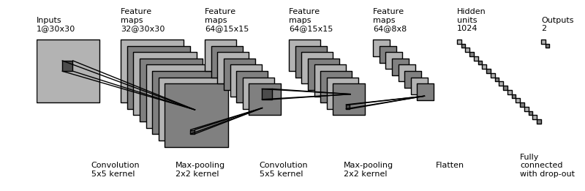
CONVOLUTIONAL NEURAL NETWORK

Slide 7
TRANSFER LEARNING SCENARIOS
Size of data set
Fine tune
pretrained source model
Train target model from scratch
Fine tune
pretrained source model
Train target model from scratch
Problem
similarity
Fine tune the lower layers of the pretrained model
Fine tune the output dense layer of the pretrained model
Fine tune the lower layers of the pretrained model
Fine tune the output dense layer of the pretrained model
6

Slide 8
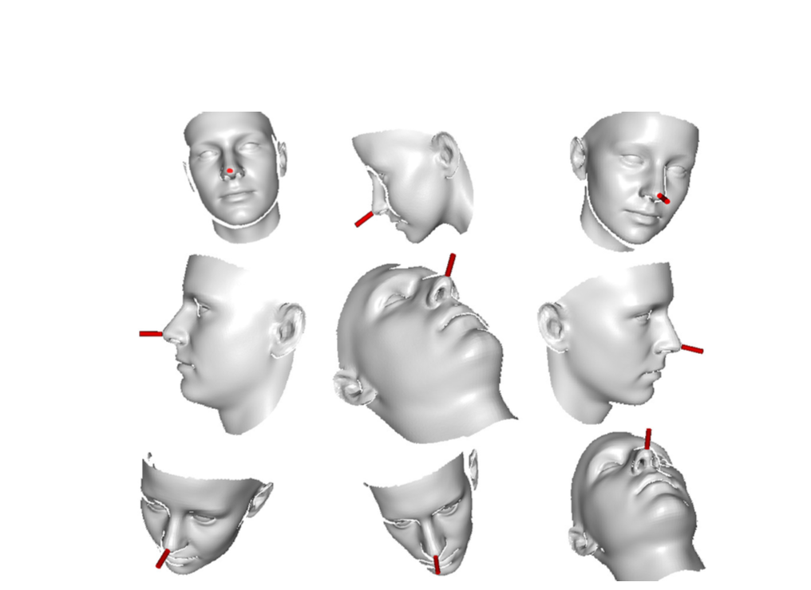
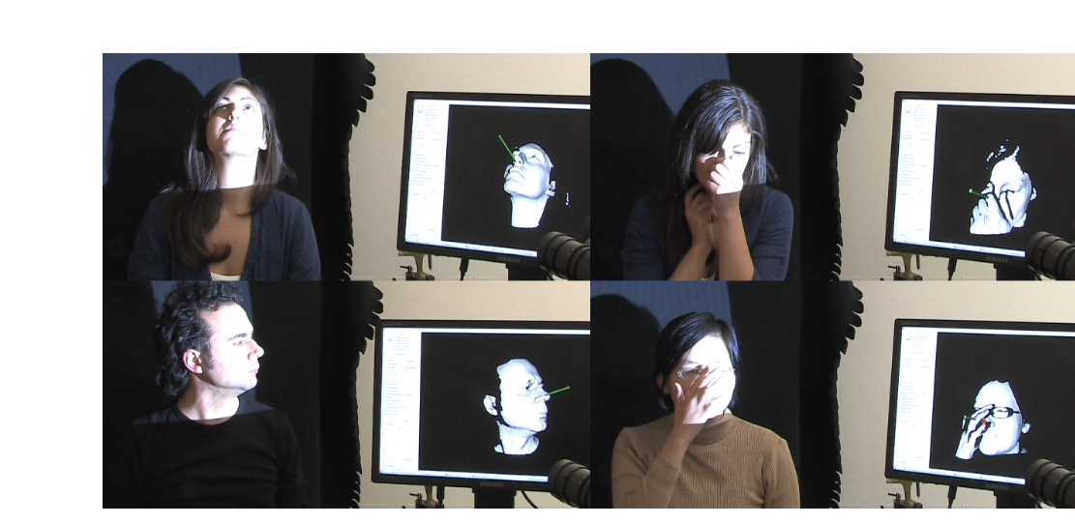
SYNTHETIC DATA GENERATION
Transfer learning has been successfully implemented for character recognition in natural images, traffic sign recognition, handwriting recognition, face recognition or protein interactions etc
Fanelli et al., 2011

Slide 9
SMALL AMPLITUDE
EARTHQUAKE DETECTION

Slide 10
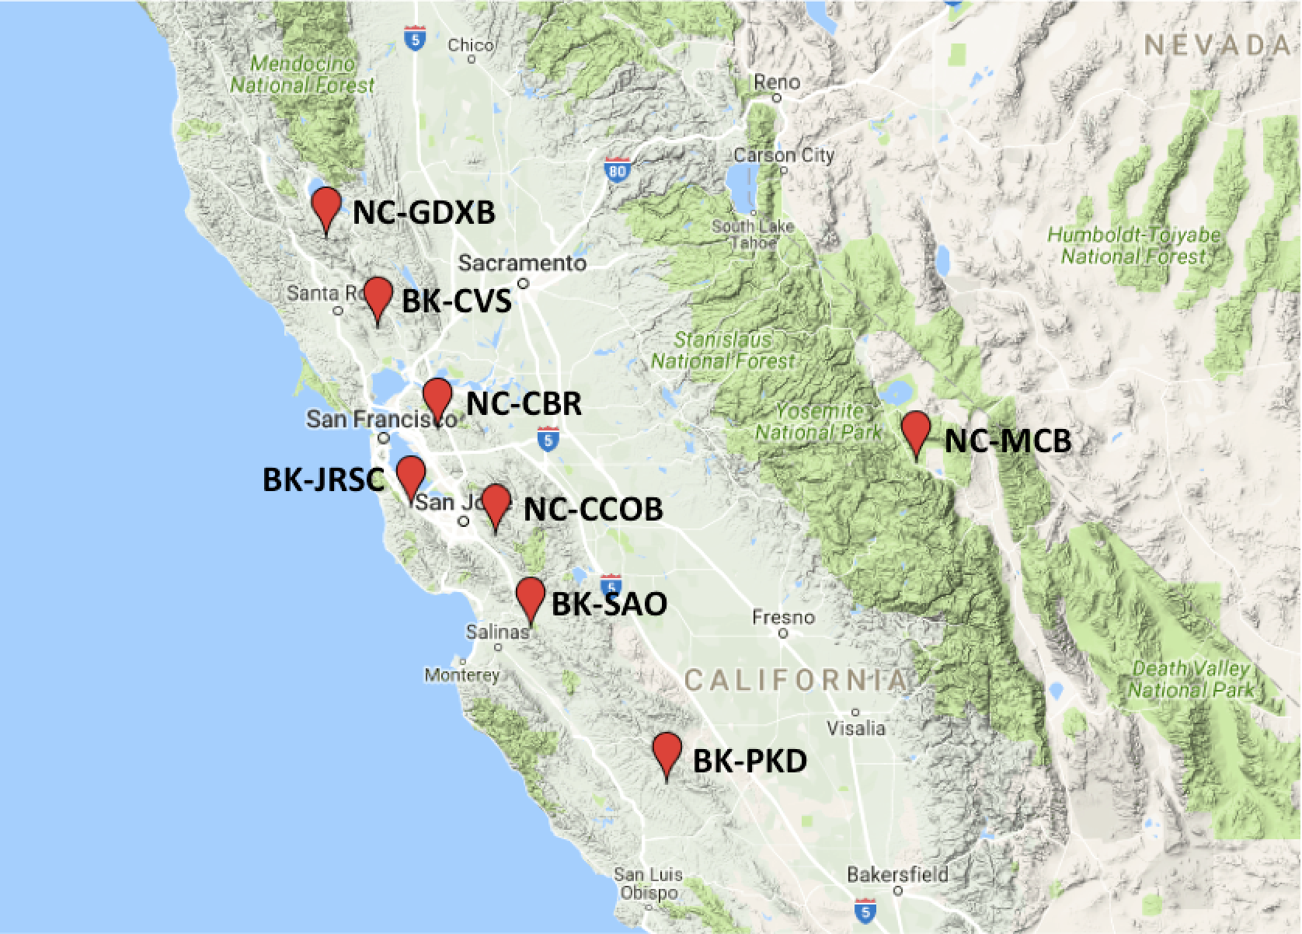
NCSN EVENT CATALOG
9

Slide 11
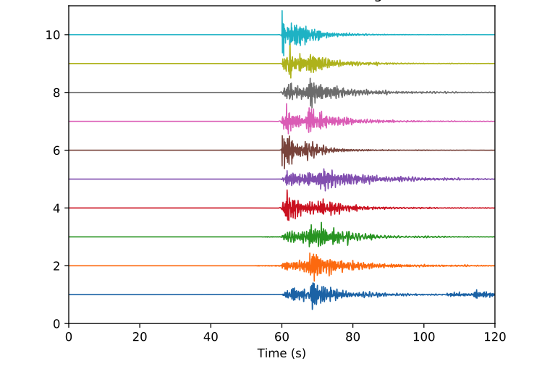
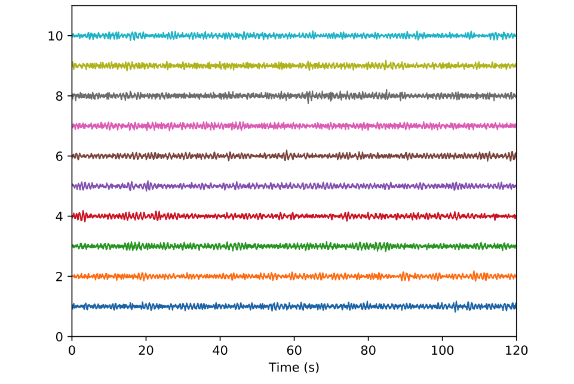
SEISMIC WAVEFORMS
EARTHQUAKES
BACKGROUND NOISE
1-10Hz bandpass
Downsampling
Data cleaning using STA/LTA thresholding
Normalization
10

Slide 12
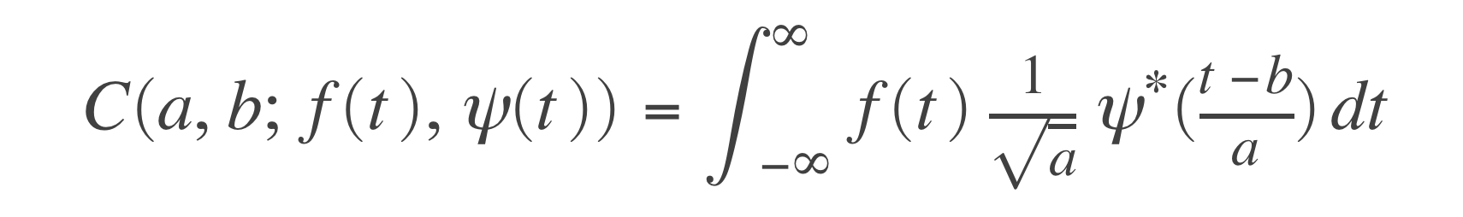
DATA ATTRIBUTES USING CONTINUOUS WAVELET TRANSFORMS
11

Slide 13
WAVELET ATTRIBUTES
EARTHQUAKES
BACKGROUND NOISE
dyadic frequency
dyadic frequency
time
time
CWT with Morlet wavelet
Time pseudo frequencies: 1 – 10Hz
15s waveform windows
Normalize

Slide 14
DATA VOLUMES
For each station:
  2,000 earthquake windows
  3,000 noise windows
Training set : test set = 80 : 20
Training and testing on one station:
ACCURACY: 65%
LIMITATIONS?
INSUFFICIENT LABELED DATA
UNBALANCED DATASET

Slide 15

TRANSFER LEARNING
Size of data set
Train target model from scratch
Fine tune
pretrained source model
Problem
similarity
Fine tune the lower layers of the pretrained model
Fine tune the lower layers of the pretrained model
Fine tune the output dense layer of the pretrained model
10
MNIST
50,000 examples in the training set
KEEP
FINE TUNE
Notes:
TODO change this plot

Slide 16
RESULTS
ACCURACY: 99.5%
Training and testing on one station:
Combining 4 stations:
ACCURACY: 96.8%
  Out of 4,000 events, about a hundred were misclassified
Increasing the depth of the network:
  Using a 7 layer CNN
ACCURACY: 98.2%

Slide 17
TRAFFIC NOISE DETECTION
USING A FIBER OPTIC
SEISMIC NETWORK

Slide 18
FIBER OPTIC ARRAY UNDER STANFORD CAMPUS
Continuous recording since September 2016 – 2.5 km loop – 600 sensors – 50 samples per second
z
Notes:
With several hundred sensors continuously recording 50 samples per second, manual inspection of most data is infeasible, making automation tools critical to extracting subsurface information from the data.

Slide 19
SEISMIC AMBIENT NOISE
Strain rates
Bandpass 0.5 – 24 Hz
Notes:
This is data set highlights the difficulties of urban seismic recording:
- patchwork of natural and manmade materials
- spatially & temporally heterogeneous noise
nonuniform coupling of cable to ground
seismically active region,
20 km from the Pacific Ocean,
7 km from the San Francisco Bay,
with major highways on either side,
a variety of roads with differing levels of traffic near the fiber,
regular quarry blasts within 15 km,
plumbing and HVAC systems throughout the site,
multiple construction sites near the array,
and foot and bicycle traffic throughout.

Slide 20
SEISMIC AMBIENT NOISE
Strain rates
Bandpass
0.5 – 24 Hz

Slide 21
SELECTIVE FILTERING
BEFORE
AFTER
“A Seismic Shift in Scalable Acquisition Demands New Processing: Fiber-Optic Seismic Signal Retrieval in Urban Areas with Unsupervised Learning for Coherent Noise Removal”, IEEE Signal processing magazine
Eileen R. Martin, Fantine Huot, Yinbin Ma, Robert Cieplicki, Steve Cole, Martin Karrenbach, Biondo L. Biondi

Slide 22
CAR DETECTION WITH A NEURAL NETWORK
CARS
SYNTHETIC CARS
BACKGROUND NOISE
Raw data
Detection window 10 channels x 10 seconds
Downsampling along the time axis : 10 x 50 samples

Slide 23
DATA SET
 | Real cars | Synthetic cars | Background noise | Total
Training | 5,000 | 20,000 | 25,000 | 50,000
Test | 5,000 | 0 | 5,000 | 10,000
Without synthetic data:
With synthetic data:
ACCURACY: 98.1%
ACCURACY: 99.4%

Slide 24
EXAMPLES OF EVENTS THAT WERE HARD TO CLASSIFY
Out of 5,000 cars:
1 was misclassified
38 obtained a normalized probability score less than 90%
59 obtained a normalized probability score less than 95%

Slide 25
CONCLUSIONS
SYNTHETIC DATA GENERATION
TRANSFER LEARNING
Compensate for limited labeled data and unbalanced data sets
Leverage domain knowledge
Generalize to new conditions
Transfer knowledge to problems with limited data

Slide 26

ACKNOWLEDGEMENTS
Karianne Bergen
Eileen R. Martin
THANK YOU
Feedback? Questions? Please share!
fantine@stanford.edu

Slide 27
BACKUP SLIDES

Slide 28
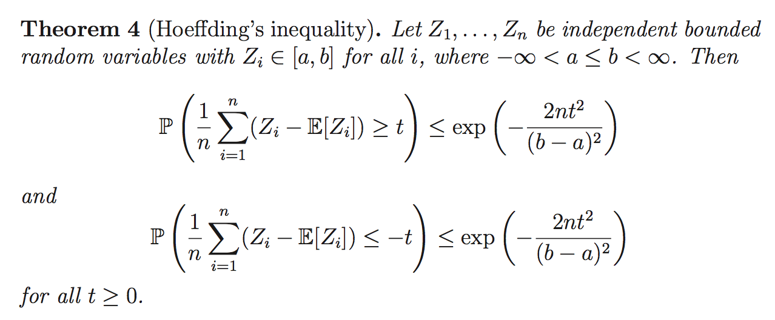
HOEFFDING INEQUALITY

Slide 29
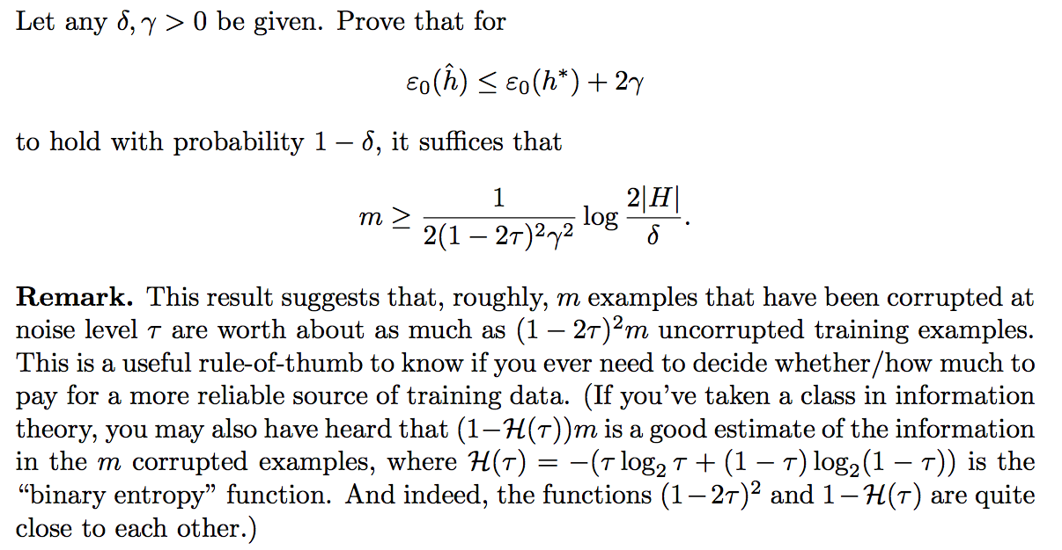
THE IMPACT OF MISLABELED DATA

Slide 30
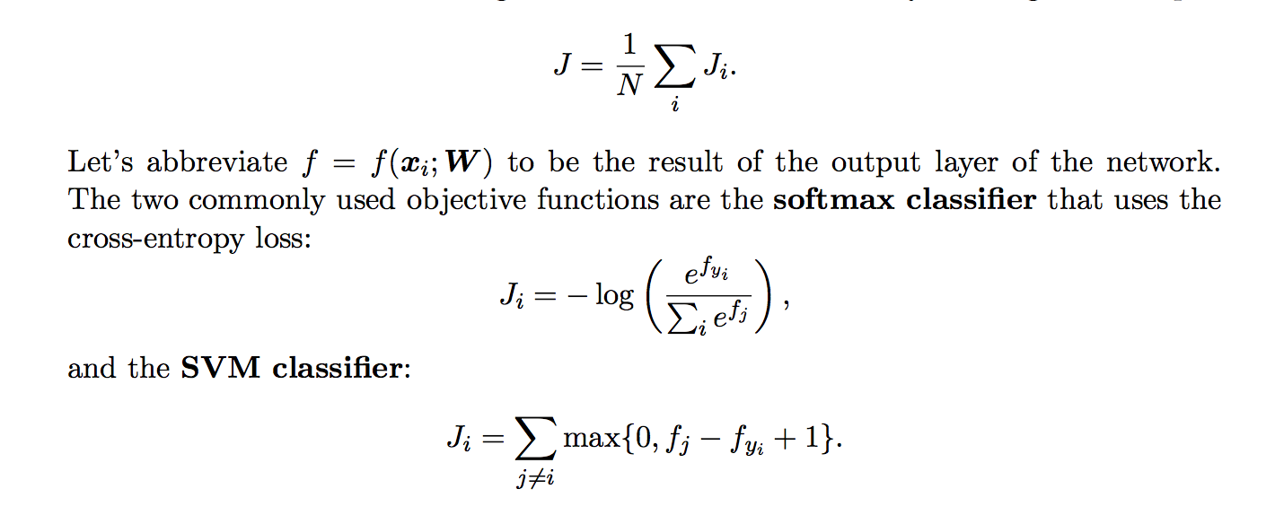
OBJECTIVE FUNCTION

Slide 31
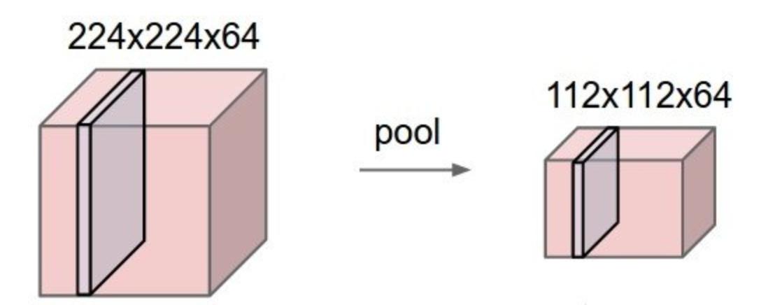
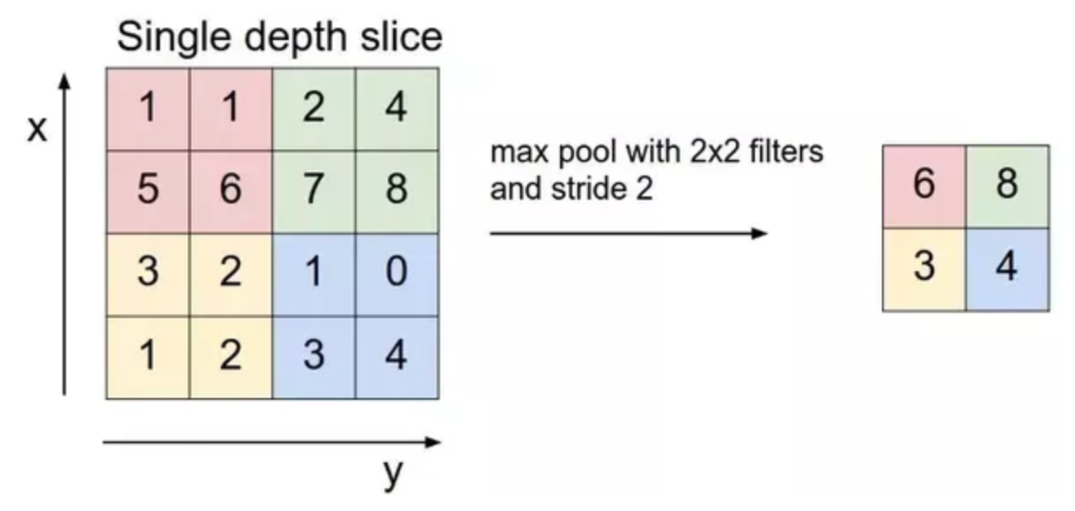
MAX POOL

Slide 32
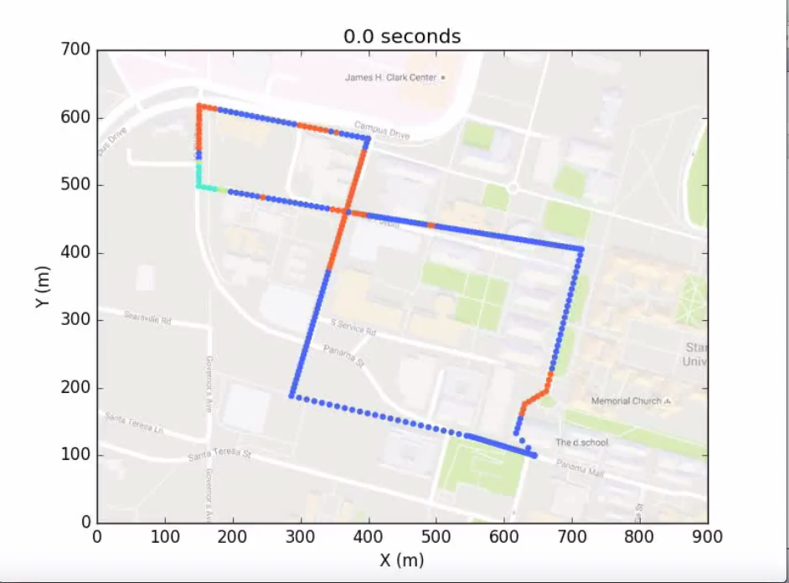

SO WHAT TYPE OF NOISE DID WE IDENTIFY ?
Hierarchical clustering
over a month of data
Cars
Coherent noise
Laser noise
Background noise

Slide 33
INTERFEROMETRY EXTRACTS SIGNAL FROM AMBIENT NOISE
Cross-correlation between receiver r & virtual source v
is maximized at the time it takes a wave to travel from one receiver to the other
32
Notes:
TODO: Change the title
This is data set highlights the difficulties of urban seismic recording:
- patchwork of natural and manmade materials
- spatially & temporally heterogeneous noise
nonuniform coupling of cable to ground
seismically active region,
20 km from the Pacific Ocean,
7 km from the San Francisco Bay,
with major highways on either side,
a variety of roads with differing levels of traffic near the fiber,
regular quarry blasts within 15 km,
plumbing and HVAC systems throughout the site,
multiple construction sites near the array,
and foot and bicycle traffic throughout.

Slide 34
INTERFEROMETRY EXTRACTS SIGNAL FROM AMBIENT NOISE
Cross-correlation between receiver r & virtual source v
is maximized at the time it takes a wave to travel from one receiver to the other
33
33
Notes:
TODO: Change the title
This is data set highlights the difficulties of urban seismic recording:
- patchwork of natural and manmade materials
- spatially & temporally heterogeneous noise
nonuniform coupling of cable to ground
seismically active region,
20 km from the Pacific Ocean,
7 km from the San Francisco Bay,
with major highways on either side,
a variety of roads with differing levels of traffic near the fiber,
regular quarry blasts within 15 km,
plumbing and HVAC systems throughout the site,
multiple construction sites near the array,
and foot and bicycle traffic throughout.

Slide 35
WE CAN EXTRACT COHERENT SIGNAL FROM THE NOISE
array corner
hyperbola along nearest
orthogonal line
34
34
34
34
34
Notes:
TODO: Change the title
This is data set highlights the difficulties of urban seismic recording:
- patchwork of natural and manmade materials
- spatially & temporally heterogeneous noise
nonuniform coupling of cable to ground
seismically active region,
20 km from the Pacific Ocean,
7 km from the San Francisco Bay,
with major highways on either side,
a variety of roads with differing levels of traffic near the fiber,
regular quarry blasts within 15 km,
plumbing and HVAC systems throughout the site,
multiple construction sites near the array,
and foot and bicycle traffic throughout.

Slide 36
WE CAN EXTRACT COHERENT SIGNAL FROM THE NOISE
array corner
hyperbola along nearest orthogonal line
REQUIRES UNCORRELATED UNIFORMLY
DISTRIBUTED NOISE
35
35
35
35
35
Notes:
TODO: Change the title
This is data set highlights the difficulties of urban seismic recording:
- patchwork of natural and manmade materials
- spatially & temporally heterogeneous noise
nonuniform coupling of cable to ground
seismically active region,
20 km from the Pacific Ocean,
7 km from the San Francisco Bay,
with major highways on either side,
a variety of roads with differing levels of traffic near the fiber,
regular quarry blasts within 15 km,
plumbing and HVAC systems throughout the site,
multiple construction sites near the array,
and foot and bicycle traffic throughout.

Slide 37
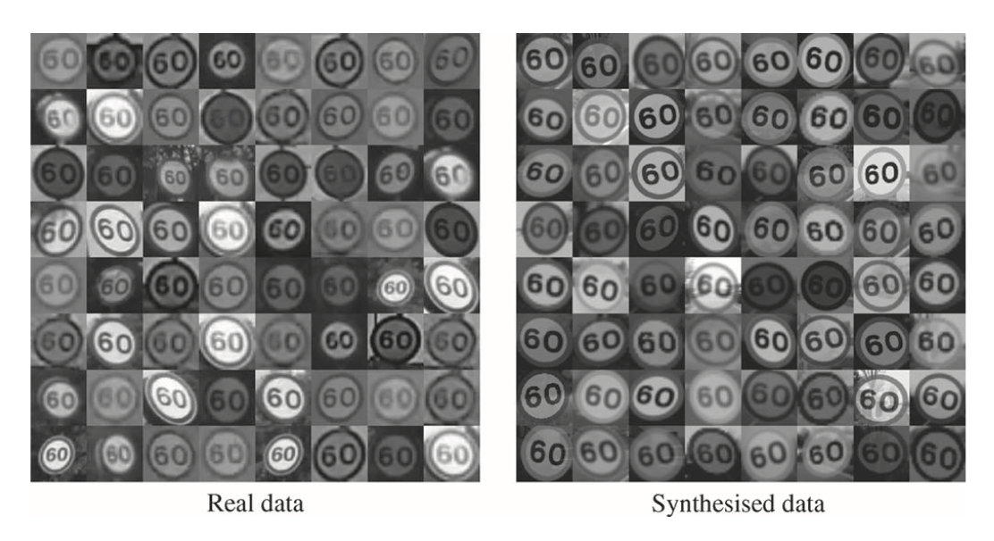
TRAIN WITH SYNTHETICALLY GENERATED DATA

Slide 38


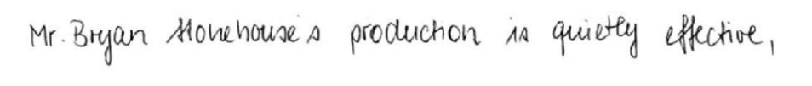


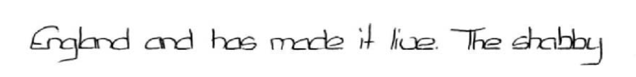
TRAIN WITH SYNTHETICALLY GENERATED DATA

Slide 39
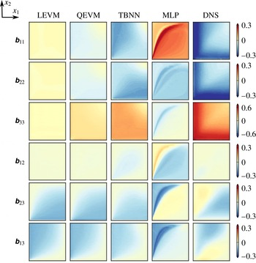
STRATEGY – TRAINING ON SYNTHETIC DATA
Commonly used in machine learning and has been successfully implemented for character recognition in natural images, traffic sign recognition, handwriting recognition, face recognition or protein interactions etc
Deep networks for physics modeling are entirely trained on synthetic data
Ling, A. Kurzawski, and J. Templeton. Journal of Fluid Mechanics, 807:155–166, 2016.
LIMITATIONS
Synthetic data do not capture the complexity of the real world
Reynolds stress anisotropy tensor

Slide 40
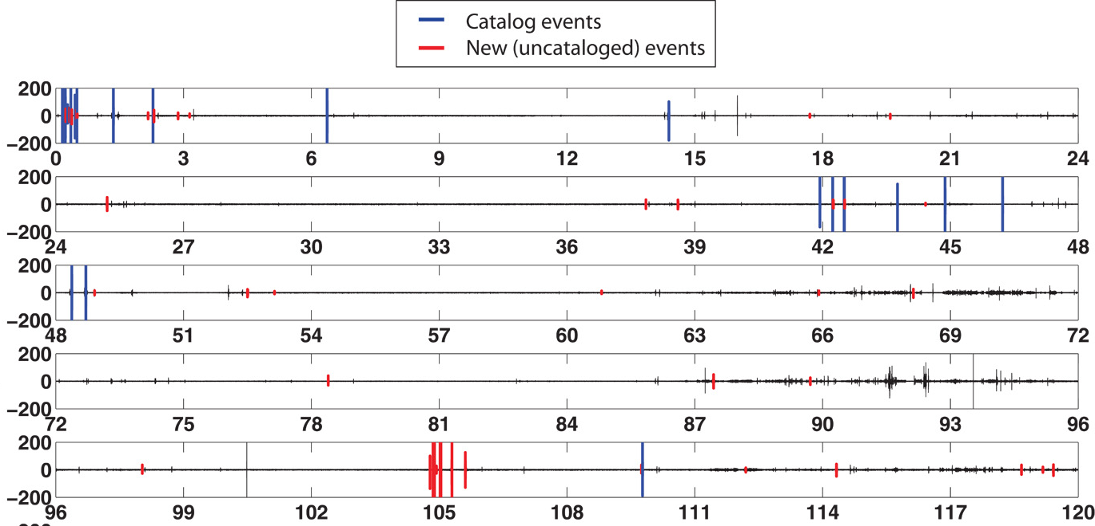
MOTIVATION
STA/LTA
Efficient Similarity Search of Seismic Waveforms using template matching
C. E. Yoon, O. OReilly, K. J. Bergen, and G. C. Beroza. Earthquake detection through computationally efficient similarity search. Science advances, 2015.
How can we find new earthquake templates?
39

Slide 41
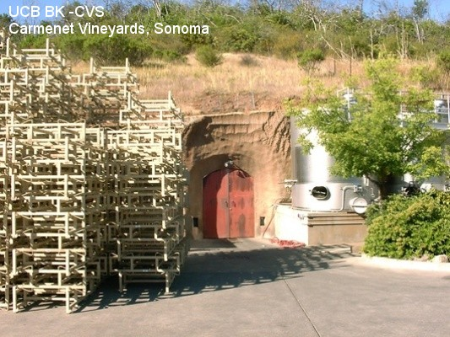
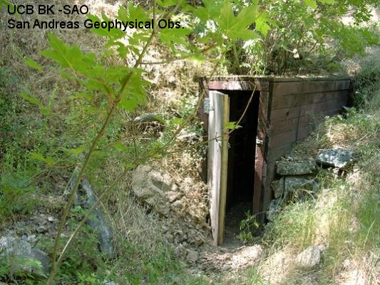
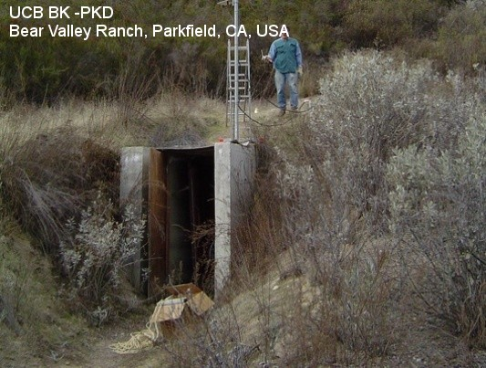
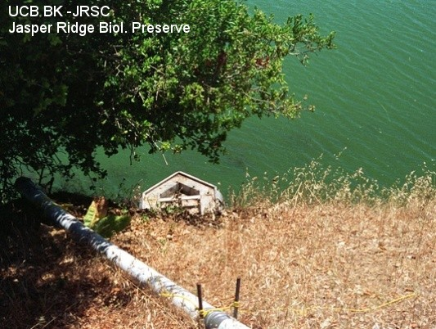
DATASET – NCSN Event catalog
BK-SAO.HHZ, San Andreas Geophysical Observatory, Hollister
BK-JRSC.HHZ, Jasper Ridge Biological Preserve, near Stanford
BK-PKD.HHZ, Bear Valley Ranch, Parkfield
BK-CVS.HHZ, Carmenet Vineyards, Sonoma
40

Slide 42
DATA WRANGLING
Decimate to 20Hz sampling rate and bandpass 1-10Hz
Normalize traces (original scale stored)
Earthquakes: remove events that don’t meet STA/LTA criteria or if P-wave arrival time is unknown
  STA window = 1
  LTA window = 30
  Threshold = 5
Background: randomly selected 2 minute segments from each 24 hour period
Background: Remove segments that are likely to contain events
  STA window = 3
  LTA window = 45
  Threshold = 6
41

