Slide 1

STRATIGRAPHIC SEQUENCE
ESTIMATION FROM SEISMIC DATA
Fantine Huot (Stanford Geophysics)
Advised by Biondo Biondi (Stanford Geophysics & ICME)
SEP 172

Slide 2
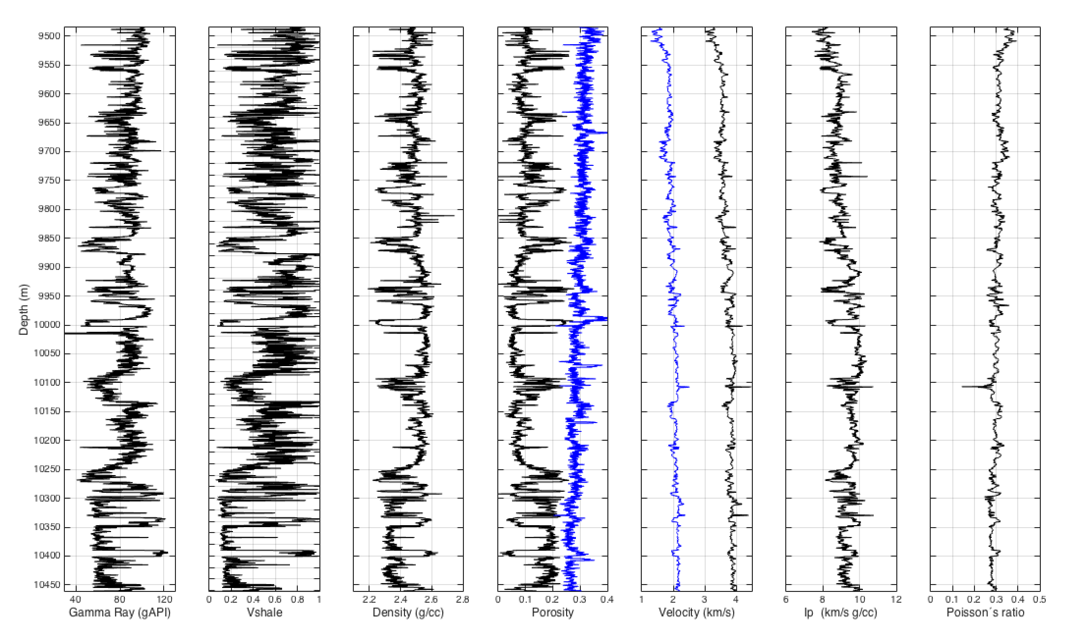
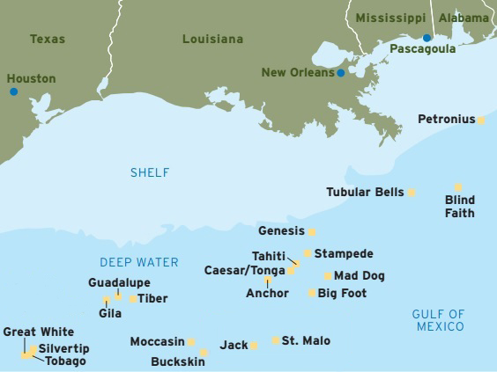
MOTIVATION
Estimate the sand and shale stratigraphy from seismic traces
60 well logs from the Wilcox formation
www.offshore-energy.biz
100 mi
Gamma ray Vshale Density Porosity Velocity
Notes:
A good example of application where we have labeled data : well logs

Slide 3
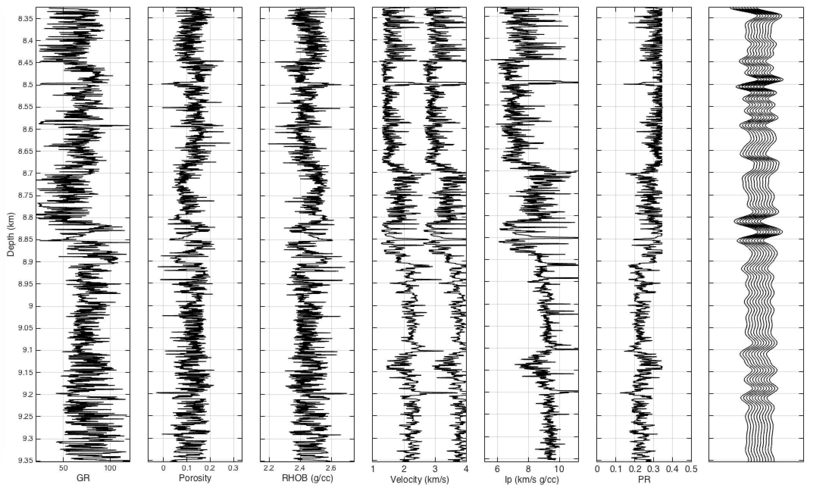
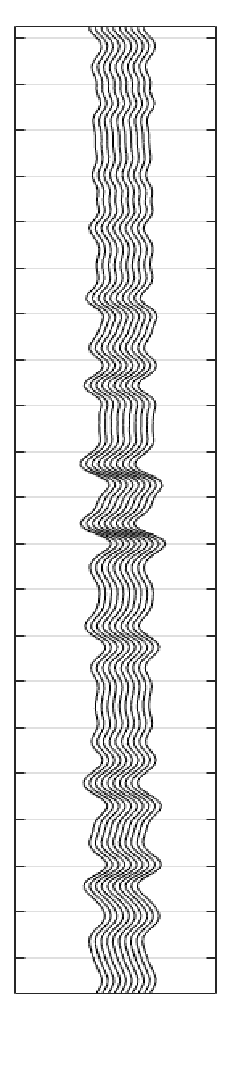
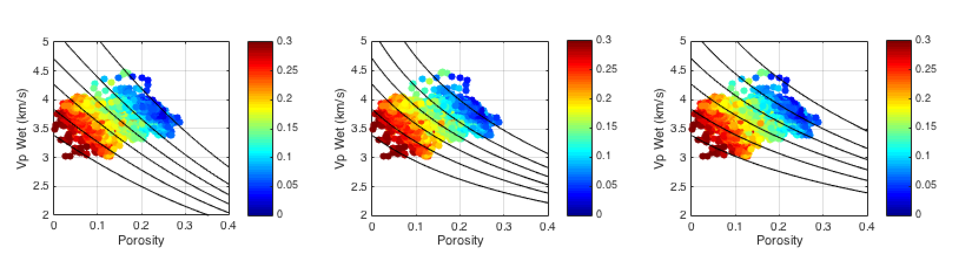
WORKFLOW
Train the algorithm
Estimate vshale
Rock physics
diagnostics
Synthetic seismic
Field seismic
Vshale
Well logs

Slide 4
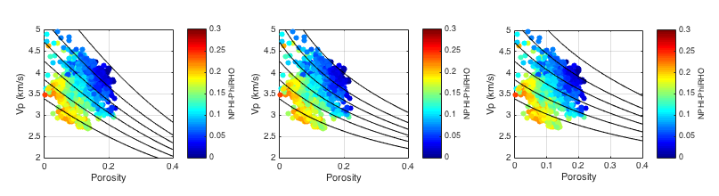
ROCK PHYSICS DIAGNOSTICS
Clay content
Clay content
Clay content
Raymer model Uncemented sand model Cemented sand model
Mavko, G., Mukerji, T., & Dvorkin, J. (2009). The rock physics handbook: Tools for seismic analysis of porous media. Cambridge university press.
Notes:
UNCEMENTED SAND MODEL

Slide 5
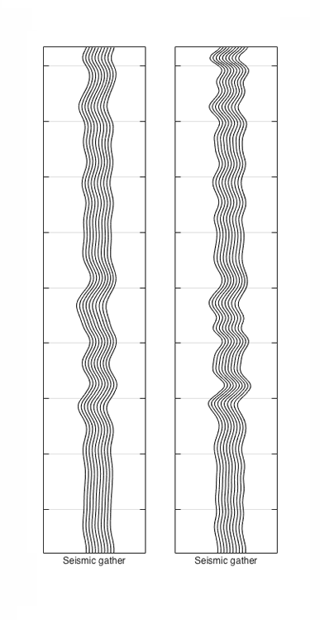
SEISMIC CONVOLUTIONAL MODELING

Slide 6
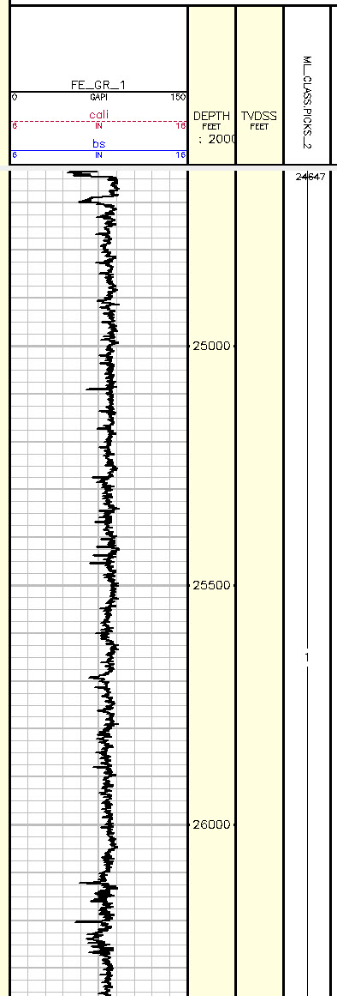
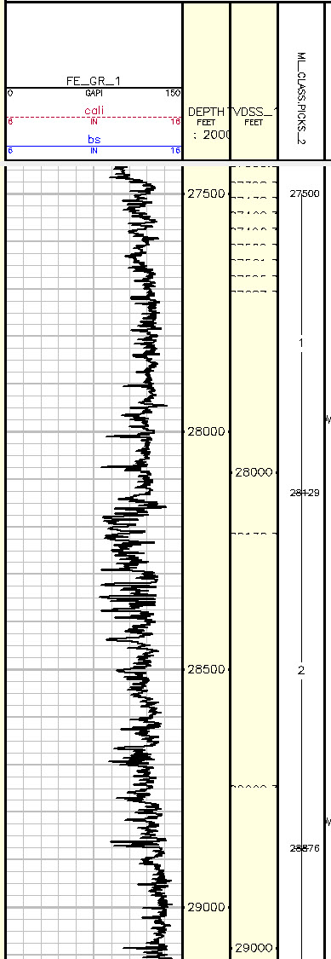
LABELED STATIGRAPHY
The difference between well log resolution (0.3 m) and seismic resolution (about 200 m) makes it difficult to label the seismic data using the Vshale log values
We label the data by chunks, and divide them into five categories:
Unimodal Thick Shale
Low Net-to-Gross Thin-bedded Shale and Sandstone.
Bimodal Blocky Shales and Sandstones (moderate NTG)
High Net-to-Gross Thin-bedded Sandstone and Shale
Very High Net-to-Gross Blocky Sandstone
80,000 labeled field data samples
Salida
Oceanographer
Class 1
Class 1
Class 2

Slide 7
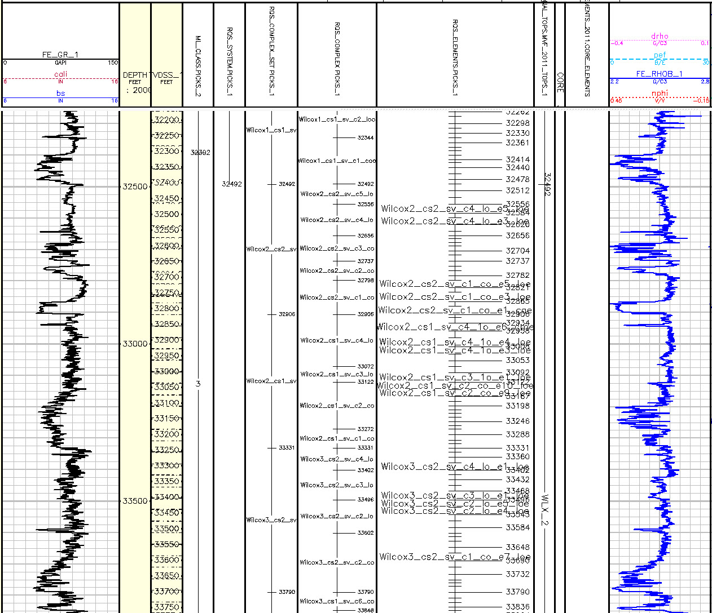
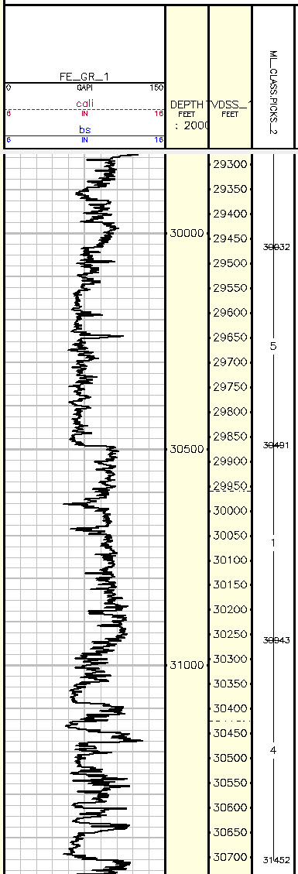
LABELED STATIGRAPHY
The difference between well log resolution (0.3 m) and seismic resolution (about 200 m) makes it difficult to label the seismic data using the Vshale log values
We label the data by chunks, and divide them into five categories:
Unimodal Thick Shale
Low Net-to-Gross Thin-bedded Shale and Sandstone.
Bimodal Blocky Shales and Sandstones (moderate NTG)
High Net-to-Gross Thin-bedded Sandstone and Shale
Very High Net-to-Gross Blocky Sandstone
80,000 labeled field data samples
North Platte
Rickenbacker
Class 5
Class 3
Class 1
Class 4

Slide 8
SYNTHETIC WELL LOG GENERATION
The loss of resolution when transitioning to seismic data makes our training set too small to obtain good performance with a neural network
SYNTHETIC DATA GENERATION WITH MARKOV CHAINS
A stochastic model describing a sequence of possible states in which the probability of each state depends only on a finite number of previous states
Generate synthetic logs with similar statistics as the field data

Slide 9
VSHALE DISTRIBUTION
To reduce the number of Markov chain states, we approximate vshale as bimodal
Cut-off value at 0.4
Reducing the number of states increases the value of the statistics to populate the Markov chain
Notes:
With learnt transition probabilities

Slide 10
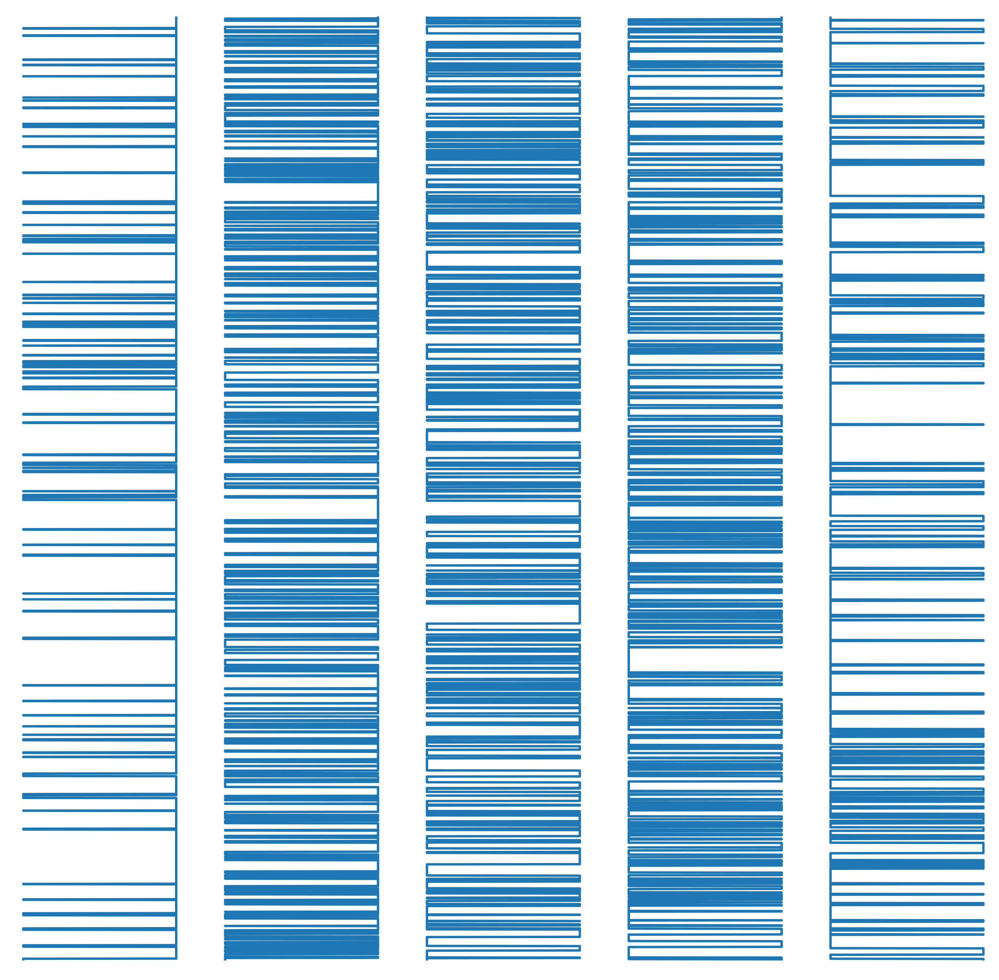
MARKOV CHAIN MODELING
vshale
Macro-level Markov chain defining transitions between the 5 types of stratigraphy
Finer-level Markov chain defining transitions within one type of stratigraphy
depth
1 STATE CHAIN
1. 2. 3. 4. 5.
Notes:
With learnt transition probabilities

Slide 11
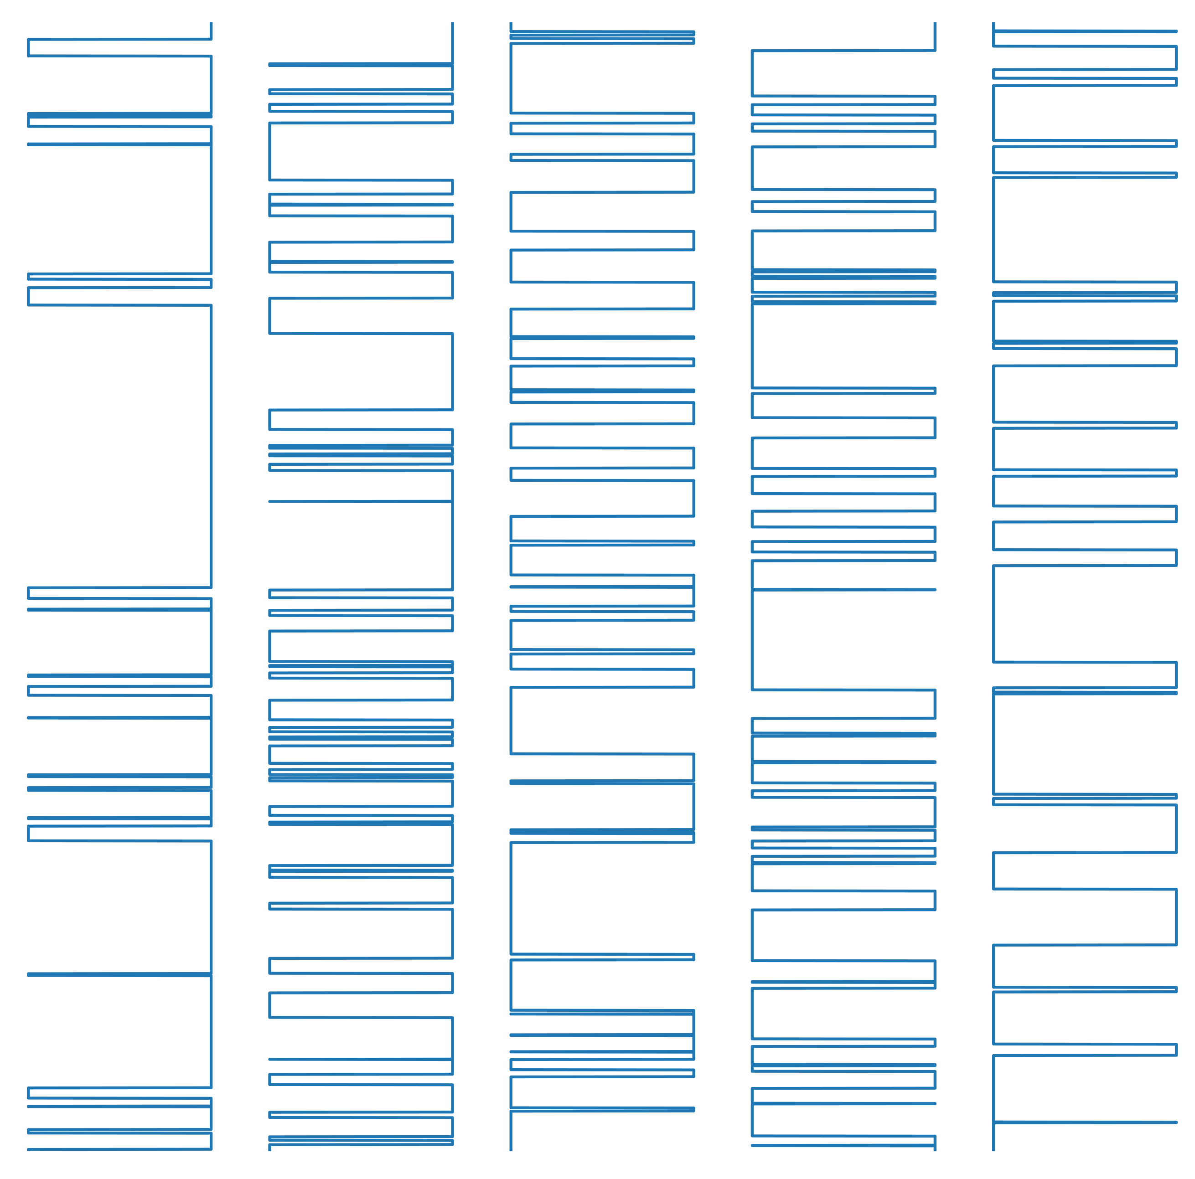
MARKOV CHAIN MODELING
vshale
Macro-level Markov chain defining transitions between the 5 types of stratigraphy
Finer-level Markov chain defining transitions within one type of stratigraphy
depth
5 STATE CHAIN
1. 2. 3. 4. 5.
Notes:
With learnt transition probabilities

Slide 12
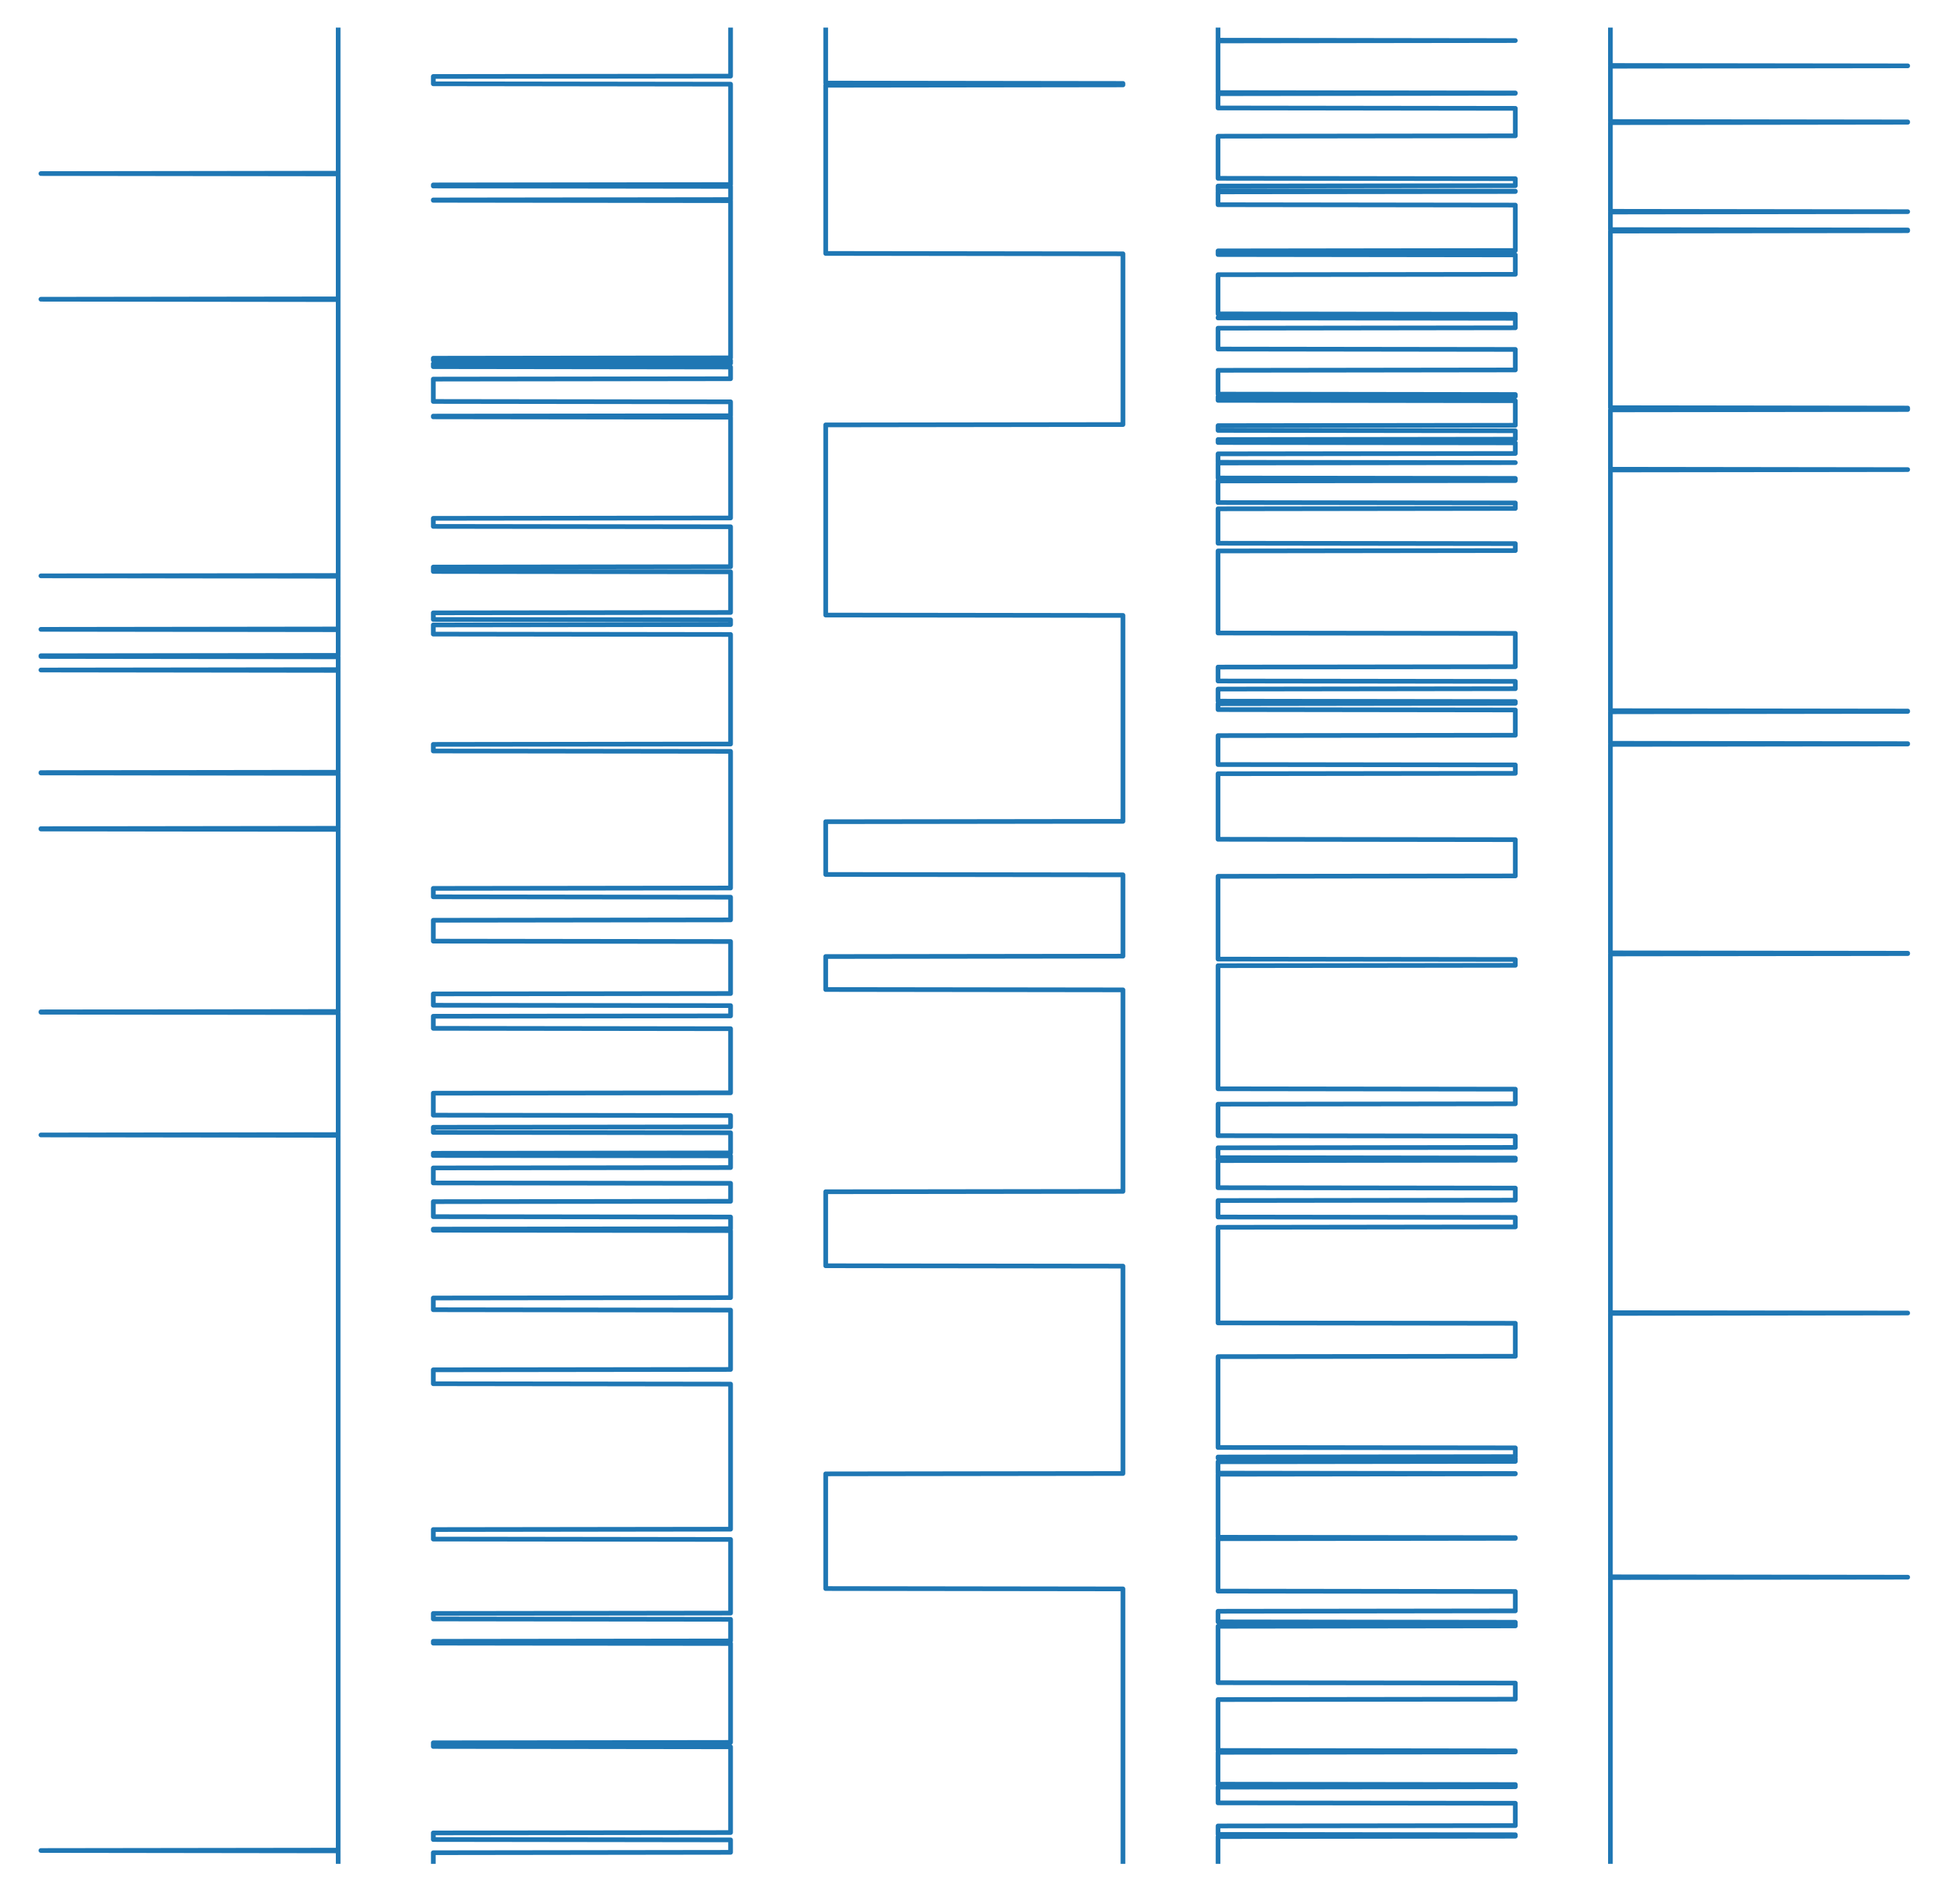
MARKOV CHAIN MODELING
vshale
Macro-level Markov chain defining transitions between the 5 types of stratigraphy
Finer-level Markov chain defining transitions within one type of stratigraphy
depth
INCREASED PROBABILITIES FOR STATIONARY MODES
1. 2. 3. 4. 5.
Notes:
With learnt transition probabilities

Slide 13
ELASTIC PROPERTIES USING STATISTICS
We then populate the elastic properties using the field data distribution
To complement the 60 field data well logs, we generated 500,000 samples of synthetic wells (75 km)
Notes:
With learnt transition probabilities

Slide 14
DEEP LEARNING USING CONVOLUTIONAL NEURAL NETWORKS
Rule-based
system
Input
Hand-designed program
Output
Classic machine learning
Input
Hand-designed features
Mapping from features
Output
Representation learning
Input
Features
Mapping from features
Output
Deep learning
Input
Simple features
Layers of abstract features
Mapping from features
Output
Notes:
The red boxes are the components that learn from the data

Slide 15
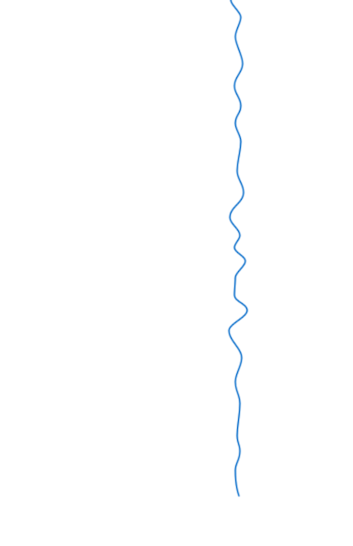
NEURAL NETWORK ARCHITECTURE
Notes:
With increased probabilities for stationary modes

Slide 16
ACCURACY FOR VARIOUS FREQUENCIES
The convolutional neural network outputs a normalized probability distribution of belonging to a certain class
Its accuracy increases with wider bandwidth
We need to incorporate additional information to perform better at low frequencies, such as the depositional context in the 3D volume
Notes:
With increased probabilities for stationary modes

Slide 17
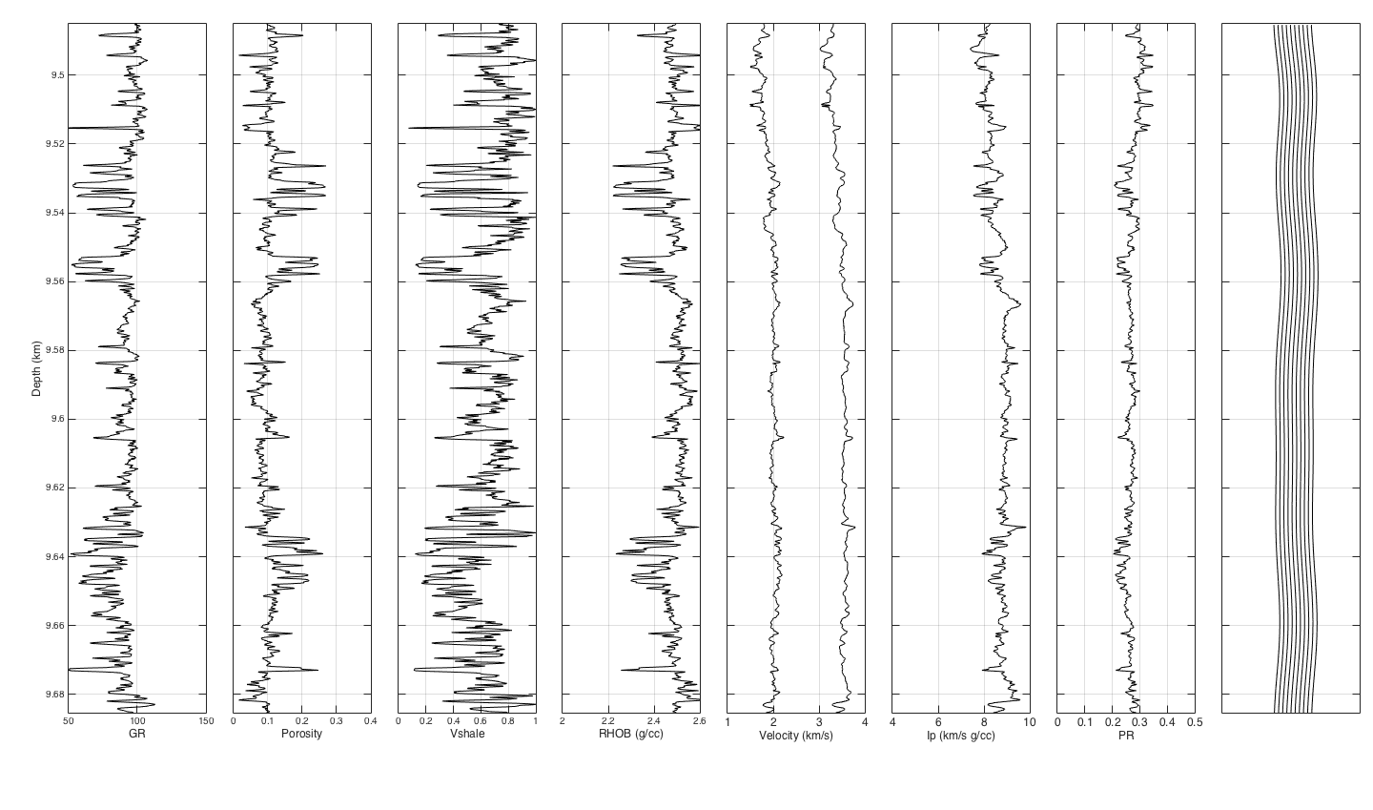
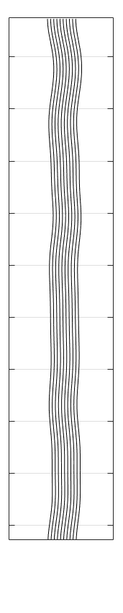

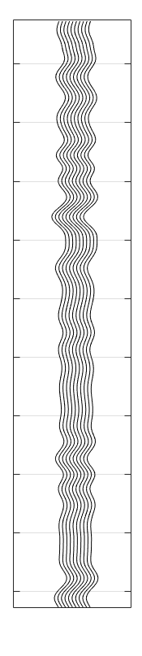
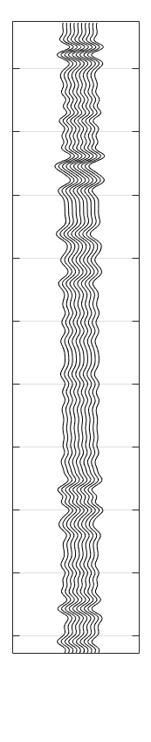
ACCURACY FOR VARIOUS FREQUENCIES
20 Hz 30 Hz 50 Hz 100 Hz 200 Hz
Notes:
With increased probabilities for stationary modes

Slide 18
CONCLUSIONS
SYNTHETIC DATA GENERATION
TRANSFER LEARNING
Compensate for limited labeled data and unbalanced data sets
Leverage domain knowledge
Generalize to new conditions
Transfer knowledge to problems with limited data
3D Seismic field data for depositional context
Notes:
3D data and depositional context + future steps

Slide 19

ACKNOWLEDGEMENTS
Chevron
Joe Stefani & Bruce Power
Humberto Samuel Arevalo Lopez, Gary Mavko & Jack Dvorkin
THANK YOU
Feedback? Questions? Please share!
fantine@stanford.edu

Slide 20
LEARNING FROM DATA
Deep learning networks can learn very accurate mappings from inputs to outputs from large amounts of labeled data
NOISE REMOVAL
OBJECT DETECTION
EVENT DETECTION
IMAGE SEGMENTATION
However, these models are immensely data-hungry and rely on huge amounts of labeled data to achieve their performance
Notes:
“As of 2016, a rough rule of thumb is that a supervised deep learning algorithm will generally achieve acceptable performance with around 5,000 labeled examples per category and will match or exceed human performance when trained with a dataset containing at least 10 million labeled examples.”

Slide 21
CHALLENGES & LIMITATIONS
LIMITED LABELED DATA
POOR GENERALIZATION
The earth is intrinsically unlabeled
Absence of ground truth
Uncertain labels
Fuzzy boundaries
Unbalanced data sets with rare events
The real world is messy
Infinite number of novel scenarios
Many sources of noise
Small signal to noise ratio
Incomplete data, drop outs
SYNTHETIC DATA GENERATION
TRANSFER LEARNING
Notes:
What our models still frightfully lack is the ability to generalize to conditions that are different from the ones encountered during training.
Every time we apply our model not to a carefully constructed dataset but to the real world.
The real world is messy and contains an infinite number of novel scenarios, many of which our model has not encountered during training and for which it is in turn ill-prepared to make predictions.

