Slide 1
“Fingerprint” extraction from the Stanford DAS recordings
2018 SEP Annual meeting
Siyuan Yuan
March 23, 2018
SEP172, page 15-26

Slide 2
Overview
Background and motivation
Inverse problem set up
  Model space and data space
  Forward and adjoint
  Inversion
Synthetic analysis
  Impulsive plane wave
  Reverberant plane wave
Field data application
  Foothill earthquake

Slide 3
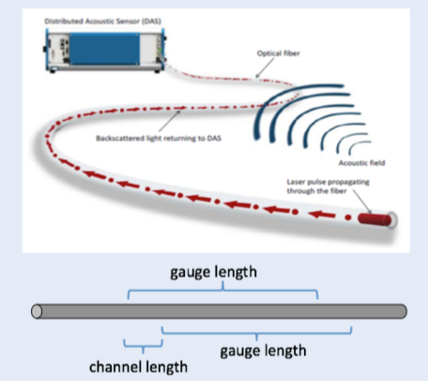
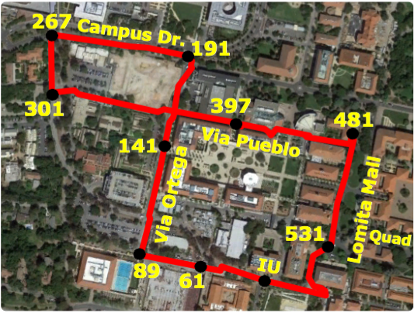
What is DAS?
It is a laser-based sensor system measuring changes in a fiber-optic cable.
Advantages:
Low cost per sensor; dense sensor distribution

Slide 4
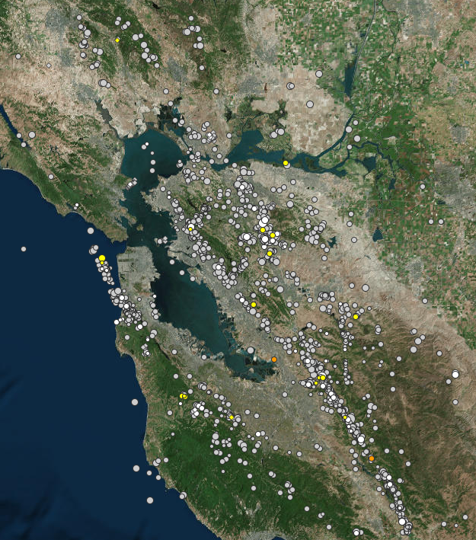
Thousands of Earthquakes recorded
The Stanford DAS array started continuously
recording ground motion since Sep., 2016
Notes:
Since DAS array installed, we have thousands of quake occurred around the bay area

Slide 5

Stanford DAS recordings are extracted based on the USGS online database
USGS online database
Data recorded by DAS
Metadata
preprocessing
Event data
Event data (raw)
Yuan et al., SEP-170

Slide 6

Catalogue that can be continuously updated set up
USGS online database
Data recorded by DAS
SEGY
& SEP3D
Metadata
save
preprocessing
recorded
Event SQL
database
Event data
Event data (raw)
Yuan et al., SEP-170

Slide 7
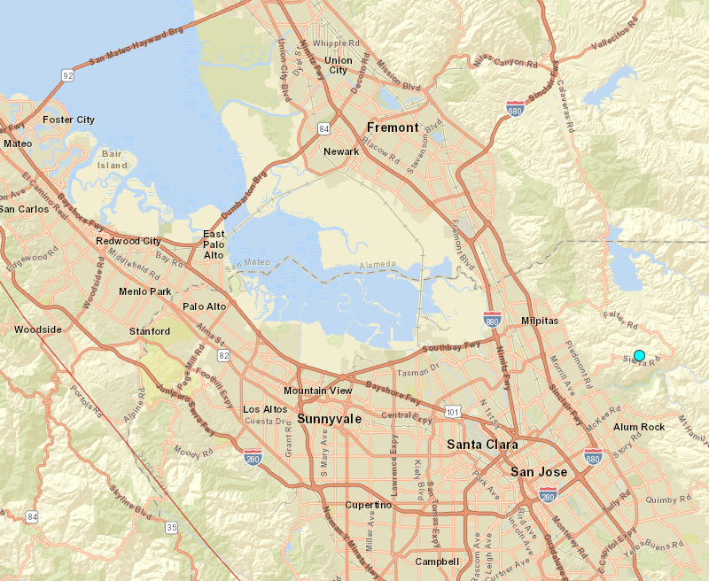
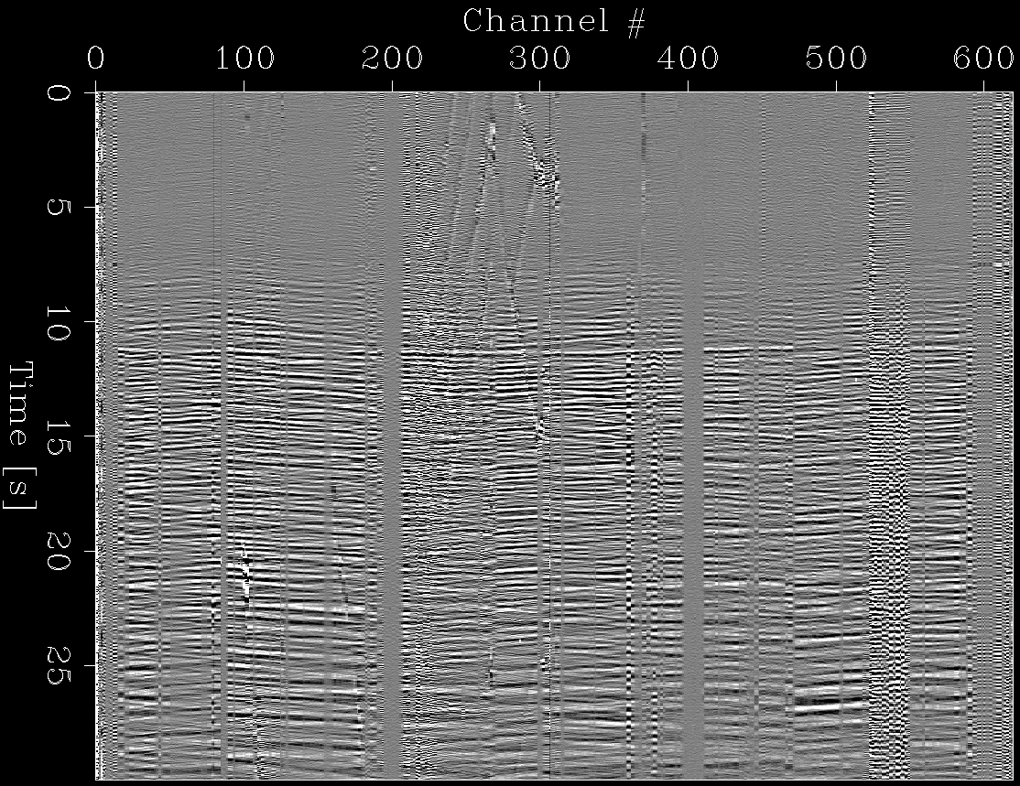
One example of DAS recordings
P
S
DAS
epicenter
N
Foothill earthquake
Magnitude: 3.3
Distance: 32.8 km
09/15/2017 01:17:47 UTC time
Notes:
In the east foothill area

Slide 8

Can DAS recordings have “Fingerprints”?
P
S
Represent the major waveform characteristics
Filter out noise
Small size
save space and computational cost
Foothill earthquake
Notes:
By representing major waveform: ignore the noise
Small size: save space and computational cost

Slide 9
A few observations
Anthropogenic noise is local with
low velocities.
Random noise is incoherent.
Earthquake data have fast
velocities, are coherent through
most of the channels
(dominant plane waves with
relatively fast velocities.)
P
S
Foothill earthquake

Slide 10
“Fingerprints” represent dominant plane-wave components
“Fingerprint”
What are the dominant
plane waves?
Propagation directions?
Apparent velocities?
Compositions of compressional
and shear waves?
Feature
extraction
P
S
Foothill earthquake

Slide 11
“Fingerprints” represent dominant plane-wave components
“Fingerprint”
What are the dominant
plane waves?
Propagation directions?
Apparent velocities?
Compositions of compressional
and shear waves?
Feature
extraction
Earthquake
recovery
Foothill earthquake

Slide 12
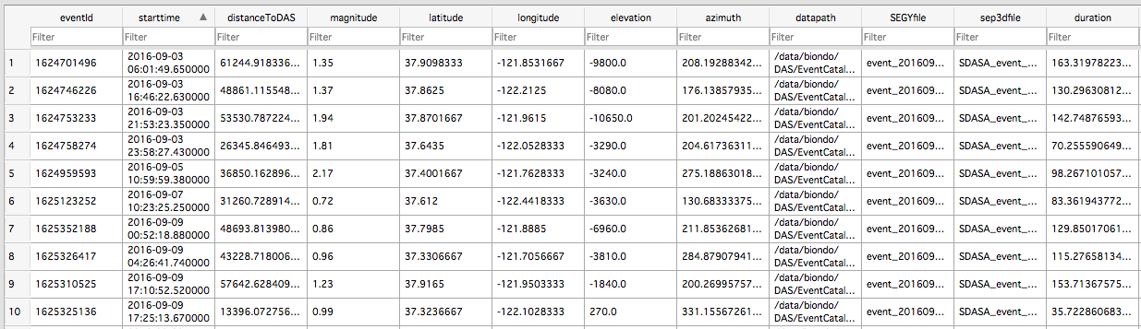
Big picture
~ 3,000 DAS recordings catalogued!
Yuan et al., SEP-170

Slide 13
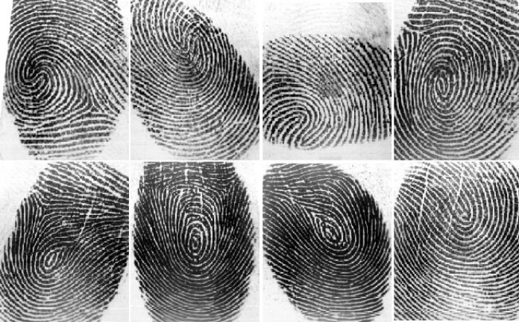
Big picture
~ 3,000 DAS recordings catalogued!
“Fingerprint” Library
Yuan et al., SEP-170
Low noise level
Small data size

Slide 14

Big picture
~ 3,000 DAS recordings catalogued!
“Fingerprint” Library
Yuan et al., SEP-170
Statistical learning
for earthquake
detection and
location!
https://www.cio.com/article/3235508/cio-role/why-cios-need-a-chief-artificial-intelligence-officer.html

Slide 15
Our focus
~ 3,000 DAS recordings catalogued!
“Fingerprint” Library
Yuan et al., SEP-170
Statistical learning
for earthquake
detection and
location!
https://www.cio.com/article/3235508/cio-role/why-cios-need-a-chief-artificial-intelligence-officer.html

Slide 16
Overview
Background and motivation
Inverse problem set up
  Model
  Forward operator
  Inversion
Synthetic analysis
  Impulsive plane wave
  Reverberant plane wave
Field data application
  Foothill earthquake

Slide 17
“Fingerprint” extraction: an inverse problem
Model
Data
What are the dominant
plane waves?
Propagation directions?
Apparent velocities?
Compositions of compressional
and shear waves?
inversion
Plane wave
extraction
forward
Plane wave
superposition
Foothill Earthquake Data

Slide 18
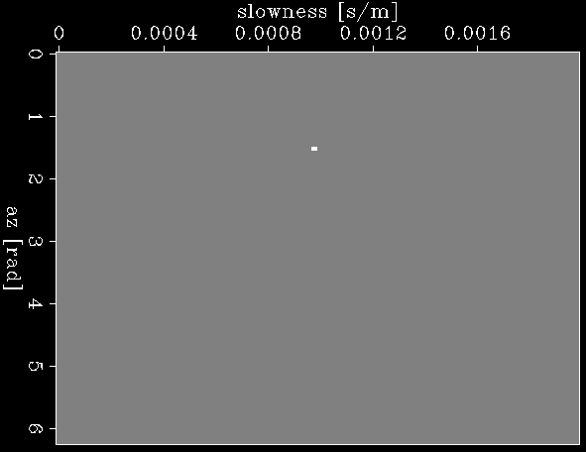
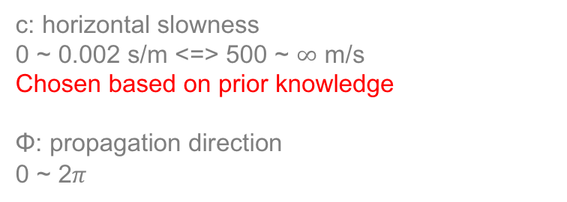
Model: m (ϕ, c)
N
c
ϕ
E
Wave front
c: horizontal slowness
0 ~ 0.002 s/m <=> 500 ~ $∞$ m/s
Chosen based on prior knowledge
Φ: propagation direction
0 ~ 2$π$

Slide 19


Compressional and shear waves have different fiber responses
Compressional wave
No polarity flipped at the
interceptions of the
orthogonal fibers
Shear wave
Polarity flipped at the
interceptions of the
orthogonal fibers
Notes:
Introduce Quary blast data: Epicenter 13 km away; Shallow
Emphasize shear wave

Slide 20
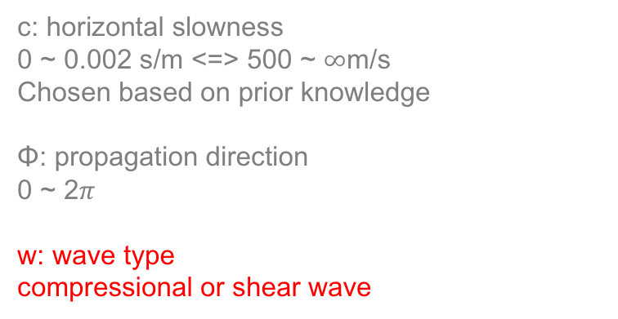
Incorporate wave type into the model space
N
c
ϕ
m (ϕ, c, w=0)
E
Wave front
Compressional
wave
c: horizontal slowness
0 ~ 0.002 s/m <=> 500 ~ $∞$m/s
Chosen based on prior knowledge
Φ: propagation direction
0 ~ 2$π$
w: wave type
compressional or shear wave
m (ϕ, c, w=1)
Shear wave

Slide 21
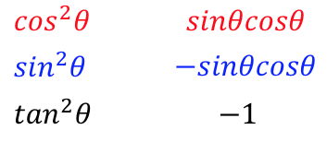

Fiber responses for compressional and shear waves
Compressional
wave
Shear
wave
fiber 2
Wave propagation direction
Fiber 1
fiber 1
Fiber 2
Ratio
Martin et al., SEP-168

Slide 22
Forward Operator: ensemble of plane-wave impulse responses
m_{k}
d
M_{k}
M_{l}
=
m_{l}
d
=
F
m
m_{k} (ϕ_{k}, c_{k}, w_{k}), t₀

Slide 23



Solve for the model (“fingerprint”)
adjoint (beamforming)
inverse with L-2 norm
inverse with L-1 norm
make the model sparse
find the most relevant plane waves
Notes:
We like few model points: L1-norm can potentially do that

Slide 24
Overview
Background and motivation
Inverse problem set up
  Model
  Forward operator
  Inversion
Synthetic analysis
  Impulsive plane wave
  Reverberant plane wave
Field data application
  Foothill earthquake

Slide 25
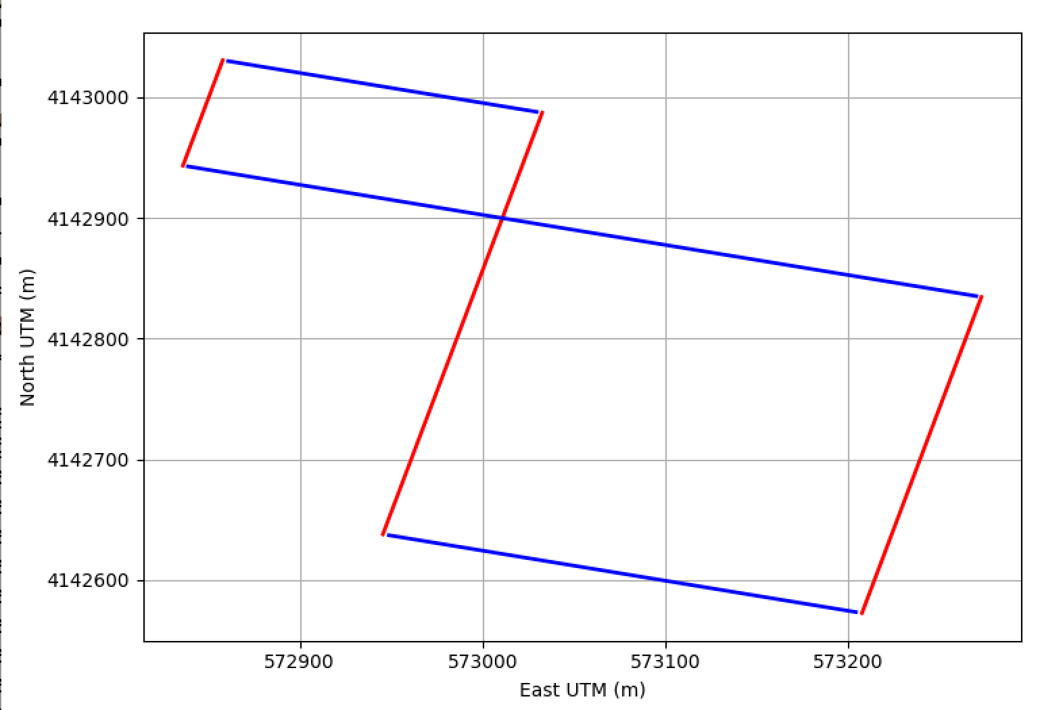
Simplified geometry

Slide 26
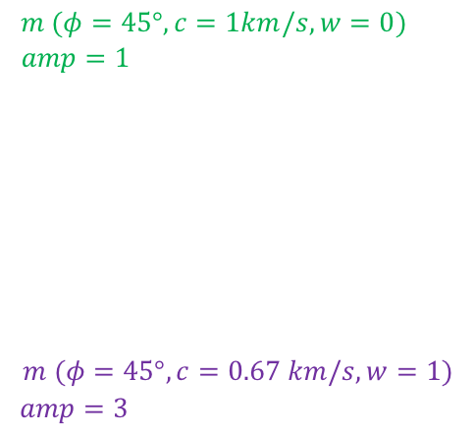

Synthetic model (ground truth)
compressional
wave
b3
r3
b2
r2
EQ
r1
b1
shear wave
Notes:
Loop through different t₀ to find wave
with different phases

Slide 27
Synthetic data: forward modeling
r1
r2
r3
b1
b2
b3
b3
r3
b2
r2
EQ
r1
b1
Notes:
Loop through different t₀ to find wave
with different phases

Slide 28
Synthetic data: forward modeling
r1
r2
r3
b1
b2
b3
b3
r3
b2
r2
EQ
r1
b1
compressional wave
shear wave
Notes:
Loop through different t₀ to find wave
with different phases

Slide 29
One challenge: compressional wave is interfered by the shear wave
r1
r2
r3
b1
b2
b3
b3
r3
b2
r2
EQ
r1
b1
Notes:
Loop through different t₀ to find wave
with different phases

Slide 30
Adjoint: “Fingerprints” with spread-out energy
compressional wave “fingerprint”
shear wave “fingerprint”

Slide 31
Adjoint: “Fingerprints” with spread-out energy
compressional wave ground truth
shear wave ground truth

Slide 32
L-2 norm inversion “Fingerprints”: better but not great
compressional wave “fingerprint”
shear wave “fingerprint”
Notes:
Loop through different t₀ to find wave
with different phases

Slide 33
L-2 norm inversion “Fingerprints”: better but not great
compressional wave ground truth
shear wave ground truth
Notes:
Loop through different t₀ to find wave
with different phases

Slide 34
L-1 norm inversion “Fingerprints”: highly sparse and focused
compressional wave “fingerprint”
shear wave “fingerprint”
# of nonzeros: 2
Notes:
Loop through different t₀ to find wave
with different phases

Slide 35
L-1 norm inversion “Fingerprints”: highly sparse and focused
compressional wave ground truth
shear wave ground truth
# of nonzeros: 2
Notes:
Loop through different t₀ to find wave
with different phases

Slide 36
L-1 norm inversion “Fingerprints”: waveform well recovered
Recovered waveform
Notes:
Loop through different t₀ to find wave
with different phases

Slide 37
L-1 norm inversion “Fingerprints”: waveform well recovered
Synthetic data
Notes:
Loop through different t₀ to find wave
with different phases

Slide 38
Waveform is compressed to two “Fingerprint” points !
“fingerprints”
Synthetic data
Notes:
Loop through different t₀ to find wave
with different phases

Slide 39
We have seen reverberation in field data
Foothill earthquake data
Notes:
Loop through different t₀ to find wave
with different phases

Slide 40

Switch from synthetic impulsive waves to reverberating waves
r1
r2
r3
b1
b2
b3
b3
r3
b2
r2
EQ
r1
b1
Notes:
Loop through different t₀ to find wave
with different phases

Slide 41

Switch from synthetic impulsive waves to reverberating waves
r1
r2
r3
b1
b2
b3
b3
r3
b2
r2
EQ
r1
b1
Notes:
Loop through different t₀ to find wave
with different phases

Slide 42
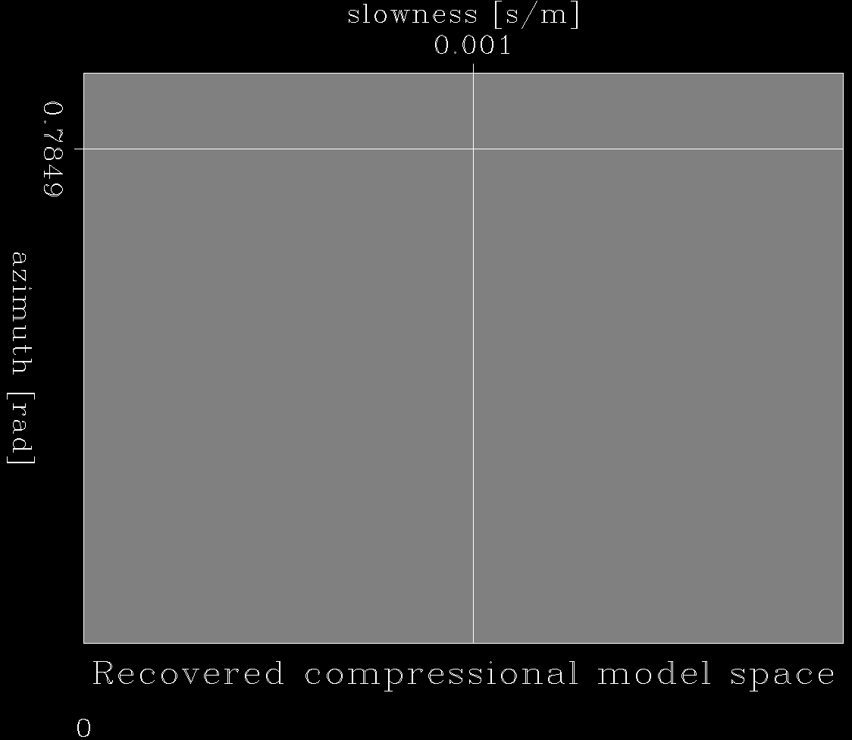

Synthetic model for reverberating waves: periodic function of t₀
compressional wave ground truth
shear wave ground truth
Notes:
Loop through different t₀ to find wave
with different phases

Slide 43
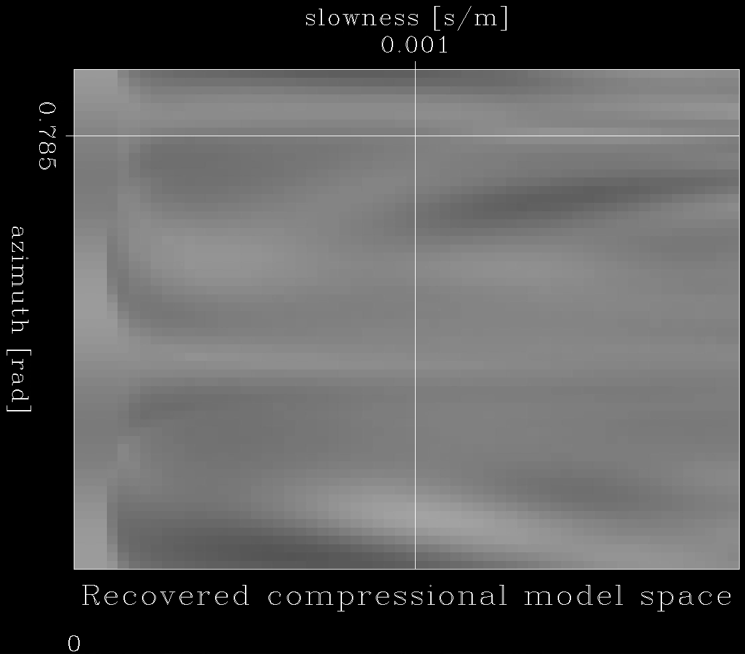
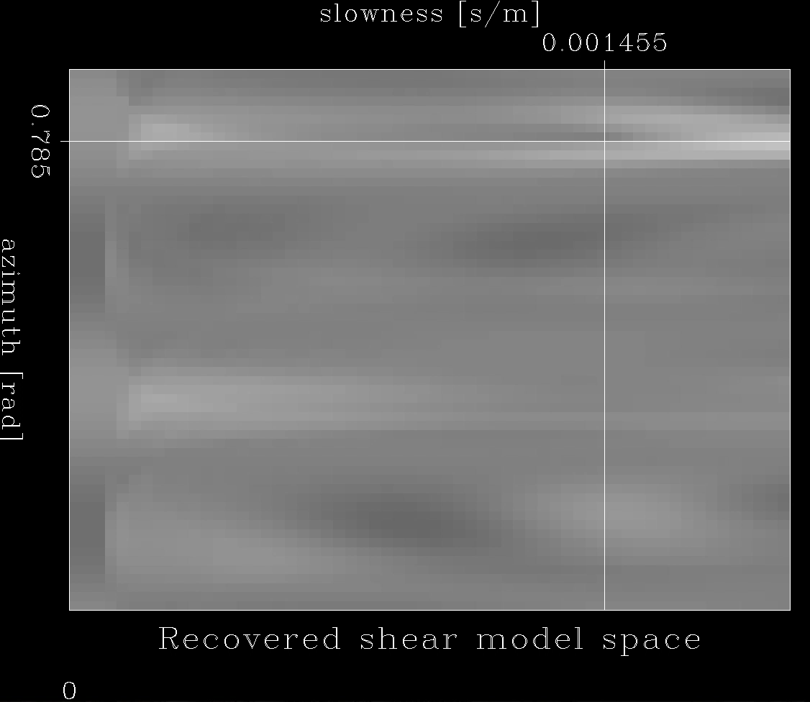
Adjoint “Fingerprints”
Compressional waves: NOT recovered!
Shear waves: recovered with spread-out energy.

Slide 44
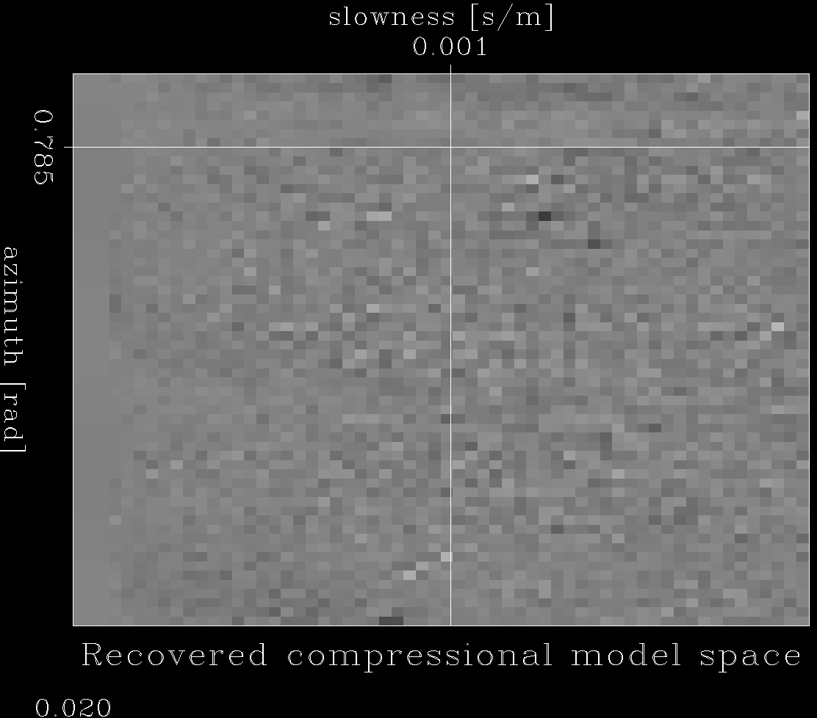

Inversion with L2 regularization “Fingerprints”
Compressional waves: obvious artifacts
Shear waves: fairly well recovered.
Notes:
Loop through different t₀ to find wave
with different phases

Slide 45
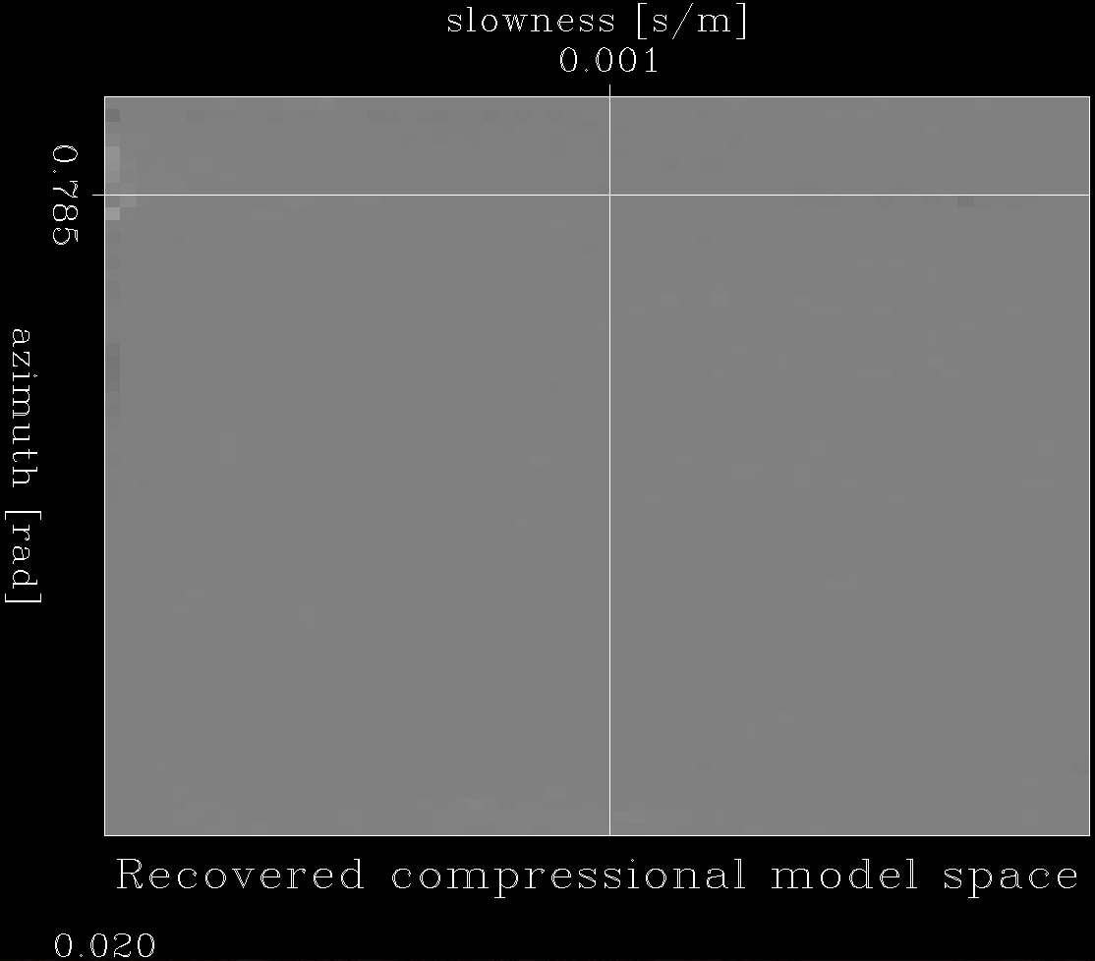

Inversion with L1 regularization:
Plane waves are well recovered
Notes:
Loop through different t₀ to find wave
with different phases

Slide 46
Waveform is compressed to sparse “Fingerprint” points
“fingerprints”
Synthetic data
Notes:
Loop through different t₀ to find wave
with different phases

Slide 47
Conclusions of the synthetic tests
Adjoint:
a rough estimation and it suffers from crosstalk artifacts.
L2 norm inverse:
better compared to the adjoint method.
L1 norm inverse:
highly focused results with no obvious artifacts.

Slide 48
Overview
Background and motivation
Inverse problem set up
  Model
  Forward operator
  Inversion
Synthetic analysis
  Impulsive plane wave
  Reverberant plane wave
Field data application
  Foothill earthquake
Notes:
Loop through different t₀ to find wave with different phases
Mention 2D model space

Slide 49
Foothill earthquake
P
S
N
Foothill earthquake
Magnitude: 3.3
Distance: 32.8 km
09/15/2017 01:17:47 UTC time
Notes:
Loop through different t₀ to find wave
with different phases

Slide 50
Foothill earthquake
P
S
Foothill earthquake
Notes:
Loop through different t₀ to find wave
with different phases

Slide 51
Foothill earthquake
b3
b1
r2
b3
r3
b2
r1
b1
r3
P
b2
S
r2
r1
b1
Foothill earthquake
Notes:
Loop through different t₀ to find wave
with different phases

Slide 52
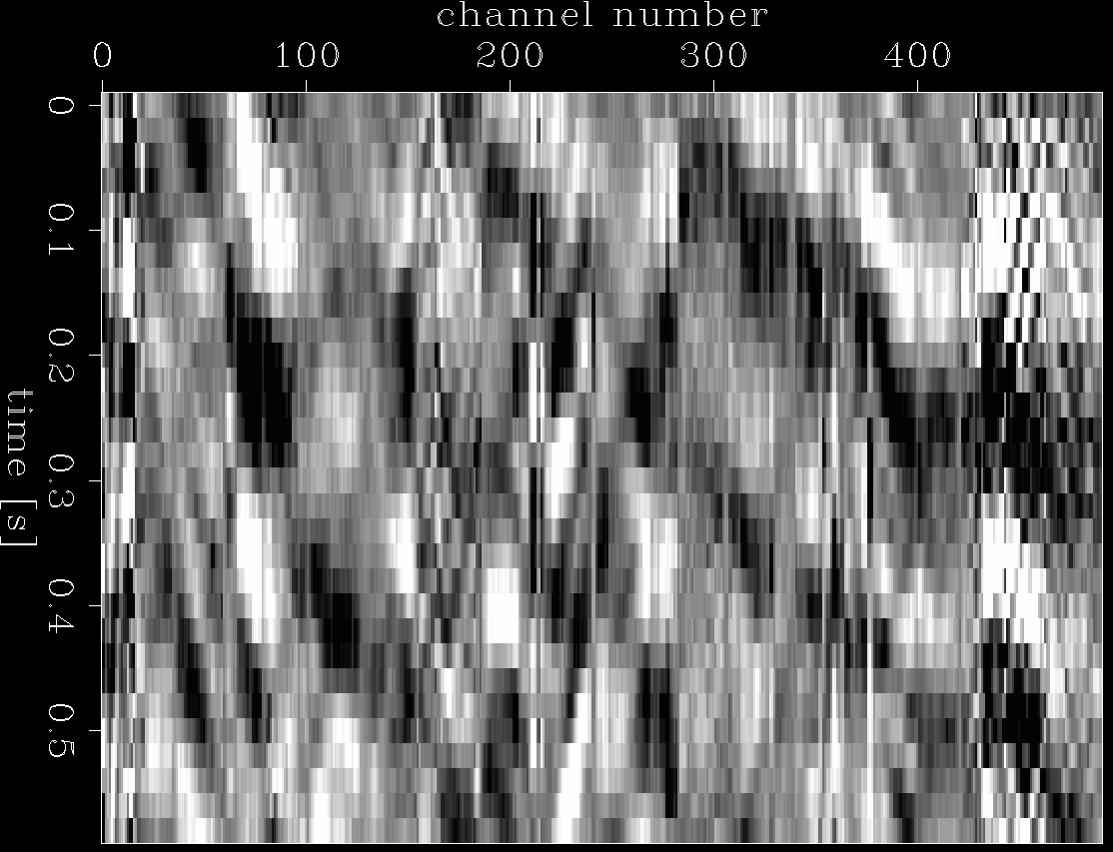
Extract data for test
r1
r2
r3
b1
b2
b3
b1
r2
b3
r3
b2
r1
b1
P
P
S
S
Extracted data
Foothill earthquake
Notes:
Loop through different t₀ to find wave
with different phases

Slide 53
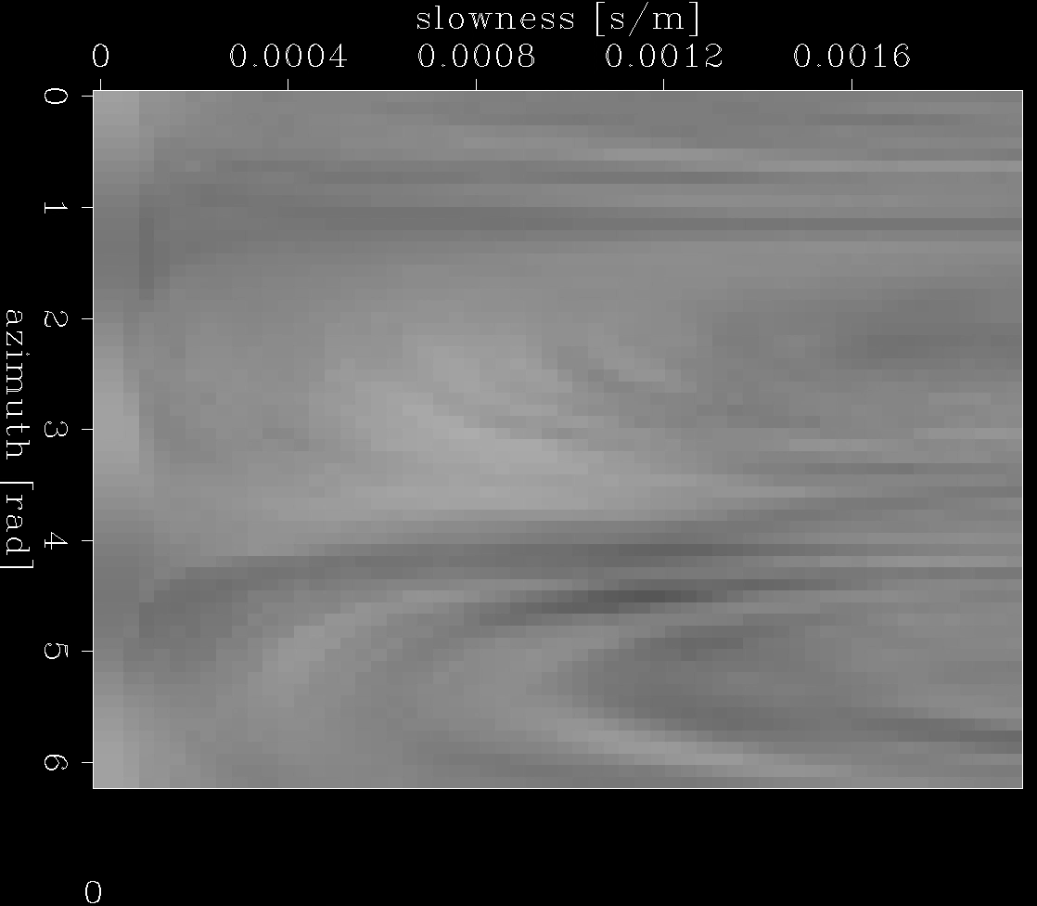
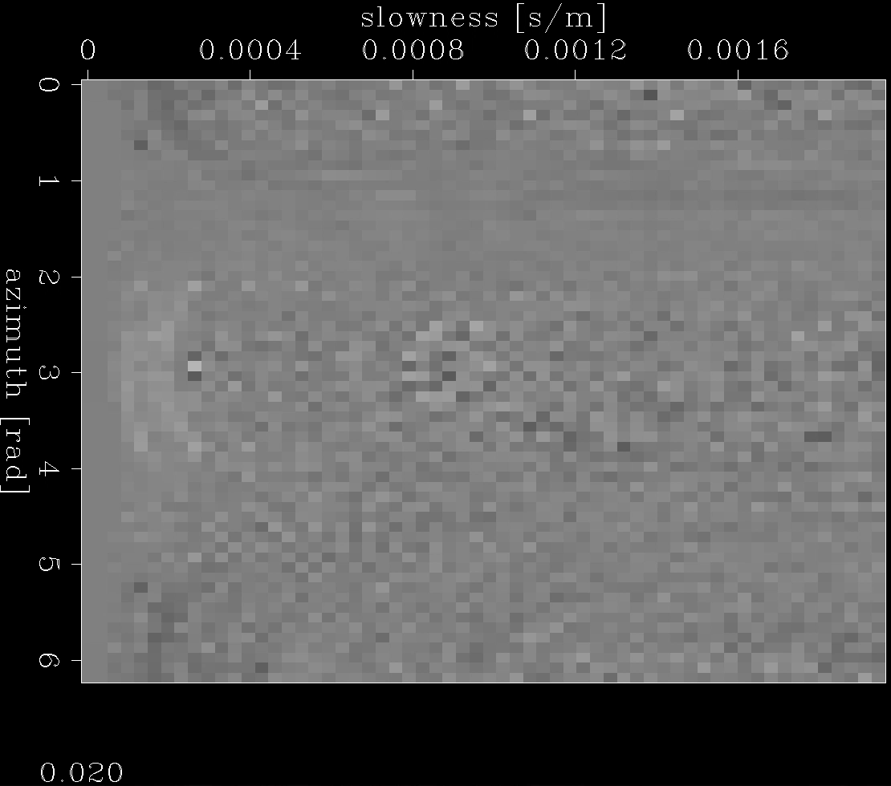

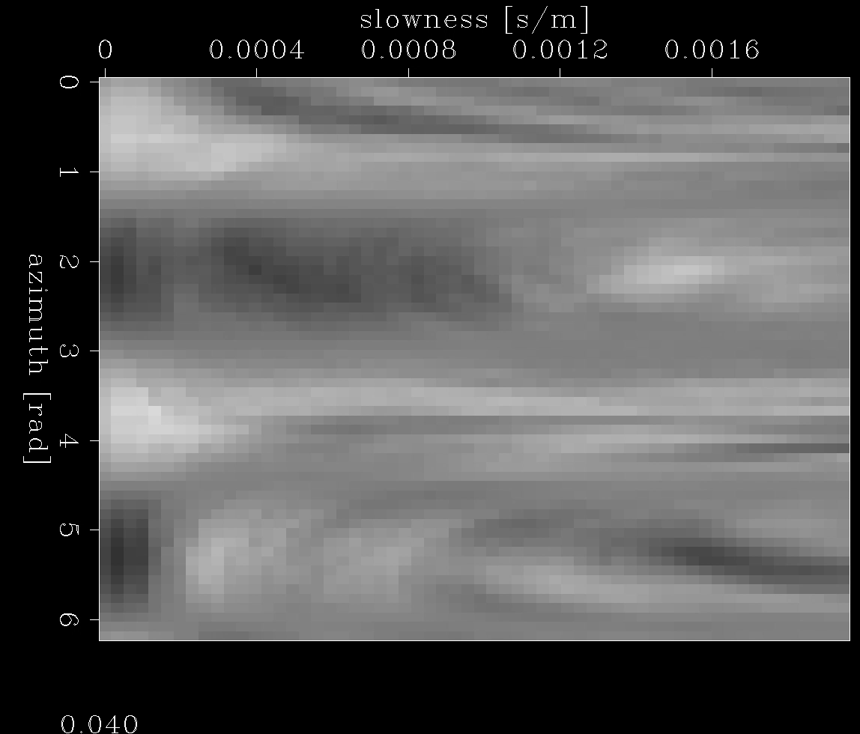
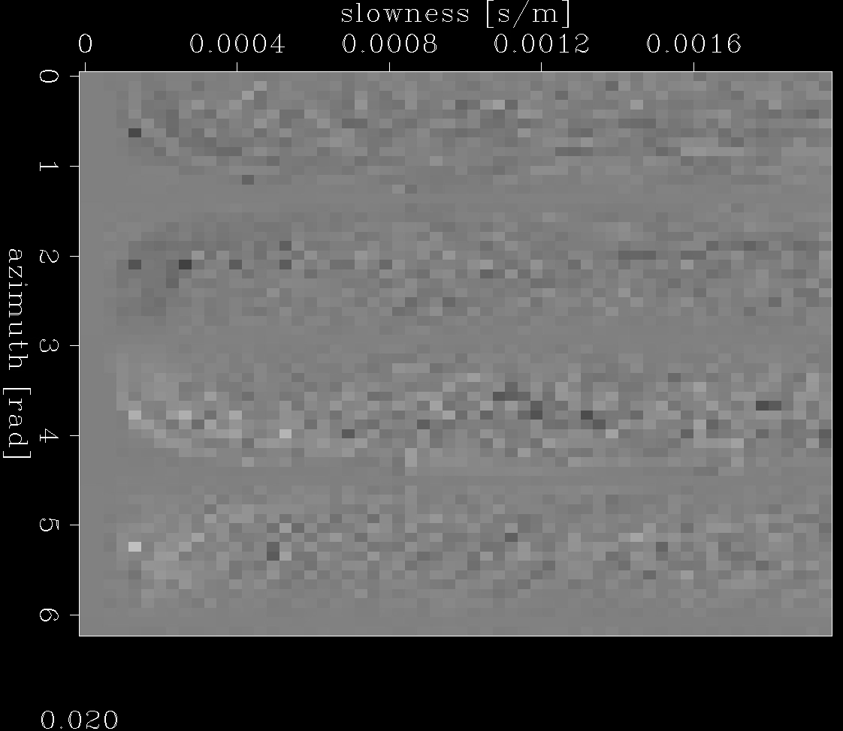

L1 inverse extracts the most sparse “Fingerprints”
adjoint
L2 inverse
L1 inverse
compressional
wave
shear wave
# of non-zeros
270,954 (94.1%)
270,954 (94.1%)
2,896 (1.0%)
Notes:
Loop through different t₀ to find wave
with different phases

Slide 54
L1 inverse recovered the major waveforms
adjoint
L2 inverse
L1 inverse
Notes:
Loop through different t₀ to find wave
with different phases

Slide 55
L1 inverse recovered the major waveforms
Data recovered by L2 inverse
Data recovered by L1 inverse
Notes:
Loop through different t₀ to find wave
with different phases

Slide 56
L1 inverse recovered the major waveforms
Field data
Notes:
Loop through different t₀ to find wave
with different phases

Slide 57
L1 inverse recovered the major waveforms
L2 inverse difference
L1 inverse difference
Notes:
Loop through different t₀ to find wave
with different phases

Slide 58
Field data are compressed to sparse “Fingerprints”
“fingerprints”
Field data
2,896 non-zeros
14,730 non-zeros
Notes:
Loop through different t₀ to find wave
with different phases

Slide 59
Conclusions
L1 norm inverse can give us highly sparse results and recover the earthquake data ignoring the noise.
L1 norm inverse can be potentially used to extract “fingerprints” from
DAS recordings to set up earthquake detection and location
algorithms.
Notes:
Loop through different t₀ to find wave
with different phases

Slide 60
Aknowledgements
Stanford Center for Induced and Triggered Seismicity for financial support
OptaSense for DAS equipment available.
Stanford Center for Computational Earth and Environmental Sciences for computing resources.
Stanford IT and SEEES IT for supporting the installation.
Our colleagues for help, especially Bob Clapp, Eileen R. Martin, Yinbin Ma.
Notes:
Loop through different t₀ to find wave
with different phases

Slide 61
Questions?
Notes:
Loop through different t₀ to find wave
with different phases

