Slide 1
Python and Jupyter notebooks for
Building synthetic datasets for machine learning
Bob Clapp

Slide 2
Python and Jupyter notebooks for
Conducting reproducible research
Bob Clapp

Slide 3
Python and Jupyter notebooks for
Writing textbooks and manuals
Bob Clapp

Slide 4
Python and Jupyter notebooks for
Labs for classes
Bob Clapp

Slide 5
Python and Jupyter notebooks for
Designing the next generation processing system
Bob Clapp

Slide 6
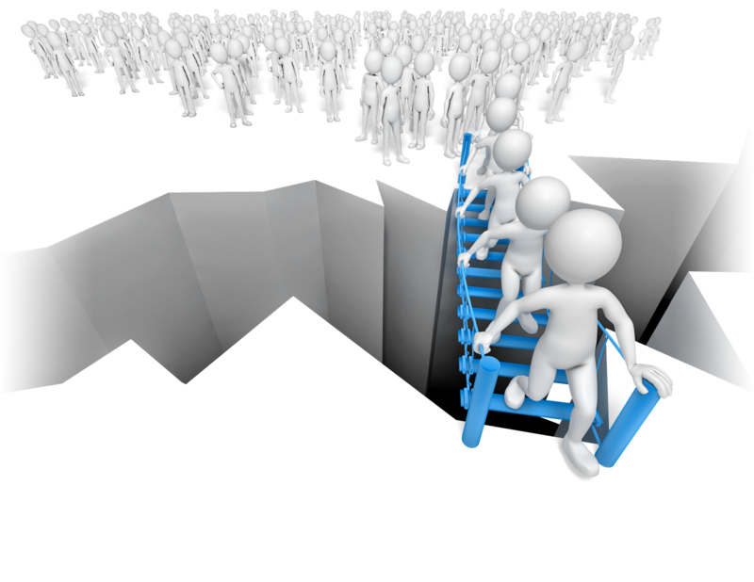
High-level potential bottlenecks
Development
Bob Clapp

Slide 7
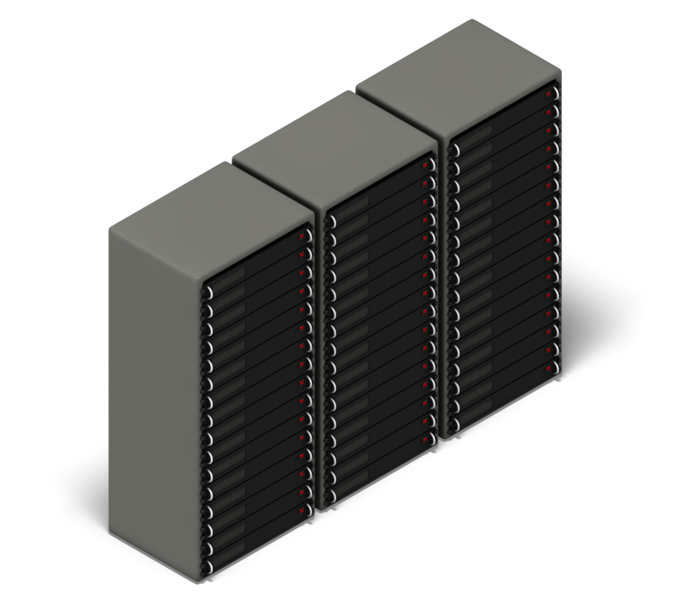
High-level potential bottlenecks
Production
Development
Bob Clapp

Slide 8
High-level potential bottlenecks
Development
to production
Production
Development
Bob Clapp

Slide 9
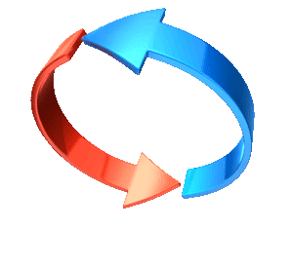
High-level potential bottlenecks
Development
Reproducibility
Turn-around time
Bob Clapp

Slide 10
What languages are students being taught
Bob Clapp

Slide 11
Open source most common languages
Bob Clapp

Slide 12
Engineering languages - IEEE spectrum
 | Language | Spectrum Ranking
1 | Python | 100
2 | c | 99.7
3 | Java | 99.4
4 | C++ | 97.2
5 | C# | 88.6
6 | R | 88.1
7 | Javascript | 85.5
15 | Matlab | 68.0
20 | Cuda | 53.9
28 | Fortran | 40.0
31 | Julia | 36.5
Bob Clapp

Slide 13
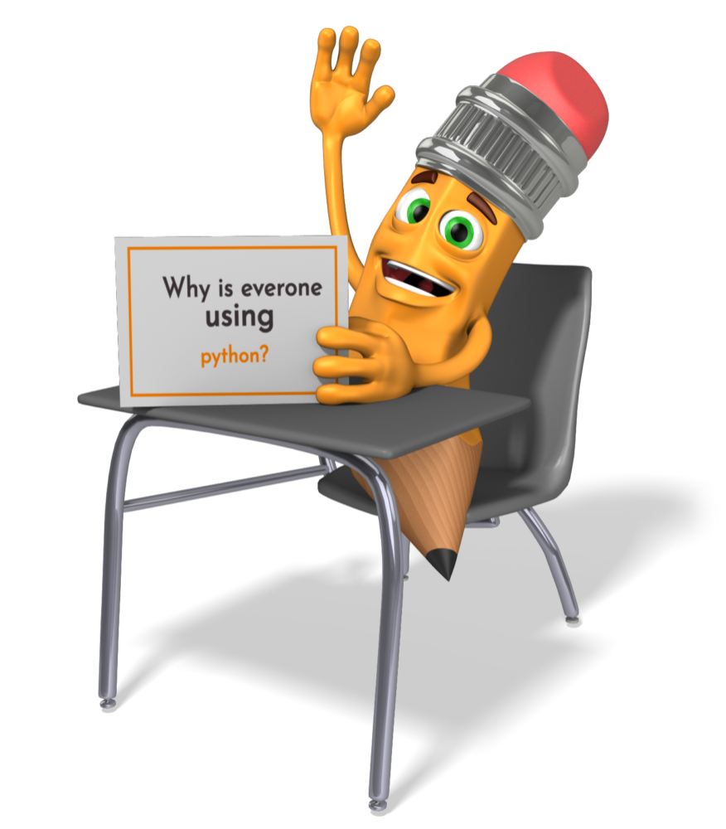
Making programmers more productive
Readability
Object-oriented
Extensive online community
For high level tasks we don’t need the speed of compiled languages
Bob Clapp

Slide 14
RTM
Read data
Read parameters
Read earth model
Read wavelet
Migrate
Write image
Bob Clapp

Slide 15
RTM
Read data
Read parameters
Read earth model
Read wavelet
Migrate
Write image
“Easier/cleaner” in python
Bob Clapp

Slide 16
Migrate
<10% of lines in CPU version needs to be parallelized/vectorized
<15% of line in GPU version written in cuda
Python with wrappers negligible performance loss
Bob Clapp

Slide 17
How
Generation of interfaces using SWIG
Directly with Boost.python/Pybind11
Example: Tensorflow
Bob Clapp

Slide 18
What it looks like ….. developer’s perspective
PYBIND11_MODULE(pyGieeOps, clsOps) {py::class_<float2DVecOp,
Operator<float2DReg, float2DReg>,
std::shared_ptr<float2DVecOp>>(clsOps, "float2DVecOp")
.def(py::init<std::shared_ptr<float2DReg>, std::shared_ptr<float2DReg>,
std::shared_ptr<VecOp>>(),
"Initialize a vector operation")
.def(“forward”,&float2DVecOp::forward,”Linear forward operator”)
.def(“adjoint”,&float2DVecOp::adjoint,”Linear adjoint operator”);
};

Slide 19
What it looks like ….. user’s perspective
import pyGieeOps
lags=[int(201)]
coefs=[float(.9)]
filt=pyGieeOps.Filter(lags,coefs,hyper.getCpp())
heliconOp=
pyGieeOps.float2DVecOp(spikesV,spikesV,pyGieeOps.helicon(filt))

Slide 20
Visualization
Hasn’t been updated in 5 years
Not included by default in Linux releases
Significant latency issues
X11
Bob Clapp

Slide 21
Visualization
vs
Bob Clapp

Slide 22
Javascript for visualization
Client/server model for visualization
Send images/movies to client from server/server farm
Minimal latency requirements (scraping/sending jpegs/mpegs)
Bob Clapp

Slide 23
Javascript
Dominant form of webApp
Browsers are optimized for performance
Ever growing community of open source platforms
Bob Clapp

Slide 24
Jupyter notebooks
One document combining
Graphics
Rich text (can be outputted in HTML)
Code
Great as a teaching tool and for report distribution
Bob Clapp

Slide 25
How we are/going to use them (classes)
Rewriting GIEE book in a notebook
Labs rewritten as notebooks
GIEE (half this year)
GP257 (next year)
BEI (???)
Bob Clapp

Slide 26
How we are/going to use them (Reproducibility)
Reports written as notebooks
Provide dockers to run notebooks
Possibly online notebooks
Bob Clapp

Slide 27
How we are/going to use them (Packages)
Inversion library in python
Incore/out-core
CPU/GPU
RTM
2D/3D
CPU/GPU
Downward continuation
2D/3D
CPU/GPU
Bob Clapp

Slide 28
How we are/going to use them (SEPlib)
Convert all of SEPlib
Regular IO already converted
Utilities such as Window finished
Jupyter equivalent to most graphic packages finished
Bob Clapp

Slide 29
Deep learning and seismic (the bad)
We need 10k-1million of training data “sets” (i.e. models)
These datasets need to be labeled for features we are interested in
Mislabeled features greatly increase the number of datasets that we need

Slide 30
Deep learning and seismic (the good?)
We can do a lot of the training of our nets using transfer learning
The closer to real data the better, but more is probably more important

Slide 31
syntheticModel
Creates synthetic model by building up a series of geologic events
Written in C++ with python interface
Easily extendable

Slide 32
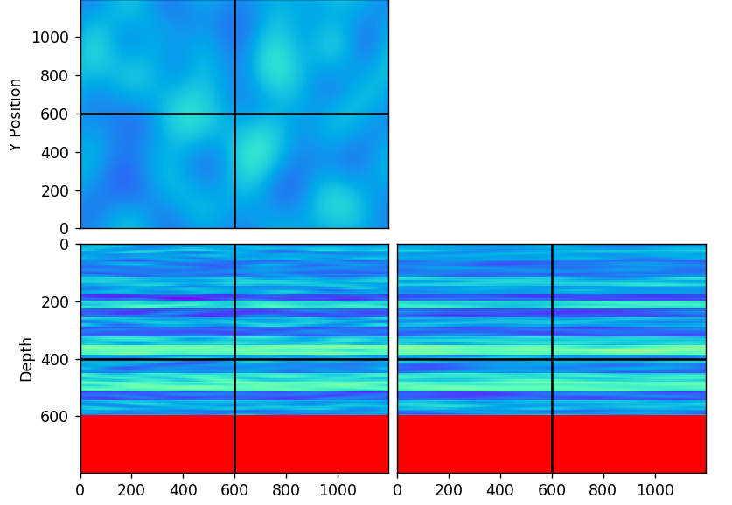
Deposition
%matplotlib notebook
mod=syntheticModel.geoModel(nx=300,ny=300)
mod.deposit(prop=2700,thick=100,var=.3,dev_pos=.1,layer=25,dev_layer=.3,layer_rand=.3,band2=.01, band3=.01)
mod.deposit(prop=2400,thick=50,var=.3,dev_pos=.1,
layer=25,dev_layer=.2,layer_rand=.3)
s=plot(mod)

Slide 33
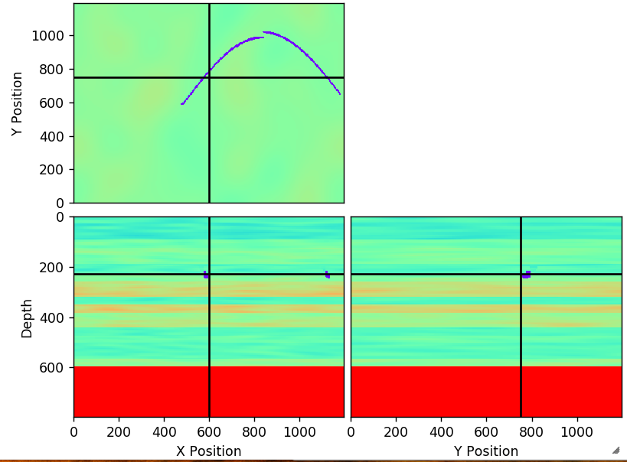
River Channels
%matplotlib notebook
mod=syntheticModel.geoModel(nx=300,ny=300)
mod.deposit(prop=2700,thick=100,var=.3,dev_pos=.1,layer=25,dev_layer=.3,layer_rand=.3,band2=.01, band3=.01)
mod.erodeRiver(start3=.5,start2=.4,
azmuth=27,nlevels=3,
wavelength=.35,waveamp=.3,thick=16)
mod.deposit(prop=2400,thick=50,var=.3,
dev_pos=.1,layer=25,dev_layer=.2,
layer_rand=.3)
b=plot(mod)

Slide 34
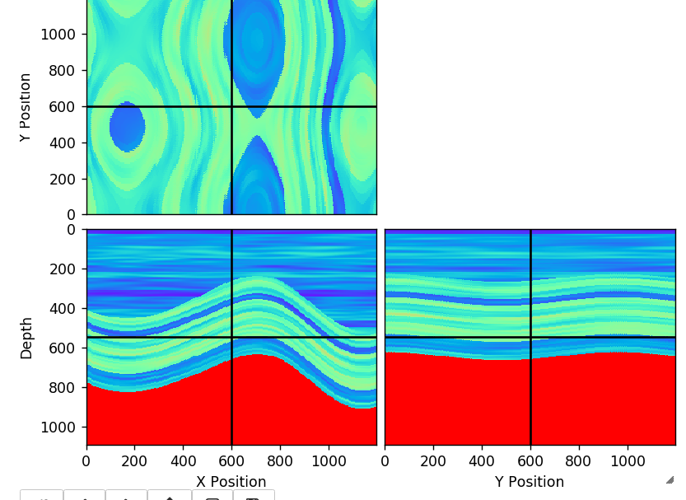
Squish
%matplotlib notebook
mod=syntheticModel.geoModel(nx=300,ny=300)
mod.deposit(prop=2700,thick=100,var=.3,dev_pos=.1,layer=25,dev_layer=.3,layer_rand=.3,band2=.01, band3=.01)
mod.squish(max=150,random_inline=2.,
random_crossline=3.,aziumth=40.,
wavelength=.2)
mod.deposit(prop=2400,thick=50,var=.3,
dev_pos=.1,layer=25,dev_layer=.2,
layer_rand=.3)
c=plot(mod)

Slide 35
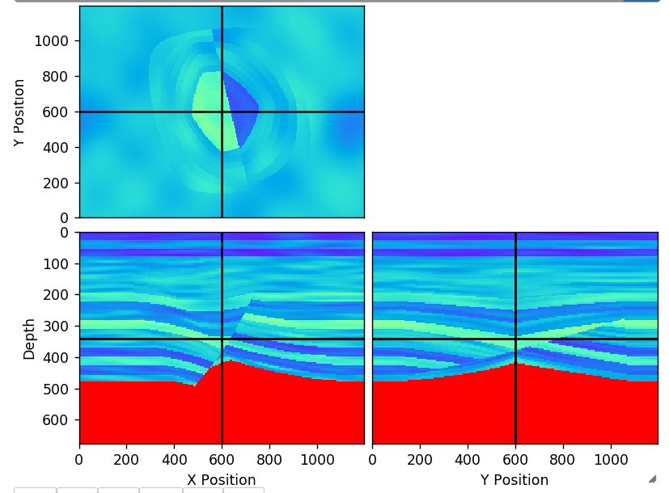
Fault
%matplotlib notebook
mod=syntheticModel.geoModel(nx=300,ny=300)
mod.deposit(prop=2700,thick=100,var=.3,dev_pos=.1,layer=25,
dev_layer=.3,layer_rand=.3,band2=.01, band3=.01)
mod.fault(begx=.5,begy=.5,begz=.5,daz=800,
dz=700,azimuth=10,theta_die=12,
theta_shit=7,dist_die=.4,perp_die=.4)
mod.deposit(prop=2400,thick=20,var=.3,
dev_pos=.1,layer=25,dev_layer=.2,
layer_rand=.3)
d=plot(mod)

Slide 36
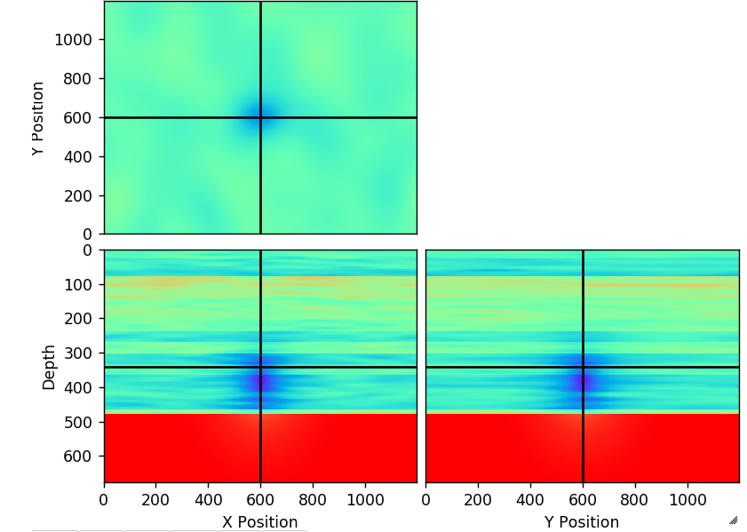
Gaussian anomaly
%matplotlib notebook
mod=syntheticModel.geoModel(nx=300,ny=300)
mod.deposit(prop=2700,thick=100,var=.3,dev_pos=.1,layer=25,dev_layer=.3,layer_rand=.3,band2=.01, band3=.01)
mod.gaussian(vplus=-1000.,var=40.)
mod.deposit(prop=2400,thick=20,var=.1,
dev_pos=.1,layer=25,dev_layer=.2,
layer_rand=.3)
d=plot(mod)

Slide 37
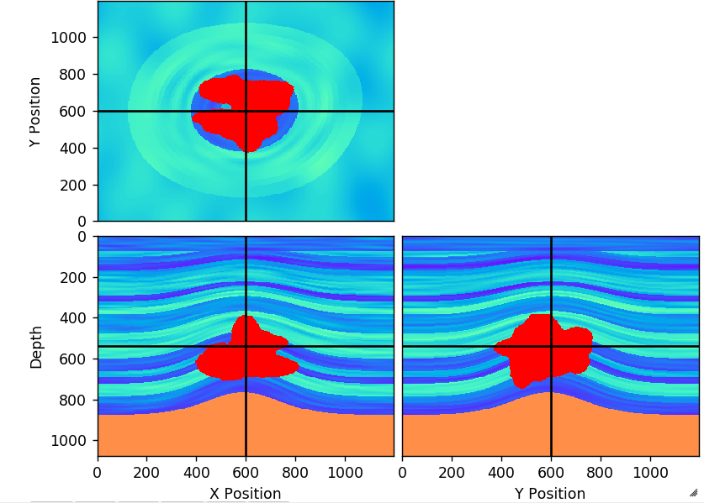
Salt emplacement
%matplotlib notebook
mod=syntheticModel.geoModel(nx=300,ny=300)
mod.deposit(prop=2700,thick=200,var=.3,dev_pos=.1,layer=25,
dev_layer=.3,layer_rand=.3,band2=.01,
band3=.01)
mod.implace(ntSteps=50)
mod.deposit(prop=2400,thick=20,var=.1
,dev_pos=.1,layer=25,dev_layer=.2,
layer_rand=.3)
d=plot(mod)

Slide 38
What I am generating (1)
Hundreds to thousands of geologic models
Simulated migrated volumes (convolution with depth dependent wavelet)
Marked with river channels, salt, faults

Slide 39
What I am generating (2)
Finite difference modeling of volumes (full coverage of receivers)
RTM migration volumes with different geometries

Slide 40
How to experiment
>docker pull rgc007/synthetic-model:latest

Slide 41
Conclusions
1
There is no reason to write everything in a compiled language
2
Python/pybind11 provide a good way to mix compiled language with python
3
Jupyter notebooks as a teaching and report tool

