Slide 1


Toward time-lapse study of anisotropic parameters over the Genesis field
Yinbin Ma
05/22/2018
Stanford Exploration Project
Ma et al., SEP 172, 2018

Slide 2
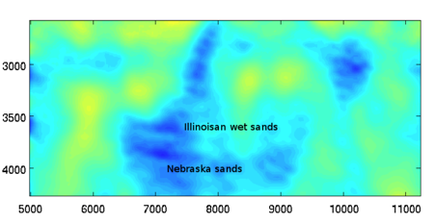
Motivation
Is there a measurable 4D anisotropic effect?
Time-lapse velocity change
M. Maharramov, Ph.D. Thesis, SEP-162, 2016

Slide 3
Outline
Data re-processing
Time-lapse RTM study
Sensitivity analysis for anisotropic parameters

Slide 4
Outline
Data re-processing
VTI model
Time-lapse RTM study
Possibility of estimating anisotropic parameters with 4D FWI
Purpose: register RTM images from multiple datasets for better estimation of 4D effect

Slide 5
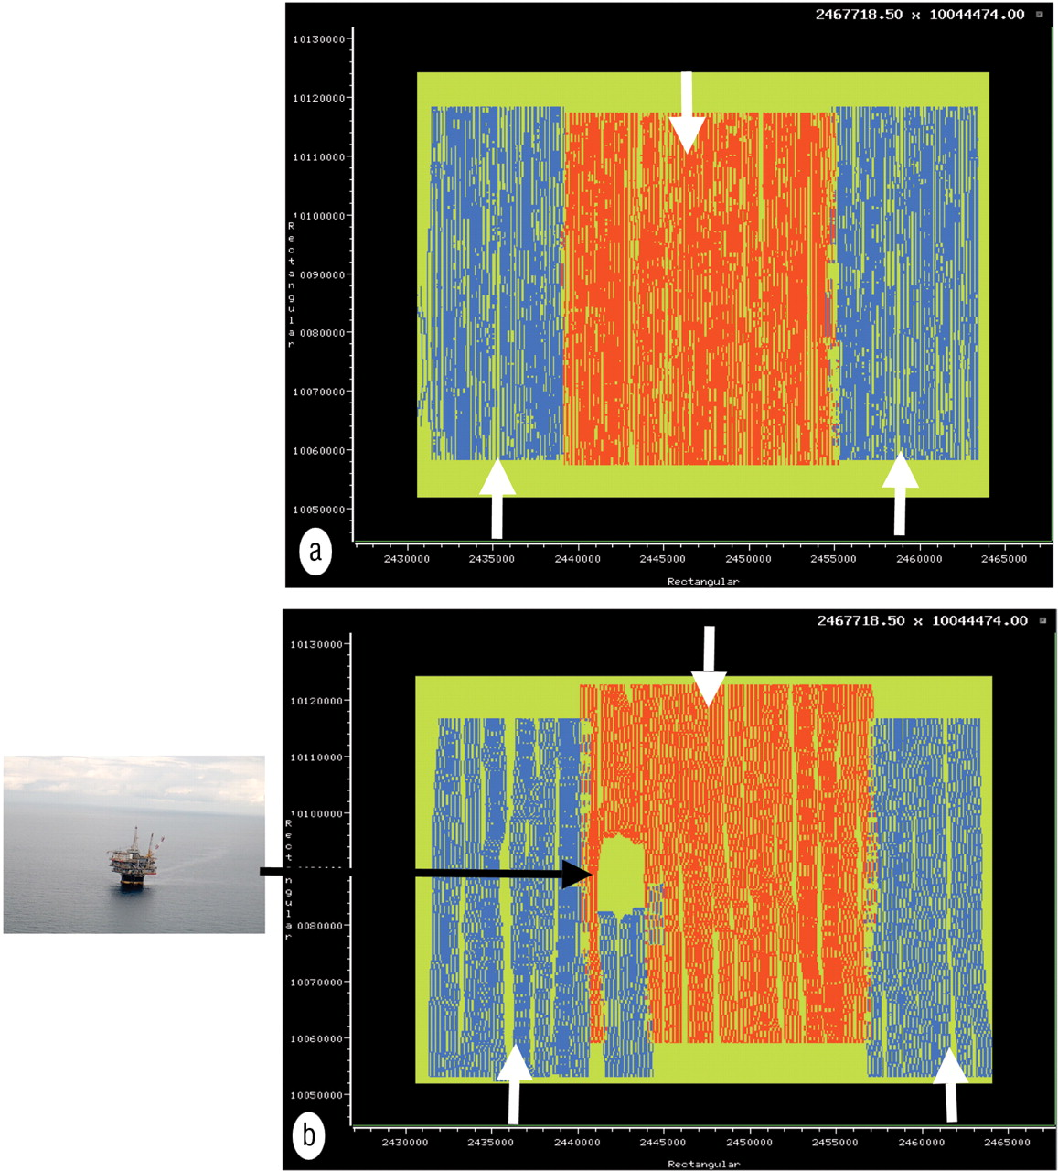
Acquisition geometry for GENESIS dataset
Baseline survey, 1990
Magesan, et al., 2005

Slide 6
Acquisition geometry for GENESIS dataset
Baseline survey, 1990
Monitor survey, 2002
Magesan, et al., 2005

Slide 7
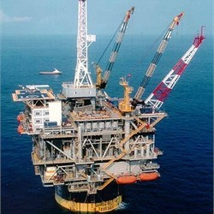
Acquisition geometry for GENESIS dataset
Baseline survey, 1990
Monitor survey, 2002
Magesan, et al., 2005

Slide 8
Acquisition geometry for GENESIS dataset
2D line used in this presentation
Pros: no acquisition gap
Cons: less 4D effect
Baseline survey, 1990
Monitor survey, 2002
Magesan, et al., 2005

Slide 9
Example of midpoint gather before data processing
Co-processed baseline and monitor data

Slide 10
Example of midpoint gather before data processing
Co-processed baseline and monitor data
Processed separately

Slide 11
Example of midpoint gather before data processing
Different range of offset

Slide 12
Example of midpoint gather before data processing
Different amplitude correction

Slide 13
Example of midpoint gather before data processing
Different signal to noise ratio

Slide 14
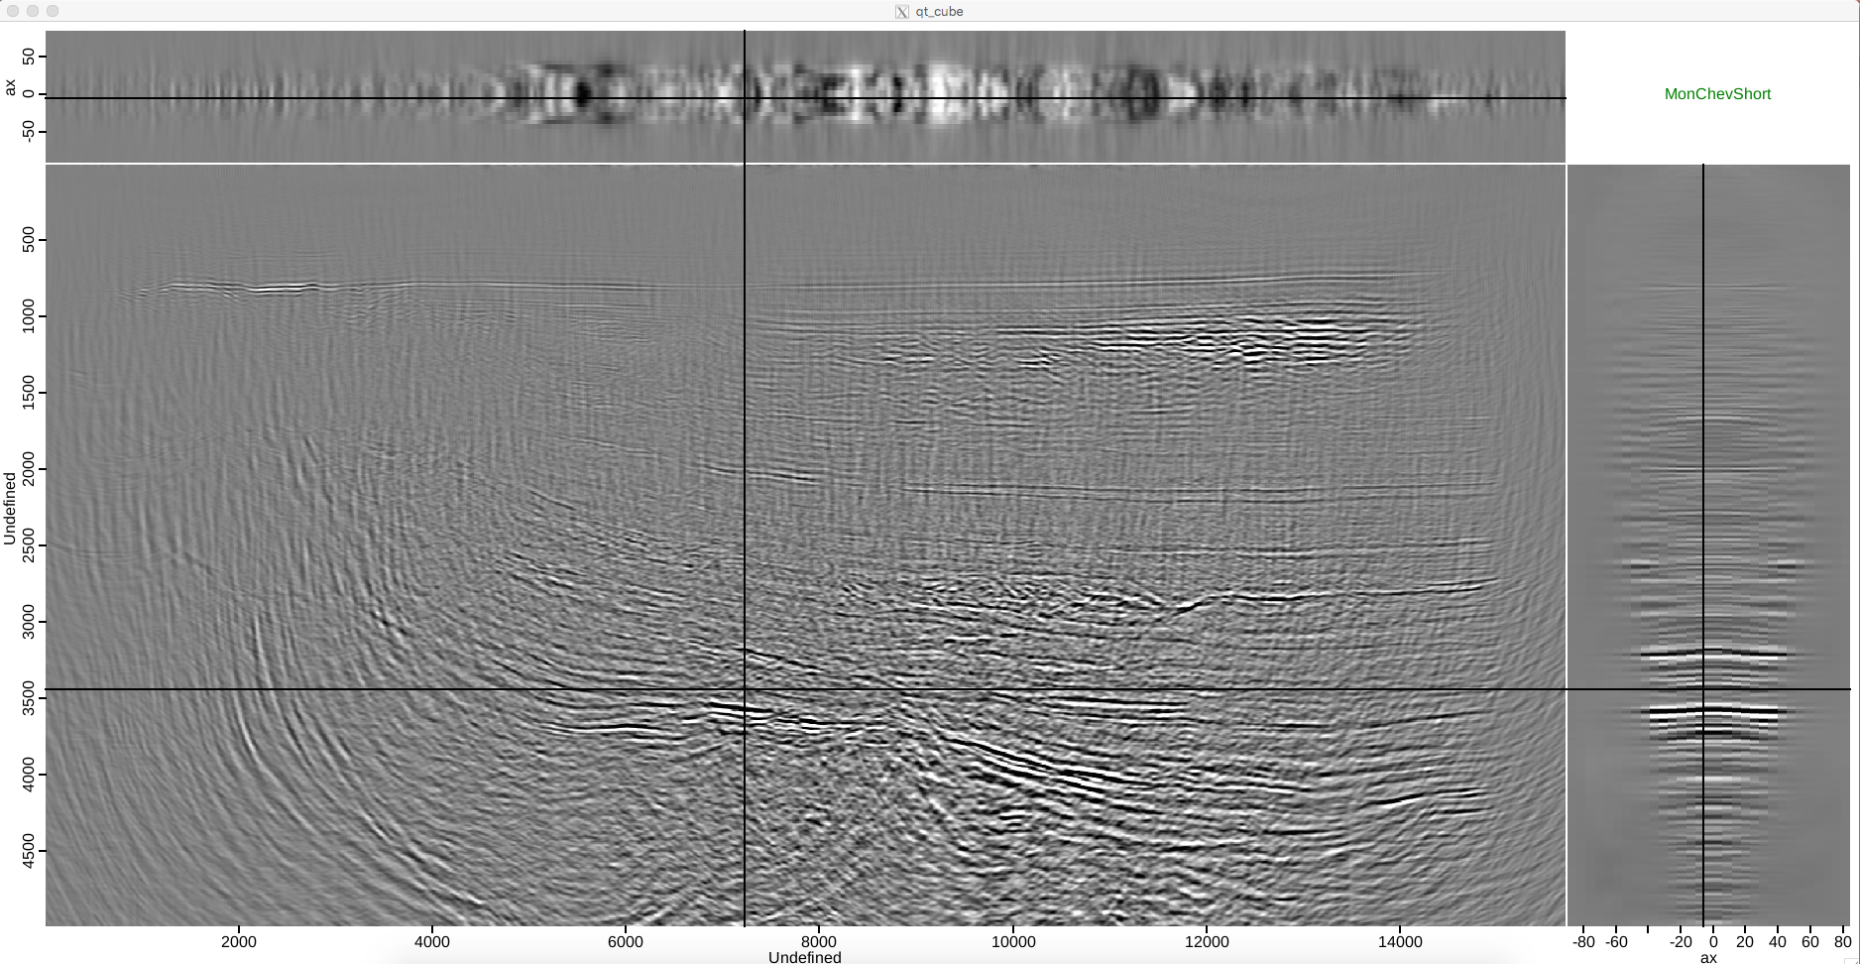
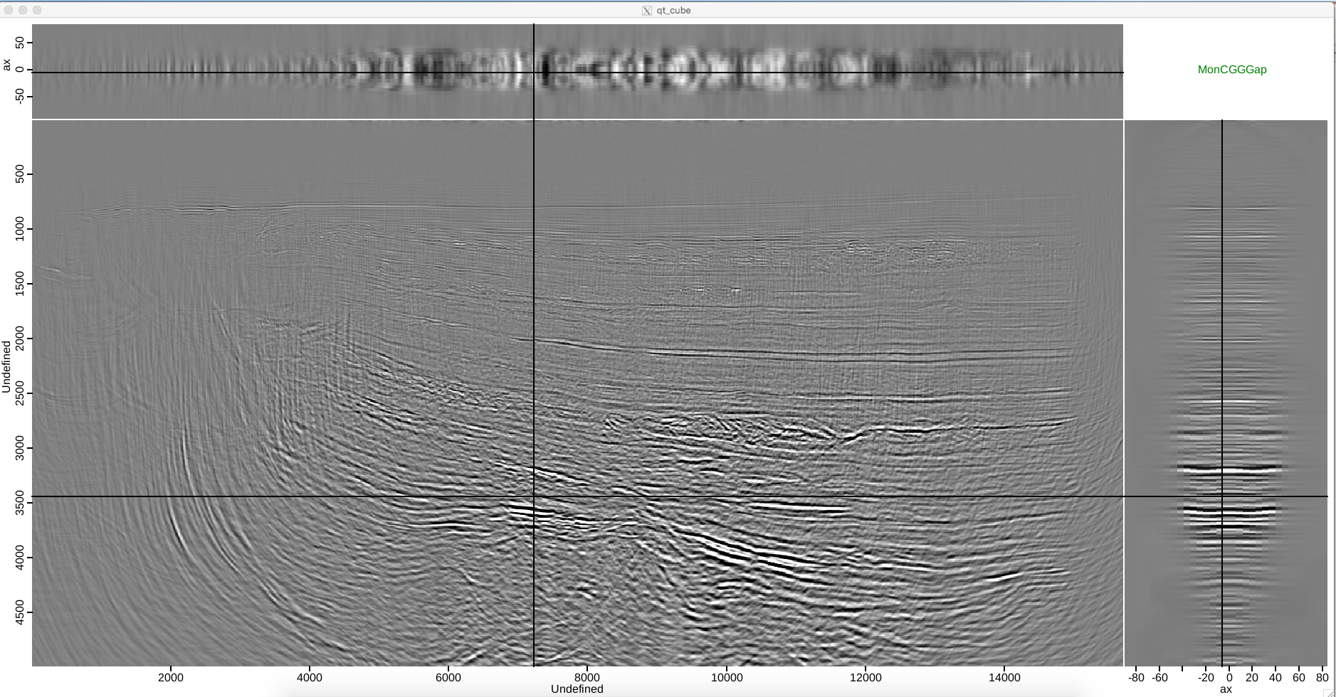
Difference between two monitor datasets: ADCIG

Slide 15
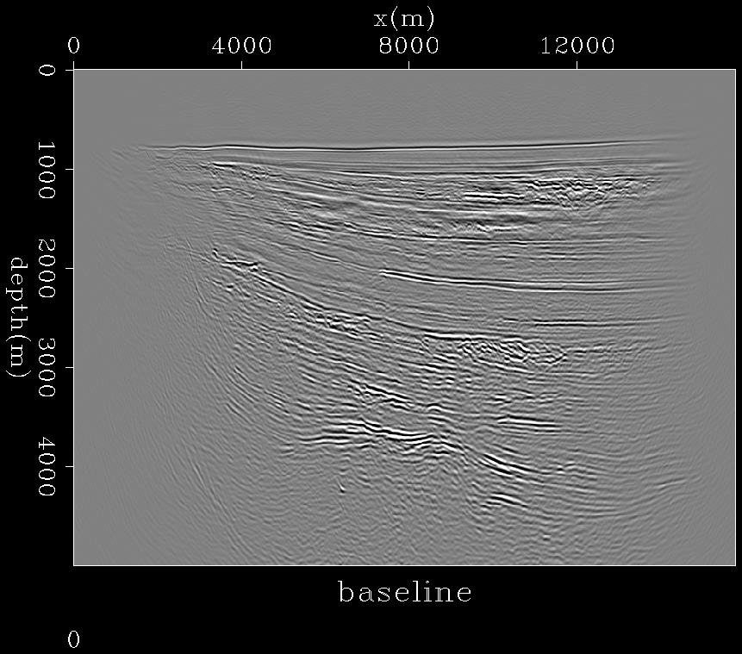
Effect from actual production vs effect from processing
Red circle: location of reservoir, time-lapse change expected
Green arrow: locations where RTM images should register
Effect of time-lapse change

Slide 16
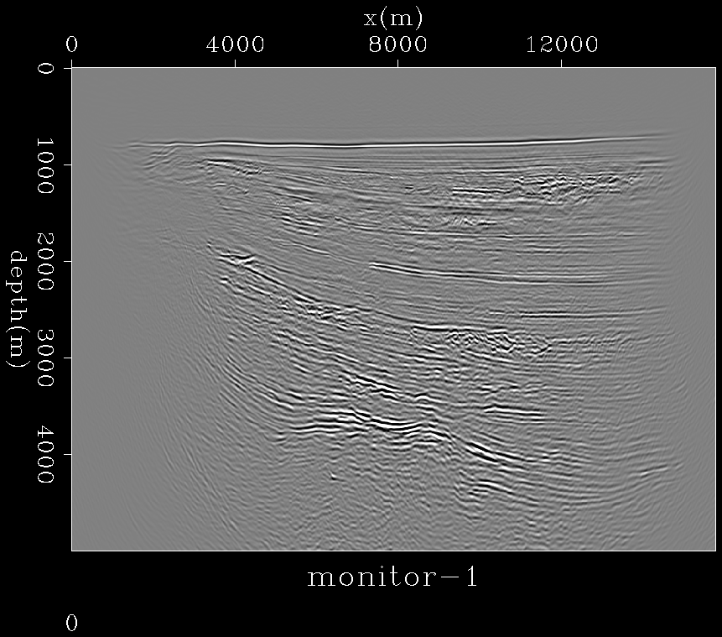
Effect from actual production vs effect from processing
Red circle: location of reservoir, time-lapse change expected
Green arrow: locations where RTM images should register
Effect of time-lapse change
Effect of processing

Slide 17
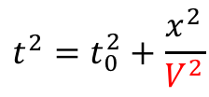
Understanding the header with semblance scan
Conventional semblance scan over velocity (NMO)
Offset fixed
$$t^{2}=t_{0}^{2}+\frac{x^{2}}{V^{2}}$$
Travel time fixed
Scan over stacking velocity
Zero offset travel time fixed

Slide 18
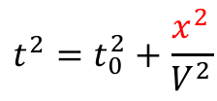
Understanding the header with semblance scan
Our approach to understand the header information
Scan over offset
$$t^{2}=t_{0}^{2}+\frac{x^{2}}{V^{2}}$$
Travel time fixed
Fixed velocity for water bottom reflection
Zero offset travel time fixed

Slide 19
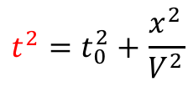
Understanding the header with semblance scan
Our approach to understand the header information
Offset fixed
$$t^{2}=t_{0}^{2}+\frac{x^{2}}{V^{2}}$$
Scan over time axis
Fixed velocity for water bottom reflection
Zero offset travel time fixed

Slide 20
New interpretation of the header information
Our initial interpretation of the time shift
new interpretation of the time shift
12 ms shift is a lot to us, because the time-lapse change is about 10 meters

Slide 21
New interpretation of the header information

Slide 22
Our “optimal” re-processing workflow
shift midpoint location;
align sources and receivers with the boat sailing direction;
shift origin of offset axis from 400 ft to 360 ft;
shift zero time by 6 ms;
apply spherical divergence correction to match the baseline data;
apply NMO correction to flatten the CMP gather;
interpolate along offset axis;
apply inverse NMO correction to recover kinematics;
sort to shot and receiver gathers to enhance illumination.

Slide 23
Example of midpoint gather before data re-processing

Slide 24
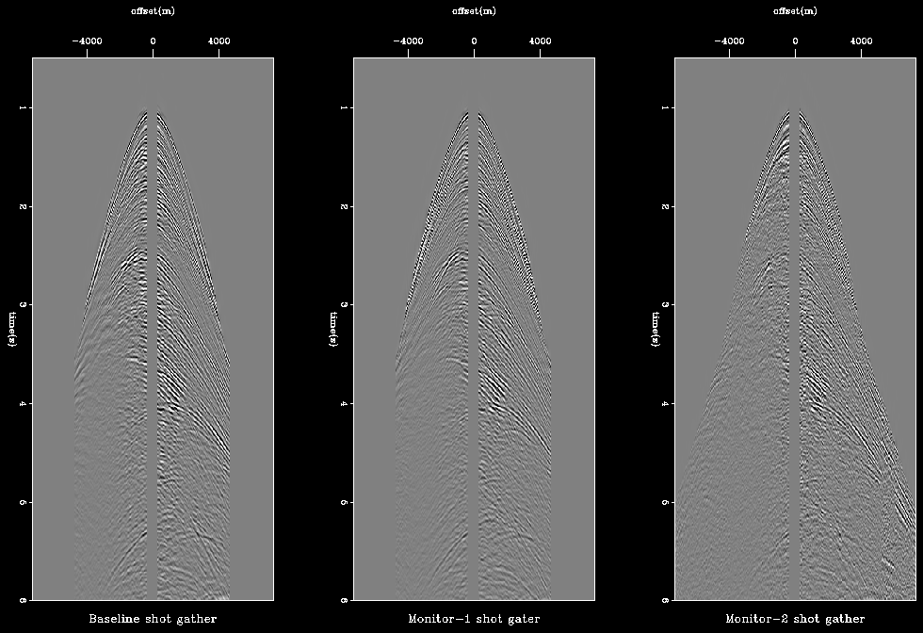
Common shot gathers after data re-processing

Slide 25
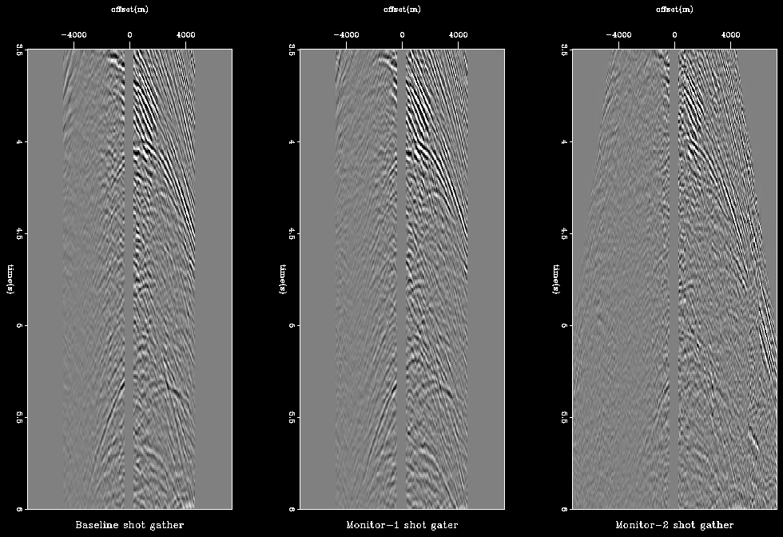
Common shot gathers after data re-processing

Slide 26
A brief summary of our data-reprocessing

Slide 27
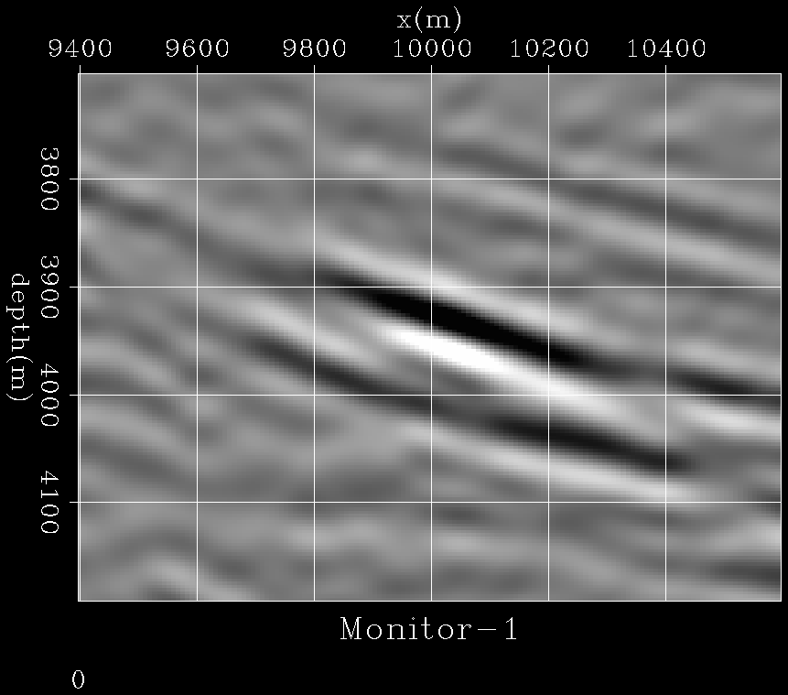
A brief summary of our data-reprocessing
Initial interpretation

Slide 28
A brief summary of our data-reprocessing
Initial interpretation
Updated interpretation

Slide 29
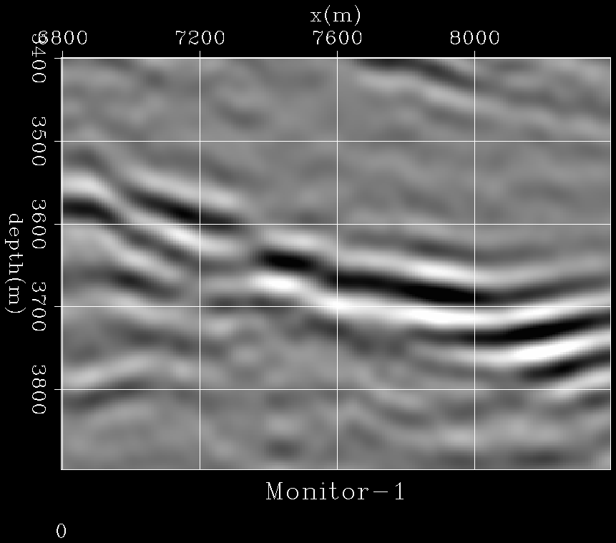
A brief summary of our data-reprocessing
Initial interpretation

Slide 30
A brief summary of our data-reprocessing
Initial interpretation
Updated interpretation

Slide 31
Outline
Data re-processing
Time-lapse RTM study
Sensitivity analysis for anisotropic parameters

Slide 32
3D VTI model: vertical velocity
Ma et al., SEP 168, 2017

Slide 33
3D VTI model: η parameter
Ma et al., SEP 168, 2017

Slide 34
RTM image with 3-35 Hz data
Stretch mute will remove low freq at shallow area
Anisotropic migration of baseline

Slide 35
RTM image with 3-35 Hz data
Stretch mute will remove low freq at shallow area
Anisotropic migration of monitor-1

Slide 36
RTM image with 3-35 Hz data
Stretch mute will remove low freq at shallow area
Anisotropic migration of monitor-2

Slide 37
Analysis of depth-shifts in migrated images stacked images
Anisotropic migration of baseline

Slide 38
Analysis of depth-shifts in migrated images stacked images
Anisotropic migration of monitor-1

Slide 39
Analysis of depth-shifts in migrated images stacked images
Anisotropic migration of monitor-2

Slide 40
Analysis of depth-shifts in migrated images stacked images
Anisotropic migration of baseline

Slide 41
Analysis of depth-shifts in migrated images stacked images
Anisotropic migration of baseline

Slide 42
Analysis of depth-shifts in migrated images stacked images
Anisotropic migration of monitor-1

Slide 43
Analysis of depth-shifts in migrated images stacked images
V-
Near offset see the velocity decreasing area, not far offset

Slide 44
Analysis of depth-shifts in migrated images stacked images
Anisotropic migration of monitor-1

Slide 45
Analysis of depth-shifts in migrated images stacked images
Anisotropic migration of monitor-2

Slide 46
Analysis of depth-shifts in migrated images stacked images
Anisotropic migration of baseline

Slide 47
Outline
Data re-processing
Time-lapse RTM study
Sensitivity analysis for anisotropic parameters

Slide 48
With correction anisotropic parameters
Anisotropic migration of monitor-2

Slide 49
With increased anisotropic parameters (3x eta)
Anisotropic migration of monitor-2

Slide 50
With increased anisotropic parameters (10x eta)
Anisotropic migration of monitor-2

Slide 51
With correction anisotropic parameters
Anisotropic migration of monitor-2

Slide 52
With increased anisotropic parameters (20x eta)
Anisotropic migration of monitor-2

Slide 53
Conclusions
RTM images register after data re-processing
Time-lapse RTM study confirmed detectable 4D effect in seismic data
Far offset data sensitive to anisotropic parameters

Slide 54
We would like to thanks Chevron, ExxonMobil and BHP for giving us the Genesis dataset.
Thank you and questions?

