Slide 1


Time-lapse FWI with shaping regularization: toward integrated reservoir monitoring
Yinbin Ma
05/22/2018
Stanford Exploration Project

Slide 2
Motivation:
Better results when combining different types of data
Inversion with seismic data alone
Y. Ma et al., SEP 158, 2015

Slide 3
Motivation:
Better results when combining different types of data
Inversion with seismic data alone
Inversion with extra geological dip info
Y. Ma et al., SEP 158, 2015

Slide 4
Outline
Challenges for integrated reservoir monitoring
Regularization to combine different types of data
Numerical Examples on time-lapse FWI

Slide 5
Outline
Challenges for integrated reservoir monitoring
Regularization to combine different types of data
Numerical Examples on time-lapse FWI

Slide 6
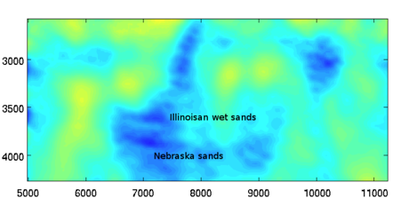
Challenges from Genesis field
How to combine different types of data for integrated reservoir monitoring?
velocity change from seismic data
M. Maharramov, 2016

Slide 7
Challenges from Genesis field
How to combine different types of data for integrated reservoir monitoring?
velocity change from seismic data
Geomechanical modeling
M. Maharramov, 2016
J. Rkckett et al., 2007

Slide 8
Challenges from Genesis field
How to combine different types of data for integrated reservoir monitoring?
velocity change from seismic data
Geomechanical modeling
Pressure change from reservoir simulation
M. Maharramov, 2016
J. Rkckett et al., 2007
N. Hodgson et al., 2007

Slide 9
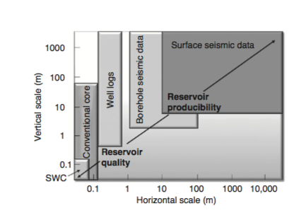
Different types of data have different coverage and resolution
D. Johnston, Practical Applications of Time-lapse Seismic Data, 2013

Slide 10
Undetermined parameters between different types of data
Seismic
geomechanics
J. Rkckett et al., 2007

Slide 11
Undetermined parameters between different types of data
Seismic
geomechanics
J. Rkckett et al., 2007

Slide 12
Outline
Challenges for integrated reservoir monitoring
Regularization to combine different types of data
Numerical Examples on time-lapse FWI

Slide 13
FWI objective function
We use FWI objective defined on data misfit :
The subsurface model is estimated by:
m: subsurface model, velocity, anisotropic parameters, elastic parameters, etc
u: synthetic data
d: observed data

Slide 14
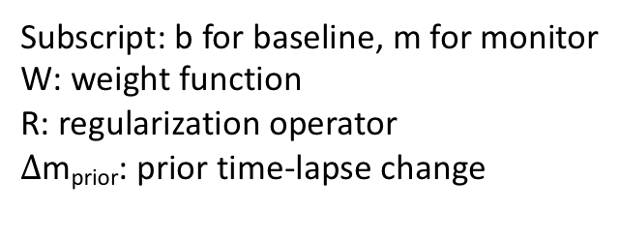
Time-lapse FWI objective function
We use joint inversion approach:
Subscript: b for baseline, m for monitor
W: weight function
R: regularization operator
$∆$m_{prior}: prior time-lapse change

Slide 15
Time-lapse FWI objective function
We use joint inversion approach:
Data fitting for baseline survey
Subscript: b for baseline, m for monitor
W: weight function
R: regularization operator
$∆$m_{prior}: prior time-lapse change

Slide 16
Time-lapse FWI objective function
We use joint inversion approach:
Data fitting for monitor survey
Subscript: b for baseline, m for monitor
W: weight function
R: regularization operator
$∆$m_{prior}: prior time-lapse change

Slide 17
Time-lapse FWI objective function
We use joint inversion approach:
Regularization on time-lapse change
Subscript: b for baseline, m for monitor
W: weight function
R: regularization operator
$∆$m_{prior}: prior time-lapse change

Slide 18
Time-lapse FWI objective function
We use joint inversion approach:
Regularization on time-lapse change
Subscript: b for baseline, m for monitor
W: weight function
R: regularization operator
$∆$m_{prior}: prior time-lapse change
How do we build the prior model?

Slide 19
Prior model building
We can build prior model based on reservoir simulation:
D. Johnston, Practical Applications of Time-lapse Seismic Data, 2013

Slide 20
Prior model building
We can build prior model based on reservoir simulation:
We can also build prior model based on geomechanics:
D. Johnston, Practical Applications of Time-lapse Seismic Data, 2013

Slide 21
Prior model building
We can build prior model based on reservoir simulation:
We can also build prior model based on geomechanics:
The challenge is that we do not know v_{inf}, A, R
D. Johnston, Practical Applications of Time-lapse Seismic Data, 2013

Slide 22
Regularization without accurate prior
We assume 4D seismic property is linearly related to prior:
$∆$p_{prior}: prior time-lapse change, vertical strain, stress, etc

Slide 23
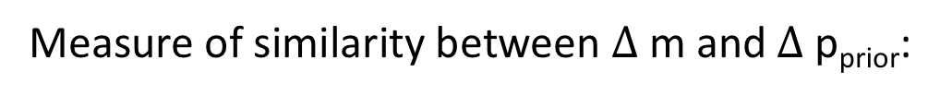
Regularization without accurate prior
We assume 4D seismic property is linearly related to prior:
Measure of similarity between $∆$m and $∆$p_{prior}:
$∆$p_{prior}: prior time-lapse change, vertical strain, stress, etc

Slide 24
Proposed 4D FWI objective function
We use the following objective function:

Slide 25
Proposed 4D FWI objective function
We use the following objective function:
Data fitting
Regularization

Slide 26
Understand the objective function with 1D model
1D transmission problem:
two layers, each with 1 km, v₁=1.5 km/s, v₂=2.5 km/s
Data generated Ricker wavelet with peak freq 10 Hz
Data fitting term

Slide 27
Understand the objective function with 1D model
1D transmission problem:
two layers, each with 1 km, v₁=1.5 km/s, v₂=2.5 km/s
Data generated Ricker wavelet with peak freq 10 Hz
ratio of v₁/v₂ used as prior for the regularization term
Data fitting term
Regularization term

Slide 28
Understand the objective function with 1D model
1D transmission problem:
two layers, each with 1 km, v₁=1.5 km/s, v₂=2.5 km/s
Data generated Ricker wavelet with peak freq 10 Hz
ratio of v₁/v₂ used as prior for the regularization term
Total objective function

Slide 29
Understand the objective function with 1D model
1D transmission problem:
two layers, each with 1 km, v₁=1.5 km/s, v₂=2.5 km/s
Data generated Ricker wavelet with peak freq 10 Hz
ratio of v₁/v₂ used as prior for the regularization term
Multiple local minimum
Total objective function

Slide 30
Outline
Challenges for integrated reservoir monitoring
Shaping regularization to combine different types of data
Numerical Examples on time-lapse FWI

Slide 31
True baseline model

Slide 32
Starting model

Slide 33
True time-lapse change

Slide 34
True time-lapse change
Fluid substitution
Overburden dilation

Slide 35
Inversion with no regularization

Slide 36
Inversion with regularization

Slide 37
Inversion with regularization

Slide 38
Inversion with strong regularization
Wrong because it is beyond the resolution of seismic data

Slide 39
Baseline data residual with noise

Slide 40
Inversion without regularization

Slide 41
Inversion with regularization

Slide 42
Inversion with regularization

Slide 43
Inversion with strong regularization

Slide 44
Conclusion and future work
We explored one possible method for integrated reservoir monitoring
Test on field data where both seismic modeling and geomechanical modeling are available

Slide 45
Thank you and questions?

