Slide 1

STRATIGRAPHY ESTIMATION
FROM SEISMIC DATA
USING DEEP LEARNING
Fantine Huot, Robert Clapp (Stanford Geophysics),
Bruce Power, Joseph Stefani (Chevron ETC)
Advised by Biondo Biondi (Stanford Geophysics & ICME)

Slide 2
OUTLINE
Learning from data
1D approach: a Wilcox field case study
Extension to 3D: Synthetic data generation
Neural network for image segmentation

Slide 3
CHALLENGES WITH SEISMIC DATA
Deep learning networks can learn very accurate mappings from inputs to outputs from large amounts of labeled data
However, these models are immensely data-hungry and rely on huge amounts of labeled data to achieve their performance
There are no ground truth labels in reflection seismology
When dealing with fuzzy boundaries and absence of ground truth, how do we train reliable machine learning models?

Slide 4
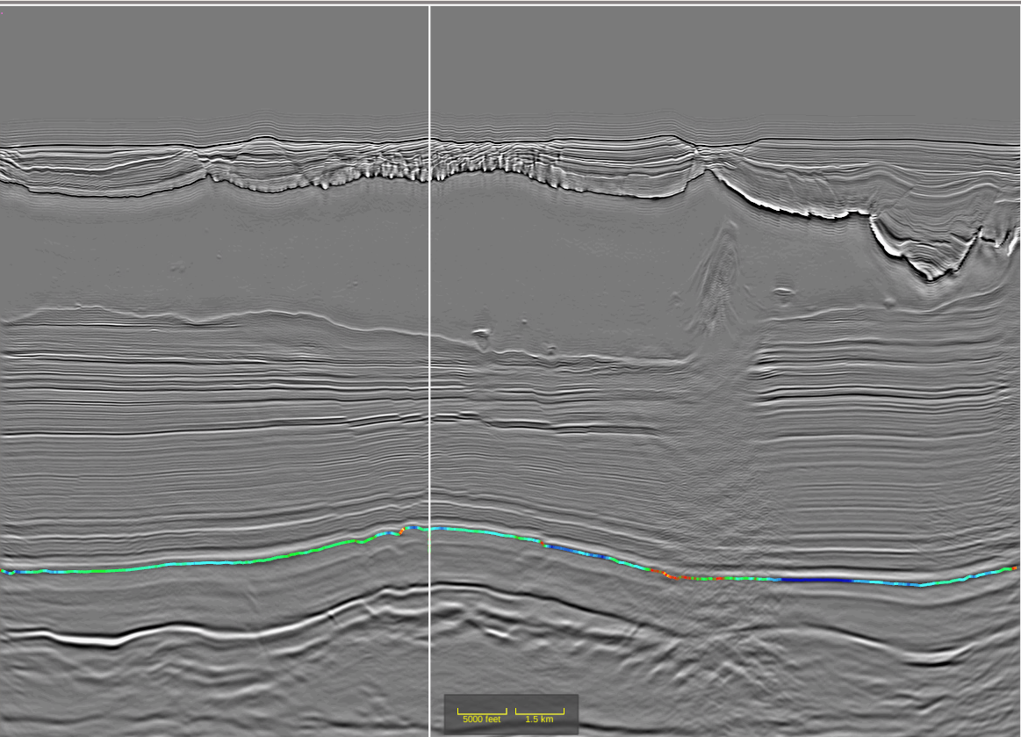
MOTIVATION
Reflection seismology allows us to estimate the properties of the Earth’s subsurface from reflected seismic waves
CHALLENGES
Sand and shale have similar seismic response
Seismic images are limited in resolution by the wavelength of the seismic wave
This makes seismic interpretation of deep stratigraphy a challenging and time-consuming task
Notes:
Context
In exploration geophysics, we use reflection seismology to estimate the properties of the Earth’s subsurface from reflection seismic waves.
This allows us to estimate where hydrocarbon is located before drilling.
Challenges
Sand (high hydrocarbon content) and shale (low hydrocarbon content) have similar elastic properties, hence a similar seismic response, making them hard to distinguish from seismic data alone.
Seismic images are limited in resolution by the wavelength of the seismic wave.
The higher seismic frequencies are attenuated as the wave propagates through the Earth.
This makes seismic interpretation of deep sub-salt stratigraphy a challenging and time-consuming task
Seismic images are usually much lower resolution (~200m) than the fine stratigraphy.

Slide 5
Motivation
Reflection seismology allows us to estimate the properties of the Earth’s subsurface from reflected seismic waves
Challenges
Sand and shale have similar seismic response
Seismic images are limited in resolution by the wavelength of the seismic wave
This makes seismic interpretation of deep sub-salt stratigraphy a challenging and time-consuming task
Notes:
Context
In exploration geophysics, we use reflection seismology to estimate the properties of the Earth’s subsurface from reflection seismic waves.
This allows us to estimate where hydrocarbon is located before drilling.
Challenges
Sand (high hydrocarbon content) and shale (low hydrocarbon content) have similar elastic properties, hence a similar seismic response, making them hard to distinguish from seismic data alone.
Seismic images are limited in resolution by the wavelength of the seismic wave.
The higher seismic frequencies are attenuated as the wave propagates through the Earth.
This makes seismic interpretation of deep sub-salt stratigraphy a challenging and time-consuming task
Seismic images are usually much lower resolution (~200m) than the fine stratigraphy.

Slide 6
OBJECTIVES
Develop a data preparation workflow to use labeled earth models for machine learning
Can we leverage deep learning algorithms to help us interpret stratigraphy content from seismic data?
What constraints or limits might there be on the seismic data quality and the granularity of interpretation?

Slide 7
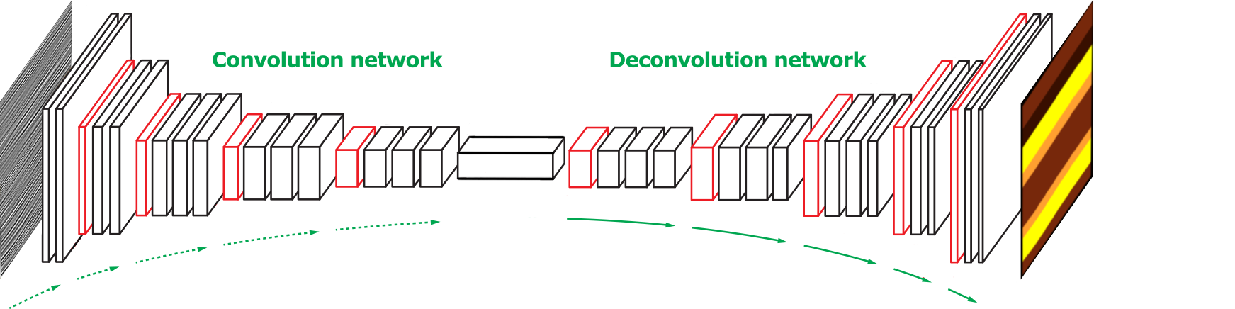
IMAGE SEGMENTATION NEURAL NETWORK

Slide 8
OUTLINE
Learning from data
1D approach: a Wilcox field case study
Extension to 3D: Synthetic data generation
Neural network for image segmentation

Slide 9
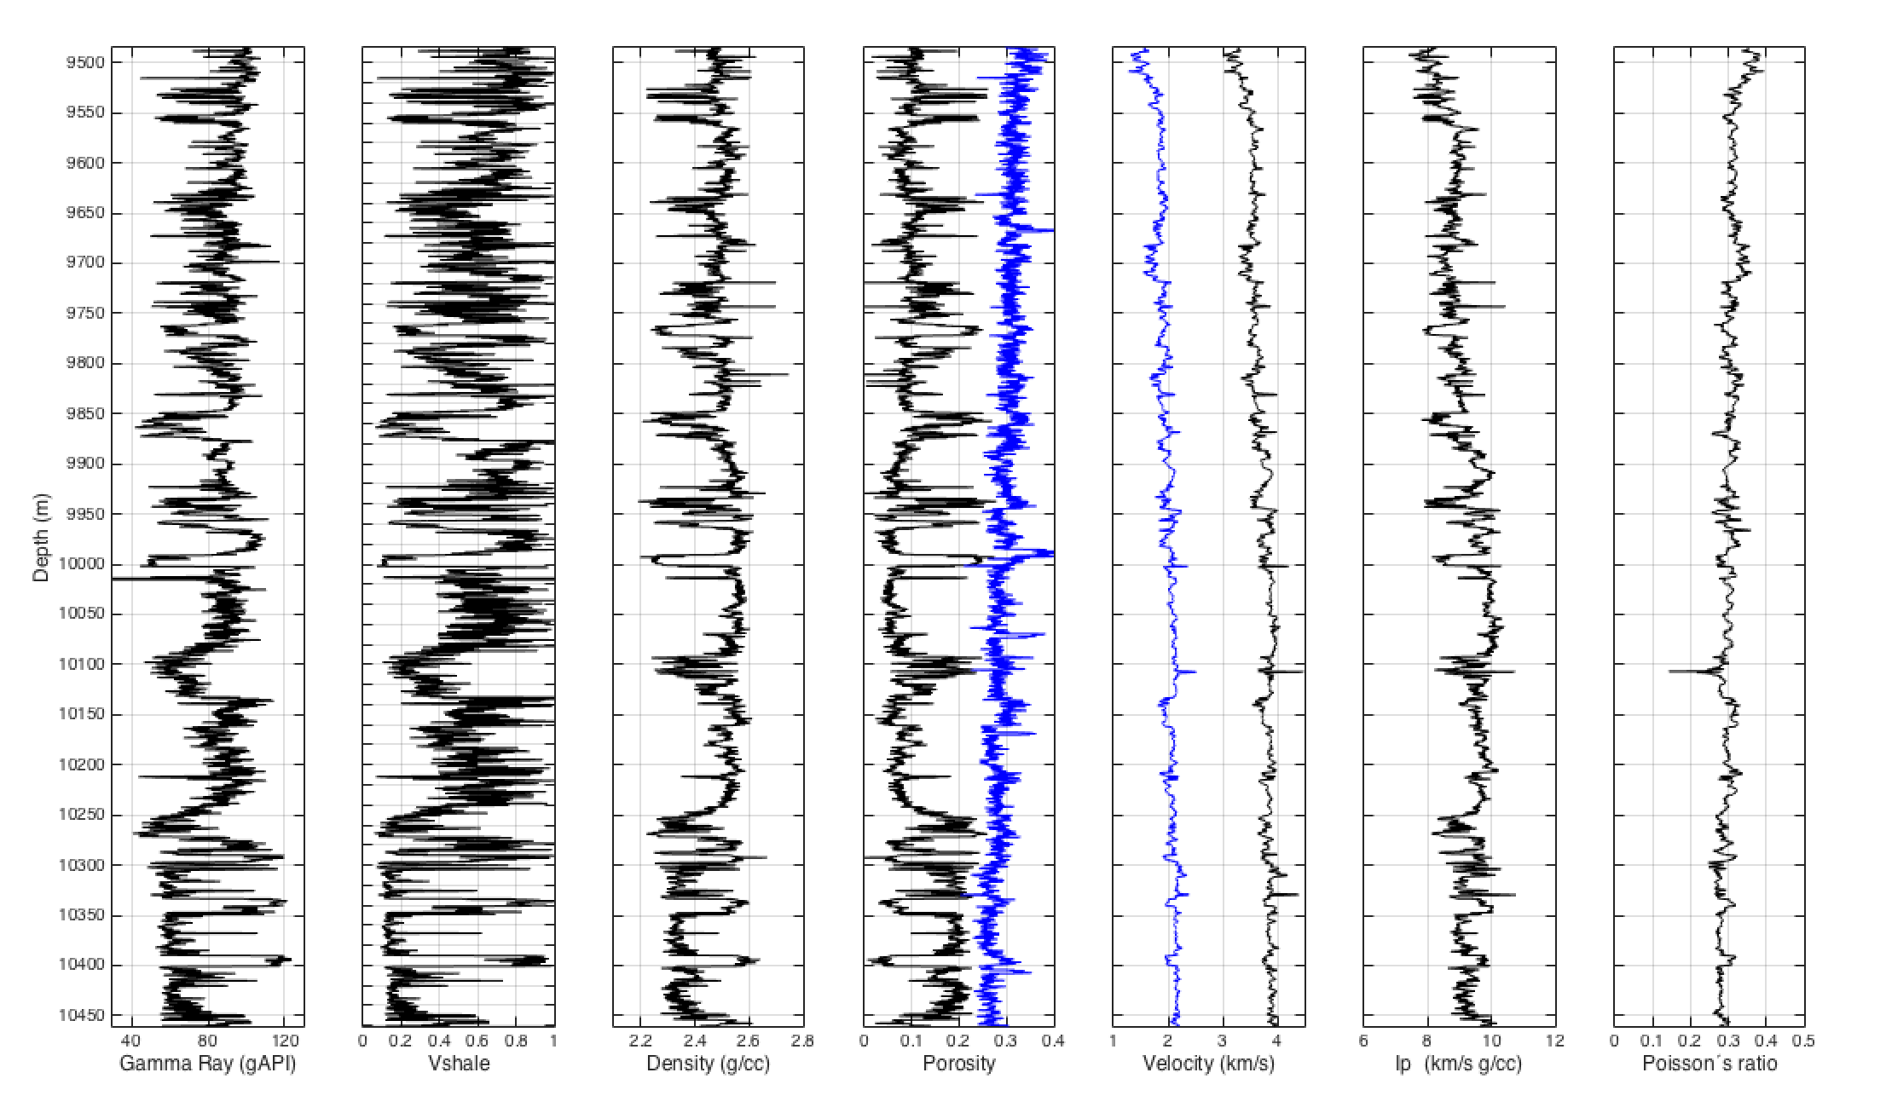
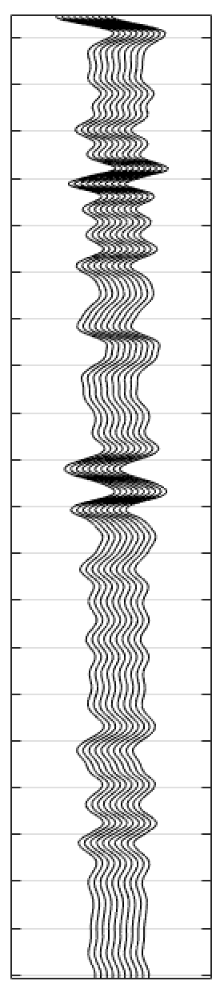
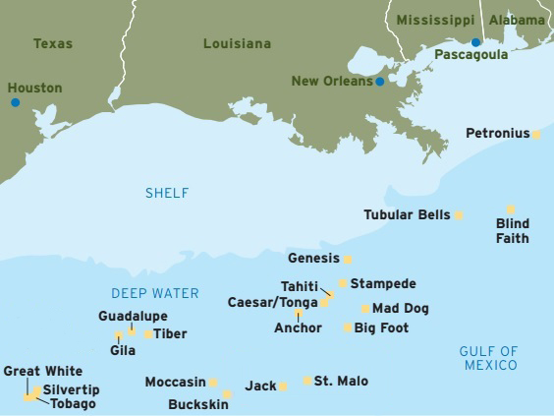
WILCOX WELL LOGS
Well logs provide us with 1D lithology & stratigraphy information
60 wells from the Wilcox formation
www.offshore-energy.biz
100 mi
Stratigraphy information
Seismic traces
Notes:
Field case study of 60 wells from the Wilcox formation in the Gulf of Mexico

Slide 10
5 CATEGORIES OF LABELED STRATIGRAPHY
Well log data and seismic data are not on the same scale
We label the data by chunks into five stratigraphy categories:
      Unimodal Thick Shale
      Low Net-to-Gross Thin-bedded Shale and Sandstone
      Bimodal Blocky Shales and Sandstones
      High Net-to-Gross Thin-bedded Sandstone and Shale
      Very High Net-to-Gross Blocky Sandstone
Low
Net-to-Gross
High
Notes:
The difference between well log resolution (0.3 m) and seismic resolution (about 200 m) makes it difficult to label the seismic data using the lithology log values

Slide 11
DATA AUGMENTATION
We developed a novel approach for generating synthetic well logs with same statistical distribution as the field data
  A macro-level Markov chain defines the transitions between the different categories of stratigraphy
  5 fine-level Markov chains define the transitions within each class of stratigraphy
Notes:
To jump-start the training of the neural network, we use data augmentation

Slide 12
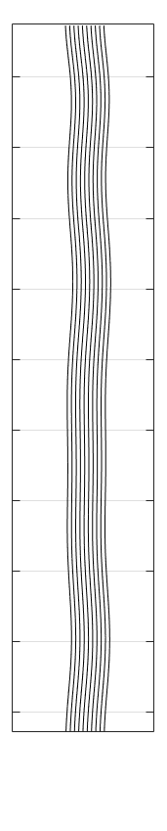
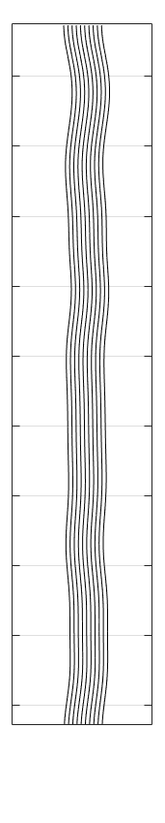

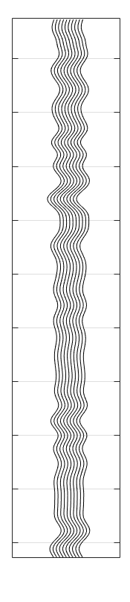
MACHINE LEARNING ESTIMATIONS FOR VARYING FREQUENCIES
Would you be able to estimate to which stratigraphy type each portion of seismic belongs?
Can machine learning algorithms assist us in this task?
20 Hz 30 Hz 50 Hz 100 Hz

Slide 13
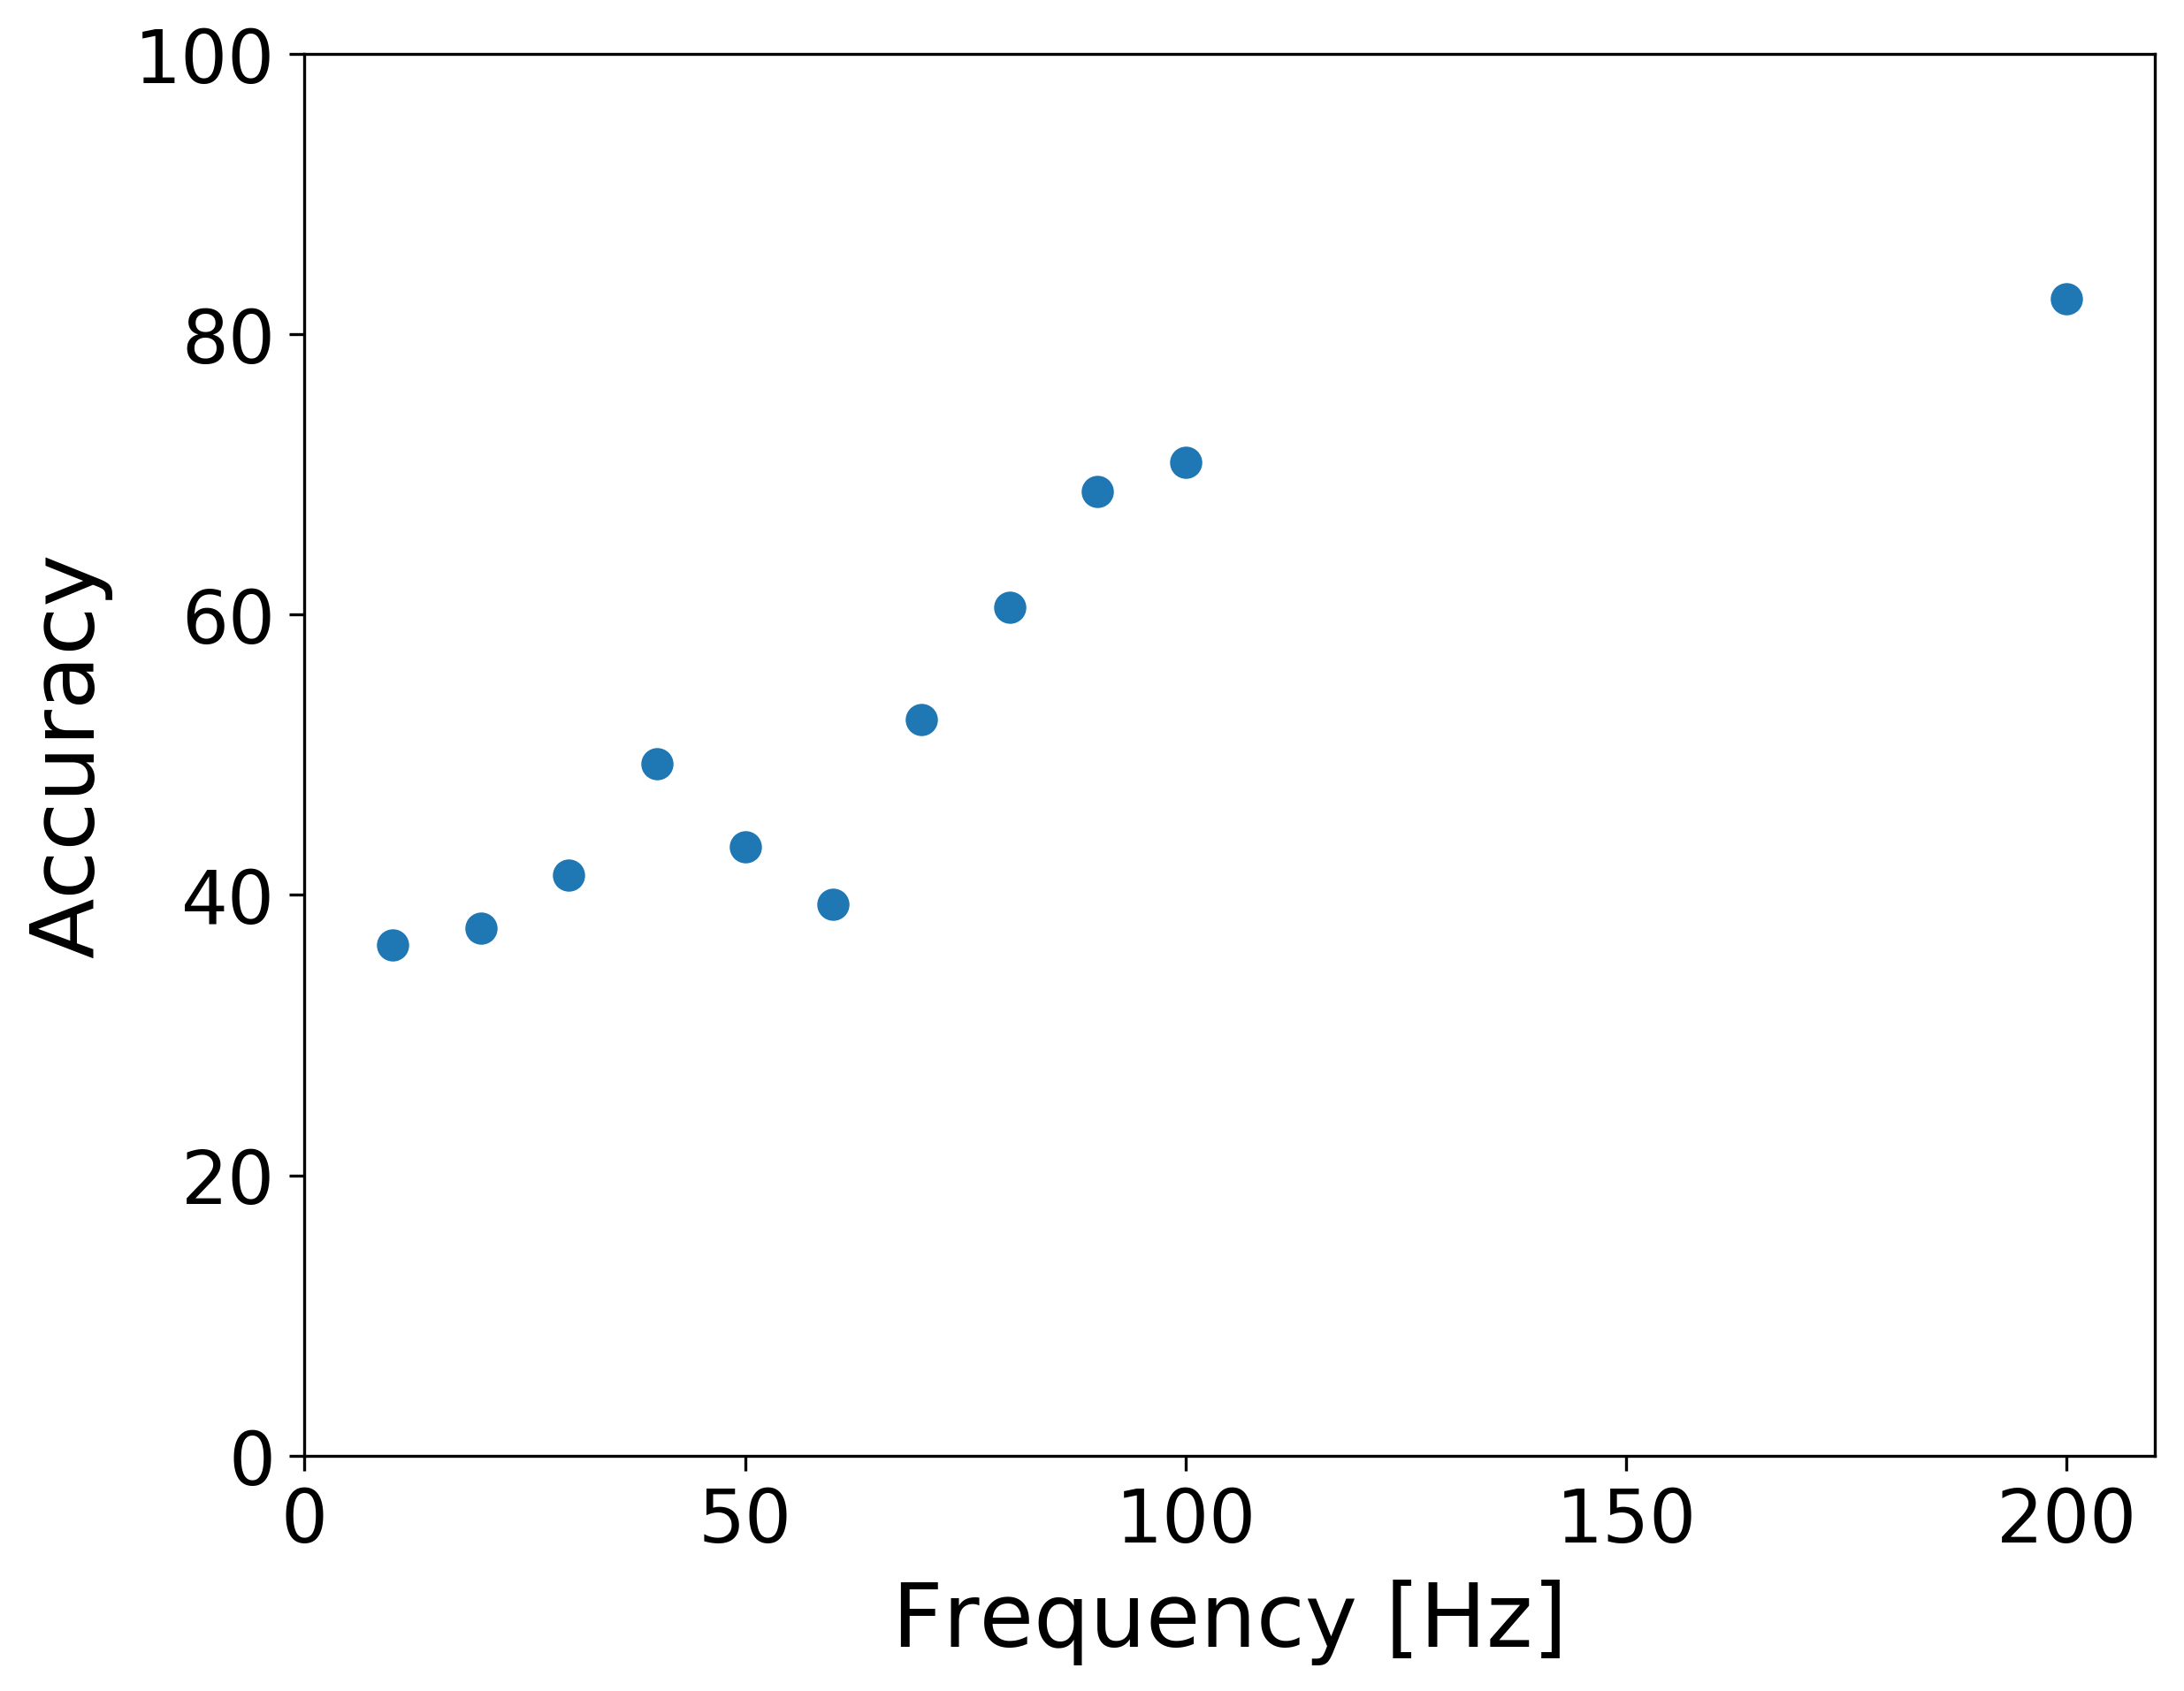
MACHINE LEARNING ESTIMATIONS FOR VARYING FREQUENCIES
Accuracy of the estimations increases with bandwidth
Jump-starting neural network training for seismic problems,
F. Huot et al., SEG 2018
Stratigraphic sequence estimation from seismic traces using convolutional neural networks,
F. Huot et al., SEP report 172
random guessing

Slide 14
DISCUSSION
Synthetic data generation allows us to generate labeled data to train machine learning models
Machine learning can provide some assistance in stratigraphy estimation from 1D data
However, 1D synthetic modeling is insufficient to solve the lithology estimation problem
Response of lithology in a sand-shale system is non-unique and highly unpredictable
    Without the 3D context in seismic data, accurate estimation is difficult
Can we utilize synthetic 3D earth modeling to aid the machine learning network in lithology estimation?
Notes:
High NTG sand-rich section and low NTG shale-rich section are essentially just mirror images of each other from an impedance and reflectivity perspective
Without significant understanding of rock physics and context given by geomorphological and textural detail in the seismic data, accurate estimation is difficult

Slide 15
OUTLINE
Learning from data
1D approach: a Wilcox field case study
Extension to 3D: Synthetic data generation
Neural network for image segmentation

Slide 16
SYNTHETIC DATA GENERATION
Random multi-property 3D earth models from the 1D field data statistics
Computationally efficient
Allows us to generate thousands of seismic volumes labeled by type of stratigraphy at low computational cost
Docker container for platform-independent deployment
User-friendly high-level and mid-level Python API
Code originally developed at Stanford University by R. Clapp
Notes:
Original code developed by Bob Clapp

Slide 17
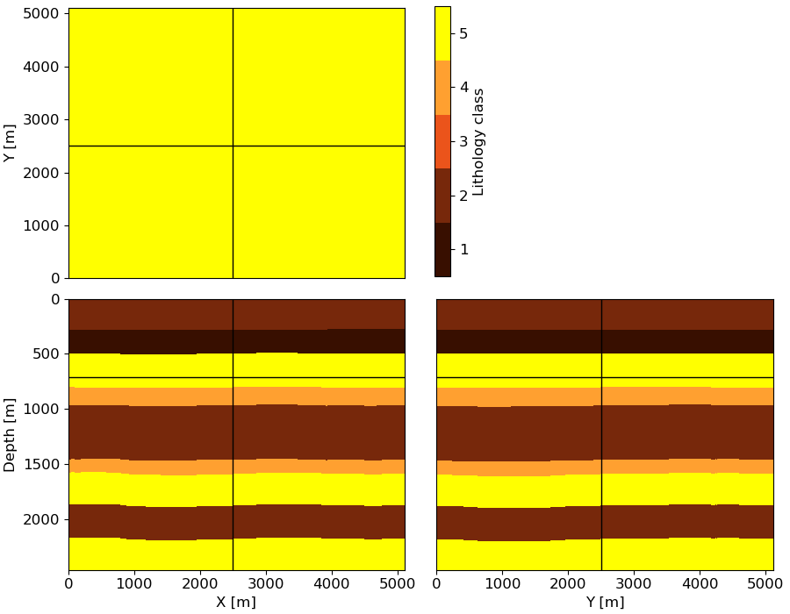
3D Synthetic data generation
Stratigraphy type
Example 1

Slide 18
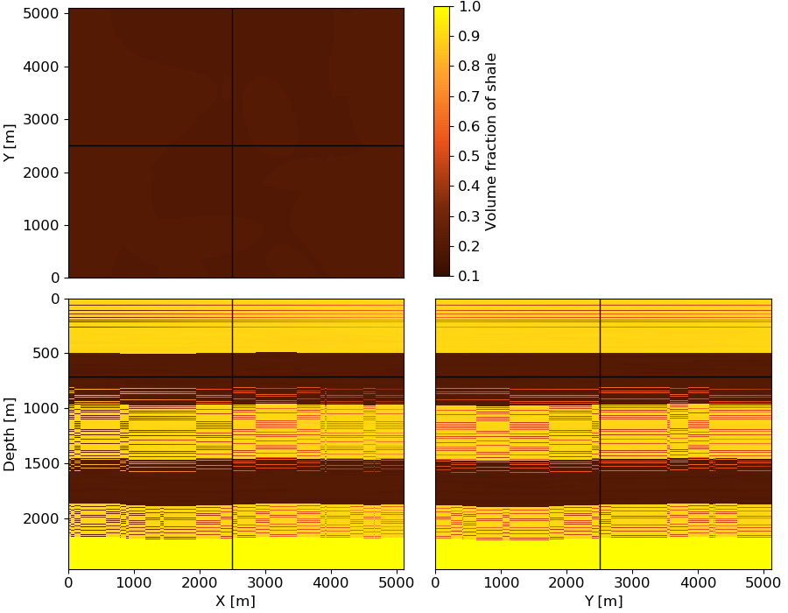
3D Synthetic data generation
Volume fraction
of shale
Example 1

Slide 19
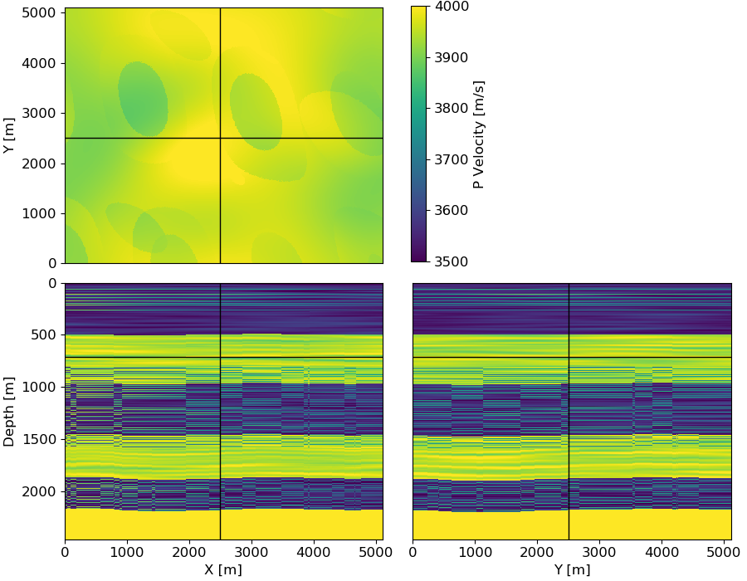
3D Synthetic data generation
P-wave velocity
Example 1

Slide 20
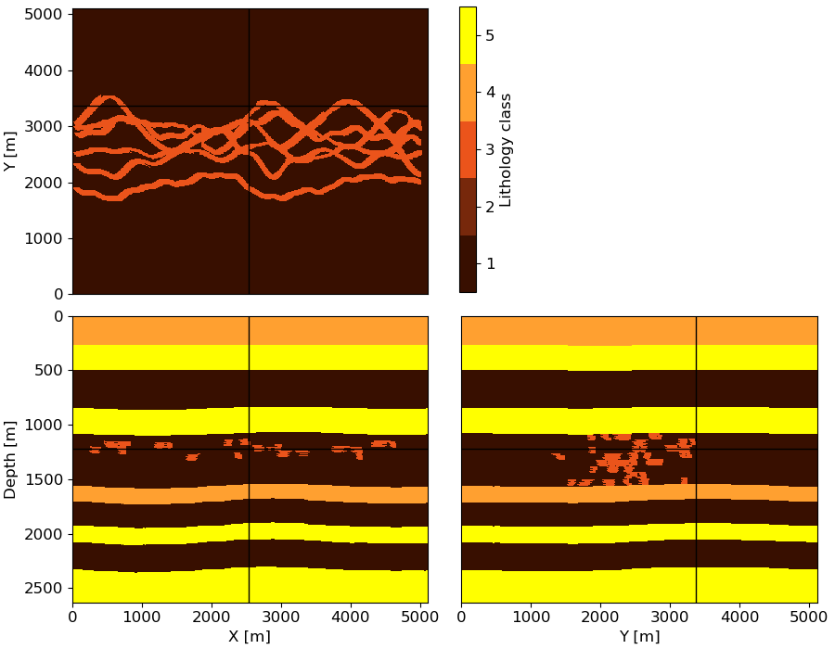
3D Synthetic data generation
Stratigraphy type
Example 2

Slide 21
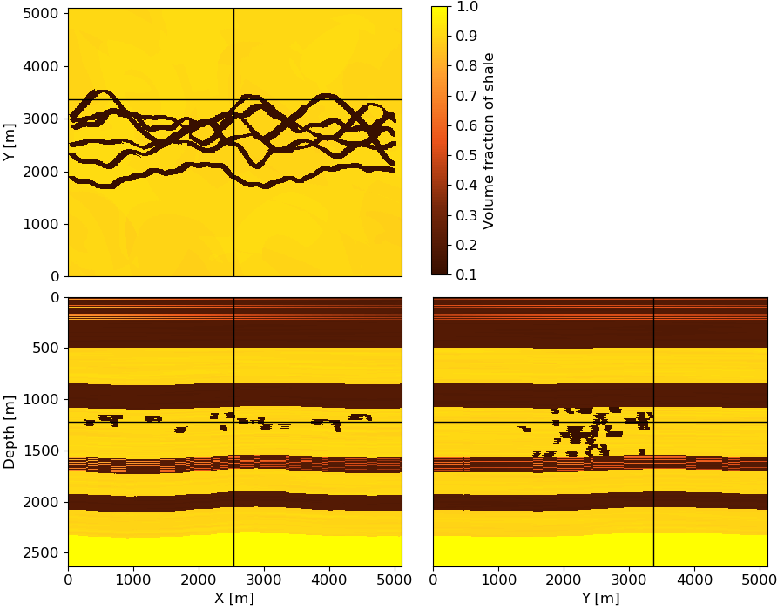
3D Synthetic data generation
Volume fraction
of shale
Example 2

Slide 22
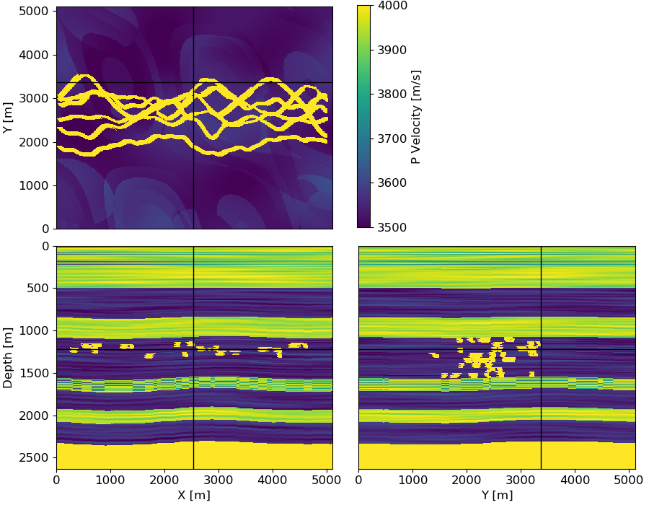
3D Synthetic data generation
P-wave velocity
Example 2

Slide 23
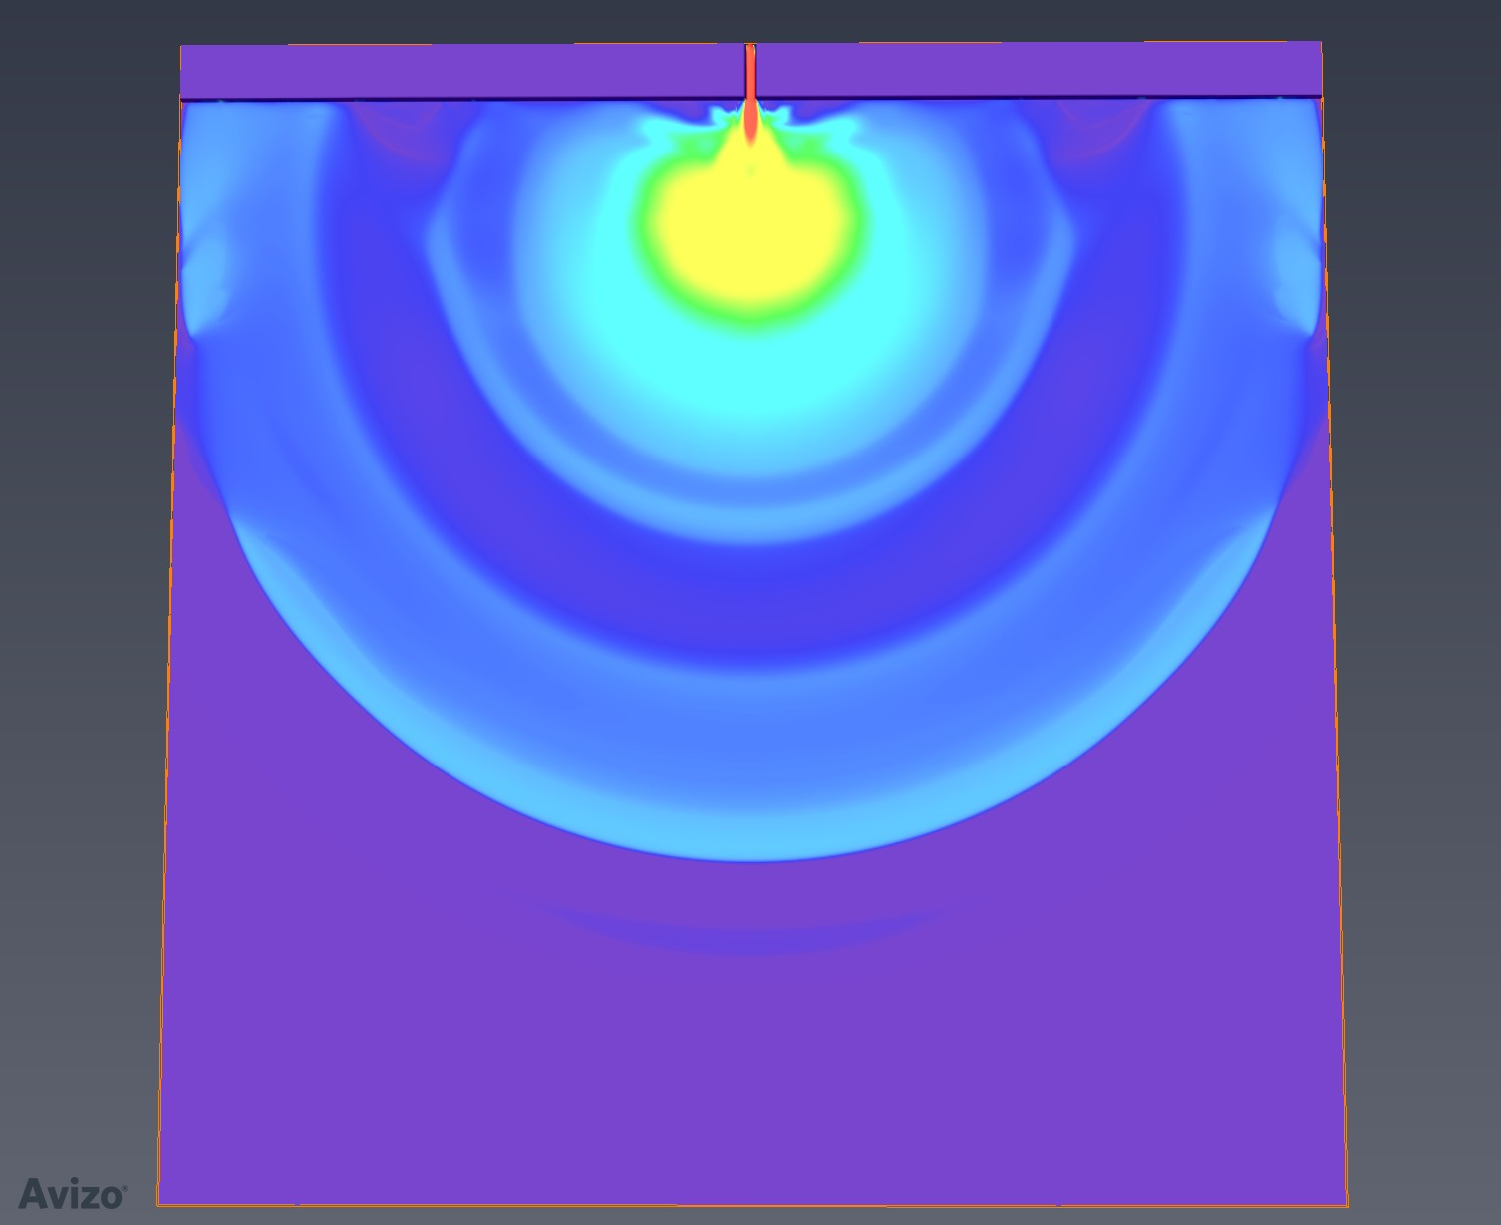
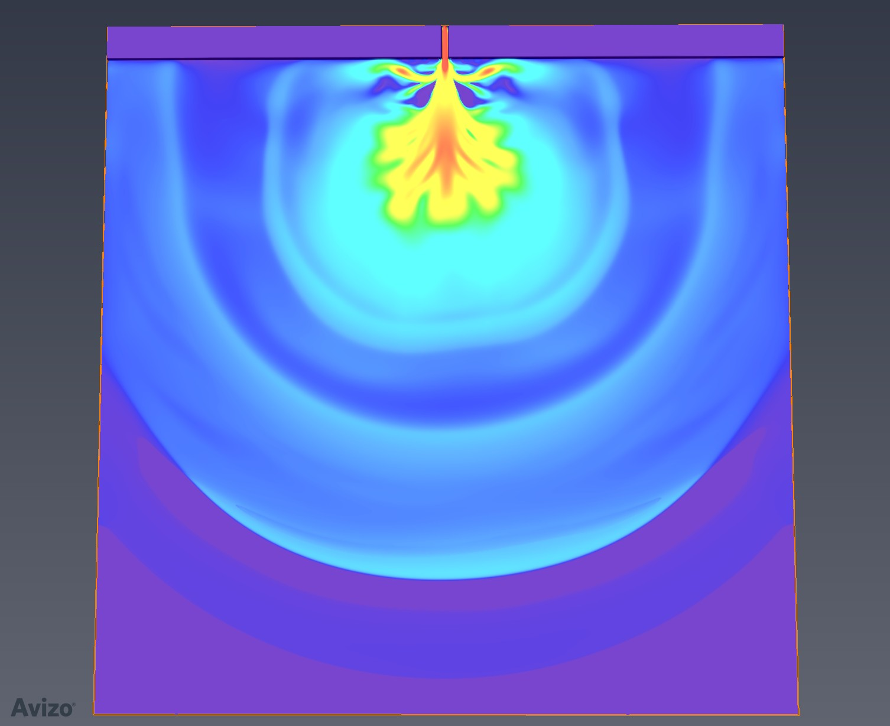
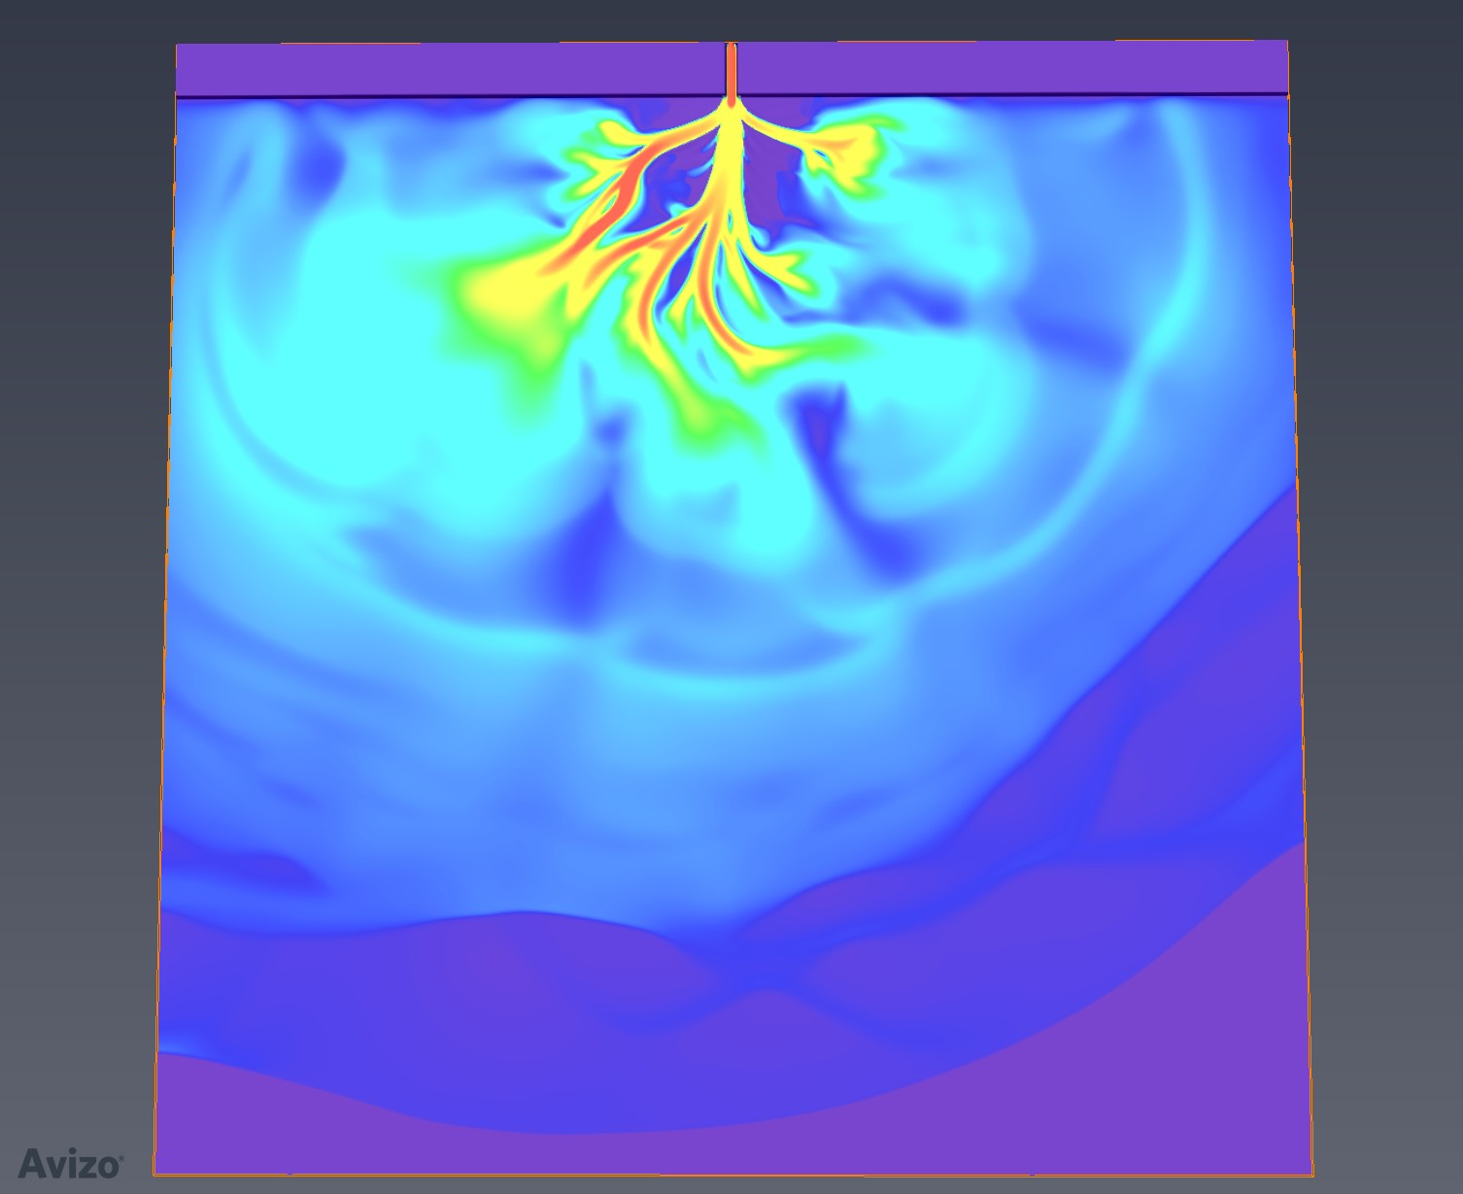
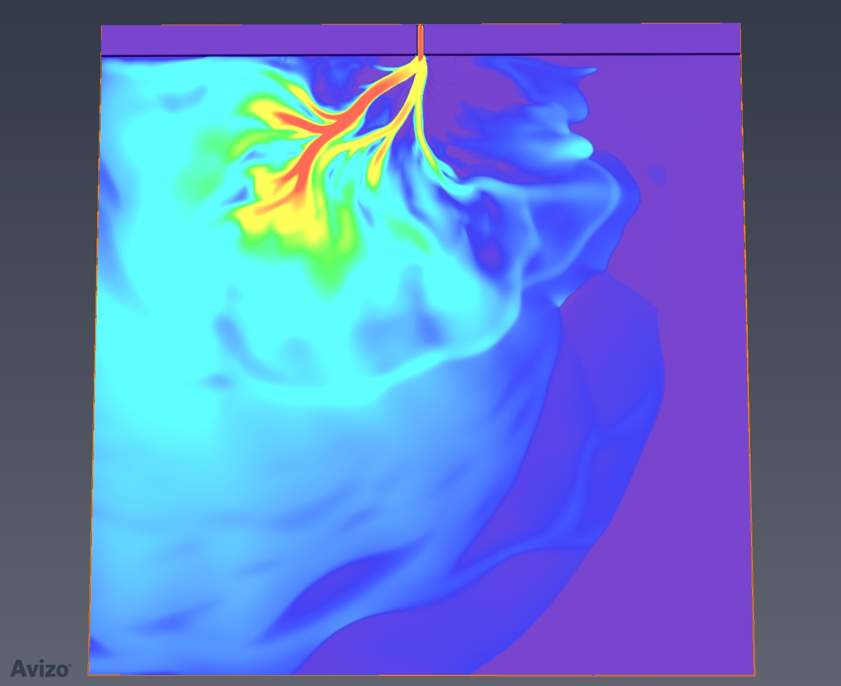
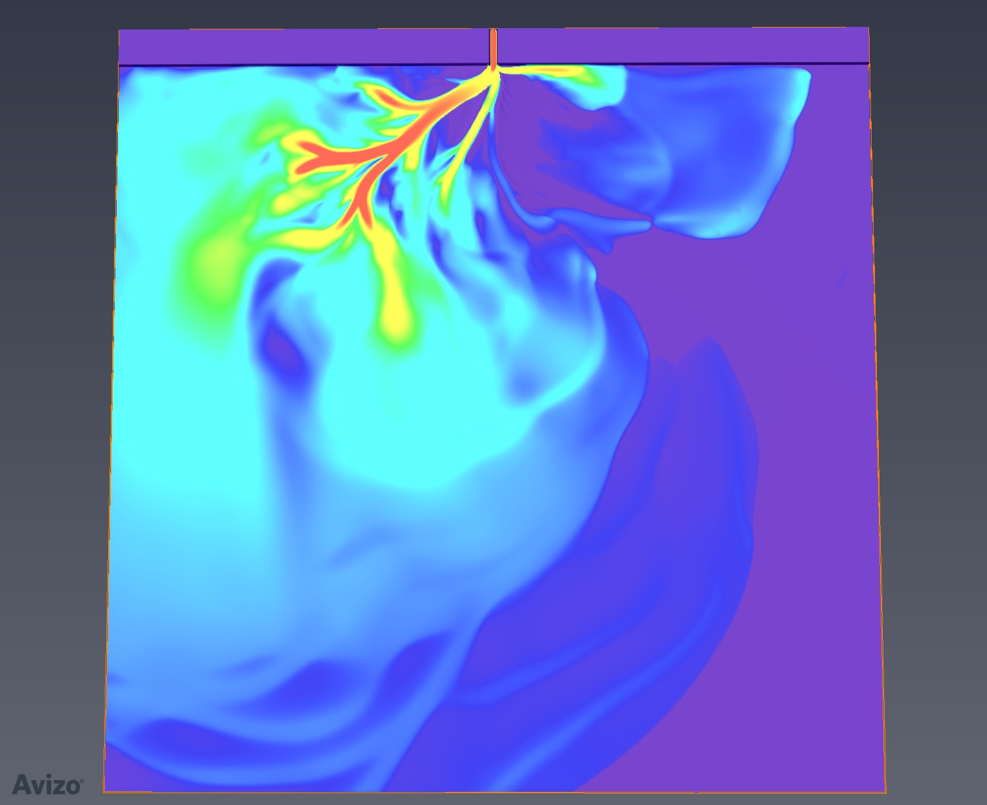
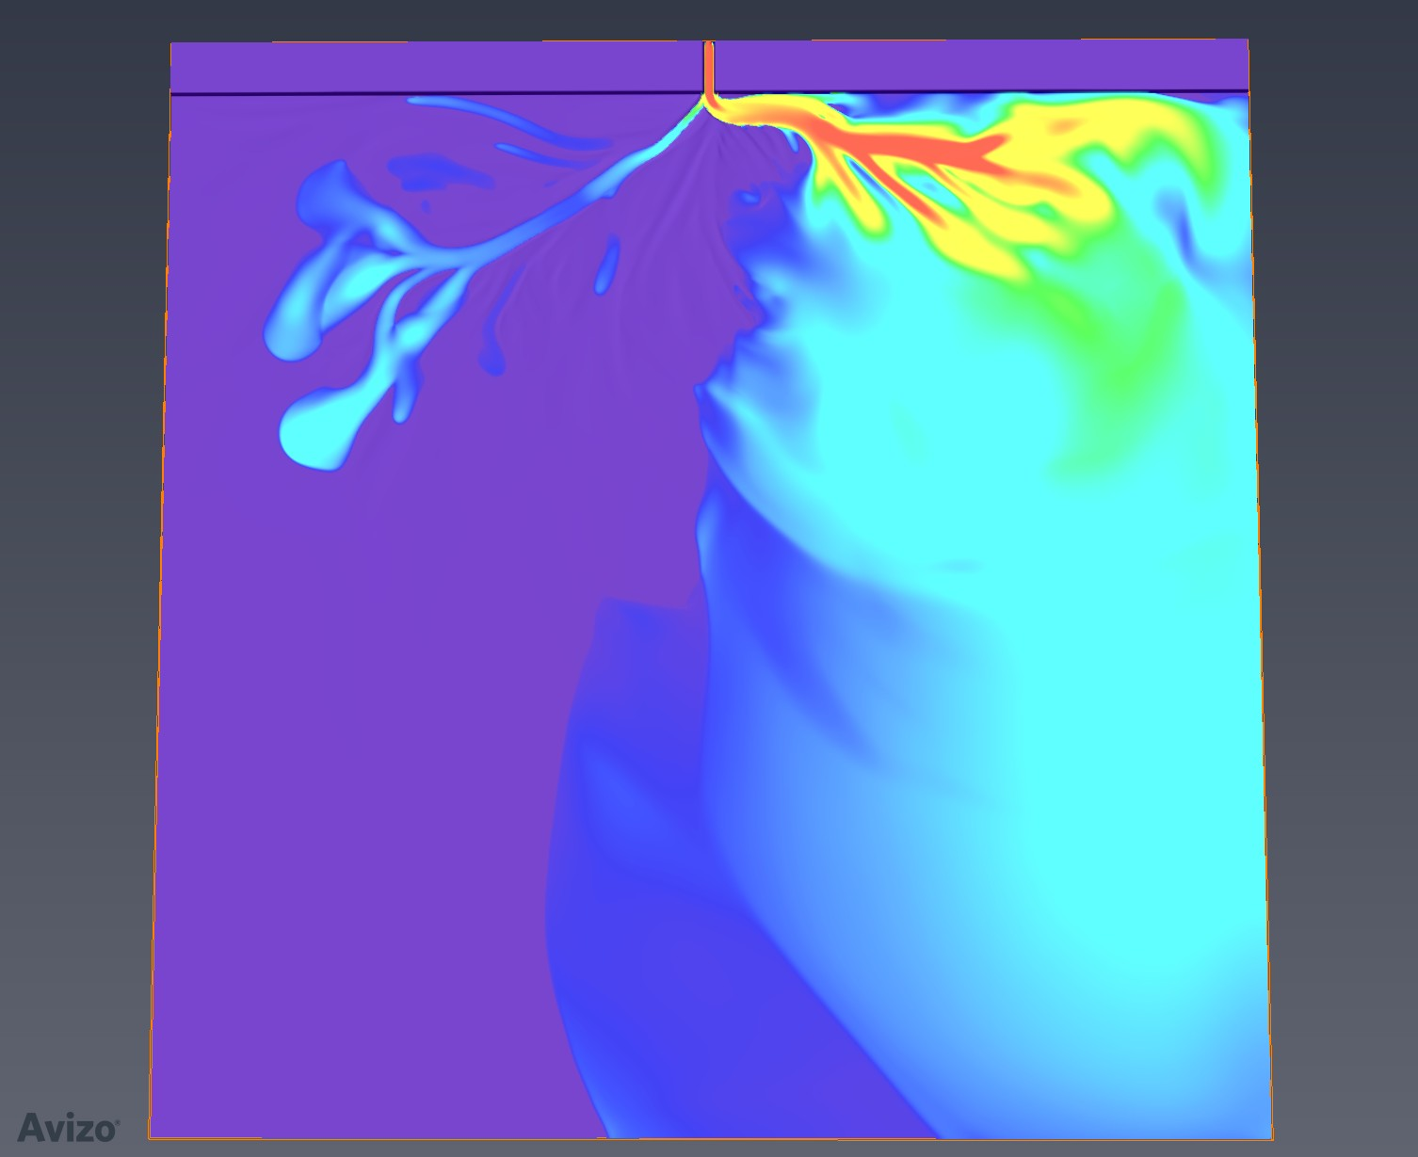
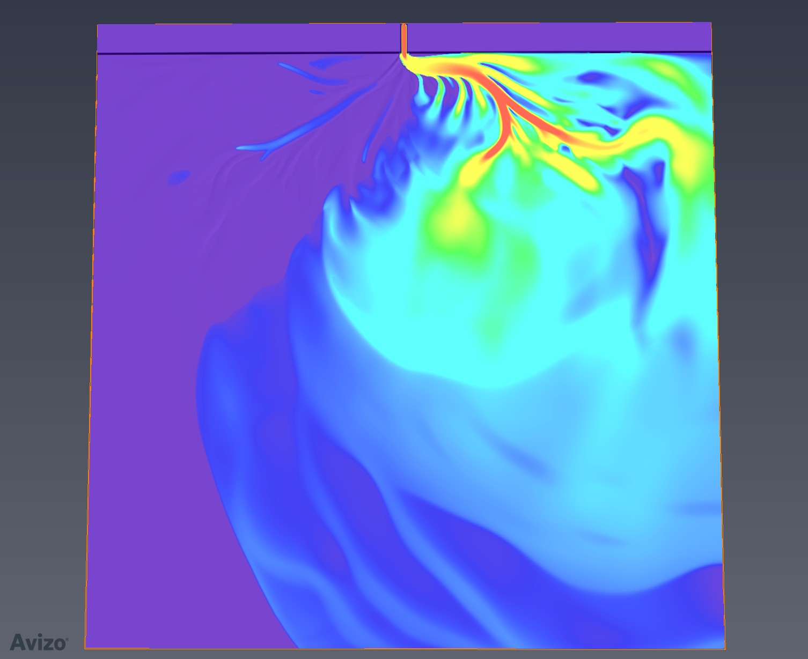
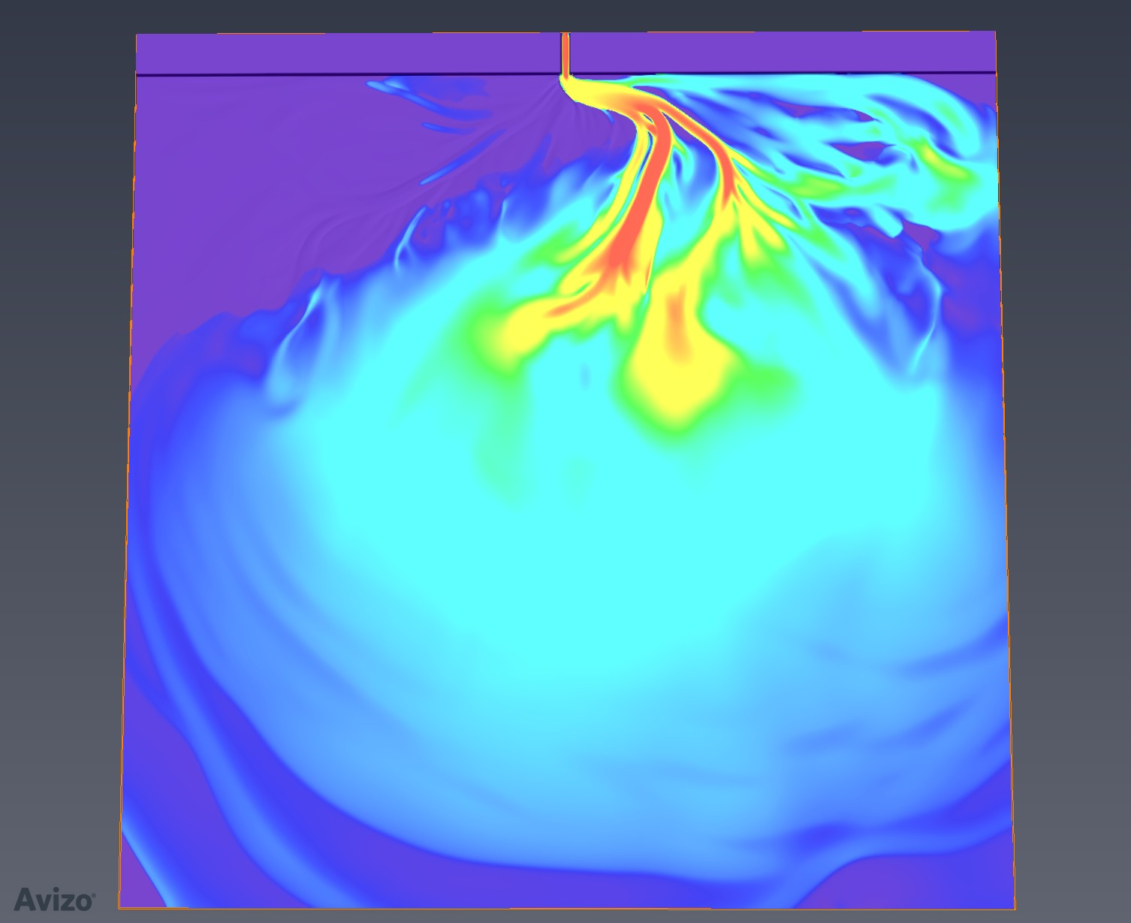
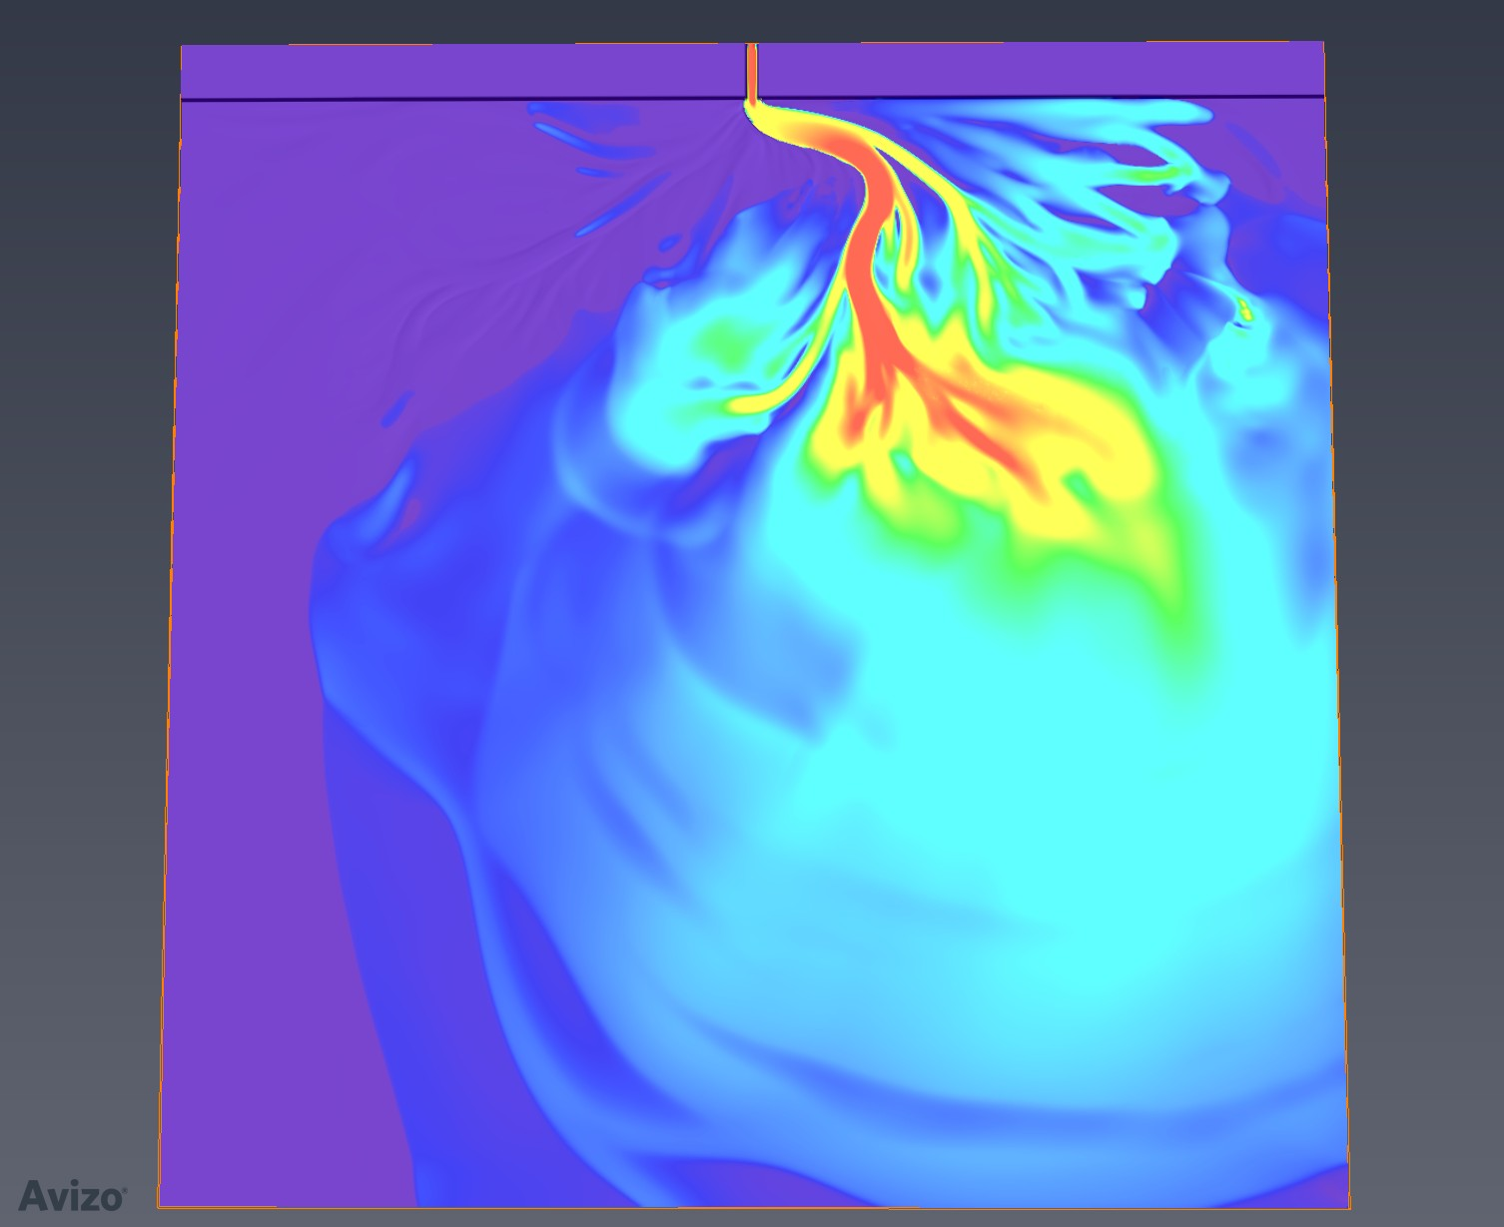
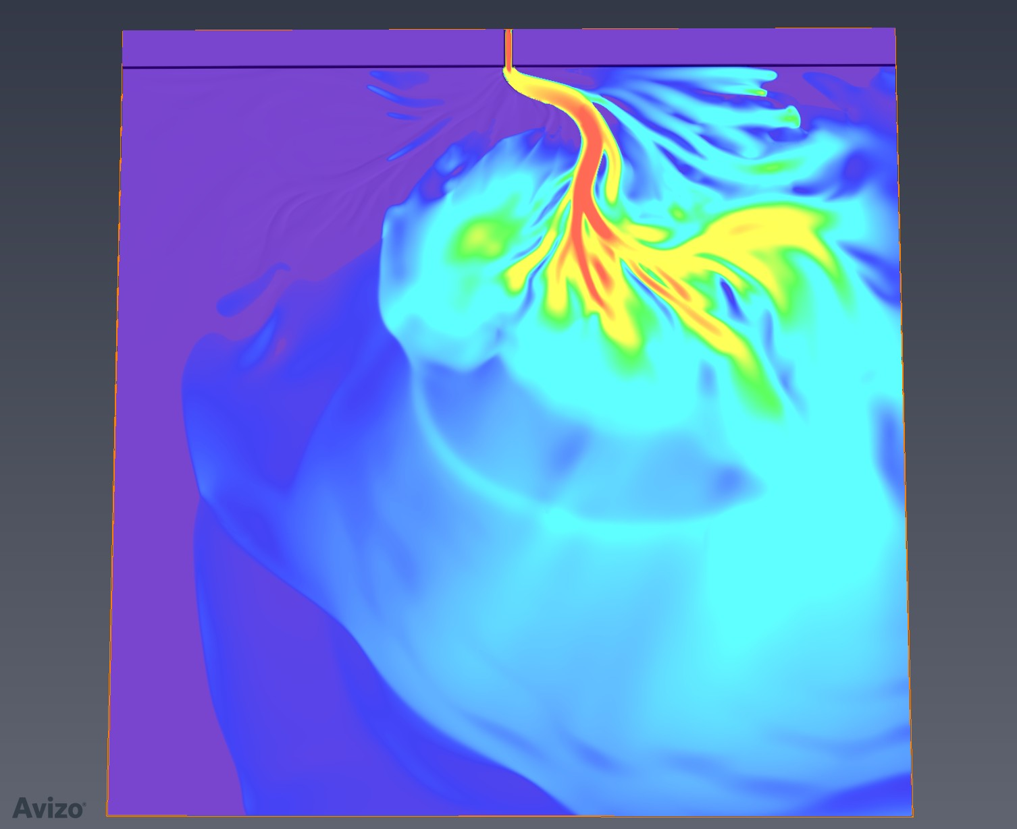
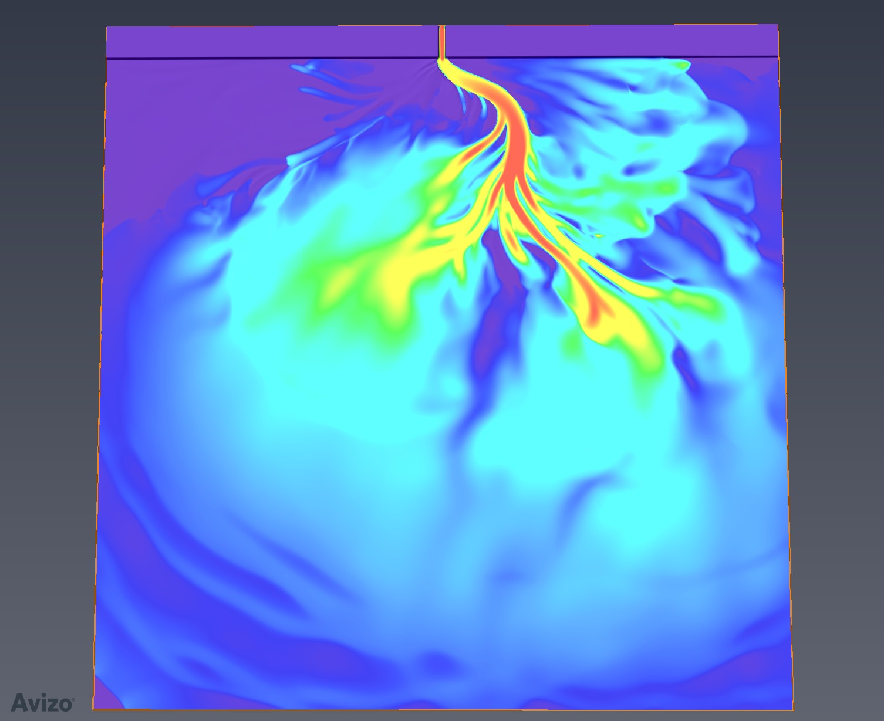










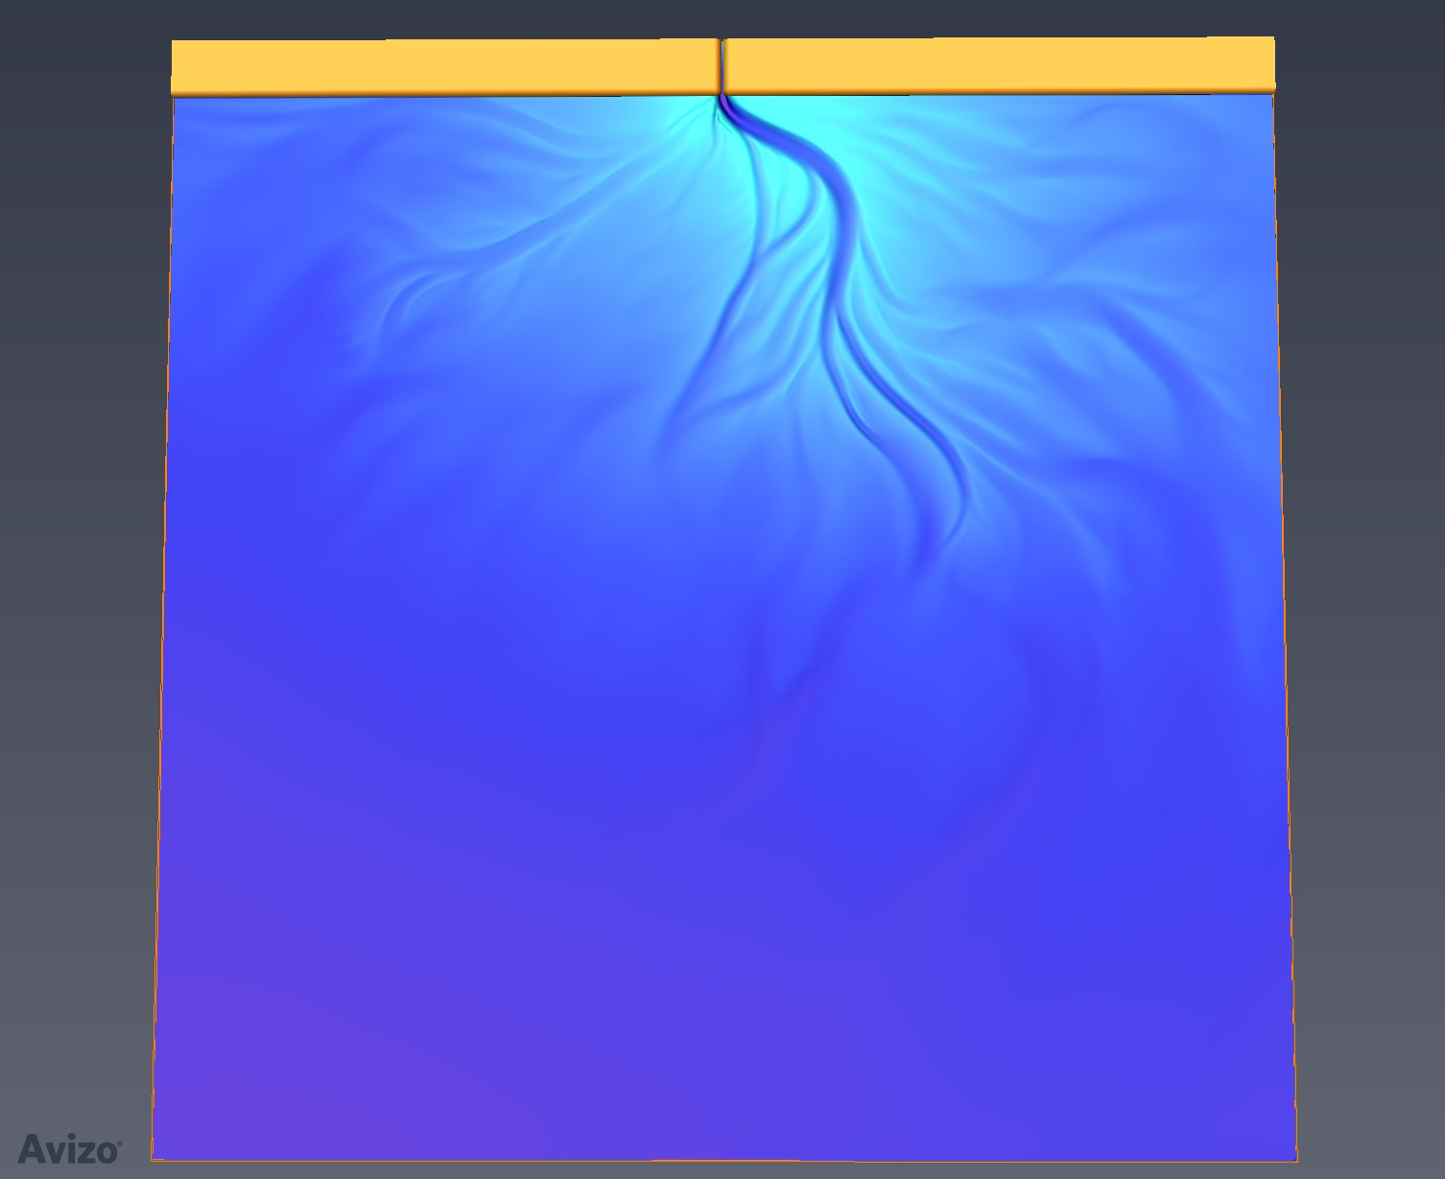
EXTERNAL MODE PLUGIN
Flow velocity
Topography
Proximal
Warm color – large grain sizes Cool color – small grain sizes
Distal
50x VE
20 km

Slide 24
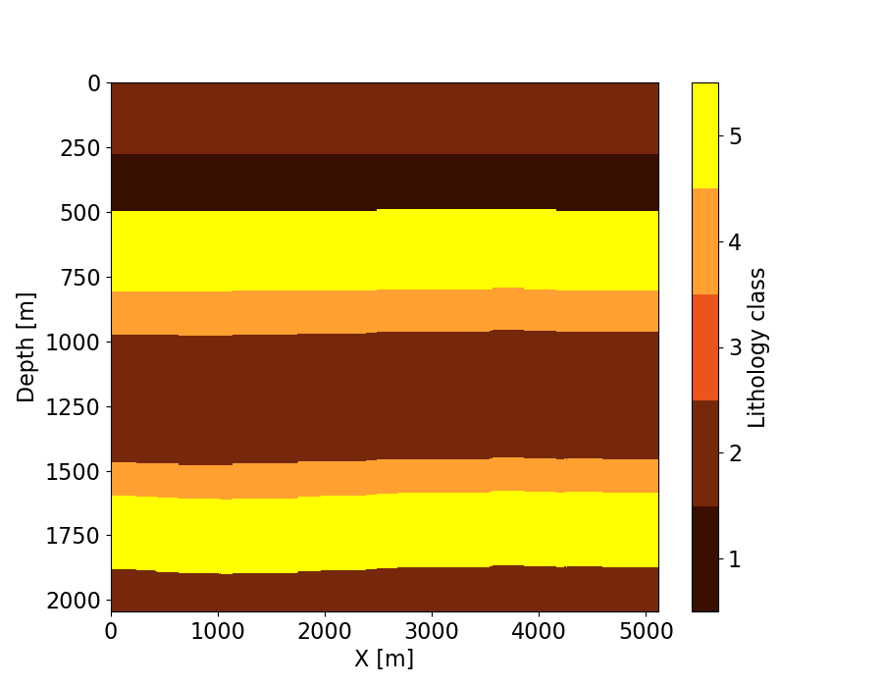
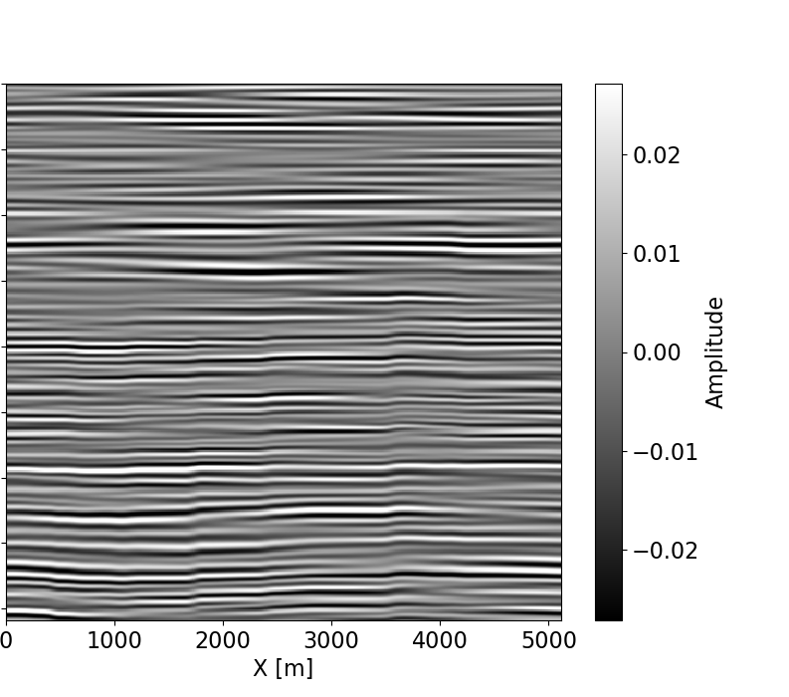
CONVOLUTIONAL SEISMIC MODELING
Stratigraphy type Seismic
Example 1

Slide 25
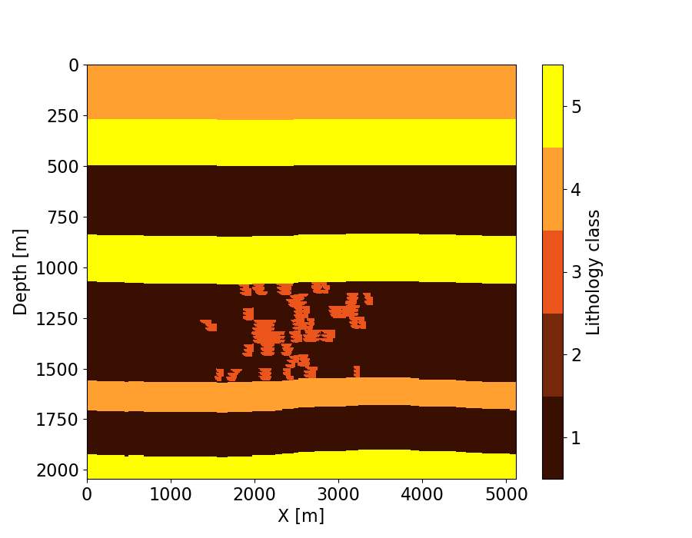
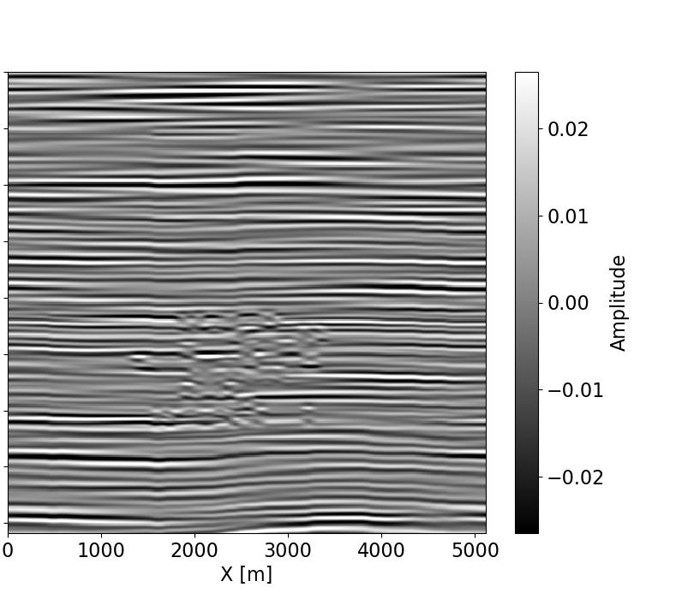
CONVOLUTIONAL SEISMIC MODELING
Stratigraphy type Seismic
Example 2

Slide 26
OUTLINE
Learning from data
1D approach: a Wilcox field case study
Extension to 3D: Synthetic data generation
Neural network for image segmentation

Slide 27
IMAGE SEGMENTATION NEURAL NETWORK
Multi-layer Convolution – Deconvolution neural network
Generates a feature representation through a series of convolution and rectification operations
Performs dense segmentation through a series of deconvolution and rectification operations

Slide 28
DATA CONSTRAINTS & COMPUTATIONAL CHALLENGES
Generated and processed 1.5Tb of synthetic data
1,800 GPU hours = 75 GPU days
~ 750,000 parameters
Hyper-parameters: different network architectures, learning rate, number of layers
    Requires a good computing strategy
    Requires large amounts of labeled training data
    Extensive hyper-parameter search to guarantee optimal performance
Notes:
This is a large amount of data, we need a strategy to tackle this problem
As a result of this, we need large amounts of training data

Slide 29
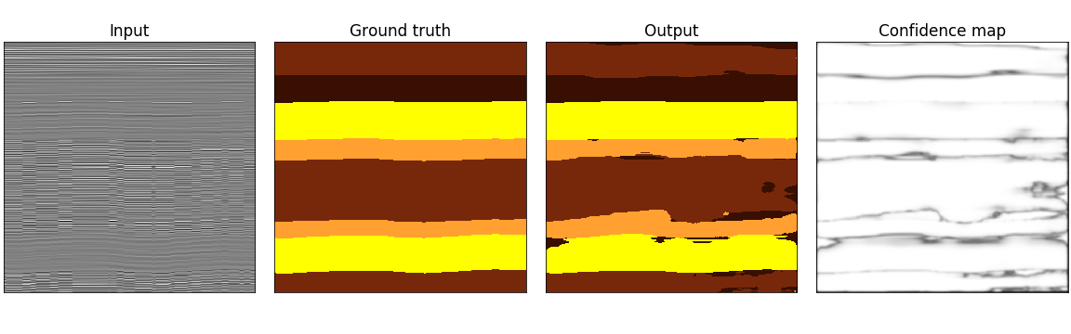
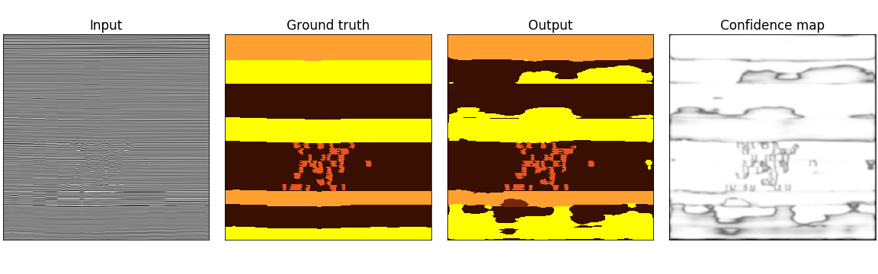
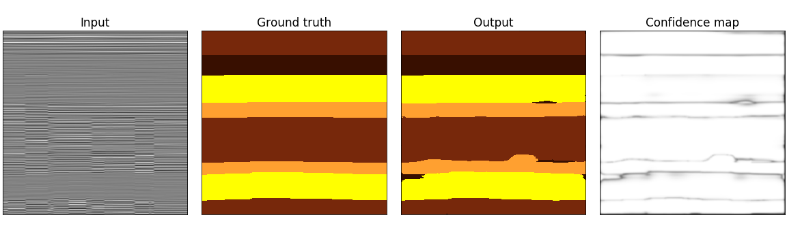
Input Ground truth Output Confidence map
Preliminary segmentation results on 100Hz seismic data

Slide 30
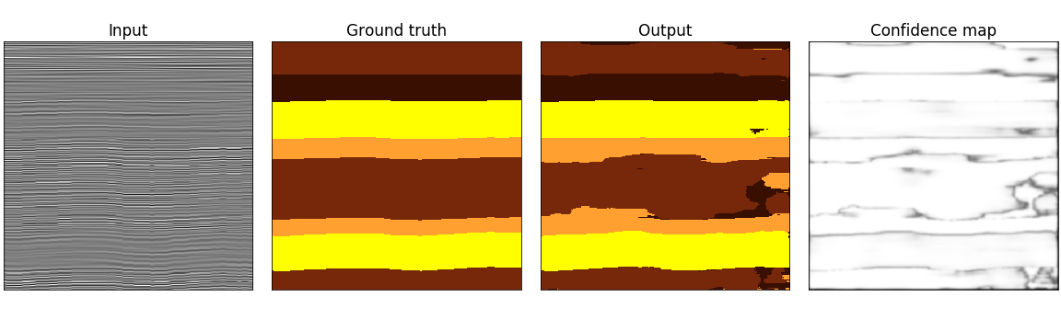
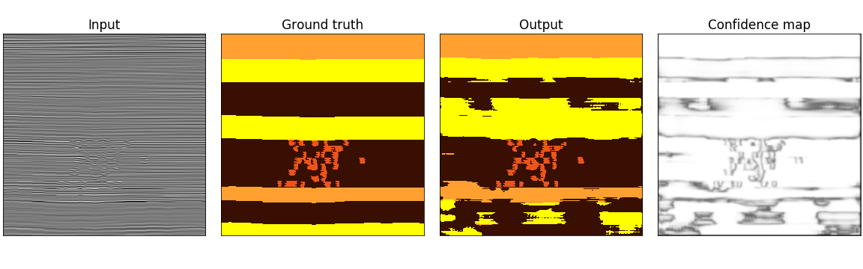
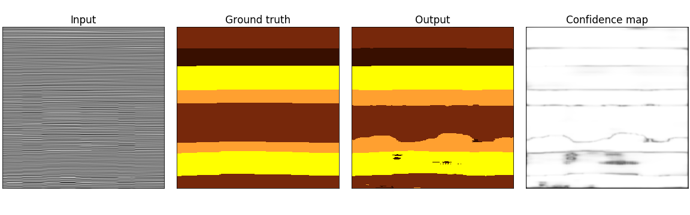
Input Ground truth Output Confidence map
Preliminary
segmentation results on 60Hz seismic data

Slide 31
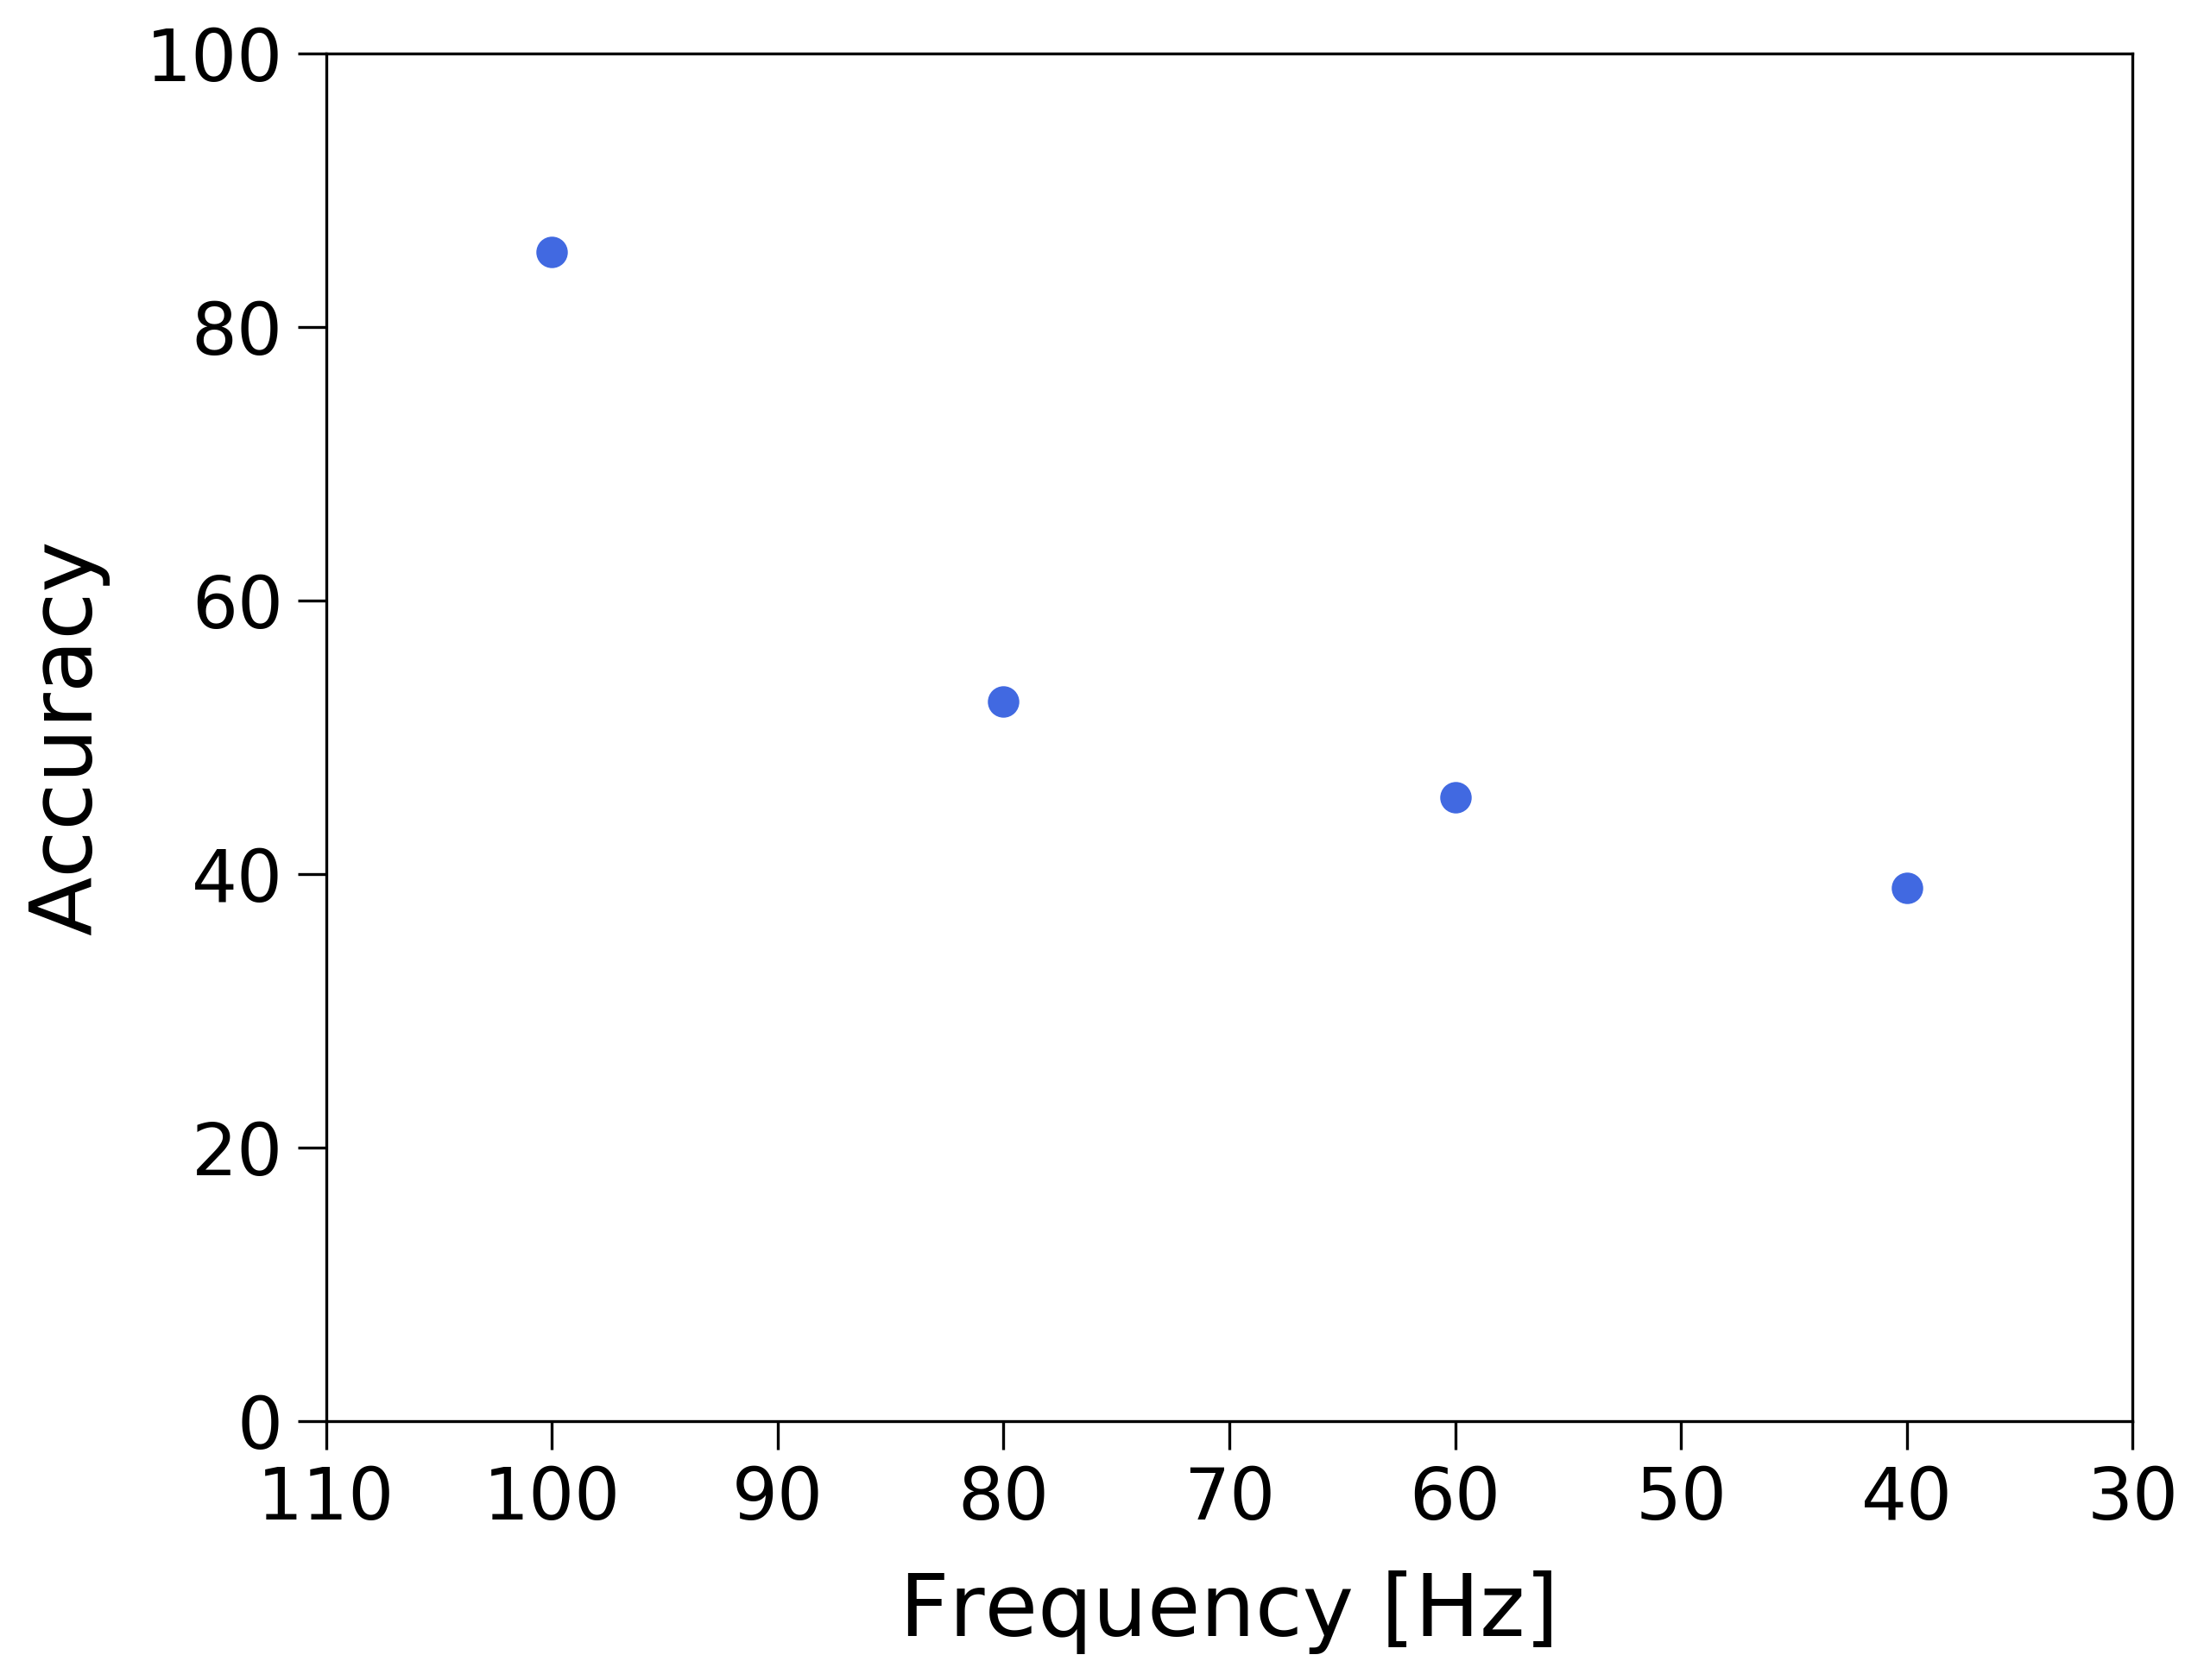
PRELIMINARY RESULTS – WITHOUT TRANSFER LEARNING
random guessing

Slide 32
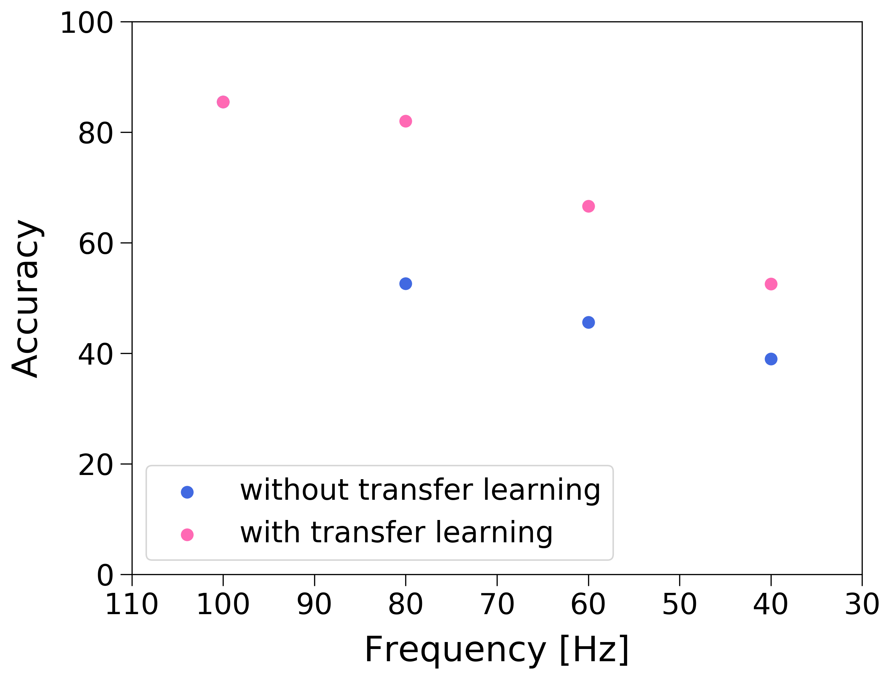
PRELIMINARY RESULTS – WITH TRANSFER LEARNING
random guessing

Slide 33
DISCUSSION
The probability distribution allows to evaluate the confidence of the estimations
Machine learning can provide some assistance in lithology estimation from 2D data
    High accuracy on channel detection
The most common estimation error comes from confusing sections which are essentially just mirror images of each other from an impedance and reflectivity perspective
Training further without field data would lead to overfitting
Notes:
TODO add lithology cartoons

Slide 34
CONCLUSIONS
Developed a modular and scalable data preparation pipeline
    and machine learning framework,
    leveraging synthetic data generation
    to create thousands of labeled examples
    with field data statistics
    on the Google Cloud Platform
Notes:
TODO add lithology cartoons

Slide 35
NEXT STEPS
Apply the workflow to field data
Extend the workflow for lithology estimation and geobody segmentation
Add coherent noise to seismic
Use seismic data migrated using different velocities

Slide 36
ACKNOWLEDGEMENTS
Chevron ETC
Tao Sun
Google TensorFlow

Slide 37
THANK YOU!
Questions? Feedback? Please share!
fantine@stanford.edu

