Slide 1

AUTOMATIC DENOISING
BY 2-D CONTINUOUS
WAVELET TRANSFORM
Fantine Huot¹, Anthony Lichnewsky², and Carlos Boneti³
Advised by Biondo Biondi^{1,4}
1. Stanford Geophysics
2. Schlumberger
3. Google, formely Schlumberger
4. Stanford ICME

Slide 2
PROJECT OUTLINE – MOTIVATION
LARGE DATA VOLUMES
OVERLAPPING
SIGNAL AND NOISE
CAN WE SEPARATE SIGNAL FROM NOISE?
CAN WE ADDRESS TRANSIENT NOISE?
CAN WE AUTOMATE THIS PROCESS?

Slide 3
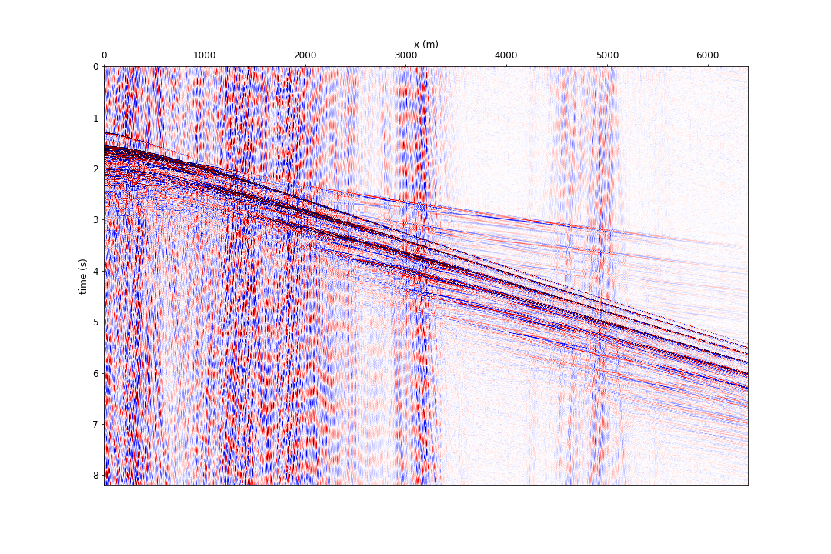
PROJECT OUTLINE – SEISMIC DATA
2D slice of data
along a sensor
line
Notes:
Time axis - travel time of waves bouncing off in the earth and coming back to the receiver array
X - distance along the receiver line
Speed of seismic waveforms is characteristic of the earth through which they pass
Most likely noise doesn’t and shouldn’t be fed in earth properties estimation methods.

Slide 4
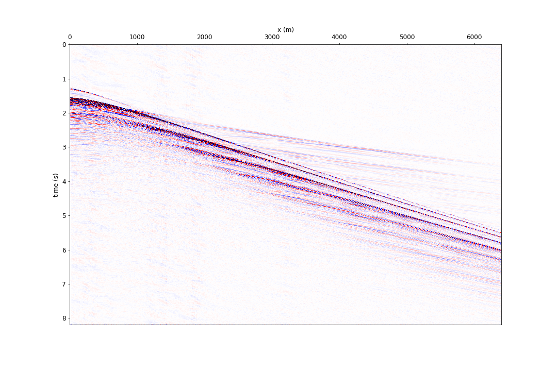
PROJECT OUTLINE – MY DENOISING RESULTS
Data after noise removal

Slide 5
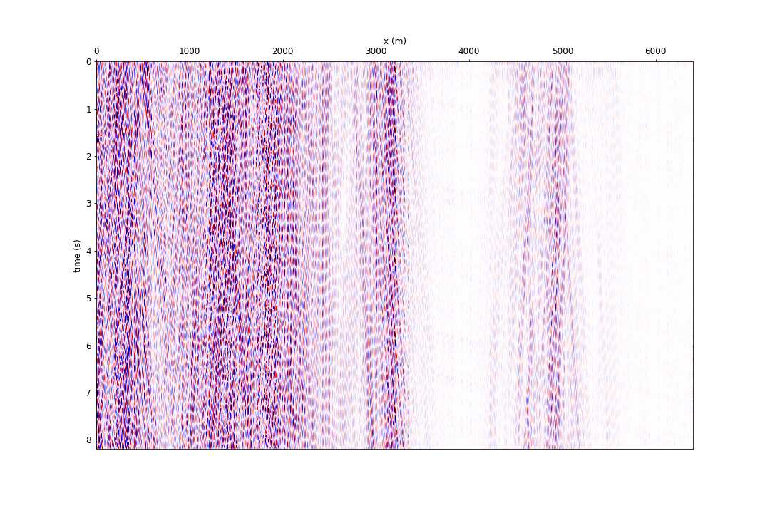
PROJECT OUTLINE – MY DENOISING RESULTS
Noise model

Slide 6
THE PROBLEM WITH
TRADITIONAL
PROCESSING TECHNIQUES
Notes:
Noise removal / estimation / separation is a traditional signal processing problem
We already have various techniques with various degrees of detail to do these things
However, they all have significant short comings.

Slide 7
BEFORE FILTER

Slide 8
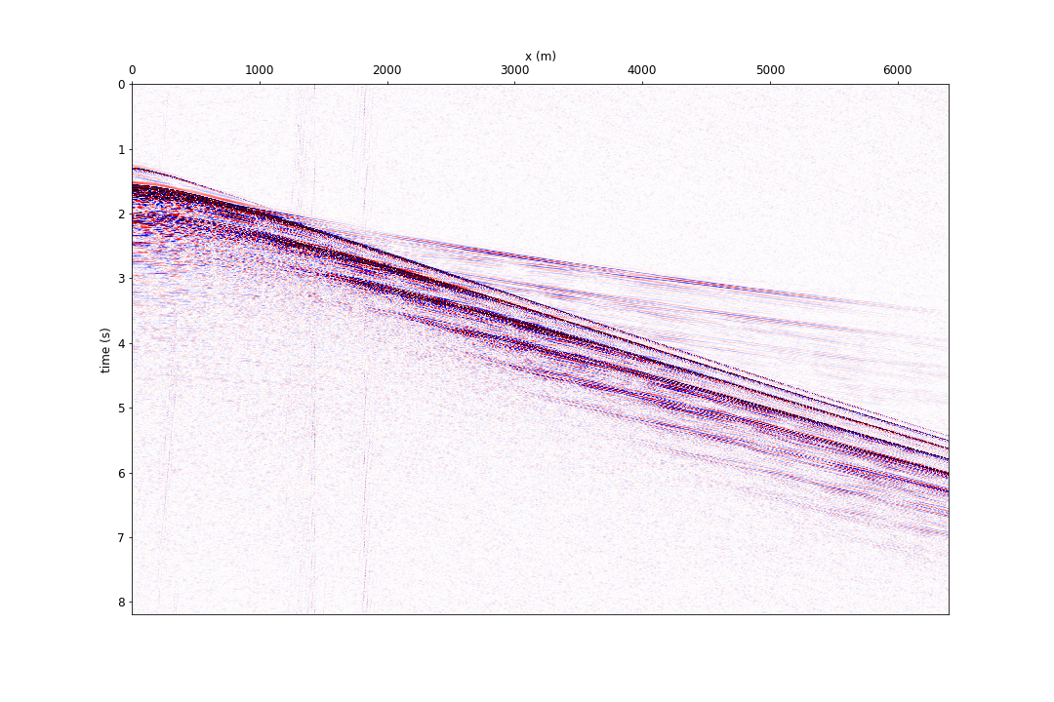
AFTER FILTER
High pass filter
at 10Hz
NOT SUITABLE for modern earth model building algorithms
Notes:
Simple signal processing technique for stationary noise
This is a simplification of what’s done in reality to give you an idea…

Slide 9
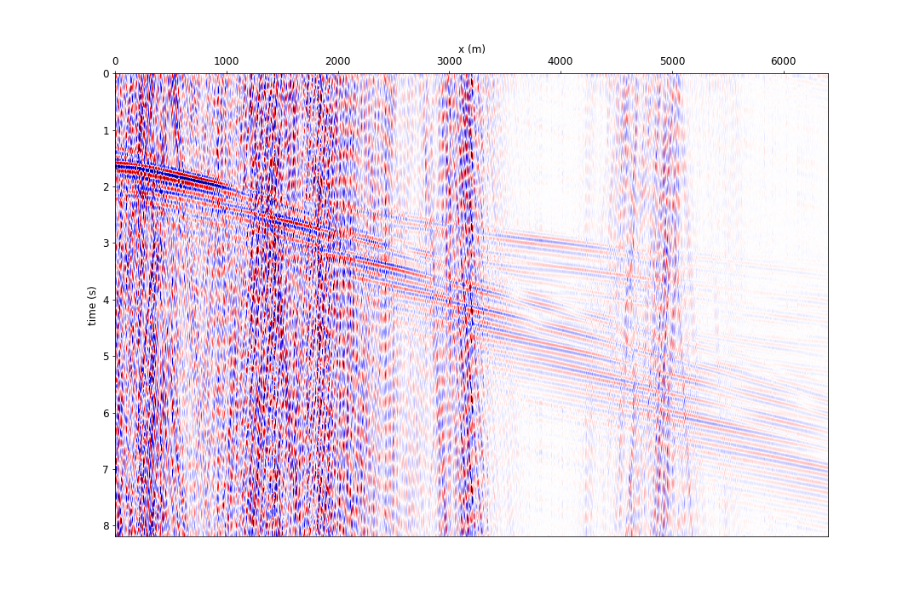
DIFFERENCE
The signal is deteriorated
Notes:
Signal leaks into noise model. Signal is not protected.

Slide 10
THE PROBLEM WITH STATIONARY FILTERS
Some noise modes have temporal and spatial locality
Traditional signal processing techniques, e.g. stationary filters, do not perform well on this type of noise, and deteriorate the signal
These techniques also require a manual fine-tuning of the parameters, which is a time-consuming task
WE NEED A FILTER THAT TAKES INTO ACCOUNT
TEMPORAL AND SPATIAL LOCALITY
Notes:
Explain what stationary means

Slide 11
MY WORKFLOW
Transform the seismic data into a domain in which the signal and noise are separable
Characterize and label the noise and train a classifier to automate this process
Design a filter to remove the noise
Transform the data back into its original domain

Slide 12
1-D
CONTINUOUS WAVELET
TRANSFORMS

Slide 13

CONTINUOUS WAVELET TRANSFORMS (CWT) – 1D CASE
Notes:
1D signal -> 2D output
Multi-scale analysis method comparing input signal to stretched analysis wavelets to capture its complexity.

Slide 14
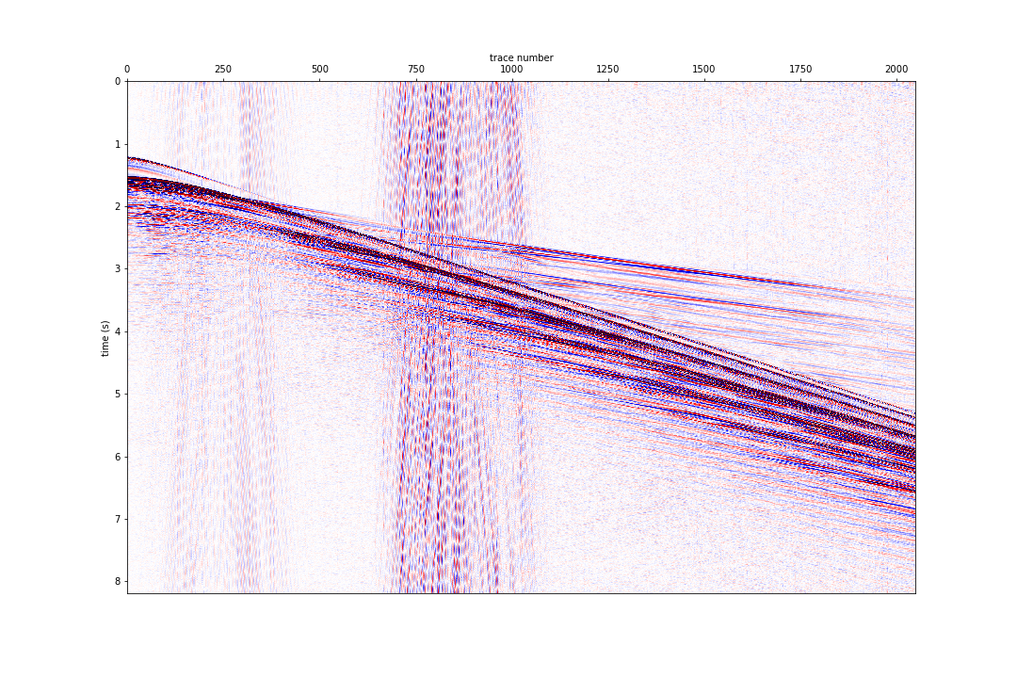
ORIGINAL DATA

Slide 15
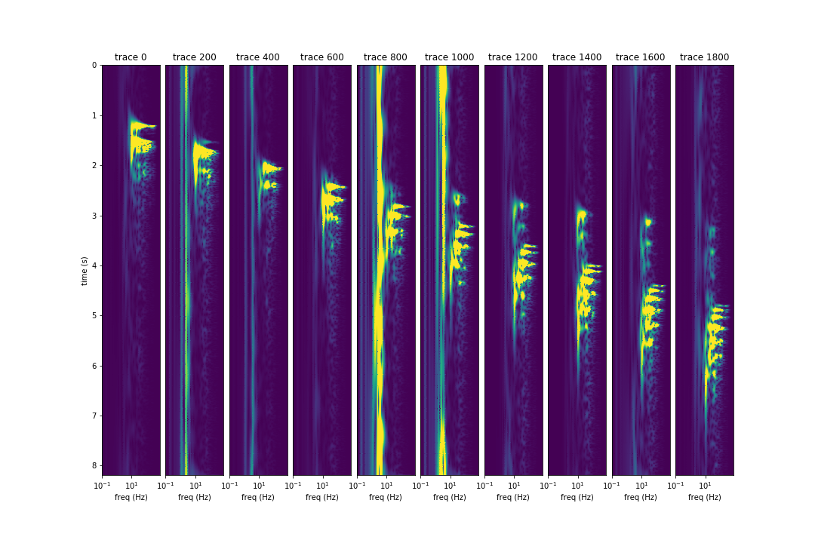
1D CWT OUTPUT

Slide 16
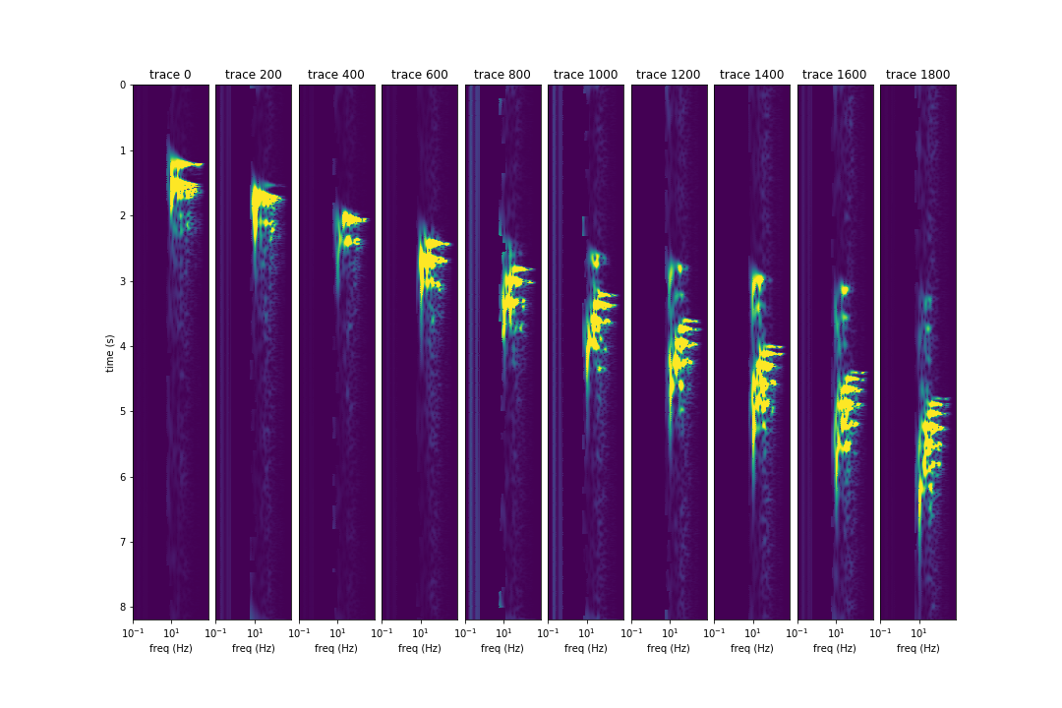
1D CWT OUTPUT – MUTED COEFFICIENTS

Slide 17
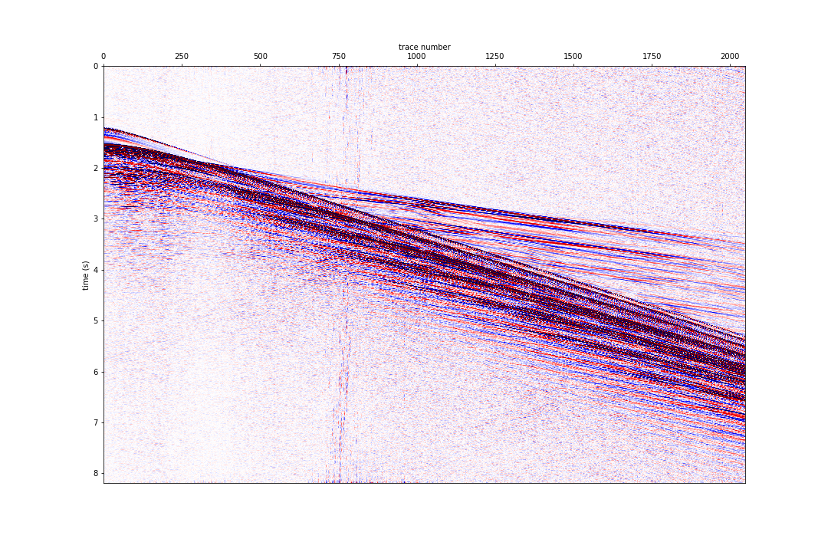
AFTER FILTER

Slide 18
BEFORE FILTER

Slide 19
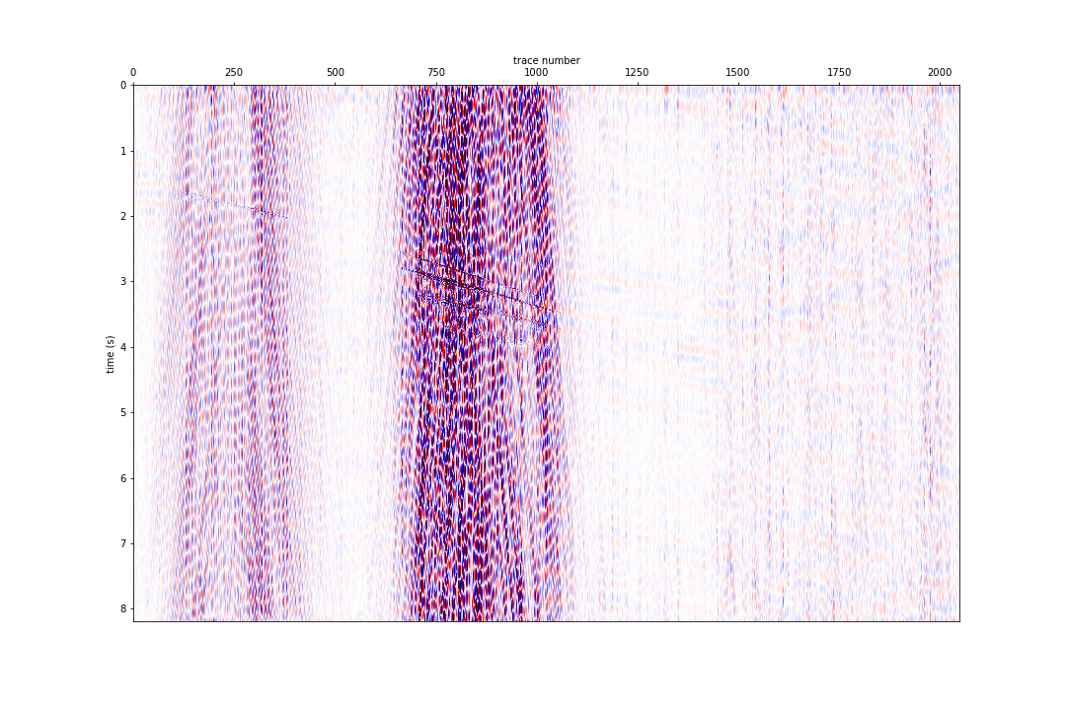
DIFFERENCE

Slide 20
OBSERVATIONS
While the results look pretty good, there is still some signal leaking into our noise model
The filter shape is hard to define analytically
We do not take advantage of the fact that our data has spatial continuity

Slide 21
MULTI-DIMENSIONAL
CONTINUOUS WAVELET
TRANSFORMS

Slide 22
CONTINUOUS WAVELET TRANSFORMS (CWT) – 2D CASE
We project the data upon a basis of 2D wavelets
The analyzing wavelets are stretched and rotated
2D data become 5D
Can be performed computationally efficiently using FFTs
Has an exact inverse
Computationally robust, because it is a highly redundant transform
Notes:
Math
Exact analytical inverse is important because we wish to reconstruct our seismic data after filter !

Slide 23
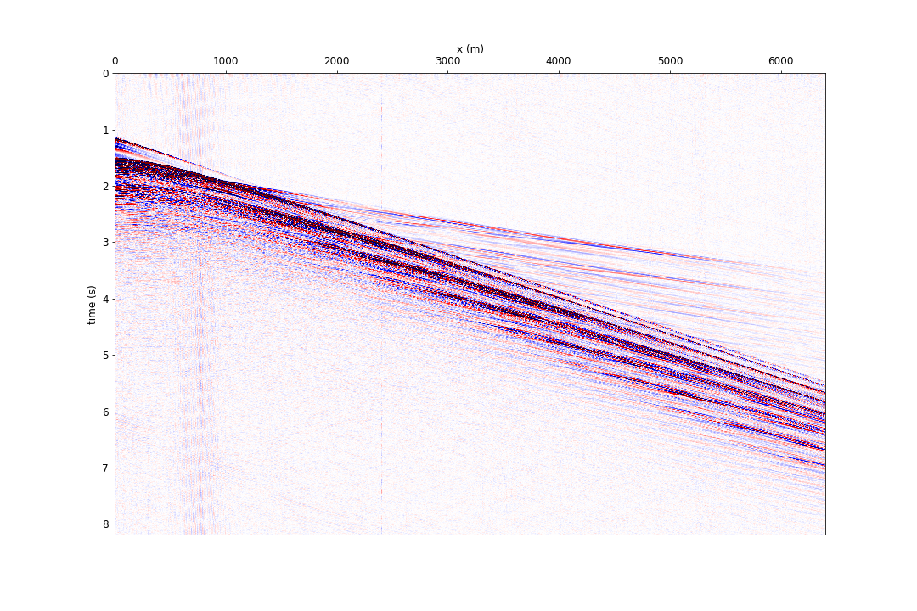
ORIGINAL DATA – LOW NOISE EXAMPLE

Slide 24
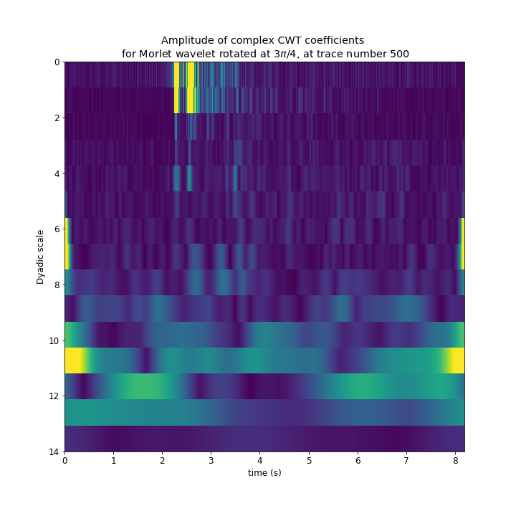
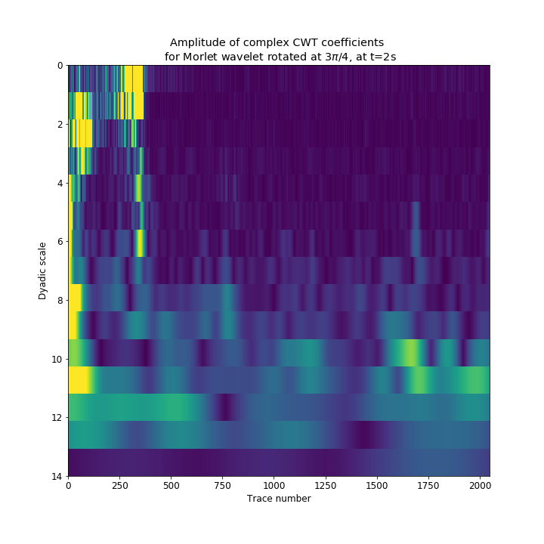
2D CWT OUTPUT – HOW TO VISUALIZE 5D DATA?
Notes:
Wavelet coefficient in general, plotted as suggested by the textbook
5D : 10 permutation of axis… * (5 2)’ combinatorial number…
That’s a lot of things to look at. Most of them are not easily interpretable.
The 2 plots you see are textbook plots for CWT for the data you have seen, I challenge you to tell me what’s signal and what’s noise when looking at it this way

Slide 25
2D CWT OUTPUT – MY CONTRIBUTIONS
2D data become 5D
(time, offset) becomes
(time, offset, pseudo-frequency, pseudo-wavenumber, rotation angle)
Found a way to reduce a 5D output space to a 4D one
Select wavelet scales so as to collapse the pseudo-frequencies and pseudo- wavenumbers onto the same axis
Found a representation of the CWT output that makes it intuitive to understand and possible to compare to the original data
Notes:
Math
Exact analytical inverse is important because we wish to reconstruct our seismic data after filter !

Slide 26
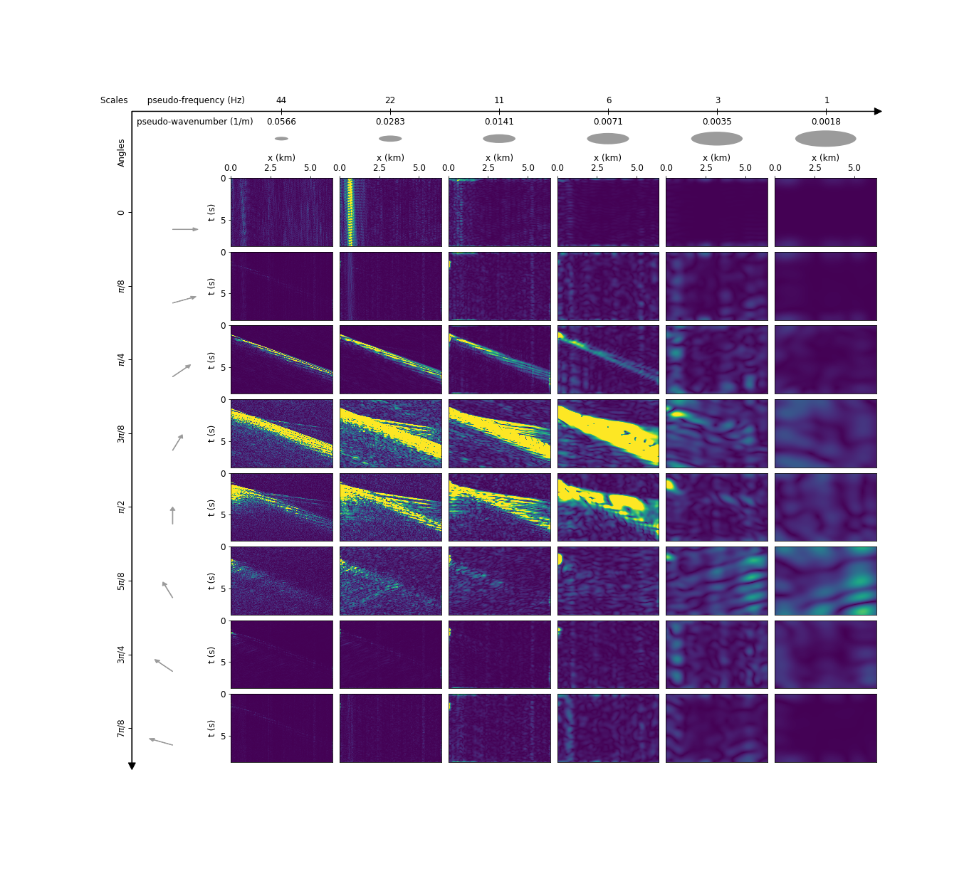
2D CWT OUTPUT – MY CONTRIBUTIONS
Notes:
2D CWT
Found a way to reduce a 5D output space to a 4D one
Found a representation of the CWT output that makes it intuitive to understand and possible to compare to the original data
IN PARTICULAR
For this dataset, 2D CWT seems to separate signal and noise efficiently
We can visually identify and separate different wave modes
This suggests that this is a good domain for signal processing filters and machine learning algorithms
-> This is what I did – let me show you the results now

Slide 27
2D CWT OUTPUT – MY CONTRIBUTIONS
2D CWT
Found a way to reduce a 5D output space to a 4D one
Found a representation of the CWT output that makes it intuitive to understand and possible to compare to the original data
IN PARTICULAR
For this dataset, 2D CWT seems to separate signal and noise efficiently
We can visually identify and separate different wave modes
This suggests that this is a good domain for signal processing filters and machine learning algorithms
Notes:
2D CWT
Found a way to reduce a 5D output space to a 4D one
Found a representation of the CWT output that makes it intuitive to understand and possible to compare to the original data
IN PARTICULAR
For this dataset, 2D CWT seems to separate signal and noise efficiently
We can visually identify and separate different wave modes
This suggests that this is a good domain for signal processing filters and machine learning algorithms
-> This is what I did – let me show you the results now

Slide 28
2D CWT OUTPUT

Slide 29
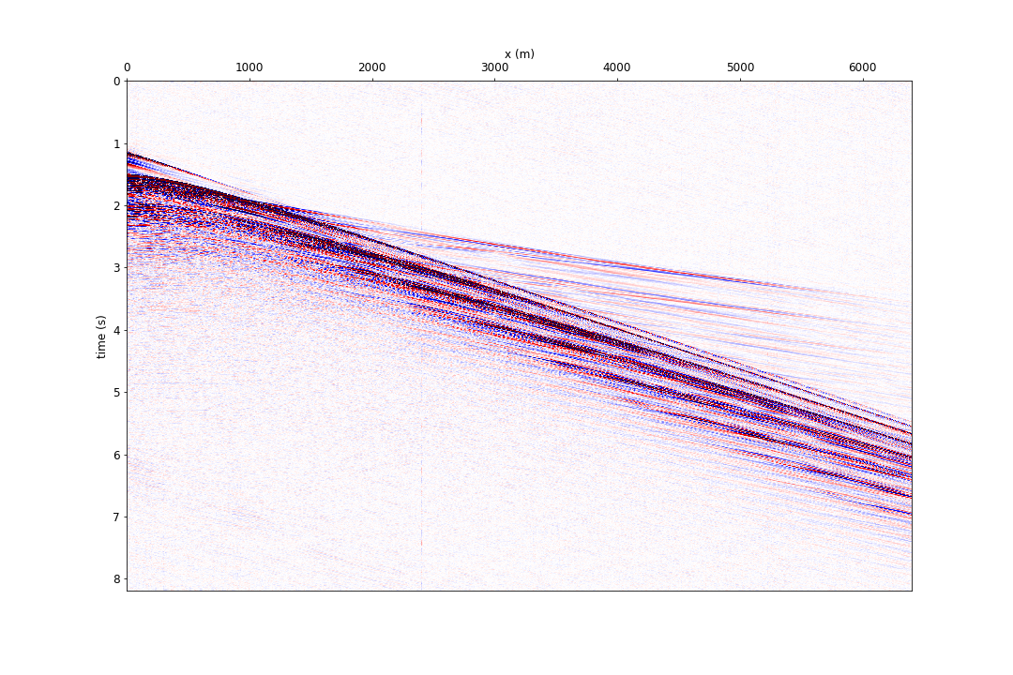
AFTER FILTER

Slide 30
BEFORE FILTER

Slide 31
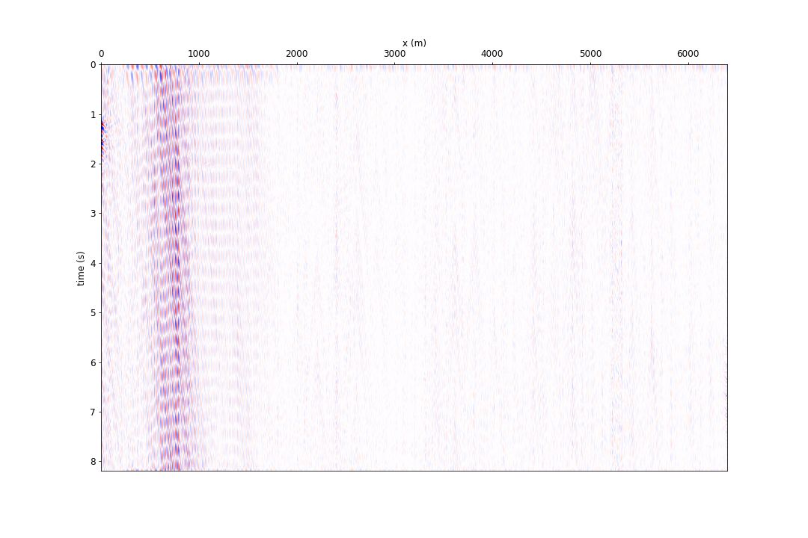
DIFFERENCE
Noise model

Slide 32
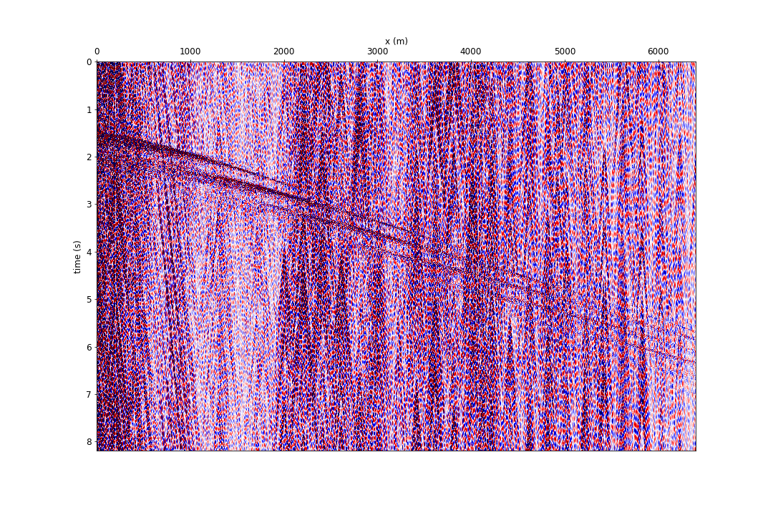
ORIGINAL DATA – HIGH NOISE EXAMPLE

Slide 33
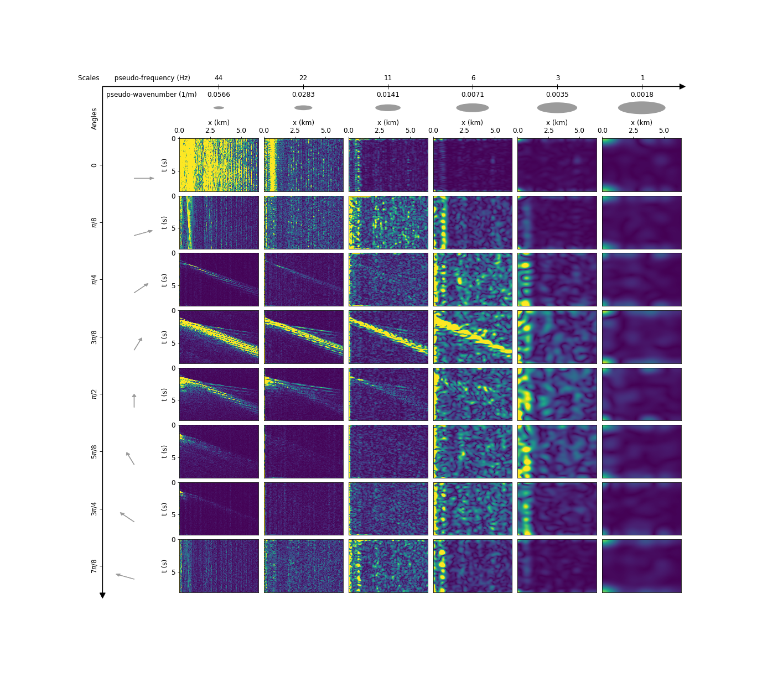
2D CWT OUTPUT
Notes:
Using the same filtering techniques

Slide 34
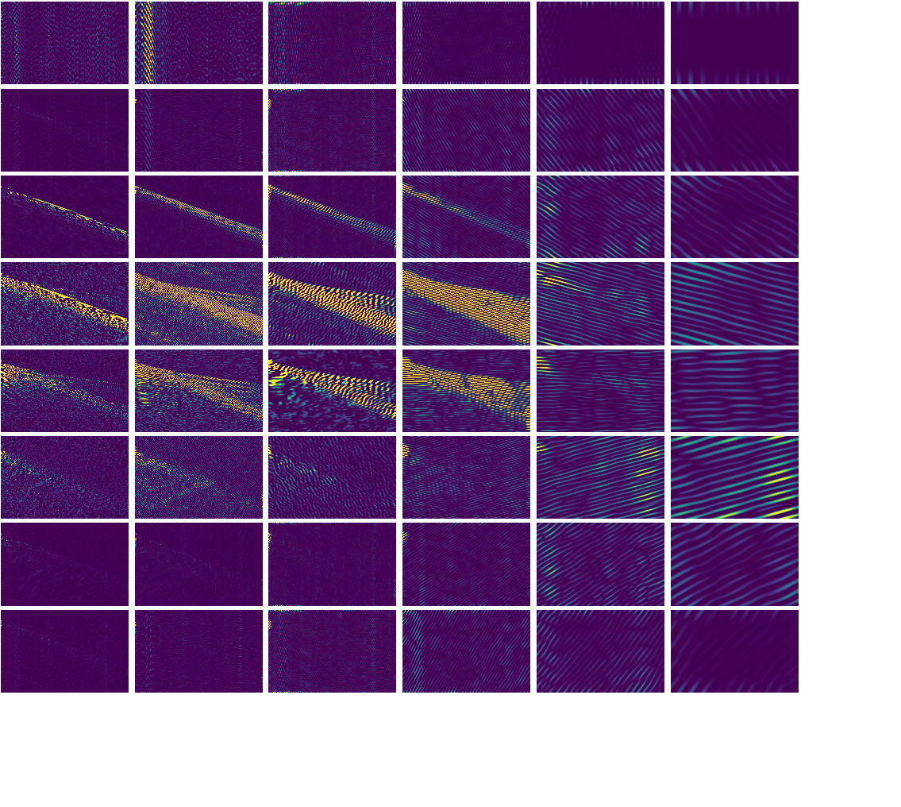
2D CWT OUTPUT – REAL COMPONENT

Slide 35

2D CWT OUTPUT – IMAGINARY COMPONENT

Slide 36
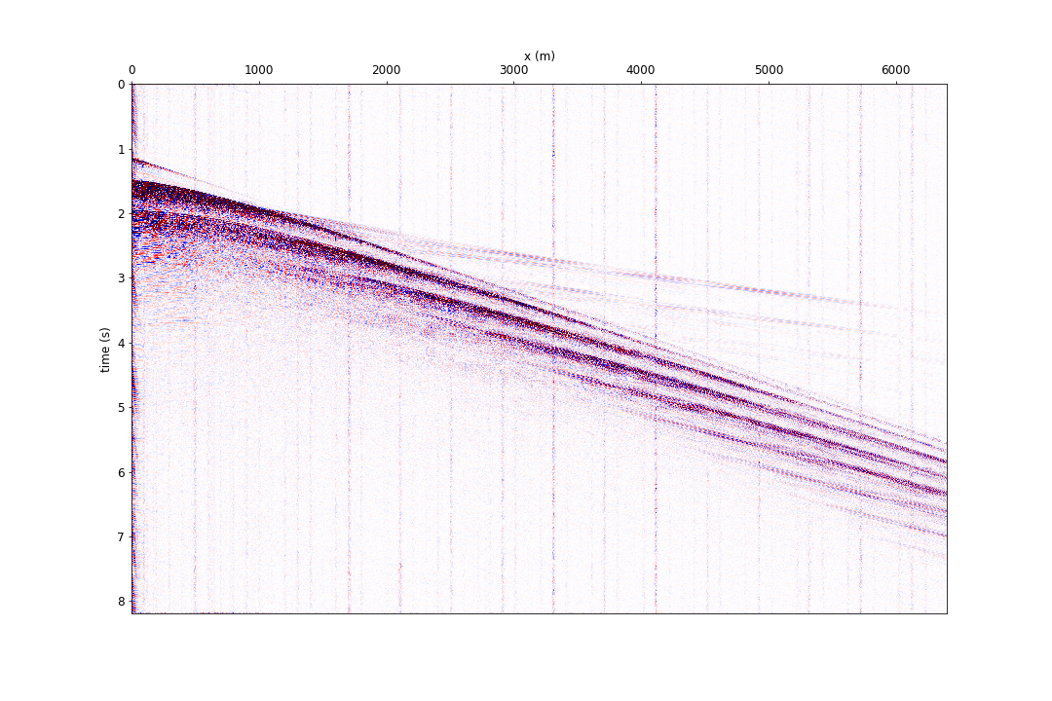
AFTER FILTER
Notes:
The remaining regular vertical pattern can probably be addressed if we are more aggressive or subtle wit the filtering process
This remaining noise mode is very regular and probably linked to acquisition hardware (connectors?)

Slide 37
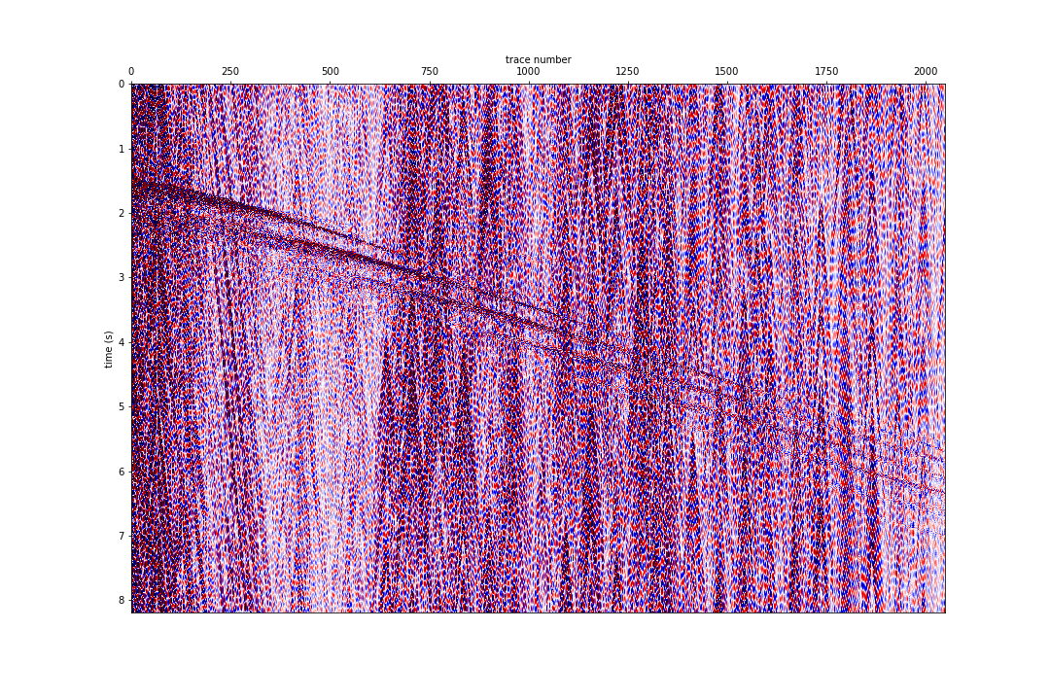
BEFORE FILTER

Slide 38
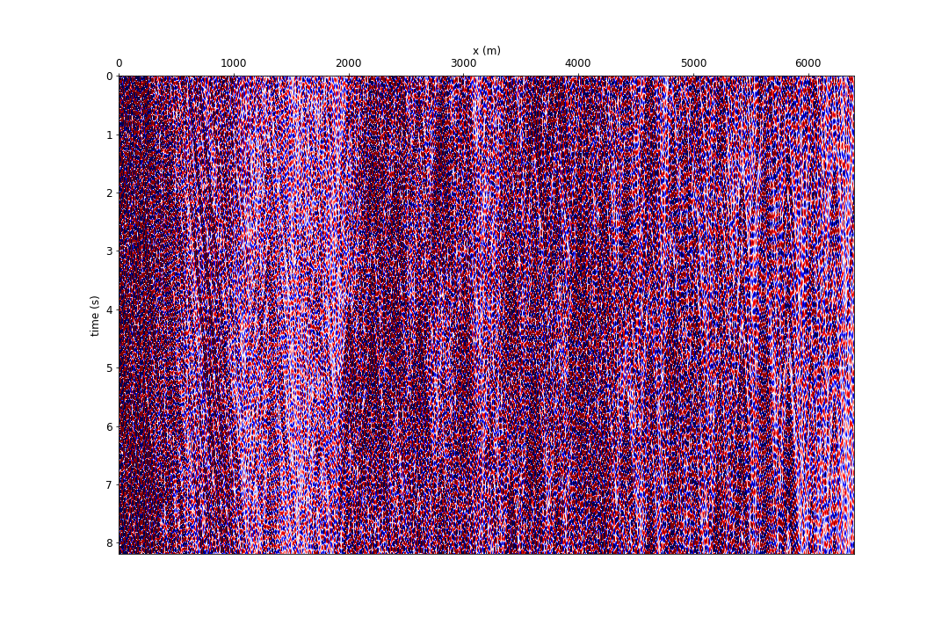
DIFFERENCE
Notes:
No signal in the noise model!

Slide 39
PARTING WORDS
Highly robust method
Can be applied to any seismic data set
Allows for separation, identification, quantification and removal of specific wave modes
Allows us to use machine learning algorithms

Slide 40
ACKNOWLEDGEMENTS
Schlumberger Technology Innovation Center

Slide 41
THANK YOU!
Questions? Feedback? Please share!
fantine@stanford.edu

