Slide 1
Velocity-based event detection using downhole DAS arrays - examples from SAFOD
Ariel Lellouch
In collaboration with:
Siyuan Yuan
Zack Spica
Biondo Biondi
William L. Ellsworth

Slide 2
Overview
Motivation
The SAFOD DAS array
P/S velocity analysis using earthquakes
Comparison with interferometry and downhole geophone survey
Automatic event detection method
Velocity-based
Comparison with USGS catalog
Conclusions

Slide 3
Motivation
Conventional seismic monitoring is challenging
Surface receivers – low S/N
Continuously recording arrays
Sparse arrays – hard to follow seismic phases
DAS has emerged as a promising alternative
Goal - utilization of array-based seismology using downhole DAS
Detection, location, characterization…
Seismic velocity is helpful
Notes:
Shorten text or do a layered version

Slide 4
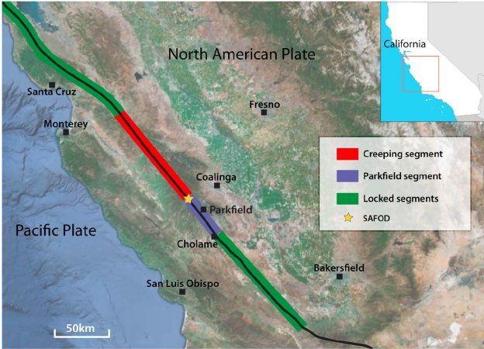
SAFOD DAS array
Richard et al, 2013
About 20 days of recording, June-July 2017!

Slide 5
What is DAS?
Distributed Acoustic Sensing
Interrogator (source + receiver) attached at fiber end
Continuously sends pulses of light through the fiber
Fiber “at rest” -> constant reflected light (backscattering)
Fiber distorted -> change in backscattering
Changes are quasi-linear to strain (or strain-rate) along the fiber
Cumulative measurement
Measurement along the fiber (directivity issues)
The speed of light in the fiber is known!
By gating, we can infer the location at which strain occurred $→ε(x)$
If we send pulses fast enough, we can also get time variations $→ ε(x,t)$

Slide 6
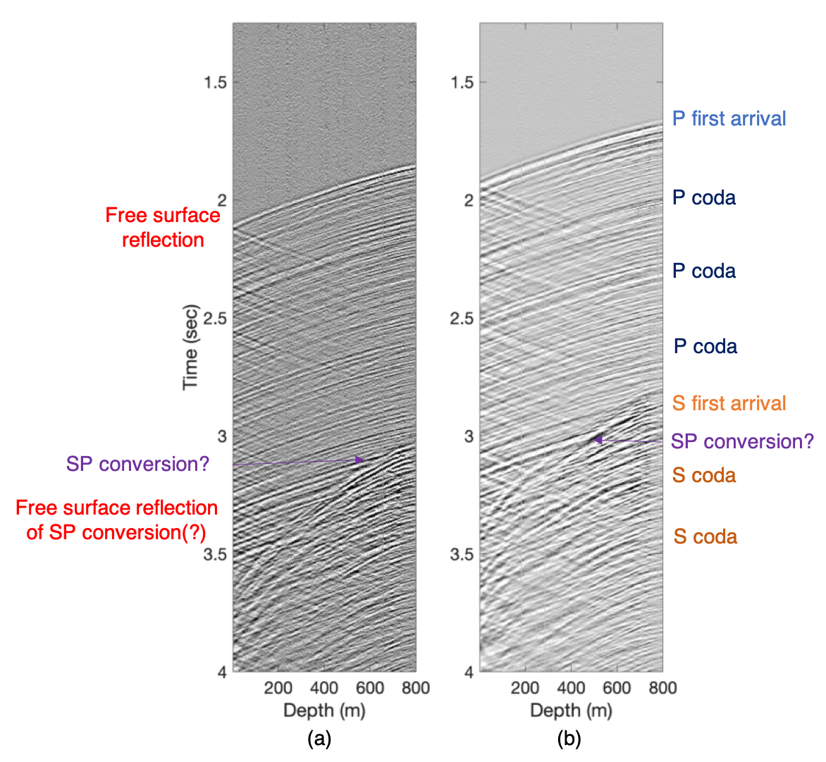
Near-vertical earthquakes
$$M=1.33$$
$$R=11.3 km$$
$$θ={9.54}^{o}$$
$$M=2.46$$
$$R =11.7 km$$
$$θ={12.31}^{o}$$
Velocity increases with depth -> incidence angle tends to vertical
Simple pre-processing
Median value removal
Down-sampling
Noisy channel auto-muting
Visible, coherent first breaks
Coda waves have similar moveout
S arrivals are harder to separate
Converted modes?
Interference with P coda waves?
”Conventional” geophone

Slide 7
Velocity analysis using earthquakes
Ideal case - earthquake far below the array
Far-field + plane wave propagation
1D propagation
Reverse zero-offset VSP
$V_{int_{n}}=\frac{Z_{R\left(n\right)}−Z_{R\left(n−1\right)}}{t_{R\left(n\right)}−t_{R\left(n−1\right)}}$
Otherwise – scaled by $cos⁡(θ)$
Incidence angle $≠$ geometrical angle!
How to estimate $t_{R\left(n\right)}−t_{R\left(n−1\right)}$?
Derivatives are dangerous…

Slide 8
Travel-times estimation
First break picking
Many (many) different algorithms
STA/LTA, Coppens, Entropy maximization…
We use a dynamic programming approach (maximum energy path)
Requires fine-tuning
We match the nearest previous zero-crossing
Manual trace editing (for S-waves)
Slant-stack decomposition
Implemented in time domain
Computes semblance
Window size choice in both time and depth

Slide 9
First break picking – P phase

Slide 10
Slant stack decomposition – P waves
0-150 m
275-425 m
650-800 m
Computed for overlapping windows
1-channel overlap
High semblance indicates local velocity
Each panel is picked
Yields continuous model
Where to pick semblance panels?

Slide 11
S waves: interference/conversions

Slide 12
S-wave picking
Trickier than P
Workflow:
Moveout-correction using P velocity
FK filtering (remove zero and negative components)
Approximate S moveout correction
Consistent phase picking!
Manual adjustments…
Downhole arrays are especially beneficial for S processing!

Slide 13
Full processing flow

Slide 14
S-waves - easier in the slant-stack domain!
P is relatively ease to estimate (red)
S events arrive later (black)
Much lower velocity!
Hard limit: $V_{S}<\sim 0.65V_{P}$
Pick maximal slant-stack semblance within those limits

Slide 15
Interferometry using ambient field
Using 1-day data records
Surface virtual source vs. constant distance
Stacking correlations
Repeated for different days

Slide 16
Conventional check-shot processing
Not really 1-D
Compensated by Euclidean distance calculation
Straight rays
Near field effects
No S-waves energy
Different sampling (~15m)
Smoothing operators are equivalent

Slide 17
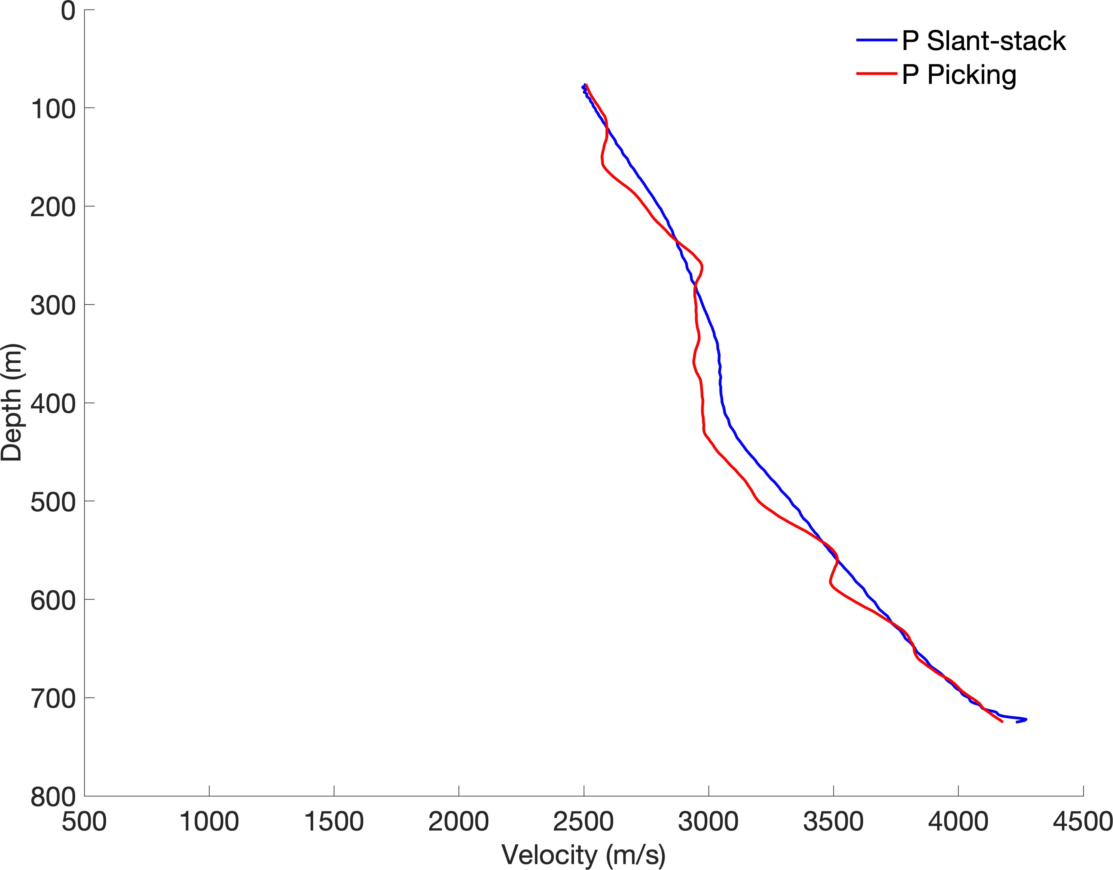
Summary – estimated velocities
Good agreement between picking and slant-stacks

Slide 18
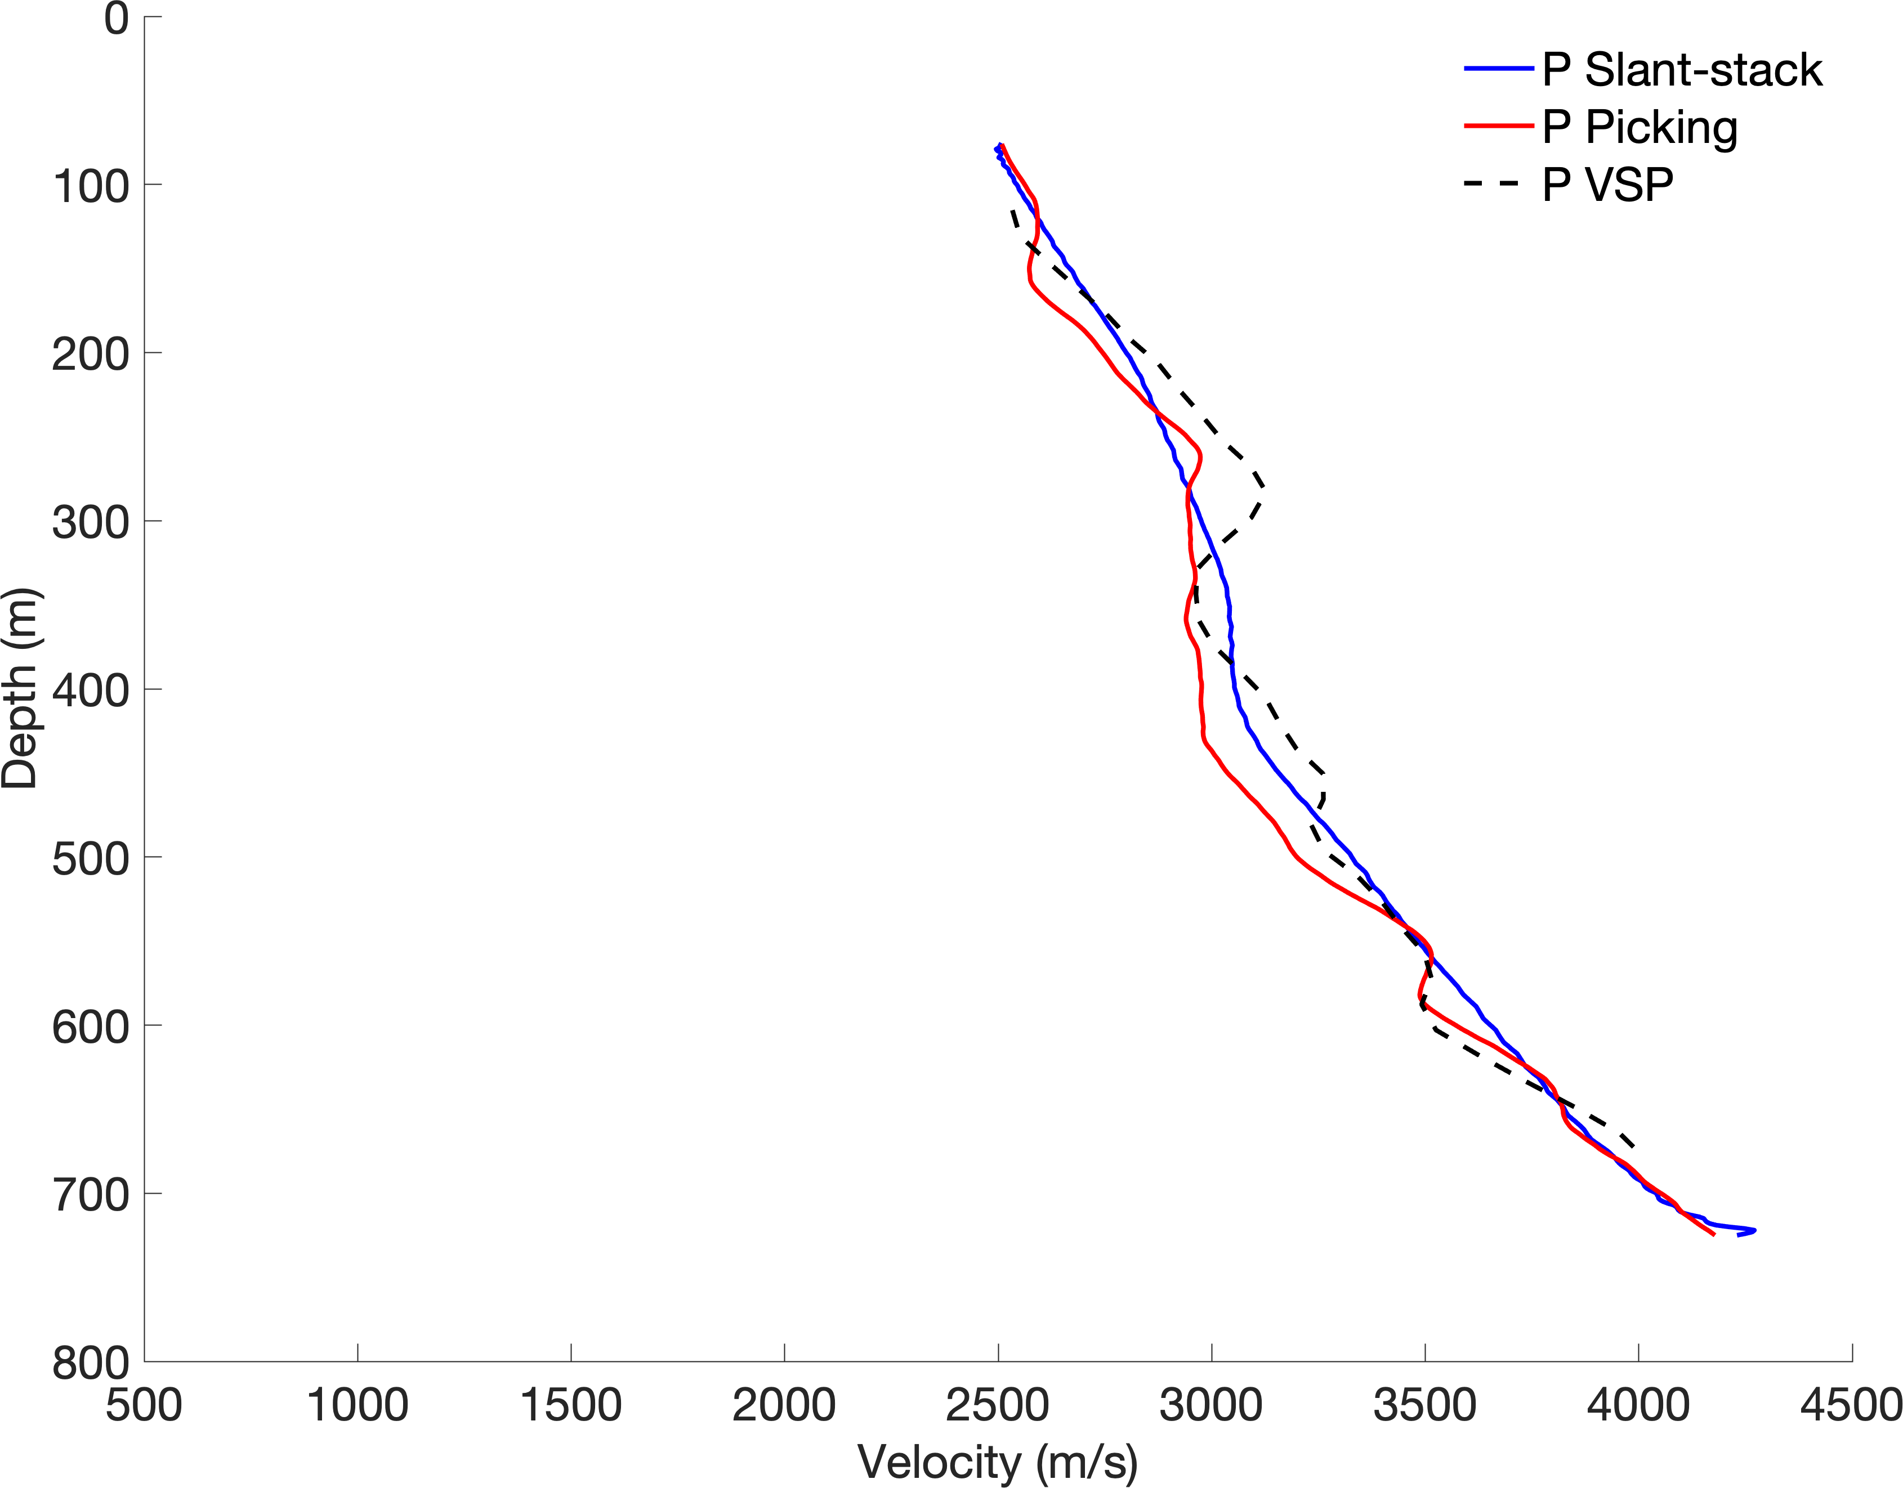
Summary – estimated velocities
Good agreement between picking and slant-stacks
Matches check-shot processing

Slide 19
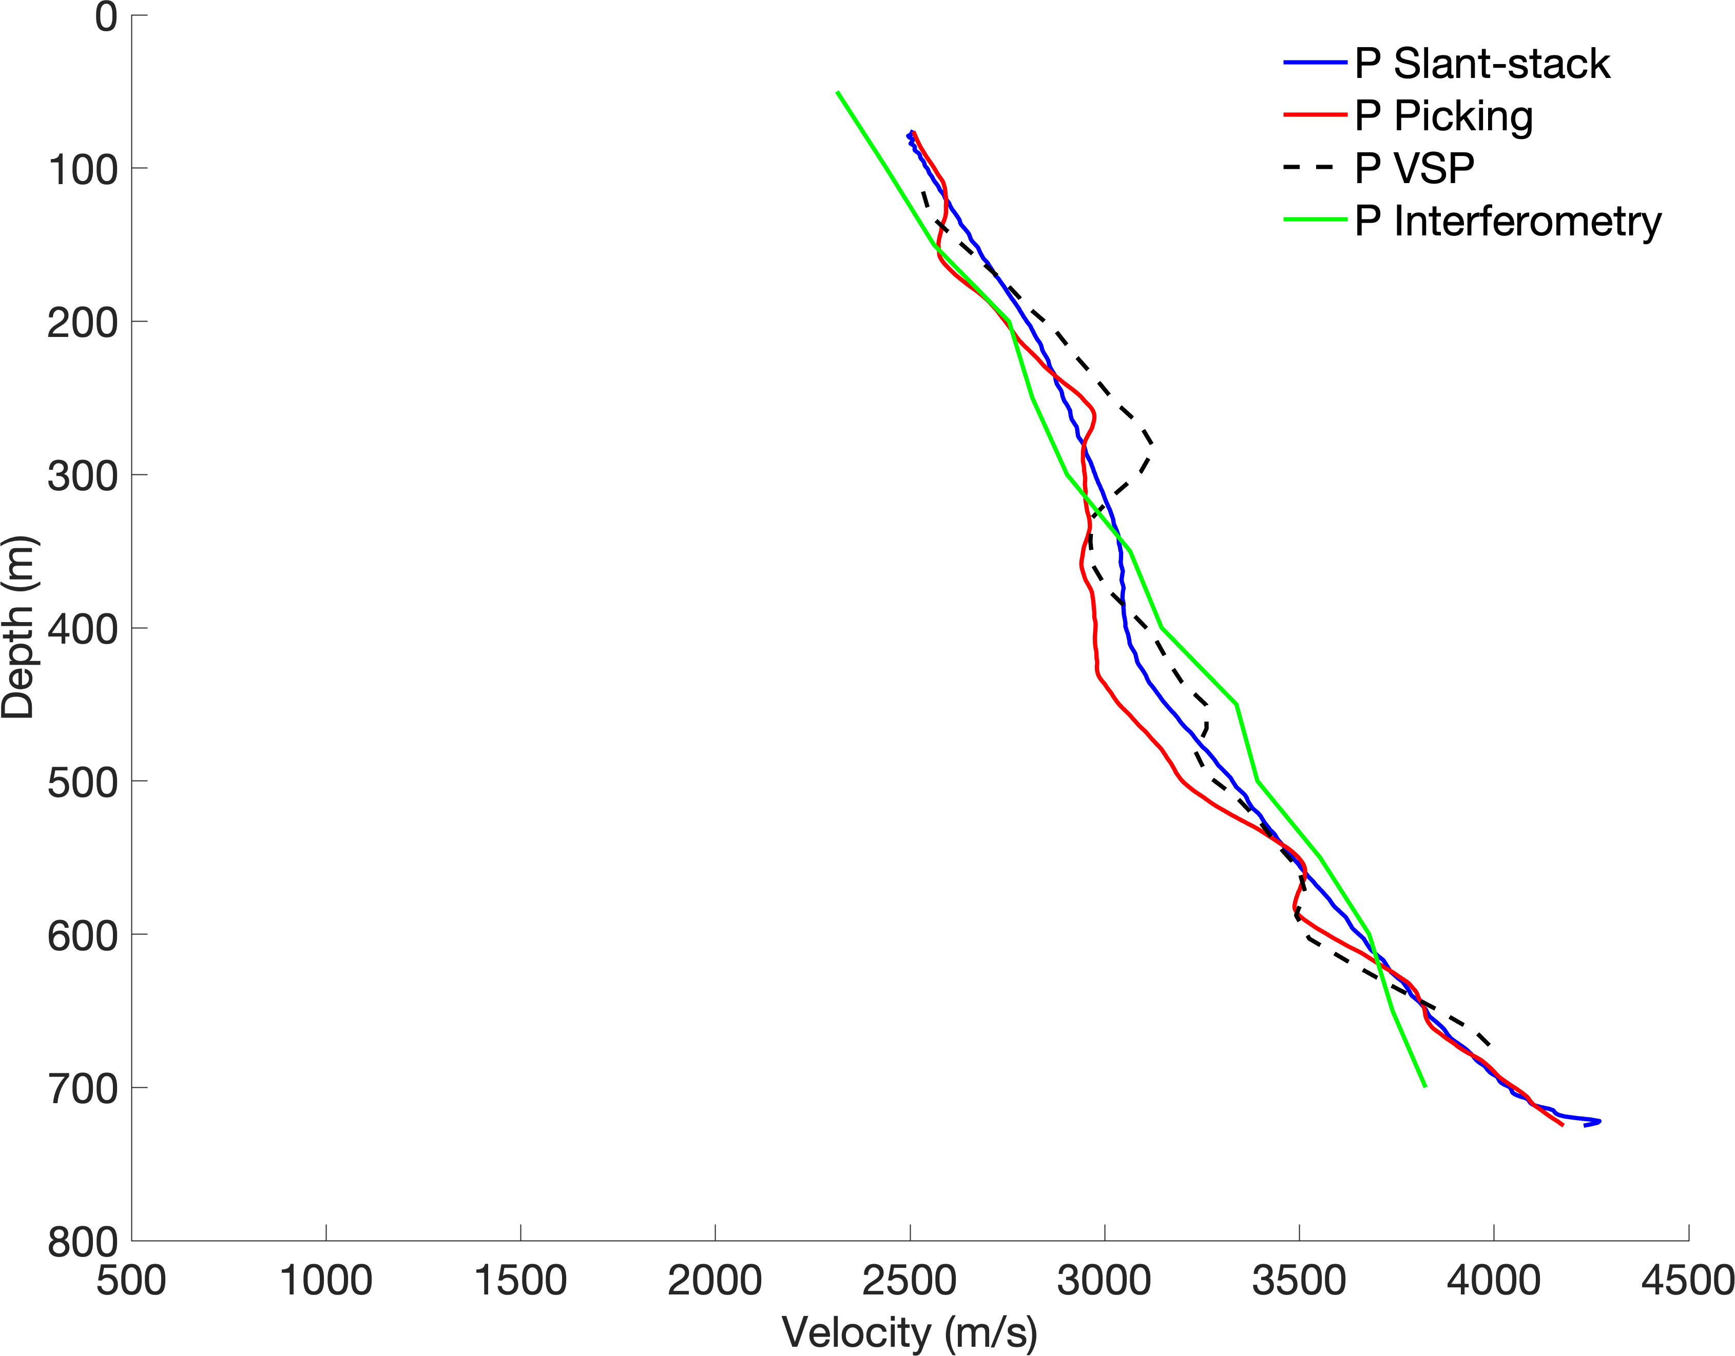
Summary – estimated velocities
Good agreement between picking and slant-stacks
Matches check-shot processing
Geological structure

Slide 20
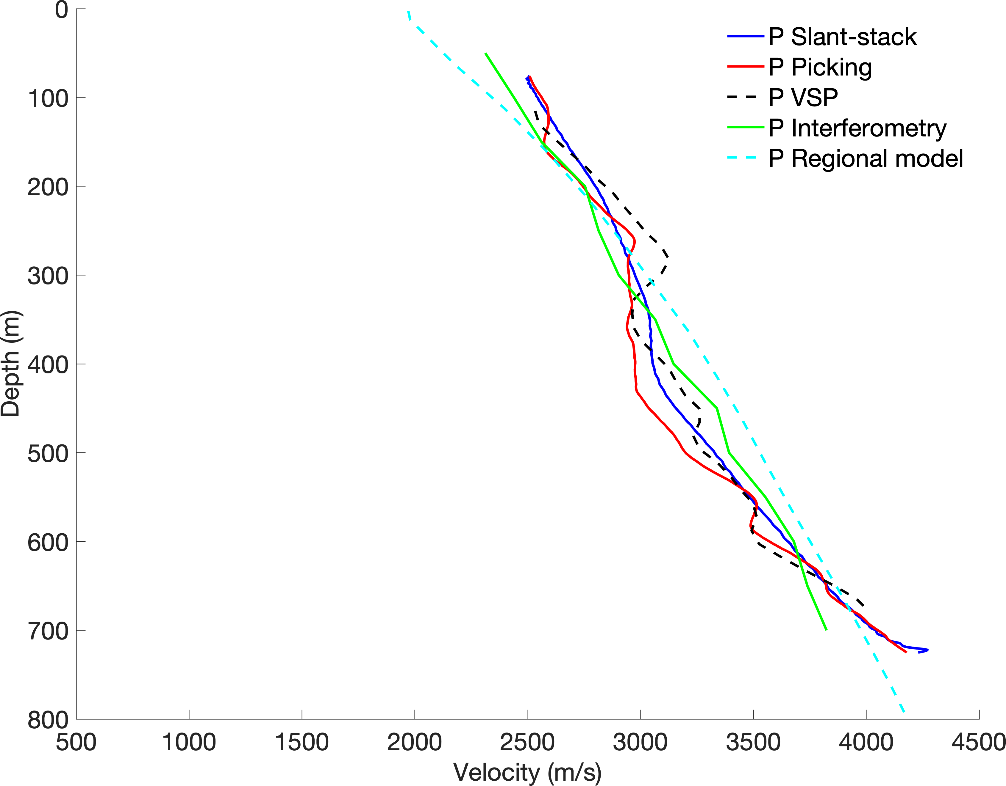
Summary – estimated velocities
Good agreement between picking and slant-stacks
Matches check-shot processing
Geological structure

Slide 21
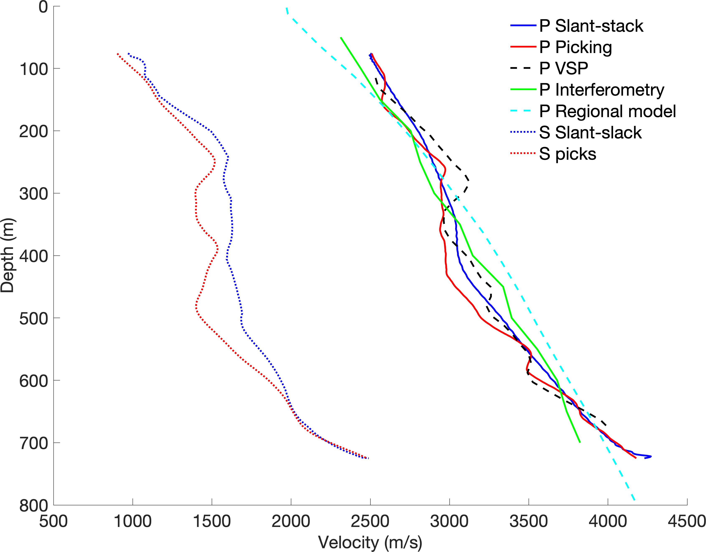
Summary – estimated velocities
Good agreement between picking and slant-stacks
Matches check-shot processing
Geological structure
S follows same structure

Slide 22
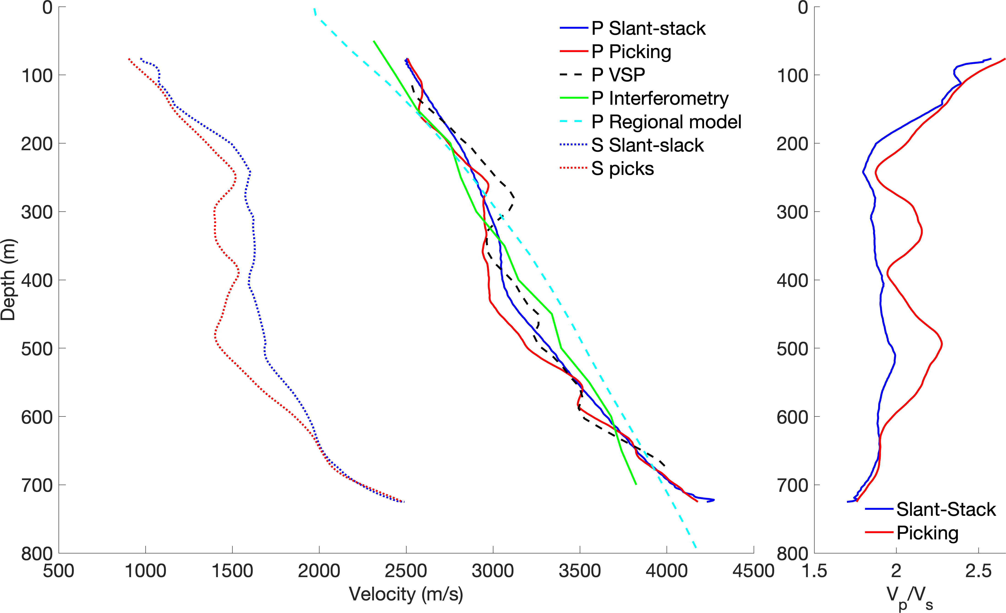
Summary – estimated velocities
Good agreement between picking and slant-stacks
Matches check-shot processing
Geological structure
S follows same structure
“Normal” $V_{P}/V_{S}$

Slide 23
Visible SP conversion around $V_{P}/V_{S}$anomaly
Different wavelet
High amplitude

Slide 24
How can we use this for detection?

Slide 25
Incidence angle effects

Slide 26
Incidence angle effects
Manually aligned
Moveout differences!

Slide 27
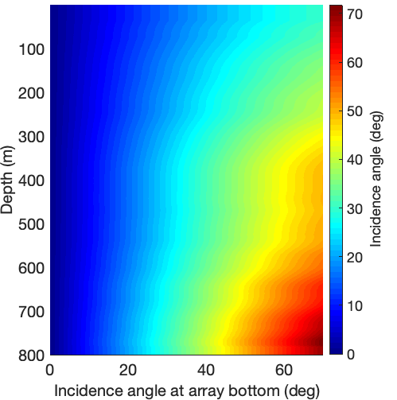
Different earthquakes, similar moveouts…
Unique temporal behavior
Source onset time is unknown, so behavior is relative
Depends on local velocity at the array location
Expected moveout can be scaled by
First order : $cos⁡(θ)$ , $θ∈[{0^{o},70}^{o}]$
Snell’s law for changes along the array
For each angle:
Calculate apparent moveout
Shift data accordingly
Compute windowed semblance, along channels, for all record
$\text{Amplitude}\left[time,channel\right]→Semblance [time,angle]$
Apply threshold for event detection
Repeat for P and S velocities

Slide 28
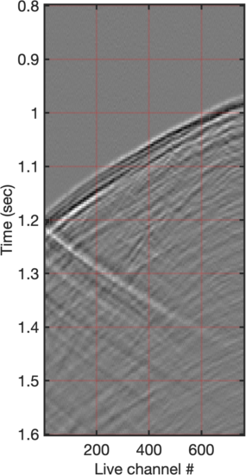
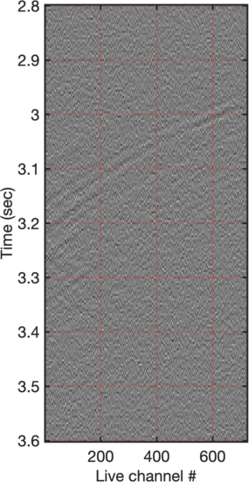
Input data

Slide 29
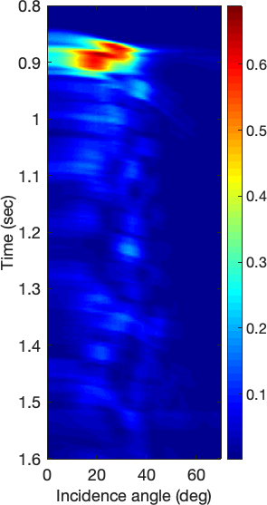
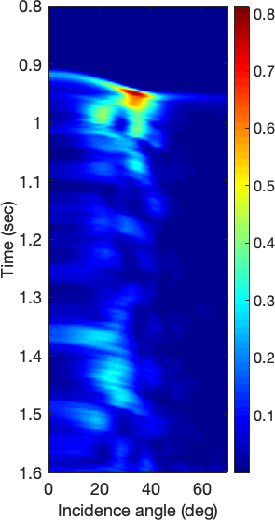
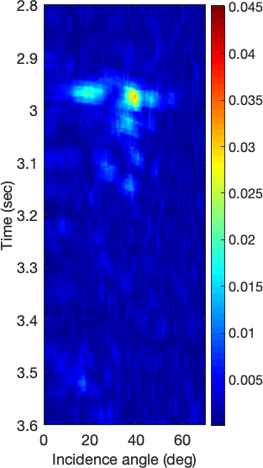
S=0.661
S=0.792
S=0.031
Constant angle

Slide 30
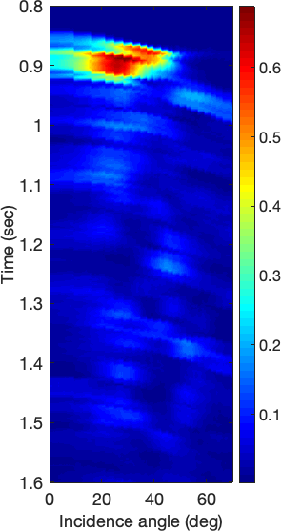
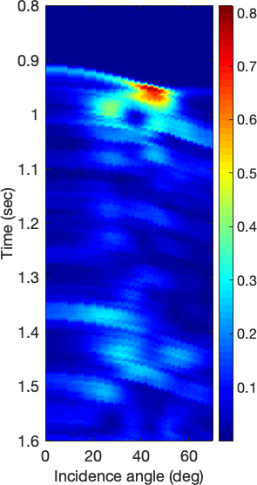
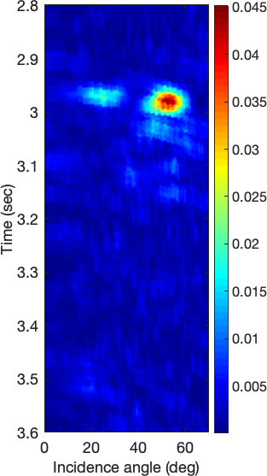
S=0.689
S=0.814
S=0.045
Variable angle

Slide 31
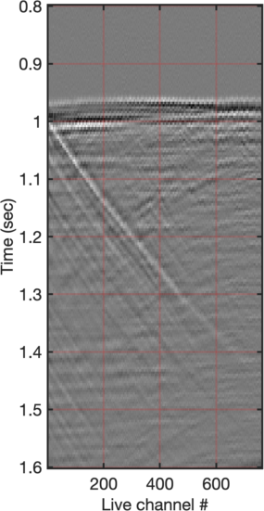
Constant angle

Slide 32
Variable angle

Slide 33
Detection results
* Manually-overidden false alarms not shown here

Slide 34
Uncatalogued event!

Slide 35
Uncatalogued event!
Low signal-to-noise
Visible P and S phases
Short P-S difference – close event (5-7km)
M<~0
Definitely an earthquake…

Slide 36
Conclusions
Downhole DAS arrays are useful
Velocity estimation
Event detection
Velocity-based filters are extremely powerful (if designed correctly)
Can significantly help with S-waves analysis (of all sorts)
High-fidelity event detection
On-the-fly data classification?

Slide 37
Questions?
ariellel@stanford.edu (for longer questions)

