Slide 1
Velocity model building using shape optimization applied to level sets
Taylor Dahlke, 5/14/2019
Notes:
Before I talk about shape opt, level sets, etc, I want to talk about vel model building and give an overview of current practice.

Slide 2
Velocity model

Slide 3
Seismic data
Velocity model

Slide 4
Seismic data
Velocity model
MIGRATE

Slide 5
DISCUSS
Seismic data
Velocity model
MIGRATE

Slide 6
REFINE
DISCUSS
Seismic data
Velocity model
MIGRATE

Slide 7
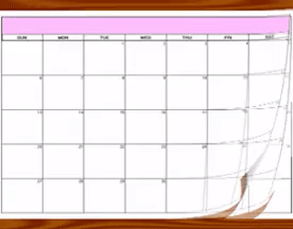
REFINE
DISCUSS
Seismic data
Velocity model
MIGRATE
Notes:
This time intensive workflow can come up against the greater business interests of exploration

Slide 8
Before Full-Waveform Inversion (FWI)
6
8
10
12
X [km]
2
4
6
Z [km]
Figure: Xukai Shen, “Salt model building at Atlantis with Full Waveform Inversion“, SEG 2017
Notes:
FWI has been touted as an approach to lessen the manual aspects of velocity model building, but it has a few problems of its own.

Slide 9
After Full-Waveform Inversion (FWI)
6
8
10
12
X [km]
2
4
6
Z [km]
Figure: Xukai Shen, “Salt model building at Atlantis with Full Waveform Inversion“, SEG 2017
Notes:
FWI has been touted as an approach to lessen the manual aspects of velocity model building, but it has a few problems of its own.

Slide 10
After Full-Waveform Inversion (FWI)
6
8
10
12
X [km]
2
FWI workflow doesn’t invert sharp boundaries well
4
6
Z [km]
Figure: Xukai Shen, “Salt model building at Atlantis with Full Waveform Inversion“, SEG 2017

Slide 11
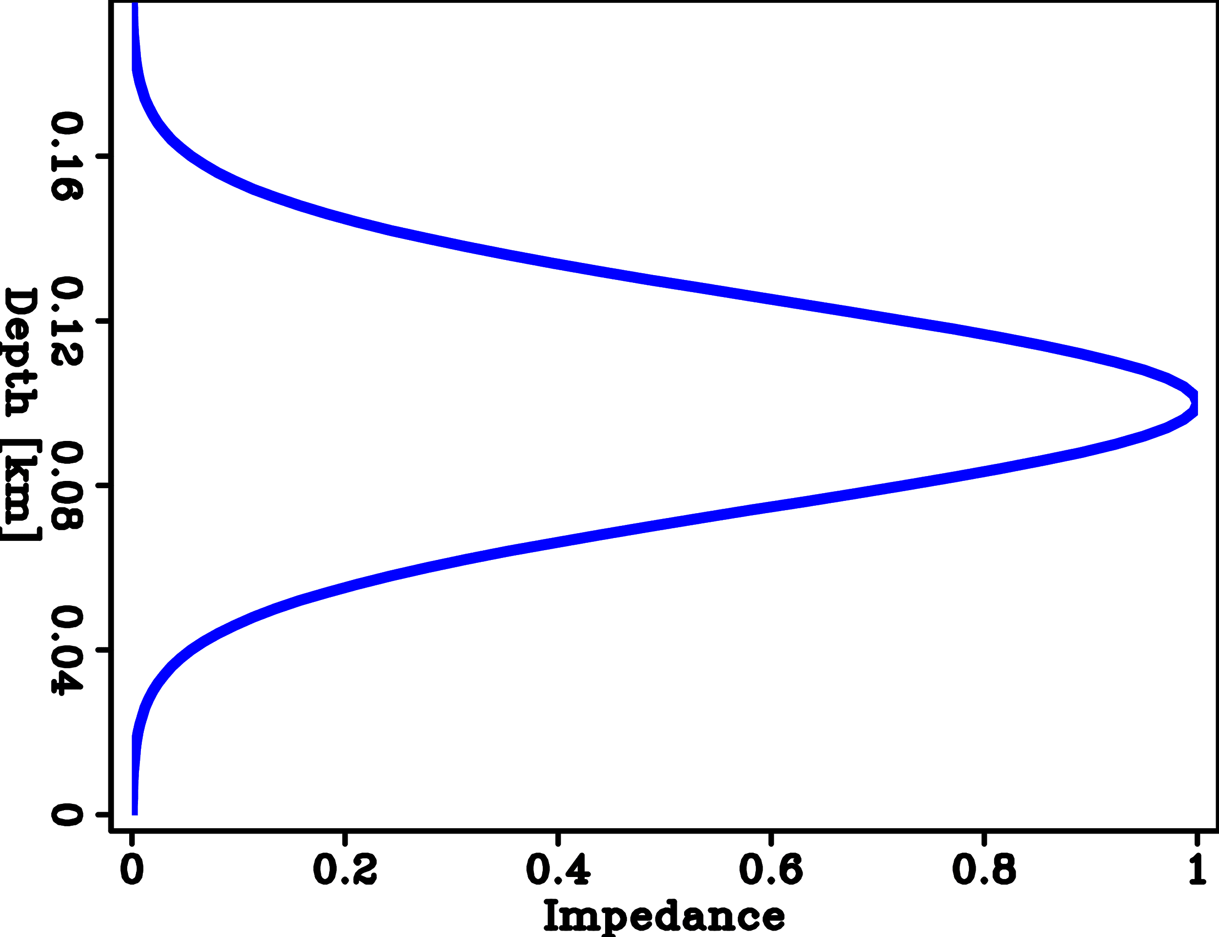
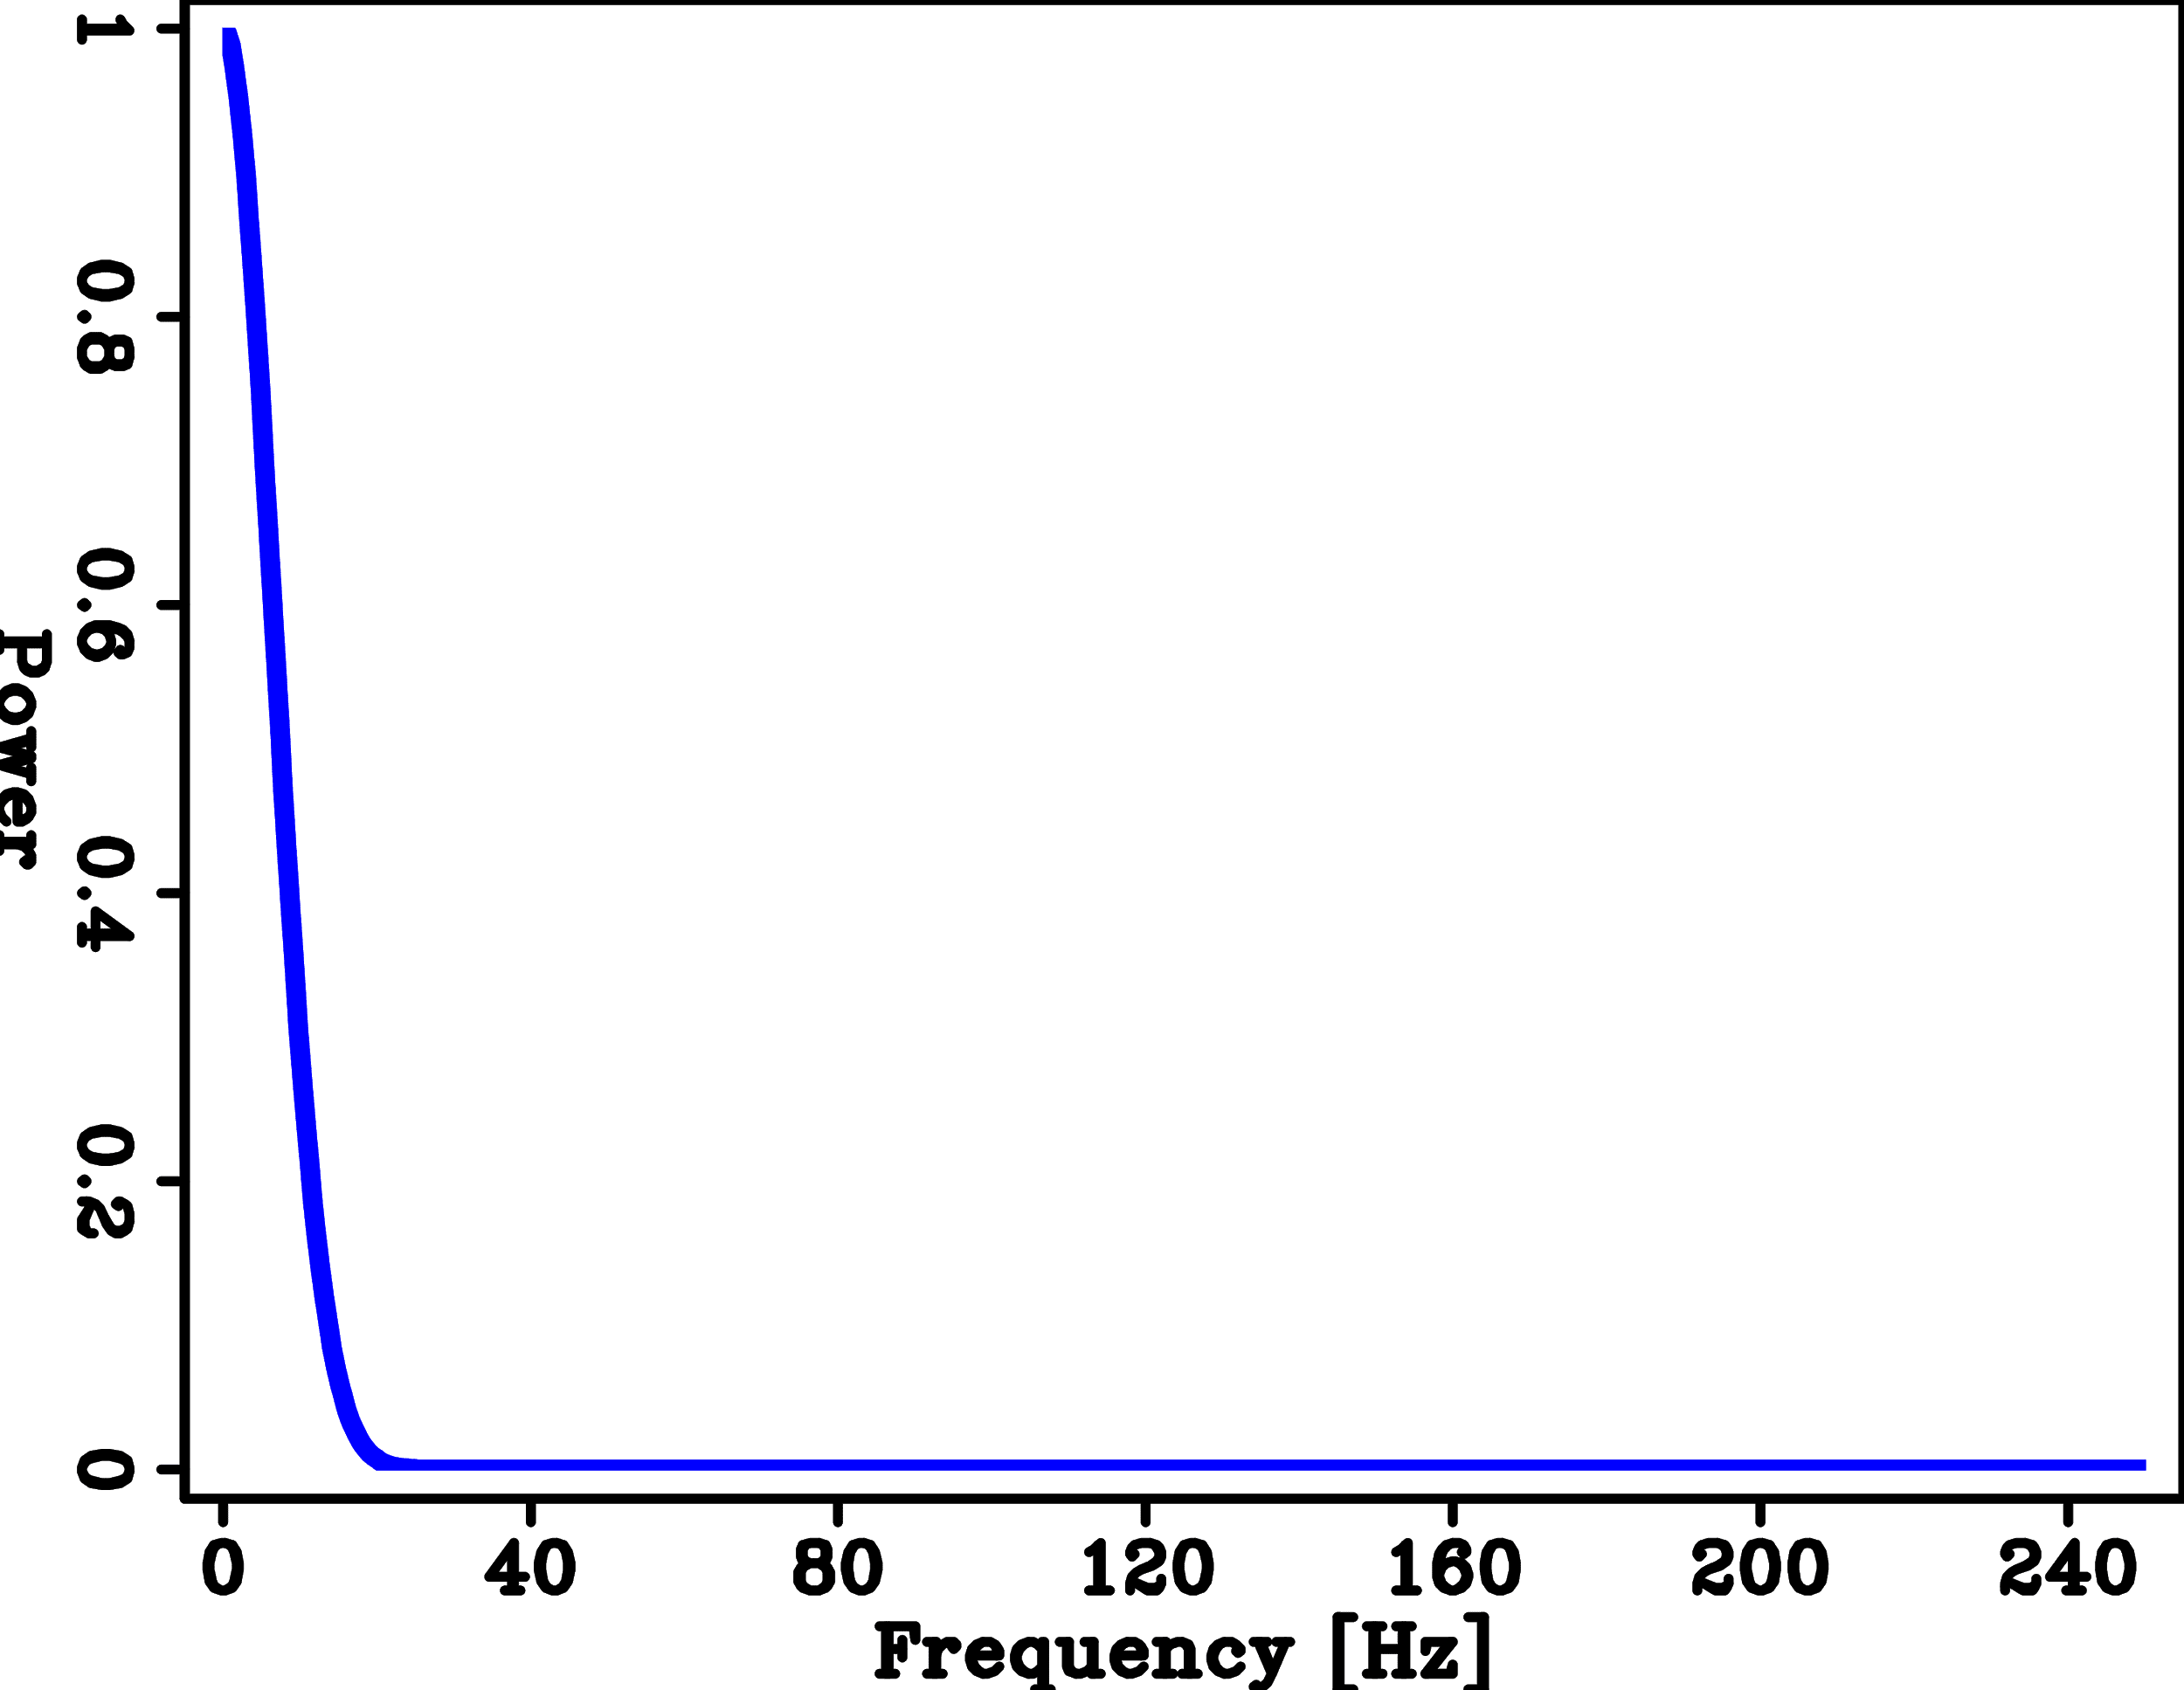
Sharp interfaces require more high frequencies
Reflector
Spectra
Impedance
Spatial frequency [1/m]

Slide 12
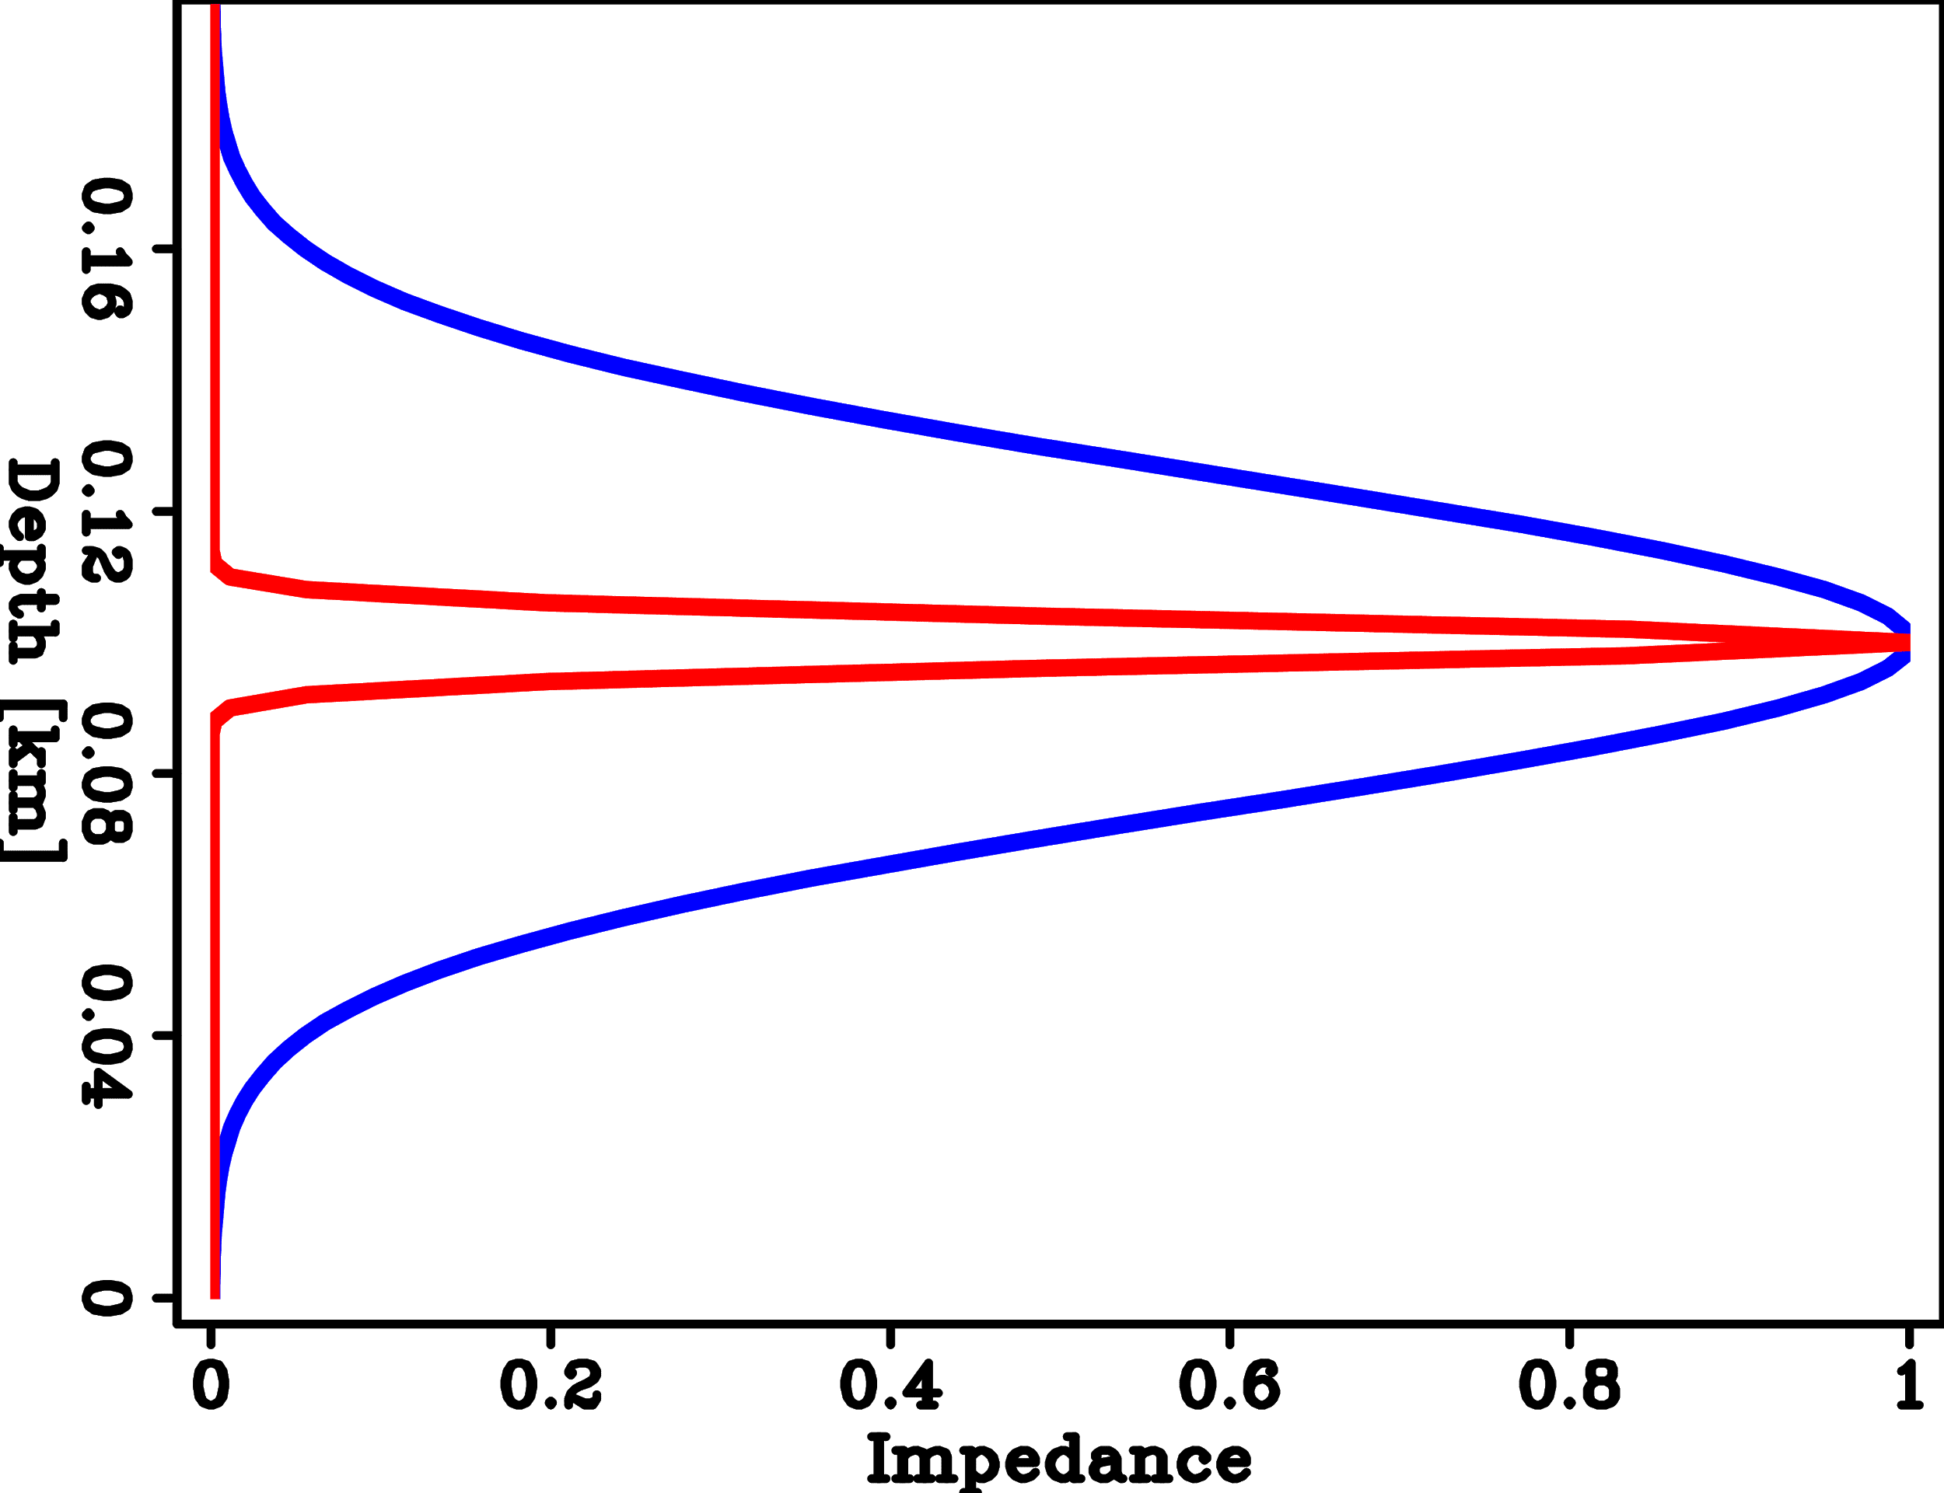
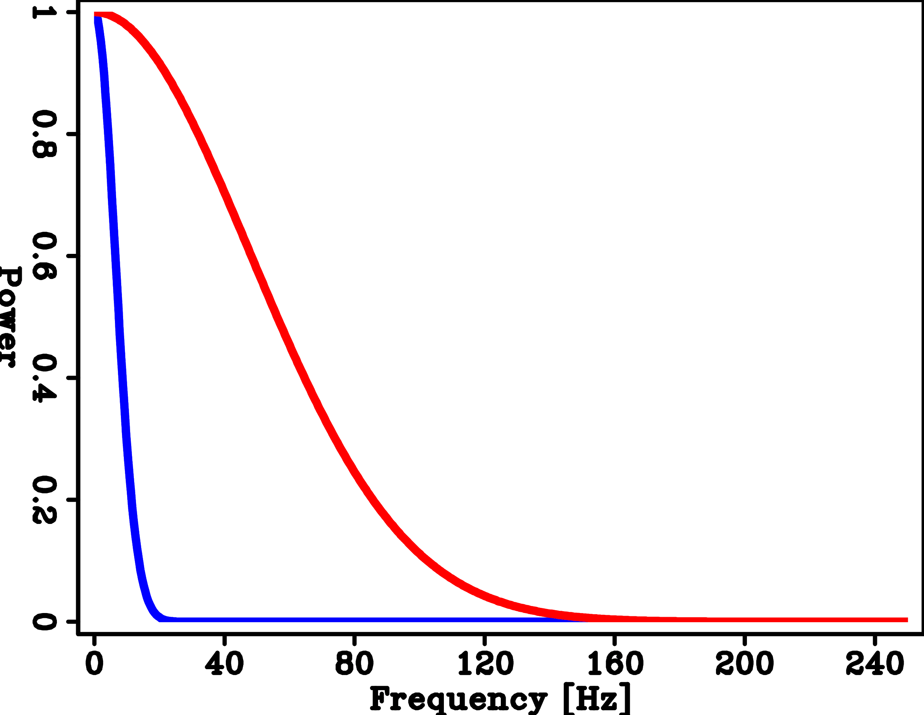
Sharp interfaces require more high frequencies
Reflector
Spectra
Impedance
Spatial frequency [1/km]
Notes:
You can see there is a pronounced increase in the high frequency content

Slide 13
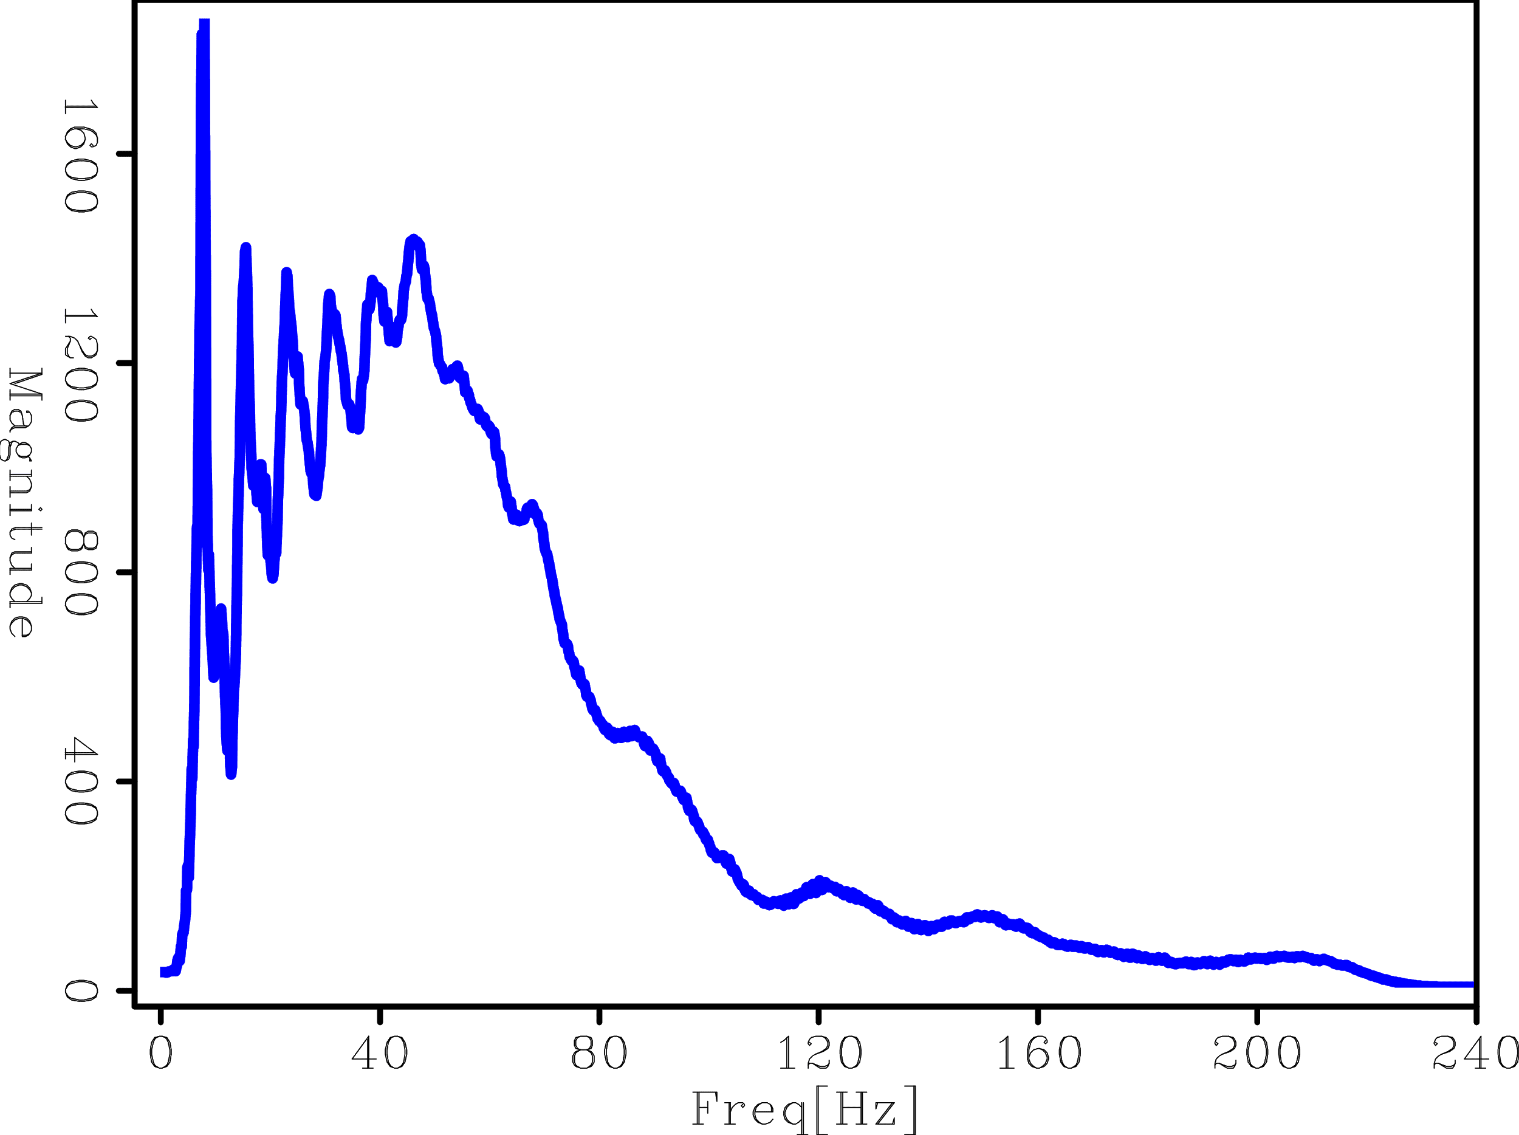
Field data has limited bandwidth
Notes:
Particularly for the deeper areas of the model where high frequencies have been attenuated.

Slide 14
Field data has limited bandwidth
Notes:
Particularly for the deeper areas of the model where high frequencies have been attenuated.

Slide 15
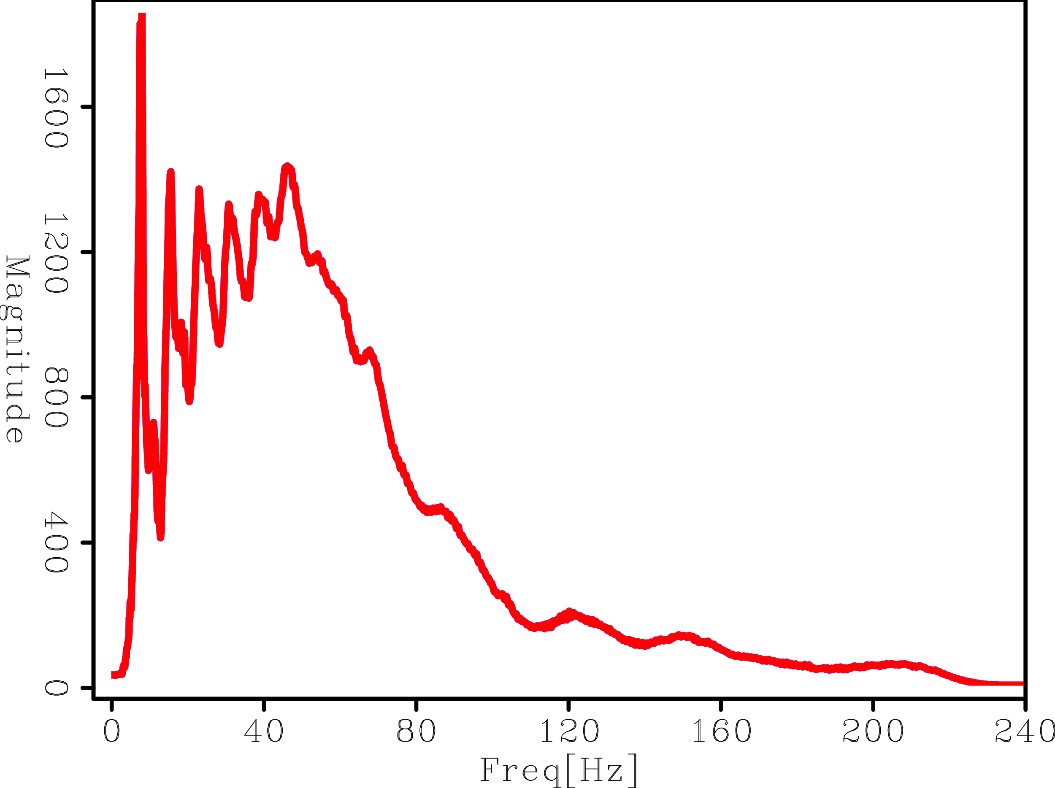
Field data has limited bandwidth
Notes:
Particularly for the deeper areas of the model where high frequencies have been attenuated.

Slide 16
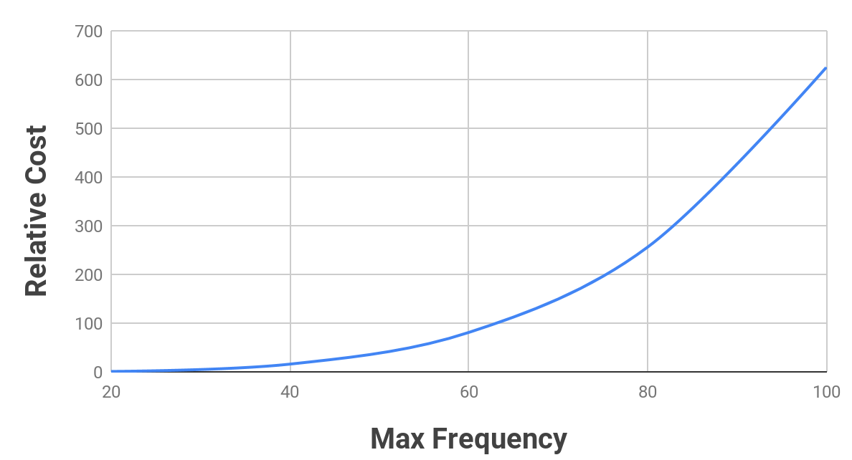
Relative FWI cost
1
Notes:
Using constant CFL and dispersion values for each frequency

Slide 17
Relative FWI cost
625x more expensive than 20Hz!
1
Notes:
Using constant CFL and dispersion values for each frequency

Slide 18
Instead of treating all areas the same ...
6
8
10
12
X [km]
2
4
6
Z [km]
Figure: Xukai Shen, “Salt model building at Atlantis with Full Waveform Inversion“, SEG 2017

Slide 19
Treat salt as a cohesive body
6
8
10
12
X [km]
2
4
6
Z [km]
Figure: Xukai Shen, “Salt model building at Atlantis with Full Waveform Inversion“, SEG 2017

Slide 20
How do we keep track of these sharp boundaries?

Slide 21
Track every point on the salt boundary?
6
8
10
12
X [km]
2
4
6
Z [km]
Figure: Xukai Shen, “Salt model building at Atlantis with Full Waveform Inversion“, SEG 2017

Slide 22
Drawback: Distributing points is not intuitive

Slide 23
Drawback: Sharp corners become tricky

Slide 24
Drawback: Merging/separating bodies is difficult

Slide 25
I am going to use level sets

Slide 26
I am going to use level sets
What are level sets?
Notes:
Osher and Sethian, Berkeley 1990’s. Used in fluid dynamics, aerospace engineering, medical imaging, etc

Slide 27
SALT

Slide 28
SALT
Implicit surface

Slide 29
SALT
Level set
Implicit surface

Slide 30
SALT
Level set
Implicit surface

Slide 31
SALT
SALT
Level set
Implicit surface

Slide 32
SALT
Level set
Implicit surface

Slide 33
Level set
SALT

Slide 34
Level set
SALT
Implicit surface

Slide 35
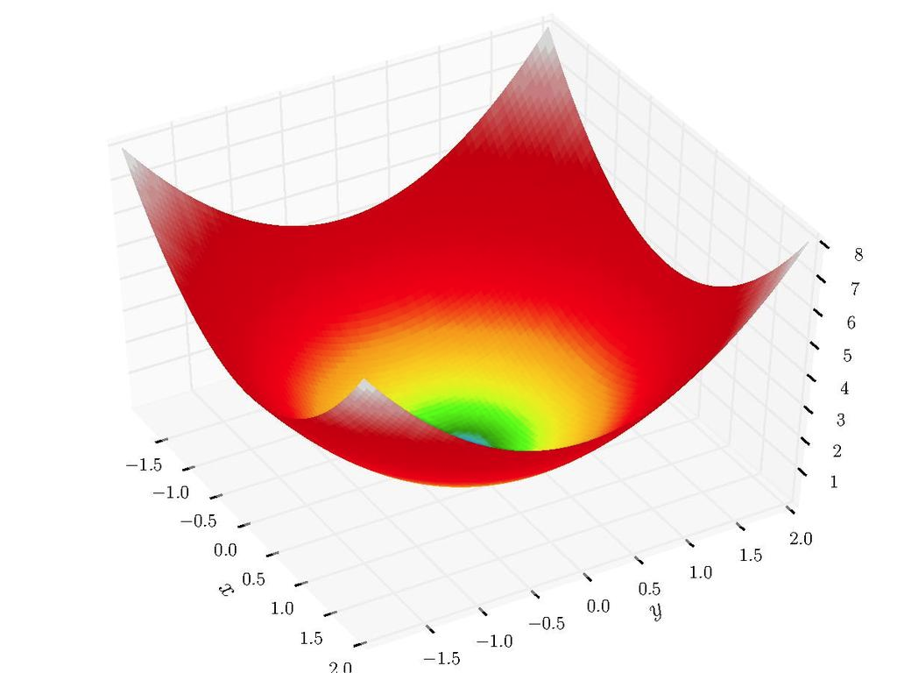
Level set
SALT
Low frequency update
Implicit surface

Slide 36
High frequency refinement
Level set
SALT
Low frequency update
Implicit surface

Slide 37
Zo
X
Z
X
SALT
Zo
Z
Notes:
A FURTHER ADVANTAGE is that we can ELEGANTLY handle TOPOLOGY CHANGES

Slide 38
Zo
X
Z
X
Zo
SALT
SALT
Z

Slide 39
Zo
X
Z
X
Zo
SALT
SALT
Z

Slide 40
How do we update the level set so that it
becomes like the real salt ?

Slide 41
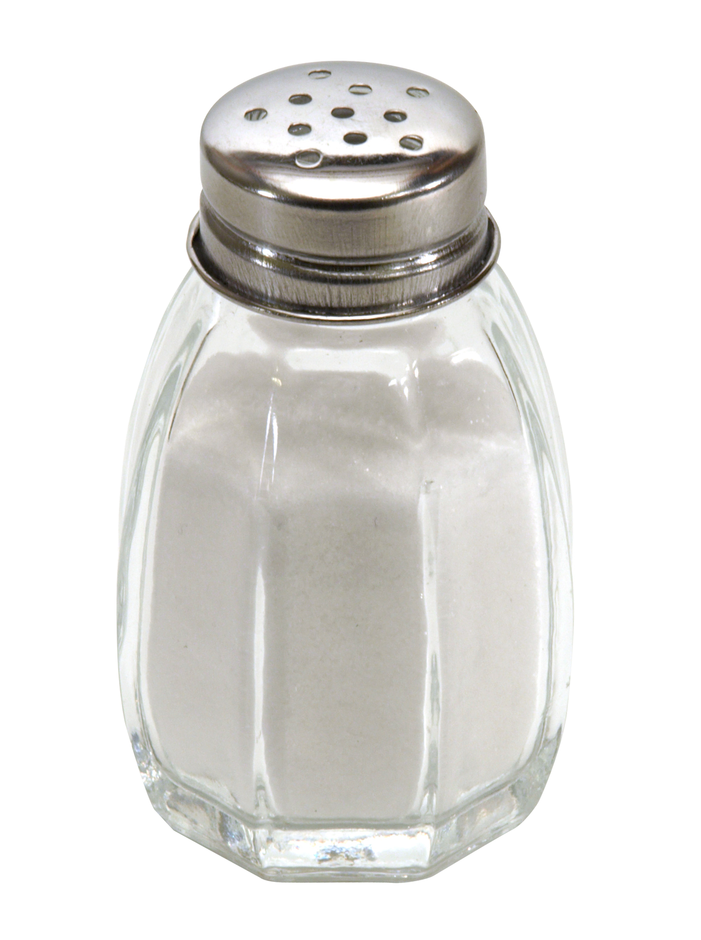
How do we update the level set so that it
becomes like the real salt ?

Slide 42
Derivation: Objective function
Typical FWI:
Notes:
To do that, we need to define our objective function. The typical FWI objective function...

Slide 43
Derivation: Objective function
Typical FWI:
L2 Norm
Notes:
Explain Psi more, as well as each term
Dobs = pressure data

Slide 44
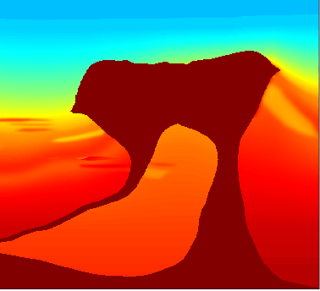
Derivation: Objective function
Typical FWI:
Acoustic wavespeed model
Notes:
Explain Psi more, as well as each term
Dobs = pressure data

Slide 45
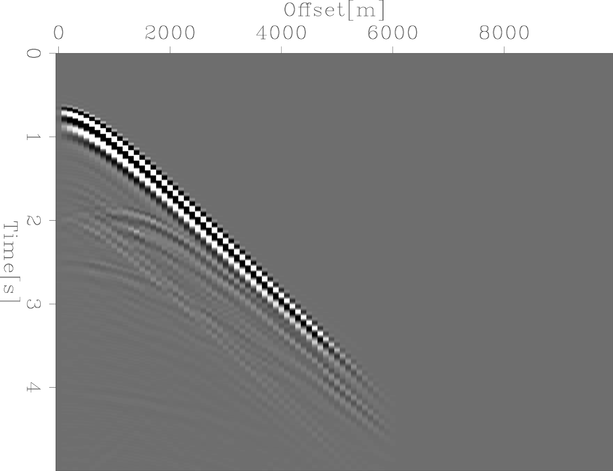
Derivation: Objective function
Typical FWI:
Synthetic data modeling

Slide 46
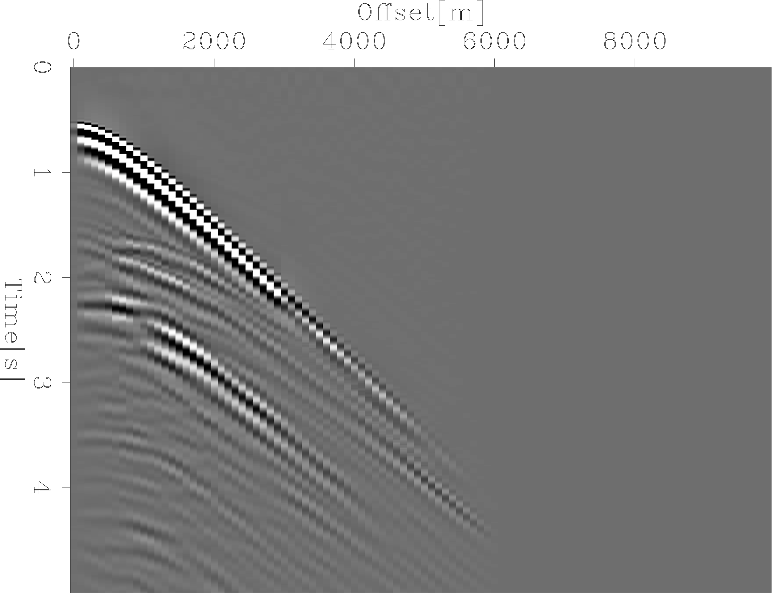
Derivation: Objective function
Typical FWI:
Observed acoustic data

Slide 47
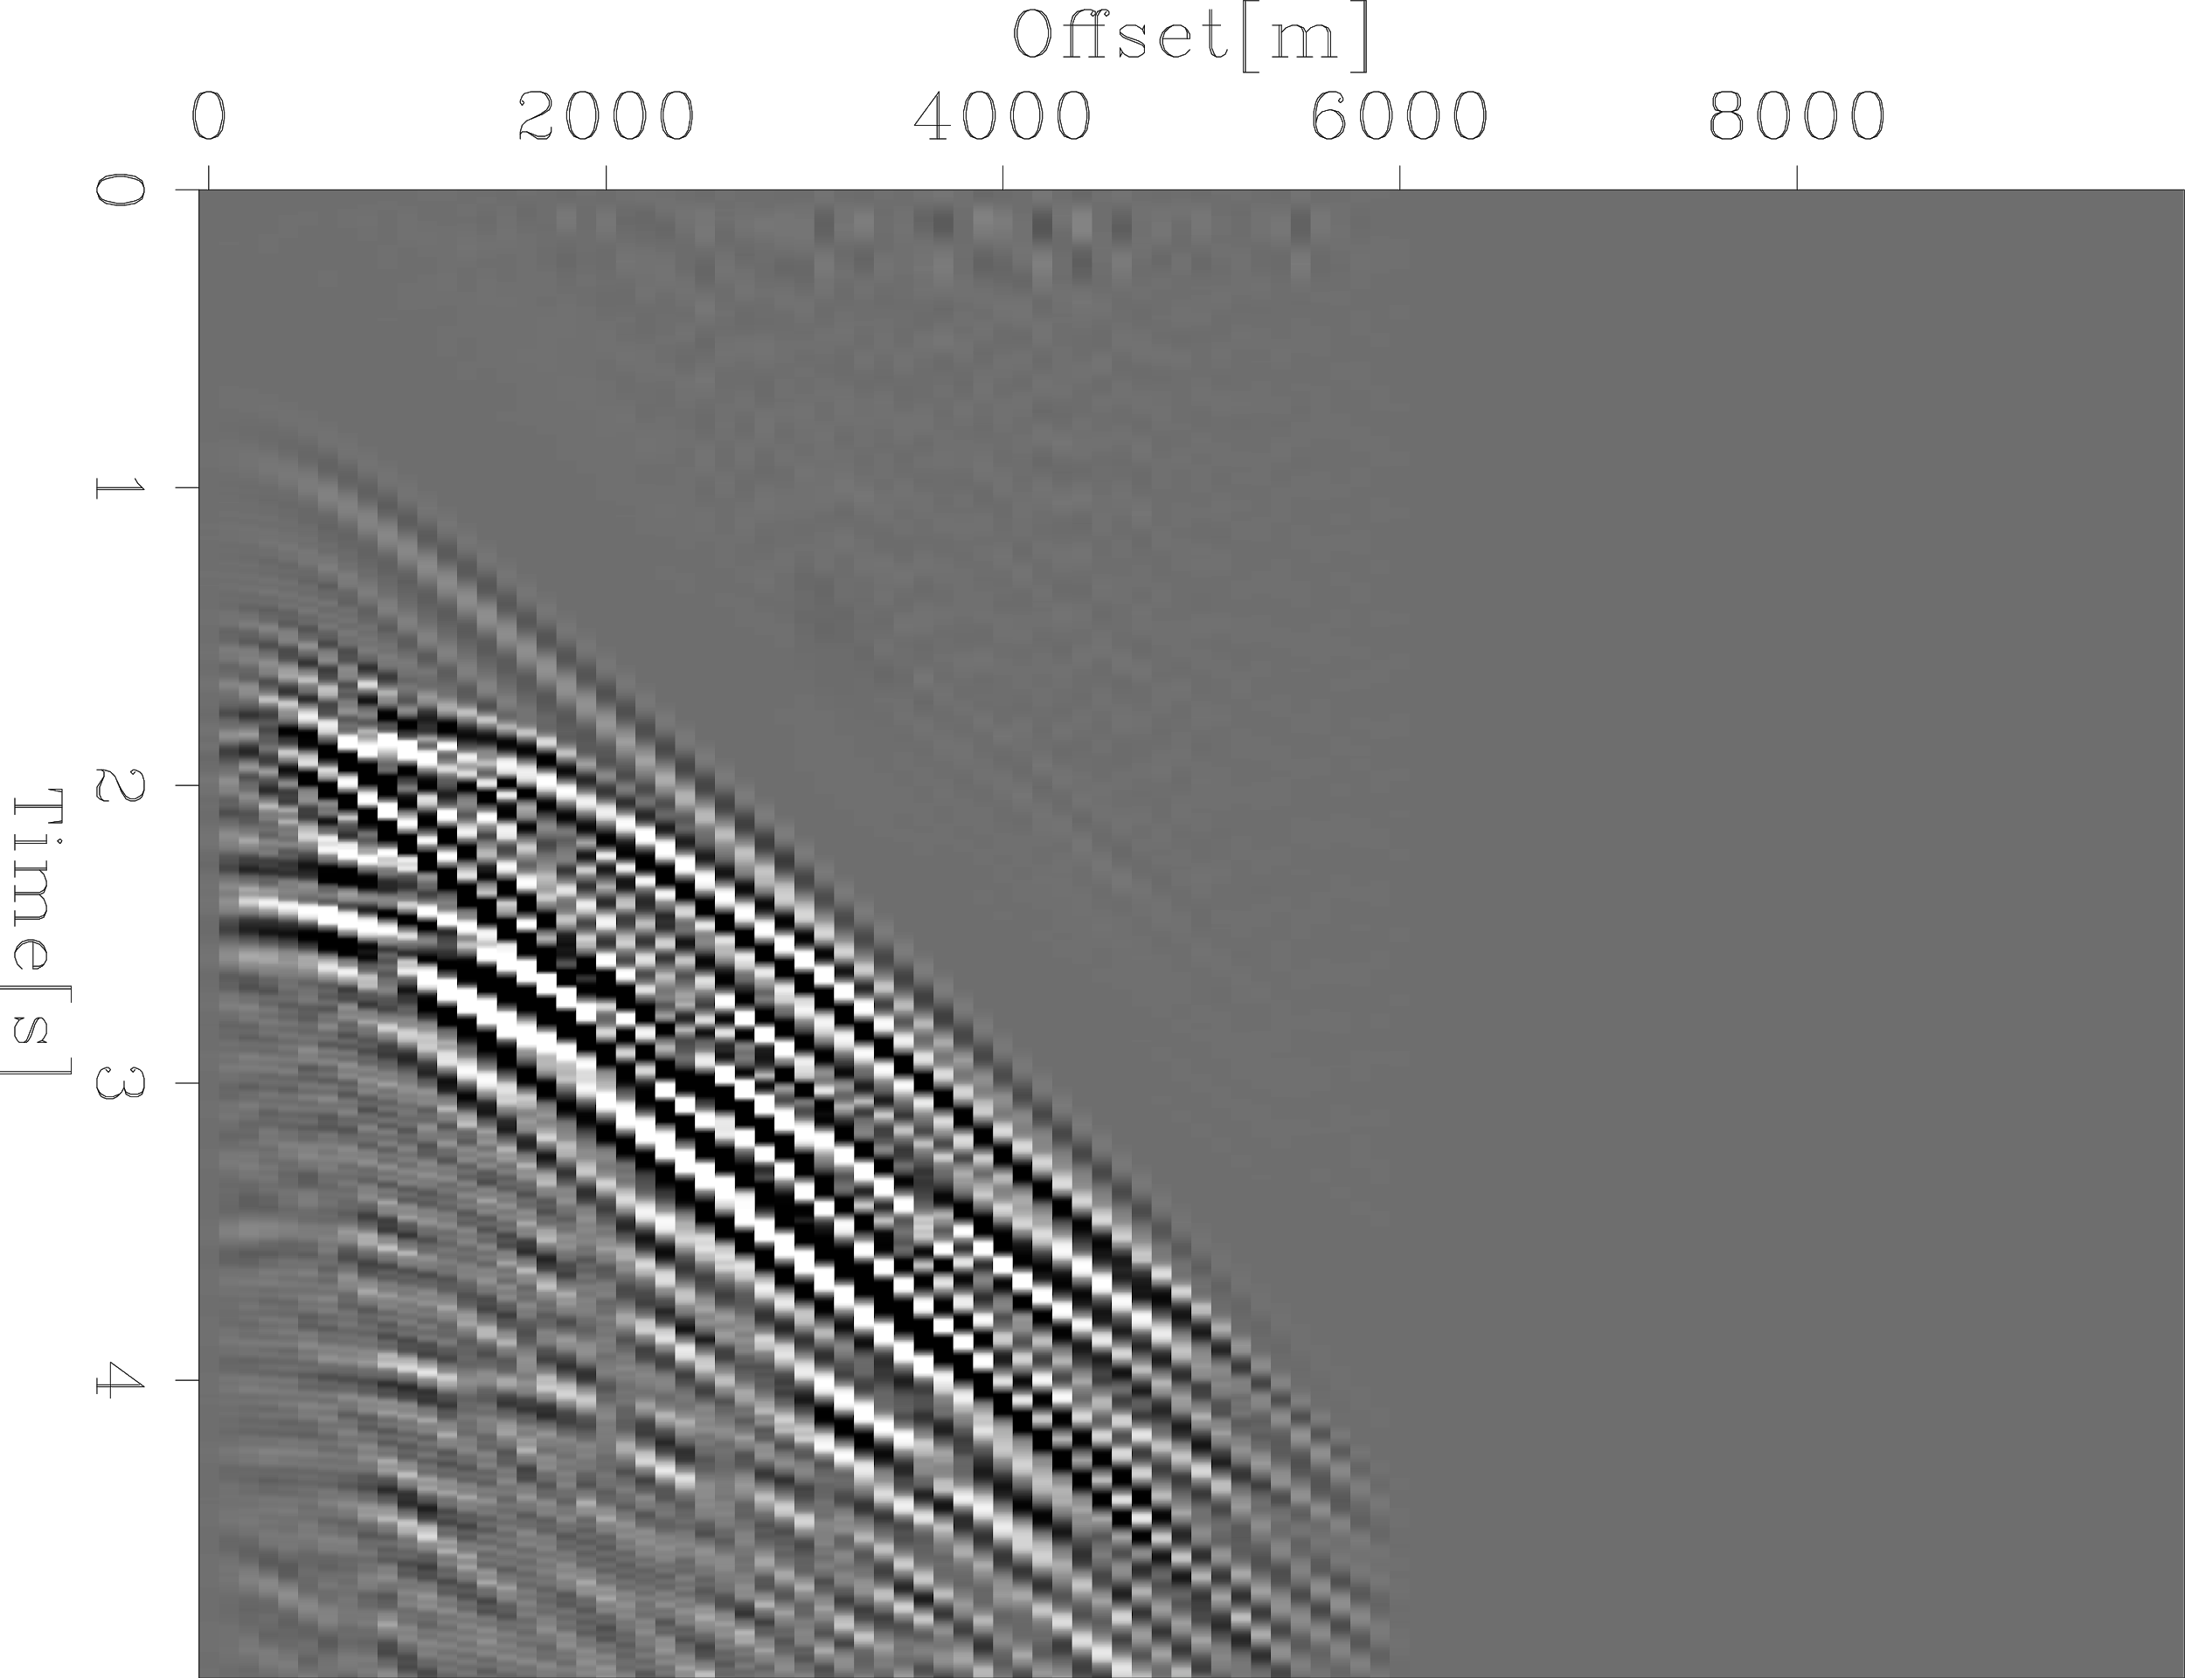
Derivation: Objective function
Typical FWI:
Data residual

Slide 48
Derivation: Objective function
Typical FWI:
First derivative = Gradient
Notes:
Explain this stuff more….
Define M (velocity, acoustic)
Show the minimum amount of equations to explain how the Hessian relates
Clarify: NOT GN, buut FULL HESSIAN
We have a non-linear problem, we have second order effects.
Massive cross talk between phi and B, and thats the non-linearity

Slide 49
Derivation: Objective function
Typical FWI:
First derivative = Gradient
Second derivative = Hessian
Notes:
Explain this stuff more….
Define M (velocity, acoustic)
Show the minimum amount of equations to explain how the Hessian relates
Clarify: NOT GN, buut FULL HESSIAN
We have a non-linear problem, we have second order effects.
Massive cross talk between phi and B, and thats the non-linearity

Slide 50
Derivation: Objective function
Level set FWI:
Notes:
Explain this stuff more….
Define M (velocity, acoustic)
Show the minimum amount of equations to explain how the Hessian relates
Clarify: NOT GN, buut FULL HESSIAN
We have a non-linear problem, we have second order effects.
Massive cross talk between phi and B, and thats the non-linearity

Slide 51
Derivation: New model space

Slide 52
Derivation: New model space
Implicit surface

Slide 53
Derivation: New model space
Salt velocity
Implicit surface

Slide 54
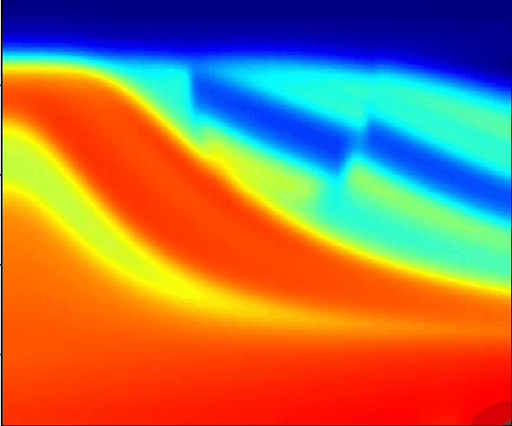
Derivation: New model space
Salt velocity
Implicit surface
Background velocity

Slide 55
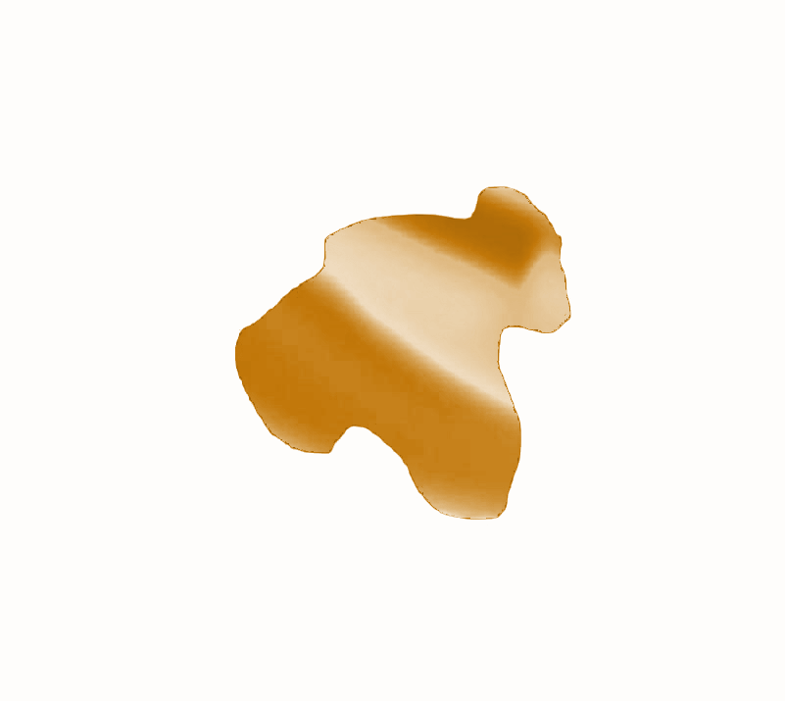
Derivation: New model space
(Approximate) Heaviside function
Salt body overlay
Background velocity

Slide 56
Derivation: New model space
Full acoustic velocity
Salt body overlay
Background velocity

Slide 57
Derivation: Gradient
Notes:
Fix this resulting phi gradient image

Slide 58
Derivation: Gradient
Notes:
Fix this resulting phi gradient image

Slide 59
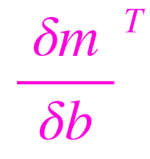
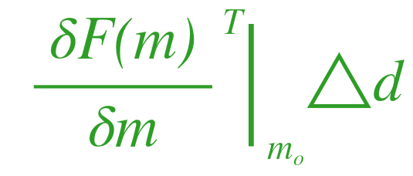
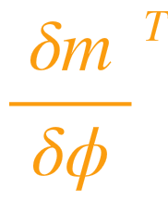
Derivation: Gradient
*
*
Notes:
Fix this resulting phi gradient image

Slide 60
Derivation: Gradient
*
*
Notes:
Fix this resulting phi gradient image

Slide 61
Isn’t this new model space twice as big now?

Slide 62
Yes, more model parameters ....

Slide 63
Yes, more model parameters ....
But we can use less!

Slide 64
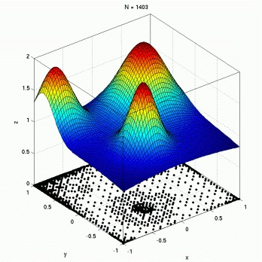
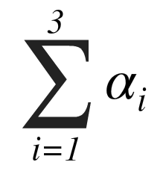
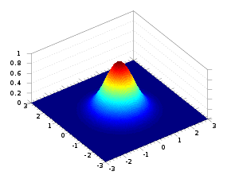
Build implicit surface with Radial Basis Functions (RBFs)
3
=
Image credit: http://www.it.uu.se/research/scientific_computing/project/rbf/rbfpde
Notes:
Re think how you describe the shifting of the Gaussian functions.

Slide 65
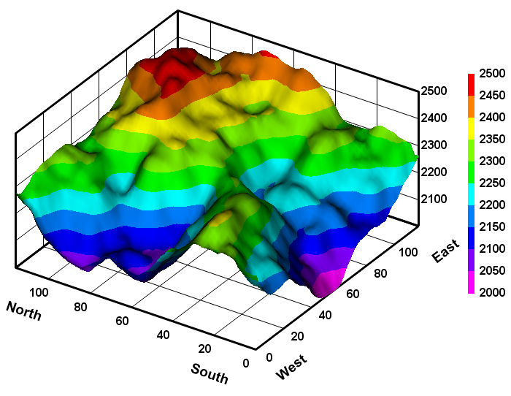
Build implicit surface with Radial Basis Functions (RBFs)
100
=
Image credit: http://www.dplot.com/features.htm

Slide 66
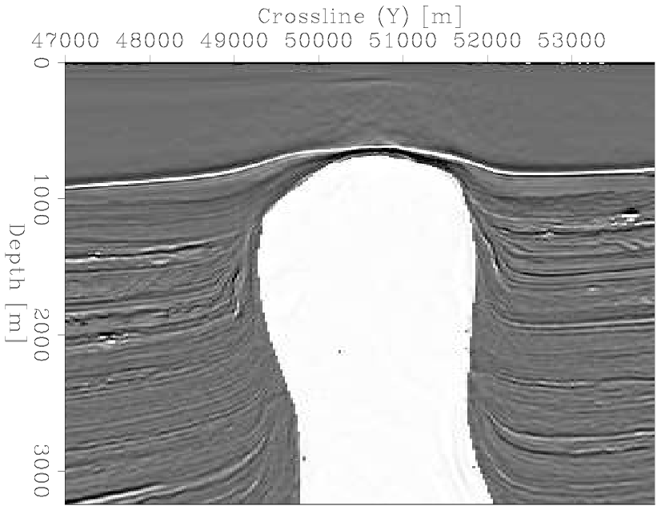
Notes:
To demonstrate, I want to show a simple 2D salt model IN WHITE

Slide 67
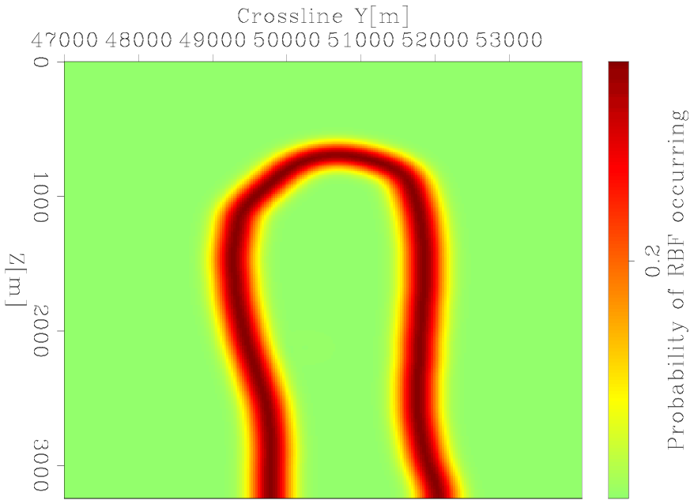
Notes:
Where I’ve created some PROBABILITY DISTRIBUTION of where I want to randomly place the RBFS

Slide 68
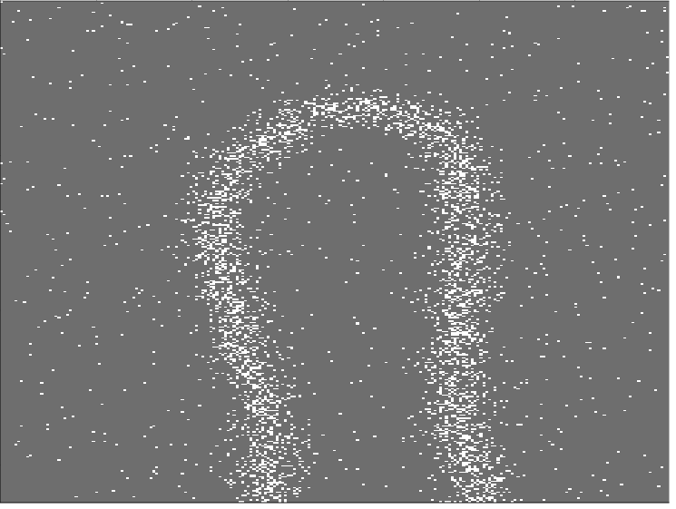

Slide 69
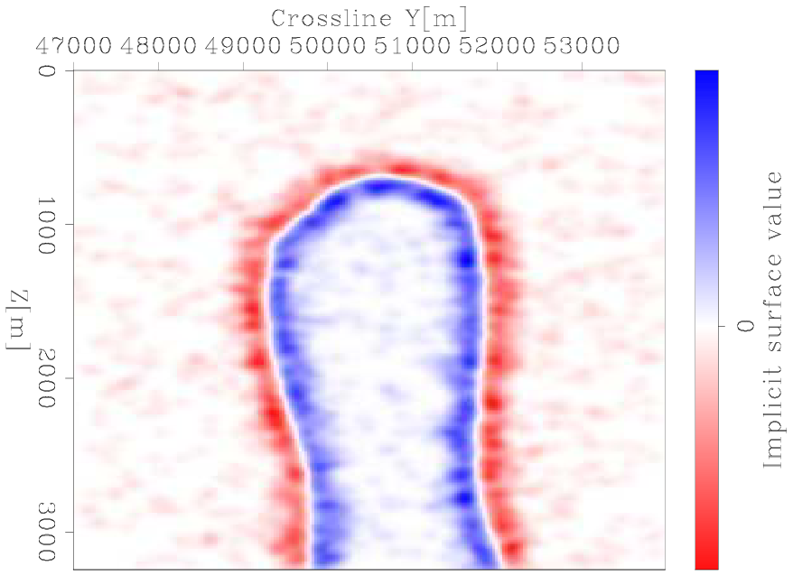

Slide 70
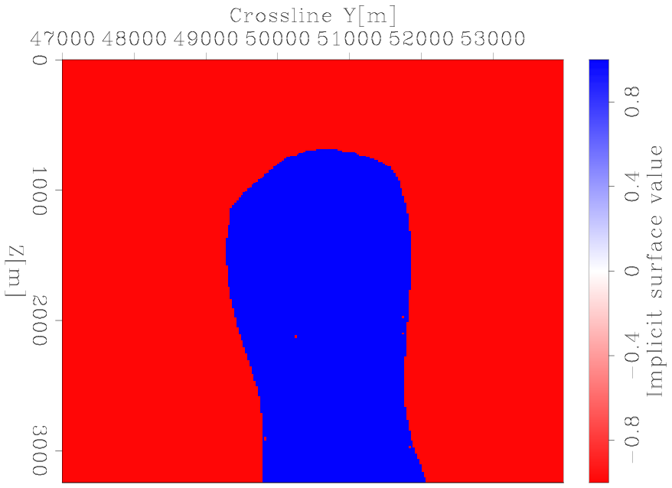

Slide 71
Reduced model parameters by ~98%

Slide 72
Do RBFs help improve the inversion outcome?
Notes:
HOW MUCH DO THEY ACTUALLY HELP??

Slide 73
First-order descent is okay sometimes ….
Notes:
One important part of our workflow

Slide 74
...But Newton’s method allows us to converge faster
Notes:
One important part of our workflow

Slide 75
...But Newton’s method allows us to converge faster
Solve Newton equation

Slide 76
...But Newton’s method allows us to converge faster
Almost always use iterative methods
Notes:
Mention that We dont store H-1 since its huge

Slide 80
Smaller system solves faster!

Slide 81
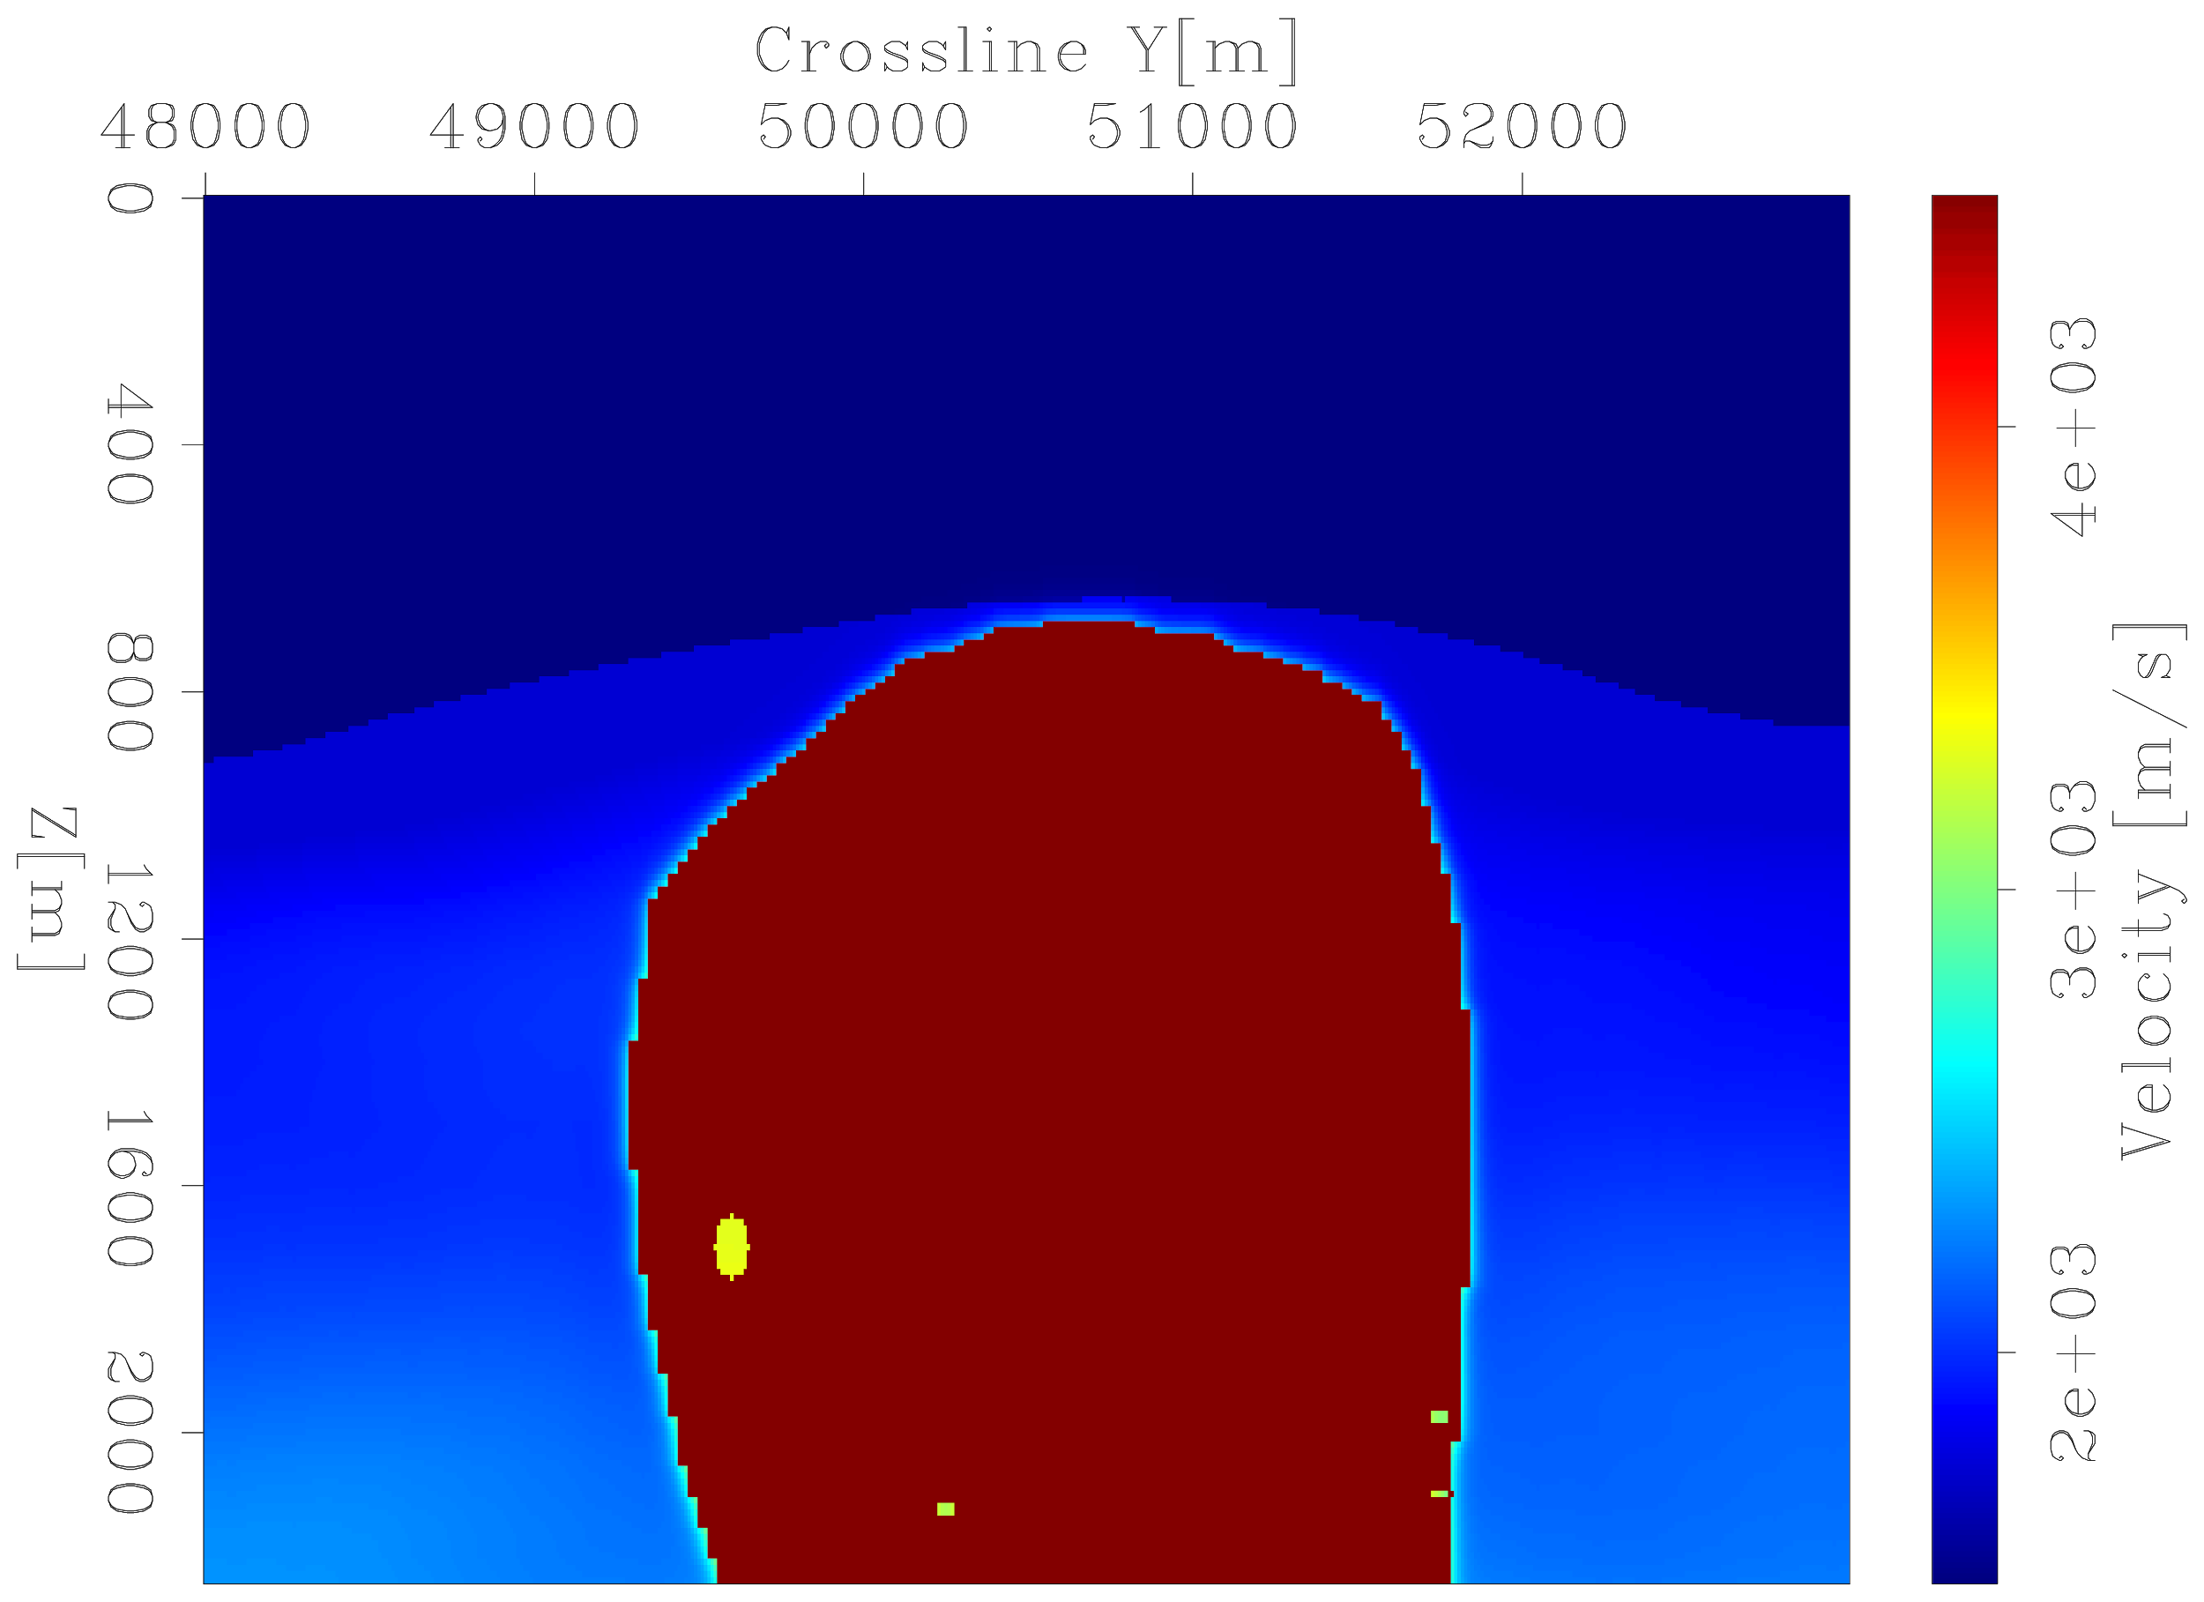
INITIAL MODEL
X [m]
Z [m]

Slide 82
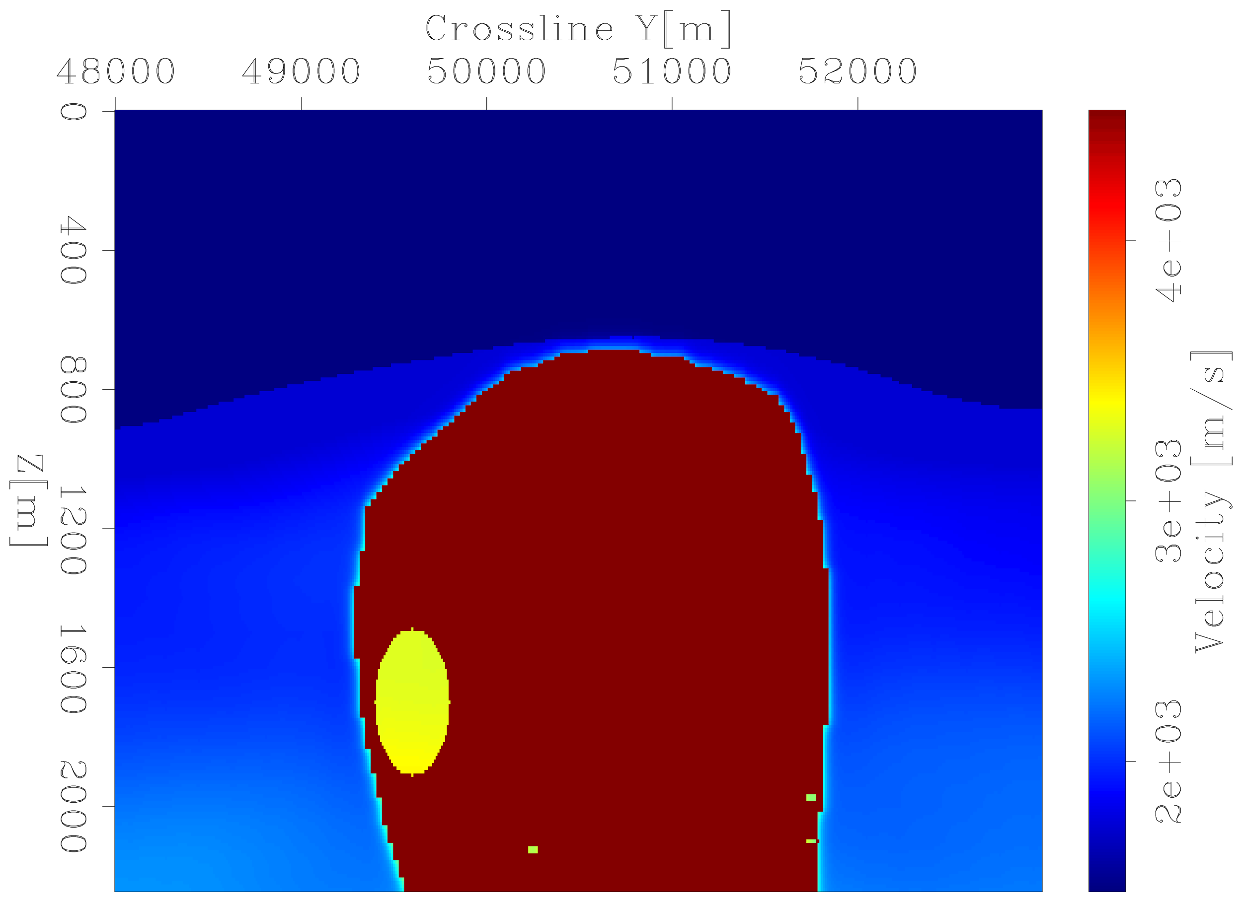
TRUE MODEL
X [m]
Z [m]

Slide 83
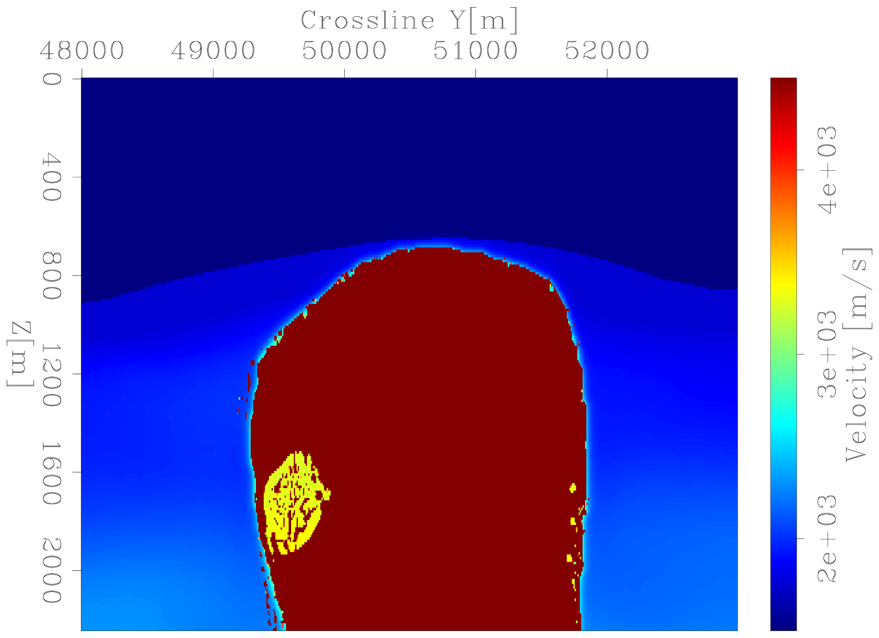
INVERTED MODEL it=30
X [m]
Without RBFs
Z [m]

Slide 84
INVERTED MODEL it=30
X [m]
With RBFs
Z [m]

Slide 85
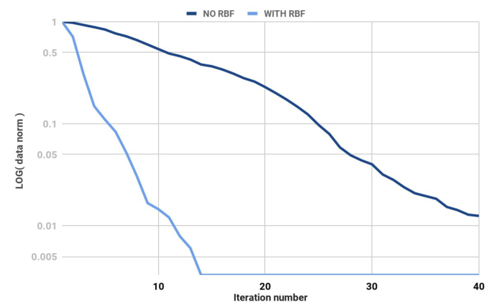
DATA RESIDUAL NORM
Normalized data residual norm
Without RBFs
With RBFs
Iteration

Slide 86
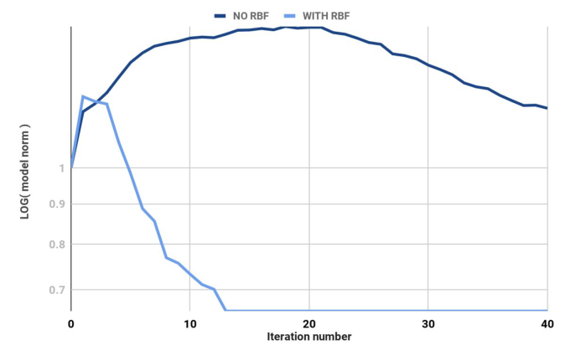
MODEL RESIDUAL NORM
Without RBFs
Normalized model residual norm
With RBFs
Iteration
Notes:
With RBFs we get a much better outcome than we do without

Slide 87
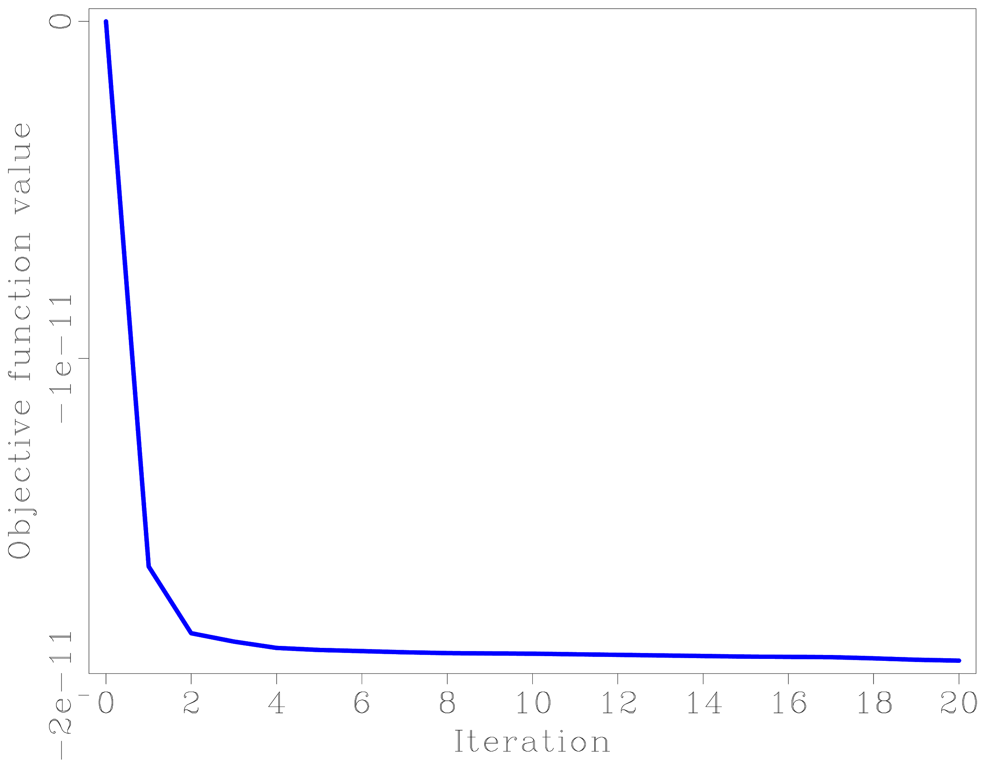
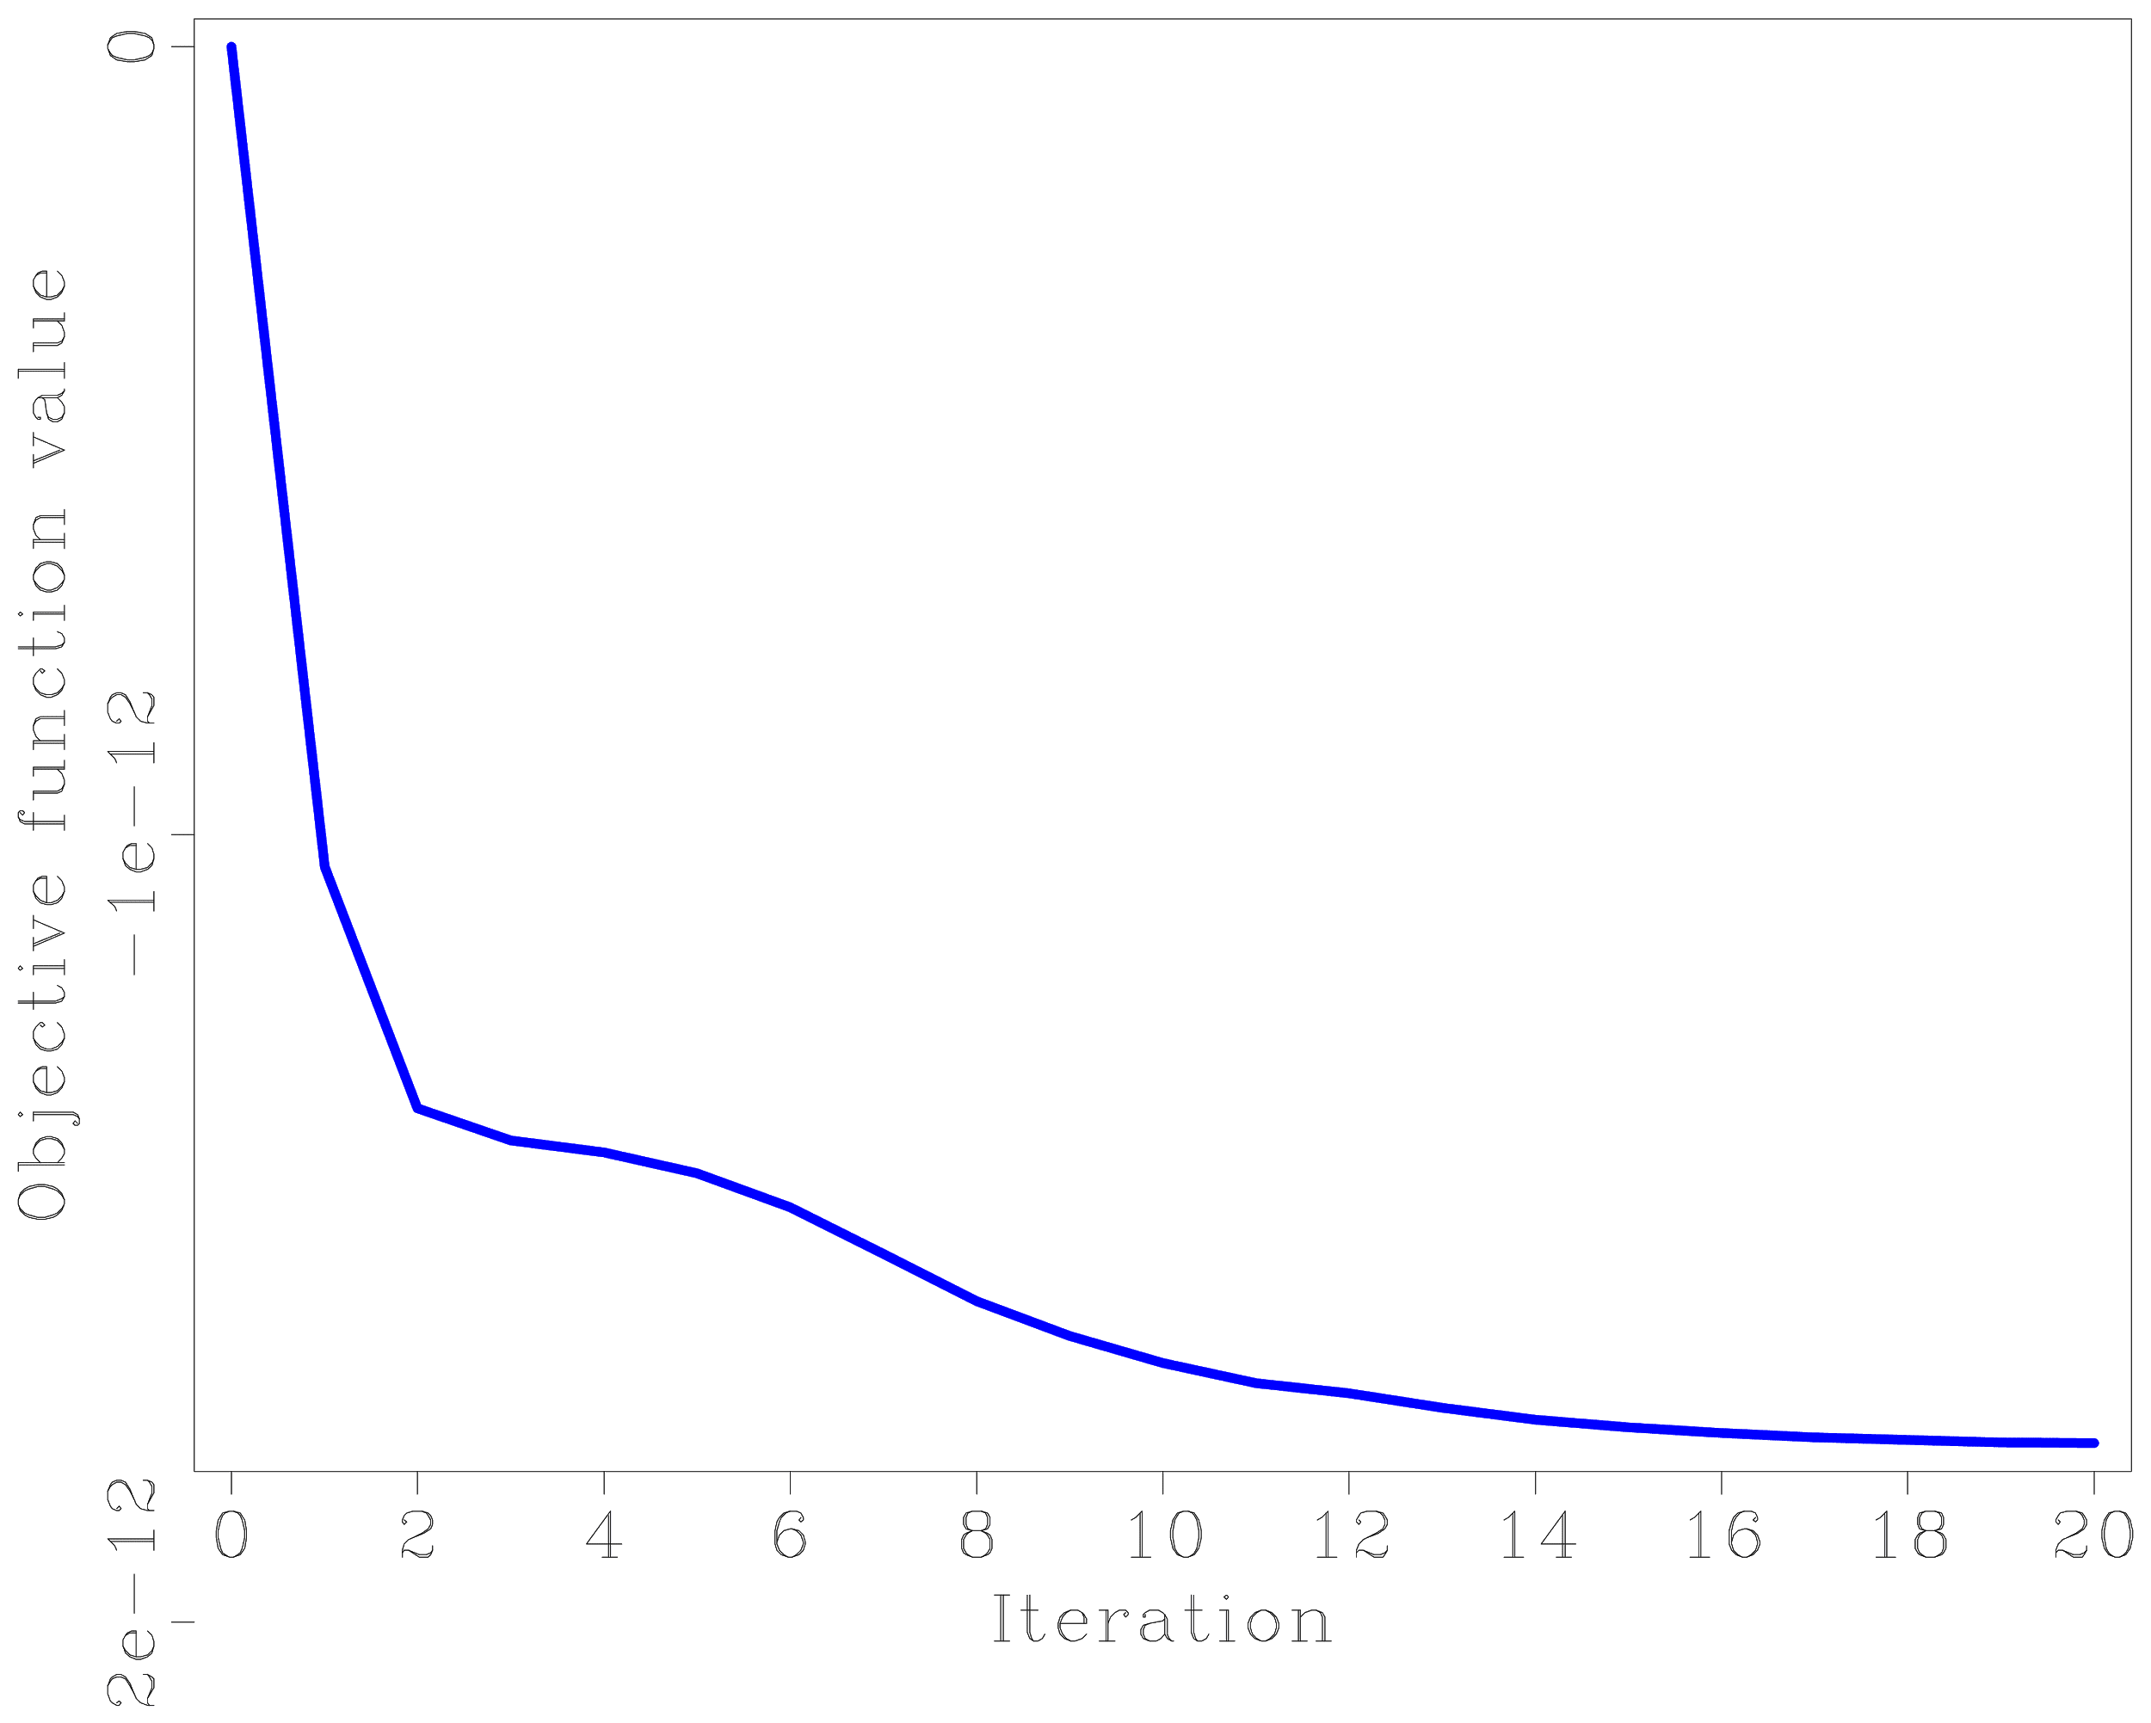
Search direction inversion is better!
With RBFS
Without RBFS

Slide 88
Is there any way we can include human input into our inversion?

Slide 89
BIG OIL, Ltd
Water
Salt

Slide 90
BIG OIL, Ltd
Water
Salt

Slide 91
BIG OIL, Ltd
Water
Salt

Slide 92
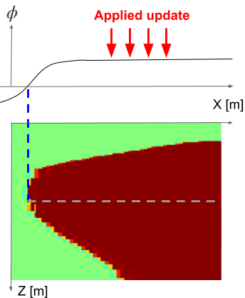
SALT

Slide 93
Uniform sensitivity
SALT

Slide 94
SALT

Slide 95
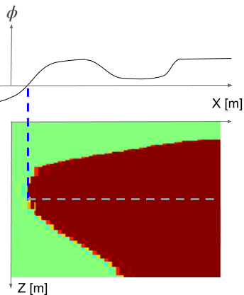
Heightened sensitivity
SALT

Slide 96
SALT

Slide 97
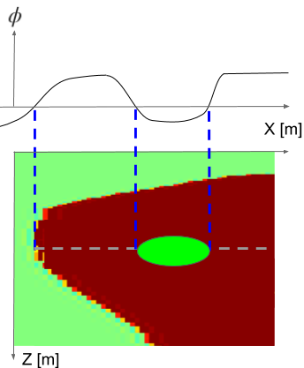
SALT

Slide 98
SALT

Slide 99
SALT

Slide 100
Wait …. can we make changes inside the salt, or only along the boundaries?

Slide 101
=
*

Slide 102
=
*

Slide 103
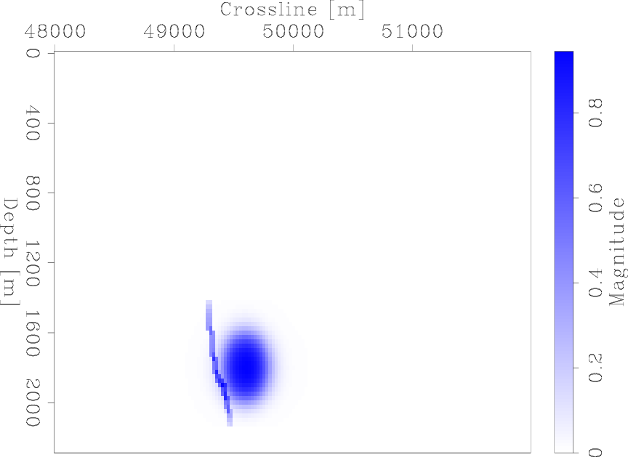
Expand the gradient footprint
X [m]
Z [m]

Slide 104
Expand the gradient footprint
X [m]
Standard masking from gradient
Z [m]

Slide 105
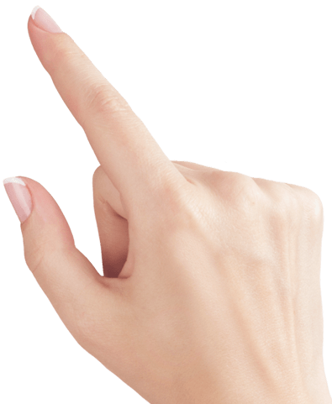
Expand the gradient footprint
X [m]
Z [m]
Interpreter input

Slide 106
How much do expanded gradients and expert guidance actually help?

Slide 107
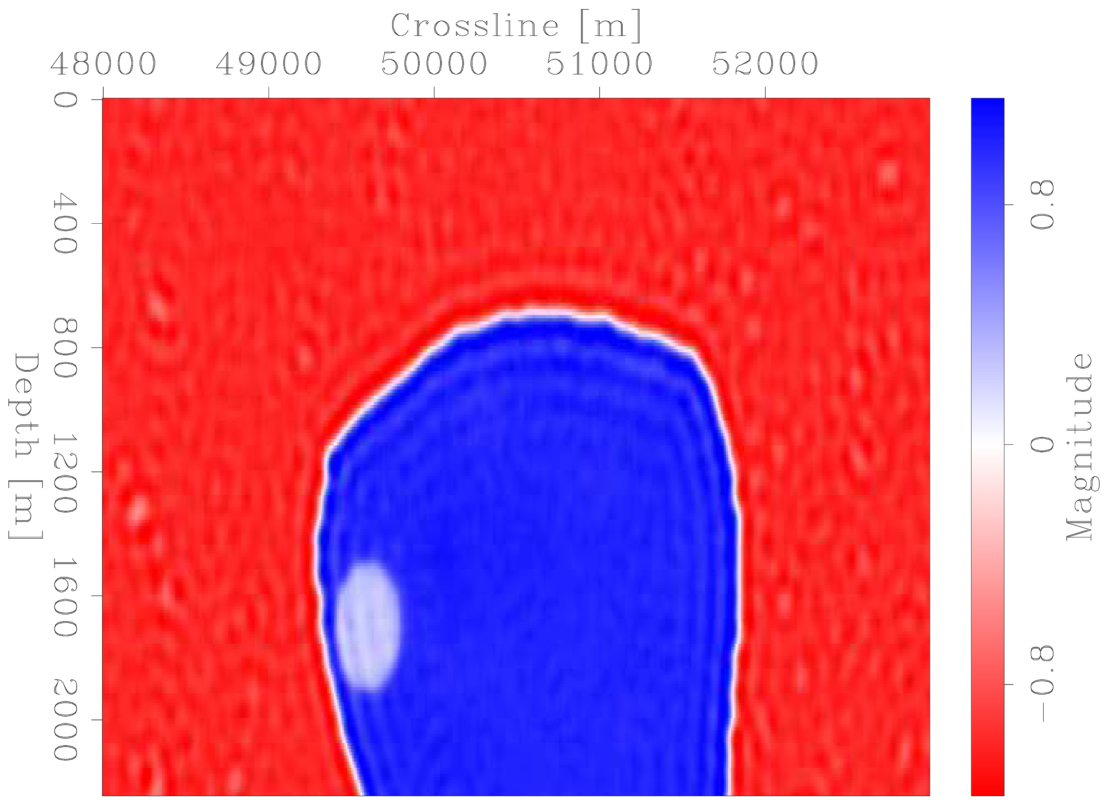
Fully guided inversion
X [m]
X [m]
Z [m]
Z [m]

Slide 108
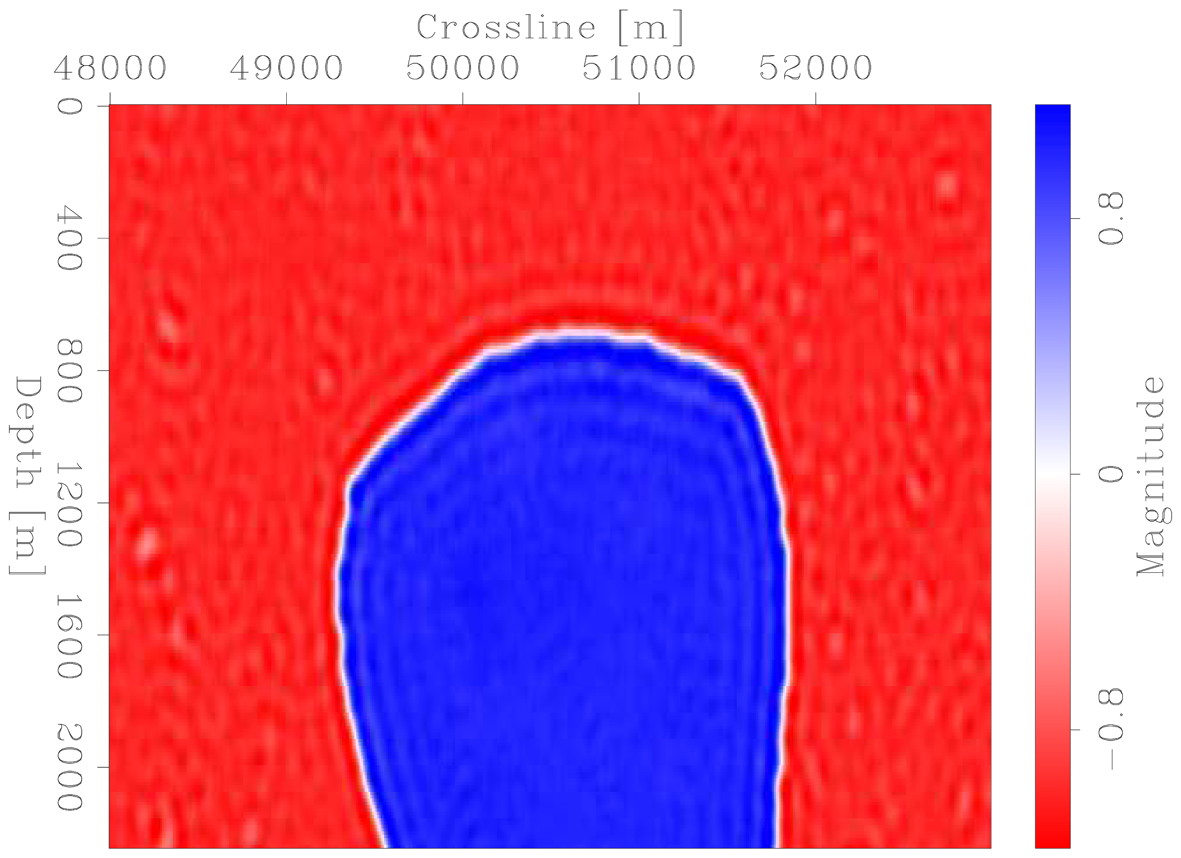
Partially guided inversion
X [m]
X [m]
Z [m]
Z [m]

Slide 109
Unguided inversion
X [m]
X [m]
Z [m]
Z [m]

Slide 110
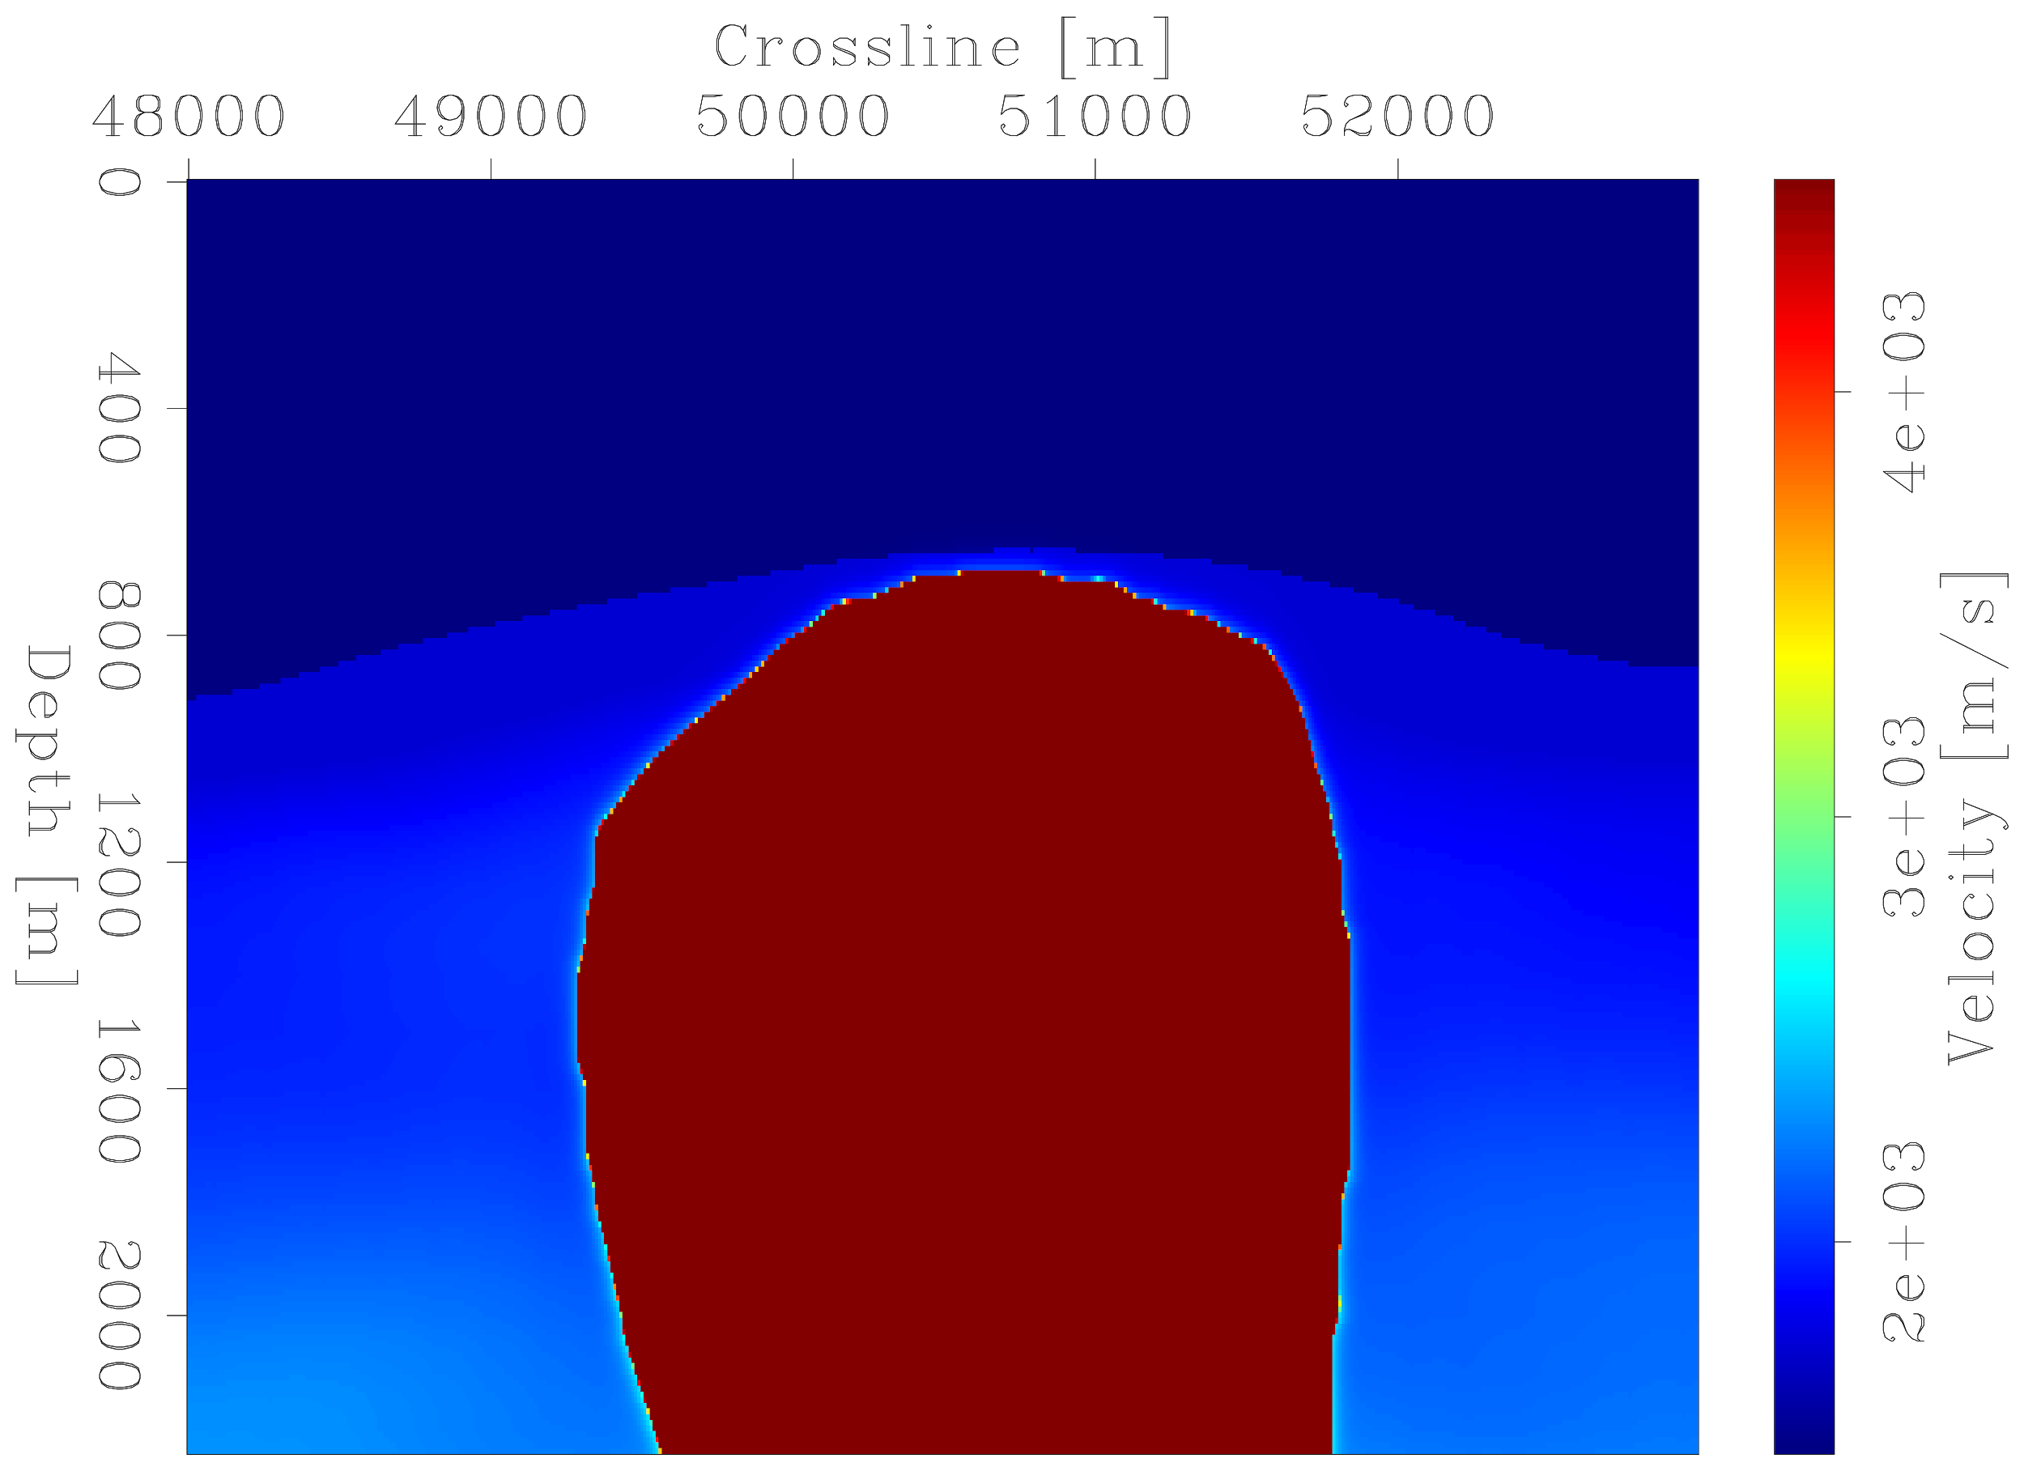
INITIAL MODEL
X [m]
Z [m]

Slide 111
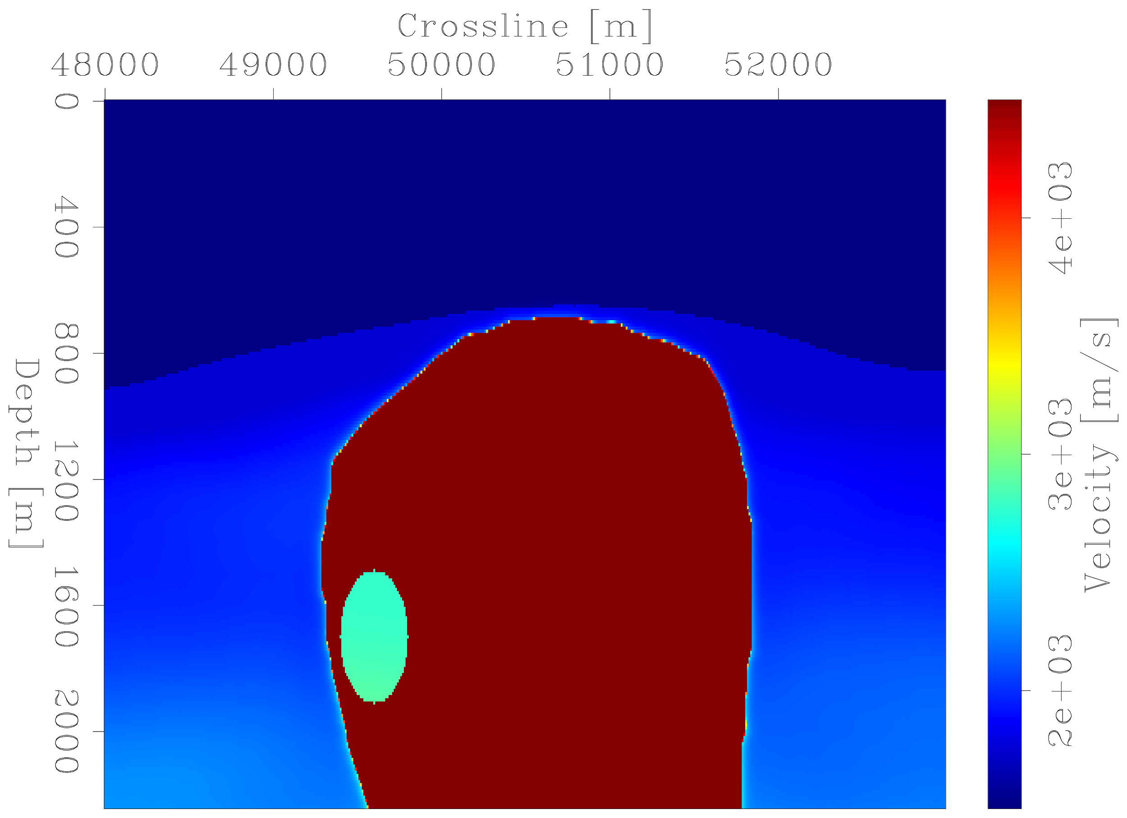
TRUE MODEL
X [m]
Z [m]

Slide 112
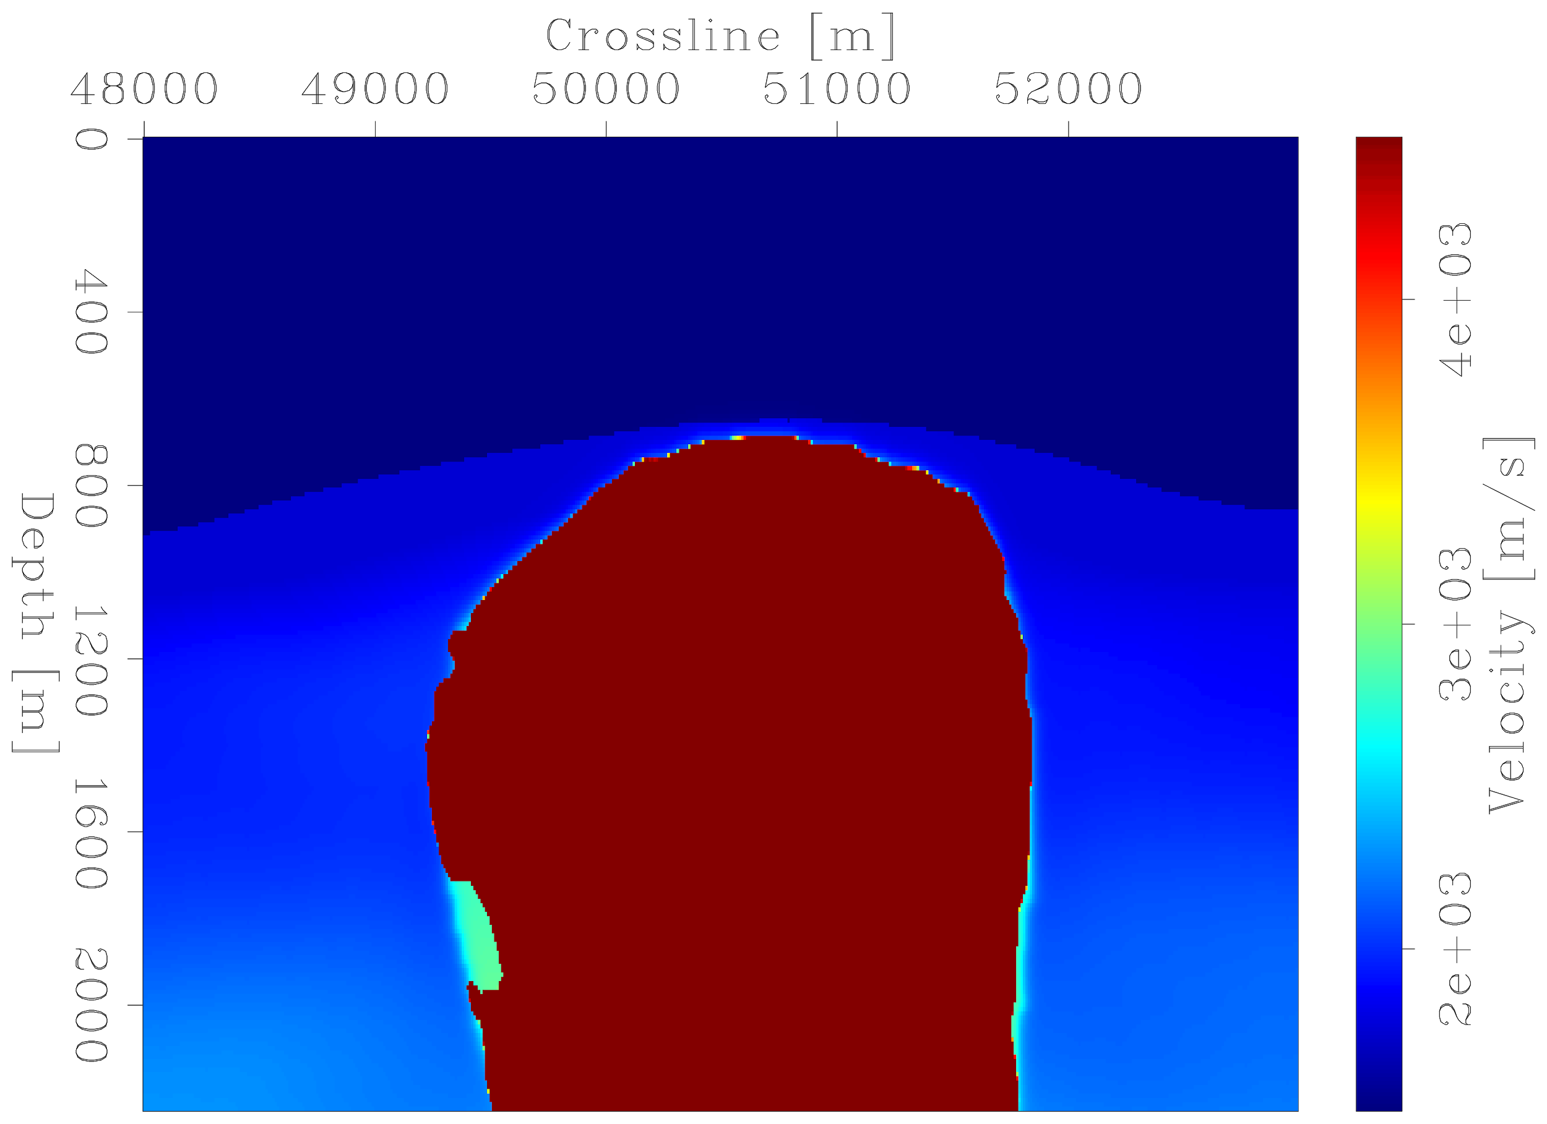
UNGUIDED Inversion result
X [m]
Iteration =15
Z [m]

Slide 113
PARTIALLY GUIDED Inversion result
X [m]
Iteration =15
Z [m]

Slide 114
FULLY GUIDED Inversion result
X [m]
Iteration =15
Z [m]

Slide 115
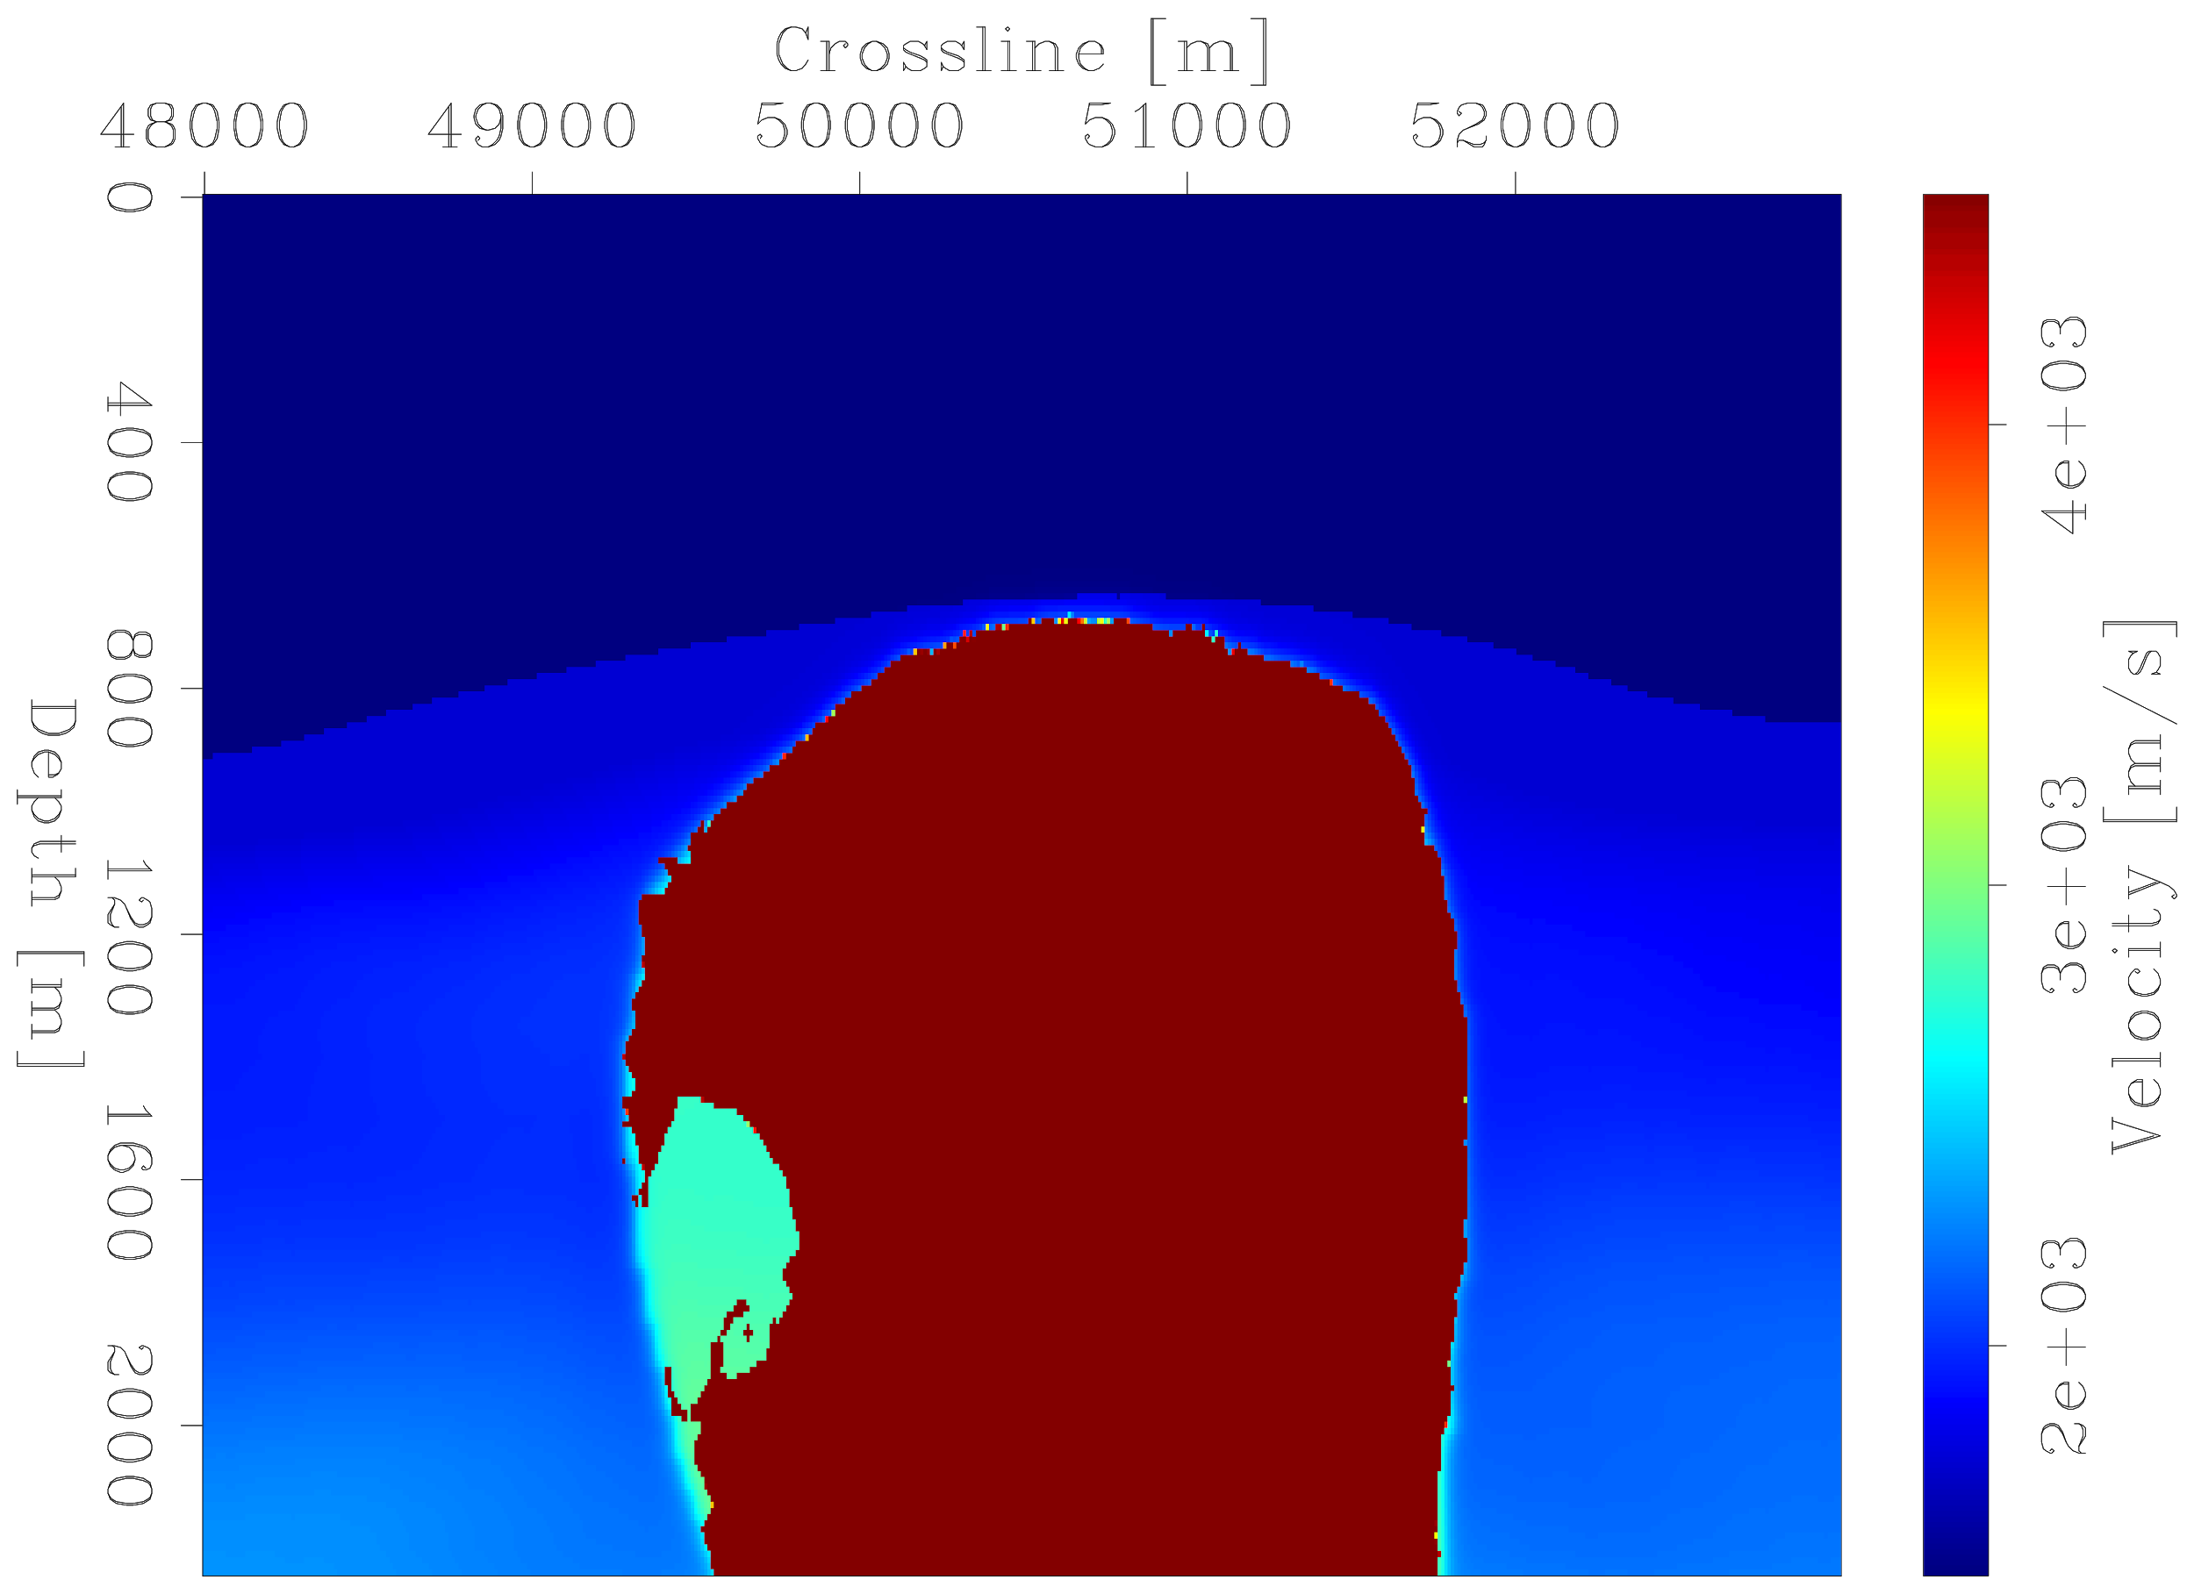
UNGUIDED Inversion result
X [m]
Iteration =65
Z [m]

Slide 116
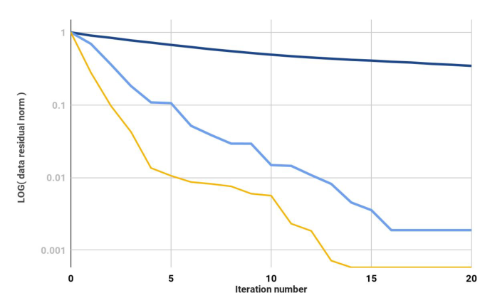
DATA NORM
Unguided
Normalized data residual norm
Partially guided
Fully guided
Iteration

Slide 117
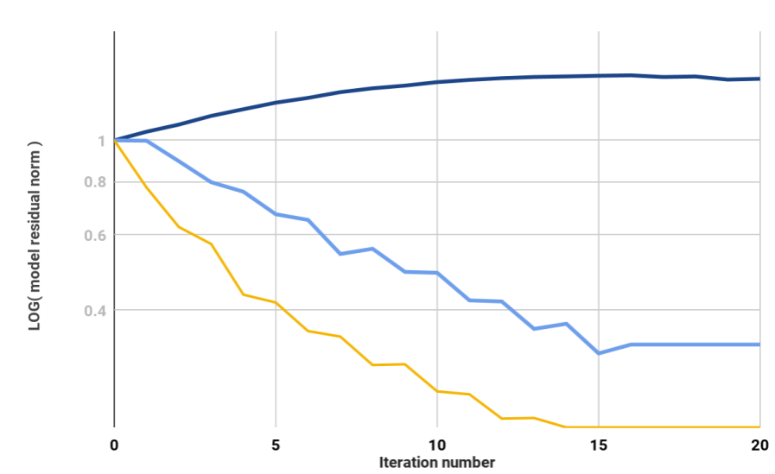
MODEL NORM
Unguided
Normalized model residual norm
Partially guided
Fully guided
Iteration

Slide 118
How well does any of this work on real data?

Slide 119
Application to 3D field data
Provided by Shell Exploration & Production Company
Notes:
Shell Exploration & Production Company

Slide 120
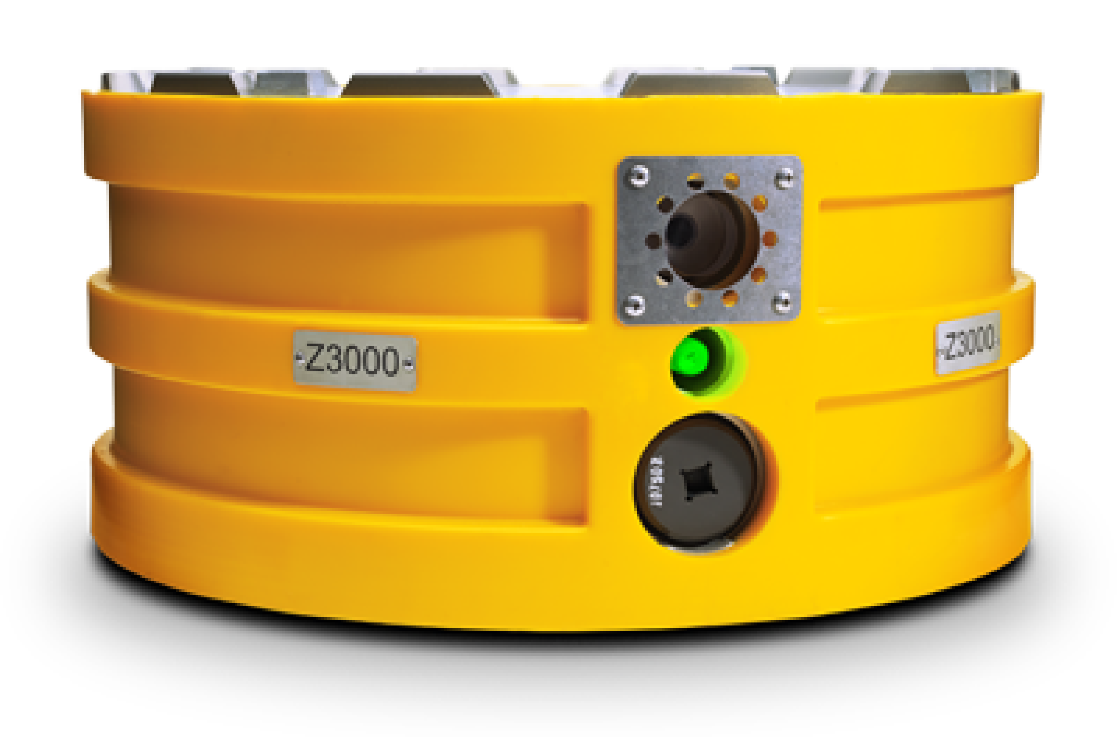
Application to 3D field data
Provided by Shell Exploration & Production Company
OBN (ocean bottom-node) survey (2010)
Notes:
Shell Exploration & Production Company

Slide 121
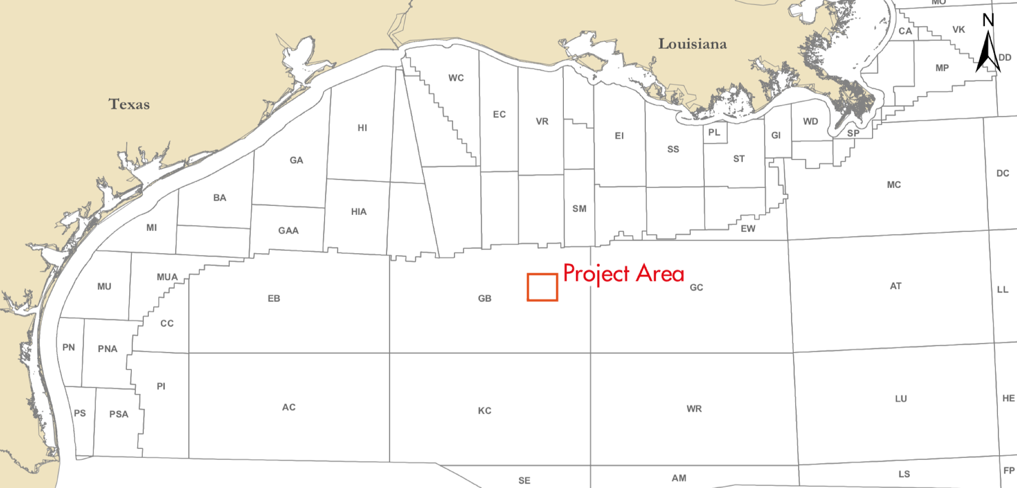
Application to 3D field data
Provided by Shell Exploration & Production Company
OBN (ocean bottom-node) survey (2010)
Gulf of Mexico, offshore Louisiana
Notes:
Shell Exploration & Production Company

Slide 122
AIRGUN SOURCE

Slide 123
Oblique view of survey area

Slide 124
Oblique view of survey area
Survey extent

Slide 125
Oblique view of survey area
Salt column

Slide 126
Y [m]
X [m]

Slide 127
Salt diapir
Y [m]
X [m]

Slide 128
Ocean bottom nodes
Y [m]
X [m]

Slide 129
Shooting lines
Y [m]
X [m]

Slide 130
Production platform
Y [m]
X [m]

Slide 131
Y [m]
6,545,039 traces
~ 22,000 shots/node
X [m]

Slide 132
STEP 1: Image the data

Slide 133
Migration velocity model
X [m]
Z [m]
Notes:
Salt diapir

Slide 134
Migration velocity model
Y [m]
X [m]
Notes:
Smoothed in slowness

Slide 135
Reverse-Time Migration (RTM) (Stanford)
Z [m]
X [m]
Y [m]

Slide 136
Reverse-Time Migration (RTM) (Shell)
Z [m]
X [m]
Y [m]

Slide 137
Reverse-Time Migration (RTM) (Stanford)
X [m]
Z [m]
Notes:
214800 [m]. Mention that it’s not a 1-1 comparison. Mention that the top of salt is slightly off.

Slide 138
Reverse-Time Migration (RTM) (Shell)
X [m]
Z [m]
Notes:
214800 [m]

Slide 139
Reverse-Time Migration (RTM) (Stanford)
X [m]
Y [m]
Notes:
1770 [m]

Slide 140
Reverse-Time Migration (RTM) (Shell)
X [m]
Y [m]
Notes:
1770 [m]

Slide 141
Reverse-Time Migration (RTM) (Stanford)
Y [m]
Z [m]

Slide 142
Reverse-Time Migration (RTM) (Shell)
Y [m]
Z [m]

Slide 143
STEP 2: Run inversion

Slide 144
3D inversion results
Parameterized salt boundary using radial basis functions.
Inner-loop inversion used Gauss-Newton Hessian.
Alternated updating between background velocity and level set (salt boundary).
77 nodes used.

Slide 145
Nodes used for RTM
X [m]
Y [m]

Slide 146
Nodes used for inversion
X [m]
Y [m]

Slide 147
Implicit surface
Notes:
Window3d f4=3 n4=1 min3=214800 n3=1 min1=1000.0 max1 min2=49000 max2=50000 < tmp/tmp_inv/RTMgrad.Hcomp | Grey color=F wantscalebar=y title=" " label1="Depth[m]" label2="Crossline[m]" label3="Magnitude" gainpanel=e > /dev/null out=tomo800.v

Slide 148
Implicit surface
Notes:
Window3d f4=3 n4=1 min3=214800 n3=1 min1=1000.0 max1 min2=49000 max2=50000 < tmp/tmp_inv/RTMgrad.Hcomp | Grey color=F wantscalebar=y title=" " label1="Depth[m]" label2="Crossline[m]" label3="Magnitude" gainpanel=e > /dev/null out=tomo800.v

Slide 149
Background velocity model
Notes:
Window3d f4=3 n4=1 min3=214800 n3=1 min1=1000.0 max1 min2=49000 max2=50000 < tmp/tmp_inv/RTMgrad.Hcomp | Grey color=F wantscalebar=y title=" " label1="Depth[m]" label2="Crossline[m]" label3="Magnitude" gainpanel=e > /dev/null out=tomo800.v

Slide 150
Synthetic modeled data
Notes:
Window3d f4=3 n4=1 min3=214800 n3=1 min1=1000.0 max1 min2=49000 max2=50000 < tmp/tmp_inv/RTMgrad.Hcomp | Grey color=F wantscalebar=y title=" " label1="Depth[m]" label2="Crossline[m]" label3="Magnitude" gainpanel=e > /dev/null out=tomo800.v

Slide 151
Data residual
Notes:
Window3d f4=3 n4=1 min3=214800 n3=1 min1=1000.0 max1 min2=49000 max2=50000 < tmp/tmp_inv/RTMgrad.Hcomp | Grey color=F wantscalebar=y title=" " label1="Depth[m]" label2="Crossline[m]" label3="Magnitude" gainpanel=e > /dev/null out=tomo800.v

Slide 152
Gradient
Notes:
Window3d f4=3 n4=1 min3=214800 n3=1 min1=1000.0 max1 min2=49000 max2=50000 < tmp/tmp_inv/RTMgrad.Hcomp | Grey color=F wantscalebar=y title=" " label1="Depth[m]" label2="Crossline[m]" label3="Magnitude" gainpanel=e > /dev/null out=tomo800.v

Slide 153
Search direction: Implicit surface
Notes:
Window3d f4=3 n4=1 min3=214800 n3=1 min1=1000.0 max1 min2=49000 max2=50000 < tmp/tmp_inv/RTMgrad.Hcomp | Grey color=F wantscalebar=y title=" " label1="Depth[m]" label2="Crossline[m]" label3="Magnitude" gainpanel=e > /dev/null out=tomo800.v

Slide 154
Search direction: Background velocity
Notes:
Window3d f4=3 n4=1 min3=214800 n3=1 min1=1000.0 max1 min2=49000 max2=50000 < tmp/tmp_inv/RTMgrad.Hcomp | Grey color=F wantscalebar=y title=" " label1="Depth[m]" label2="Crossline[m]" label3="Magnitude" gainpanel=e > /dev/null out=tomo800.v

Slide 155
Implicit surface iteration=0
X [m]
Z [m]

Slide 156
Implicit surface iteration=1
X [m]
Z [m]

Slide 157
Implicit surface iteration=5
X [m]
Z [m]

Slide 158
Implicit surface iteration=10
X [m]
Z [m]

Slide 159
Implicit surface iteration=20
X [m]
Z [m]

Slide 160
Implicit surface iteration=30
X [m]
Z [m]

Slide 161
Implicit surface iteration=35
X [m]
Z [m]

Slide 162
Velocity model iteration=0
X [m]
Z [m]

Slide 163
Velocity model iteration=1
X [m]
Z [m]

Slide 164
Velocity model iteration=5
X [m]
Z [m]

Slide 165
Velocity model iteration=10
X [m]
Z [m]

Slide 166
Velocity model iteration=20
X [m]
Z [m]

Slide 167
Velocity model iteration=30
X [m]
Z [m]

Slide 168
Velocity model iteration=35
X [m]
Z [m]

Slide 169
Velocity model iteration=0
X [m]
Y [m]

Slide 170
Velocity model iteration=1
X [m]
Y [m]

Slide 171
Velocity model iteration=5
X [m]
Y [m]

Slide 172
Velocity model iteration=10
X [m]
Y [m]

Slide 173
Velocity model iteration=20
X [m]
Y [m]

Slide 174
Velocity model iteration=30
X [m]
Y [m]

Slide 175
Velocity model iteration=35
X [m]
Y [m]

Slide 176
TOTAL OBJECTIVE FUNCTION

Slide 177
TOTAL OBJECTIVE FUNCTION
Salt boundary / inclusion updates
Notes:
The salt boundary updates made only small changes in the objective function

Slide 178
SALT COMPONENT OF OBJECTIVE FUNCTION

Slide 179
SALT COMPONENT OF OBJECTIVE FUNCTION
Only small decrease due to salt / inclusion
Notes:
Objective function doesn’t tell the whole story. I show before/after RTM to demonstrate the difference

Slide 180
BIG OIL, Ltd
Water
Salt

Slide 181
BIG OIL, Ltd
Water
Salt

Slide 182
STEP 3:
Compare new & old RTM images

Slide 183
X [m]
214800m Inline
214800m Inline
2000
Z [m]
0
-2000

Slide 184
X [m]
BEFORE UPDATES
214800m Inline
Z [m]

Slide 185
X [m]
AFTER SALT + BACKGROUND UPDATES
214800m Inline
Z [m]

Slide 186
X [m]
BEFORE UPDATES
214800m Inline
Z [m]

Slide 187
X [m]
AFTER SALT UPDATES
214800m Inline
Z [m]

Slide 188
X [m]
AFTER SALT + BACKGROUND UPDATES
214800m Inline
Z [m]

Slide 189
X [m]
214950m Inline
2000
Z [m]
0
-2000

Slide 190
X [m]
BEFORE UPDATES
214950m Inline
Z [m]

Slide 191
X [m]
AFTER SALT + BACKGROUND UPDATES
214950m Inline
Z [m]

Slide 192
X [m]
BEFORE UPDATES
214950m Inline
Z [m]

Slide 193
X [m]
AFTER SALT UPDATES
214950m Inline
Z [m]

Slide 194
X [m]
AFTER PLAIN FWI
214950m Inline
Z [m]
Notes:
Clipping from 1500-4500

Slide 195
X [m]
AFTER SALT + BACKGROUND UPDATES
214950m Inline
Z [m]
Notes:
Clipping from 1500-4500

Slide 196
X [m]
BEFORE UPDATES
Z [m]

Slide 197
X [m]
AFTER SALT + BACKGROUND UPDATES
Z [m]

Slide 198
X [m]
AFTER PLAIN FWI
Z [m]

Slide 199
Conclusions
Level sets can be used to track sharp salt boundaries in a velocity model inversion context.
The implicit surface can be sparsely represented, making inversion of the Hessian more computationally feasible.
The implicit surface offers an elegant means of including expert guidance into the inversion workflow, and can hasten convergence.
The full method can be used on 3D datasets to find improved salt models, even with inclusions.

Slide 200
STANDARD FWI
SHAPE OPTIMIZATION

Slide 202
BIG OIL, Ltd

Slide 203
BIG OIL, Ltd
Water
Salt
Notes:
Typically begins with some starting velocity model

Slide 204
BIG OIL, Ltd
Water
Salt
Notes:
The earth scientists would likely be focusing on the salt. The salt acts as a lens for seismic energy, because it is in high contrast to the surrounding sediments in terms of density and acoustic velocity, much like a pair of glasses is a higher density than the air through which light travels.

Slide 205
BIG OIL, Ltd
Water
Seismic data
Salt
Notes:
The earth scientists would likely be focusing on the salt. The salt acts as a lens for seismic energy, because it is in high contrast to the surrounding sediments in terms of density and acoustic velocity, much like a pair of glasses is a higher density than the air through which light travels.

Slide 206
BIG OIL, Ltd
Water
Notes:
The earth scientists would likely be focusing on the salt. The salt acts as a lens for seismic energy, because it is in high contrast to the surrounding sediments in terms of density and acoustic velocity, much like a pair of glasses is a higher density than the air through which light travels.

Slide 207
BIG OIL, Ltd
Water
Notes:
The earth scientists would likely be focusing on the salt. The salt acts as a lens for seismic energy, because it is in high contrast to the surrounding sediments in terms of density and acoustic velocity, much like a pair of glasses is a higher density than the air through which light travels.

Slide 208
BIG OIL, Ltd
Water
Salt
Notes:
Much as you would tweak the curvature of a lens in a pair of glasses, you want to get the boundary of the salt just right.

Slide 209
BIG OIL, Ltd
Water
Salt
Notes:
Much as you would tweak the curvature of a lens in a pair of glasses, you want to get the boundary of the salt just right.

Slide 210
BIG OIL, Ltd
Water
Salt
Notes:
The earth scientists would likely be focusing on the salt. The salt acts as a lens for seismic energy, because it is in high contrast to the surrounding sediments in terms of density and acoustic velocity, much like a pair of glasses is a higher density than the air through which light travels.

Slide 211
BIG OIL, Ltd
Water
Salt
Notes:
Because the ray paths that travel through salt can be very complex, it can be a difficult problem to solve. Often, there are different opinions about what the salt should look like.

Slide 212
BIG OIL, Ltd
Water
Salt
Notes:
Because the ray paths that travel through salt can be very complex, it can be a difficult problem to solve. Often, there are different opinions about what the salt should look like.

Slide 213
BIG OIL, Ltd
Water
Salt

Slide 214
BIG OIL, Ltd
Water
Salt

Slide 215
BIG OIL, Ltd
Water
Salt

Slide 216
Initial model
Initial seismic image
SALT

Slide 217
Refined model
Refined seismic image
SALT
Notes:
Figures from: http://www.tleonline.org/theleadingedge/march_2019/MobilePagedArticle.action?articleId=1468367#articleId1468367

