Slide 1

Full waveform inversion by model extension using a model-space multi-scale approach
(FWIME)
Guillaume Barnier* and Ettore Biondi*
SEP 176, pp. 11-30
May 14th, 2019

Slide 2
FWIME in a nutshell
The product
  Robust acoustic velocity-model building algorithm
The features
  Inaccurate initial models
  No need for low-frequency + long-offset data
  User-friendly
  Deployable to 3D field data
The results
  Diving waves (sep172)
  Reflection data

Slide 3
FWIME in a nutshell
The product
  Robust acoustic velocity model building algorithm
The features
  Inaccurate initial models
  No need for low-frequency + long-offset data
  User-friendly
  Deployable to 3D field data
The results
  Diving waves (sep172)
  Reflection data

Slide 4
Initial model

Slide 5
Conventional FWI
Full data (reflections + refractions)
Data-space multi-scale (4-15 Hz)

Slide 6
FWIME
Reflections only (6km maximum offset)
Model-space multi-scale (4-15 Hz)

Slide 7
FWIME + FWI

Slide 8
True model

Slide 9
FWIME + FWI

Slide 10
Conventional FWI

Slide 11
Outline
Step-by-step dissection of FWIME
Inversion of reflection data
Making it feasible in 3D
Conclusions and opportunities

Slide 12
Dissection of FWIME:
How does it work?

Slide 13
Dissection of FWIME
Objective function
Data-fitting term
Regularization term
Variable projection step
Gradient

Slide 14
Dissection of FWIME
Objective function
Data-fitting term
Regularization term
Variable projection step
Gradient

Slide 15
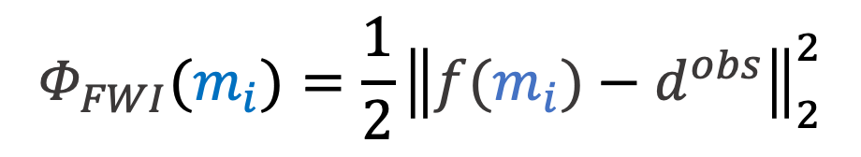
Conventional FWI
Observed data
Current model estimate
$$Φ_{FWI}(m_{i})=\frac{1}{2}{\left\|f(m_{i})−d^{obs}\right\|}_{2}^{2}$$
Predicted data

Slide 16
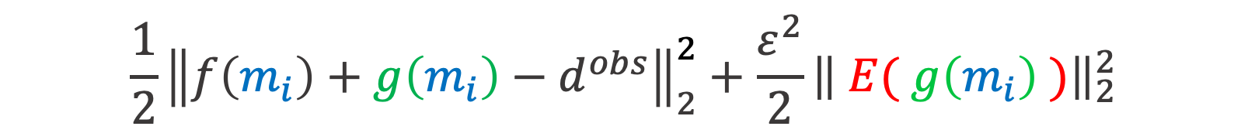

FWIME objective function
$$Φ(m_{i})=$$
$$\frac{1}{2}{\left\|f\left(m_{i}\right)+g\left(m_{i}\right)−d^{obs}\right\|}_{2}^{2}+\frac{ε^{2}}{2}{\left\| E( g\left(m_{i}\right) )\right\|}_{2}^{2}$$
$g\left(m_{i}\right)$: Data correcting term

Slide 17
FWIME objective function
$$Φ(m_{i})=$$
$$\frac{1}{2}{\left\|f\left(m_{i}\right)+g\left(m_{i}\right)−d^{obs}\right\|}_{2}^{2}+\frac{ε^{2}}{2}{\left\| E( g\left(m_{i}\right) )\right\|}_{2}^{2}$$
$g\left(m_{i}\right)$: Data correcting term
$E$: Enhances energy of data-correcting term $g\left(m_{i}\right)$
$ε$: Trade-off parameter

Slide 18
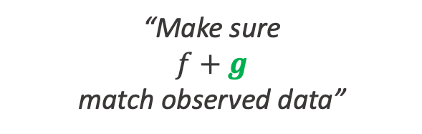
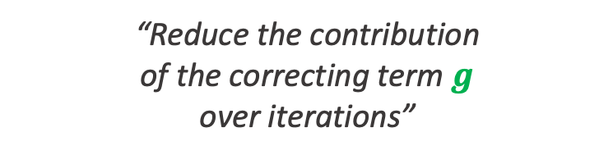
FWIME objective function
“Reduce the contribution
of the correcting term $g$
over iterations”
$$Φ(m_{i})=$$
$$\frac{1}{2}{\left\|f\left(m_{i}\right)+g\left(m_{i}\right)−d^{obs}\right\|}_{2}^{2}+\frac{ε^{2}}{2}{\left\| E( g\left(m_{i}\right) )\right\|}_{2}^{2}$$
“Make sure
$f+g$
match observed data”

Slide 19
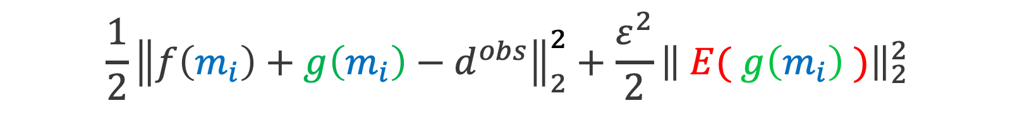
FWIME objective function
$$Φ(m_{i})=$$
$$\frac{1}{2}{\left\|f\left(m_{i}\right)+g\left(m_{i}\right)−d^{obs}\right\|}_{2}^{2}+\frac{ε^{2}}{2}{\left\| E( g\left(m_{i}\right) )\right\|}_{2}^{2}$$
Data-fitting term
Regularization term
Notes:
- Explain that if f~dobs, and g->0, then we found the same solution as fwi. Assuming that the solution is unique, this implies that we converged to the optimal solution
- In other word, the two formulations (FWI and FWIME) have the same global minimum
- Explain why our formulation has better chances of being more convex

Slide 20
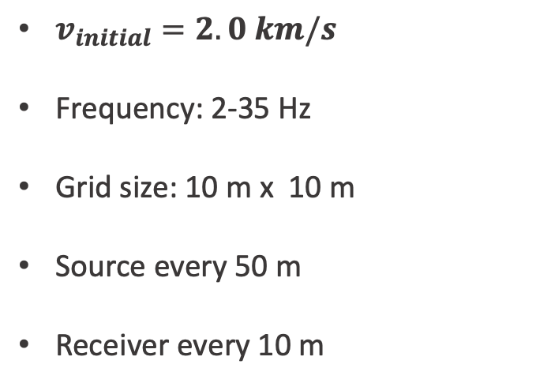

Sampling the objective function
1 km
x
$v_{initial}=2.0 km/s$
Frequency: 2-35 Hz
Grid size: 10 m x 10 m
Source every 50 m
Receiver every 10 m
1 km
$$v_{true}=2.5 km/s$$
z

Slide 21





Sampling the objective function
FWI
$$ε_{4}$$
$$ε_{3}$$
$$ε=0$$
$$ε_{2}$$
$$ε_{1}$$

Slide 22

Sampling the objective function
$$ε_{2}$$

Slide 23
Sampling the objective function
Total
Data-fitting term
Regularization term

Slide 24
Dissection of FWIME
Objective function
Data-fitting term
Regularization term
Variable projection step
Gradient

Slide 25
Dissection of FWIME
Objective function
Data-fitting term
Regularization term
Variable projection step
Gradient

Slide 26

Data-fitting term
Goal of correcting term $g\left(m_{i}\right)$
Conventional Born modeling
Extended Born modeling
Notes:
$m_{i}$ is your current velocity model guess!!!!!

Slide 27
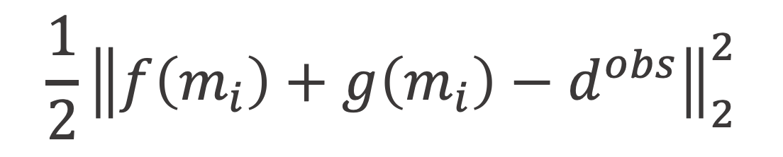

Goal of correcting term $g\left(m_{i}\right)$
$$\frac{1}{2}{\left\|f\left(m_{i}\right)+g\left(m_{i}\right)−d^{obs}\right\|}_{2}^{2}$$

Slide 28
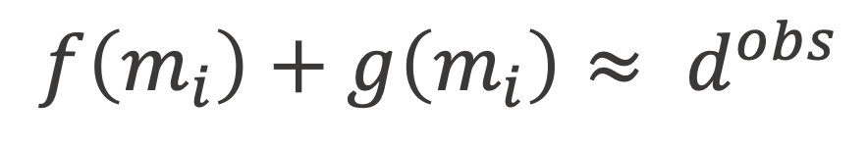
Goal of correcting term $g\left(m_{i}\right)$
$$f\left(m_{i}\right)+g\left(m_{i}\right){≈ d}^{obs}$$

Slide 29
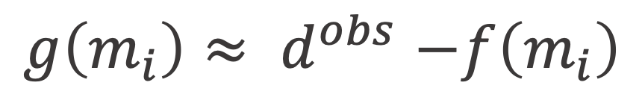
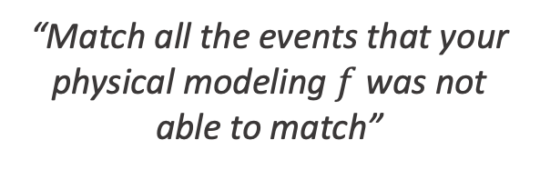
Goal of correcting term $g\left(m_{i}\right)$
FWI data-residuals
$$g\left(m_{i}\right){≈ d}^{obs}−f\left(m_{i}\right)$$
“Match all the events that your physical modeling $f$ was not able to match”

Slide 30
Numerical example – Velocity model
Interface
Interface
True velocity model
1D velocity profiles

Slide 31



Numerical example - Data
$$d^{obs}$$
$$f\left(m_{i}\right)$$
$$d^{obs}−f(m_{i})$$

Slide 32
Conventional Born modeling

Slide 33

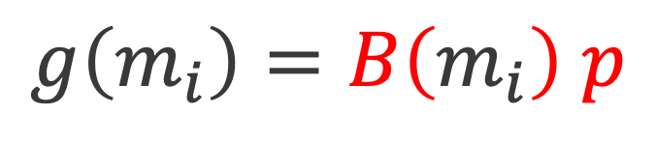
Conventional Born modeling
Born modeling operator
$$g\left(m_{i}\right)=B\left(m_{i}\right) p$$
Image
$B\left(m_{i}\right)$: Born modeling operator
$p$: Image (perturbation)

Slide 34

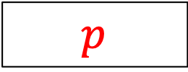

Conventional Born modeling – Dimensional analysis
shots
x
$$B$$
receivers
MODELING
z
time
$$p$$
$$data$$

Slide 35

Conventional Born modeling – Dimensional analysis
shots
x
$$B^{∗}$$
receivers
MIGRATION
z
time
$$p$$
$$data$$

Slide 36
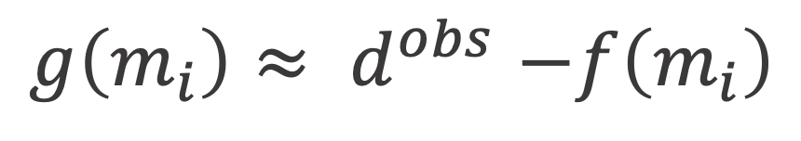
Conventional Born modeling
$$g\left(m_{i}\right){≈ d}^{obs}−f\left(m_{i}\right)$$

Slide 37
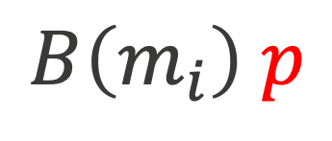

Conventional Born modeling
$$B\left(m_{i}\right) p$$
$$g\left(m_{i}\right){≈ d}^{obs}−f\left(m_{i}\right)$$
Can we find $p$ that satisfies
this condition?

Slide 38
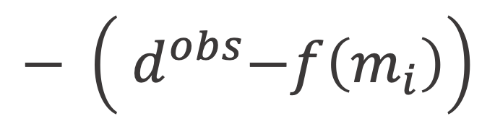
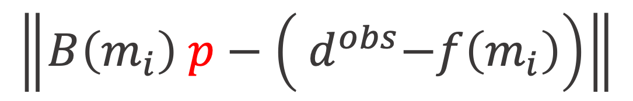
Conventional Born modeling
2
$$\left\|B\left(m_{i}\right) p−\left({ d}^{obs}−f\left(m_{i}\right)\right)\right\|$$
$$− \left({ d}^{obs}−f\left(m_{i}\right)\right)$$
2

Slide 39

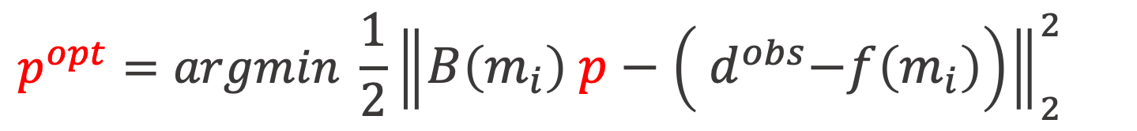

Conventional Born modeling
FWI data-residuals
$$p^{opt}=argmin \frac{1}{2}{\left\|B\left(m_{i}\right) p−\left({ d}^{obs}−f\left(m_{i}\right)\right)\right\|}_{2}^{2}$$
$$p$$
$$r(p)$$

Slide 40
Conventional Born modeling
$$p^{opt}=argmin \frac{1}{2}{\left\|B\left(m_{i}\right) p−\left({ d}^{obs}−f\left(m_{i}\right)\right)\right\|}_{2}^{2}$$
$$p$$

Slide 41



Conventional Born modeling – Iteration #1
$$d^{obs}−f\left(m_{i}\right)$$
$$B\left(m_{i}\right)p$$
$$r\left(p\right)$$

Slide 42
Conventional Born modeling – Iteration #20
$$d^{obs}−f\left(m_{i}\right)$$
$$B\left(m_{i}\right)p$$
$$r\left(p\right)$$

Slide 43
Conventional Born modeling – Iteration #200
$$d^{obs}−f\left(m_{i}\right)$$
$$B\left(m_{i}\right)p$$
$$r\left(p\right)$$

Slide 44
Convergence curves
Conventional

Slide 45

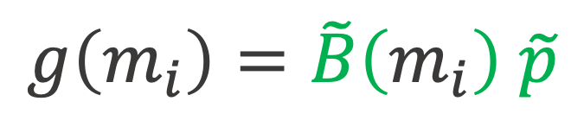
Extended Born modeling
Extended Born modeling operator
$$g\left(m_{i}\right)=\tilde{B}\left(m_{i}\right) \tilde{p}$$
Extended image
$\tilde{B}(m_{i})$: Extended Born modeling operator
$\tilde{p}$: Extended image (perturbation)

Slide 46



Extended Born modeling – Dimensional analysis
EXTENDED AXIS
shots
x
$$\tilde{B}$$
receivers
EXTENDED
MODELING
z
time
$$\tilde{p}$$
$$data$$

Slide 47

Extended Born modeling – Dimensional analysis
EXTENDED AXIS
shots
x
$${\tilde{B}}^{∗}$$
receivers
EXTENDED
MIGRATION
z
time
$$\tilde{p}$$
$$data$$

Slide 48

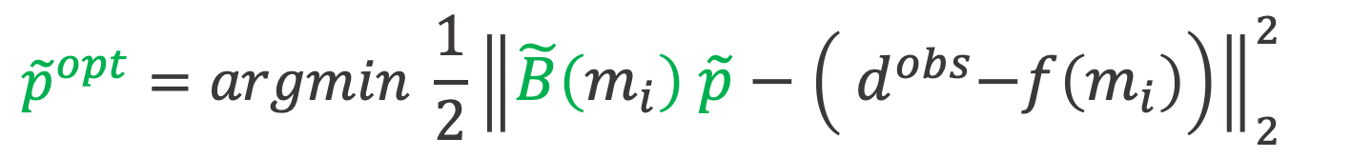

Extended Born modeling
FWI data-residuals
$${\tilde{p}}^{opt}=argmin \frac{1}{2}{\left\|\tilde{B}\left(m_{i}\right) \tilde{p}−\left({ d}^{obs}−f\left(m_{i}\right)\right)\right\|}_{2}^{2}$$
$$\tilde{p}$$
$$r(\tilde{p})$$
${\tilde{p}}^{opt}={\tilde{p}}^{opt}(m_{i})$

Slide 49
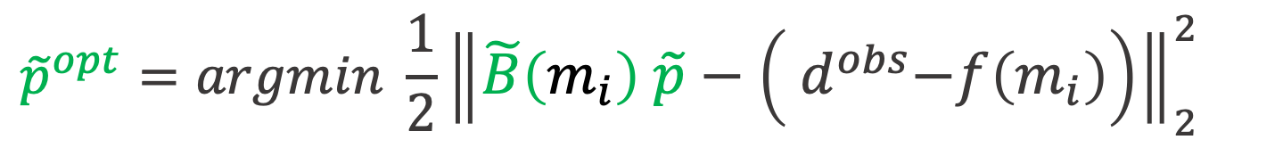
Extended Born modeling
$${\tilde{p}}^{opt}=argmin \frac{1}{2}{\left\|\tilde{B}\left(m_{i}\right) \tilde{p}−\left({ d}^{obs}−f\left(m_{i}\right)\right)\right\|}_{2}^{2}$$
$$\tilde{p}$$
$$r(\tilde{p})$$
${\tilde{p}}^{opt}={\tilde{p}}^{opt}(m_{i})$

Slide 50


Extended Born modeling – Iteration #1
$$d^{obs}−f\left(m_{i}\right)$$
$$\tilde{B}\left(m_{i}\right)\tilde{p}$$
$$r\left(\tilde{p}\right)$$

Slide 51
Extended Born modeling – Iteration #20
$$d^{obs}−f\left(m_{i}\right)$$
$$\tilde{B}\left(m_{i}\right)\tilde{p}$$
$$r\left(\tilde{p}\right)$$

Slide 52
Extended Born modeling – Iteration #200
$$d^{obs}−f\left(m_{i}\right)$$
$$\tilde{B}\left(m_{i}\right)\tilde{p}$$
$$r\left(\tilde{p}\right)$$

Slide 53
Convergence curves
Conventional

Slide 54
Convergence curves
Conventional
Extended

Slide 55






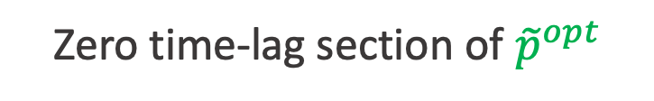
Optimal extended perturbation - ${\tilde{p}}^{opt}$
$$τ$$
$$x$$
$$τ=0$$
Zero time-lag section of ${\tilde{p}}^{opt}$
$${\tilde{p}}^{opt}$$
$$z$$

Slide 56


Optimal extended perturbation - ${\tilde{p}}^{opt}$
$$τ$$
$$x$$
$$x=5 km$$
$${\tilde{p}}^{opt}$$
$$z$$
CIG of ${\tilde{p}}^{opt}$

Slide 57


Optimal extended perturbation - ${\tilde{p}}^{opt}$
$$\tilde{B}$$
EXTENDED
MODELING
CIG of ${\tilde{p}}^{opt}$
$$\tilde{B}\left(m_{i}\right)\tilde{p}$$

Slide 58
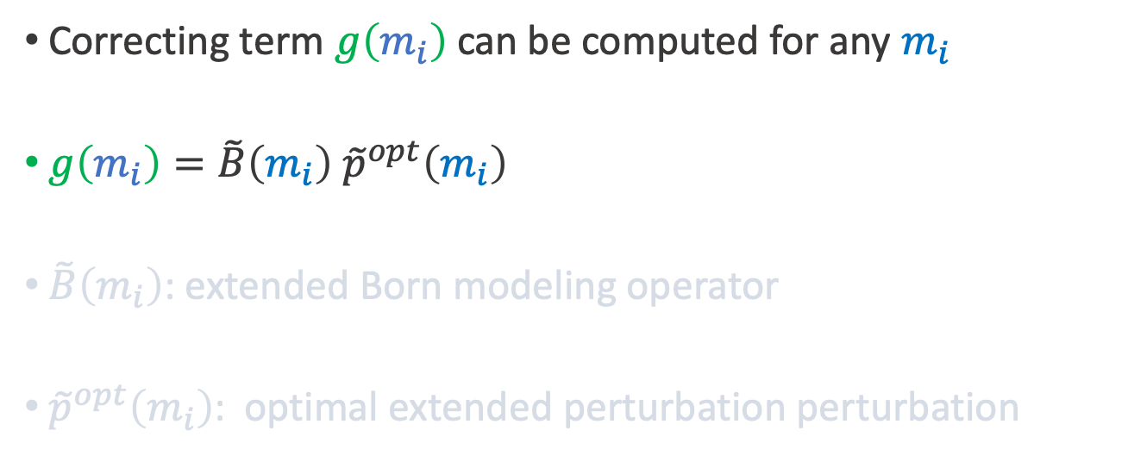
Data-fitting term - Summary
Correcting term $g\left(m_{i}\right)$ can be computed for any $m_{i}$
$g\left(m_{i}\right)=\tilde{B}\left(m_{i}\right) {\tilde{p}}^{opt}\left(m_{i}\right)$
$\tilde{B}\left(m_{i}\right)$: extended Born modeling operator
${\tilde{p}}^{opt}\left(m_{i}\right)$: optimal extended perturbation perturbation

Slide 59
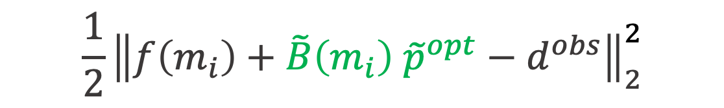
Data-fitting term - Summary
$$\frac{1}{2}{\left\|f\left(m_{i}\right)+\tilde{B}\left(m_{i}\right) {\tilde{p}}^{opt}−d^{obs}\right\|}_{2}^{2}$$
“As small as we want”

Slide 60
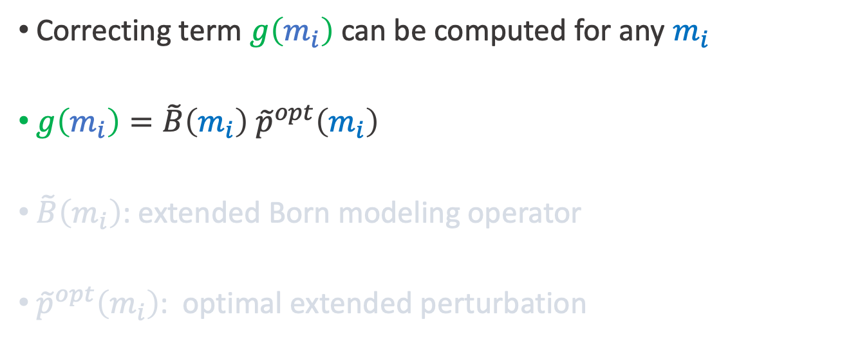
Data-fitting term - Summary
Correcting term $g\left(m_{i}\right)$ can be computed for any $m_{i}$
$g\left(m_{i}\right)=\tilde{B}\left(m_{i}\right) {\tilde{p}}^{opt}\left(m_{i}\right)$
$\tilde{B}\left(m_{i}\right)$: extended Born modeling operator
${\tilde{p}}^{opt}\left(m_{i}\right)$: optimal extended perturbation

Slide 61
Dissection of FWIME
Objective function
Data-fitting term
Regularization term
Variable projection step
Gradient

Slide 62
Dissection of FWIME
Objective function
Data-fitting term
Regularization term
Variable projection step
Gradient

Slide 63
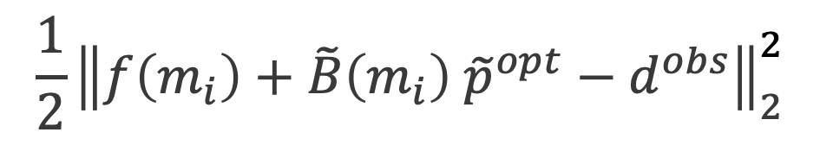
Goal of regularization term
$$\frac{1}{2}{\left\|f\left(m_{i}\right)+\tilde{B}\left(m_{i}\right) {\tilde{p}}^{opt}−d^{obs}\right\|}_{2}^{2}$$
Keep this term “small”

Slide 64


Goal of regularization term
keep data-fitting term “small”
make ${\tilde{p}}^{opt}$ vanish
$$+$$

Slide 65



Regularization operator $D$
$${\frac{ε^{2}}{2}\left\|D{\tilde{p}}^{opt}\right\|}_{2}^{2}$$
Modified differential semblance optimization (DSO)
Invertible, linear, diagonal
Enhances non-zero energy of ${\tilde{p}}^{opt}$

Slide 66
Regularization operator – Penalty function

Slide 67

Regularization operator $D$
$${\frac{ε^{2}}{2}\left\|D{\tilde{p}}^{opt}\right\|}_{2}^{2}$$
Modified differential semblance optimization (DSO)
Invertible, linear, diagonal
Enhances all the energy of ${\tilde{p}}^{opt}$

Slide 68
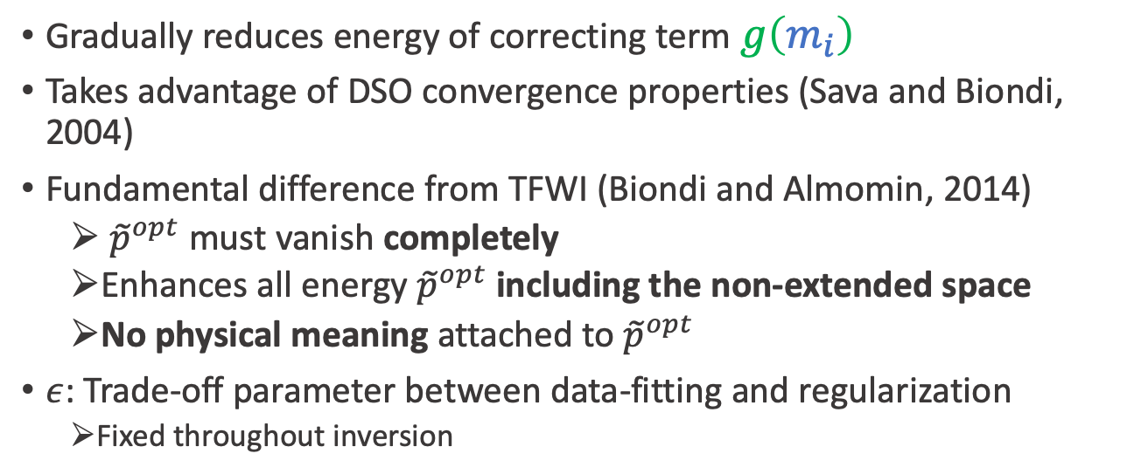
Regularization term - Summary
Gradually reduces energy of correcting term $g\left(m_{i}\right)$
Takes advantage of DSO convergence properties (Sava and Biondi, 2004)
Fundamental difference from TFWI (Biondi and Almomin, 2014)
  ${\tilde{p}}^{opt}$ must vanish completely
  Enhances all energy ${\tilde{p}}^{opt}$ including the non-extended space
  No physical meaning attached to ${\tilde{p}}^{opt}$
$ε$: Trade-off parameter between data-fitting and regularization
  Fixed throughout inversion

Slide 69
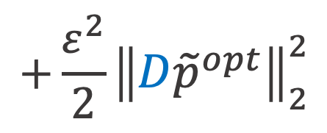
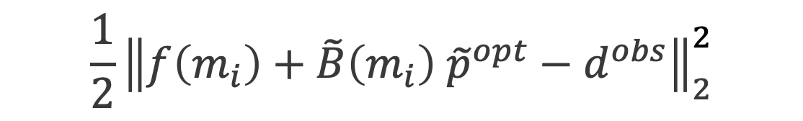

Regularization term - Summary
$$\frac{1}{2}{\left\|f\left(m_{i}\right)+\tilde{B}\left(m_{i}\right) {\tilde{p}}^{opt}−d^{obs}\right\|}_{2}^{2}$$
$$+\frac{ε^{2}}{2}{\left\|D{\tilde{p}}^{opt}\right\|}_{2}^{2}$$
Keep this term “small”
Make ${\tilde{p}}^{opt}$ vanish

Slide 70
Dissection of FWIME
Objective function
Data-fitting term
Regularization term
Variable projection step
Gradient

Slide 71

Dissection of FWIME
Objective function
Data-fitting term
Regularization term
Variable projection step
  Computation of ${\tilde{p}}^{opt}$
  Effect of $ε$
Gradient

Slide 72

Dissection of FWIME
Objective function
Data-fitting term
Regularization term
Variable projection step
  Computation of ${\tilde{p}}^{opt}$
  Effect of $ε$
Gradient

Slide 73
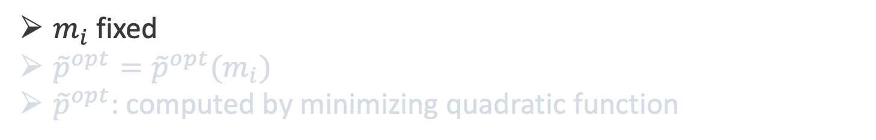

Variable projection step – Computing ${\tilde{p}}_{ε}^{opt}$
$$Φ(m_{i})=\frac{1}{2}{\left\|f\left(m_{i}\right)+\tilde{B}\left(m_{i}\right) {\tilde{p}}^{opt}−d^{obs}\right\|}_{2}^{2}+\frac{ε^{2}}{2}{\left\|D{\tilde{p}}^{opt}\right\|}_{2}^{2}$$
$m_{i}$ fixed
${\tilde{p}}^{opt}={\tilde{p}}^{opt}(m_{i})$
${\tilde{p}}^{opt}$: computed by minimizing quadratic function

Slide 74
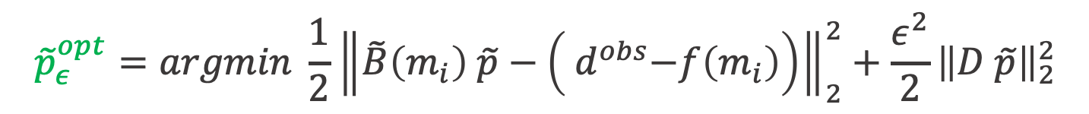
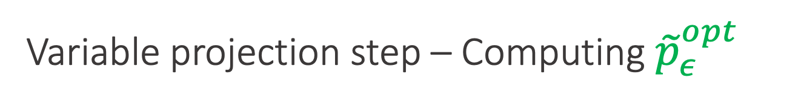
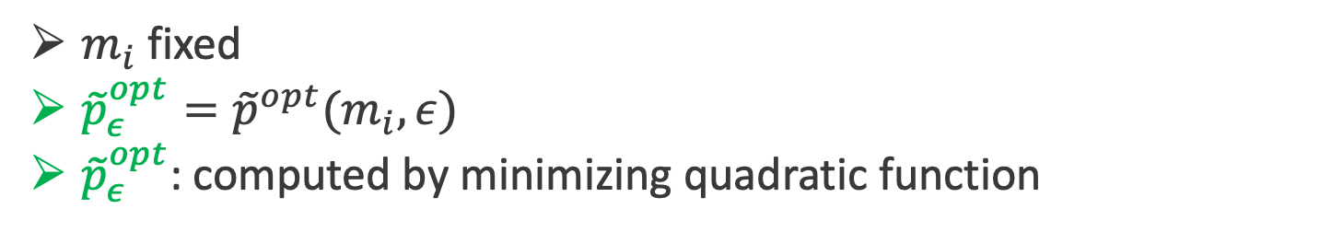

Variable projection step – Computing ${\tilde{p}}_{ε}^{opt}$
$${\tilde{p}}_{ε}^{opt}=argmin \frac{1}{2}{\left\|\tilde{B}\left(m_{i}\right) \tilde{p}−\left({ d}^{obs}−f\left(m_{i}\right)\right)\right\|}_{2}^{2}+\frac{ε^{2}}{2}{\left\|D \tilde{p}\right\|}_{2}^{2}$$
$$\tilde{p}$$
$m_{i}$ fixed
${\tilde{p}}_{ε}^{opt}={\tilde{p}}^{opt}(m_{i},ε)$
${\tilde{p}}_{ε}^{opt}$: computed by minimizing quadratic function

Slide 75

Dissection of FWIME
Objective function
Data-fitting term
Regularization term
Variable projection step
  Computation of ${\tilde{p}}_{ε}^{opt}$
  Effect of $ε$
Gradient

Slide 76
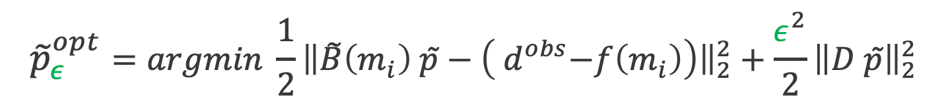

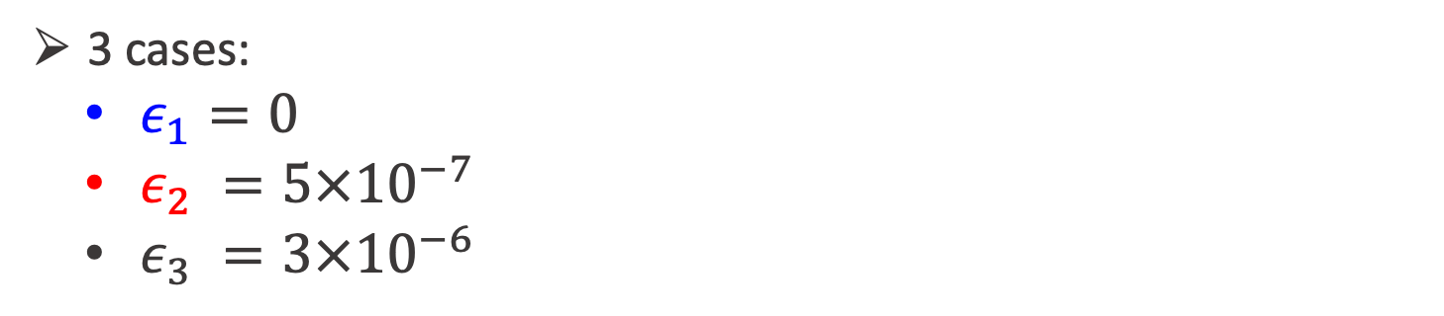

Effect of $ε$
FWI data-residuals
$${\tilde{p}}_{ε}^{opt}=argmin \frac{1}{2}{\left\|\tilde{B}\left(m_{i}\right) \tilde{p}−\left({ d}^{obs}−f\left(m_{i}\right)\right)\right\|}_{2}^{2}+\frac{ε^{2}}{2}{\left\|D \tilde{p}\right\|}_{2}^{2}$$
$$\tilde{p}$$
3 cases:
  $ε_{1}=0$
  $ε_{2} =5×{10}^{−7}$
  $ε_{3} =3×{10}^{−6}$

Slide 77

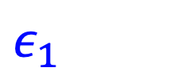
Effect of $ε$ on data-fitting
$$ε_{1}$$

Slide 78

Effect of $ε$ on data-fitting
$$ε_{1}$$
$$ε_{2}$$

Slide 79

Effect of $ε$ on data-fitting
$$ε_{1}$$
$$ε_{2}$$
$$ε_{3}$$

Slide 80




Effect of $ε$ on ${\tilde{p}}_{ε}^{opt}$ (CIG at $x=5km$)
$${\tilde{p}}^{opt}(ε_{1})$$
$${\tilde{p}}^{opt}(ε_{2})$$
$${\tilde{p}}^{opt}(ε_{3})$$

Slide 81

Dissection of FWIME
Objective function
Data-fitting term
Regularization term
Variable projection step
  Computation of ${\tilde{p}}^{opt}$
  Effect of $ε$
Gradient computation

Slide 82

Dissection of FWIME
Objective function
Data-fitting term
Regularization term
Variable projection step
  Computation of ${\tilde{p}}^{opt}$
  Effect of $ε$
Gradient computation

Slide 83
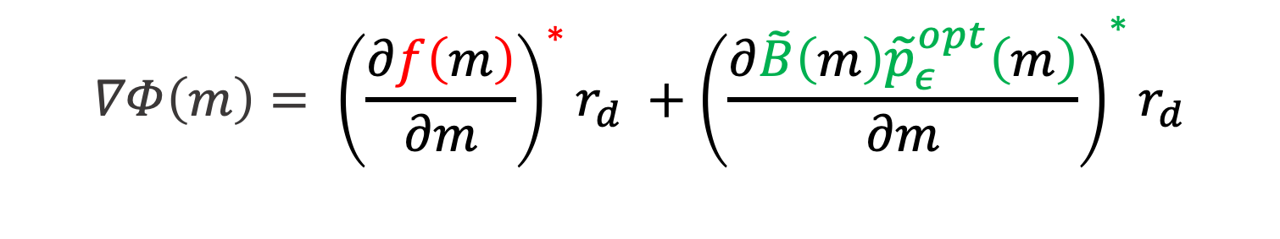
Gradient computation
$$∇Φ\left(m\right)= {\left(\frac{∂f\left(m\right)}{∂m}\right)}^{∗}r_{d} +{\left(\frac{∂\tilde{B}\left(m\right){\tilde{p}}_{ε}^{opt}\left(m\right)}{∂m}\right)}^{∗}r_{d}$$
SIMILAR TO
CONVENTIONAL FWI
GRADIENT
GRADIENT FROM CORRECTING TERM

Slide 84
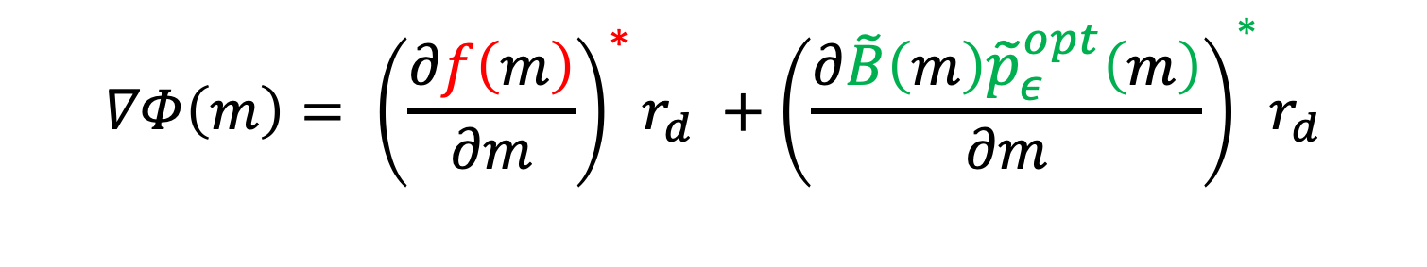
Gradient computation
$$∇Φ\left(m\right)= {\left(\frac{∂f\left(m\right)}{∂m}\right)}^{∗}r_{d} +{\left(\frac{∂\tilde{B}\left(m\right){\tilde{p}}_{ε}^{opt}\left(m\right)}{∂m}\right)}^{∗}r_{d}$$
BORN
TOMOGRAPHIC

Slide 85

Gradient computation
FWIME data residual
$$∇Φ\left(m\right)=\left(B^{∗}+T^{∗}\right) r_{d}$$

Slide 86
Numerical example – Velocity model
Interface
Interface
True velocity model
1D velocity profiles

Slide 87
FWI first search direction
True interface position

Slide 88
FWIME first search direction – Born component
True interface position

Slide 89
FWIME first search direction – Tomo component

Slide 90
FWIME first search direction (Born + tomo)

Slide 91
FWIME first search direction - Spline grid

Slide 92
FWIME first search direction after spline interpolation

Slide 93

Ideal search direction
$$m_{true}−m_{init}$$

Slide 94
FWIME first search direction - Summary
Born component
Tomographic component
Total search direction (Born + tomographic)
Total search direction with spline

Slide 95
Inversion of reflection data:
The Marmousi model

Slide 96


Velocity models – 2D panels
$$m_{true}$$
$$m_{initial}$$

Slide 97

Velocity models – 1D profiles ($x=5 km$)

Slide 98
Inverted seismic data
FWI
Data-space multi-scale approach
  Energy between 4-15 Hz
  5 frequency-bands
Acoustic noise-free data
  500 receivers (20m spacing)
  100 sources (100m spacing)
  10 km-offset maximum
  8s recording
Reflected and refracted energy

Slide 99
Conventional FWI – Frequency content

Slide 100
Inverted seismic data
FWI
Data-space multi-scale approach
  Energy between 4-15 Hz
  5 frequency-bands
Acoustic noise-free data
  500 receivers (20m spacing)
  100 sources (100m spacing)
  10 km-offset maximum
  8s recording
Reflected and refracted energy

Slide 101
Inverted seismic data
FWI
Data-space multi-scale approach
  Energy between 4-15 Hz
  5 frequency-bands
Acoustic noise-free data
  500 receivers (20m spacing)
  100 sources (100m spacing)
  10 km-offset maximum
  8s recording
Reflected and refracted energy

Slide 102


Shot gathers inverted with FWI
$$x_{source}=1 km$$
$$x_{source}=5 km$$

Slide 103
Initial model

Slide 104
Conventional FWI

Slide 105
True model

Slide 106
Inverted seismic data
FWI
Data-space multi-scale approach
  Energy between 4-15 Hz
  5 frequency-bands
Acoustic noise-free data
  500 receivers (20m spacing)
  100 sources (100m spacing)
  10 km-offset maximum
  8s recording
Reflected and refracted energy

Slide 107
Inverted seismic data
FWI
FWIME
Data-space multi-scale approach
  Energy between 4-15 Hz
  5 frequency-bands
Acoustic noise-free data
  500 receivers (20m spacing)
  100 sources (100m spacing)
  10 km-offset maximum
  8s recording
Reflected and refracted energy
Model-space multi-scale approach
  Energy between 4-15 Hz
  4 spline grid dispositions

Slide 108
Frequency content
FWIME

Slide 109
Inverted seismic data
FWI
FWIME
Data-space multi-scale approach
  Energy between 4-15 Hz
  5 frequency-bands
Acoustic noise-free data
  500 receivers (20m spacing)
  100 sources (100m spacing)
  10 km-offset maximum
  8s recording
Reflected and refracted energy
Model-space multi-scale approach
  Energy between 4-15 Hz
  4 spline grid dispositions
Acoustic noise-free data
  500 receivers (20m spacing)
  100 sources (100m spacing)
  6 km-offset maximum
  5s recording
Reflected energy only

Slide 110


Shot gathers inverted with FWIME
$$x_{source}=1 km$$
$$x_{source}=5 km$$

Slide 111

First iteration of FWIME - $m_{0}$
$$Φ(m_{0})=\frac{1}{2}{\left\|f\left(m_{0}\right)+\tilde{B}\left(m_{0}\right) {\tilde{p}}_{ε}^{opt}−d^{obs}\right\|}_{2}^{2}+\frac{ε^{2}}{2}{\left\|D{\tilde{p}}_{ε}^{opt}\right\|}_{2}^{2}$$

Slide 112

First iteration of FWIME - $m_{0}$
$$Φ(m_{0})=\frac{1}{2}{\left\|f{\left(m_{0}\right)+\tilde{B}\left(m_{0}\right) {\tilde{p}}_{ε}^{opt}−d}^{obs}\right\|}_{2}^{2}+\frac{ε^{2}}{2}{\left\|D{\tilde{p}}_{ε}^{opt}\right\|}_{2}^{2}$$
Compute FWI data residual $f\left(m_{0}\right)−d^{obs}$
Compute ${\tilde{p}}_{ε}^{opt}(m_{0})$
Compute gradient

Slide 113
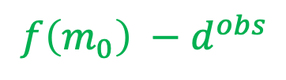


Initial data
$$d^{obs}$$
$$f\left(m_{0}\right)$$
$${f\left(m_{0}\right) −d}^{obs}$$

Slide 114

First iteration of FWIME - $m_{0}$
$$Φ(m_{0})=\frac{1}{2}{\left\|f{\left(m_{0}\right)+\tilde{B}\left(m_{0}\right) {\tilde{p}}_{ε}^{opt}−d}^{obs}\right\|}_{2}^{2}+\frac{ε^{2}}{2}{\left\|D{\tilde{p}}_{ε}^{opt}\right\|}_{2}^{2}$$
Compute FWI data residual $f\left(m_{0}\right)−d^{obs}$
Compute gradient

Slide 115

First iteration of FWIME - $m_{0}$
$$Φ(m_{0})=\frac{1}{2}{\left\|f{\left(m_{0}\right)+\tilde{B}\left(m_{0}\right) {\tilde{p}}_{ε}^{opt}−d}^{obs}\right\|}_{2}^{2}+\frac{ε^{2}}{2}{\left\|D{\tilde{p}}_{ε}^{opt}\right\|}_{2}^{2}$$
Compute FWI data residual $f\left(m_{0}\right)−d^{obs}$
Compute ${\tilde{p}}_{ε}^{opt}(m_{0})$
Compute gradient

Slide 116






A close look at ${\tilde{p}}_{ε}^{opt}(m_{0})$
$$τ$$
$$x$$
$$τ=0$$
$$z$$
${\tilde{p}}_{ε}^{opt}\left(m_{0}\right)$

Slide 117


A close look at ${\tilde{p}}_{ε}^{opt}$
$$m_{true}$$

Slide 118
A close look at ${\tilde{p}}_{ε}^{opt}(m_{0})$
$$τ$$
$$x$$
$$τ=0$$
$$z$$
${\tilde{p}}_{ε}^{opt}\left(m_{0}\right)$

Slide 119
A close look at ${\tilde{p}}_{ε}^{opt}$
$$m_{true}$$

Slide 120
A close look at ${\tilde{p}}_{ε}^{opt}(m_{0})$
$$τ$$
$$x$$
$$τ=0$$
$$z$$
${\tilde{p}}_{ε}^{opt}\left(m_{0}\right)$

Slide 121







A close look at ${\tilde{p}}_{ε}^{opt}(m_{0})$
$$x$$
$$x=x_{i}$$
$$z$$
$$x=3 km$$
$$x=5.5 km$$
$$x=7.5 km$$

Slide 122

First iteration of FWIME - $m_{0}$
$$Φ(m_{0})=\frac{1}{2}{\left\|f{\left(m_{0}\right)+\tilde{B}\left(m_{0}\right) {\tilde{p}}_{ε}^{opt}−d}^{obs}\right\|}_{2}^{2}+\frac{ε^{2}}{2}{\left\|D{\tilde{p}}_{ε}^{opt}\right\|}_{2}^{2}$$
Compute FWI data residual $f\left(m_{0}\right)−d^{obs}$
Compute ${\tilde{p}}_{ε}^{opt}(m_{0})$
Compute gradient

Slide 123
First search direction
FWIME

Slide 124
Ideal search direction
IDEAL

Slide 125
First search direction after spline interpolation
FWIME + SPLINE

Slide 126
Ideal search direction after spline interpolation
IDEAL + SPLINE

Slide 127

Initial model
$$m_{0}$$

Slide 128

FWIME – First spline grid
$$m_{s_{1}}$$

Slide 129

FWIME – Last inverted model
$$m_{inv}$$

Slide 130

True model
$$m_{true}$$

Slide 131
FWIME + FWI
FWIME + FWI

Slide 132
True model
$$m_{true}$$

Slide 133
Conventional FWI

Slide 134


${\tilde{p}}^{opt}$ as a QC tool
Evolution of ${\tilde{p}}^{opt}$ for first spline disposition
Evolution of ${\tilde{p}}^{opt}$ for last spline disposition

Slide 135

${\tilde{p}}^{opt}$ as a QC tool
${\tilde{p}}_{ε}^{opt}\left(m_{0}\right)$

Slide 136
${\tilde{p}}^{opt}$ as a QC tool
$$m_{true}$$

Slide 137

${\tilde{p}}^{opt}$ as a QC tool
${\tilde{p}}_{ε}^{opt}\left(m_{s_{1}}\right)$

Slide 138
${\tilde{p}}^{opt}$ as a QC tool
${\tilde{p}}_{ε}^{opt}\left(m_{0}\right)$

Slide 139

${\tilde{p}}^{opt}$ as a QC tool – Initial
$$x=3 km$$
$$x=5.5 km$$
$$x=7.5 km$$

Slide 140

${\tilde{p}}^{opt}$ as a QC tool – After spline #1
$$x=3 km$$
$$x=5.5 km$$
$$x=7.5 km$$

Slide 141

${\tilde{p}}^{opt}$ as a QC tool
Evolution of ${\tilde{p}}^{opt}$ for first spline disposition
Evolution of ${\tilde{p}}^{opt}$ for last spline disposition

Slide 142

${\tilde{p}}^{opt}$ as a QC tool – Initial spline #4

Slide 143

${\tilde{p}}^{opt}$ as a QC tool – Final spline #4

Slide 144

${\tilde{p}}^{opt}$ as a QC tool – Initial spline #4

Slide 145

${\tilde{p}}^{opt}$ as a QC tool – Final spline #4

Slide 146

Evolution of ${\tilde{p}}^{opt}$ throughout FWIME
Initial
After spline #1
Initial spline #4
Final

Slide 147
Making it feasible in 3D:
Accelerating the variable projection step

Slide 148


FWIME main challenge - Variable projection step
$$Φ(m_{i})=$$
$$\frac{1}{2}{\left\|f\left(m_{i}\right)+\tilde{B}\left(m_{i}\right) {\tilde{p}}^{opt}\left(m_{i}\right)−d^{obs}\right\|}_{2}^{2}+\frac{ε^{2}}{2}{\left\|D{\tilde{p}}^{opt}\left(m_{i}\right)\right\|}_{2}^{2}$$
Computed iteratively until convergence
Must be recomputed for every tested $m_{i}$
Accounts for $\sim$99% of total computational cost of FWIME!
Notes:
Mention that you need to reach vp convergence for optimal gradient

Slide 149



How many iterations do we need?
$$m_{0}$$
$$m_{1}$$
$$m_{2}$$

Slide 150

Preconditioning the iterative process
The optimal perturbation is given by:
$${\tilde{p}}^{opt}=\underset{\tilde{p}}{argmin}{\frac{1}{2}{\left\|f\left(m_{0}\right)+\tilde{B}\left(m_{0}\right) \tilde{p}−d^{obs}\right\|}_{2}^{2}+\frac{ε^{2}}{2}{\left\|D\tilde{p}\right\|}_{2}^{2}}$$

Slide 151
Preconditioning the iterative process
The optimal perturbation is given by:
$${\tilde{p}}^{opt}={\left[\tilde{B}{\left(m_{i}\right)}^{∗}\tilde{B}\left(m_{i}\right)+ε^{2}D^{∗}D\right]}^{−1}\tilde{B}{\left(m_{i}\right)}^{∗}\left[d^{obs}−f\left(m_{i}\right)\right]$$

Slide 152
Preconditioning the iterative process
The optimal perturbation is given by:
$${\tilde{p}}^{opt}={\left[\tilde{B}{\left(m_{i}\right)}^{∗}\tilde{B}\left(m_{i}\right)+ε^{2}D^{∗}D\right]}^{−1}\tilde{B}{\left(m_{i}\right)}^{∗}\left[d^{obs}−f\left(m_{i}\right)\right]$$
Hessian of the linear problem

Slide 153
Preconditioning the iterative process
The optimal perturbation is given by:
$${\tilde{p}}^{opt}={\left[\tilde{B}{\left(m_{i}\right)}^{∗}\tilde{B}\left(m_{i}\right)+ε^{2}D^{∗}D\right]}^{−1}\tilde{B}{\left(m_{i}\right)}^{∗}\left[d^{obs}−f\left(m_{i}\right)\right]$$
Hessian of the linear problem
FWI residuals

Slide 154

Preconditioning the iterative process
The optimal perturbation is given by:
$$ε=0$$
$${\tilde{p}}^{opt}={\left[\tilde{B}{\left(m_{i}\right)}^{∗}\tilde{B}\left(m_{i}\right)+ε^{2}D^{∗}D\right]}^{−1}\tilde{B}{\left(m_{i}\right)}^{∗}\left[d^{obs}−f\left(m_{i}\right)\right]$$

Slide 155
Preconditioning the iterative process
The optimal perturbation is given by:
$${\tilde{p}}^{opt}={\left[\tilde{B}{\left(m_{i}\right)}^{∗}\tilde{B}\left(m_{i}\right)\right]}^{−1}\tilde{B}{\left(m_{i}\right)}^{∗}\left[d^{obs}−f\left(m_{i}\right)\right]$$
Hou and Symes (2017) derived an approximate pseudo inverse:
$$\tilde{B}{\left(m_{i}\right)}^{†}≈{\left[\tilde{B}{\left(m_{i}\right)}^{∗}\tilde{B}\left(m_{i}\right)\right]}^{−1}\tilde{B}{\left(m_{i}\right)}^{∗}$$

Slide 156
Preconditioning the iterative process
The optimal perturbation is given by:
$${\tilde{p}}^{opt}={\left[\tilde{B}{\left(m_{i}\right)}^{∗}\tilde{B}\left(m_{i}\right)\right]}^{−1}\tilde{B}{\left(m_{i}\right)}^{∗}\left[d^{obs}−f\left(m_{i}\right)\right]$$
Hou and Symes (2017) derived an approximate pseudo inverse:
$$\tilde{B}{\left(m_{i}\right)}^{†}=W_{m}{\tilde{B}}^{∗}W_{d}$$

Slide 157

Preconditioning the iterative process
The optimal perturbation is given by:
$${\tilde{p}}^{opt}={\left[\tilde{B}{\left(m_{i}\right)}^{∗}\tilde{B}\left(m_{i}\right)\right]}^{−1}\tilde{B}{\left(m_{i}\right)}^{∗}\left[d^{obs}−f\left(m_{i}\right)\right]$$
Hou and Symes (2017) derived an approximate pseudo inverse:
$$\tilde{B}{\left(m_{i}\right)}^{†}=W_{m}{\tilde{B}}^{∗}W_{d}$$
$$I_{t}I_{t}I_{t}$$

Slide 158

Preconditioning the iterative process
The optimal perturbation is given by:
$${\tilde{p}}^{opt}={\left[\tilde{B}{\left(m_{i}\right)}^{∗}\tilde{B}\left(m_{i}\right)\right]}^{−1}\tilde{B}{\left(m_{i}\right)}^{∗}\left[d^{obs}−f\left(m_{i}\right)\right]$$
Hou and Symes (2017) derived an approximate pseudo inverse:
$$\tilde{B}{\left(m_{i}\right)}^{†}=W_{m}{\tilde{B}}^{∗}W_{d}$$
$${{−8v}^{4}D}_{z}$$
$$I_{t}I_{t}I_{t}$$

Slide 159


$${\tilde{p}}_{0}=0$$
$${\tilde{p}}_{0}={\tilde{B}}^{†}[d_{obs}−f(m)]$$
With one migration process we match more than 80% of the data!

Slide 160
$${\tilde{p}}_{0}=0$$
$${\tilde{p}}_{0}={\tilde{B}}^{†}[d_{obs}−f(m)]$$

Slide 161
Zero time-lag cross-section
Linear CG – iteration #100

Slide 162

Zero time-lag cross-section
$${\tilde{p}}^{opt}={\tilde{B}}^{†}[d_{obs}−f(m)]$$

Slide 163
Future steps
Implement weighted CG algorithm (Hou and Symes, 2015)
Find pseudo inverse for regularized problem
Adapt to different kind of extensions

Slide 164
Conclusions and opportunities

Slide 165

Conclusions
Successfully applied FWIME
  Model-space multi-scale approach
  Reflection data
  Short offsets
  Lack of low frequencies
  Inaccurate starting model
${\tilde{p}}^{opt}$ provides QC tool for inversion process
FWIME requires minimum user input
  Spline refinement rate
  $ε$-value

Slide 166

Next steps and opportunities
Conduct FWIME workflow until full convergence
Accelerate variable project step (3D applications)
Assess robustness with elastic data and noise
Automatize
  Selection of $ε$-parameter
  Spline grid refinement rate
Suggest models (2D or 3D) to benchmark FWIME

Slide 167
In reality the subsurface is certainly elastic
Vp
Vs
Density

Slide 168
In reality the subsurface is certainly elastic
Vp
Vs
Density

Slide 169
In reality the subsurface is certainly elastic
Vp
Vs
Density
Redatuming using linearized extended waveform inversion (SEP 172)
True amplitude migration (tomorrow @8:00am)

Slide 170
However, we need an accurate acoustic velocity model!
?
Vp

Slide 171
An ideal workflow
Data pre-processing
Acoustic model building FWIME
Accurate overburden velocity model
Redatuming by
Extended Linearized Waveform Inversion
Elastic data as if it was acquired
on top of the target area
Target-oriented elastic FWI
Reservoir elastic properties

Slide 172
Thank you – Questions?

Slide 173
Acknowledgements
We would like to thank William Symes for useful discussions and guidance

Slide 174
Auxiliary slides

Slide 175
Inversion of refracted waves
TRUE
FWI
FWIME
FWIME + FWI

Slide 176
Inversion of refracted waves - FWIME®
FWIME
FWIME + FWI

Slide 177
Inversion of refracted waves - FWI
3-5 Hz
3-12 Hz

Slide 178
Summary – Recap what we are showing in the presentation
We successfully apply FWIME on reflection data and avoid cycle-skipping

Slide 179
Add a slide at the end to explain how Ettore’s and my projects are linked
We want to create a full solution
Accurate background
  Good images (Earth structure)
  Elastic parameters (reservoir fluid content)

Slide 180
How to pick g(m)?
We choose to pick g(m)=Bp
Explain that B tilde is the extended demigration operator (its adjoint is well-known: extended RTM)
We claim that we can always find an extended p that matches any data residual (if we set it up as an inverse problem)
Show 2 examples,
  Diving waves
  Complex salt body (power of the extended modeling)
Mention that matching the data residuals is useless by itself
The data-fitting term enables us to maintain control on the level of data matching

Slide 181
Outline – Junk
Theoretical review
  Objective function – Example on borehole transmission data
  Data-fitting term – Example on Marmousi starting with water velocity
  Regularization term – Show the modified DSO
  Variable projection – Combining everything together
  Gradient computation - Discuss with Ettore how to explain tomo (conceptually)
Step-by-step dissection of FWIME – Example on Mora2.0
  First step of FWIME
  Vp + Pick epsilon
  Compute gradient (+spline)
  Compare for FWI
Inversion of reflection data – Marmoush
  Stuff from paper (CIGs, zero-offset sections)
  Explain that high-resultion data -> higher resolution p -> higher accuracy on moveout info -> better tomo gradient
Making it feasible in 3D – Symes’ preconditioning
  Explain that the vp step accounts for 95% of FWIME cost ($$$)
  Show example that illustrate the importance of converging for VP (effect on the gradient vs iteration on curve) (we have to do it)
  Solutions: Symes’ preconditioning
    Theory (show the equation of the approximate pseudo-inverse) and explain the cost (very cheap) and the different terms
    Show convergence curves, extended images (zero-offset + cigs + predicted data)
    Explain that we are trying to adapt it to the regularized version
Conclusions and opportunities

Slide 182
Goal of regularization term
$$\frac{1}{2}{\left\|f\left(m_{i}\right)+\tilde{B}\left(m_{i}\right) {\tilde{p}}^{opt}−d^{obs}\right\|}_{2}^{2}$$
make ${\tilde{p}}^{opt}$ vanish
$$+$$
Keep this term “small”

Slide 183

FWIME objective function
$$Φ(m_{i})=$$
$$\frac{1}{2}{\left\|f\left(m_{i}\right)+g\left(m_{i}\right)−d^{obs}\right\|}_{2}^{2}+\frac{ε^{2}}{2}{\left\| E( g\left(m_{i}\right) )\right\|}_{2}^{2}$$
$g\left(m_{i}\right)$: Data correcting term
$E$: Enhances energy of data-correcting term $g\left(m_{i}\right)$

Slide 184
FWIME objective function
$$Φ(m_{i})=$$
$$\frac{1}{2}{\left\|f\left(m_{i}\right)+g\left(m_{i}\right)−d^{obs}\right\|}_{2}^{2}+\frac{ε^{2}}{2}{\left\| E( g\left(m_{i}\right) )\right\|}_{2}^{2}$$

Slide 185
FWIME objective function
$$Φ(m_{i})=$$
$$\frac{1}{2}{\left\|f\left(m_{i}\right)+g\left(m_{i}\right)−d^{obs}\right\|}_{2}^{2}+\frac{ε^{2}}{2}{\left\| E( g\left(m_{i}\right) )\right\|}_{2}^{2}$$
$g\left(m_{i}\right)$: Data correcting term
$E$: Enhances energy of data-correcting term $g\left(m_{i}\right)$

