Slide 1


Time-lapse full waveform inversion (FWI): estimating stress-induced anisotropic parameter changes
Yinbin Ma
05/14/2019
Stanford Exploration Project
Yinbin Ma^{1,3}, Timur Garipov², Stew Levin¹, Biondo Biondi^{1,3}, Hamdi Tchelepi^{2,3} (Stanford University), and Mark A. Meadows (Chevron ETC)
Geophysics Department
Energy Resource Engineering Department
Institute of Computational and Mathematical Engineering

Slide 2
Overview
Motivation: why stress-induced anisotropic parameters change
4D VTI model building from coupled flow-geomechanical simulation
Sensitivity analysis of seismic data
Preliminary 4D FWI results

Slide 3
Genesis (GOM) production wells – Failed in Red
Production related depletion, reservoir compaction, overburden dilation are common interest of seismic imaging, reservoir simulation, and geomechanics
Figure from M. Maharramov, Ph.D. Thesis, SEP-162, 2016

Slide 4
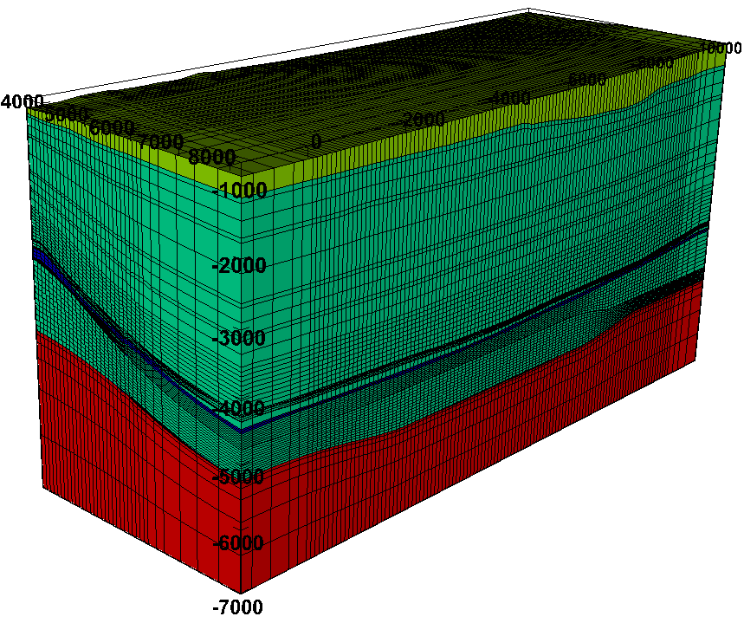
Coupled flow & geomechanics
ERE, Stanford
Seismic modeling & inversion
Geophysics, Stanford

Slide 5
starting seismic model for 4D FWI
Constraints/update on geomechanical model
Coupled flow & geomechanics
Seismic modeling & inversion
long term goal: closed-loop solution for reservoir monitoring

Slide 6
This presentation: feasibility study of geomechanics to seismic
seismic model for synthetic FWI study
Coupled flow & geomechanics
Seismic modeling & inversion
Goal # 1: feasibility to build time-lapse seismic model?
Goal # 2: understand the limitations of the acquisition geometry.
Goal # 3: develop 4D FWI strategies.

Slide 7
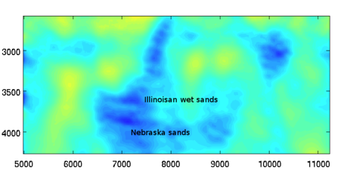
Is there a measurable 4D anisotropic effect from seismic data?
Our goal is to go beyond isotropic model to make connection between seismic and geomechanics
Time-lapse velocity change
M. Maharramov, Ph.D. Thesis, SEP-162, 2016

Slide 8
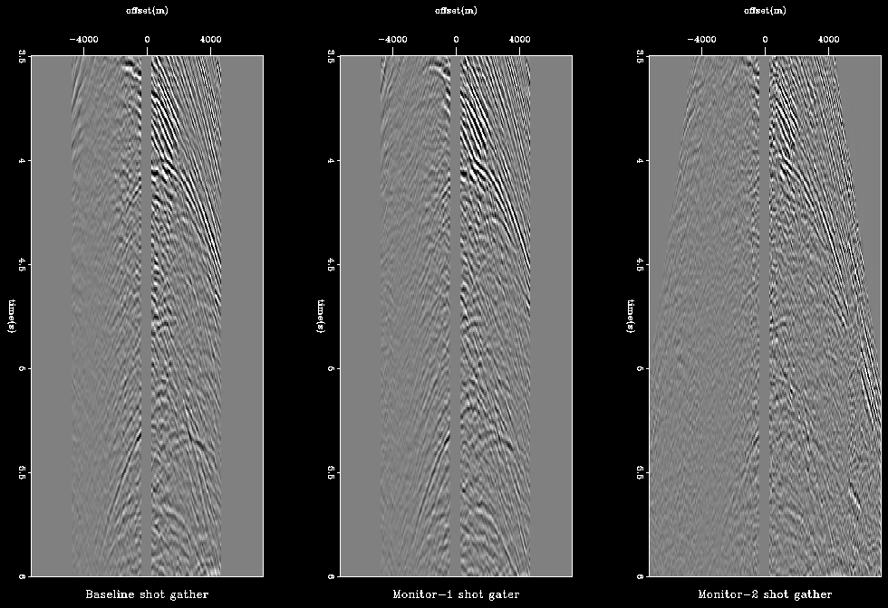
Common shot gathers after data re-processing
Baseline
Monitor
Middle panel will be muted at presentation
Maximum offset 4.5 km
Maximum offset 7.2 km

Slide 9
RTM images
VTI model is built based on NMO velocity
Not updated with FWI, tomography, etc
Ma et al., SEP 168, 2017

Slide 10
Analysis of depth shifts in migrated images
Migrate both baseline and monitor data, with the same VTI model
Anisotropic migration of baseline

Slide 11
Analysis of depth shifts in migrated images
Migrate both baseline and monitor data, with the same VTI model
Anisotropic migration of monitor

Slide 12
Analysis of depth shifts in migrated images
Migrate both baseline and monitor data, with the same VTI model
Anisotropic migration of baseline

Slide 13
Analysis of depth shifts in migrated images
Migrate both baseline and monitor data, with the same VTI model
Anisotropic migration of monitor

Slide 14
Analysis of depth shifts in migrated images
Migrate both baseline and monitor data, with the same VTI model
V-
Near offsets see an area of decreasing velocity, but far offsets do not
We have no clue about time-lapse changes in anisotropic parameters

Slide 15
Overview
Motivation: why stress-induced anisotropic parameter changes
4D VTI model building from coupled flow-geomechanical simulation
Sensitivity analysis of seismic data
Preliminary 4D FWI results

Slide 16
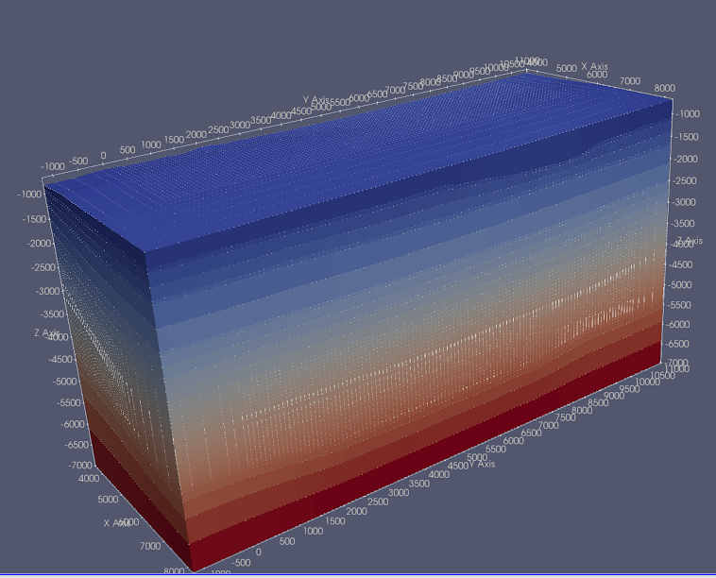
VTI model building
Young’s modulus
Vertical velocity
Finite element geomechanics model
Finite difference seismic model
Geometry challenge (FEM->FDM, scaling, artificial boundary at cell faces)
Physical challenge:
  find equations that convert geomechanical properties to seismic properties
  approximation from isotropic to anisotropic model

Slide 17
VTI model building: geomechanical properties
Young’s modulus
Density
Poisson’s ratio
The geomechanical model is isotropic
Young’s modulus, Poisson’s ratio, and density do not change with time (limited by the simulation)

Slide 18
VTI model building: geomechanical properties
Volumetric strain changes
Vertical strain changes
Significant strain changse at reservoir due to depletion
Negligible volumetric strain changes in the overburden
Vertical strain changes due to overburden dilation

Slide 19
VTI model building: baseline models
Vp
Vs
We can directly build isotropic velocity model from geomechanics

Slide 20
VTI model building: baseline model
Vz
Epsilon
Delta
Vz is the isotropic Vp
We add artificial anisotropy to baseline model
Our purpose is to study time-lapse FWI, therefore we are safe as long as the baseline model is reasonable

Slide 21
VTI model building: monitor model
We use 3rd order elasticity equations to compute the (orthorhombic) stiffness tensor change as a function of strain.
We scale the strain to remove plastic deformation
Stiffness tensor changes
Strain changes
The geomechanical simulation is done in an isotropic medium, but we apply the modeled strains to anisotropic tri-axial equations
The resulting monitor stiffness perturbations are orthorhombic in the triaxial stress-state reference frame
The final monitor model is projected to nearest VTI model
Dellinger, J., 2005, Computing the optimal transversely isotropic approximation of a general elastic tensor, GEOPHYSICS, 70 , I1–I10.

Slide 22
VTI model building: monitor model
We use 3rd order elasticity equations to compute the (orthorhombic) stiffness tensor change as a function of strain.
We scale the strain to remove plastic deformation
Stiffness tensor changes
elastic component
plastic component
Strain changes
The geomechanical simulation is done in an isotropic medium, but we apply the modeled strains to anisotropic tri-axial equations
The resulting monitor stiffness perturbations are orthorhombic in the triaxial stress-state reference frame
The final monitor model is projected to nearest VTI model
Dellinger, J., 2005, Computing the optimal transversely isotropic approximation of a general elastic tensor, GEOPHYSICS, 70 , I1–I10.

Slide 23
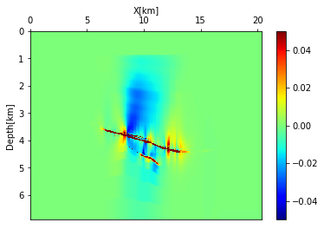
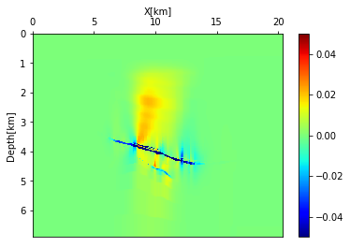
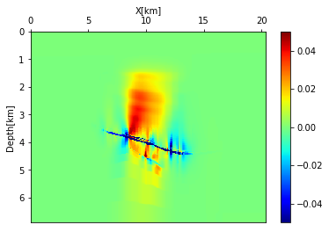
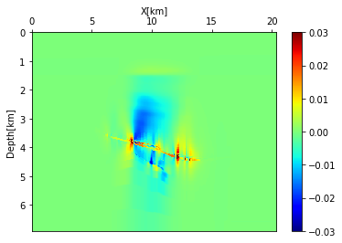
VTI model building: time-lapse change
Vertical velocity
Epsilon
Delta
Eta

Slide 24
VTI model building: time-lapse change
Goal # 1: feasibility to build time-lapse seismic model? Yes, it is feasible
Goal # 2: understand the limitation of the acquisition geometry.
Goal # 3: develop 4D FWI strategies.
Vertical velocity
Epsilon
Delta
Eta

Slide 25
Overview
Motivation: why stress-induced anisotropic parameter changes
4D VTI model building from coupled flow-geomechanical simulation
Sensitivity analysis of seismic data
Preliminary 4D FWI results

Slide 26
Experiment 1: can we detect changes from seismic data?
Migrate both baseline and monitor data, with the same VTI model
Maximum offset = 5km
Anisotropic migration of baseline

Slide 27
Experiment 1: can we detect changes from seismic data?
Migrate both baseline and monitor data, with the same VTI model
Maximum offset = 5km
Anisotropic migration of monitor

Slide 28
Experiment 1: can we detect changes from seismic data?
Migrate both baseline and monitor data, with the same VTI model
Maximum offset = 5km
Anisotropic migration of baseline

Slide 29
Experiment 1: can we detect changes from seismic data?
Migrate both baseline and monitor data, with the same VTI model
Maximum offset = 5km
Anisotropic migration of monitor

Slide 30
Experiment 1: can we detect changes from seismic data?
Migrate both baseline and monitor data, with the same VTI model
Maximum offset = 5km
V-
Anisotropic migration of baseline

Slide 31
Experiment 1: can we detect changes from seismic data?
Migrate both baseline and monitor data, with the same VTI model
Maximum offset = 5km
V-
Anisotropic migration of monitor

Slide 32
Experiment 1: can we detect changes from seismic data?
Migrate both baseline and monitor data, with the same VTI model
Maximum offset = 5km
We should be able to detect production-induced velocity changes with short-offset (5km) data.
V-
Anisotropic migration of monitor

Slide 33
Experiment 2: can we detect changes in anisotropic parameters?
Migration baseline and monitor data with correct Vz, Vnmo, and assume changes in eta is unknown
Maximum offset = 5km
Anisotropic migration of baseline

Slide 34
Experiment 2: can we detect changes in anisotropic parameters?
Migration baseline and monitor data with correct Vz, Vnmo, and assume changes in eta is unknown
Maximum offset = 5km
Anisotropic migration of monitor

Slide 35
Experiment 2: can we detect changes in anisotropic parameters?
Migration baseline and monitor data with correct Vz, Vnmo, and assume changes in eta is unknown
Maximum offset = 5km
4D anisotropic parameters has negligible effect on the curvature of angle gathers with 5km offset
Anisotropic migration of monitor

Slide 36
Experiment 2: can we detect changes in anisotropic parameters?
Migration baseline and monitor data with correct Vz, Vnmo, and assume changes in eta is unknown
Maximum offset limited by the size of the model, ~ 15 km
Anisotropic migration of baseline

Slide 37
Experiment 2: can we detect changes in anisotropic parameters?
Migration baseline and monitor data with correct Vz, Vnmo, and assume changes in eta is unknown
Maximum offset limited by the size of the model, ~ 15 km
Anisotropic migration of monitor

Slide 38
Experiment 2: can we detect changes in anisotropic parameters?
Migration baseline and monitor data with correct Vz, Vnmo, and assume changes in eta is unknown
Maximum offset limited by the size of the model
Production induced changes in anisotropic parameters can be detected if:
Long-offset data
Anisotropic migration of monitor

Slide 39
Experiment 2: can we detect changes in anisotropic parameters?
Migration baseline and monitor data with correct Vz, Vnmo, and assume changes in eta is unknown
Maximum offset limited by the size of the model
Production induced changes in anisotropic parameters can be detected if:
Long-offset data
Data are clean
No significant non-repeatability issues
Careful data processing
Accurate estimation of the velocity model
Anisotropic migration of monitor

Slide 40
Experiment 2: can we detect changes in anisotropic parameters?
Migration baseline and monitor data with correct Vz, Vnmo, and assume changes in eta is unknown
Maximum offset limited by the size of the model
Goal # 1: feasibility to build time-lapse seismic model? Yes, it is feasible!
Goal # 2: understand the limitation of the acquisition geometry. We need long-offset data!
Goal # 3: develop 4D FWI strategies.
Anisotropic migration of monitor

Slide 41
Overview
Motivation: why stress-induced anisotropic parameter changes
4D VTI model building from coupled flow-geomechanical simulation
Sensitivity analysis of seismic data
Preliminary 4D FWI results

Slide 42
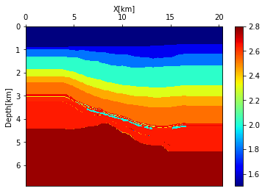
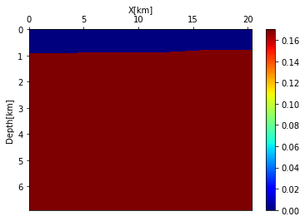
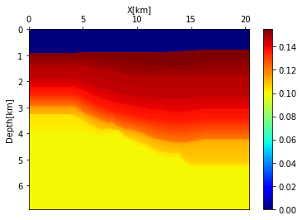
Baseline VTI model
Vertical velocity
Epsilon
Delta

Slide 43
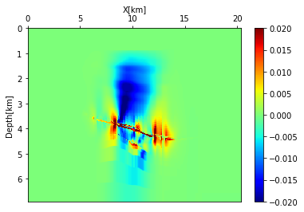
Time-lapse changes
True Eta changes

Slide 44
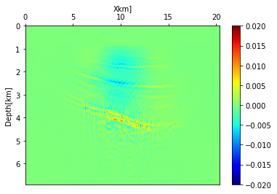
Time-lapse changes
Offsets up to 5 km
True Eta changes
Estimated Eta changes

Slide 45
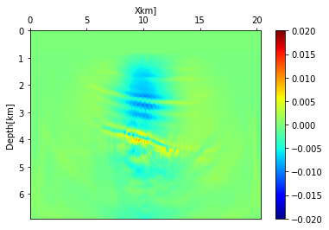
Time-lapse changes
Offsets up to 5 km
True Eta changes
Estimated Eta changes
Offsets up to 20 km
Estimated Eta changes

Slide 46
Time-lapse changes
Offsets up to 5 km
Goal # 1: feasibility to build time-lapse seismic model? Yes, it is feasible!
Goal # 2: understand the limitation of the acquisition geometry. We need long offset data!
Goal # 3: develop 4D FWI strategies. In progress.
True Eta changes
Estimated Eta changes
Offset up to 20 km
Estimated Eta changes

Slide 47
Next: how can we improve 4D VTI FWI results?
We have no control over the data acquisition, data processing
Non-physical constraint (no extra info added)
  Minimum-norm
  Total-variation regularization
Physical/geological constraint (extra info added)
  Image alignment between baseline image and monitor image
  Constraint by elasticity equations

Slide 48
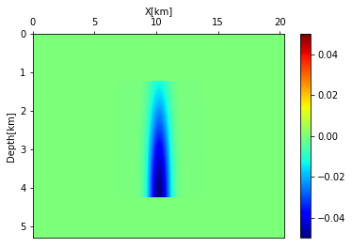
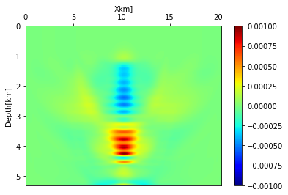
Preliminary results
Correct sign at shallow area
True model
Inversion without reg
Eta
Eta
wrong sign at shallow area

Slide 49
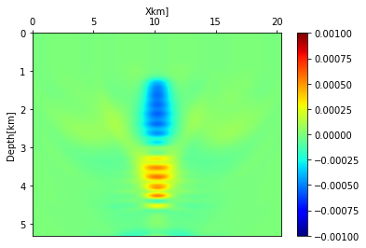
Preliminary results
Correct sign at shallow area
True model
Inversion without reg
Eta
Eta
wrong sign at shallow area
Minimum norm reg
Eta

Slide 50
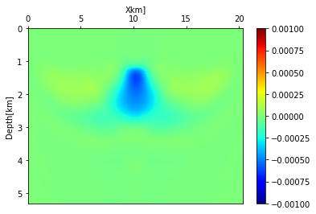
Preliminary results
Correct sign in shallow area
True model
Inversion without reg
Eta
Eta
wrong sign at shallow area
Total variation reg
Minimum norm reg
Eta
Eta

Slide 51
This presentation: feasibility study of geomechanics to seismic
seismic model for synthetic FWI study
Coupled flow & geomechanics
Seismic modeling & inversion
Goal # 1: feasibility to build time-lapse seismic model? Yes, it is feasible!
Goal # 2: understand the limitation of the acquisition geometry. We need long offset data!
Goal # 3: develop 4D FWI strategies. In progress

Slide 52
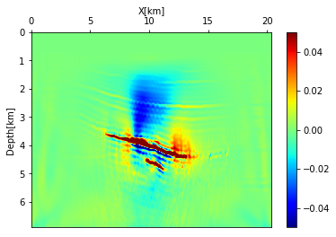
Summary of workflow and road ahead
Starting point
3rd order elasticity
Time-lapse change of stiffness tensor
Time-lapse change of seismic properties
Coupled flow & geomechanics
modeling
Seismic data
Update geomechanical model
(beyond my work)
We are here==>
Inversion (FWI, etc)
<== My target
Non-deterministic
Estimated time-lapse change of stiffness tensor
Estimated strain
Estimated time-lapse change of seismic properties

Slide 53
We would like to thank Chevron, ExxonMobil and BHP for sharing the Genesis dataset
SUPRI-B for providing ADGPRS simulation package
Mark A. Meadows (Chevron) and Timur Garipov (previously Stanford) for their help in this project

Slide 54
Thank you and questions?
Starting point
3rd order elasticity
Time-lapse change of stiffness tensor
Time-lapse changes of seismic properties
Coupled flow & geomechanics
modeling
Seismic data
Update geomechanical model
(beyond my work)
We are here==>
Inversion (FWI, etc)
<== My target
Non-deterministic
Estimated time-lapse changes of stiffness tensor
Estimated strain
Estimated time-lapse changes of seismic properties

Slide 55
END OF PRESENTATION

Slide 56
Backup slides #1: 4D FWI strategies

Slide 57
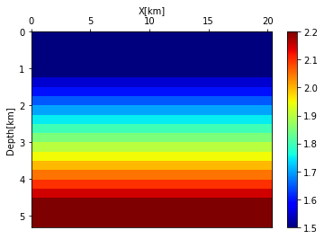
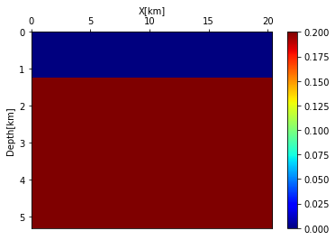
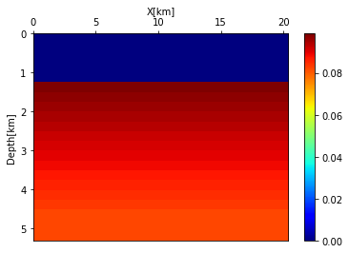
FWI on simple synthetic model: baseline model
Vertical velocity
Epsilon
Delta

Slide 58
Backup slides #2: image alignment

Slide 59
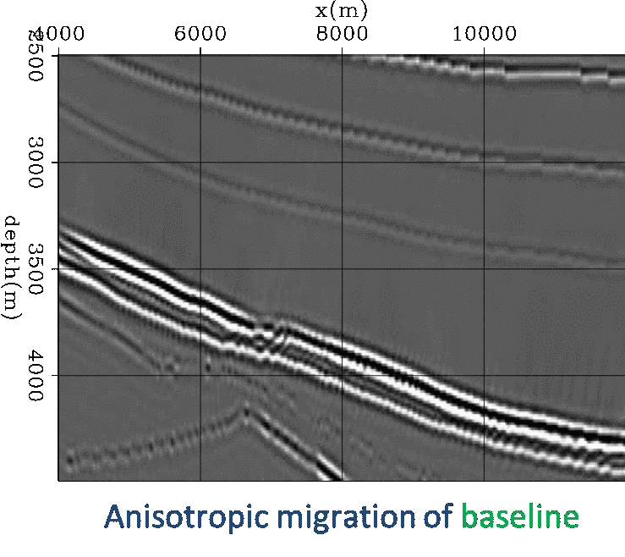
Physical constraints
Misalignment mostly due to change in V_{z}
We may use image alignment as regularization to estimate change in V_{z}

