Slide 1
Yang Zhang
5th year PhD student
RMO based wave-equation migration velocity analysis
2011, steering filter with Schlumberger
2012,2013 RTM WEMVA with Chevron
seg2013 abstract on partial stack-power-maximization objective function
Notes:
Good evening everyone, thank you for being here.
I am a 5th year student in SEP.
My research focus on advance imaging algorithm using linearized inversion (commonly known as LSRTM).
My main interest is on imaging with multiples. I use inversion to get extra subsurface illumination from the multiples in hard to image areas.
My other research involves joint imaging of up- and down-going OBN data and to combine streamer and OBN data.

Slide 2
RMO based WEMVA
Use similar workflow from ray-based tomography, but with finite-frequency wave kernels (SEP-147)
RMO parameter
Cost function associates velocity model through RMO
Modified image space wave-equation tomographic operator
Stanford Exploration Project

Slide 3
RMO based WEMVA (II)
Acceleration scheme (SEP-149, seg2013 abstract)
ADCIG reconstruction from subsampled ODCIG using compressed-sensing
Cheaper image residual back-projection with an approximated image/data pair
Stanford Exploration Project

Slide 4
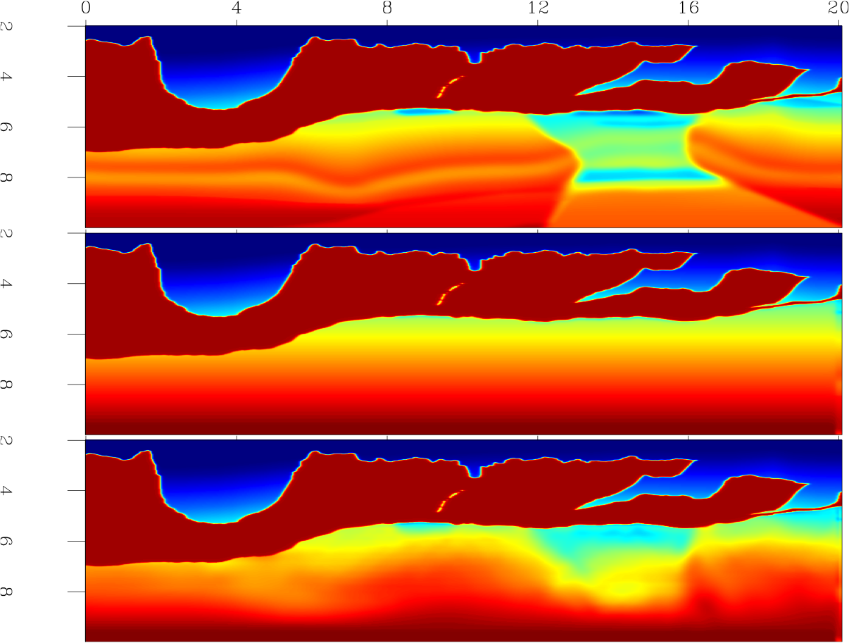
Synthetic BP model results
x(km)
True
z(km)
Initial
RMO

Slide 5
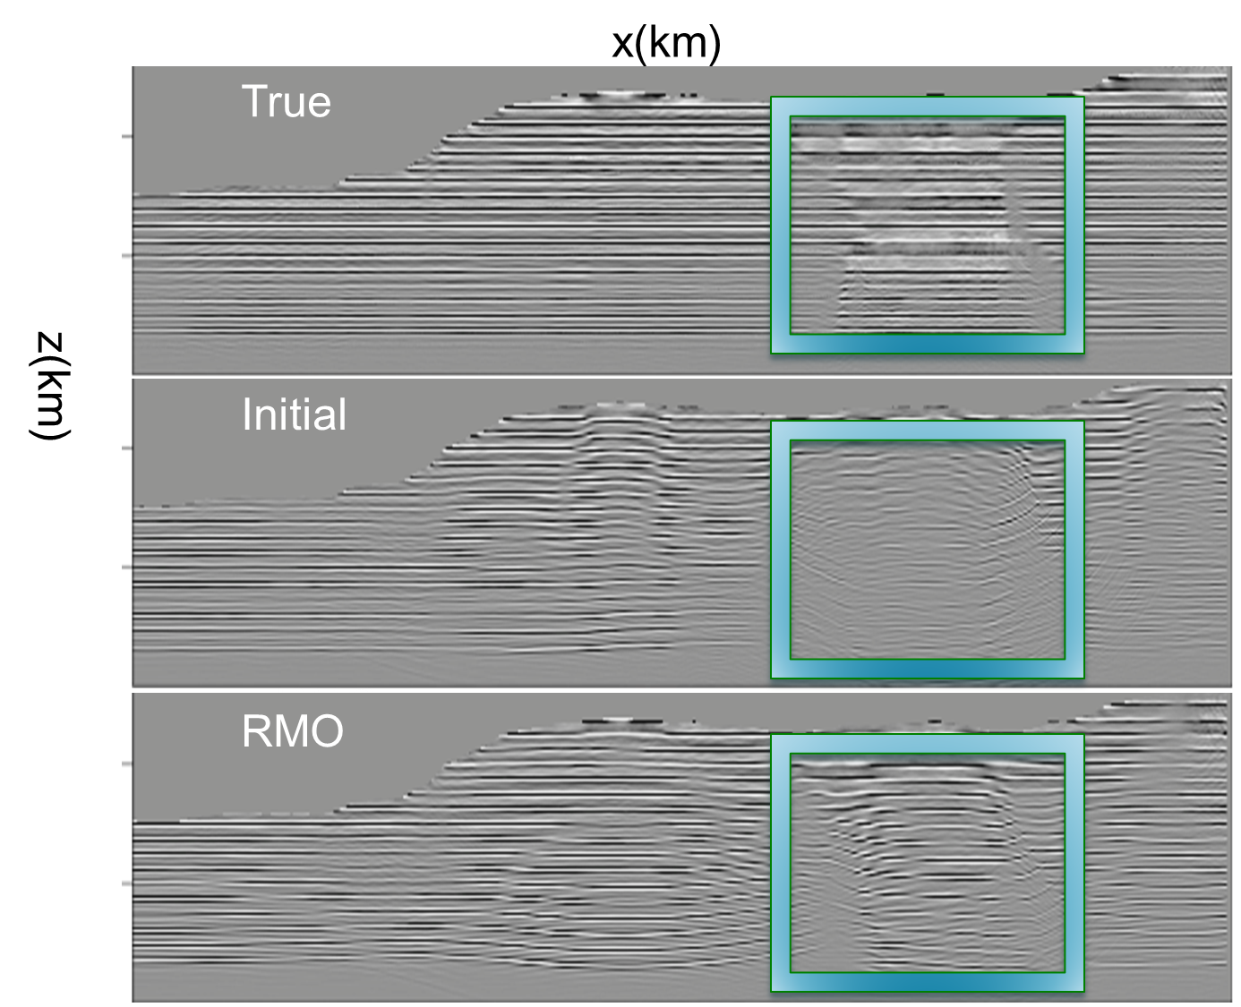

Slide 6
