Slide 1
Efficient and robust waveform-inversion workflow: tomographic FWI followed by FWI
Biondo Biondi & Ali Almomin
SEP Meeting
June 3, 2014
Notes:
Good morning
I must confess that I am excited about the work that Ali and I will present you in the next hour. I believe we have finally cracked the nut on how to estimate reliably high-resolution velocity models such as
the ones that are routinely produced by FWI,
But with the robust convergence properties of WEMVA-like methods. And all of this at a computational cost that is reasonable; that is, comparable to the one of these two methods.
Because the method fit the recorded waveforms but optimally uses the kinematic information in the data, we called it Tomographic Full Waveform Inversion or TFWI.
The program for the hour is that I will present you first a complete and self-consistent solution, that is however computationally very expensive.
My task is to motivate the approach and convince you that it is appealing.
Once I sold you on the general idea, Ali will present a method to achieve similar results, but at reasonable computational cost.
If you allow me the car analogy, I will sell you the concept of a Ferrari, but Ali will then deliver a Chevy at a price you like.
I must also add that TFWI as I present it is not 100% new, because it is related to work presented by Bill Symes in recent years.

Slide 2
“Mud volcano” in BP 2005 model

Slide 3
Starting model

Slide 4
Data with true model
Diving waves
Refractions
Reflections from gas clouds

Slide 5
Data with starting model
Diving waves
Refractions

Slide 6
FWI result – stuck at 200 iterations

Slide 7
TFWI after 35 outer iterations

Slide 8
“Mud volcano” in BP 2005 model

Slide 9
TFWI vs. FWI convergence ≈ cost

Slide 10
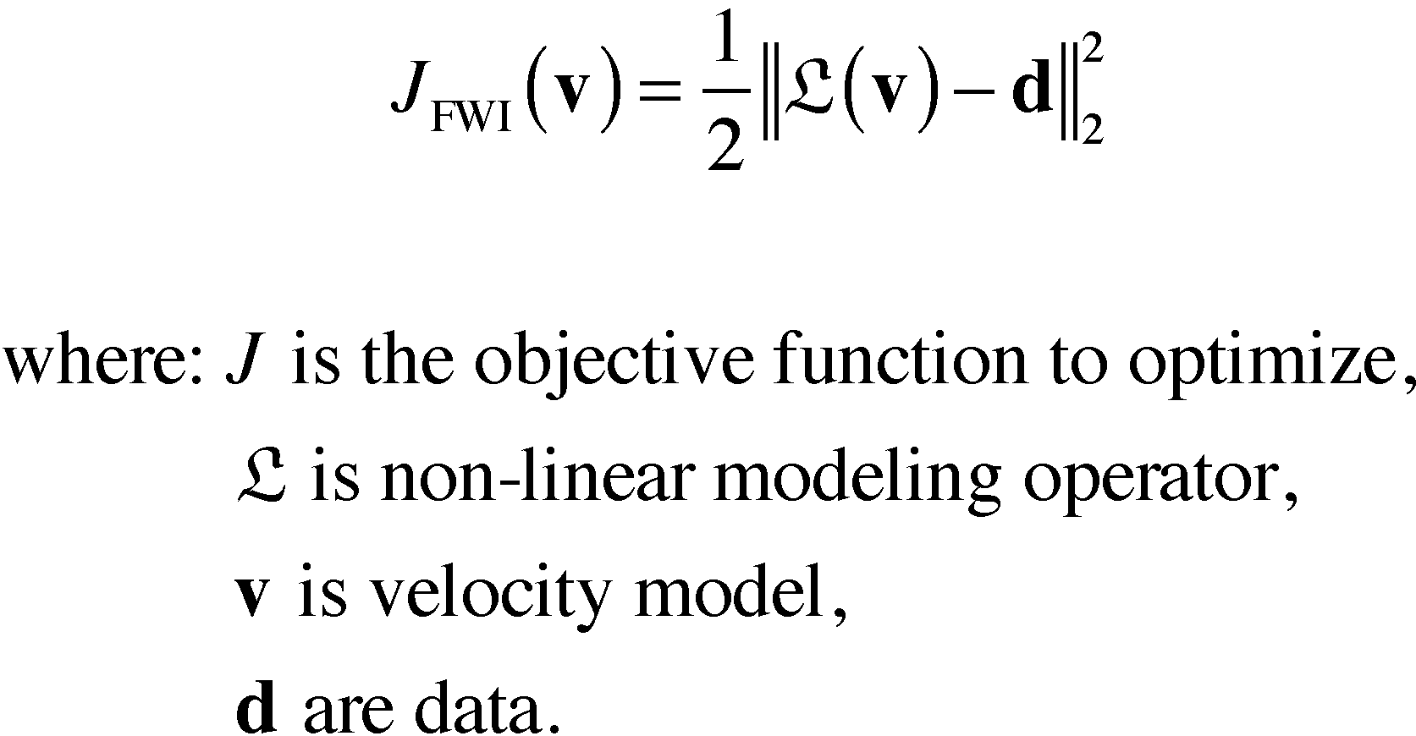
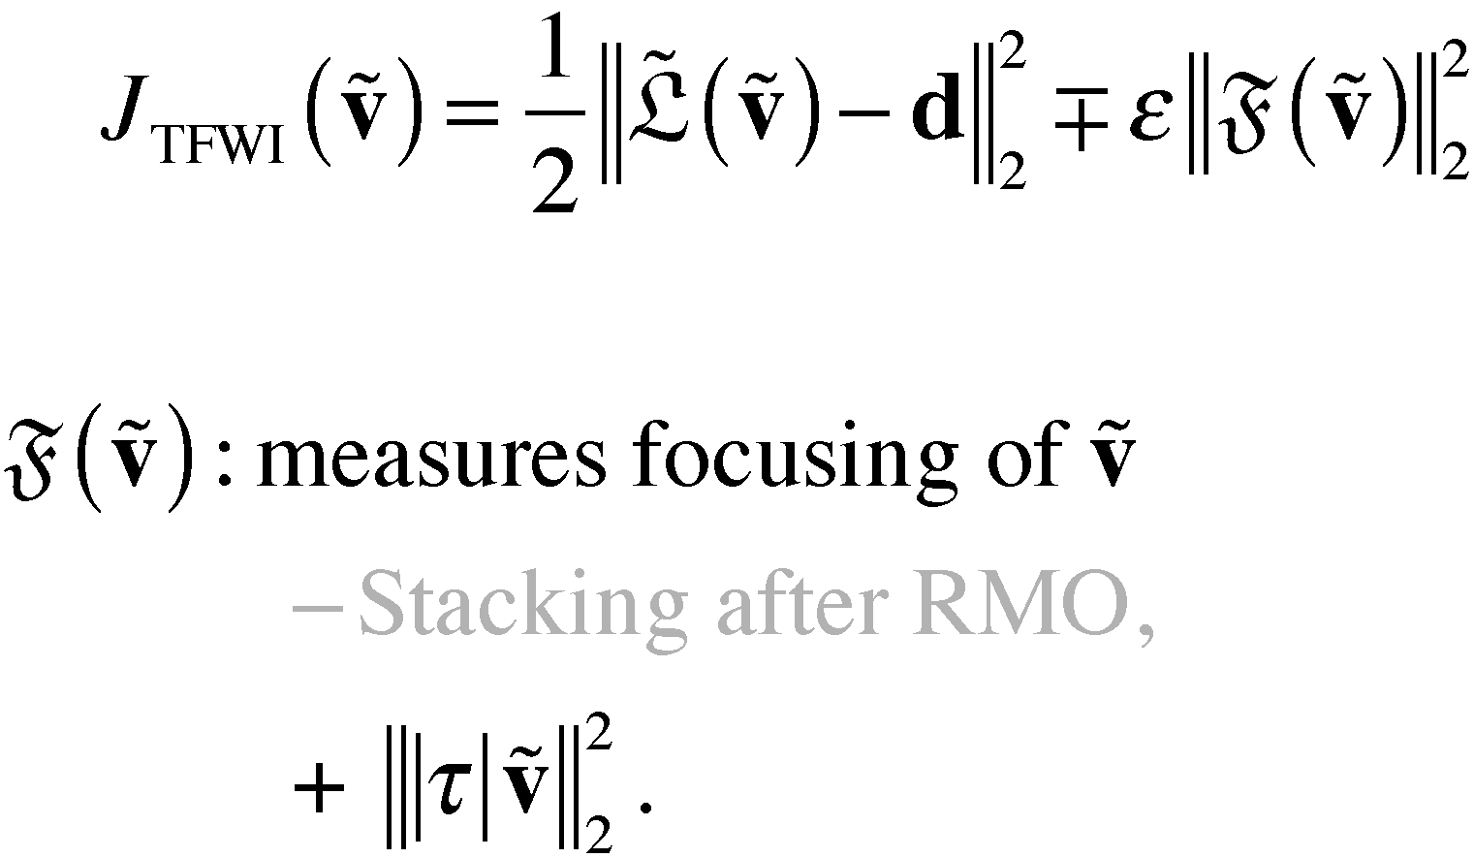
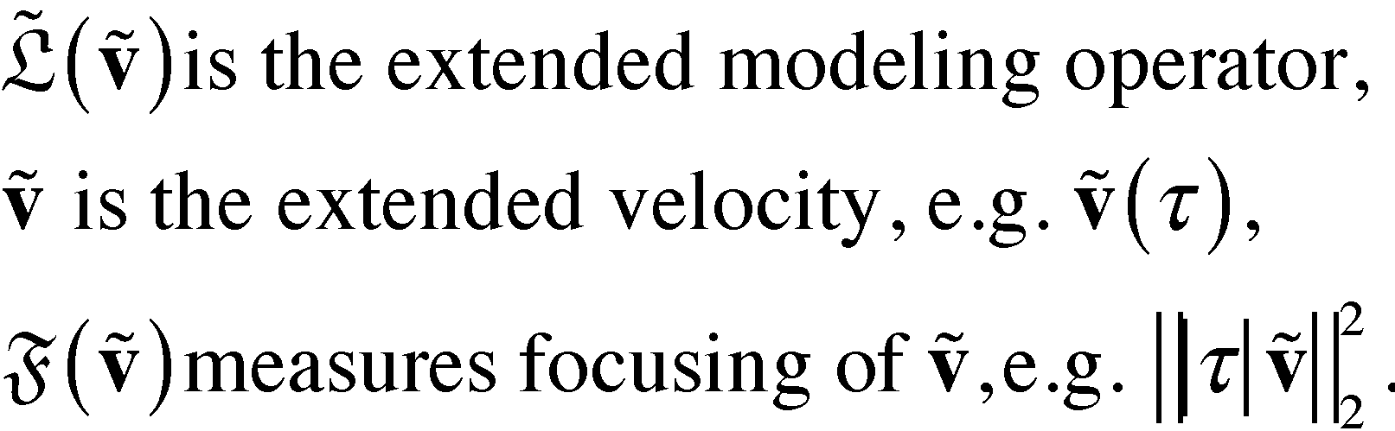
FWI vs. TFWI
FWI
TFWI
Notes:
We can thus define an Extended FWI, or EFWI, that minimizes the objective function on the right box.
It is similar to the objective function used in prestack linearized inversion, except that the modeling operators
L tilde is fully non linear as a function of the velocity model.
Notice that the domain over which the velocity is now defined comprises also the subsurface offset axis.
This is needed to be able to preserve the energy that is imaged away from zero-subsurface offset by the
backprojection of the residuals.
To the best of my knowledge, this objective function in this form was first published by Bill Symes in a Geophysical Prospecting paper in 2008.

Slide 11
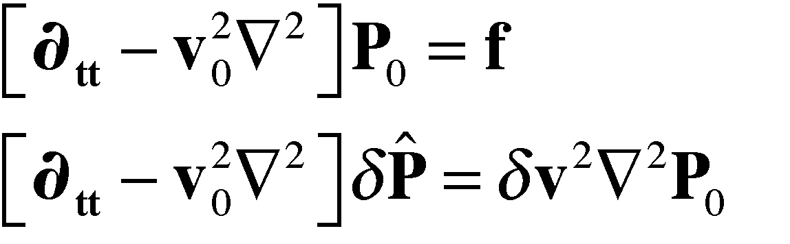
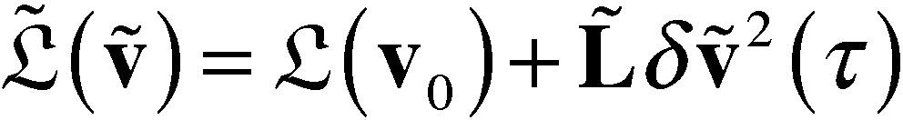
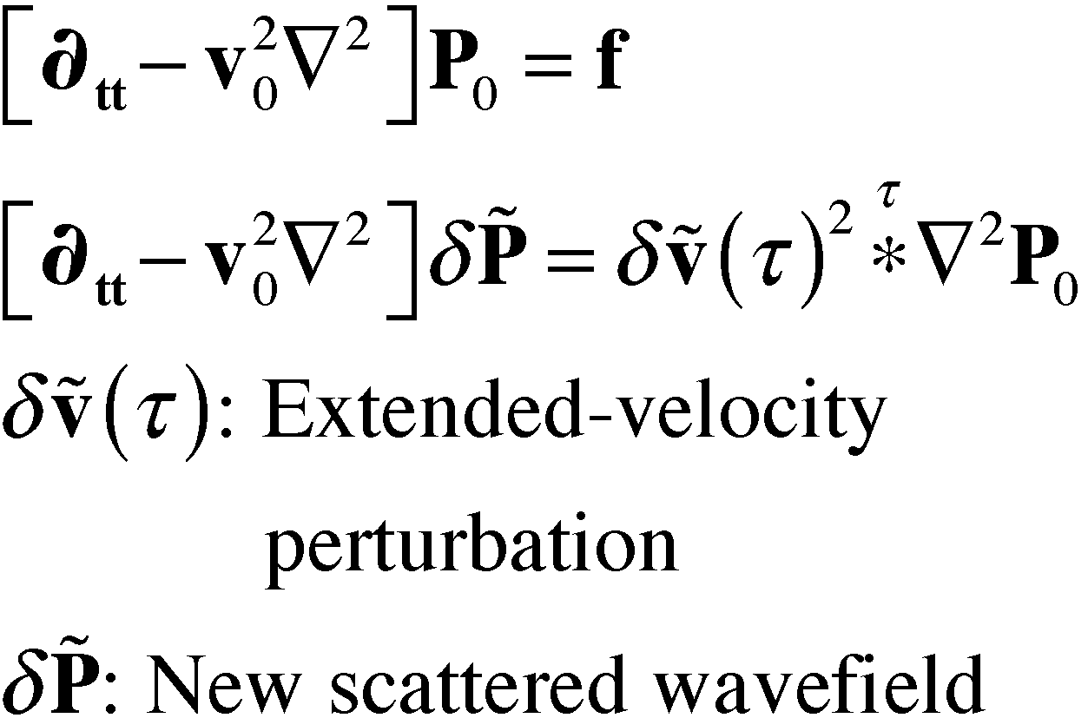
Cost of FWI vs. TFWI
FWI
TFWI
Cost ∞ freq⁴
Cost ∞ freq⁴
Notes:
We can thus define an Extended FWI, or EFWI, that minimizes the objective function on the right box.
It is similar to the objective function used in prestack linearized inversion, except that the modeling operators
L tilde is fully non linear as a function of the velocity model.
Notice that the domain over which the velocity is now defined comprises also the subsurface offset axis.
This is needed to be able to preserve the energy that is imaged away from zero-subsurface offset by the
backprojection of the residuals.
To the best of my knowledge, this objective function in this form was first published by Bill Symes in a Geophysical Prospecting paper in 2008.

Slide 12
Cost of FWI vs. TFWI
FWI
TFWI
Cost ∞ freq⁴
Cost ∞ (1+freq•Δv)•freq⁴
Notes:
We can thus define an Extended FWI, or EFWI, that minimizes the objective function on the right box.
It is similar to the objective function used in prestack linearized inversion, except that the modeling operators
L tilde is fully non linear as a function of the velocity model.
Notice that the domain over which the velocity is now defined comprises also the subsurface offset axis.
This is needed to be able to preserve the energy that is imaged away from zero-subsurface offset by the
backprojection of the residuals.
To the best of my knowledge, this objective function in this form was first published by Bill Symes in a Geophysical Prospecting paper in 2008.

Slide 13
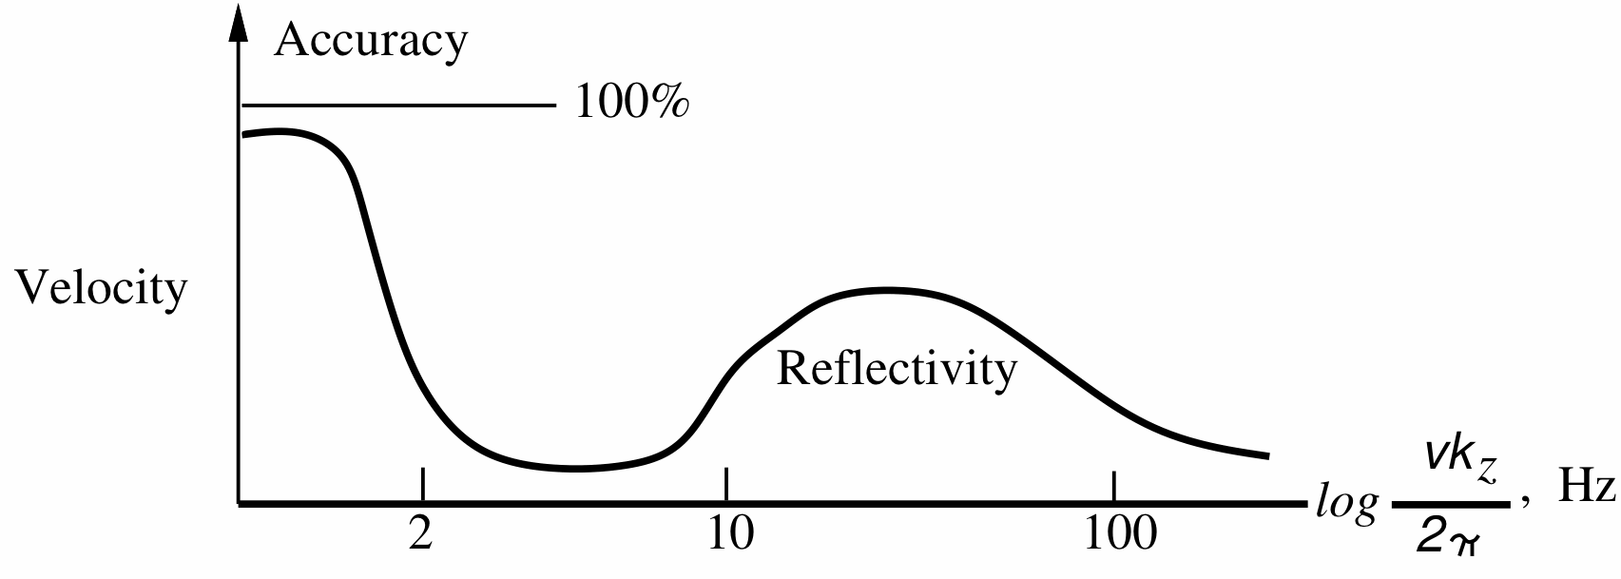
Scale separation in
seismic imaging
From Jon Claerbout’s “Imaging the Earth Interior”

Slide 14
FWI tries to close the gap by using reflectivity from low-frequency data …
Low-frequency
data

Slide 15
hoping to get close enough for the FWI tomographic component to converge
Low-frequency
data
FWI tomographic
component

Slide 16
TFWI improves convergence of the tomographic component
Low-frequency
data
TFWI tomographic
component

Slide 17
Can we run TFWI only on the low frequencies?
TFWI
FWI

Slide 18
True Marmousi 2 model

Slide 19
Starting model

Slide 20
FWI & freq. continuation (3-25 Hz)

Slide 21
TFWI all frequencies (3-25 Hz)

Slide 22
TFWI (3-10 Hz) after 30 iterations

Slide 23
TFWI (3-10 Hz) + FWI (10-25 Hz)

Slide 24
TFWI all frequencies (3-25 Hz)

Slide 25
FWI & freq. continuation (5-25 Hz)

Slide 26
TFWI all frequencies (5-25 Hz)

Slide 27
TFWI (5-10 Hz) after 20 iterations

Slide 28
TFWI (5-10 Hz) + FWI (10-25 Hz)

Slide 29
TFWI all frequencies (5-25 Hz)

Slide 30
Can we run TFWI only on the low frequencies? Yes!
TFWI
FWI

Slide 31
Can we stop TFWI before it reaches convergence?
TFWI
FWI

Slide 32
TFWI (5-10 Hz) after 10 iterations

Slide 33
TFWI (5-25 Hz & 10 iter.) + FWI

Slide 34
TFWI (5-25 Hz & 20 iter.) + FWI

Slide 35
TFWI (5-10 Hz) after 5 iterations

Slide 36
TFWI (5-25 Hz & 5 iter.) + FWI

Slide 37
TFWI (5-25 Hz & 20 iter) + FWI

Slide 38
Can we stop TFWI before it reaches convergence? With care
TFWI
FWI

Slide 39
Conclusions
  Cost of TFWI iterations is proportional to the fifth power of the maximum frequency in the data.
  A workflow that: 1) uses TFWI on the low frequencies in the data and then 2) switches to FWI can be a good compromise between cost and convergence properties.
  Further computational savings could be achieved by not running TFWI to full convergence on the low frequencies.
  Field-data tests are next!
Notes:
Best place to start demonstrating that a velocity inversion method is attractive is showing its application on Marmousi, or the deep water variation of Marmousi
that you see displayed on the screen.
This is the “true” model, and …

Slide 40
Acknowledgments
  Frank Agnar Maaø with Statoil for first suggesting the idea of the TFWI+FWI workflow
Notes:
Best place to start demonstrating that a velocity inversion method is attractive is showing its application on Marmousi, or the deep water variation of Marmousi
that you see displayed on the screen.
This is the “true” model, and …

Slide 42
Scale separation in seismic imaging
From Jon Claerbout’s “Imaging the Earth Interior”

Slide 43
Gap is closing
Tomographic
velocities
Low-frequency
data

