Slide 1
High-frequency surface and body waves from ambient noise cross-correlations at Long Beach, CA
Jason P. Chang, Sjoerd de Ridder, and Biondo Biondi
June 4, 2014
SEP Sponsors Meeting
SEP152-279

Slide 2
Outline
Recap / motivation
Ambient noise cross-correlation method
High-frequency Rayleigh waves
Body waves
Conclusions / future direction

Slide 3
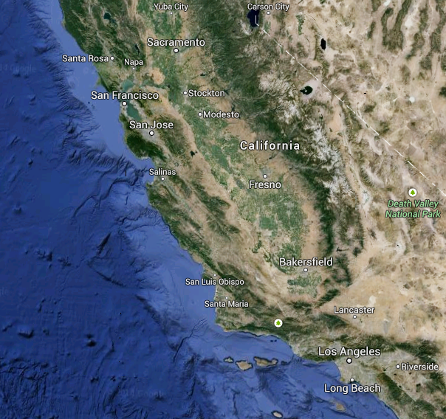
Long Beach array

Slide 4
Long Beach array
8.5 x 4 km² region
2400-3000 vertical-component geophones
100 m average station spacing
3 months of continuous (24 hr/day) recording

Slide 5
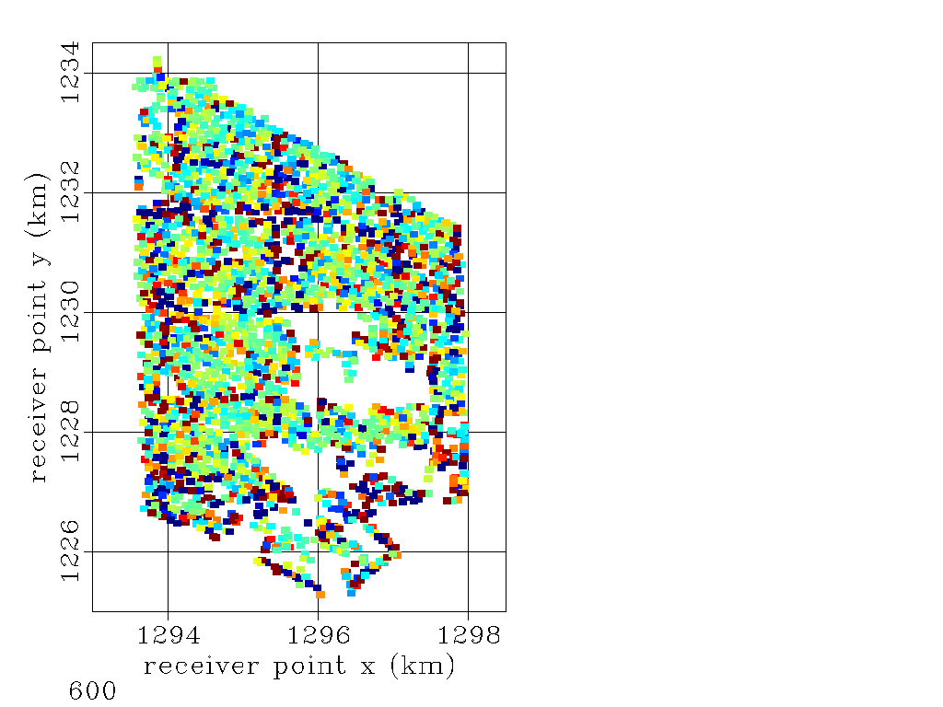
Long Beach array
8.5 x 4 km² region
2400-3000 vertical-component geophones
100 m average station spacing
3 months of continuous (24 hr/day) recording
(s)

Slide 6
Beamforming
3.5-4.0 Hz
px (s/km)
-4 -2 0 2 4
N
-4 -2 0 2 4
  Traffic noise generates high-frequency Rayleigh waves
-4 -2 0 2 4
-4 -2 0 2 4
-4 -2 0 2 4
-4 -2 0 2 4

Slide 7
Virtual super-source gather
Can identify body-wave energy up to 4 Hz

Slide 8
Virtual super-source gather
Can identify body-wave energy up to 4 Hz
2 km/s

Slide 9
Motivation
Is there coherent energy at frequencies well beyond the microseism band (up to 15 Hz)?
Want to better-separate surface waves from body waves

Slide 10
Motivation
Higher-frequency surface waves can be used to characterize the near-surface
  Important for earthquake hazard analysis
Body waves can be used to characterize the subsurface with high resolution
  Need body waves for reflection imaging

Slide 11
Outline
Recap / motivation
Ambient noise cross-correlation method
High-frequency Rayleigh waves
Body waves
Conclusions / future direction

Slide 12
ANCC idea
record ambient noise

Slide 13
ANCC idea
cross-correlate

Slide 14
ANCC idea
estimate of Green’s function (EGF)

Slide 15
ANCC implementation

Slide 16
Outline
Recap / motivation
Ambient noise cross-correlation method
High-frequency Rayleigh waves
Body waves
Conclusions / future direction

Slide 17
Virtual source gathers
Focus on a line of receivers perpendicular to Interstate 405
Move through virtual source locations (from south to north)
35 days of correlations

Slide 18
Virtual source gathers
Focus on a line of receivers perpendicular to Interstate 405
Move through virtual source locations (from south to north)
35 days of correlations
Interstate 405
E 7th St

Slide 19
Virtual source gathers (3-5 Hz)

Slide 20
Virtual source gathers (3-5 Hz)

Slide 21
Virtual source gathers (3-5 Hz)

Slide 22
Virtual source gathers (3-5 Hz)
280 m/s

Slide 23
Virtual source gathers (3-5 Hz)

Slide 24
Virtual source gathers (3-5 Hz)

Slide 25
Virtual source gathers (3-5 Hz)

Slide 26
Virtual source gathers (3-5 Hz)

Slide 27
Virtual source gathers (3-5 Hz)

Slide 28
Virtual source gathers (3-5 Hz)

Slide 29
Virtual source gathers (3-5 Hz)

Slide 30
Virtual source gathers (3-5 Hz)

Slide 31
Virtual source gathers (3-5 Hz)

Slide 32
Virtual source gathers (3-5 Hz)

Slide 33
Virtual source gather: observations
Two strong sources
  Highway (Interstate 405)
  Busy street (E 7th Street)
How reliable are these high-frequency Rayleigh waves?

Slide 34
Reliability of Rayleigh waves
Group velocity dispersion images
Arrival time as a function of azimuth

Slide 35
Group arrivals
Based on peak of the envelope of the correlation result

Slide 36
Group-velocity dispersion images
For a single EGF, display envelopes for a number of frequencies
Peaks correspond to wave arrivals
Results are shown in the slowness-frequency domain

Slide 37
Dispersion images for reliability
Compare four virtual source locations and similarly-oriented receivers

Slide 38
Dispersion images for reliability
virtual source

Slide 39
Dispersion images for reliability
receiver

Slide 40
Dispersion images for reliability
1.1 km

Slide 41
Dispersion images for reliability

Slide 42
Dispersion images for reliability

Slide 43
Dispersion images for reliability

Slide 44
Dispersion images for reliability

Slide 45
Dispersion images for reliability

Slide 46
Dispersion images for reliability

Slide 47
Dispersion images for reliability

Slide 48
Dispersion images: observations
Nearby virtual source-receiver paths display similar patterns
  Recovering consistent and stable EGFs
Smoother EGFs when parallel to the highway rather than perpendicular
  More energy in the Fresnel zones

Slide 49
Dispersion images: observations

Slide 50
Dispersion images: observations

Slide 51
Dispersion images: observations

Slide 52
Arrival time vs azimuth
Plot arrival time as a function of virtual source-receiver azimuth
  To determine reliability of arrival times from different azimuths at different frequencies
  Select ring of receivers 1.1 km away from the virtual source

Slide 53
Northern stations
90
±180
0
-90

Slide 54
Arrival time vs azimuth: 3 Hz
250 m/s
500 m/s
W
S
E
W
S
E

Slide 55
Arrival time vs azimuth: 3 Hz
250 m/s
500 m/s
W
S
E
W
S
E

Slide 56
Arrival time vs azimuth: 4 Hz
250 m/s
500 m/s
W
S
E
W
S
E

Slide 57
Arrival time vs azimuth: 4 Hz
250 m/s
500 m/s
W
S
E
W
S
E

Slide 58
Arrival time vs azimuth: 5 Hz
250 m/s
500 m/s
W
S
E
W
S
E

Slide 59
Southern stations
90
±180
0
-90

Slide 60
Arrival time vs azimuth: 3 Hz
250 m/s
500 m/s
W
S
E
W
S
E

Slide 61
Arrival time vs azimuth: 3 Hz
250 m/s
500 m/s
W
S
E
W
S
E

Slide 62
Arrival time vs azimuth: 4 Hz
250 m/s
500 m/s
W
S
E
W
S
E

Slide 63
Arrival time vs azimuth: 4 Hz
250 m/s
500 m/s
W
S
E
W
S
E

Slide 64
Arrival time vs azimuth: 5 Hz
250 m/s
500 m/s
W
S
E
W
S
E

Slide 65
Arrival time vs azimuth: observations
Can use EGFs along various azimuths at high frequencies
  Up to 5 Hz if carefully selective
More reliable when either the virtual source or the receiver is near the highway

Slide 66
High-frequency surface waves: recap
Surface waves at these frequencies are generated by traffic energy
Arrival times along different azimuths can be regarded as reliable
Harness Rayleigh waves from traffic energy for input into a 2D transmission tomography

Slide 67
Outline
Recap / motivation
Ambient noise cross-correlation method
High-frequency Rayleigh waves
Body waves
Conclusions / future direction

Slide 68
Body waves
Difficult to recover
  Body waves attenuate more rapidly with distance than surface waves
  Noise sources are often near the surface
To boost body-wave energy, stack over all virtual source gathers
  Expect to recover diving waves and refractions

Slide 69
Body waves
Frequency range: 3-15 Hz
35 days of data
No spatial resolution

Slide 70
Body waves
Frequency range: 3-15 Hz
35 days of data
No spatial resolution
Appears to be diving waves
2.75 km/s
2 km/s

Slide 71
Body waves
What direction are they coming from?
Where are they the strongest?

Slide 72
What direction are body waves coming from?
Strategy:
  Look at super-source gathers as a function of azimuth
  Stacking over multiple virtual sources within each 10-degree azimuth bin

Slide 73
Direction: south-southeast (-55 to -65 deg.)
0.5 – 1 Hz
3-15 Hz

Slide 74
Direction: south-southeast (-55 to -65 deg.)
0.5 – 1 Hz
3-15 Hz
0.5 km/s
1 km/s
2 km/s

Slide 75
Direction: south (-95 to -85 deg.)
0.5 – 1 Hz
3-15 Hz

Slide 76
Direction: south (-95 to -85 deg.)
0.5 – 1 Hz
3-15 Hz
0.5 km/s
1 km/s
2 km/s

Slide 77
Where are body waves strongest?
Strategy:
  Look at super-source gathers from square patches of receivers of various sizes throughout the array
  The smaller the patch size needed to resolve body waves, the stronger the body-wave energy is in that region

Slide 78
Receiver patches
Square patches centered along a regular grid with 0.75 km-spacing

Slide 79
Receiver patches
Square patches centered along a regular grid with 0.75 km-spacing

Slide 80
Receiver patches
2x2 km² patch
  Approx. 370 receivers

Slide 81
Receiver patches
2x2 km² patch
  Approx. 370 receivers
3x3 km² patch
  Approx. 750 receivers

Slide 82
Receiver patches
2x2 km² patch
  Approx. 370 receivers
3x3 km² patch
  Approx. 750 receivers
4x4 km² patch
  Approx. 1270 receivers

Slide 83
Receiver patches
2x2 km² patch
  Approx. 370 receivers
3x3 km² patch
  Approx. 750 receivers
4x4 km² patch
  Approx. 1270 receivers
5x5 km² patch

Slide 84
Receiver patches
2x2 km² patch
  Approx. 370 receivers
3x3 km² patch
  Approx. 750 receivers
4x4 km² patch
  Approx. 1270 receivers
5x5 km² patch

Slide 85
Patch: 1295 km, 1230 km
2x2 km²
3x3 km²

Slide 86
Patch: 1295.75 km, 1230.75 km
2x2 km²
3x3 km²

Slide 87
Super-source gather patches
Colors correspond to minimum patch size needed to resolve body waves
  Green: 2x2 km²
  Blue: 3x3 km²
  Yellow: 4x4 km²
  Red: 5x5 km² +

Slide 88
Super-source gather patches: observations
Best resolved in the center of the array
Difficult to resolve around the highway
  Highway cuts through center of those patches
  Contaminated by surface waves

Slide 89
Body waves: recap
Arrive primarily from the north-northwest
Strongest in the center of the array (but not near the highway)
Source of this energy is difficult to infer
  Possibilities include city of Los Angeles and highways

Slide 90
Outline
Recap / motivation
Ambient noise cross-correlation method
High-frequency Rayleigh waves
Body waves
Conclusions / future direction

Slide 91
Conclusions: general
Can recover surface waves and body waves from ambient noise at frequencies well beyond the microseism band
  Surface waves: up to 5 Hz
  Body waves: up to 15 Hz

Slide 92
Conclusions: surface waves
Generated by busy roads and highways
Can be reliable enough for use in a 2D transmission tomography framework

Slide 93
Conclusions: body waves
Dominantly arriving from the north-northwest direction
Strongest in the center of the array
Still need to sum over multiple virtual source gathers

Slide 94
Future direction
Use high-frequency Rayleigh waves generated by Interstate 405 to perform a 2D tomography
Important for fields such as earthquake hazard analysis

Slide 95
Acknowledgments
Signal Hill Petroleum, Inc. for access to the dataset and permission to show results
Dan Hollis and NodalSeismic for help obtaining the data
Nori Nakata and Bob Clapp for fruitful conversations and guidance
Stew Levin for help converting the data

Slide 96
Questions?

