Slide 1

Imaging with multiples using least-squares reverse-time migration
SEP Sponsor Meeting
June 4th, 2014
Thesis presentation
Mandy Wong
Stanford Exploration Project

Slide 2
Thesis Overview
Chapter 1: Introduction
Chapter 2: Joint LSRTM of up- and down-going data on 2D OBN data
Chapter 3: 3D field data applications – the Deimos dataset
Chapter 4: Joint LSRTM of primary and higher-order multiples
Chapter 5: 3D synthetic data example (under construction)
Chapter 6: Conclusion

Slide 3
Thesis Overview
Chapter 1: Introduction
Chapter 2: Joint LSRTM of up- and down-going data on 2D OBN data
Chapter 3: 3D field data applications – the Deimos dataset
Chapter 4: Joint LSRTM of primary and higher-order multiples
Chapter 5: 3D synthetic data example (under construction)
Chapter 6: Conclusion

Slide 4
Thesis Overview
Chapter 1: Introduction
Chapter 2: Joint LSRTM of up- and down-going data on 2D OBN data
  Theory
  2D Seam field data example
  Cascadia 2D field data example
Chapter 3: 3D field data applications – the Deimos dataset
Chapter 4: Joint LSRTM of primary and higher-order multiples
Chapter 5: 3D synthetic data example (under construction)
Chapter 6: Conclusion

Slide 5
Thesis Overview
Chapter 1: Introduction
Chapter 2: Joint LSRTM of up- and down-going data on 2D OBN data
Chapter 3: 3D field data applications – the Deimos dataset
  Improvements to LSRTM
  Results
Chapter 4: Joint LSRTM of primary and higher-order multiples
Chapter 5: 3D synthetic data example (under construction)
Chapter 6: Conclusion

Slide 6
Thesis Overview
Chapter 1: Introduction
Chapter 2: Joint LSRTM of up- and down-going data on 2D OBN data
Chapter 3: 3D field data applications – the Deimos dataset
Chapter 4: Joint LSRTM of primary and higher-order multiples
  Theory
  2D Sigsbee2B synthetic example
Chapter 5: 3D synthetic data example (under construction)
Chapter 6: Conclusion

Slide 7
Presentation overview
Chapter 4: Joint LSRTM of primary and higher-order multiples on 2D synthetic OBN data
Chapter 2: Joint LSRTM of up- an down-going data on 2D OBN data
Chapter 3: 3D field data applications – the Deimos dataset
Conclusion
Stanford Exploration Project

Slide 8
Chapter 4: Overview
Introduction
Challenges in multiple imaging
Theory
Sigsbee2B example
Stanford Exploration Project

Slide 9
Imaging with multiples
Motivations for imaging with multiples
  Multiples can provide sub-surface information not found in primary
  Incomplete removal of all multiples from the primaries
    Migrating multiples as primary results in crosstalk artifacts in the image
  Multiples are sensitive to velocity information
Stanford Exploration Project

Slide 10
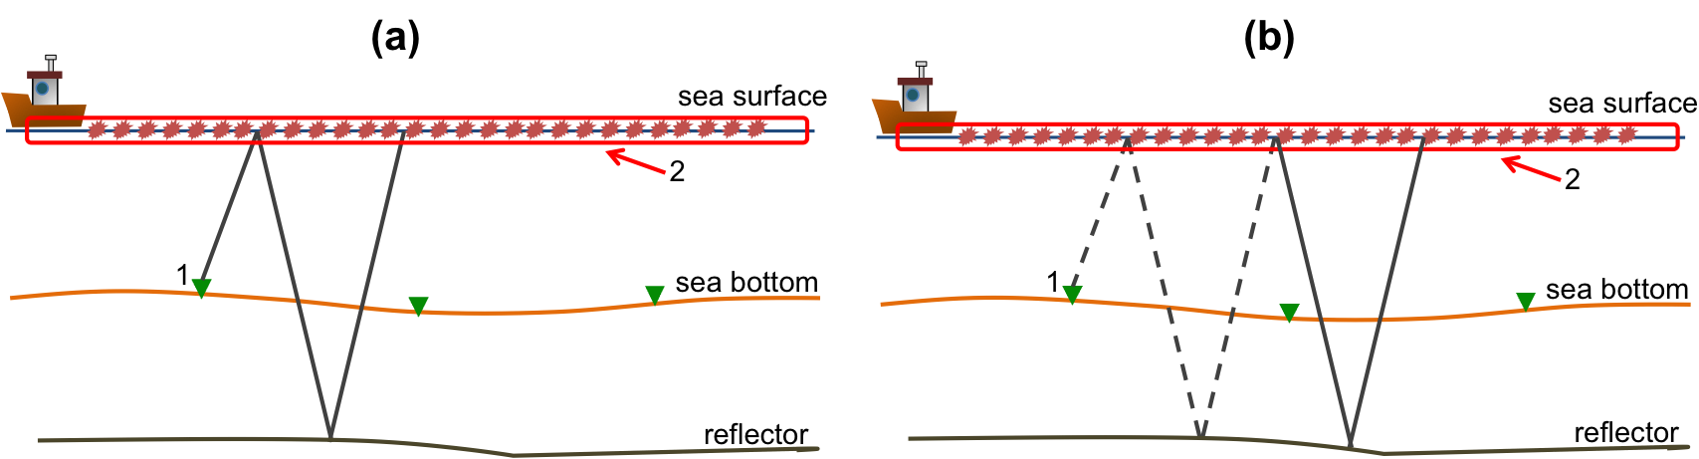
Introduction
Mirror reflection
Double-mirror reflection
Stanford Exploration Project
10
Notes:
Mention Reciprocity – treat source as receiver and vice versa
10

Slide 11
Mirror-signal
wavefield
Double-mirror
wavefield
shadow zone
11

Slide 12
Mirror-signal
wavefield
Double-mirror
wavefield
shadow zone
12

Slide 13
Mirror-signal
wavefield
Double-mirror
wavefield
shadow zone
13

Slide 14
Mirror-signal
wavefield
Double-mirror
wavefield
shadow zone
14

Slide 15
Mirror-signal
wavefield
Double-mirror
wavefield
shadow zone

Slide 16
Mirror-signal
wavefield
Double-mirror
wavefield
shadow zone
16

Slide 17
Mirror-signal
wavefield
Double-mirror
wavefield
shadow zone

Slide 18
Mirror-signal
wavefield
Double-mirror
wavefield
shadow zone
18

Slide 19
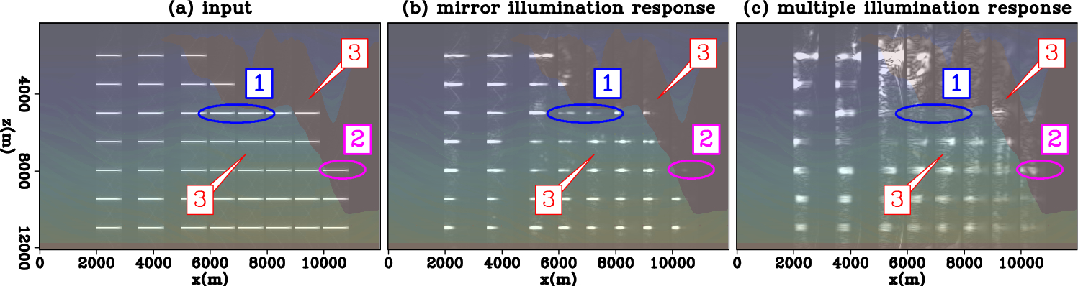
Angular illumination response
Mirror
Illumination response
Double-mirror illumination response
Stanford Exploration Project

Slide 20

Angular illumination response
Mirror
Illumination response
Double-mirror illumination response
angle
0º
80º
Stanford Exploration Project

Slide 21
Angular illumination response
Mirror
Illumination response
Double-mirror illumination response
Stanford Exploration Project

Slide 22
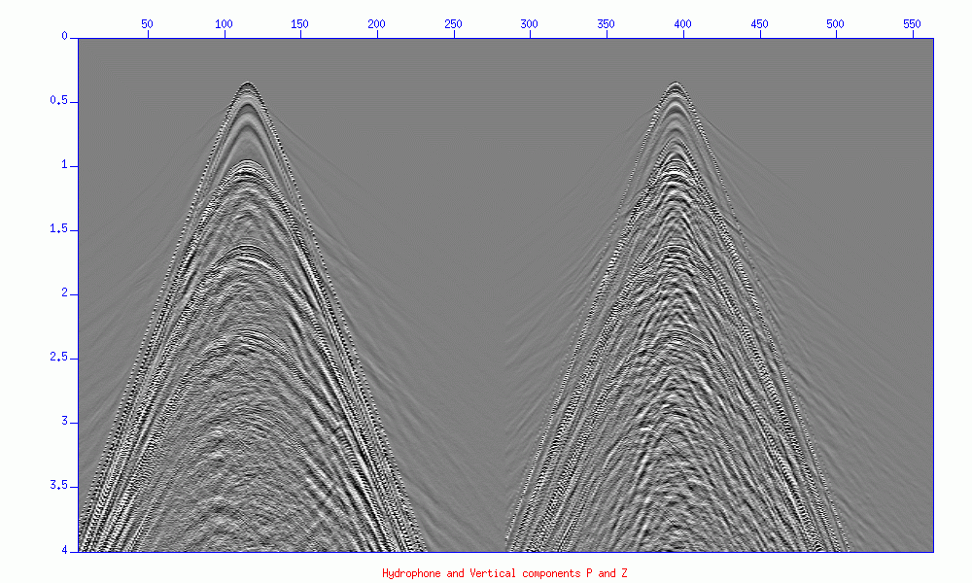
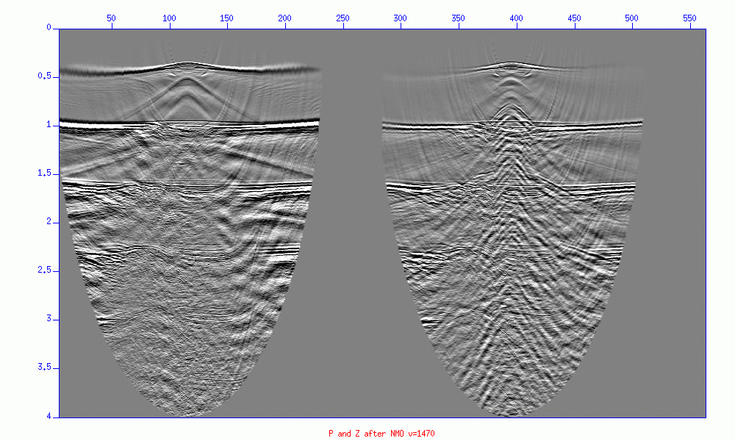
Imaging with multiples
direct
primary
mirror
double
mirror
(Ronen et al. 2009)

Slide 23
Chapter 4: Overview
Introduction
Challenges in multiple imaging
Theory
Sigsbee2B example
Stanford Exploration Project

Slide 24
Challenges in multiple imaging
True model
RTM of primary and multiples
24
Notes:
24

Slide 25
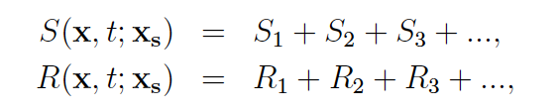
Challenges in multiple imaging
25
Notes:
25

Slide 26
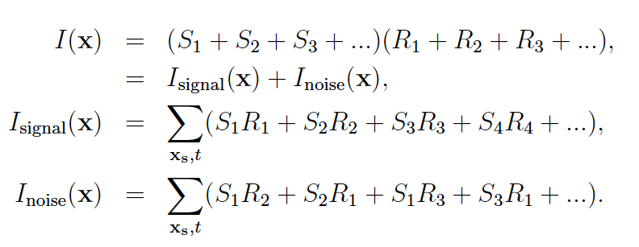
Challenges in multiple imaging
signal
26
Notes:
26

Slide 27
Challenges in multiple imaging
noise
27
Notes:
27

Slide 28
Challenges in multiple imaging
28
Notes:
28

Slide 29
Chapter 4: Overview
Introduction
Challenges in multiple imaging
Theory
Sigsbee2B example
Stanford Exploration Project

Slide 30






What is least-squares migration (LSM) ?
Forward modeling operator
modeled data
field data
Image model
Obtain the best image by minimizing the difference between the modeled data and the field data
Stanford Exploration Project
30
Notes:
30

Slide 31
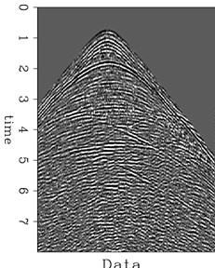
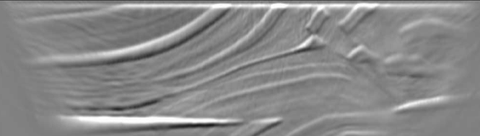
LSM Workflow
Iterative inversion by conjugate gradient
data residual
field data
migration
modeling
model
d_{mod} - d
gradient
synthetic data
Stanford Exploration Project
31

Slide 32




Joint Least-squares RTM (Joint-LSRTM)
Mirror Born modeling operator
Double mirror Born modeling operator
Observed data
Notes:
Doing separation can be hard. Mention methods for separation or which one you used.

Slide 33

Joint Least-squares RTM (Joint-LSRTM)
Mirror Born modeling operator
Double mirror Born modeling operator
Mirror reflection data
Double mirror reflection data
Notes:
Here is an overview

Slide 34
Mirror modeling operator
Notes:
Here is an overview

Slide 35
Double-mirror modeling operator
Notes:
Use the recorded data just like in SRME

Slide 36
Chapter 4: Overview
Introduction
Challenges in multiple imaging
Theory
Sigsbee2B example
Stanford Exploration Project

Slide 37
Sigsbee2B example
Mirror RTM
Mirror LSRTM
crosstalk
poorly illuminated
Double mirror LSRTM
Joint LSRTM
poorly illuminated
Notes:
Here is an overview

Slide 38
Sigsbee2B example
Mirror RTM
Mirror LSRTM
poorly illuminated
Double mirror LSRTM
Joint LSRTM
Notes:
Here is an overview

Slide 39
Sigsbee2B example
Mirror RTM
Mirror LSRTM
Double mirror LSRTM
Joint LSRTM
Notes:
Here is an overview

Slide 40
Presentation overview
Chapter 4: Joint LSRTM of primary and higher-order multiples on 2D synthetic OBN data
Chapter 2: Joint LSRTM of up- an down-going data on 2D OBN data
Chapter 3: 3D field data applications – the Deimos dataset
Conclusion
Stanford Exploration Project
Notes:
Here is an overview

Slide 41
Chapter 2 Overview
Characteristics of primary and mirror signal
Joint LSRTM
2D SEAM example
2D Cascadia field example
Stanford Exploration Project

Slide 42
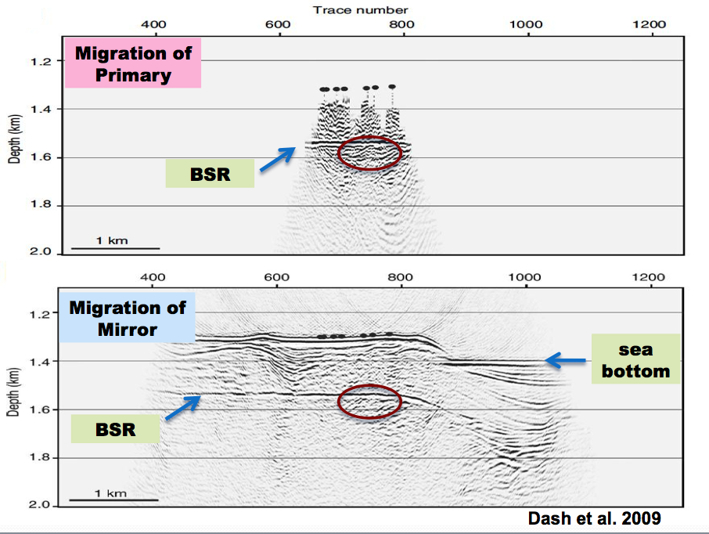
42
Notes:
Define what is “BSR”.
42

Slide 43
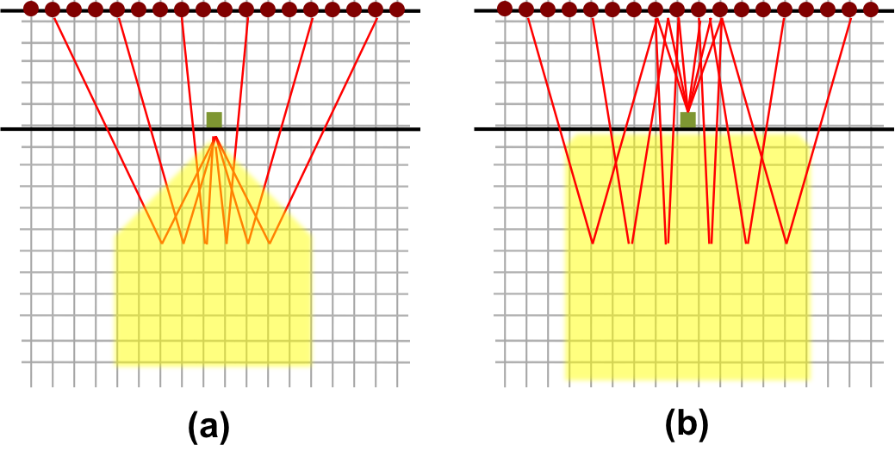
Comparison of illuminations
Primary
(up-going)
Better quality illumination
Mirror
(down-going)
Wider illumination
Stanford Exploration Project
Notes:
Too fast, slow down

Slide 44
Primary (up-going)
sea-surface
seabed
subsurface reflector
Stanford Exploration Project
Notes:
Too fast, slow down
Say angular aperture is different BEFORE blinking

Slide 45
Mirror (down-going)
sea-surface
seabed
subsurface reflector
Stanford Exploration Project
Notes:
Too fast, slow down

Slide 46
Chapter 2 Overview
Characteristics of primary and mirror signal
Joint LSRTM
2D SEAM example
2D Cascadia field example
Stanford Exploration Project

Slide 47





Joint Least-squares RTM (Joint-LSRTM)
primary Born modeling operator
mirror Born modeling operator
primary reflection data
mirror reflection data

Slide 48
Chapter 2 Overview
Characteristics of primary and mirror signal
Least-squares migration
2D SEAM example
2D Cascadia field example
Stanford Exploration Project

Slide 49
2D SEAM model
velocity
up RTM
down RTM
49
Notes:
49

Slide 50
2D SEAM Model
up RTM
down RTM
velocity
up LSRTM
down LSRTM
joint LSRTM
50
Notes:
50

Slide 51
2D SEAM Model – angular illumination
5655 m
Down LSRTM
-46deg
5655 m
Joint LSRTM
-46deg
51
Notes:
51

Slide 52
Chapter 2 Overview
Characteristics of primary and mirror signal
Least-squares migration
2D SEAM example
2D Cascadia field example
Stanford Exploration Project

Slide 53
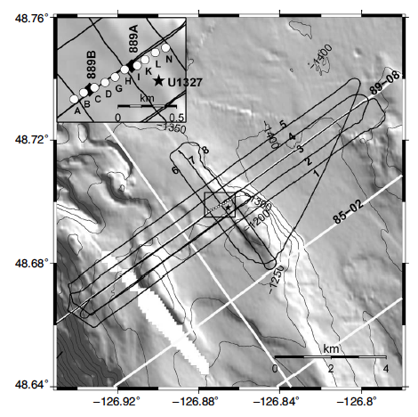
Cascadia OBN survey
Location | Northern Cascadia
Study | Gas hydrates
Receivers | 10 OBS nodes (100m spacing)
Shots | 5 shots lines at 500m spacing
Depth | 1300 m

Slide 54
Up RTM
Down RTM
Joint RTM

Slide 55
Up LSRTM
Down LSRTM
Joint LSRTM

Slide 56
Up LSRTM
Down LSRTM
Joint LSRTM

Slide 57
Comparison of Down and Joint imaging
Down RTM
Joint RTM
Down LSRTM
Joint LSRTM

Slide 58
Acknowledgement
Professor George Spence from the University of Victoria and the Dalhousie University for collection and permission to publish the OBS data
Ranjan Dash for information and previous work on the field dataset
Stanford Exploration Project

Slide 59
Presentation overview
Chapter 4: Joint LSRTM of primary and higher-order multiples on 2D synthetic OBN data
Chapter 2: Joint LSRTM of up- an down-going data on 2D OBN data
Chapter 3: 3D field data applications – the Deimos dataset
Conclusion
Stanford Exploration Project

Slide 60
Chapter 3: 3D field data applications – the Deimos dataset
Survey geometry
Imaging challenges
  Salt Dimming (SEP 149)
  Data reweighting
  Shot-gather angle domain noise filtering (SEP 152)
Inversion results
Stanford Exploration Project

Slide 61
Chapter 3: 3D field data applications – the Deimos dataset
Survey geometry
Imaging challenges
  Salt Dimming (SEP 149)
  Data reweighting
  Shot-gather angle domain noise filtering (SEP 152)
Inversion results
Stanford Exploration Project

Slide 62
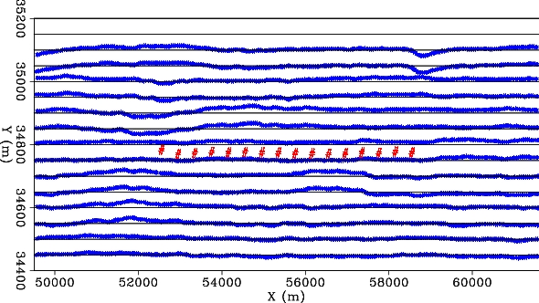
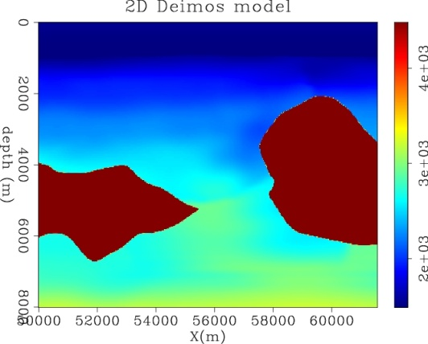
16 3-components OBN nodes + hydrophone
Source: dsx=dsy=50m (15 shot lines)
Receivers: drx=400m
Areal span: 800m X 12km
Seabed ~ 1km deep

Slide 63
16 3-components OBN nodes + hydrophone
Source: dsx=dsy=50m (15 shot lines)
Receivers: drx=400m
Areal span: 800m X 12km
Seabed ~ 1km deep

Slide 64
Chapter 3: 3D field data applications – the Deimos dataset
Survey geometry
Improvements to the LSRTM algorithm
  Salt Dimming (SEP 149)
  Data reweighting (SEP 150)
  Shot-gather angle domain noise filtering (SEP 152)
Inversion results
Stanford Exploration Project

Slide 65

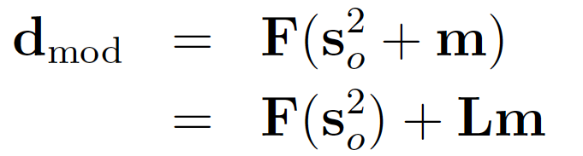



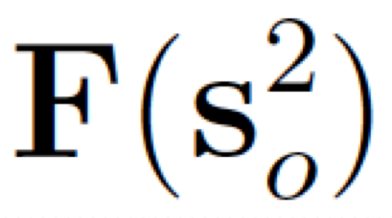
Forward modeling in LSM
The forward modeling operator is linearized with respect to
Linearized forward modeling operator
Synthetic data
Migration slowness
Background data

Slide 66
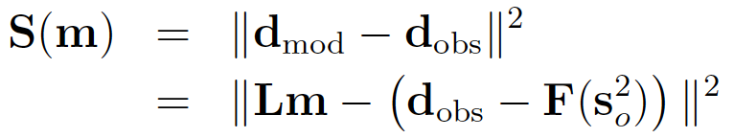

LSM objective function
The forward modeling operator is linearized with respect to
Perturbed data
Linearized forward modeling operator
Synthetic data
Observed data
Migration slowness
Background data

Slide 67


LSRTM with salt dimming
data weighting function that down-weights the salt reflection energy.
Get the most out of as few iterations as possible while addressing the background data problem

Slide 68
Chapter 3: 3D field data applications – the Deimos dataset
Survey geometry
Improvements to the LSRTM algorithms
  Salt Dimming (SEP 149)
  Data reweighting (SEP 150)
  Shot-gather angle domain noise filtering (SEP 152)
Inversion results
Stanford Exploration Project

Slide 69
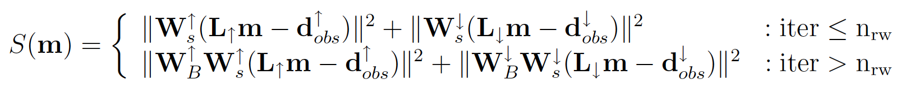



Objective function with data-reweighting
When using iterative inversion, we can reweight the objective function
and
Data weightings that emphasize poorly illuminated areas
Iteration number to perform reweighting
Stanford Exploration Project

Slide 70
Data-reweighting
Apply data space reweighting
Use RTM image to help pick subsurface reflectors
Apply Born modeling to the picked reflectors
Generate a data-weighting using the envelop of the Born modeled data
Stanford Exploration Project
Notes:
Forward modeling is needed because the weighting is in the data space

Slide 71
Data-reweighting
Apply data space reweighting
Use RTM image to help pick subsurface reflectors
Apply Born modeling to the picked reflectors
Generate a data-weighting using the envelop of the Born modeled data
Stanford Exploration Project
Notes:
Forward modeling is needed because the weighting is in the data space

Slide 72
Data-reweighting
Apply data space reweighting
Use RTM image to help pick subsurface reflectors
Apply Born modeling to the picked reflectors
Generate a data-weighting using the envelop of the Born modeled data
Stanford Exploration Project

Slide 73
Chapter 3: 3D field data applications – the Deimos dataset
Survey geometry
Improvements to the LSRTM algorithms
  Salt Dimming (SEP 148)
  Data reweighting (SEP 150)
  Shot-gather angle domain noise filtering (SEP 152)
Inversion results
Stanford Exploration Project

Slide 79
RTM before filtering

Slide 80
RTM after filtering

Slide 81
Difference

Slide 82
Chapter 3: 3D field data applications – the Deimos dataset
Survey geometry
Imaging challenges
  Salt Dimming (SEP 148)
  Data reweighting (SEP 150)
  Shot-gather angle domain noise filtering (SEP 152)
Inversion results
Stanford Exploration Project

Slide 83
RTM
up RTM
down RTM

Slide 84
RTM with spectral balancing
up RTM
down RTM
Notes:
Next, I apply the classical post-migration processing by whitening the spectrum.

Slide 85
RTM with spectral balancing
up RTM
down RTM

Slide 86
LSRTM
up LSRTM
down LSRTM

Slide 87
LSRTM
up LSRTM
down LSRTM

Slide 88
Image comparison
up LSRTM
down LSRTM

Slide 89
Image comparison
Joint LSRTM
Joint LSRTM

Slide 90
LSRTM
up LSRTM
down LSRTM

Slide 91
Image comparison
up LSRTM
down LSRTM

Slide 92
Image comparison
Joint LSRTM
Joint LSRTM

Slide 93
Angle gather at x=54000m
up LSRTM
down LSRTM
joint LSRTM

Slide 94
Angle gather at x=57000m
up LSRTM
down LSRTM
joint LSRTM

Slide 95
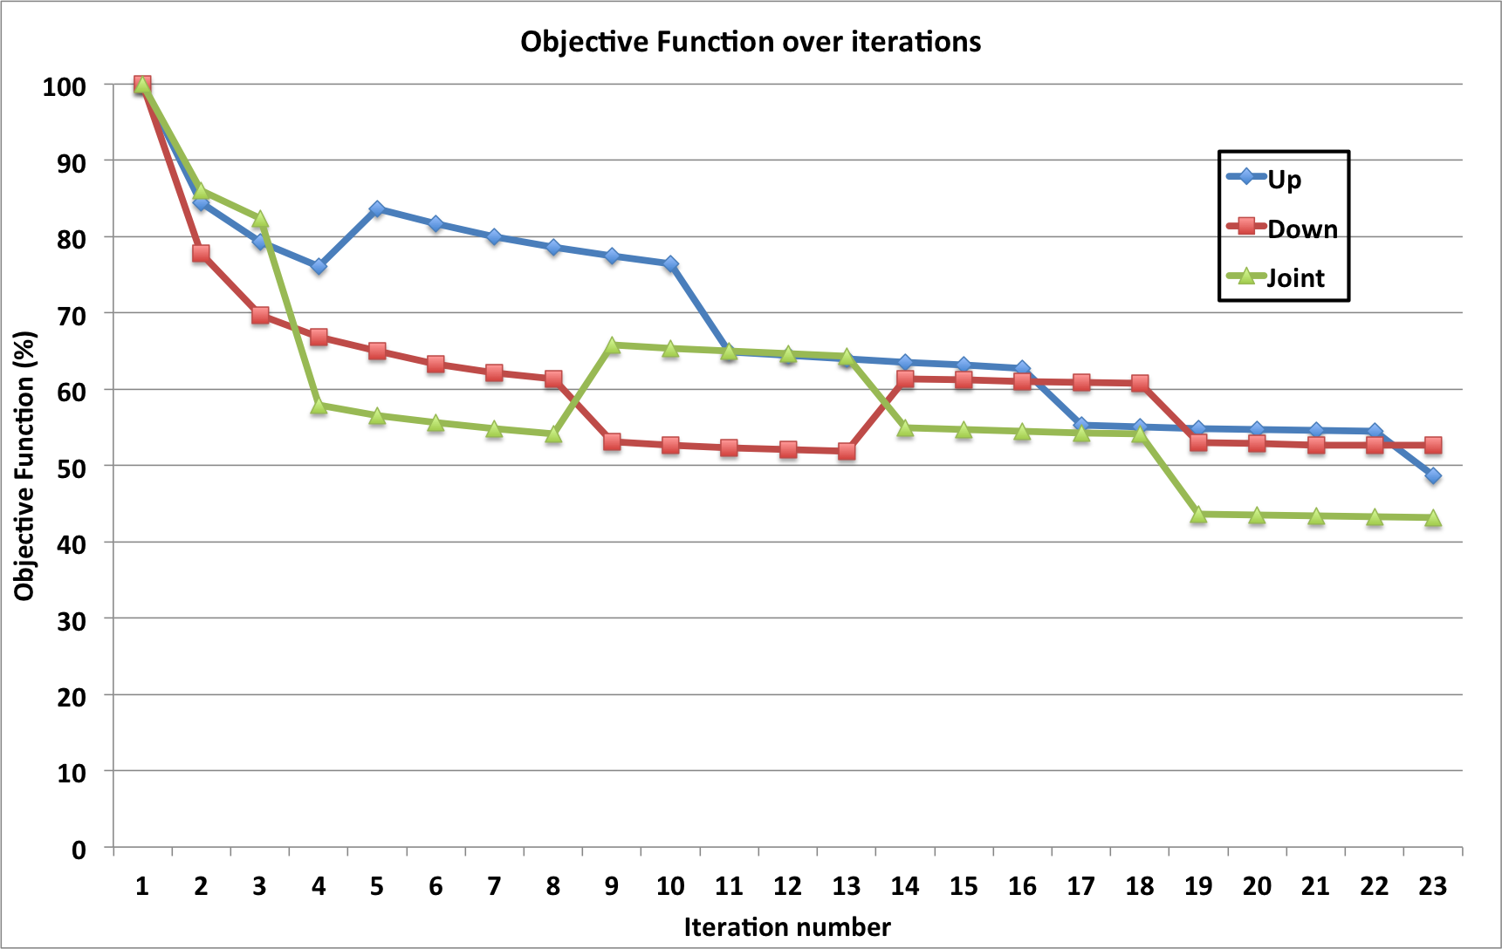

Slide 96
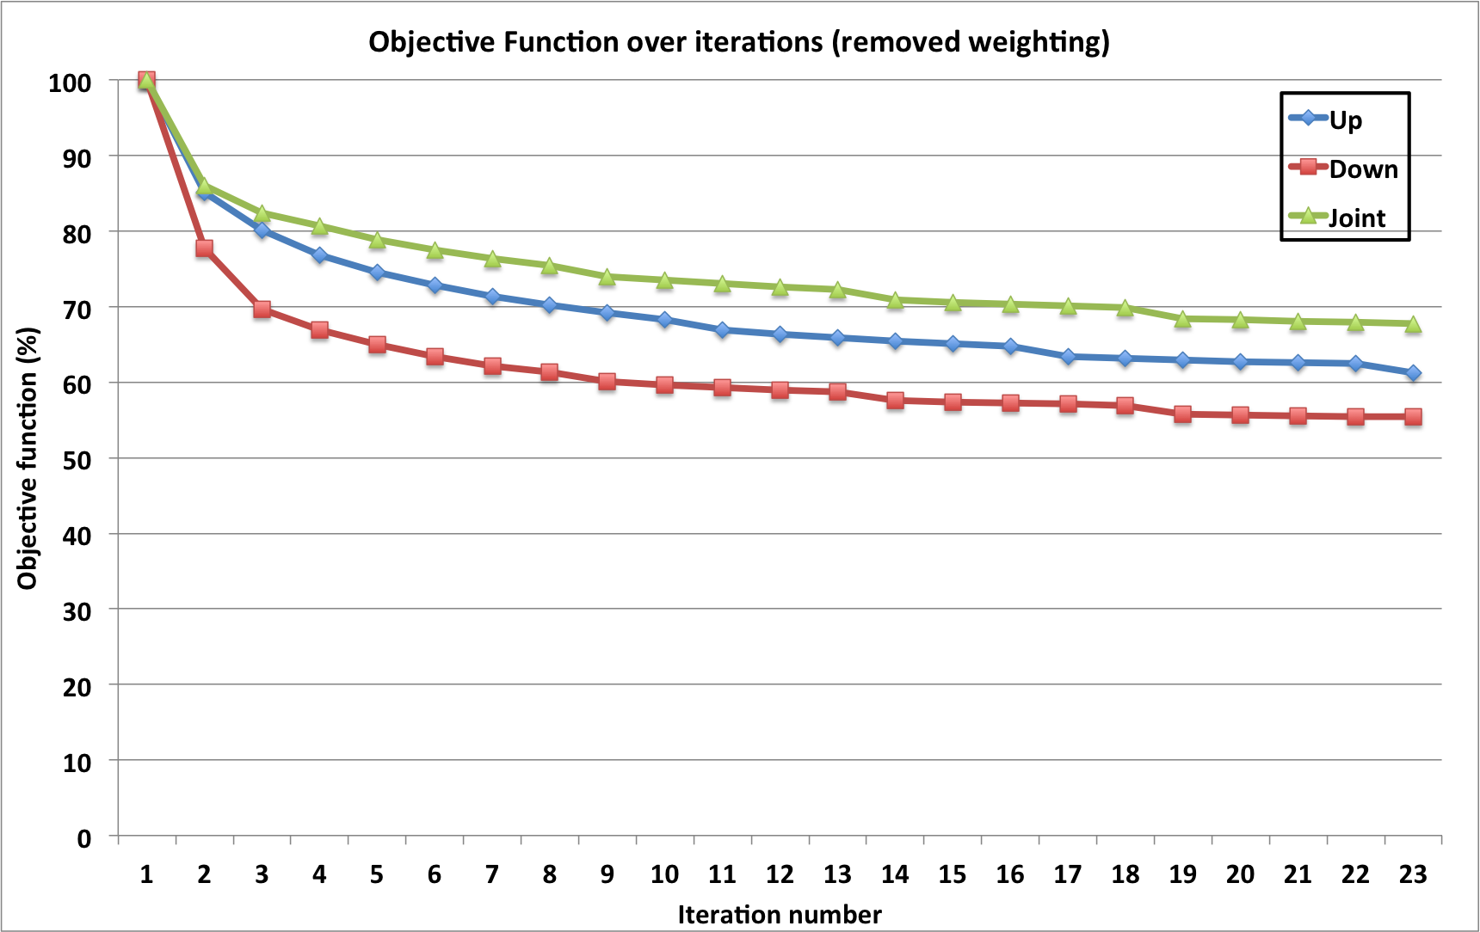

Slide 97
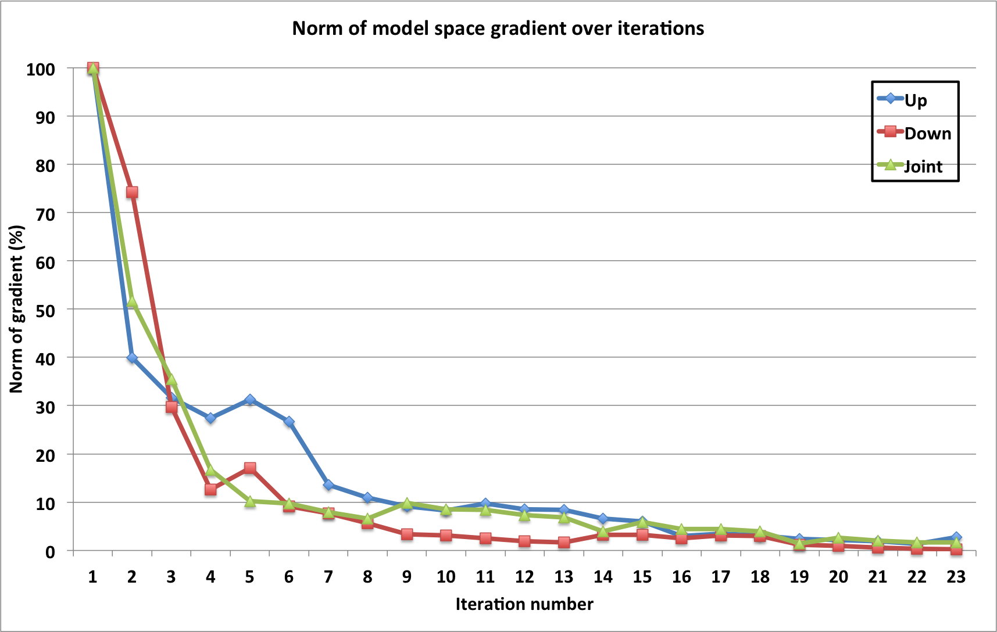

Slide 98
Acknowledgement
Shell and BP America for permission to publish the work on the Deimos OBN dataset.
Dave Nichols and Robert Clapp for suggestions and comments
Michael Merritt, Richard Cook, Colin Perkins, Vanessa Goh, Alexander Stopin, and Henning Kuehl for helpful suggestions, data processing, and discussions.
Stanford Exploration Project

Slide 99
Presentation overview
Chapter 4: Joint LSRTM of primary and higher-order multiples on 2D synthetic OBN data
Chapter 2: Joint LSRTM of up- an down-going data on 2D OBN data
Chapter 3: 3D field data applications – the Deimos dataset
Conclusion
Stanford Exploration Project

Slide 100
Conclusion
Using LSRTM can better address the crosstalk problem when migrating multiples
For the Deimos dataset with a complex subsurface, we used the following techniques to help improve LSRTM results.
  salt-dimming,
  data-space reweighting, and
  shot-gather angle-domain noise filtering
Joint-LSRTM of primary and multiples gives an overall better image, including a more complete angular coverage.
Stanford Exploration Project

Slide 101
Questions?
mandyman@sep.stanford.edu
Stanford Exploration Project

Slide 102
Some successful examples
LSM – using one-way operator
  Kuehl, H. and Sacchi M., 2002, Robust AVP estimation using least-squares wave-equation migration: SEG Technical Program Expanded Abstract, 21, 281
  Clapp, M. R. Clapp, and B. Biondi, 2005, Regularized least-squares inversion for 3-D subsalt imaing: SEG Technical Expanded Abstract, 24, 1814-1817
LSRTM
  Dai, W., C. Boonyasiriwat, and G. Schuster, 2010 – 3D multi-source least-squares reverse time migration: SEG Technical Expanded Abstract, 29, 3120-3124
  Wong, M., Biondo B., and Ronen S., 2010, Joint inversion of up- and down-going signal for ocean bottom data, SEG Expanded Abstracts,
  Dai, W., X. Wang, and G. Schuster, 2011, Least-squares migration of multisource data with a deblurring filter: Geophysics, 76, R135-R146
  Gang, Y. and Jakubowicz M., 2012 – Least-squares Reverse-Time Migration
  Dong et al., 2012, Least-squares reverse time migration: towards true amplitude imaging and improving the resolution
  Wong, M., Biondo B. and Ronen S., 2012, Imaging with multiples using linearized full-wave inversion

