Slide 1
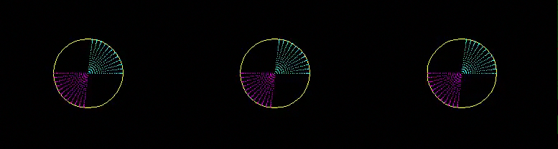


Wave mode separation with
six-component seismic data
1C
3C
6C
Ohad Barak, Priyank Jaiswal, John Giles, Sjoerd de Ridder, Robert Brune and Shuki Ronen
SEP Report 152
pp. 325-339
Notes:
Note all the motion that we are missing by not recording the rotations.
There is a wealth of information there about the waves that reach the receivers, and we must find a way to use it to our advantage.

Slide 2
Wave mode separation with
six-component seismic data
1C
3C
6C
Different seismic wave modes generate different strains.
Recording strains → separation of wave modes
Notes:
Note all the motion that we are missing by not recording the rotations.
There is a wealth of information there about the waves that reach the receivers, and we must find a way to use it to our advantage.

Slide 3
Outline
Motion in a 3D world. What do we record?
Six-component Ponca City survey
Instrument designature of rotation sensors
SVD of six-component data for wave type identification and attenuation

Slide 4
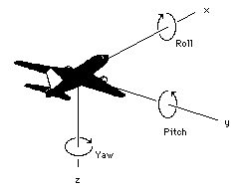
3 dimensional world
A particle can move in 3 directions, displacement has 3 components:
(u_{x}, u_{y}, u_{z})
A rigid body has 6 degrees of freedom, 3 displacements and 3 rotations:
(Roll, Pitch, Yaw)

Slide 5
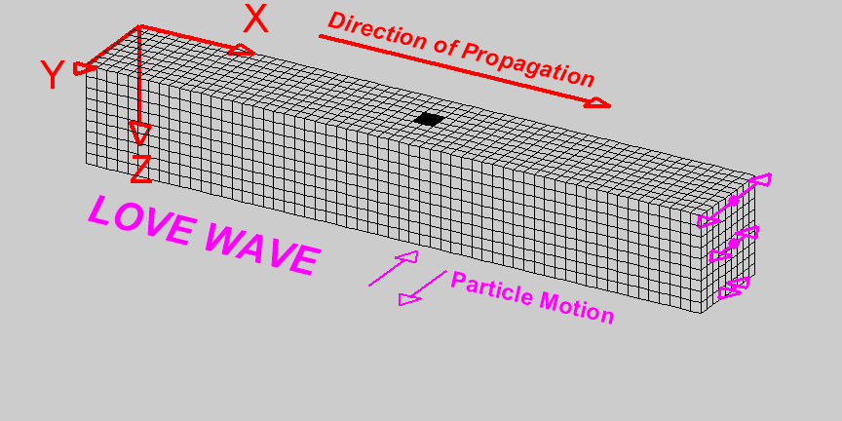
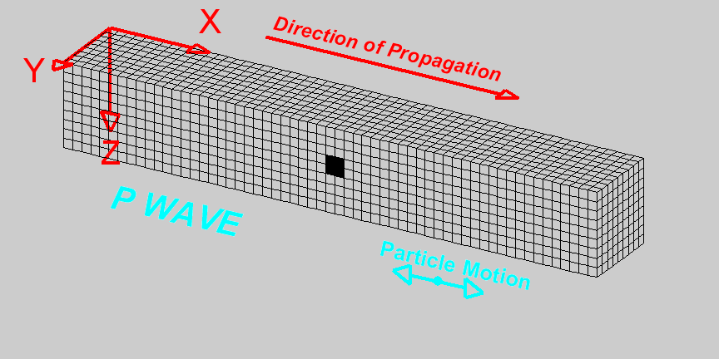
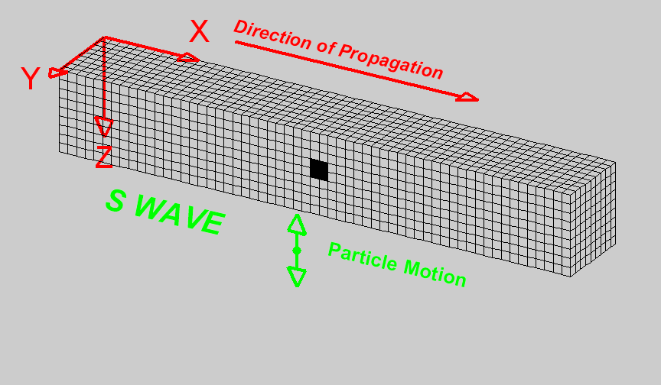
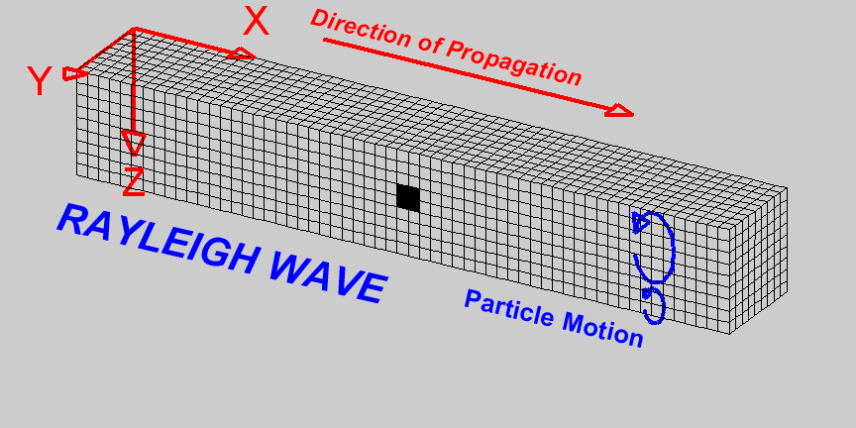
Strains generated by different wave modes
Particle Motion
Particle Motion
S WAVE
P WAVE
Michigan Tech. University website (http://www.geo.mtu.edu/Upseis/images)
Notes:
Different wave modes generate different strains in the medium.

Slide 6
What is recorded by current seismic acquisition?
1 hydrophone: pressure
3 geophones: displacements
Seismic data is incomplete since we do not record rotations.
Notes:
Different wave modes generate different strains in the medium.

Slide 7
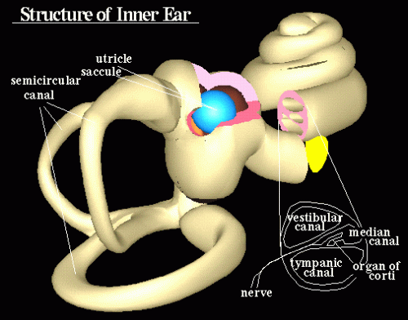
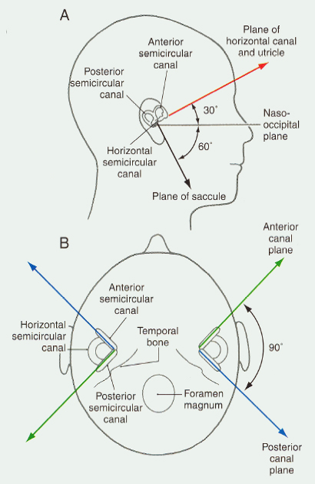
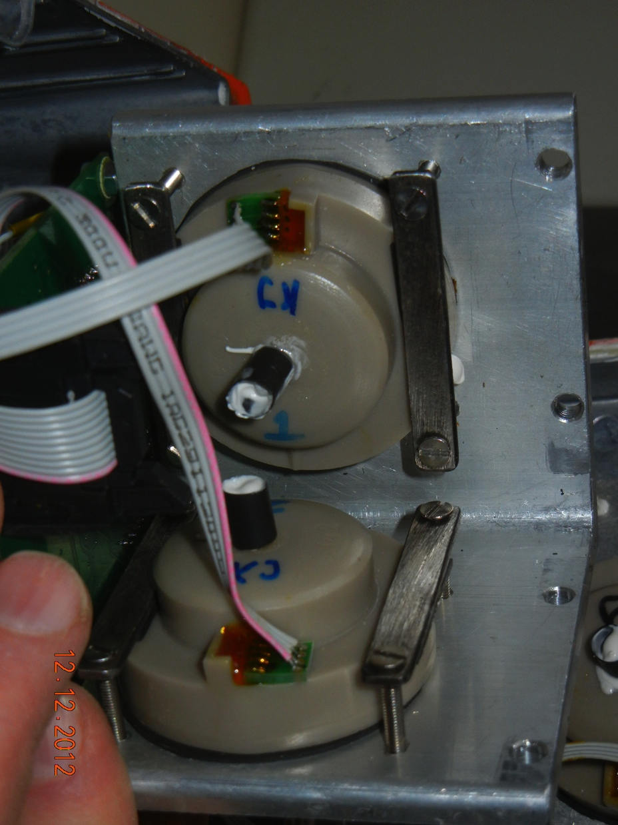
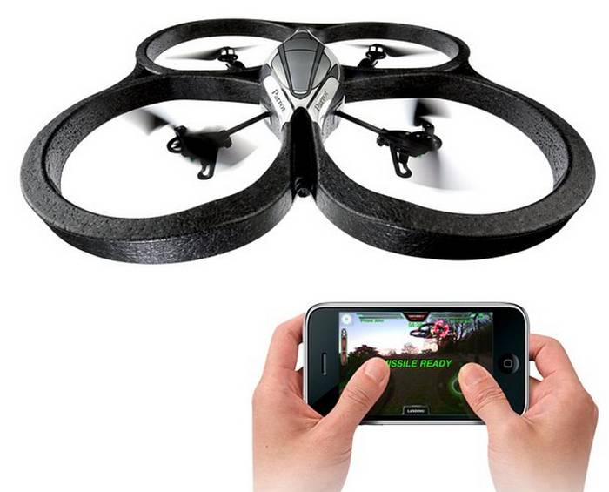
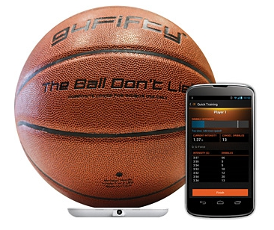
The human 7-Component sensor
1 audio (~hydrophone)
3C accelerometer
3 rotations
Notes:
Evolution knows we need to record rotations.
So did the Germans.
So do other applications.
But where do we get rotational seismic data from?
Chevron’s experiment.
Go get your own.

Slide 8
Outline
Motion in a 3D world. What do we record?
Six-component Ponca City survey
Instrument designature for rotation sensors
SVD of six-component data for wave type identification and attenuation

Slide 9
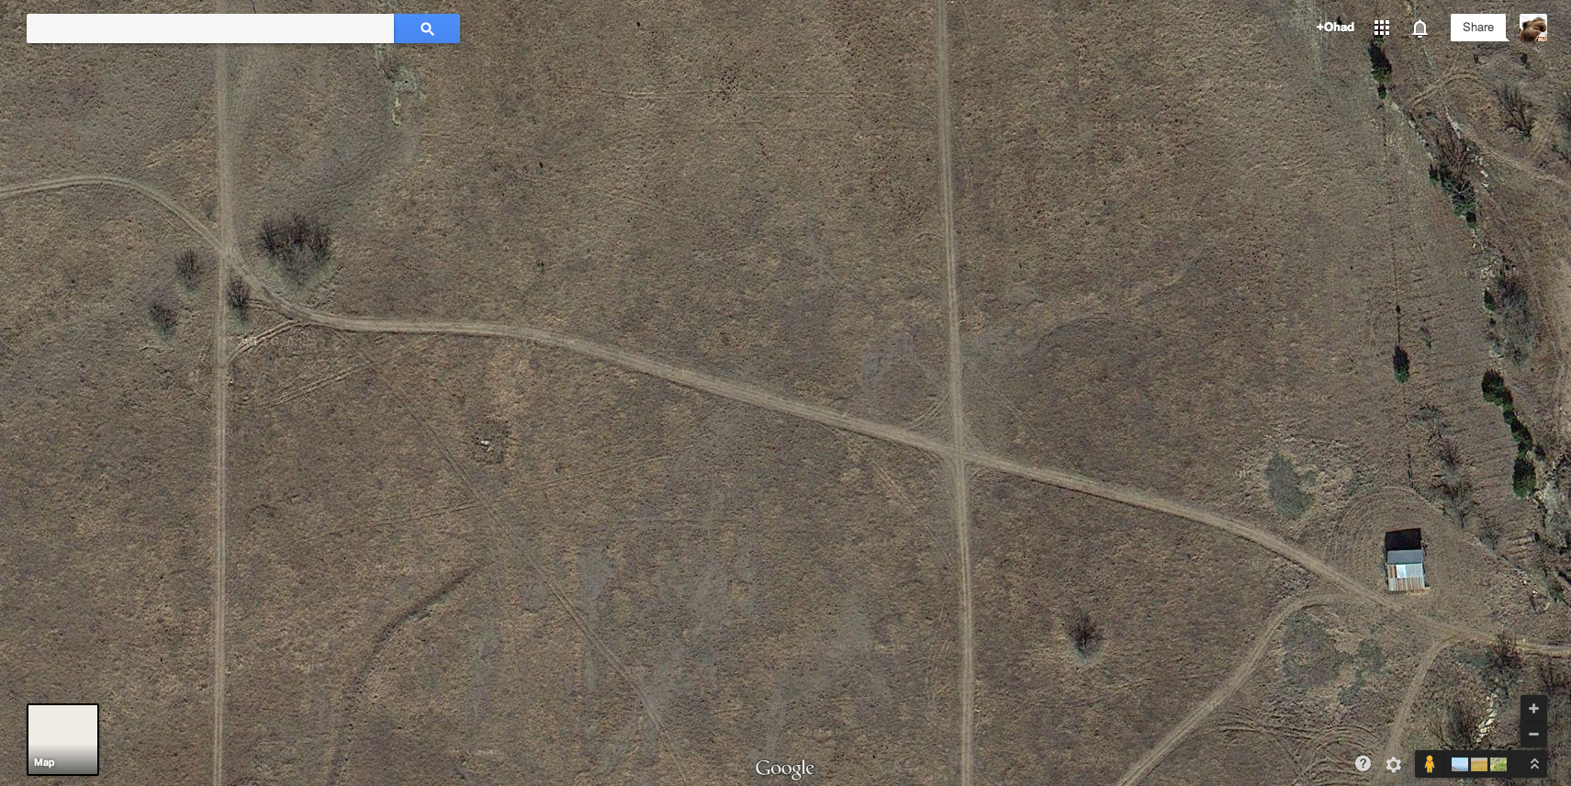
Survey area near Ponca City, OK
North
East
260m

Slide 10
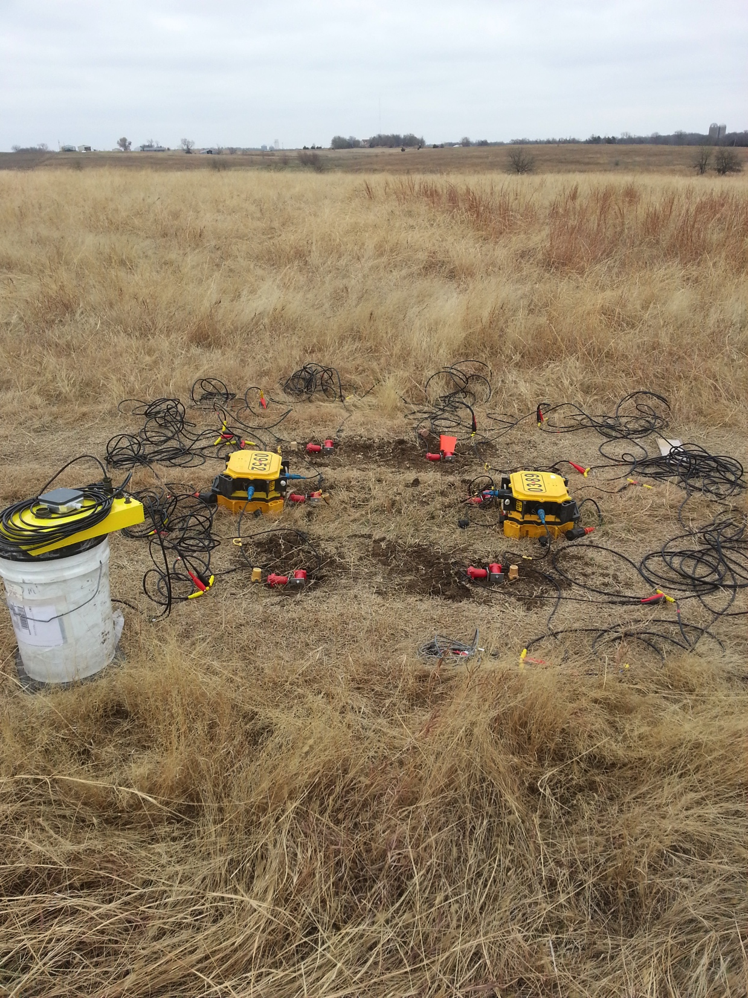
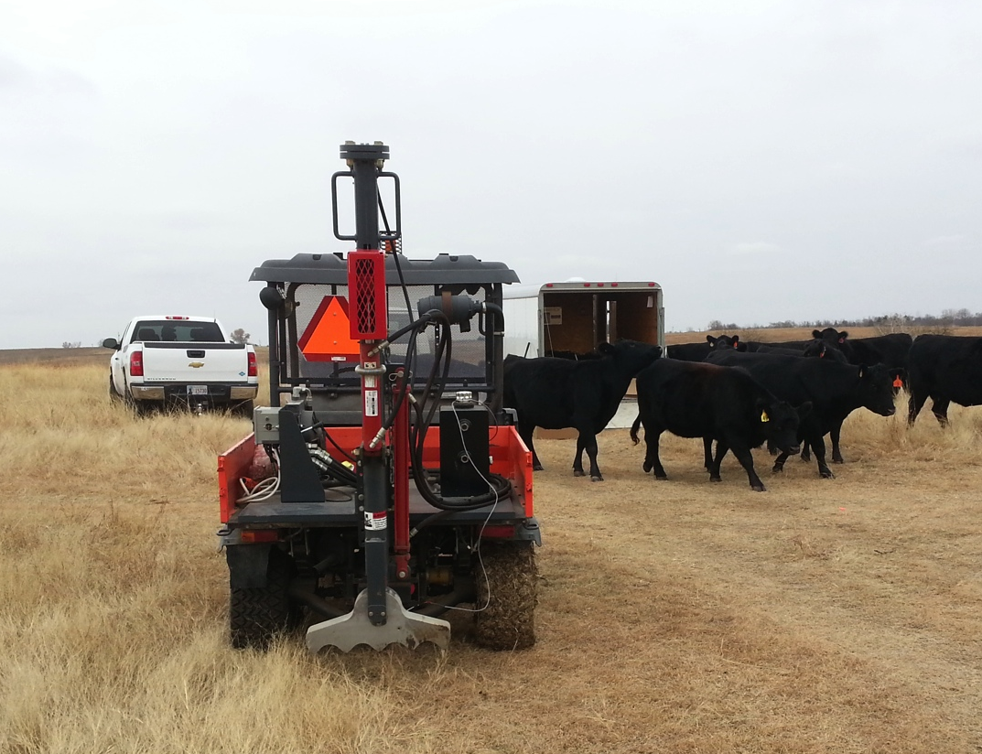
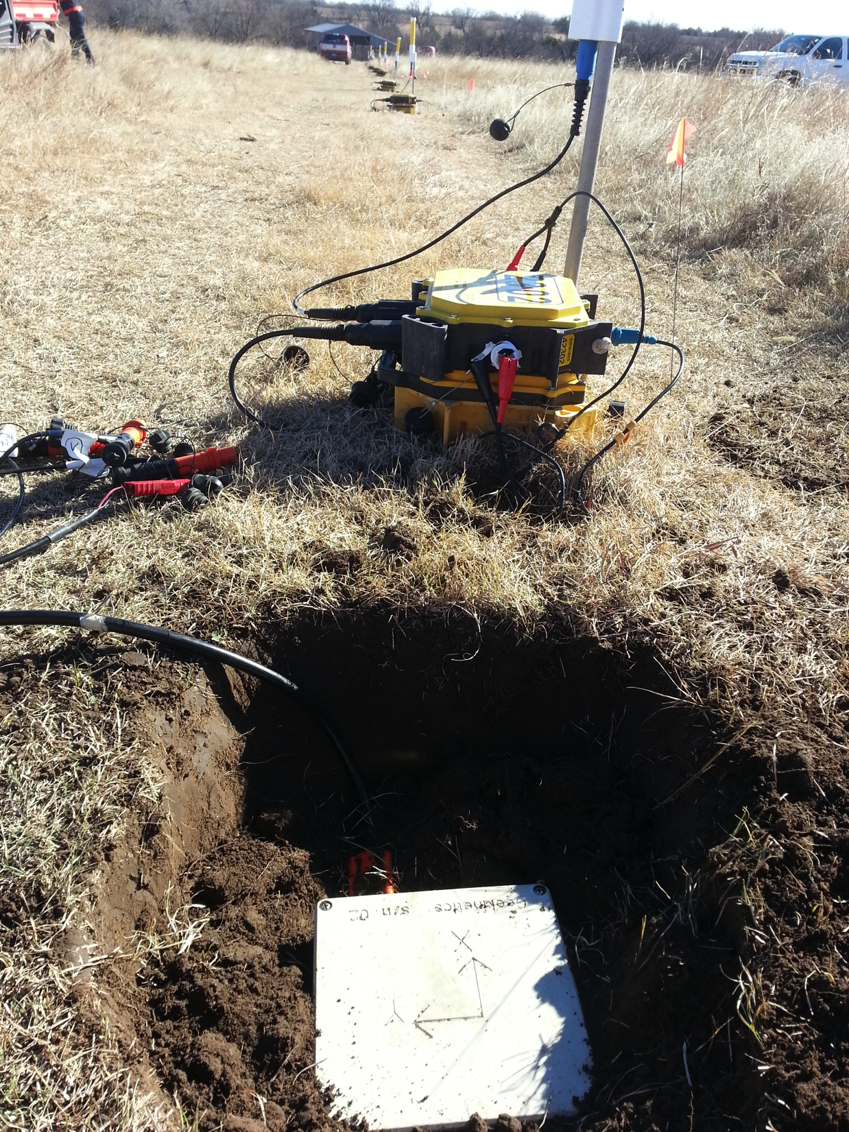
Survey area near Ponca City, OK
North
East
260m

Slide 11
Survey geometry
Black: Regular 3C+3R stations.
Black/blue: cluster 3C+3R stations
Red: 1C vertical geophones
East
c
c
c
c
c
c
c
c
c
c
c
c
c
c
c
c
c
c
c
c
c
c
c
c
c
1C line: 100m
10x1C vertical geophones
3C+3R line: 80 meters
9x6C sensors
1C line: 80m
8x1C vertical geophones
Total receiver line: 27 stations, 260m

Slide 12
Survey geometry
Vertical shots: 5 at each station
Interval: 10m. Nearest offset: 5m
Maximum 1C offset: 255m
Maximum 3C+3R offset: 180m
Black: Regular 3C+3R stations.
Black/blue: cluster 3C+3R stations
Red: 1C vertical geophones
Green: Shots
East
Total shot line: 25 stations, 240m
c
c
c
c
c
c
c
c
c
c
c
c
c
c
c
c
c
c
c
c
c
c
c
c
c
c
c
c
c
c
c
c
c
c
c
c
c
c
c
c
c
c
c
c
c
c
c
c
1C line: 100m
10x1C vertical geophones
3C+3R line: 80 meters
9x6C sensors
1C line: 80m
8x1C vertical geophones
Total receiver line: 27 stations, 260m

Slide 13
Survey geometry
Vertical shots: 5 at each station
Interval: 10m. Nearest offset: 5m
Maximum 1C offset: 255m
Maximum 3C+3R offset: 180m
Black: Regular 3C+3R stations.
Black/blue: cluster 3C+3R stations
Red: 1C vertical geophones
Green: Shots
0.6m
0.6m
East
0.6m
Cluster 3C + 3R stations
Total shot line: 25 stations, 240m
c
c
c
c
c
c
c
c
c
c
c
c
c
c
c
c
c
c
c
c
c
c
c
c
c
c
c
c
c
c
c
c
c
c
c
c
c
c
c
c
c
c
c
c
c
c
c
c
1C line: 100m
10x1C vertical geophones
3C+3R line: 80 meters
9x6C sensors
1C line: 80m
8x1C vertical geophones
Total receiver line: 27 stations, 260m

Slide 14
Adjacent geophones and rotation sensors
Quality assurance of rotation data
Wave mode identification using 6C SVD analysis
Interpolation of vertical geophone using horizontal rotation sensors
Black: 3C geophones
Blue: 3C rotation sensor

Slide 15
Outline
Motion in a 3D world. What do we record?
Six-component Ponca City survey
Instrument designature for rotation sensors
SVD of six-component data for wave type identification and attenuation

Slide 16
Instrument designature
Remove the effect of the mechanics of the recording system on the recorded signal
Prerequisite for doing any multicomponent analysis
Need to know the instrument transfer function

Slide 17
Geophone instrument response
(Lowrie, 1997,
“Fundamentals of geophysics”)
Scaling factor G [Vm⁻¹s]

Slide 18
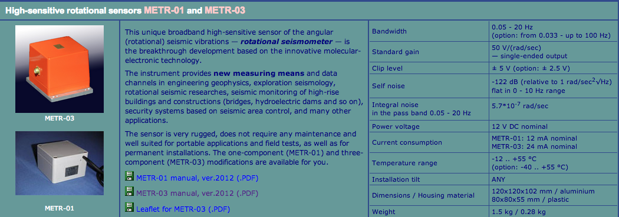
R-sensor instrument response ???

Slide 19
R-sensor instrument response ???
Designature geophones
Difference the adjacent inline vertical geophones at the cluster stations
Calculate the phase difference between the pitch sensor and the vertical geophone difference signal.

Slide 20
Free-surface boundary
Hooke’s law:
At a free surface (z=0)
there are no tangential stresses:
Rotation is caused by the
anti-symmetric strains
Horizontal rotation is the horizontal gradient of vertical displacement

Slide 21
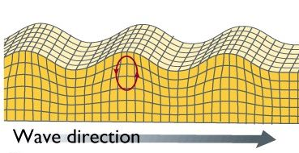
Geophone differencing
Too far

Slide 22
Geophone differencing
Too near

Slide 23
Geophone differencing
Just right!

Slide 25
Low SNR
Aliasing
Rotation sensors have high-cut at around 50 Hz

Slide 26
Low SNR
Aliasing
Geophone differencing as a measure of rotation is impractical in the field
Rotation sensors have high-cut at around 50 Hz

Slide 27
Receiver gather
Correlation
Black: Vertical geophone difference, after designature
Cyan: Pitch sensor before designature
Blue: Correlation of vertical geophone difference and pitch sensor before designature.

Slide 28
Receiver gather
Correlation
Black: Vertical geophone difference, after designature
Cyan: Pitch sensor after designature
Blue: Correlation of vertical geophone difference and pitch sensor after designature.

Slide 29
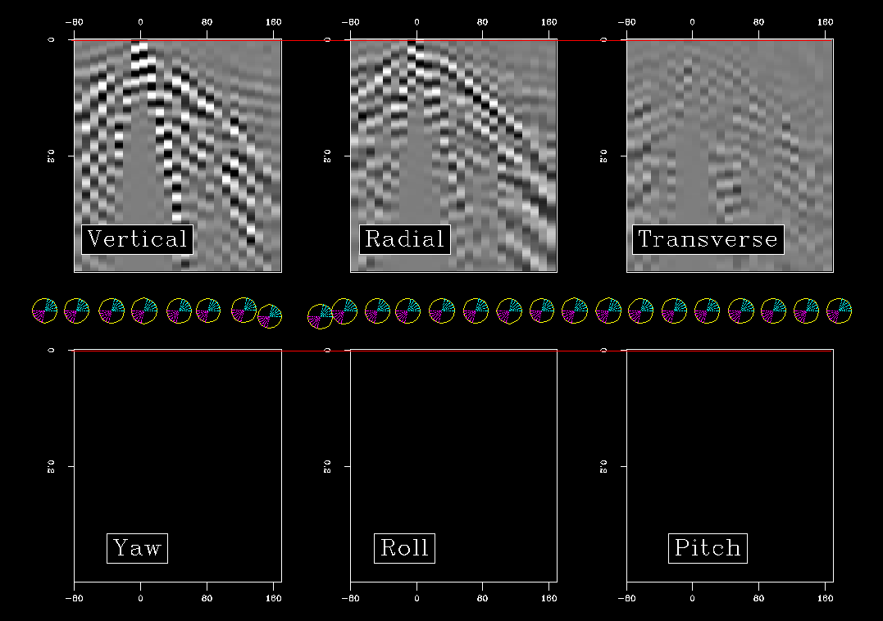

Offset (m)
Offset (m)
Offset (m)
Time (sec)
Time (sec)
Time (sec)
-80
0
80
160
Time (sec)
Time (sec)
Time (sec)
Offset (m)
Offset (m)
Offset (m)
Notes:
Bandpass between 2-45Hz

Slide 30
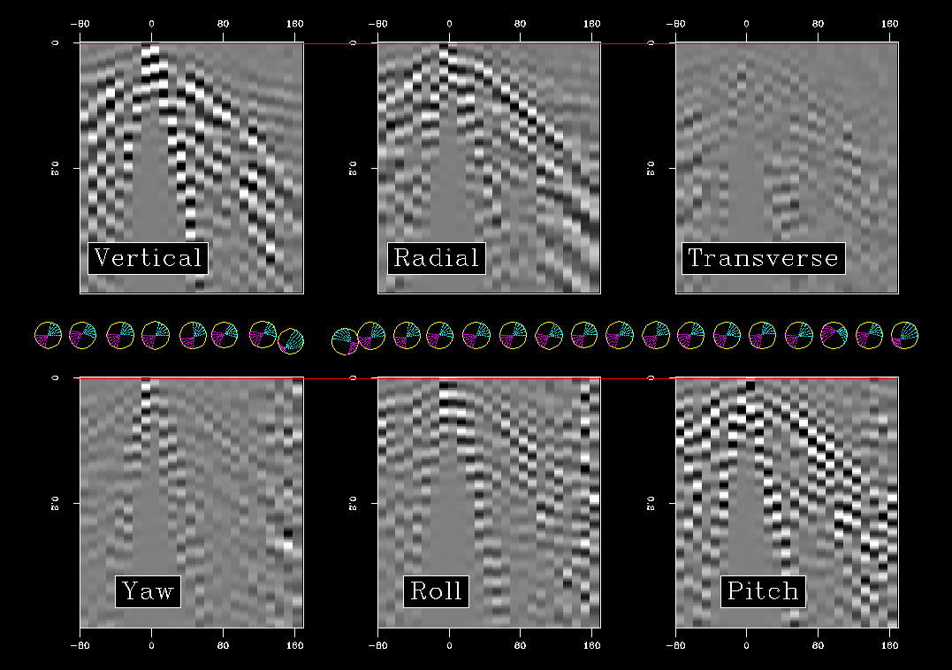

Offset (m)
Offset (m)
Offset (m)
Time (sec)
Time (sec)
Time (sec)
-80
0
80
160
Time (sec)
Time (sec)
Time (sec)
Offset (m)
Offset (m)
Offset (m)
Notes:
Note how much richer the data are with rotations.
The rotational motion CANNOT be inferred from the linear components.
Bandpass between 2-45Hz.
Balanced linear components according to weights used to balance Vz.
Balanced rotational components according to weights used to balance Ry.

Slide 31
Outline
Motion in a 3D world. What do we record?
Six-component Ponca City survey
Instrument designature for rotation sensors
SVD of six-component data for wave type identification and attenuation

Slide 32
six-component SVD
Data: six-component seismogram (single trace)
SVD:
Decompose a time-window from a 6C trace into:
Waveform
Magnitude
Polarization
Scaled
polarization vectors:

Slide 33
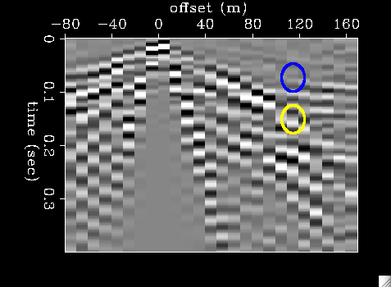
Wave signatures from SVD
Polarization vectors in
blue time-window
Vertical geophone
Notes:
Blue time window = [0.76,0.96]
Yellow time window = [0.128,0.148]
We look at the three components that have most of the signal.
These are the vertical, radial and pitch, resulting from the 2D nature of the survey.

Slide 34
Wave signatures from SVD
Polarization vectors in
yellow time-window
Vertical geophone
Notes:
Blue time window = [0.76,0.96]
Yellow time window = [0.128,0.148]
We look at the three components that have most of the signal.
These are the vertical, radial and pitch, resulting from the 2D nature of the survey.

Slide 35
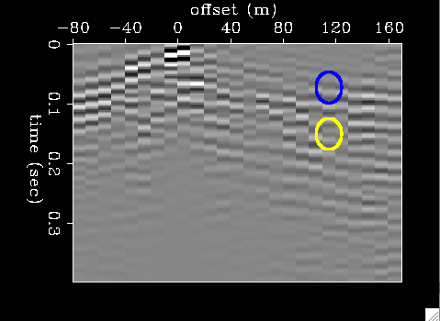
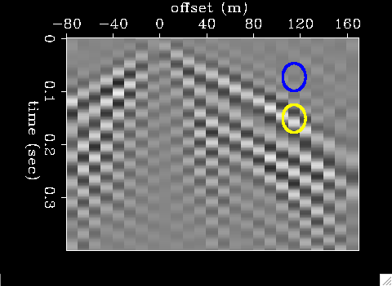
Wave signatures from SVD
Low wavenumbers
High wavenumbers
blue
yellow
Notes:
First time we have validation of the idea of wave signatures!!
Blue time window = [0.76,0.96]
Yellow time window = [0.128,0.148]
FK low wavenumbers: flo=32 fhi=85 vlo=1000
FK high wavenumbers: flo=6 fhi=40 vhi=1000

Slide 36
Mapping wave modes to 6C polarizations
Notes:
I claim that 6C polarization vectors help to identify wave modes.
Need to create a mapping between wave modes and their appearance in the 6C polarization space.
I have synthetics as a tool to help in that mapping.
But how can we trust this mapping to always work?
Idea: estimate the signature from the data.

Slide 37
Estimating the signature of the undesired signal
Fast ground roll
Slow ground roll
Vertical
Radial
Pitch
Notes:
The signature of the undesired wave mode was taken from the data.
One for the slow ground roll, one for the fast ground roll.

Slide 38
Estimating the signature of the undesired signal
Vertical
Radial
Pitch
Notes:
The signature of the undesired wave mode was taken from the data.
One for the slow ground roll, one for the fast ground roll.

Slide 39
Undesired polarization template
SVD
Vz Vx Ry
Notes:
The signature of the undesired wave mode was taken from the data.
One for the slow ground roll, one for the fast ground roll.

Slide 40
Undesired polarization template
V_{z}
SVD
V_{x}
Vz Vx Ry
R_{y}
Notes:
The signature of the undesired wave mode was taken from the data.
One for the slow ground roll, one for the fast ground roll.

Slide 41
Weighting function
Design damping weight for the 1st singular value
1
V_{z}
0
SVD
V_{x}
Vz Vx Ry
R_{y}
Notes:
The signature of the undesired wave mode was taken from the data.
One for the slow ground roll, one for the fast ground roll.
Independent parameters:
Time window length
Angular difference

Slide 42
Filtering by 1st polarization vector
1
V_{z}
0
SVD
V_{x}
R_{y}
V_{x}
V_{z}
R_{y}
Notes:
The signature of the undesired wave mode was taken from the data.
One for the slow ground roll, one for the fast ground roll.
Independent parameters:
Time window length
Angular difference

Slide 43
Filtering by 1st polarization vector
1
V_{z}
0
SVD
V_{x}
R_{y}
If 1st polarization vector of data window is within angular range, then damp 1st singular value
V_{x}
V_{z}
R_{y}
Notes:
The signature of the undesired wave mode was taken from the data.
One for the slow ground roll, one for the fast ground roll.
Independent parameters:
Time window length
Angular difference
Assumptions:
Undesired stronger than desired
Undesired orthogonal to desired → The more attributes we have the more chance we have to find the orthogonality

Slide 44
Filtering by 1st polarization vector
Damp 1st singular value.
Recompose data
R_{y}
V_{x}
V_{z}
Notes:
The signature of the undesired wave mode was taken from the data.
One for the slow ground roll, one for the fast ground roll.
Independent parameters:
Time window length
Angular difference
Assumptions:
Undesired stronger than desired
Undesired orthogonal to desired → The more attributes we have the more chance we have to find the orthogonality

Slide 45
Before filtering
Vertical
Radial
Pitch

Slide 46
After filtering
Vertical
Radial
Pitch
Notes:
How much desired is left vs how much undesired is attenuated
Problem with this dataset: Weak source, reflection signal is not above noise, so by filtering we don’t suddenly see reflections.

Slide 47
3C polarization analysis
K. De Meersman, “Ground Roll polarization filtering with spatial smoothness constraints”
R. Kendall et al., “An SVD-polarization filter for ground roll attenuation on multicomponent data”
J. Vidale, “Complex Polarization analysis of particle motion”
Diallo et al., “Characterization of polarization attributes of seismic waves using continuous wavelet transform”
Notes:
I want to incorporate rotation data into these types of analysis.

Slide 48
Future work
Incorporate rotation data into these types of analyses
Apply to Chevron’s rotation data – better SNR
Calculate divergence from adjacent geophones in cluster stations → 7C analysis?
Interpolate using vertical-geophone derivative
Notes:
I want to incorporate rotation data into these types of analysis.

Slide 49
Summary
Rotations provide additional information that cannot be derived from geophone data.
The more strains we record, the better we can separate between the wave modes generating these strains.
Separation can be done at the level of the single receiver (no spatial sampling requirement).
Ground roll attenuation is just an example.
Notes:
I want to incorporate rotation data into these types of analysis.

Slide 50
Acknowledgements
Everhard Muyzert, Schlumberger
Robert Brune, Freelance consultant
-80
0
80
160
Notes:
Seisballs are a derivation from Bob’s idea of using the BMW symbol

Slide 52
(Cochard et al., 2006,
“Rotational motions in seismology: Theory, observations, simulation”)

Slide 53
Interpolation of vertical geophone
Land seismic data acquisition using rotation sensors
Muyzert et al., EAGE 2012

