Slide 1
Reverse-time migration
using the rapid expansion method
(REM)
SEP 158: p. 151-162
May 20, 2015
Alejandro Cabrales
Notes:
This is my presentation, my research about RTM using the rapid expansion method. You can find it in these pages in the SEP report.

Slide 2
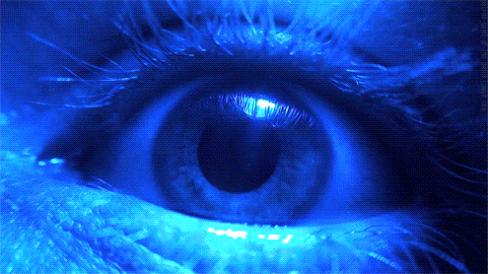
REM? PLEASE DO NOT SLEEP!
2
Notes:
Well, this is not the REM I’m going to talk about, but please make your best and try not to sleep during the presentation.

Slide 3
OUTLINE
Motivation
Reverse-time migration and REM
Anisotropy and REM
Numerical examples
Conclusions
Acknowledgements
3

Slide 4
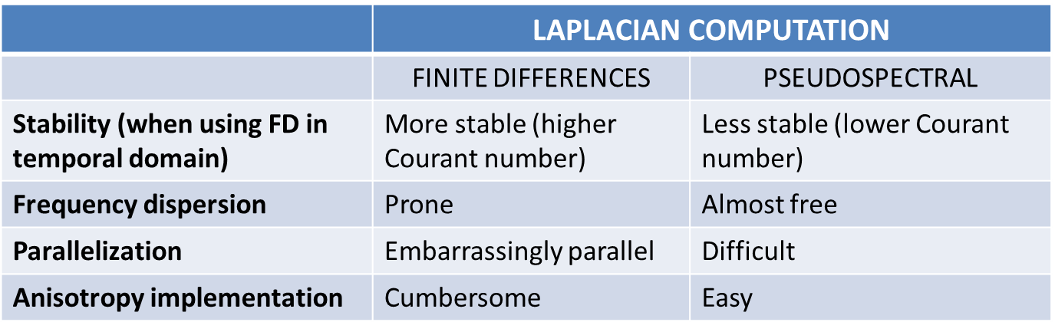
MOTIVATION
Ever increasing geologic complexity of oil & gas exploration targets demands RTM imaging. Its implementation using the rapid expansion method (REM) offers an alternative to high-order FD, with the potential advantage of allowing arbitrary coarse time sampling. Its implementation jointly with the pseudospectral method achieves high accuracy, and allows the direct implementation of tilted-transverse isotropy (TTI).
4

Slide 5
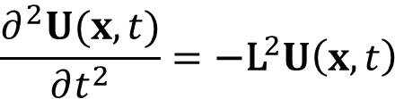


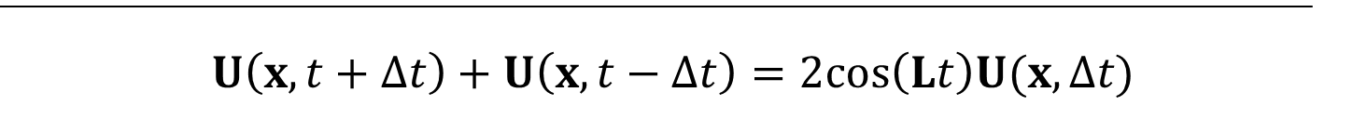
REVERSE-TIME MIGRATION AND REM
To derive the REM-based RTM (Tal-Ezer, 1987; Kosloff et al., 1989), express the scalar wave equation as
where U: Displacement field;
The solution for initial conditions at t = 0, U(x,0), and U_{t}(x,0) is
Then we can compute the solutions for U(t+Δt), and U(t-Δt), and add them:
5
Notes:
This method was first proposed by Tal-Ezer in 1987, and improved by Kosloff et al. in 1989.
Computing solutions for time steps forward and backward, we eliminate the terms with the first derivative in time. This expression contains the cosine of an operator, has to be approximated.
We can use a Taylor expansion and then obtain approximations like the 2nd and the 4th order finite differences, and complaint with the stability condition that corresponds. Another alternative is the rapid expansion method..

Slide 6
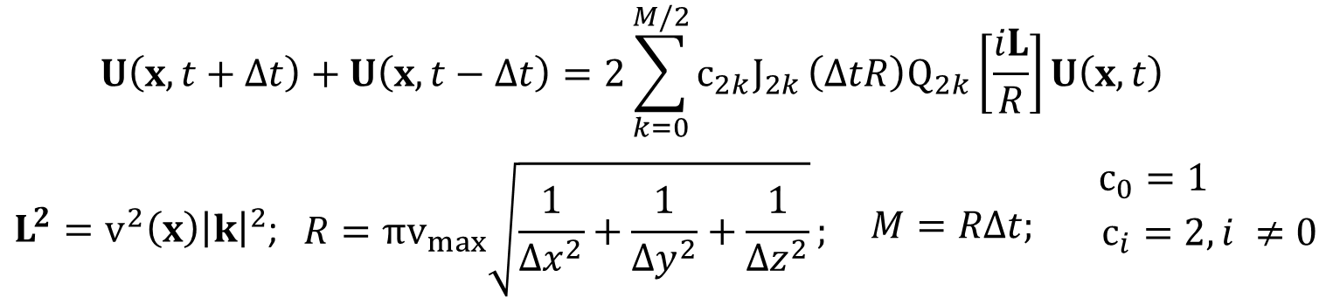
REVERSE-TIME MIGRATION AND REM
REM consists of expanding the cosine term in Chebyshev polynomials:
6
Notes:
…where we approximate the cosine term as a series of modified Chebyshev polynomials and Bessel functions of first kind. Just to clarify, this quantities are the arguments of both the functions and the polynomials. Very important, the number of iterations is controlled by this quantity and ultimately by the highest velocity and the gridsize on one hand, and on the other hand is controlled by the time sampling.
Just for you to get the feeling about the implementation, here it is the expansion of some of the terms of the summation. As far as we keep the number of terms enough as expressed here, we do not have to worry about interpolating to smaller time samplings. Now what about anisotropy?

Slide 7
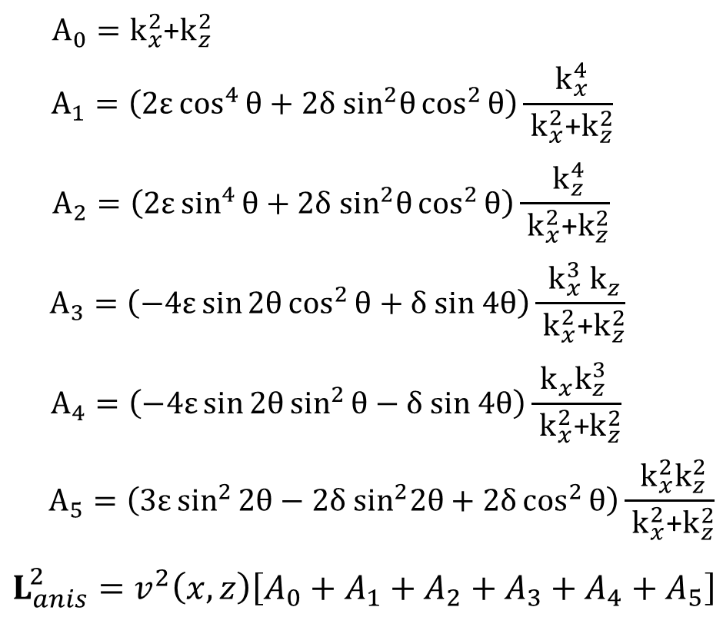
WANT ANISOTROPY?
I utilize the pseudo-differential TTI decoupled equations (Zhan et al., 2012):
7
Notes:
I utilize the TTI decoupled equations, fully applicable with the pseudospectral method… they include the Thomsen parameters eps and delta, and the dip field. Now our L2 operator becomes this summation of operators. And of course, we may drop some of them if we use VTI or elliptical anisotropy. Let’s see some numerical results…

Slide 8
Numerical results

Slide 9
NUMERICAL RESULTS
9
Notes:
This is the first model that I utilize. It is known as the Amoco 2.5D model, and to my knowledge it is calculated for an SEG talk in 1998, by Jonn Etgen and others. Intended to make Kirchhoff methods fail. For me it was important to use this model because of the challenging complexity, the strong velocity contrasts, and additionally the unusual time sampling (10 ms). We would normally have to interpolate to meet the stability condition, but I let the rapid expansion method to self adjust the number of terms of the series.

Slide 10
10

Slide 11
NUMERICAL RESULTS
11
Notes:
This is Marmousi, not the conventional one, but the anisotropic version prepared by Tariq Alkahlifah. This is the velocity and the parameter eta, which we normally use in time migration. For depth migration we can use it instead of epsilon, and set delta to zero.

Slide 12
NUMERICAL RESULTS
12

Slide 13
NUMERICAL RESULTS
13
Notes:
This is the salt VTI model prepared by the Hess company. The objective is trying to adequately image the reservoir levels visible in the velocity, epsilon and delta, among the fault and the anticline below salt.

Slide 14
NUMERICAL RESULTS
14
Notes:
I have to mention that I decimated the data both in the shot and the receiver domain, that accounts for some of the noise in the image.

Slide 15
CONCLUSIONS
RTM using the REM in 2-D synthetic models yielded good results, regardless of the time sampling of the data. Original time samplings were used. Tapering and random boundary conditions were used in the numerical tests.
The anisotropic solution can be easily incorporated when we implement the REM using the pseudospectral approach to apply the Laplacian.
Benchmarking against high-order FD approximations is required!
Move to 3-D quickly.
Finite differences instead of pseudospectral?
15

Slide 16
ACKNOWLEDGEMENTS
To the SEP crew and sponsors.
Special thanks to Petroleos Mexicanos, for the financial support.
To Tariq Alkhalifah, for clarifications about his anisotropic Marmousi.
To Kurt Marfurt and the AASPI crew, for their support during the first steps in this project.
Special thanks to Kaixi and Musa, for the corrections in my SEP report.
16

Slide 17

QUESTIONS?
Are you done, Daddy…?

Slide 19
FUTURE WORK
Benchmark the REM with high-order FD.
Finer time sampling vs. number of expansion terms.
Test Poynting vectors to ameliorate low-wavenumber shadows.
Finite differences vs. pseudospectral.
Source signature estimation from data.
Produce angle gathers.
Explore the symplectic scheme in REM (Araujo et al., 2014).
Implement the 3-D solution.

