Slide 1
Inverse demigration for simultaneous source separation
Chris Leader and Biondo Biondi
SEP-158 pg 103
Tuesday, May 19th
SEP Annual Meeting
Dana Point, California

Slide 2
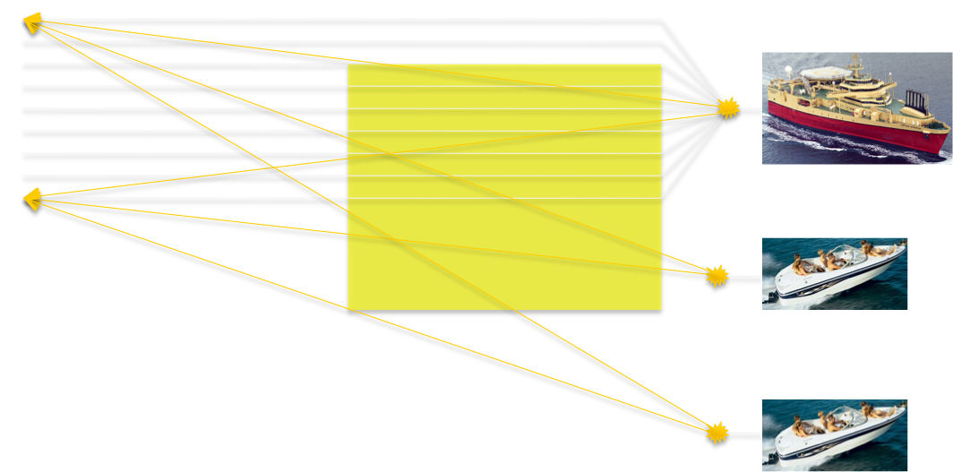
Seismic acquisition
WATS
86400 seconds in a day
~7000 shot points
> 20 weeks for 10⁶ shots
Multiple sources/reduce waiting
Huge potential savings
Acquire surveys in half the time (or faster)
Same (or better) quality images

Slide 3
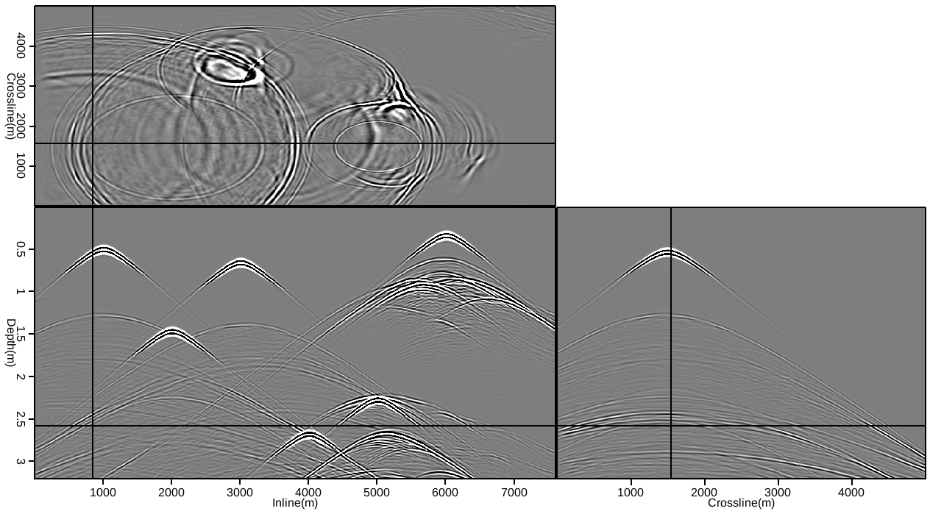
Randomly blended
Time(s)
Notes:
Can be 1 boat, many, ISS, DS3

Slide 4
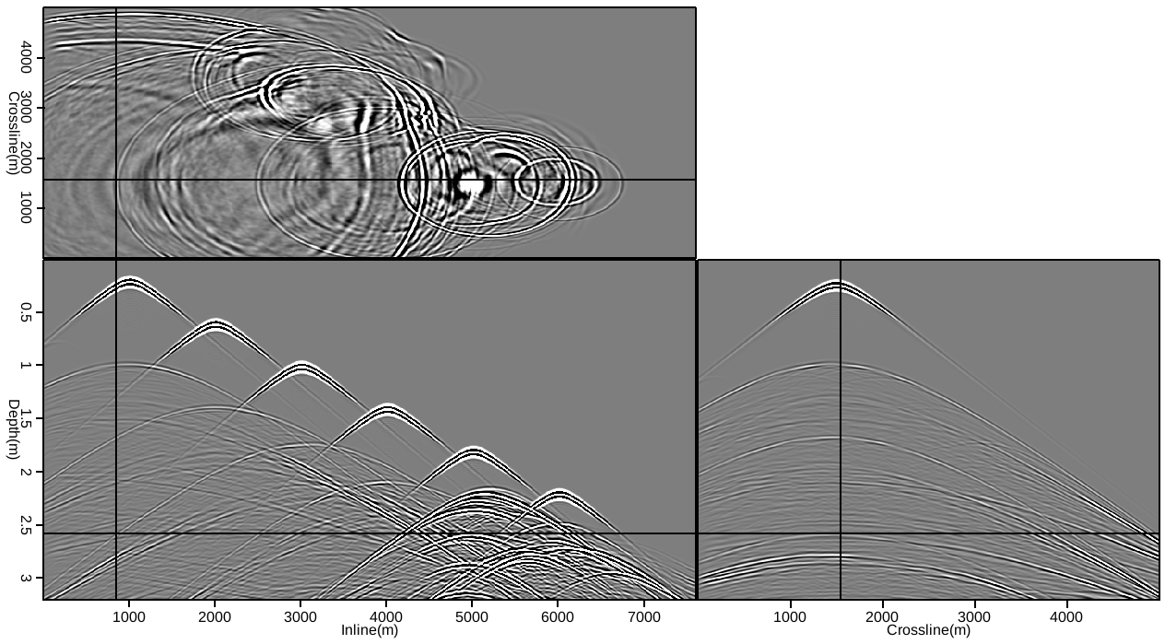
Linearly blended
Time(s)
Notes:
Can be 1 boat, many, ISS, DS3

Slide 5
Agenda
Simultaneously acquired data
Demigration
Adjoint method
As an inverse process
Image-space data separation
Accurate velocity model
Inaccurate velocity model
Future work

Slide 6
Agenda
Simultaneously acquired data
Demigration
Adjoint method
As an inverse process
Image-space data separation
Accurate velocity model
Inaccurate velocity model

Slide 7
Simultaneously acquired data
Simultaneous/blended/continuous recording…
No concern for shot overlap
Single or multiple sources
Denser acquisition per unit time
Compute time is vastly cheaper than field time
Save time in the field => afford more processing

Slide 8
How to process?
Direct imaging
Migration
Inversion
Separation
Filtering
Data-space inversion
Image-space inversion

Slide 9
How to process?
Direct imaging
Migration
Inversion
Separation
Filtering
Data-space inversion
Image-space inversion
Implicit model knowledge

Slide 10
How to process?
Direct imaging
Migration
Inversion
Separation
Filtering
Data-space inversion
Image-space inversion

Slide 11
How to process?
Direct imaging
Migration
Inversion
Separation
Filtering
Data-space inversion
Image-space inversion
Separation and imaging fits into production flows
Fewer implicit model assumptions

Slide 12
Separation by inversion
Data-space inversion
Coherency pass methods (Abma, 2012; Doulgeris, 2011; Ayeni and Biondi, 2011)
Compressive sensing/inversion (Haneet and Herrman, 2011)
Decoding transforms (Ikelle, 2007)
All successful methods
All stringently require random time delays and source positioning

Slide 13
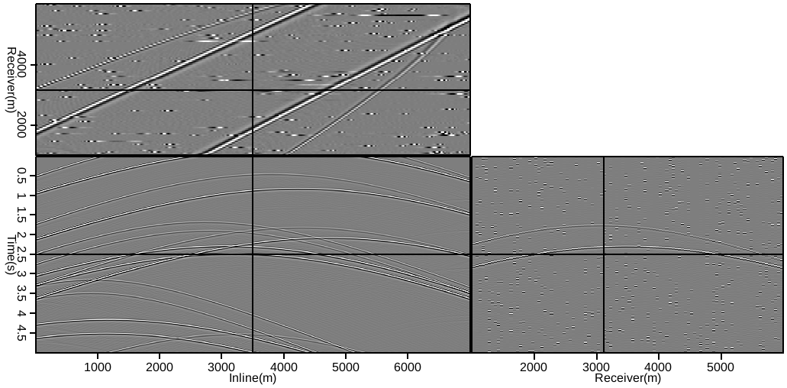
Overlap 50% of data - randomly
Notes:
Can be 1 boat, many, ISS, DS3

Slide 14
Overlap 50% of data - randomly
Shot gather
Receiver gather
Notes:
Can be 1 boat, many, ISS, DS3

Slide 15
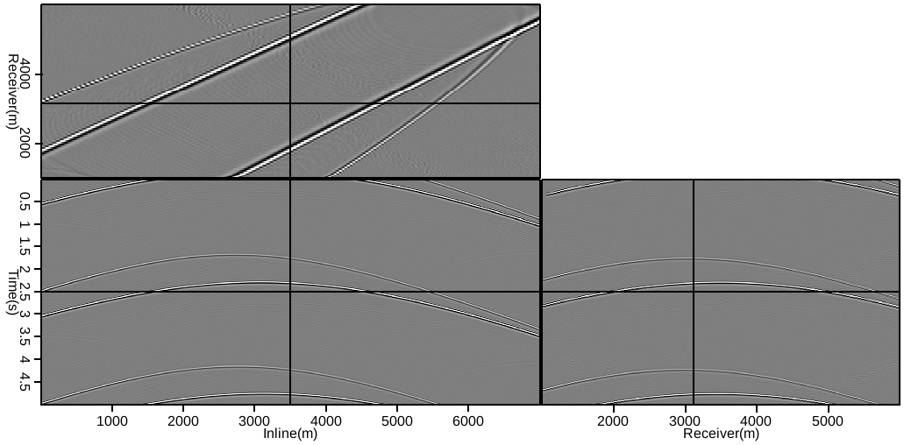
Overlap 50% of data - linearly
Shot gather
Receiver gather
Notes:
Can be 1 boat, many, ISS, DS3

Slide 16
Image space separation
Imaging is a type of coherency pass filter
Overlapping events can be untangled in the extended image space
Move-out/focusing characteristics are different
Successful for multiples (Weibull and Arntsen, 2013)
Demigration required
Output the equivalently unblended survey
Extended imaging preserves kinematics
Can augment with data space methods
Notes:
Compare multiples to sim src

Slide 17
Agenda
Simultaneously acquired data
Demigration
Adjoint method
As an inverse process
Image-space data separation
Accurate velocity model
Inaccurate velocity model

Slide 18
Imaging conditions
RTM imaging condition:
Extended imaging condition:
Notes:
Can be 1 boat, many, ISS, DS3

Slide 19
Imaging conditions
Image
RTM imaging condition:
Extended imaging condition:
Receiver wavefield
Source wavefield
Subsurface offset index
Notes:
Can be 1 boat, many, ISS, DS3

Slide 20
Why extended migration?
Construct offset/angle gathers
Model deficiencies manifested here (velocity, anisotropy…)
Eg WEMVA, WEMQA
Isolate coherent noise
Improve images (Wong, 2014; Alvarez, 2007)
Recover clean(er) data (Weibull and Arntsen, 2013)
Notes:
Can be 1 boat, many, ISS, DS3

Slide 21
Extended demigration
Isolate ‘primary’ shot energy
Demigrate and create unblended data
Theoretically independent of velocity model
Kinematics correctly constructed, not amplitudes
Apply correction term (Sava and Biondi, 2001)
LSRTM to balance image
Demigration as an inverse process
Notes:
Can be 1 boat, many, ISS, DS3

Slide 22
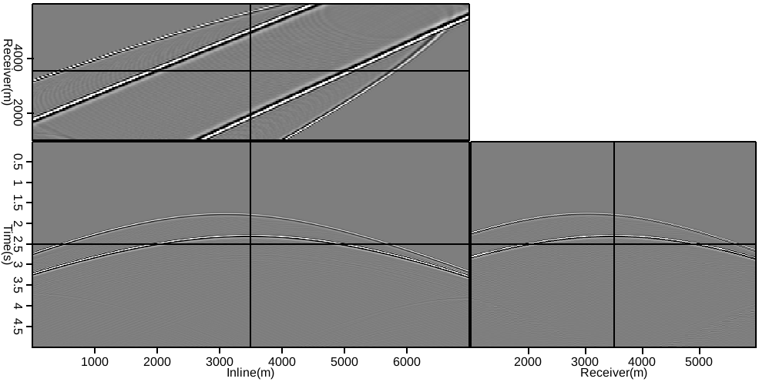
Input dataset

Slide 23
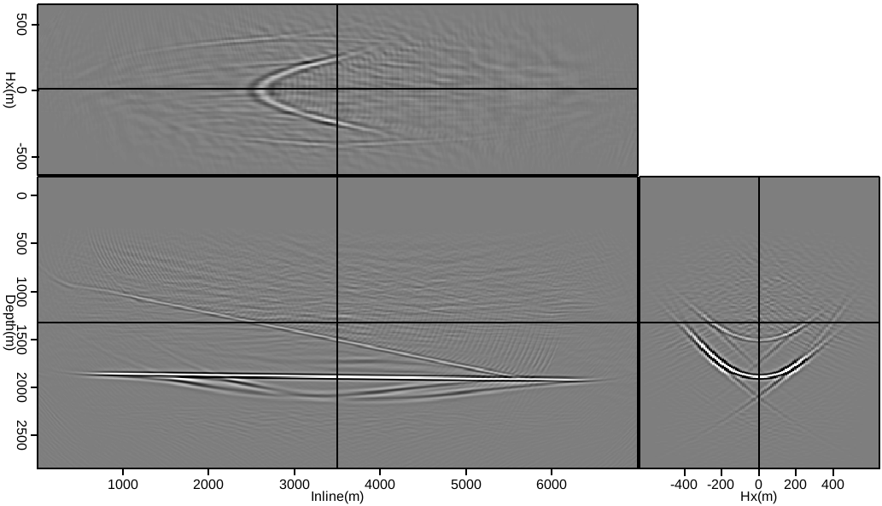
Constant model image

Slide 24
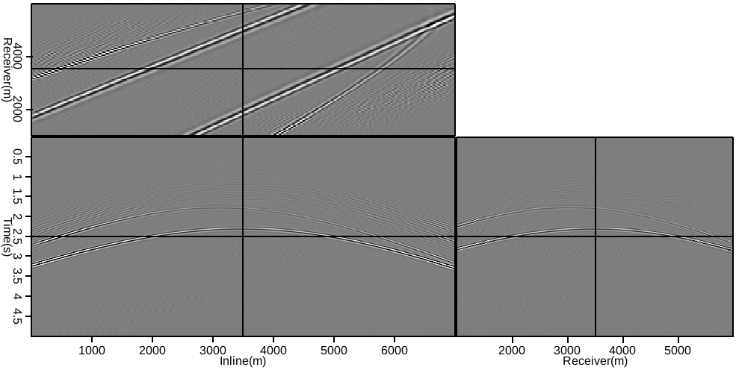
Adjoint demigration

Slide 25
Linearised inversion
For LSRTM
The system looks for the most representative m, to describe the input data d

Slide 26
Linearised inversion
For LSRTM
The system looks for the most representative m, to describe the input data d
Gradient is size of image
CG is in data-space

Slide 27
Inverse demigration
Swap operators and sense of data/model
The system looks for the most representative d, to describe the input image m

Slide 28
Inverse demigration
Swap operators and sense of data/model
The system looks for the most representative d, to describe the input image m
Gradient is size of data
Conj. gradient is in image-space
(as is “data-space” residual)

Slide 29
Adjoint demigration (not inversion)

Slide 30
Output dataset after 10 iterations

Slide 31
Convergence?

Slide 32
Convergence?
0.31% residual
0.039% residual

Slide 33
Agenda
Simultaneously acquired data
Demigration
Adjoint method
As an inverse process
Image-space data separation
Accurate velocity model
Inaccurate velocity model

Slide 34
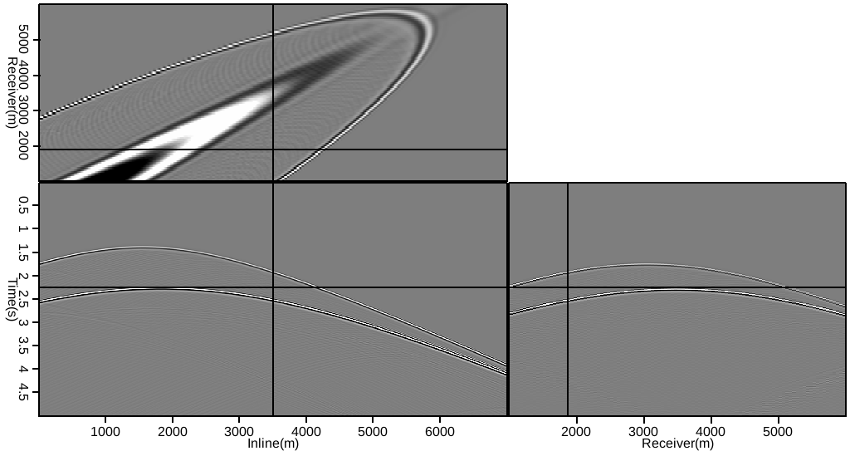
Conventional dataset

Slide 35
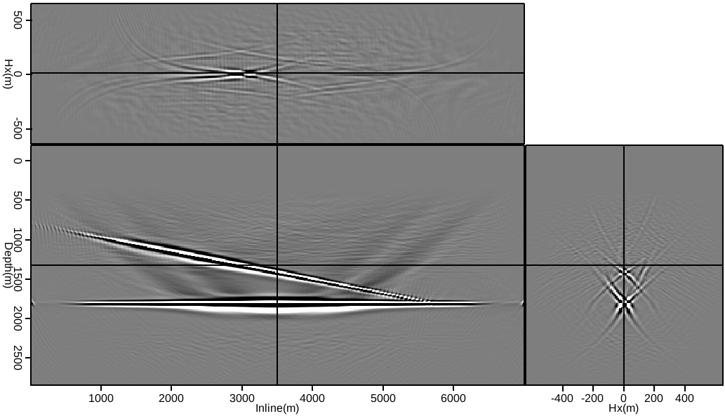
Extended RTM image

Slide 36
Extended image
Hx -> indicative of velocity model accuracy
Collapse to a point => correct velocity
Finite acquisition artifacts

Slide 37
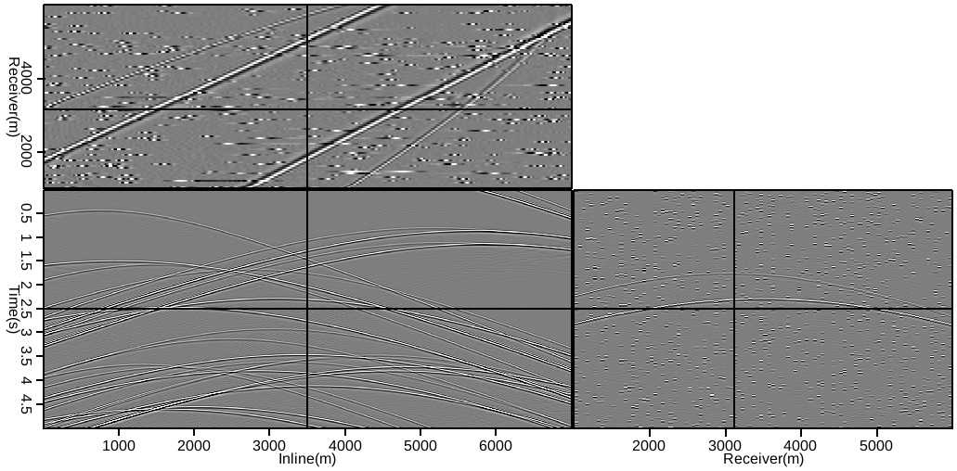
Random blending (5x)
Notes:
Can be 1 boat, many, ISS, DS3

Slide 38
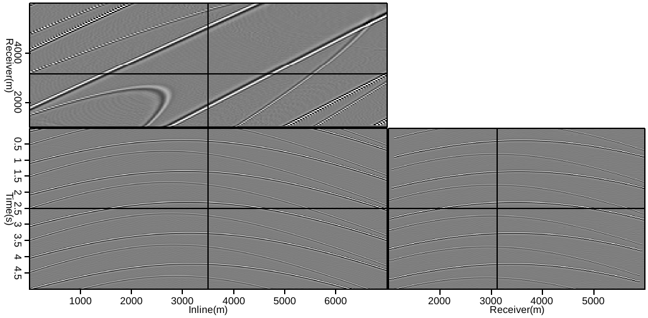
Linear blending (5x)
Notes:
Can be 1 boat, many, ISS, DS3

Slide 39
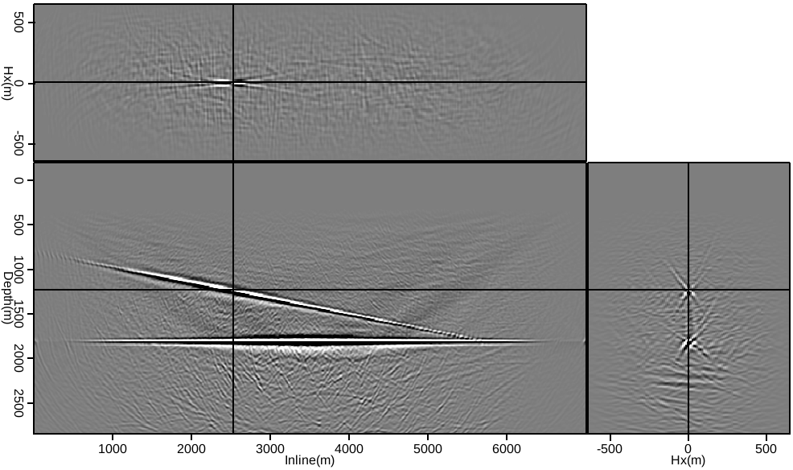
Random, 5x, image
Notes:
Can be 1 boat, many, ISS, DS3

Slide 40
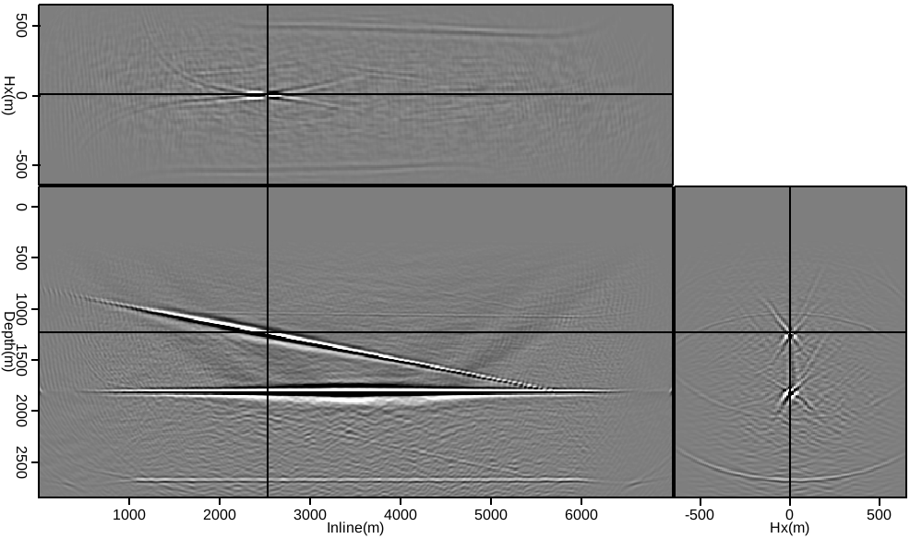
Linear, 5x, image
Notes:
Can be 1 boat, many, ISS, DS3

Slide 41
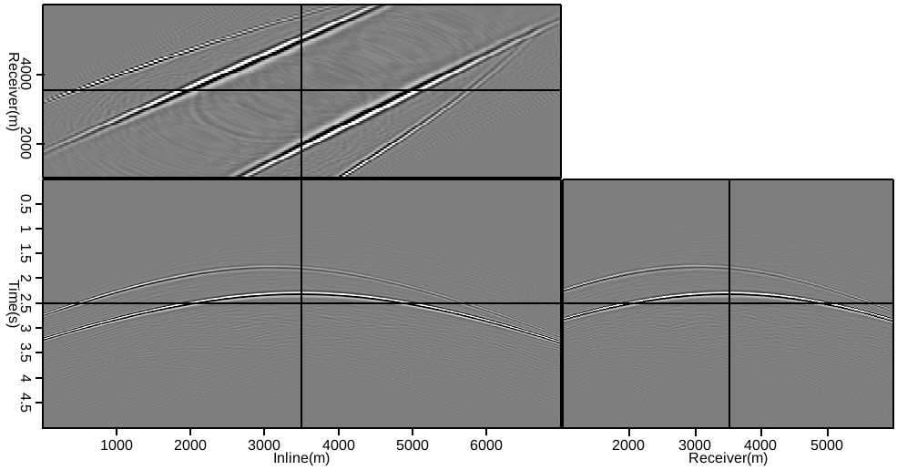
5x random data separated
Notes:
Can be 1 boat, many, ISS, DS3

Slide 42
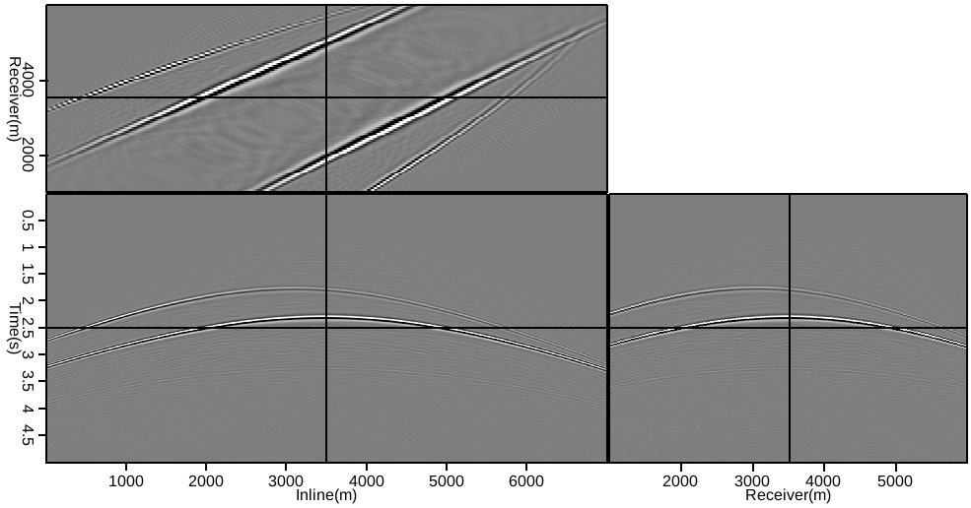
5x linear data separated
Notes:
Can be 1 boat, many, ISS, DS3

Slide 43
Velocity model considerations
Well constrained velocity model
Data separation is trivial
Primary information is collapsed to zero-offset, blended energy spread out (focusing contrast)
Rough velocity model
Loosely focused image
Curvature in subsurface offset
Primary/secondary events still distinguishable
Less focusing contrast

Slide 44
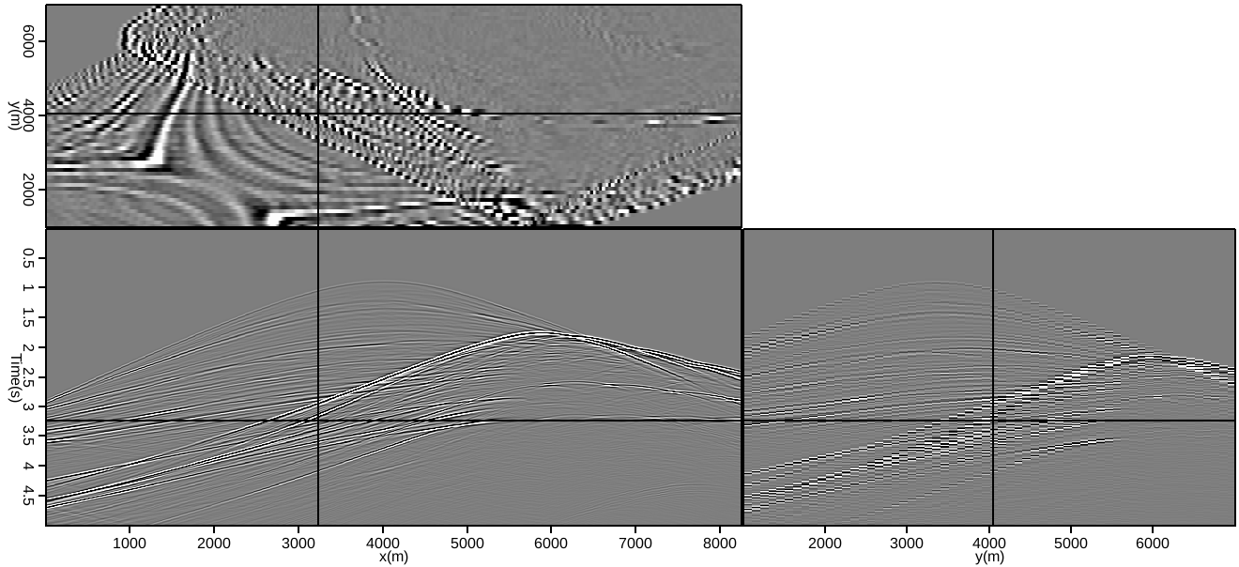
SEAM pseudo-linear data

Slide 45
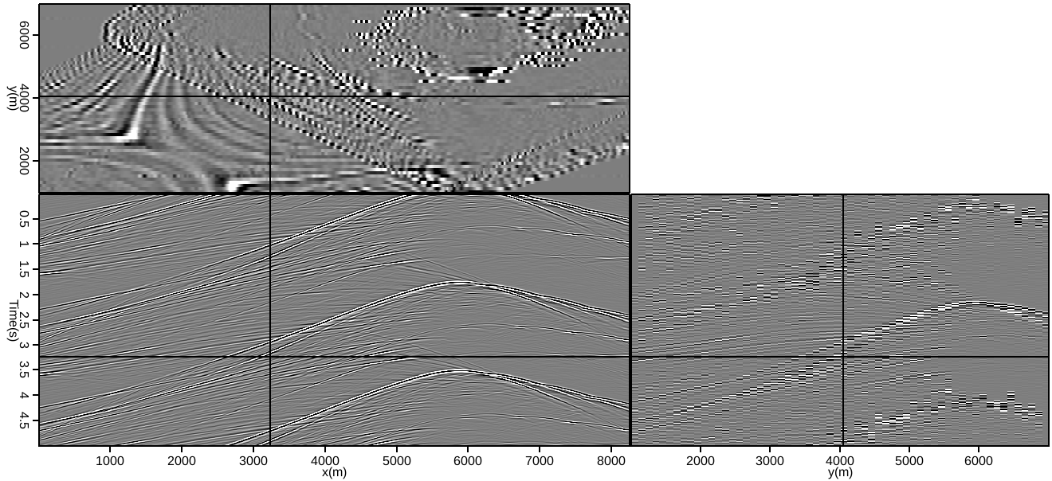
SEAM pseudo-linear data (3x)

Slide 46
Blended inversion / demigration
Adjoint process does not recover amplitudes
Inverse demigration can be extended to include blending
Forward – create continuous record from data
Adjoint – cut and window continuous data

Slide 47
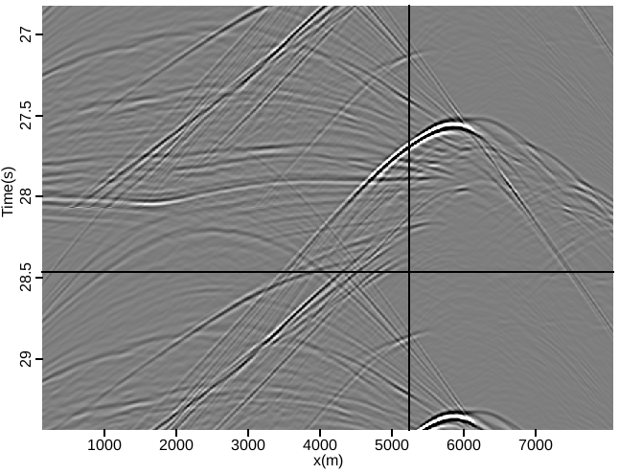
Continuous recording input

Slide 48
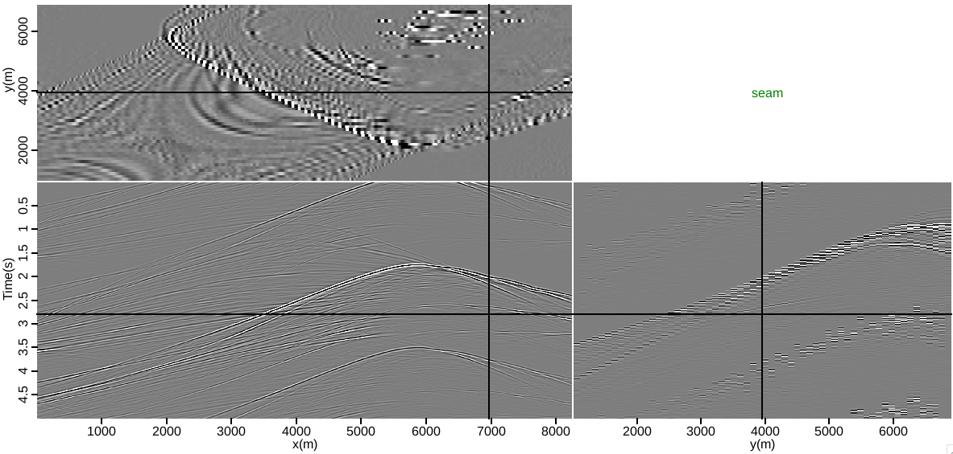
Blending operator (gamma)

Slide 49
Blended inverse demigration
Include gamma
Conventionally image d_{b}, estimate the data d_{d} that, once blended, would result in that image

Slide 50
Blended inverse demigration
Include gamma
Conventionally image d_{b}, estimate the data d_{d} that, once blended, would result in that image
This is unblended data
Gradient is size of blended data
CG is in (extended) image-space

Slide 51
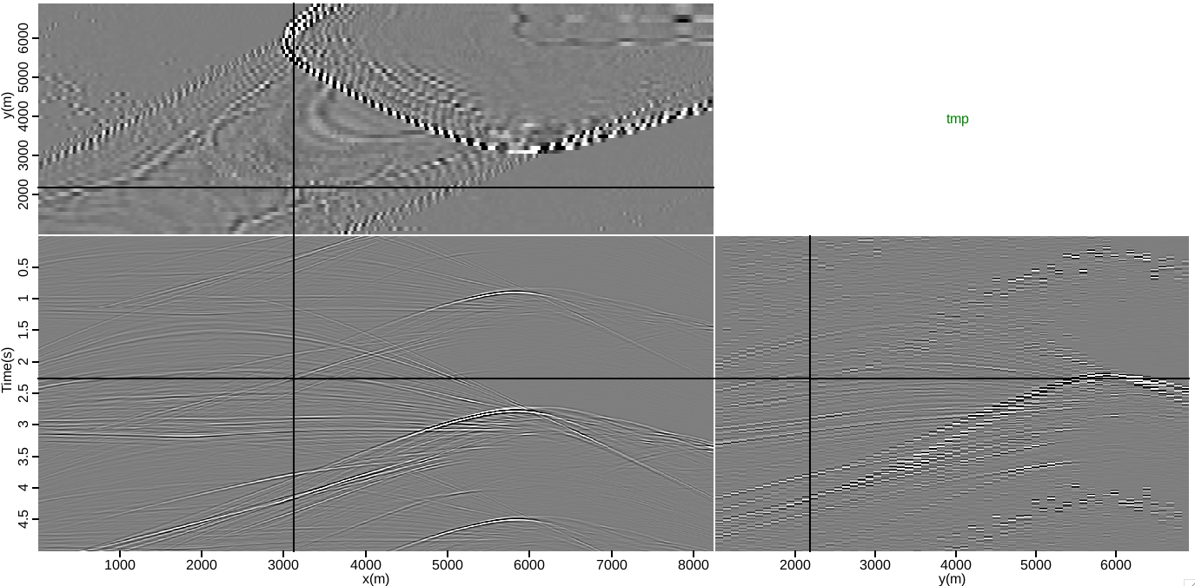
SEAM pseudo-linear data

Slide 52
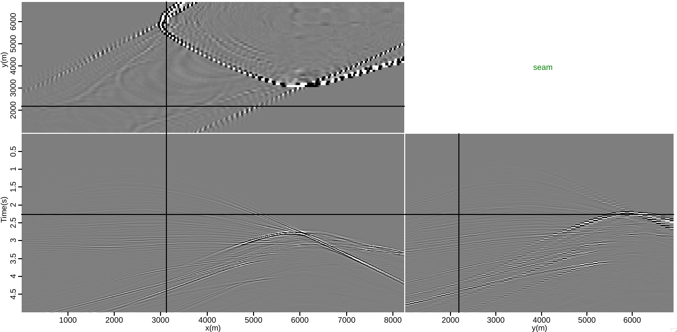
Exact velocity, adjoint separation

Slide 53
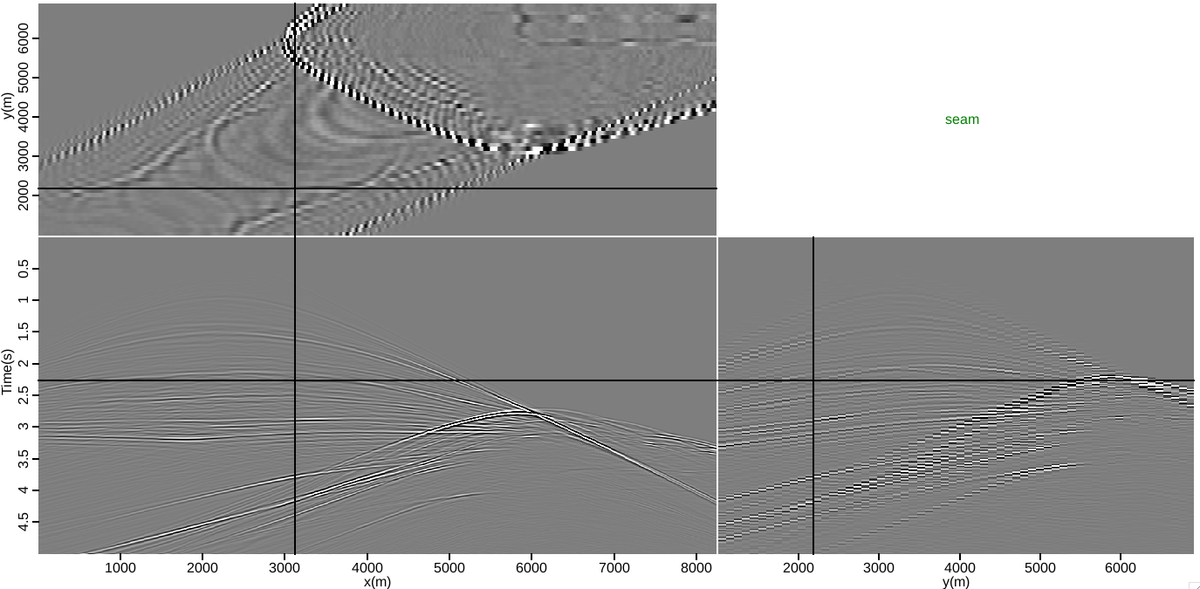
Exact velocity, inverse separation

Slide 54
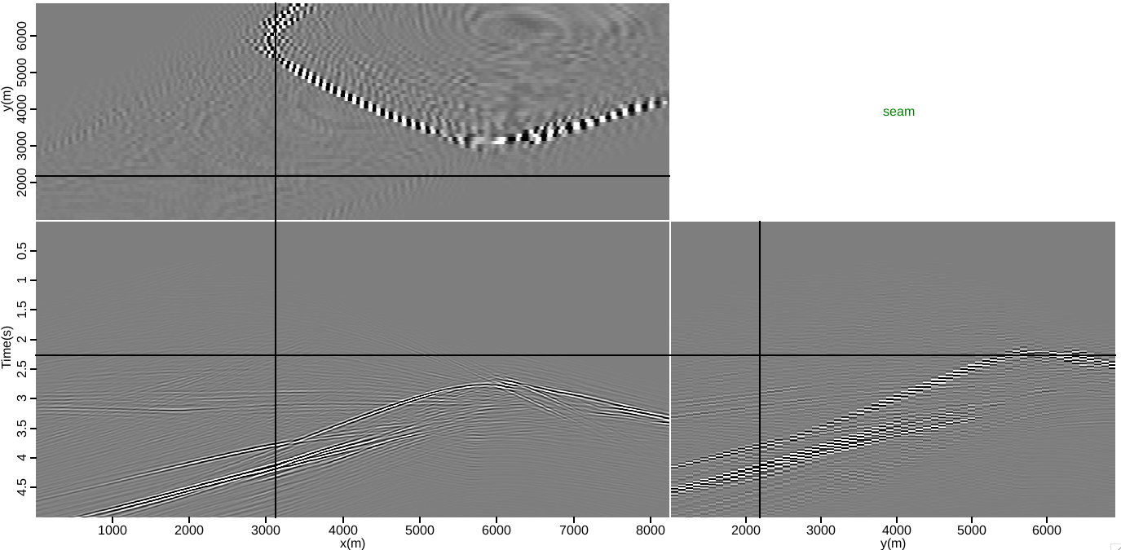
Inexact velocity, adjoint separation

Slide 55
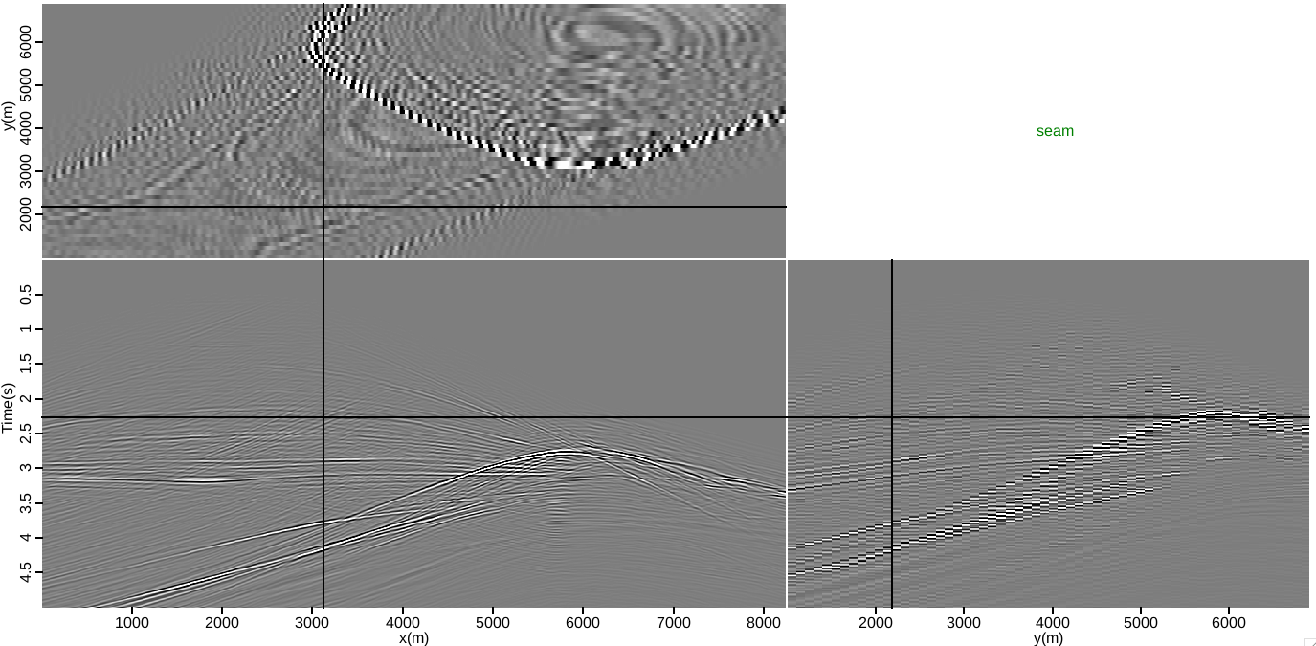
Inexact velocity, inverse separation

Slide 56
Residual behaviour

Slide 57
Combine with velocity updates
Consider separation as an outer loop process
Inner loop velocity updates
During each pass of separation
WEMVA
Extended image already created
Improved velocity control <-> improved separation

Slide 58
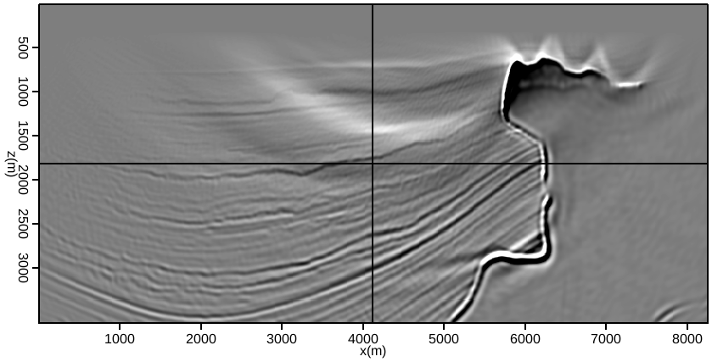
Combine with velocity updates

Slide 59
Combine with velocity updates
WEMVA

Slide 60
Summary
Acquiring simultaneous data can save substantial acquisition costs
(Extended) migration is a powerful coherency pass filter
Kinematics preserved
Inversion recovers amplitudes
Linear, random and pseudo-linear encoding can all be separated
Can be combined with other separation methods, or with WEMVA

Slide 61
Agenda
Simultaneously acquired data
Demigration
Adjoint method
As an inverse process
Image-space data separation
Accurate velocity model
Inaccurate velocity model

Slide 62
Acknowledgements
Paulius Micikevicius (NVIDIA)
Ray Abma (BP)
Ali Almomin (SEP)

Slide 63
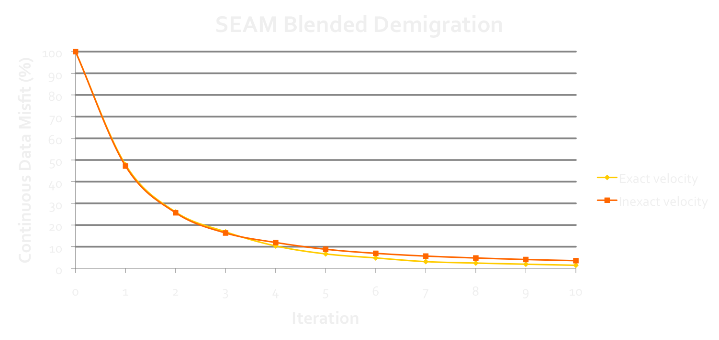
Questions?

Slide 64
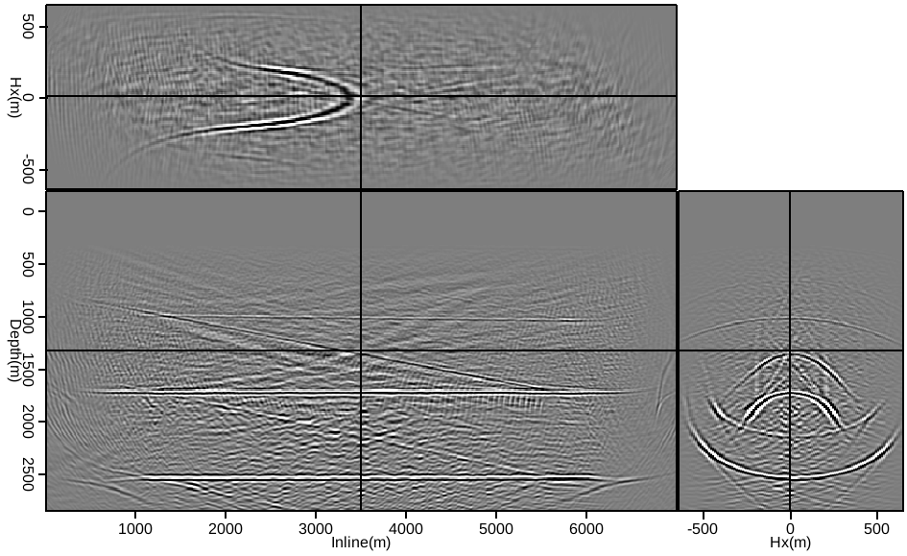
Slow velocity, offset domain,
Constant time delays

Slide 65
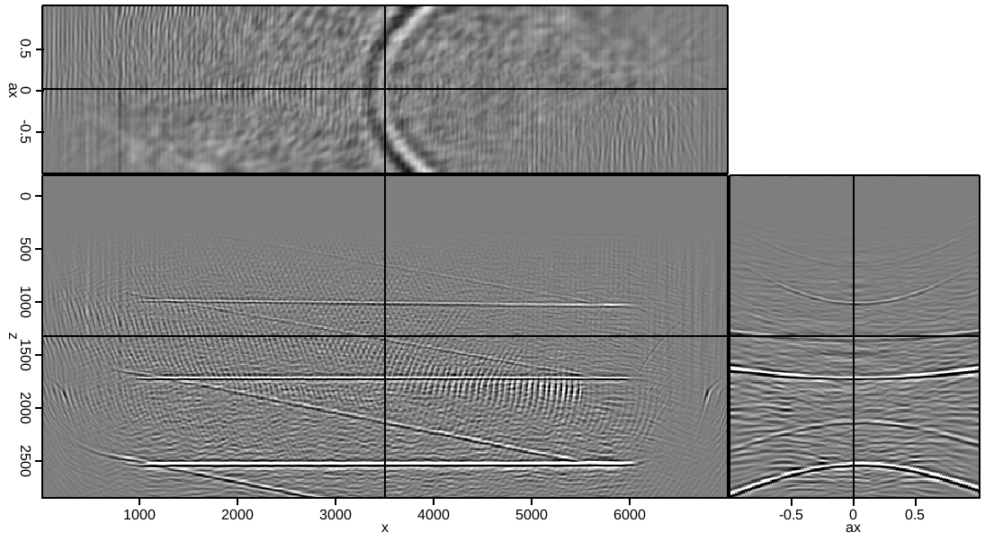
Slow velocity, angle domain
Constant time delays

Slide 66
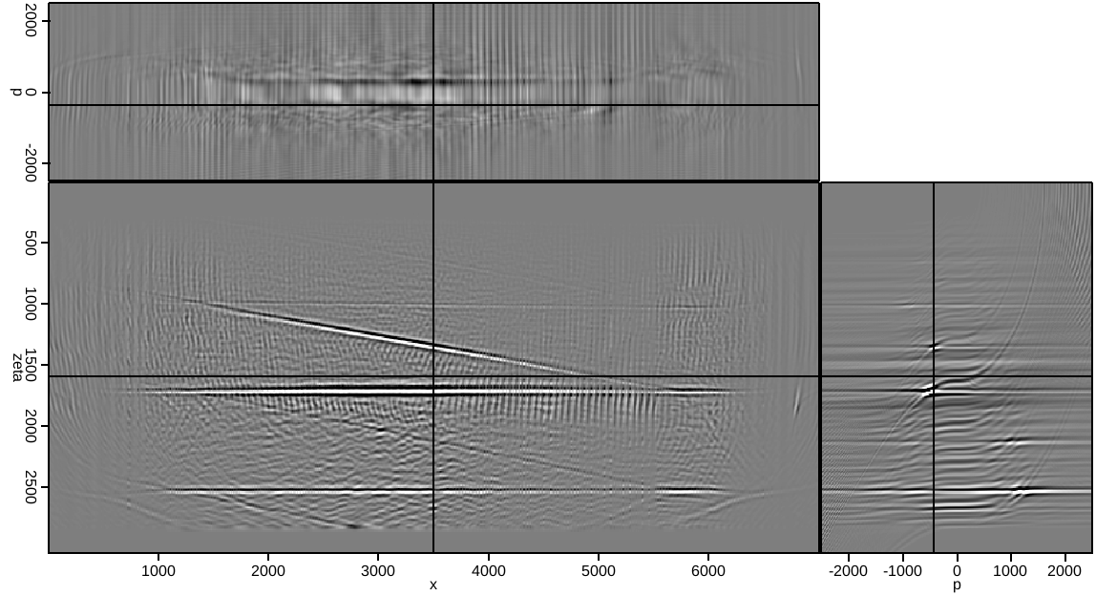
Single hyperbolic Radon transform
p is a measure of hyperbolic curvature

Slide 67
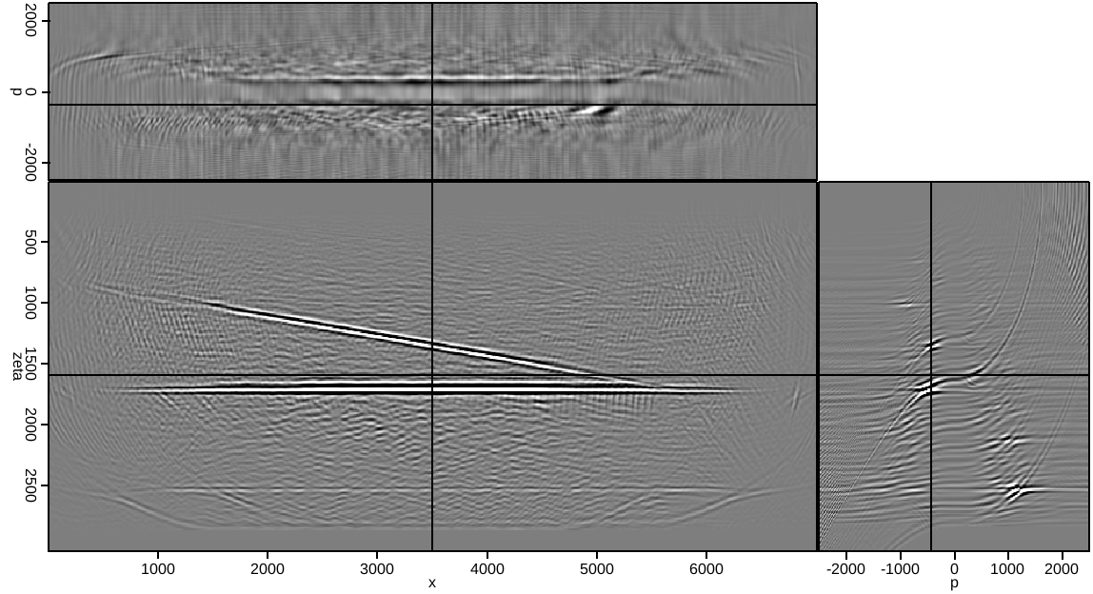
Ten iterations
p is a measure of hyperbolic curvature

Slide 68
However…
For more complicated models
Angle domain is not as well behaved
Curvature is not a reliable measure
Use data from latest SEAM model
Apply blended inversion
Aim to recover separated data
Imaging acts as as a powerful coherency pass filter
Offsets preserve kinematics

