Slide 1

Image-based Q tomography using two-way wavefield-continuation
Yi Shen and Tieyuan Zhu
SEP158 -- P164-174
Stanford Exploration Project

Slide 2
Outline
Motivation: why two-way?
Theory
Numerical examples
Conclusions

Slide 3
motivation
Wave-equation migration Q analysis (WEMQA: Yi Shen et al., 2014)
Notes:
To generate an accurate image and to perform tomography.
Two equation we can rely on to compute wave equation; for the image: RTM
Past year: one way

Slide 4
motivation
Wave-equation migration Q analysis
  Estimate effective Q from migration image
Notes:
To generate an accurate image and to perform tomography.
Two equation we can rely on to compute wave equation; for the image: RTM
Past year: one way

Slide 5
motivation
Wave-equation migration Q analysis
  Estimate effective Q from migration image
  Estimate interval Q using wave-equation based tomography
Notes:
To generate an accurate image and to perform tomography.
Two equation we can rely on to compute wave equation; for the image: RTM
Past year: one way

Slide 6
motivation
Wave-equation migration Q analysis
  Estimate effective Q from migration image
  Estimate interval Q using wave-equation based tomography
Wavefield continuation
(One way vs. two way)
Notes:
To generate an accurate image and to perform tomography.
Two equation we can rely on to compute wave equation; for the image: RTM
Past year: one way

Slide 7
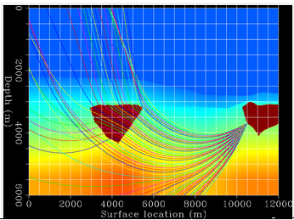
One-way vs. two-way
Compared with two-way migration, one-way migration cannot image overturned events (only propagate along one direction)
http://sepwww.stanford.edu/sep/biondo/HTML/WaveMig.html

Slide 8
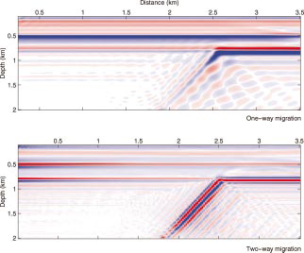
Migration images for a dipping interface at 60º
One way migration
Two way migration
W. A. Mulder and R.-E. Plessix, 2004
Notes:
Shows two way better present the overturned wave, benifet both migration and tomography. Therefore, use two way

Slide 9
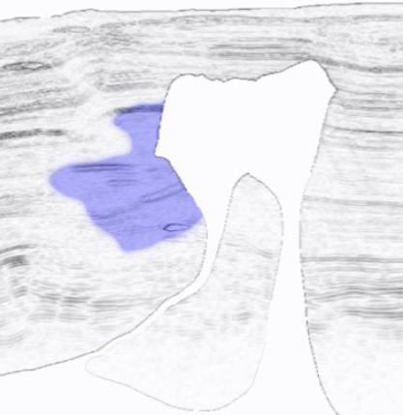
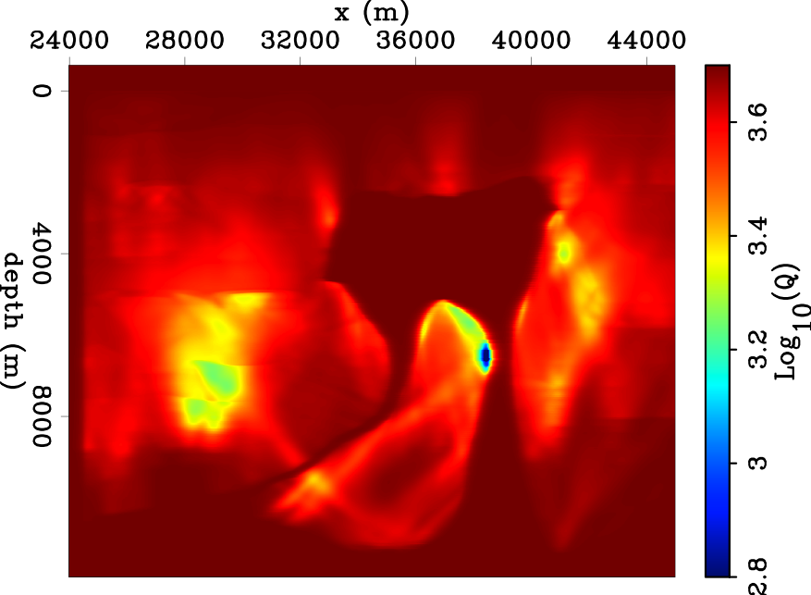
Inverted Q model using one-way
True Q

Slide 10
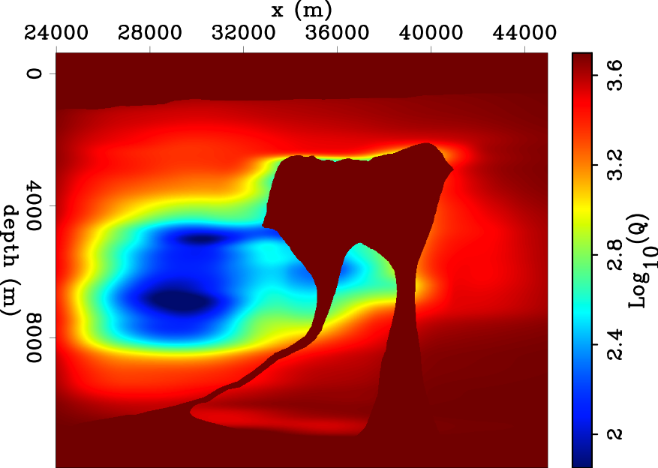
Inverted Q model using two-way
True Q
Notes:
Much improved
But not perfect
Diving wave creates the artifacts
Upper salt body

Slide 11
Q model
Image
ΔQ model
Q₀ model
Q effects
Q₀ model (Q=10,000)
True Q model
Notes:
Say:
walkyou through the workflow, where the two way come in and how
it does not have to be correct;
We usually use the constant value for the initial model; most of the real case, we assume the initial model is non-attenuating
Log display

Slide 12
data
Q model
Image
ΔQ model
Q₀ model
Q effects
  Wavefield-continuation Q migration
Notes:
It compensate the Q effects on the image. If the current Q model is incorrect, the image will be either under or over compensation,

Slide 13
Two-way
(Zhu & Harris, 2013)
Notes:
Noise not well recorded

Slide 14
Two-way
dispersion
(Zhu & Harris, 2013)
Notes:
Noise not well recorded

Slide 15
Two-way
absorption
(Zhu & Harris, 2013)
Notes:
Noise not well recorded

Slide 16
Two-way
Low-pass filter
absorption
(Zhu & Harris, 2013)
Notes:
Noise not well recorded

Slide 17
Two-way
Low-pass filter
absorption
Compensated image
Max(amp)=∞
(Zhu & Harris, 2013)
(Zhu & Harris, 2013)
Notes:
Noise not well recorded

Slide 18
Two-way

Slide 19
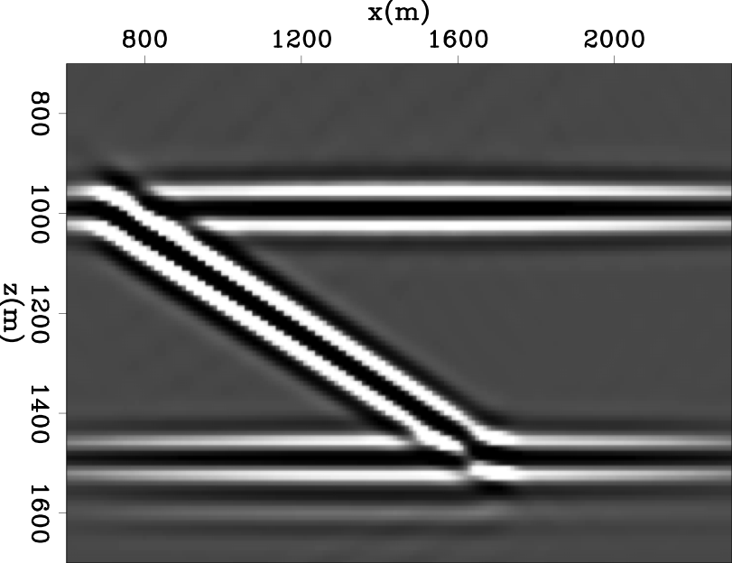
Non-attenuated image

Slide 20
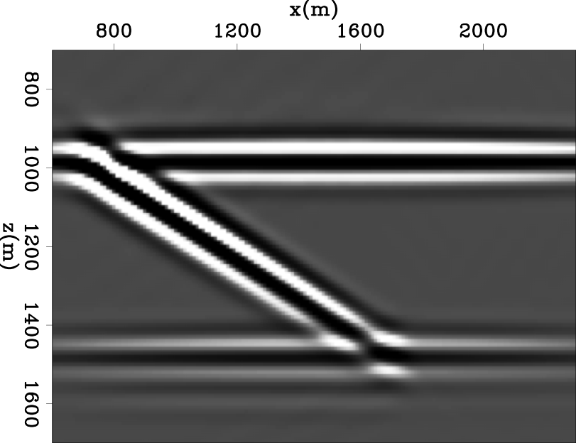
Attenuated image

Slide 21

Compensated image

Slide 22
Non-attenuated image

Slide 23
Q model
Image
ΔQ model
Q₀ model
Q effects
  (Yi Shen et al., 2014)

Slide 24
Q model
Image
ΔQ model
Q₀ model
Q effects
  Back projection:
  wave-equation tomographic operator
  Where E is Q effects;
  T* is the adjoint of the tomographic operator

Slide 25
Q model
Image
ΔQ model
Q₀ model
Q effects
  Back projection:
  wave-equation tomographic operator

Slide 26
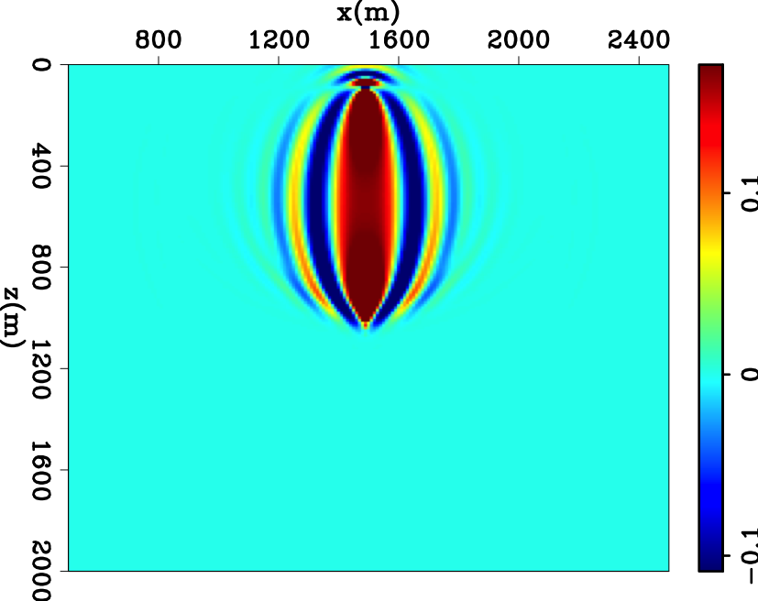
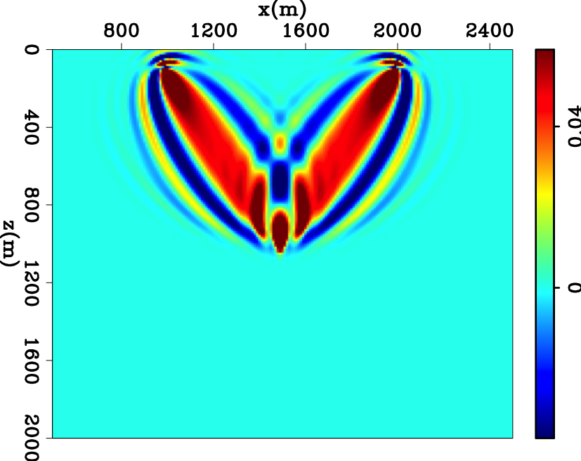
Sensitivity kernel
zero offset
non-zero offset

Slide 27
Q model
Image
ΔQ model
Q₀ model
Q effects

Slide 28
Q model
Image
ΔQ model
Q₀ model
Q effects
Output Q model

Slide 29
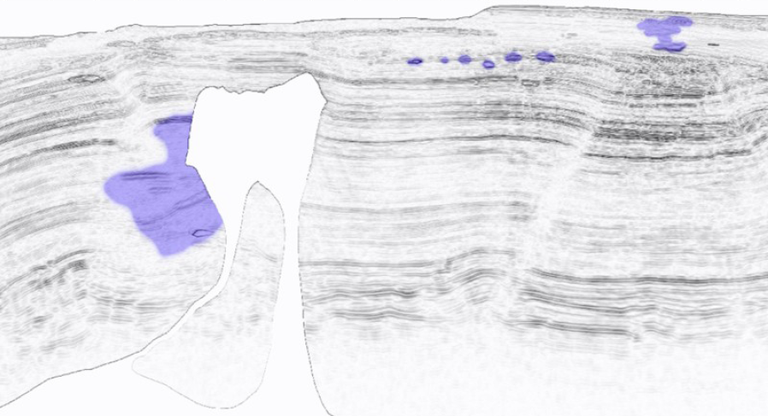
Shallow gas; Q=10~200
Q=50
Courtesy of WesternGeco (Cavalca et al, 2013)
Courtesy of BP (Billette and Brandsberg-Dahl, 2005)

Slide 30
Attenuated image: one-way

Slide 31
Attenuated image: two-way

Slide 32
Inverted Q model using one-way
True Q

Slide 33
Inverted Q model using two-way
Q=55
True Q
Notes:
Much improved
But not perfect
Diving wave creates the artifacts
Upper salt body

Slide 34
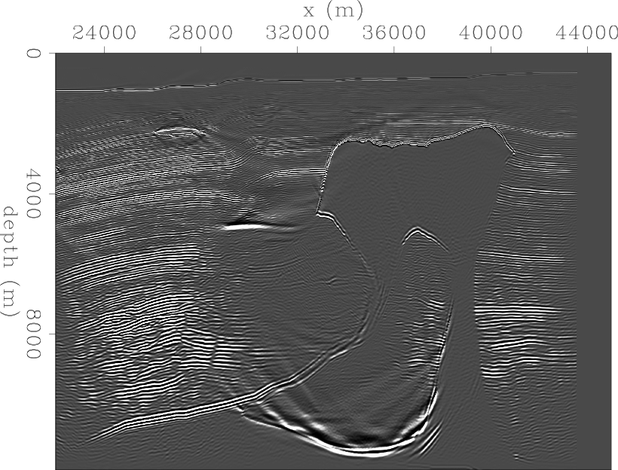
Migration with starting Q model

Slide 35
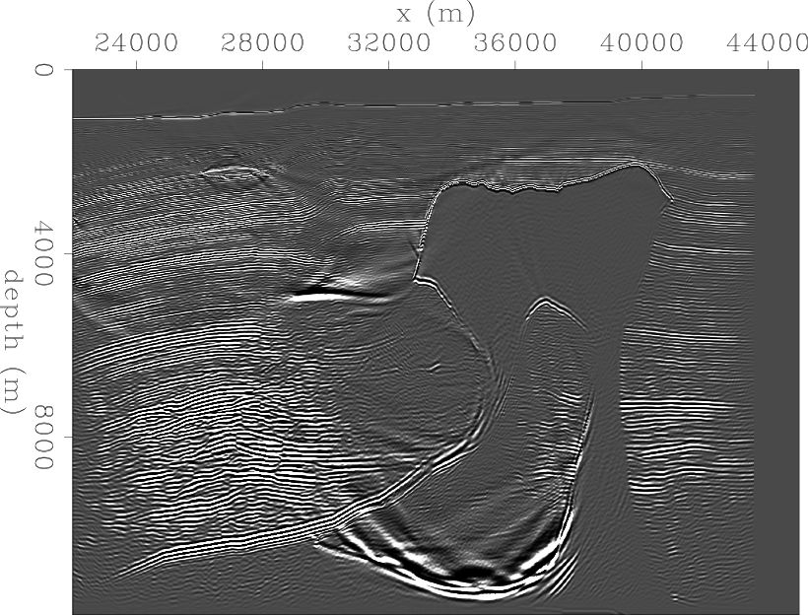
Migration with inverted Q model
Notes:
Artifacts;
Move up: high frequency as reference; low frequency travels slower; if not compensate the velocity error
You can also tell the weak updates from the artifacts here.
Other region is good

Slide 36
Migration with starting Q model

Slide 37
Conclusions
We present a new WEMQA based on a two-way wavefield continuation method
When Compared with the previous work that uses one-way method, the two-way method
  Better images the salt flanks and the reflectors adjacent the salt body
  Better recovers the Q model beside the salt

Slide 38
Acknowledgements
Schlumberger and BP for WG_BP2004Q visco-acoustic surface seismic data
Ali Almonin for help with programming
Biondo Biondi, Robert Clapp and Yang Zhang for their advice and suggestions
SEP colleagues
SEP Sponsors
ThanQ & Q?

Slide 39
Two-way
(Zhu & Harris, 2013)

Slide 40
Two-way
Low-pass filter
(Zhu & Harris, 2013)

Slide 41
tomographic operator

Slide 42
tomographic operator

Slide 43
tomographic operator

Slide 44
tomographic operator

Slide 45
tomographic operator

Slide 46
tomographic operator

Slide 47
tomographic operator

Slide 48
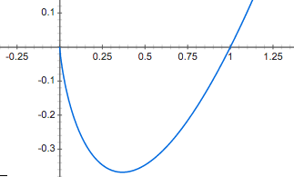
tomographic operator

