Slide 1

Using rock physics to improve Qp quantification in seismic data
Yi Shen， Jack Dvorkin
SEP 158, Page 221-234
Stanford Exploration Project

Slide 2
Outline
Motivation
Theory
  Modeling seismic attenuation
  Modeling velocity
  Linking seismic attenuation and velocity analytically
Validating the closed-form solution using well data
Seismic application: improved Qp quantification in seismic data

Slide 3
Motivation
Gas pockets or clouds
  are notoriously challenging problems for reservoir identification and interpretation
  have low Qp and low Vp
(Zhou, 2011)

Slide 4
Motivation
A quantification of the relation between Vp and Qp
  Has been barely studied
  Brings additional information for seismic inversion
True Q
Inverted Q without additional information
Inverted Q with
additional information

Slide 5
What causes attenuation?
Uniform distribution
Patchy distribution
Water
Gas
Notes:
This talk, focused on patchy distribution;

Slide 6
What causes attenuation?
The oscillatory liquid cross-flow between fully-liquid-saturated patches and the surrounding rock with partial-gas-saturated patches causes attenuation.
Notes:
For the illustration: water-gas system
Fluid has viscosity; friction causes attenuation
Atteunation is especatially strong in pathey with partial satuation
Different modulus, pore pressure are different
Wave-induced variation of pore pressure results in the fluid moving in and out of the gas-saturated pore space
Cross-flow causes strong attenuation

Slide 7
High frequency
Unrelaxed: M∞
Notes:
For the illustration: water-gas system
Fluid has viscosity; friction causes attenuation
Atteunation is especatially strong in pathey with partial satuation
Different modulus, pore pressure are different
Wave-induced variation of pore pressure results in the fluid moving in and out of the gas-saturated pore space
Cross-flow causes strong attenuation
Average modulus

Slide 8
Low frequency
Relaxed: M₀
Notes:
Porosity: how much the rock is open space

Slide 9
How to quantify attenuation?
Standard linear solid model relates 1/Qp to the compressional moduli as a function of frequency.
We use the upper bound of 1/Q to describe attenuation, without addressing frequency dependence.
Notes:
Don’t expect Q varies with frequency

Slide 10
How to quantify velocity?
The compressional velocity of rock

Slide 11
How to relate velocity to Q?
The compressional velocity of rock
The compressional Qp of rock

Slide 12
How to relate velocity to Q?
M_{S}, ϕ, M_{Dry}, K_{G}, K_{W}, S_{w}, ρ
Vp
Qp
M_{S}: compressional modulus of the mineral phase
ϕ: total porosity
M_{Dry}: compressional modulus of the dry frame of the rock
K_{G} and K_{W}: modulus of gas and water, respectively
S_{w}: water saturation
ρ: bulk density
Notes:
For example, phi, merge equation, eliminate phi to link them
We can not take care 7 with 2 equation
we only linked Vp with Qp using the rock properties which, when modified, generate a significant change in these two properties and therefore in their relation.
We assigned a spatially constant value to the rest of the rock parameters.
What we did to find the sensitive

Slide 13
How to relate velocity to Q?
M_{S}, ϕ, M_{Dry}, K_{G}, K_{W}, S_{w}, ρ
Vp
Qp
M_{S}: compressional modulus of the mineral phase
ϕ: total porosity
M_{Dry}: compressional modulus of the dry frame of the rock
K_{G} and K_{W}: modulus of gas and water, respectively
S_{w}: water saturation
ρ: bulk density
Notes:
For example, phi, merge equation, eliminate phi to link them
We can not take care 7 with 2 equation
we only linked Vp with Qp using the rock properties which, when modified, generate a significant change in these two properties and therefore in their relation.
We assigned a spatially constant value to the rest of the rock parameters.
What we did to find the sensitive

Slide 14
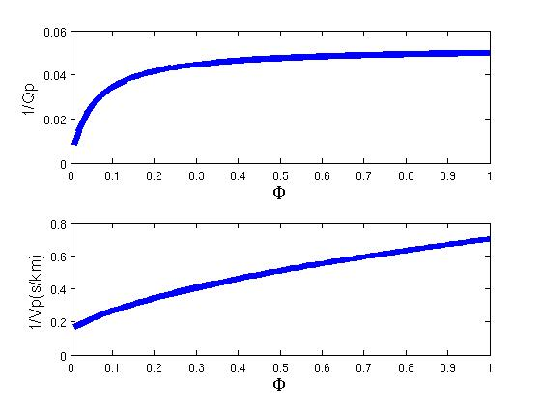
What’s the effects of ϕ

Slide 15
Link Qp to Vp
The approximate analytical relation

Slide 16
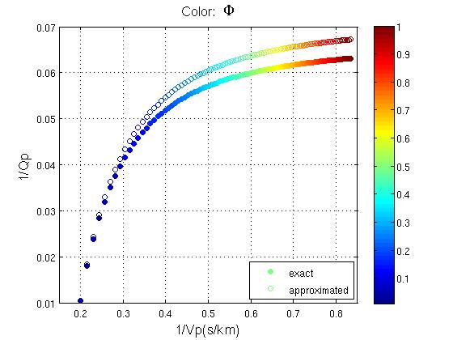
How the approximation works?
S_{W} = 0.3
Notes:
Real worlds, porosity small

Slide 17
Link Qp to Vp
The approximate analytical relation

Slide 18
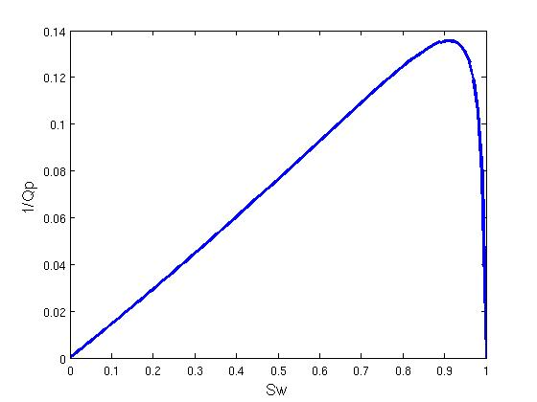
Link Qp to Vp
Notes:
Stay validated; sometimes relation fall apart

Slide 19
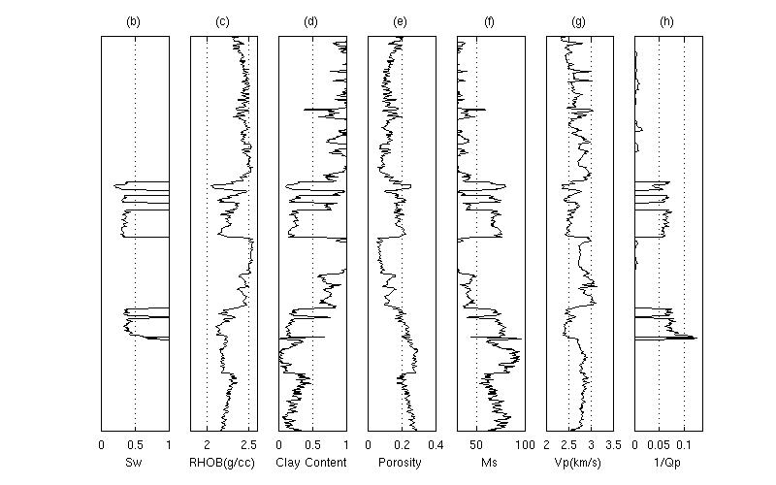
How it works on a field gas log

Slide 20
How it works on a field gas log

Slide 21
How it works on a field gas log

Slide 22
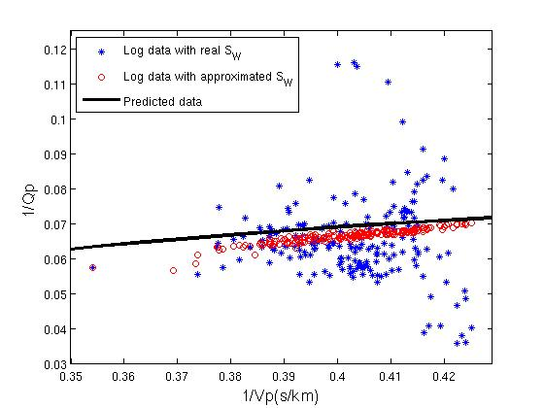
Validation
Notes:
Real world; dots scattered

Slide 23
Seismic application
Objectives of seismic inversion for Q
d_{cal} is the calculated data; d_{obs} is the observed data
m is the model, which is Q here; A is the regularization operator
Data
fitting
Model regularization

Slide 24
Seismic application
Objectives of seismic inversion for Q
d_{cal} is the calculated data; d_{obs} is the observed data
m is the model, which is Q here; A is the regularization operator
Data
fitting
Model regularization

Slide 25
Velocity and Qp
Velocity
Qp
Li et al. (2015); Want et al. (2013)

Slide 26
Estimated Q without constraint

Slide 27
Estimated Q with constraint

Slide 28
True model

Slide 29
Before compensation

Slide 30
After compensation

Slide 31
Conclusions
We derived an approximate closed-form solution relating Vp to Qp using rock physics modeling.
This solution is validated using field gas well data
We applied our new Qp – Vp to synthetic seismic data
  It produced an improved Q estimated model
  The improved Q model leads to a better seismic migration image

Slide 32
Acknowledgements
SEP colleagues
SEP sponsors
ThanQ & Q?

Slide 33
Background review
Modulus:
  Stiffer the rock, the larger the Modulus
  Compressional modulus M= RHOB*Vp*Vp
  Shear modulus G = RHOB*Vs*Vs
  Bulk modulus K = M- 4/3*G
Porosity
  The ratio of pore volume to rock volume
Saturation
  E.g. water saturation: the ratio of water volume to pore volume

Slide 34
Background review
M_{S}: compressional modulus of the mineral phase
ϕ: total porosity
M_{Dry}: compressional modulus of the dry frame of the rock
Notes:
Porosity: how much the rock is open space

Slide 35
Background review
K_{G}: modulus of gas
K_{W}: modulus of water
S_{w}: water saturation
ρ: bulk density
Notes:
Porosity: how much the rock is open space

Slide 36
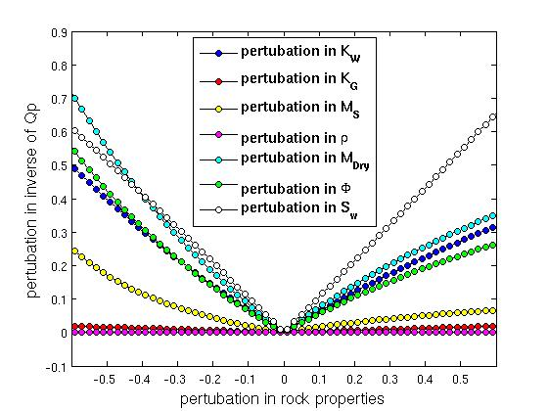
Which makes a big change?
M_{S}
ϕ
M_{Dry}
K_{G}
K_{W}
S_{w}
ρ
S_{W}
M_{Dry}
K_{W}
ϕ
M_{S}

Slide 37
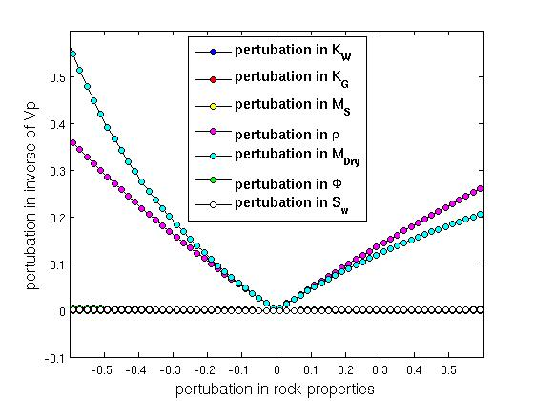
Which makes a big change?
M_{S}
ϕ
M_{Dry}
K_{G}
K_{W}
S_{w}
ρ
ρ
M_{Dry}
Notes:
M dry is the the parameter has significant change to both parameter.
For the rest, some non-sensitive
Some others are sensitive to only

Slide 38
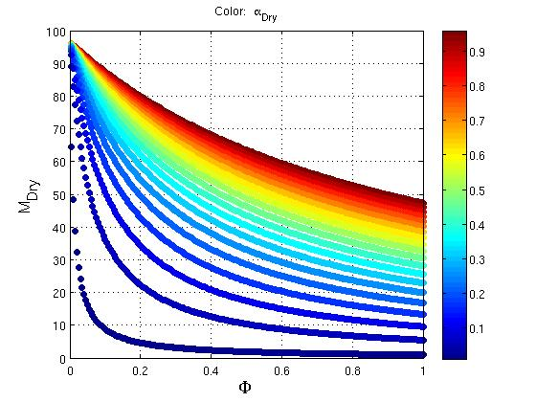
What is M_{dry}?

Slide 39
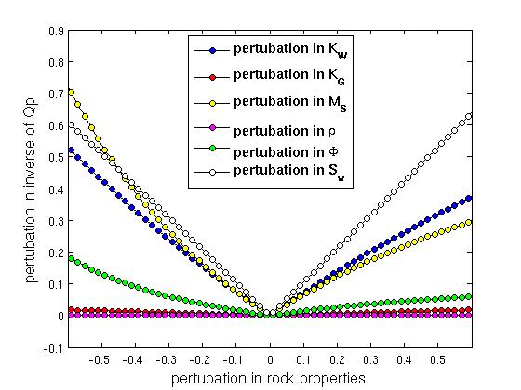
Which makes a big change?
S_{W}
K_{W}
M_{s}
ϕ
M_{S}
ϕ
M_{Dry}
K_{G}
K_{W}
S_{w}
ρ

Slide 40
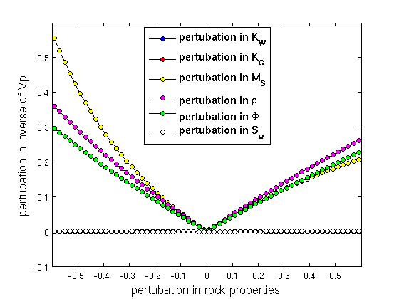
Which makes a big change?
M_{S}
ϕ
M_{Dry}
K_{G}
K_{W}
S_{w}
ρ
ρ
ϕ
M_{s}

Slide 41
Some approximations
The equation of Qp
where 0<S_{W}<1: M₀≈M∞; 0=S_{W} or S_{W}<1: M₀=M∞
Approximation: define M∞=M₀(1+Δ) and use Taylor expansion to reduce the high order of Δ

Slide 42
Porosity and Saturation
Porosity
Gas saturation
Li et al. (2015); Want et al. (2013)

Slide 43
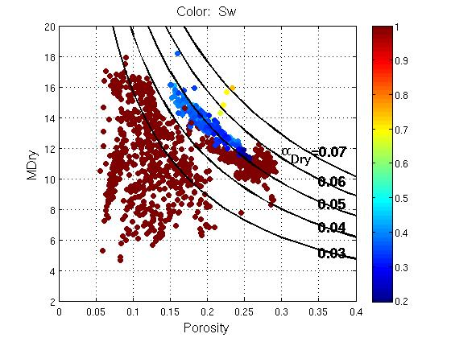
Find our α_{Dry}

Slide 44
How the approximation works?
α= 0.05;
S_{W} = 0.3

Slide 45
How to relate velocity to Q?
M_{S}, ϕ, M_{Dry}, K_{G}, K_{W}, S_{w}, ρ
Vp
Qp
M_{S}: compressional modulus of the mineral phase
ϕ: total porosity
M_{Dry}: compressional modulus of the dry frame of the rock
K_{G} and K_{W}: modulus of gas and water, respectively
S_{w}: water saturation
ρ: bulk density
Notes:
For example, phi, merge equation, eliminate phi to link them
We can not take care 7 with 2 equation
we only linked Vp with Qp using the rock properties which, when modified, generate a significant change in these two properties and therefore in their relation.
We assigned a spatially constant value to the rest of the rock parameters.
What we did to find the sensitive

Slide 46
What is M_{dry}?
M_{Dry} is the compressional modulus of the dry frame of the rock
M_{Dry} is not a direct measurable parameter from the well log
The previous studies built the rock physics model to compute M_{Dry} using other parameter. (Raymer et al., 1980; Dvokin and Nur, 1996, etc.)
Problem: these models have not provided an analytical equation that can be used conveniently to derive Vp vs Qp

Slide 47
What is M_{dry}?
M_{Dry} ~ 1/ϕ
M_{Dry}
Porosity ϕ
pore

Slide 48
What is M_{dry}?
(M_{s} - M_{Dry})~ ϕ
ΔM_{Dry}
Porosity ϕ
pore

Slide 49
What is M_{dry}?
Notes:
Alpha calibrate;
2 in to 1 param

Slide 50
How to relate velocity to Q?
M_{S}, ϕ, M_{Dry}, K_{G}, K_{W}, S_{w}, ρ
Vp
Qp
M_{S}: compressional modulus of the mineral phase
ϕ: total porosity
M_{Dry}: compressional modulus of the dry frame of the rock
K_{G} and K_{W}: modulus of gas and water, respectively
S_{w}: water saturation
ρ: bulk density
Notes:
For example, phi, merge equation, eliminate phi to link them
We can not take care 7 with 2 equation
we only linked Vp with Qp using the rock properties which, when modified, generate a significant change in these two properties and therefore in their relation.
We assigned a spatially constant value to the rest of the rock parameters.
What we did to find the sensitive

Slide 51
What’s the effects of ϕ
α = 0.05

