Slide 1
REVERSE-TIME MIGRATION
USING THE ENERGY IMAGING CONDITION
IN ISOTROPIC AND VTI MEDIA
SEP 163, pp. 77
Alejandro Cabrales
April 12, 2016
Notes:
Good afternoon everyone, me again. My second presentation is about the implementation of the so-called Energy Imaging Condition. I’ll show the implementation in isotropic and anisotropic VTI media. I derived the latter using a similar criterion as in the elastic case, that I don’t discuss here.

Slide 2
OUTLINE
Motivation
Theoretical review
Synthetic examples
Conclusions
2
Notes:
This is the ouline that I’m going to follow…

Slide 3
OUTLINE
Motivation
Theoretical review
Synthetic examples
Conclusions
3
Notes:
… and I begin with the motivation.

Slide 4
MOTIVATION
RTM low-wavenumber artifacts.
Low-cut filters?
Wavefield separation: Works well vertically; requires Fourier transforms.
Poynting vectors: Required weighting function.
4
Notes:
Firstly, of course, we have the RTM low-wavenumber events when we use the xcorrelation imaging condition, where the source and receiver wavefields travel in the same direction.
The easiest solution is to apply low-cut filters, at the risk of attenuating useful seismic events.
A smarter solution is performing wavefield separation, which works very well vertically, but fails when the low-wavenumber artifacts are due to turning waves, in other words, when the wavefields travel horizontally. Besides that, it requires forward and backward Fourier transforms each spatial axis.
Another alternative is to use Poynting vectors, but we need to compute a weighting function to select the angles that we would need to nullify.
Alternatively, we can use the EIC.

Slide 5
OUTLINE
Motivation
Theoretical review
Synthetic examples
Conclusions
5
Notes:
…and we’ll se some theory, I promise it is brief!

Slide 6
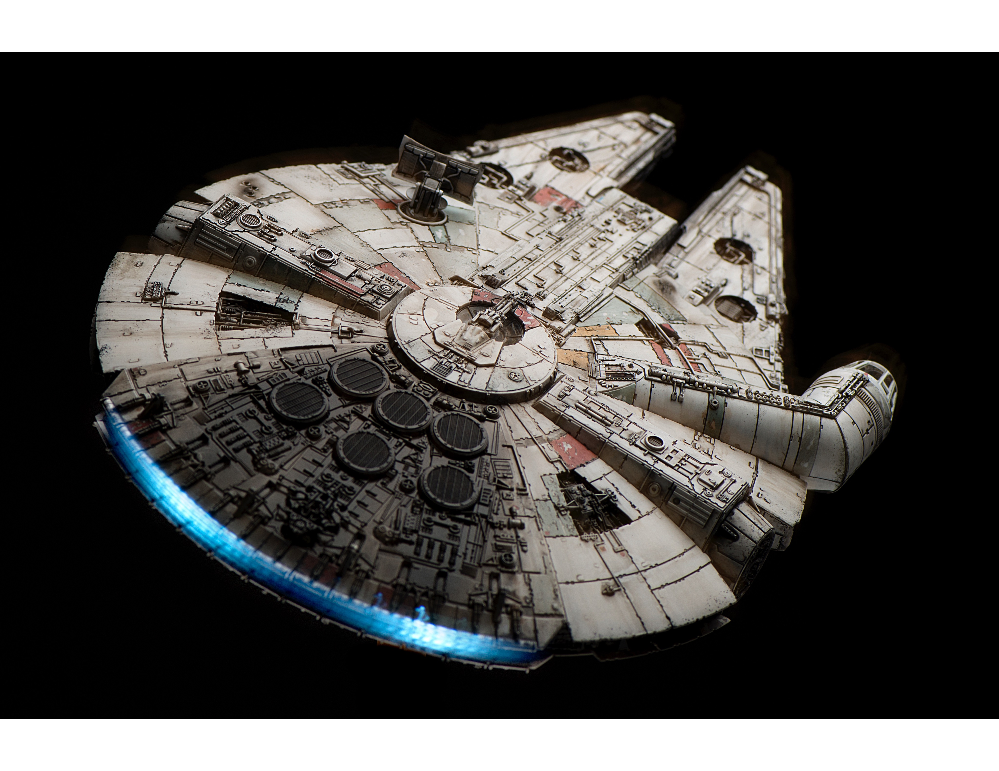
THEORETICAL REVIEW
Acoustic wave equation:
Energy of the solution (Rocha, 2016):
Kinetic energy
Potential energy
Isotropic EIC:
6
Notes:
Beginning with the acoustic, wave equation, where P is pressure and v is P-wave velocity,
We can obtain the energy of the solution. The temporal and spatial derivatives constitute the kinetic and the potntial energy respectively. and the total energy is conserved in time assuming there is no absorption in the medium. We can identify this expression as a norm of a space-time gradient, with Special Relativity shades, and then come up with an inner-product, now summing in the time direction.
Now this expression is inflexible, so we introduce a cut-off angle, which allows us to reject propagations that we don’t want in the image. I’ll show you how it works.

Slide 7
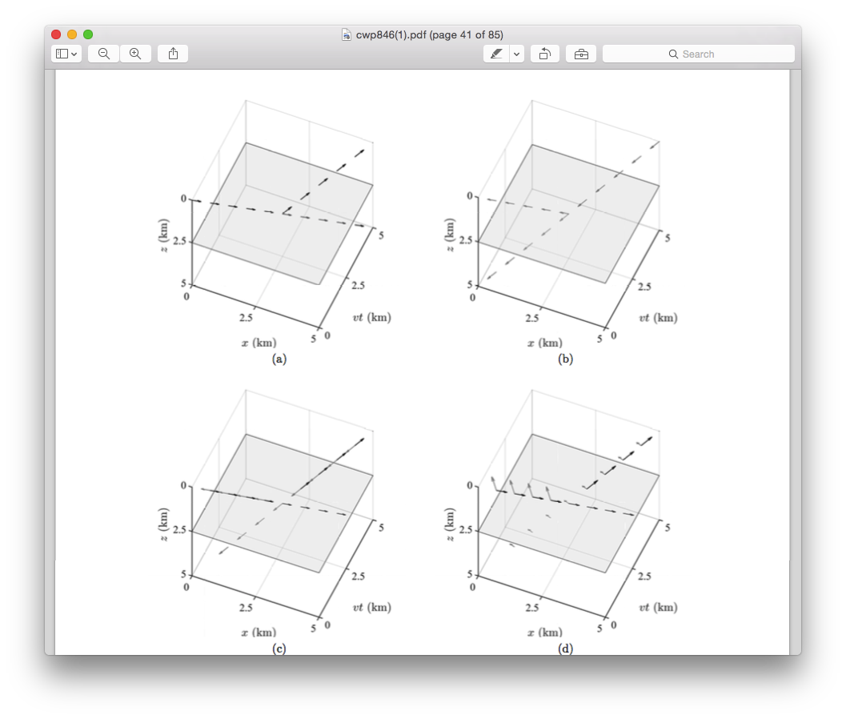
☐S(x,t)
THEORETICAL REVIEW
☐R(x,t)
2θ_{c}=0°
2θ_{c}=180°
Figures after Rocha (2016)
7
Notes:
These are some cartoons of the space-time gradients of the source and receiver wavefields, which reflect and transmit in the presence of a reflector.
If we set the cut-off angle as zero, it is equivalent to the original inner-product. The space-time gradients will make the imaging condition reward backscattering because the corresponding vectors are in the same direction.
On the other hand, if we set the cut-off angle to 180 degrees, giving this minus sign, the gradients corresponding to backscattering become orthogonal in space-time, therefore they are cancelled.

Slide 8
After Rocha (2016)
THEORETICAL REVIEW
2θ_{c}=0°
2θ_{c}=180°
8
Notes:
And these are examples of each case. In this case the preservation of the tomographic component (the low-wavenumber artifacts), while attenuating reflections, can be useful when computing the FWI gradient, improving the convergence. In RTM, the other solution speaks by itself.
I’ve shown so far the application of EIC in acoustic isotropic media, and it has been developed as well in elastic isotropic media.

Slide 9
THEORETICAL REVIEW
VTI wave equation (Zhang et al., 2011):
Energy of VTI solution (Zhang et al., 2011):
EIC for the VTI wave equation:
9
Notes:
Now I’ll show you one implementation in VTI media. I use the approach proposed by Zhang et al., where p is the stress vector with the horizontal and vertical components, B is a matrix that contains the Thomsen parameters, epsilon and delta, and D is a diagonal matrix with the second derivative operators.
I initially decided to expand my code for anisotropy and used this equation, The authors prove the stability by deriving an expression for the energy of the solution and showing that it remains stationary. Matrices lambda and Y come from the diagonalization of matrix B. From here we have a norm of a space-time gradient, so I can obtain a VTI EIC for this equation, and here it is. Again, zero cut-off angle means enhancement of the low-wavenumber events; and 180 degrees is their attenuation. The only problem that I can see is that matrix B becomes singular in areas where anisotropy is zero. I fixed that problem in the code by adding an small number to the lambda eigenvalues.

Slide 10
OUTLINE
Motivation
Theoretical review
Synthetic examples
Conclusions
10
Notes:
Now let see synthetic results.

Slide 11
SYNTHETIC EXAMPLES
Cross-correlation IC
Energy IC (θ_{c}=0°)
Energy IC (θ_{c}=90°)
11

Slide 12
SYNTHETIC EXAMPLES
Marmousi anisotropic
Cross-correlation IC
Energy IC (θ_{c}=0°)
Energy IC (θ_{c}=90°)
12
Notes:
This is the Marmousi anisotropic model. The first image is the cross-correlation IC, which contains reflections and artifacts.
The second corresponds to the energy IC with zero cut-off angle removes mainly deeper reflections and preserve the artifacts. Shallow reflections persist because they correspond to broader angles.
The third one corresponds to the energy IC for cut-off angles of 90 degrees, and the artifacts are almost completely gone.

Slide 13
SYNTHETIC EXAMPLES
Hess VTI salt model
Cross-correlation IC
Energy IC (θ_{c}=0°)
Energy IC (θ_{c}=90°)
13
Notes:
Now we have the Hess VTI salt model. The first figure shows the result of the cross-correlation imaging condition. The VTI solution works very well in the sense of positioning the seismic events. As before, we have both the reflections and the artifacts.
Using the EIC with zero cut-off angle we attenuate mainly deeper reflections and conserve the artifacts.
And this time, when using the EIC for cut-off angle of 90 degrees, we obtain a fair result. I still don’t have an answer for the remaining artifacts, but my educated guess is that zero-anisotropy areas in the water layer may induce such inaccuracies, I still have to figure it out.

Slide 14
OUTLINE
Motivation
Theoretical review
Synthetic examples
Conclusions
14
Notes:
Let’s move to the conclusions.

Slide 15
CONCLUSIONS
EIC allows separation of the RTM tomographic and the reflectivity components.
Anisotropic cases work fairly well. Need to address remaining artifacts.
15

Slide 16
Thanks to the SEP sponsors for their continuous support.
Thanks to Tariq Alkhalifah for the Marmousi anisotropic model.
Thanks to Hess Corporation for the VTI salt model.
Thanks to Yinbin and Huy, for comments and corrections.
Thanks to Petroleos Mexicanos, for the non-stop financial support.
16

Slide 17
THANKS FOR YOUR ATTENTION!
17

