Slide 1
Elastic random boundaries
SEP 163 Pg.49

Slide 2
Wave equation reversible

Slide 3
Wave equation reversible

Slide 4
Wave equation reversible

Slide 5
A good boundary condition
Modeling
Damps energy at all frequencies
Migration
Does not produce any coherent events after applying imaging condition

Slide 6
Sound deadening material

Slide 7
Boundary construction
Random boundary
Problem domain

Slide 8
Boundary construction
While not all boundary assigned{
Randomly choose a point

Slide 9
Boundary construction
While not all boundary assigned{
Randomly choose a point
While we are growing region{
Randomly decide whether to grow{
If grow{

Slide 10
Boundary construction
While not all boundary assigned{
Randomly choose a point
While we are growing region{
Randomly decide whether to grow{
If grow{
While not all directions tested
& direction not chosen{
Randomly choose direction
}
}
}
}
}

Slide 11
Boundary construction
While not all boundary assigned{
Randomly choose a point
While we are growing region{
Randomly decide whether to grow{
If grow{
While not all directions tested
& direction not chosen{
Randomly choose direction
}
}
}
}
}

Slide 12
Boundary construction
While not all boundary assigned{
Randomly choose a point
While we are growing region{
Randomly decide whether to grow{
If grow{
While not all directions tested
& direction not chosen{
Randomly choose direction
}
}
}
}
}

Slide 13
Boundary construction
While not all boundary assigned{
Randomly choose a point
While we are growing region{
Randomly decide whether to grow{
If grow{
While not all directions tested
& direction not chosen{
Randomly choose direction
}
}
}
}
}

Slide 14
Boundary construction
While not all boundary assigned{
Randomly choose a point
While we are growing region{
Randomly decide whether to grow{
If grow{
While not all directions tested
& direction not chosen{
Randomly choose direction
}
}
}
}
}

Slide 15
Boundary construction
While not all boundary assigned{
Randomly choose a point
While we are growing region{
Randomly decide whether to grow{
If grow{
While not all directions tested
& direction not chosen{
Randomly choose direction
}
}
}
}
}

Slide 16
Boundary construction
While not all boundary assigned{
Randomly choose a point
While we are growing region{
Randomly decide whether to grow{
If grow{
While not all directions tested
& direction not chosen{
Randomly choose direction
}
}
}
}
}

Slide 17
Boundary construction
Loop over region{
Choose random value for region
Variance increases away problem
domain
Mean lambda, mu increase
Mean rho decreases
Make sure stability constraint
maintained
}

Slide 18
Boundary construction
Loop over region{
Choose random value for region
Variance increases away problem
domain
Mean lambda, mu increase
Mean rho decreases
Make sure stability constraint
maintained
}

Slide 19
Boundary example

Slide 20
Reverse time migration
Random boundaries to avoid saving the wavefield
Propagate source to end time
Save last wave fields
Propagate source and receiver backward in time
Apply imaging condition

Slide 21
Single source
Image
Source wavefield
Receiver wavefield

Slide 22
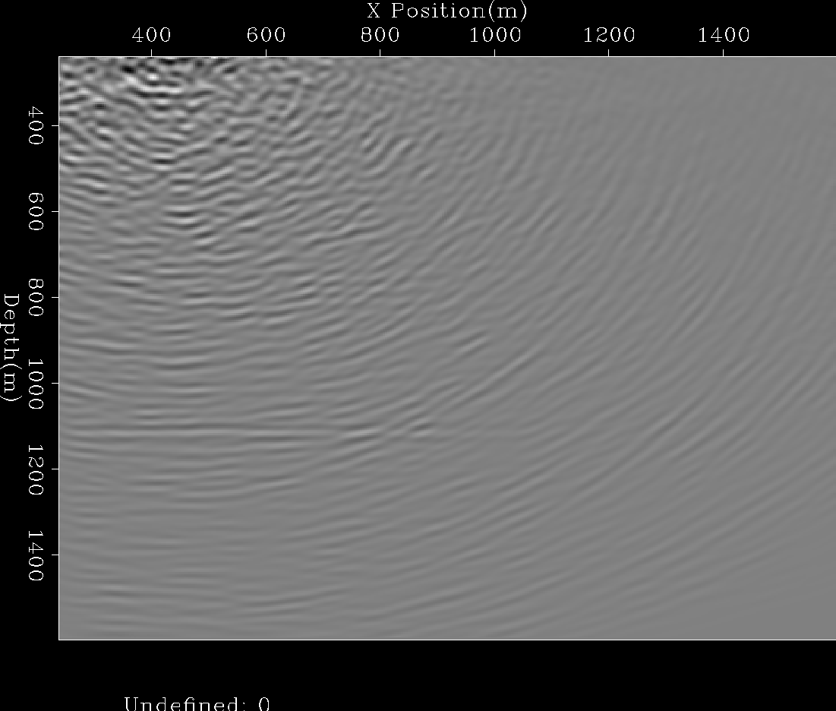
Many sources

Slide 23
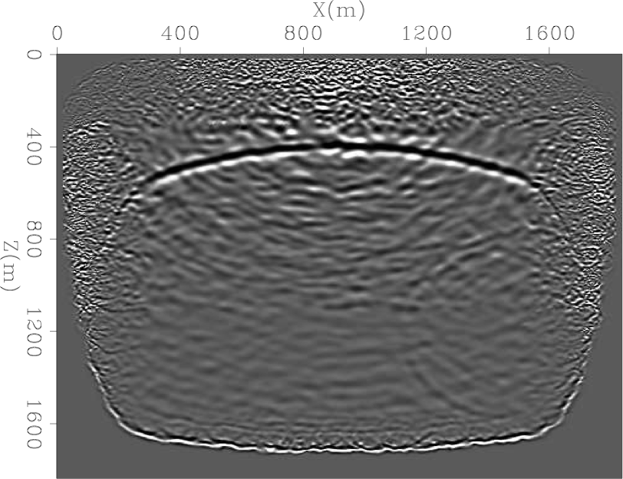
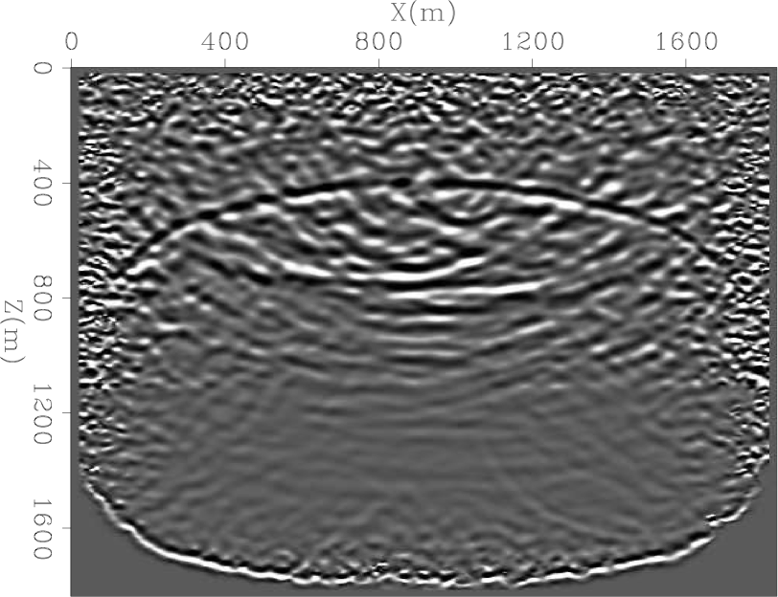
Acoustic vs elastic
Acoustic
Elastic

Slide 24
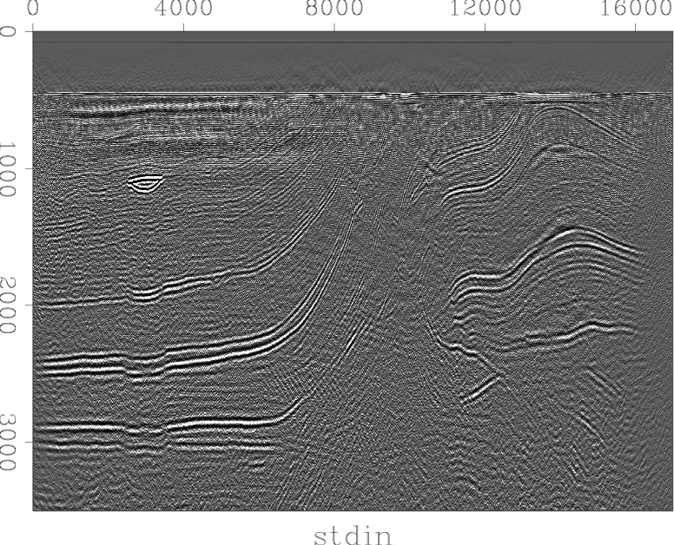
Rho image

Slide 25
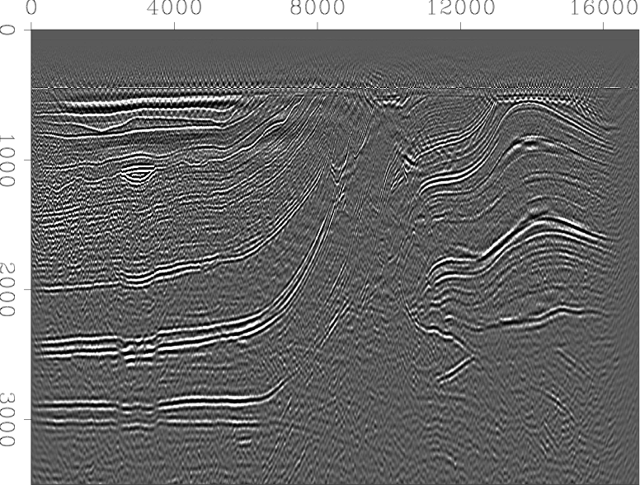
Lambda image

Slide 26
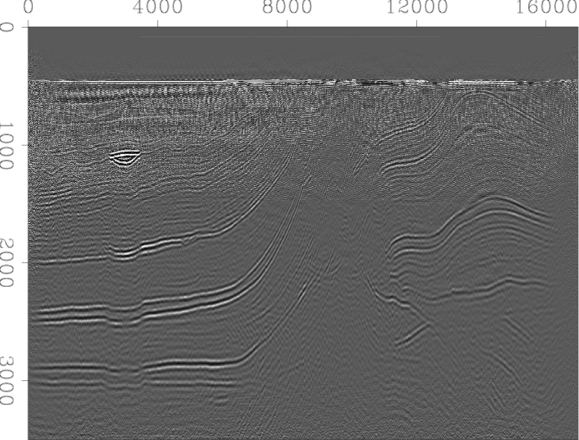
Mu image

Slide 27
Conclusions
An elastic random boundary can be constructed using randomly sized grain cells of random lambda, rho, and mu parameters
Boundary is a more effective attenuator that an acoustic alternative due to mode conversions

