Slide 1
AUTOMATED NOISE EXPLORATION
IN URBAN AREAS
Fantine Huot
Yinbin Ma, Robert Cieplicki, Biondo Biondi

Slide 2
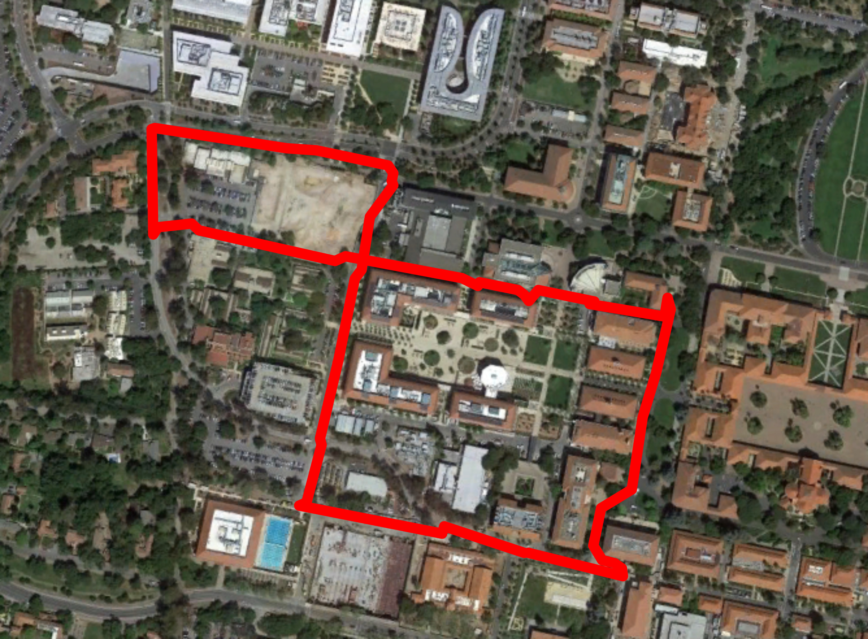
FIBER OPTICS ARRAY UNDER STANFORD CAMPUS
Continuous recording - 2.4 km loop - 600 sensors - 50 samples per second

Slide 3

MOTIVATION
CHEAP ACQUISITION
LARGE DATA VOLUMES
AUTOMATED PROCESSING
Notes:
With ambient noise data becoming increasingly easy to record, data volumes are increasing,
We can only extract their full value if we further automate the processing workflow.
We worked on some tools, mixing traditional signal processing and machine learning,
to automatically assist geophysicists in analyzing the ambient noise recorded and selecting non-ideal noises.

Slide 4
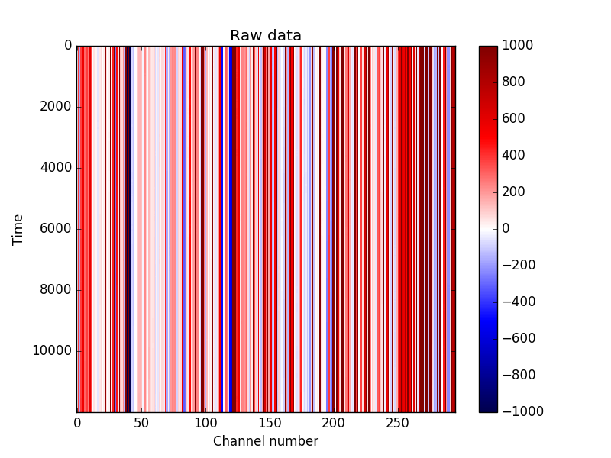
BASICALLY… NOISE

Slide 5
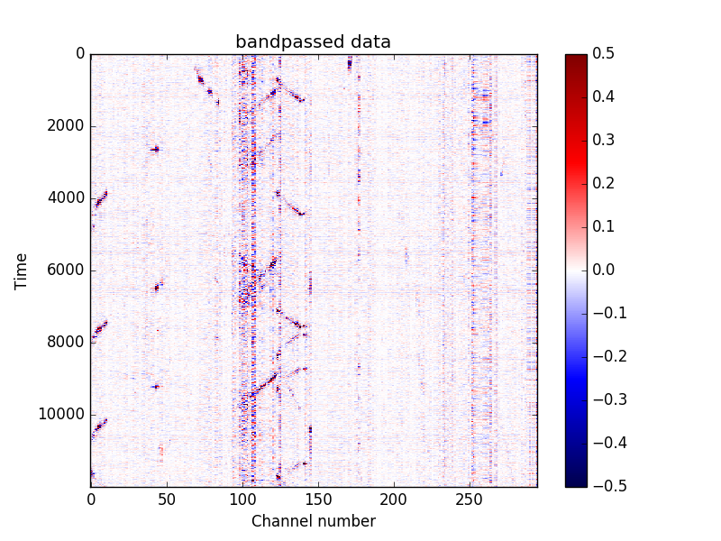
BASICALLY… NOISE

Slide 6
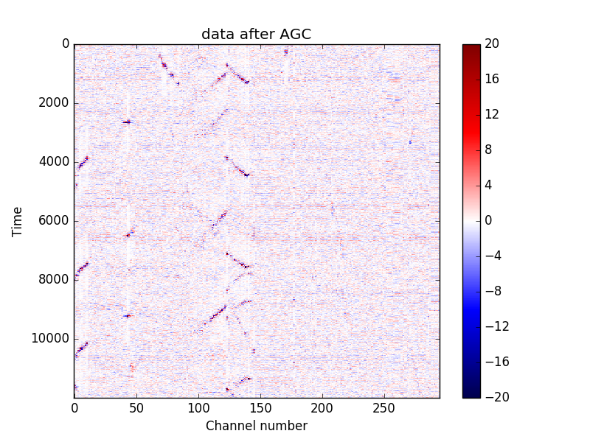
BASICALLY… NOISE

Slide 7
ALL NOISE IS EQUAL,
BUT SOME NOISE
IS MORE EQUAL THAN OTHERS
Notes:
UNSUPERVISED LEARNING

Slide 8
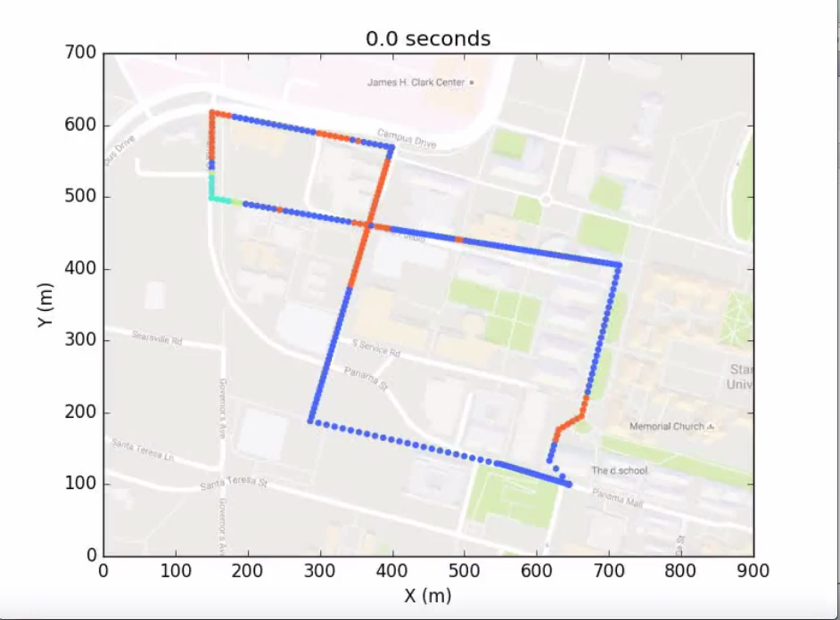

AUTOMATICALLY IDENTIFYING DIFFERENT TYPES OF NOISE
Cars
?
?
?

Slide 9
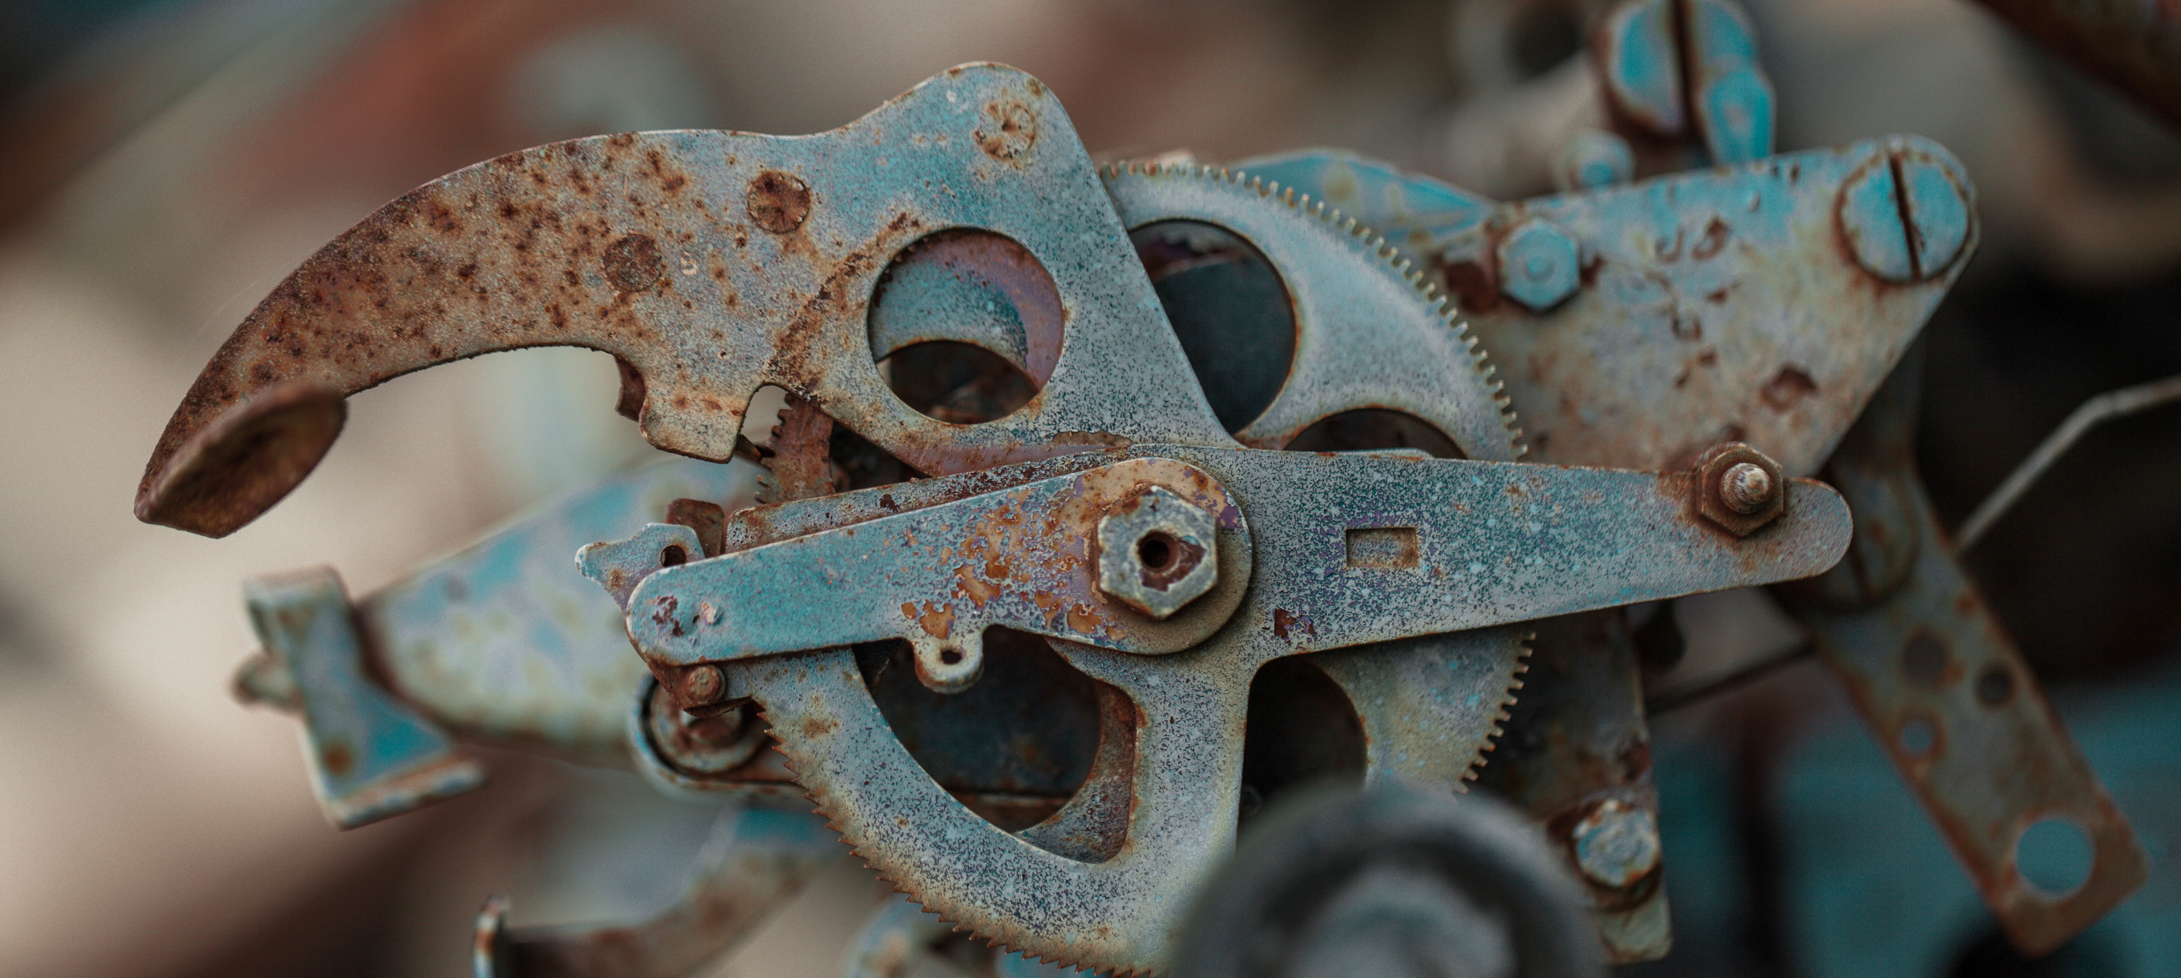
HOW ?
TAKE A BIG CHUNK OF DATA
COMPUTE DATA ATTRIBUTES
PERFORM CLUSTERING

Slide 10
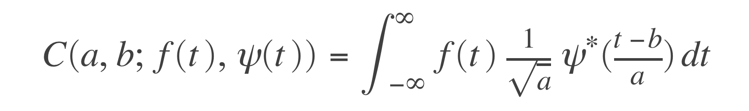
DATA ATTRIBUTES USING CONTINUOUS WAVELET TRANSFORMS
9

Slide 11
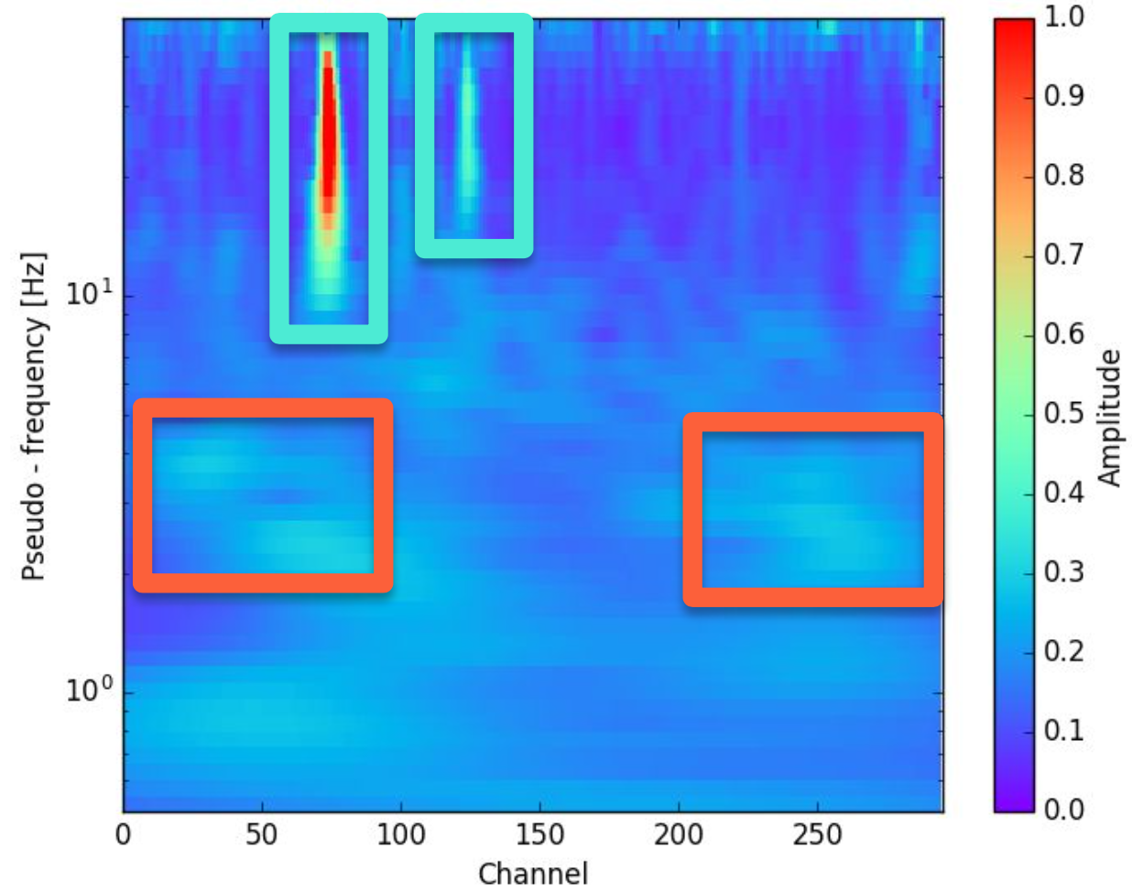
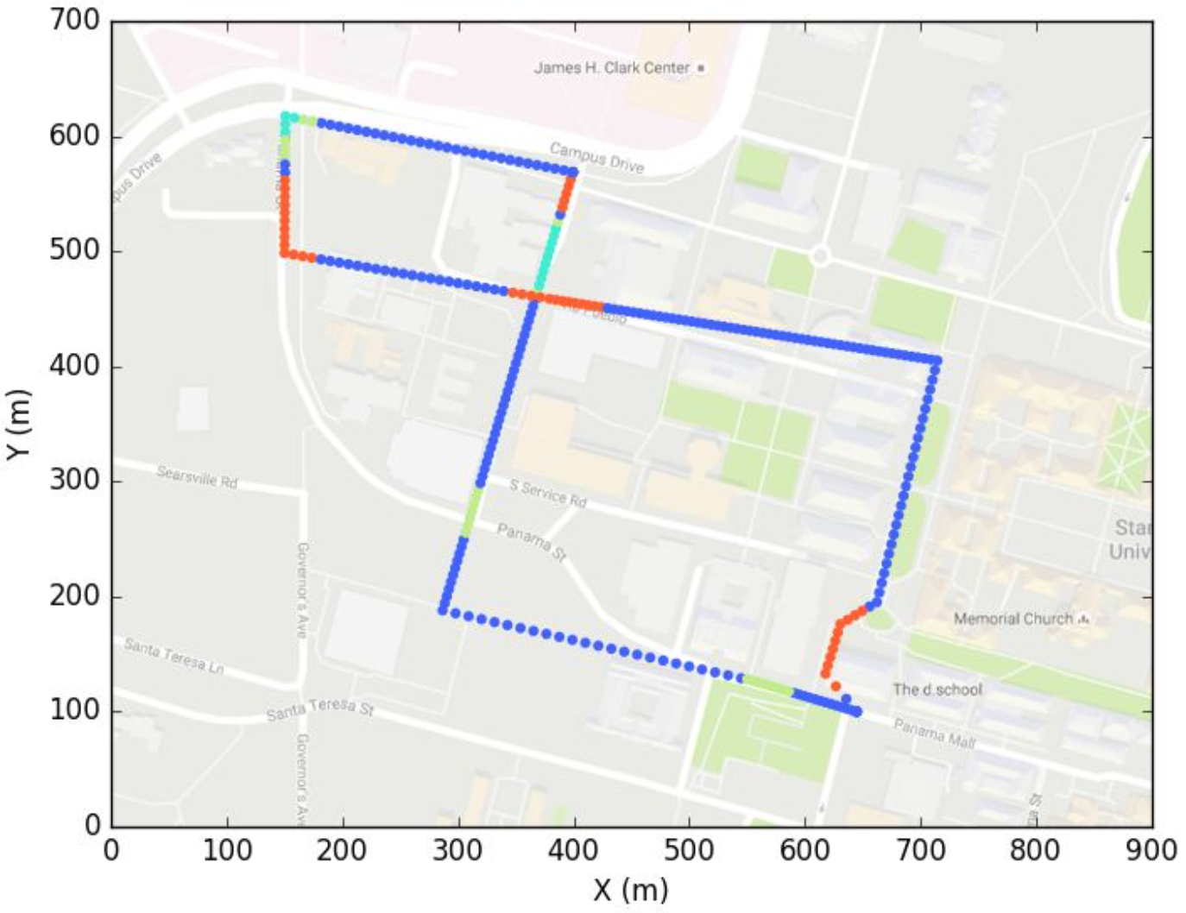
DATA ATTRIBUTES USING CONTINUOUS WAVELET TRANSFORMS

Slide 12
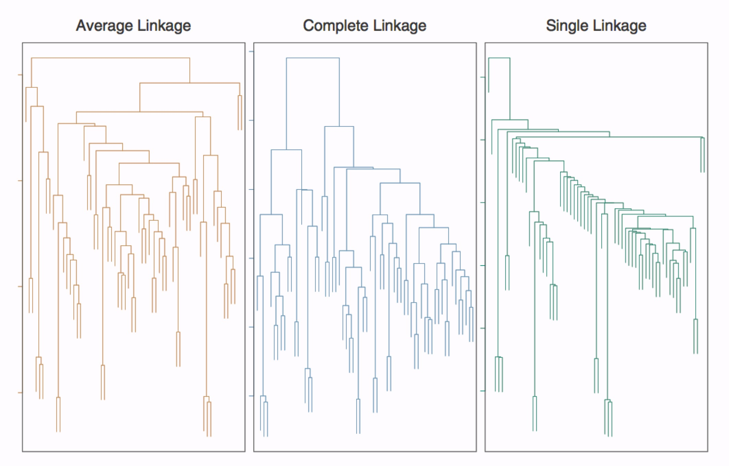
HIERARCHICAL CLUSTERING

Slide 13
CHOICES HAD TO BE MADE
Which attributes to compute?
What clustering algorithm?
What type of linkage?
How many clusters?
How to interpret these clusters?

Slide 14
SO WHAT TYPE OF NOISE DID WE IDENTIFY ?
Cars
Coherent noise
Laser noise
Background noise

Slide 15

IS THIS OF ANY USE?
AUTOMATIC DATA EXPLORATION
TRACK VEHICLE TRAFFIC
IDENTIFY MAIN TYPES
OF NOISE
EARTHQUAKE DETECTION?
SELECTIVELY FILTER OUT
NON-IDEAL NOISE SOURCES
AUTOMATICALLY RETRIEVE ARRAY GEOMETRY?

Slide 16
LET’S FOCUS ON
THE HIGH AMPLITUDE EVENTS

Slide 17
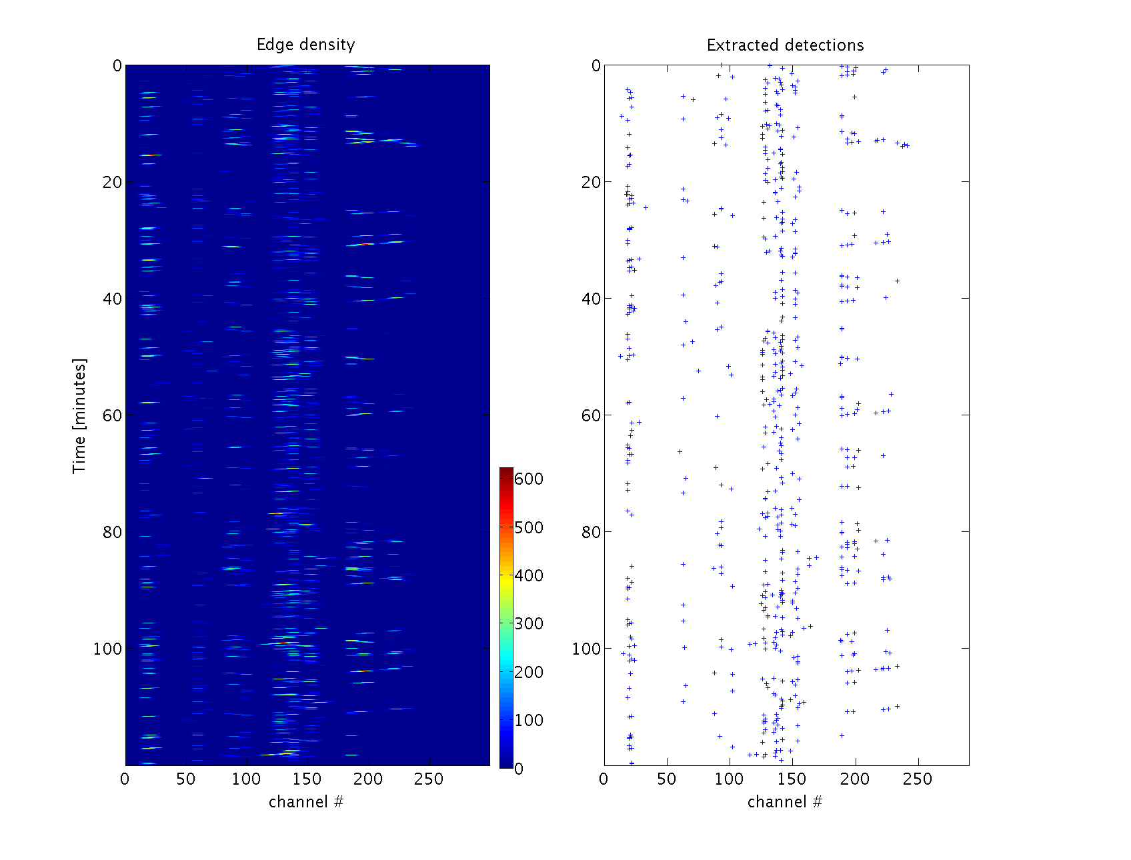
EVENT DETECTION USING EDGE DENSITY

Slide 18
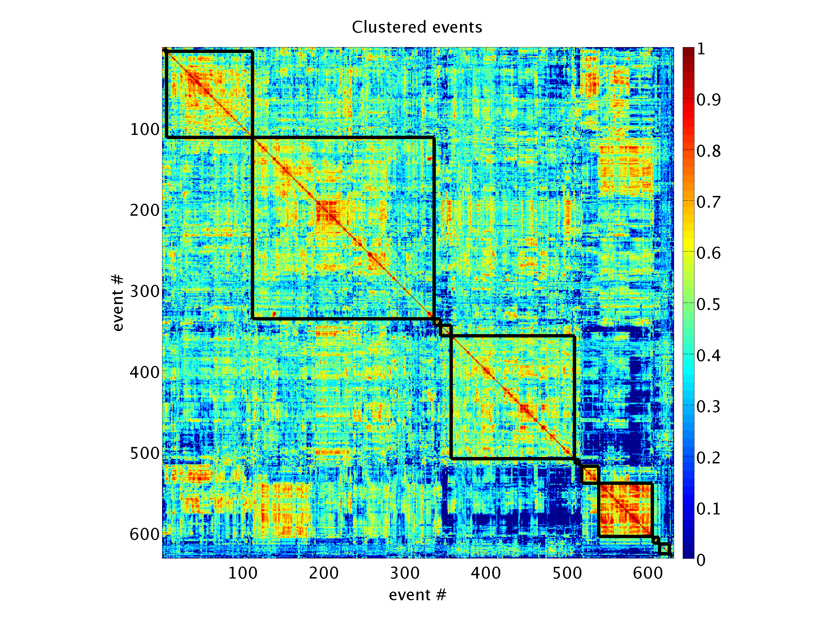
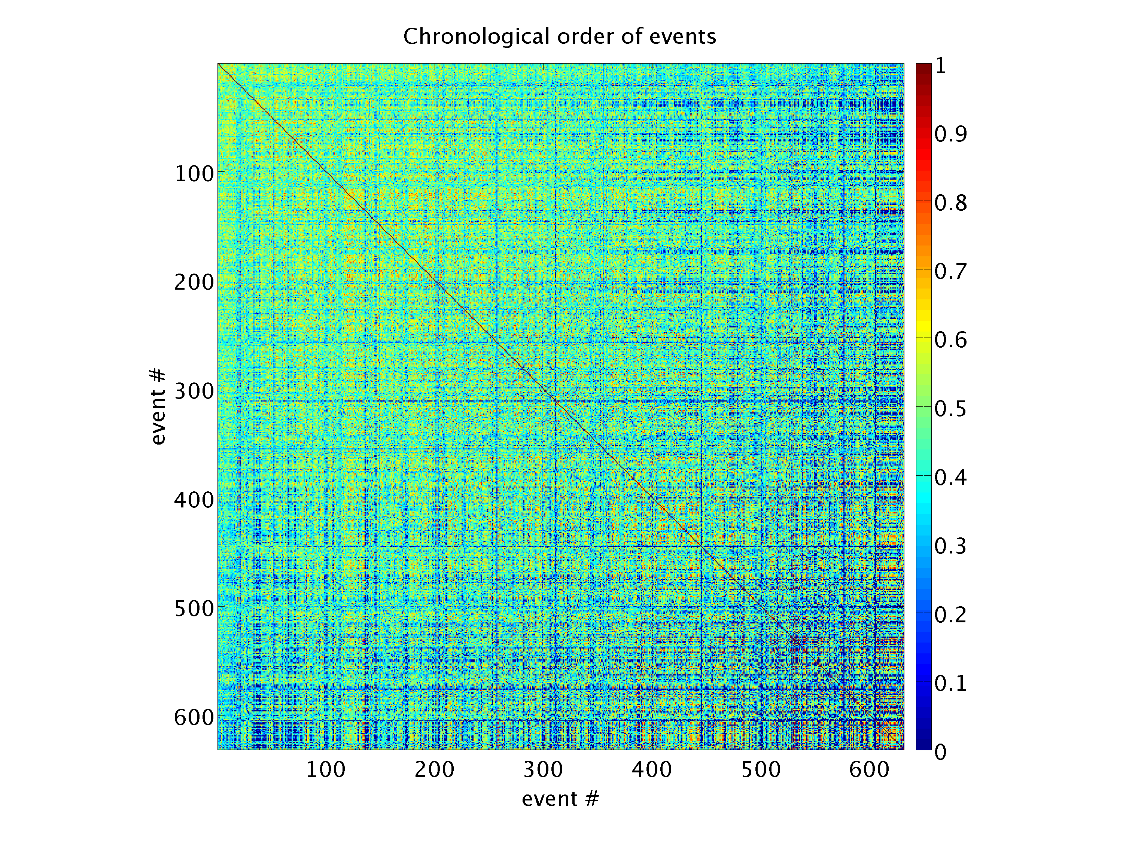
SIMILARITY MEASURE

Slide 19
CLUSTERING

Slide 20
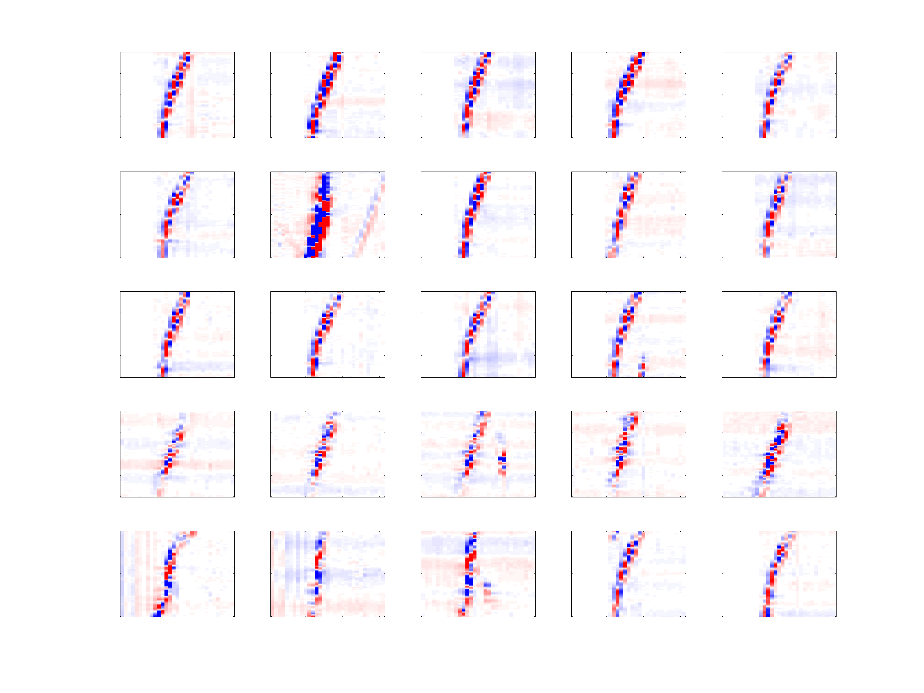
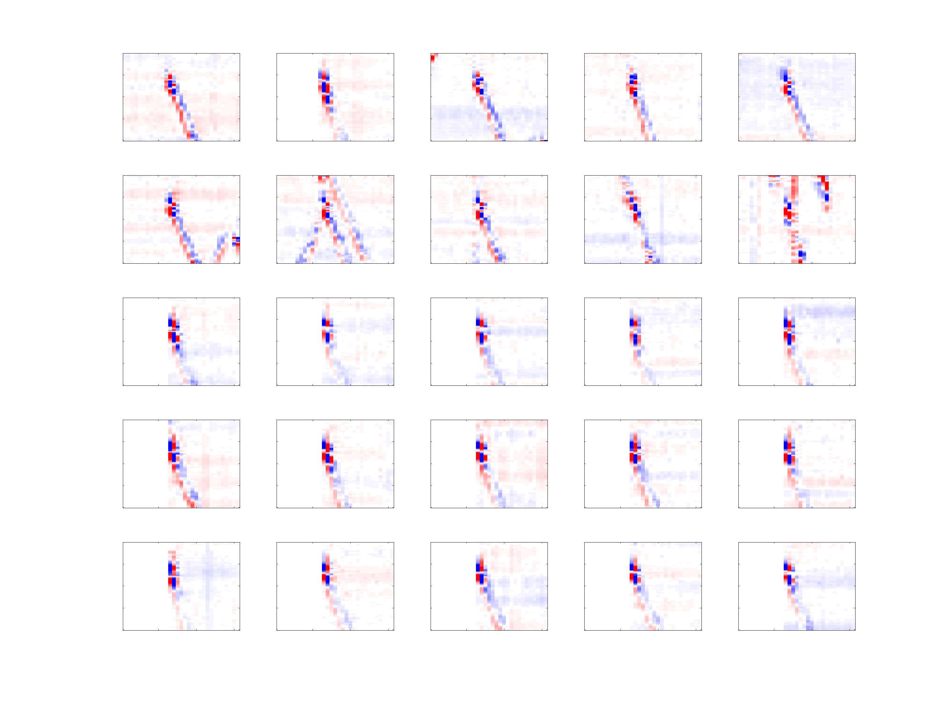
CLUSTERED EVENTS

Slide 21
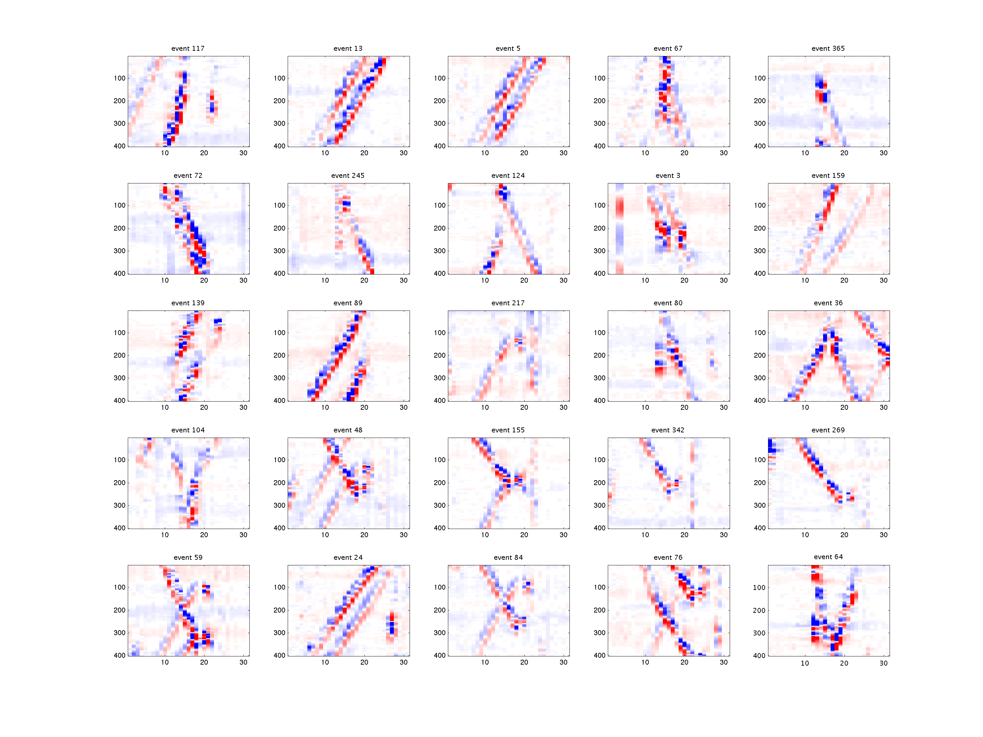
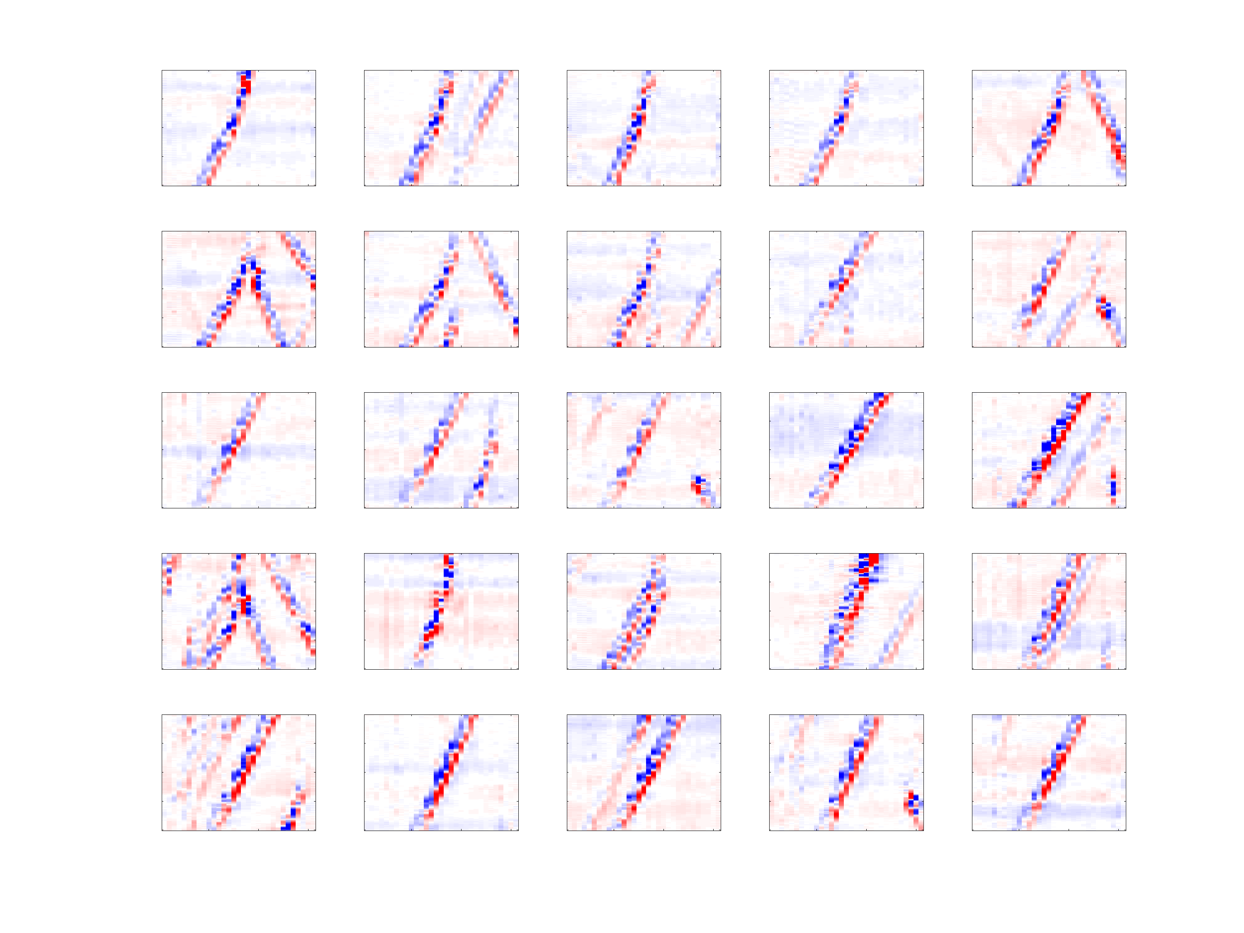
CLUSTERED EVENTS

Slide 22
DAS IS WATCHING YOU
Notes:
SUPERVISED LEARNING

Slide 23
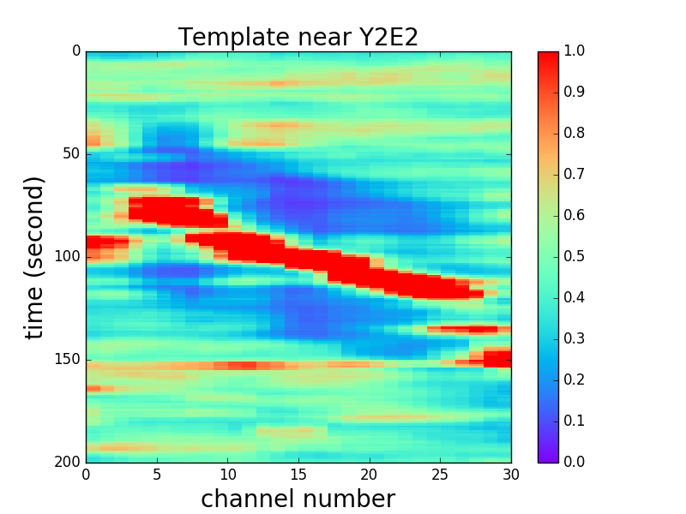
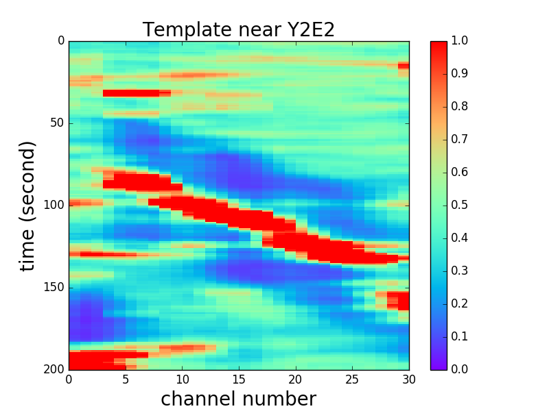
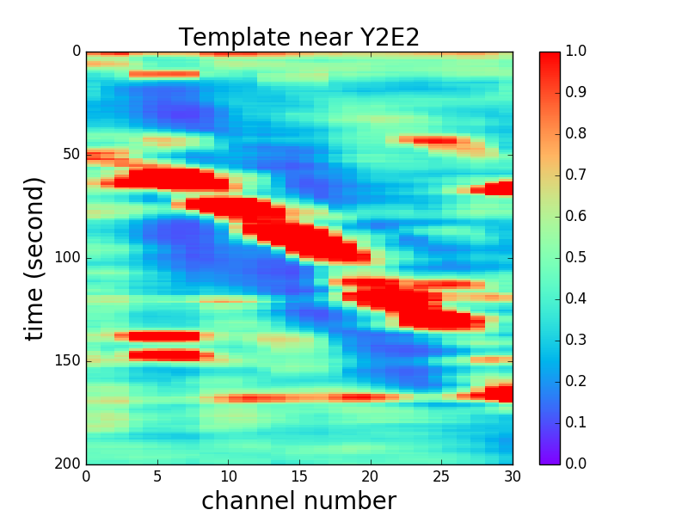
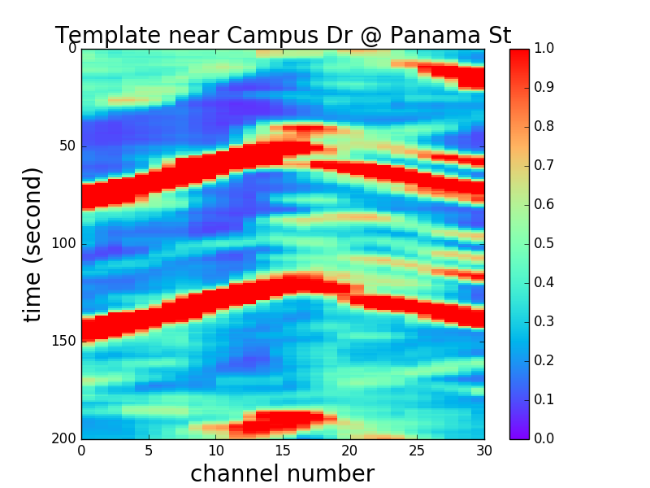
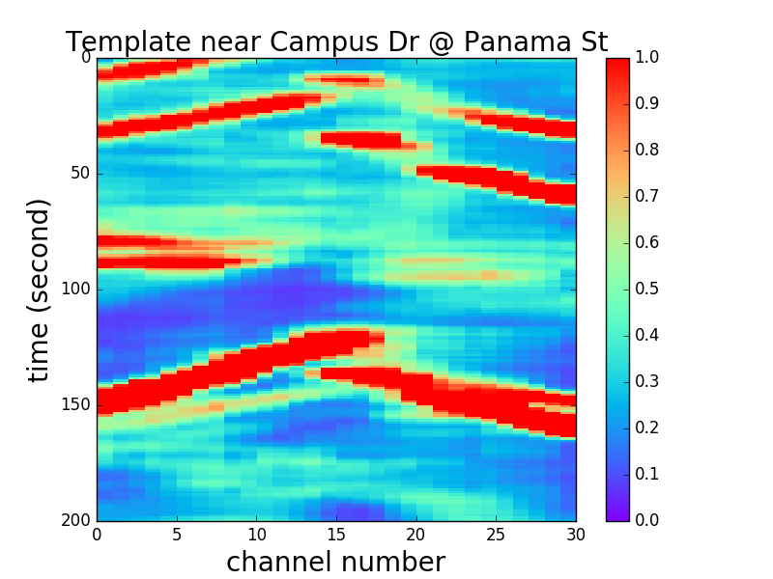
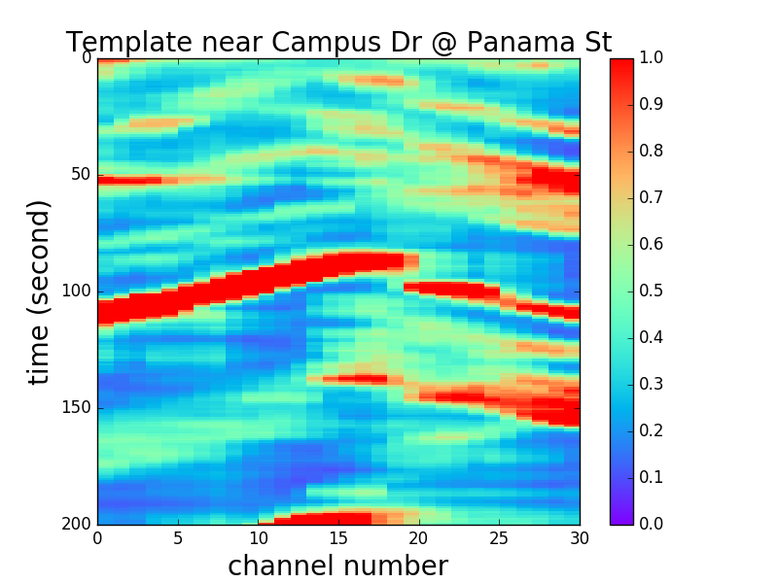
EVENT DETECTION USING TEMPLATE MATCHING

Slide 24
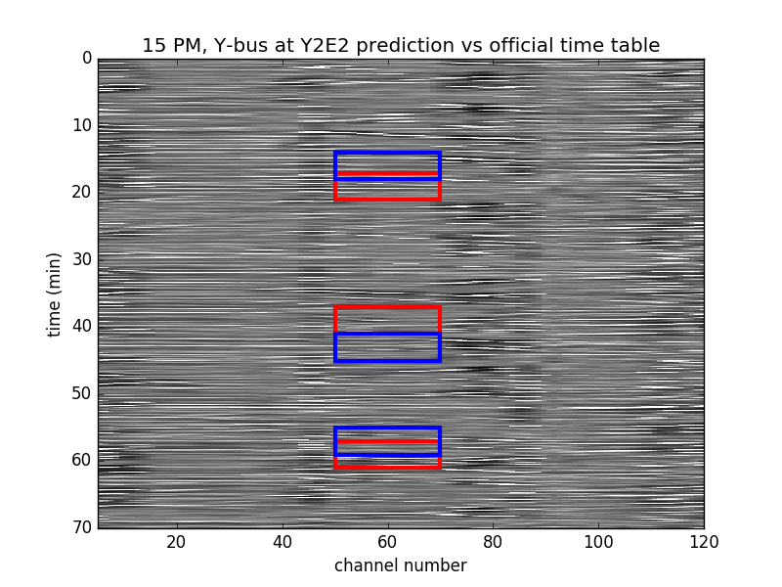
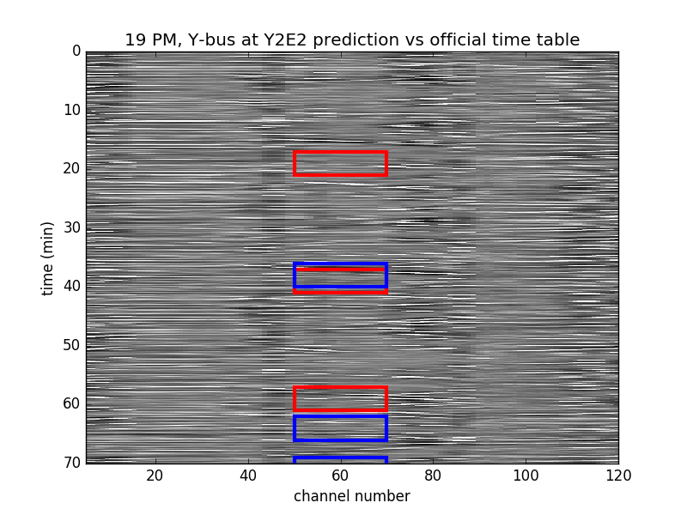
BUS, YOU ARE LATE!
Detected events
Official bus schedule

Slide 25
PARTING WORDS
The more data, the better
Leveraging machine learning algorithms can help us automate and speed up processing
This is only the beginning: there are many types of games we could play

Slide 26
THANK YOU!
Feedback? Questions? Please share!
fantine@stanford.edu

Slide 27
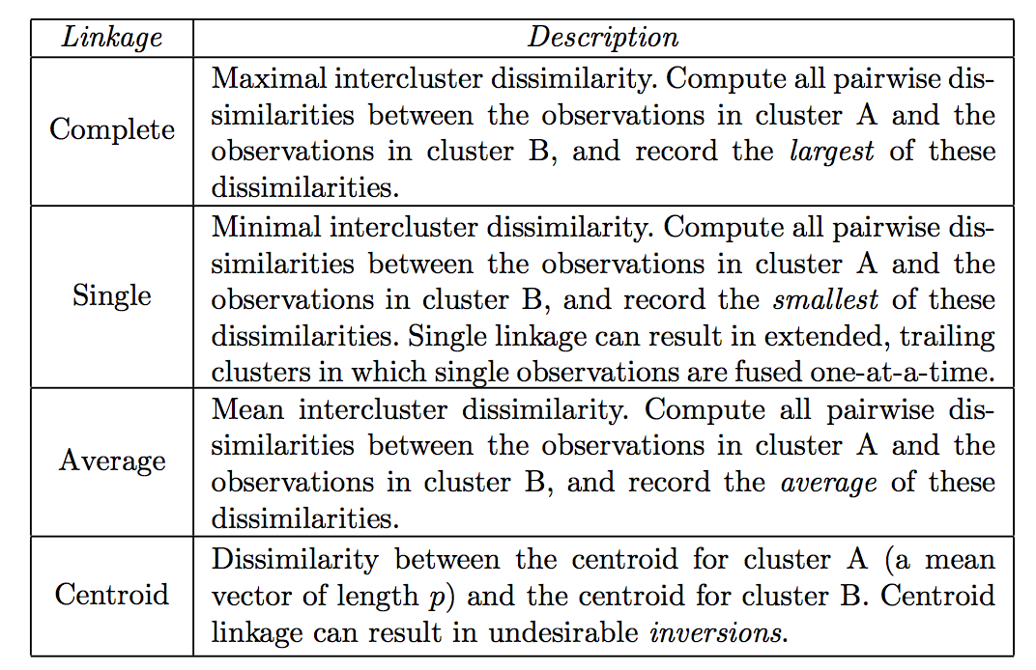
HIERARCHICAL CLUSTERING

