Slide 1
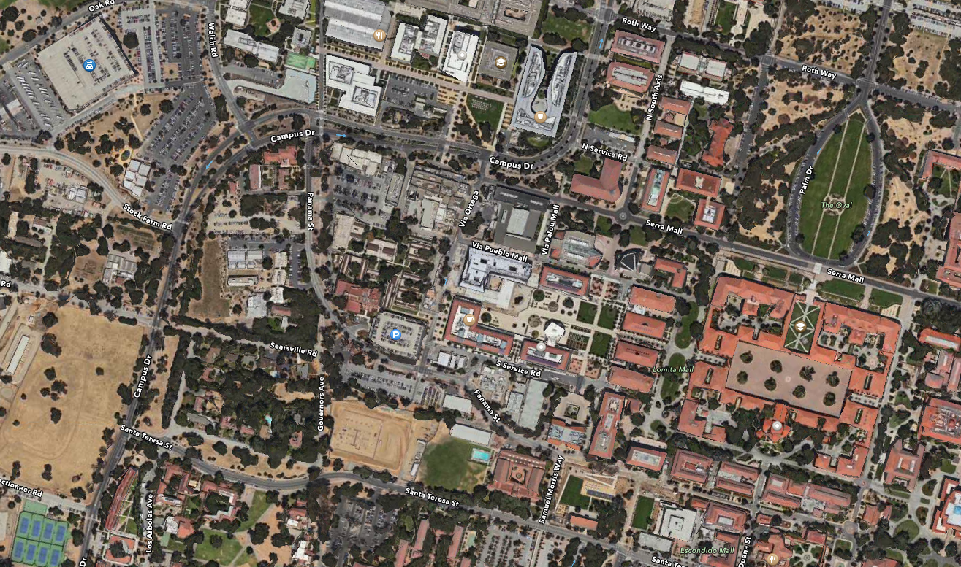
Continuous subsurface monitoring by passive seismic data recorded with Distributed Acoustic Sensors:
the “Stanford DAS Array” experiment
B. Biondi*,E. Martin (Stanford University),
M. Karrenbach, and S. Cole (OptaSense Ltd.)
Notes:
Best place to start demonstrating that a velocity inversion method is attractive is showing its application on Marmousi, or the deep water variation of Marmousi
that you see displayed on the screen.
This is the “true” model, and …

Slide 2

Notes:
Best place to start demonstrating that a velocity inversion method is attractive is showing its application on Marmousi, or the deep water variation of Marmousi
that you see displayed on the screen.
This is the “true” model, and …

Slide 3
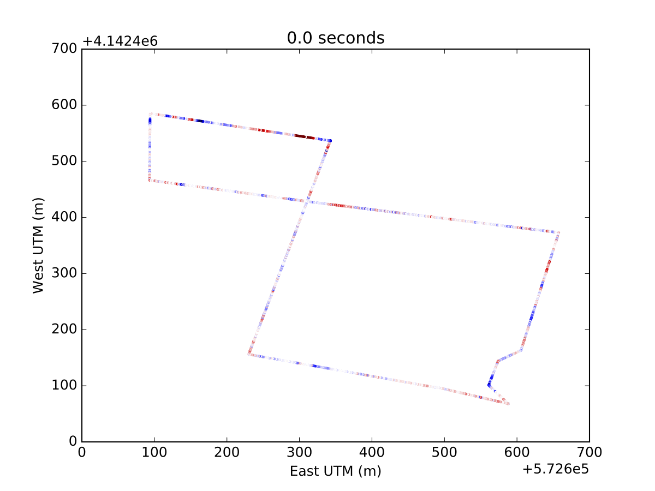
Notes:
Best place to start demonstrating that a velocity inversion method is attractive is showing its application on Marmousi, or the deep water variation of Marmousi
that you see displayed on the screen.
This is the “true” model, and …

Slide 4
Notes:
Best place to start demonstrating that a velocity inversion method is attractive is showing its application on Marmousi, or the deep water variation of Marmousi
that you see displayed on the screen.
This is the “true” model, and …

Slide 5
Notes:
Best place to start demonstrating that a velocity inversion method is attractive is showing its application on Marmousi, or the deep water variation of Marmousi
that you see displayed on the screen.
This is the “true” model, and …

Slide 6
Notes:
Best place to start demonstrating that a velocity inversion method is attractive is showing its application on Marmousi, or the deep water variation of Marmousi
that you see displayed on the screen.
This is the “true” model, and …

Slide 7
Notes:
Best place to start demonstrating that a velocity inversion method is attractive is showing its application on Marmousi, or the deep water variation of Marmousi
that you see displayed on the screen.
This is the “true” model, and …

Slide 8
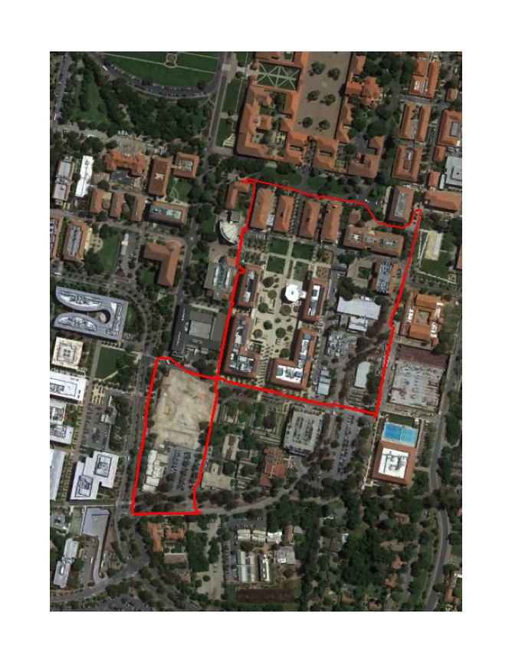
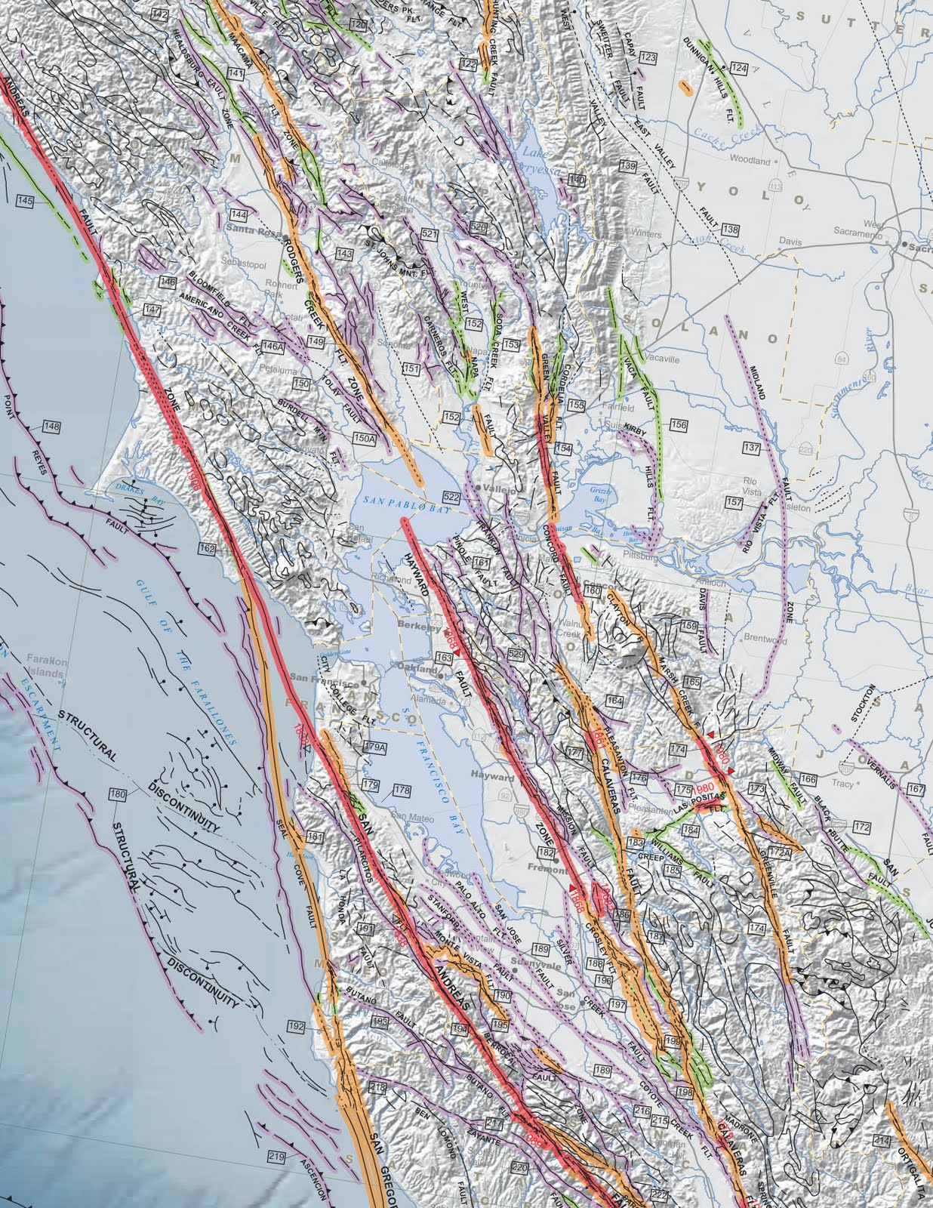

Slide 9
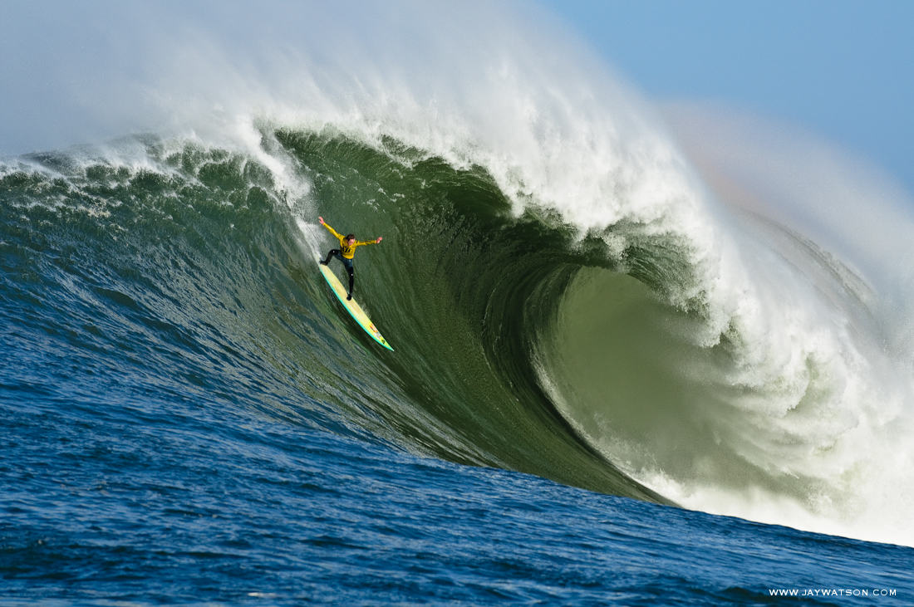

Slide 10
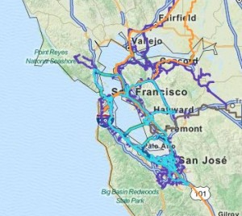
Billion Seismic Sensors Project
(… in just a few years)
Bay Area fiber-optic backbone
Bay Area geologic faults

Slide 11
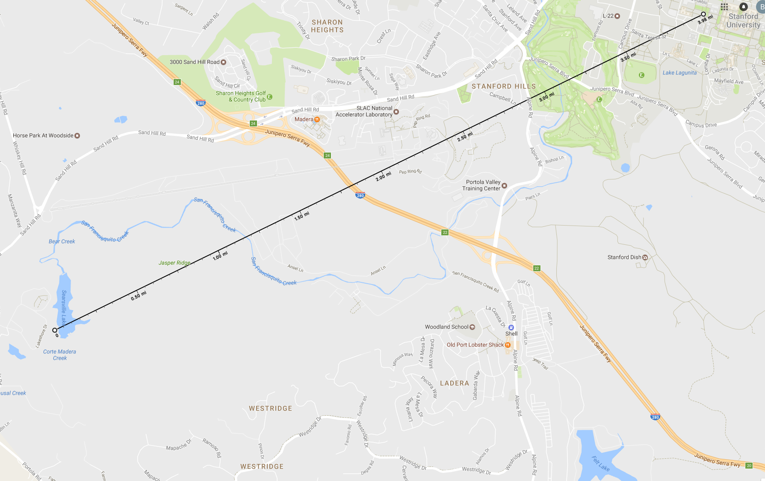
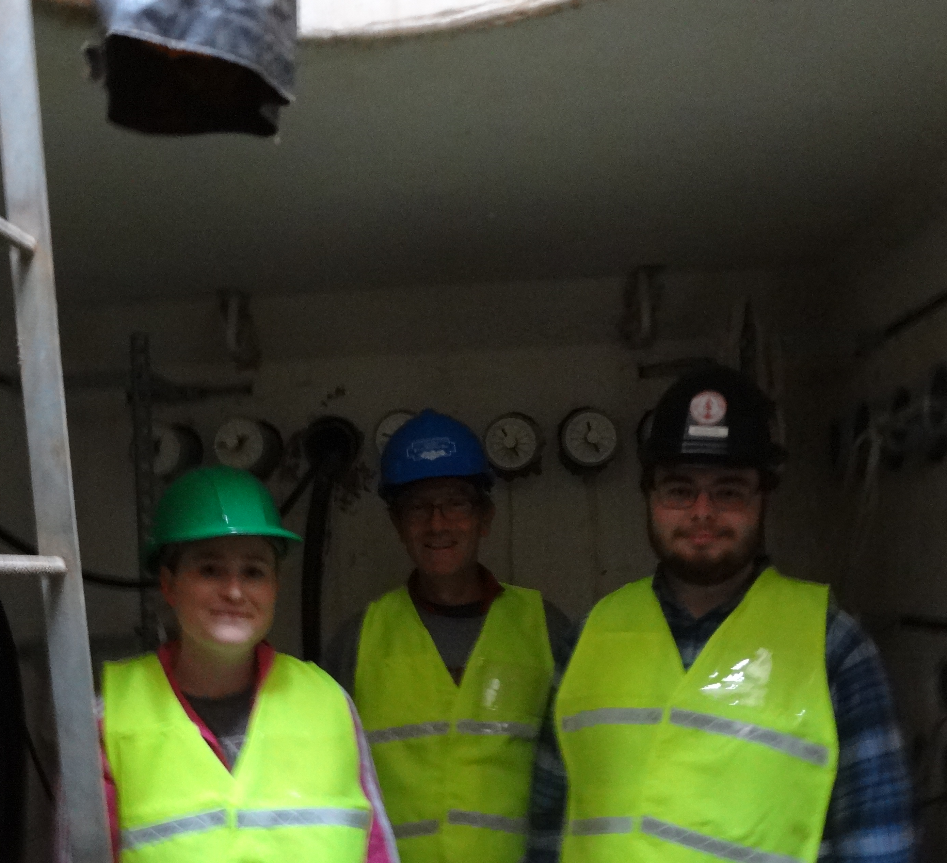
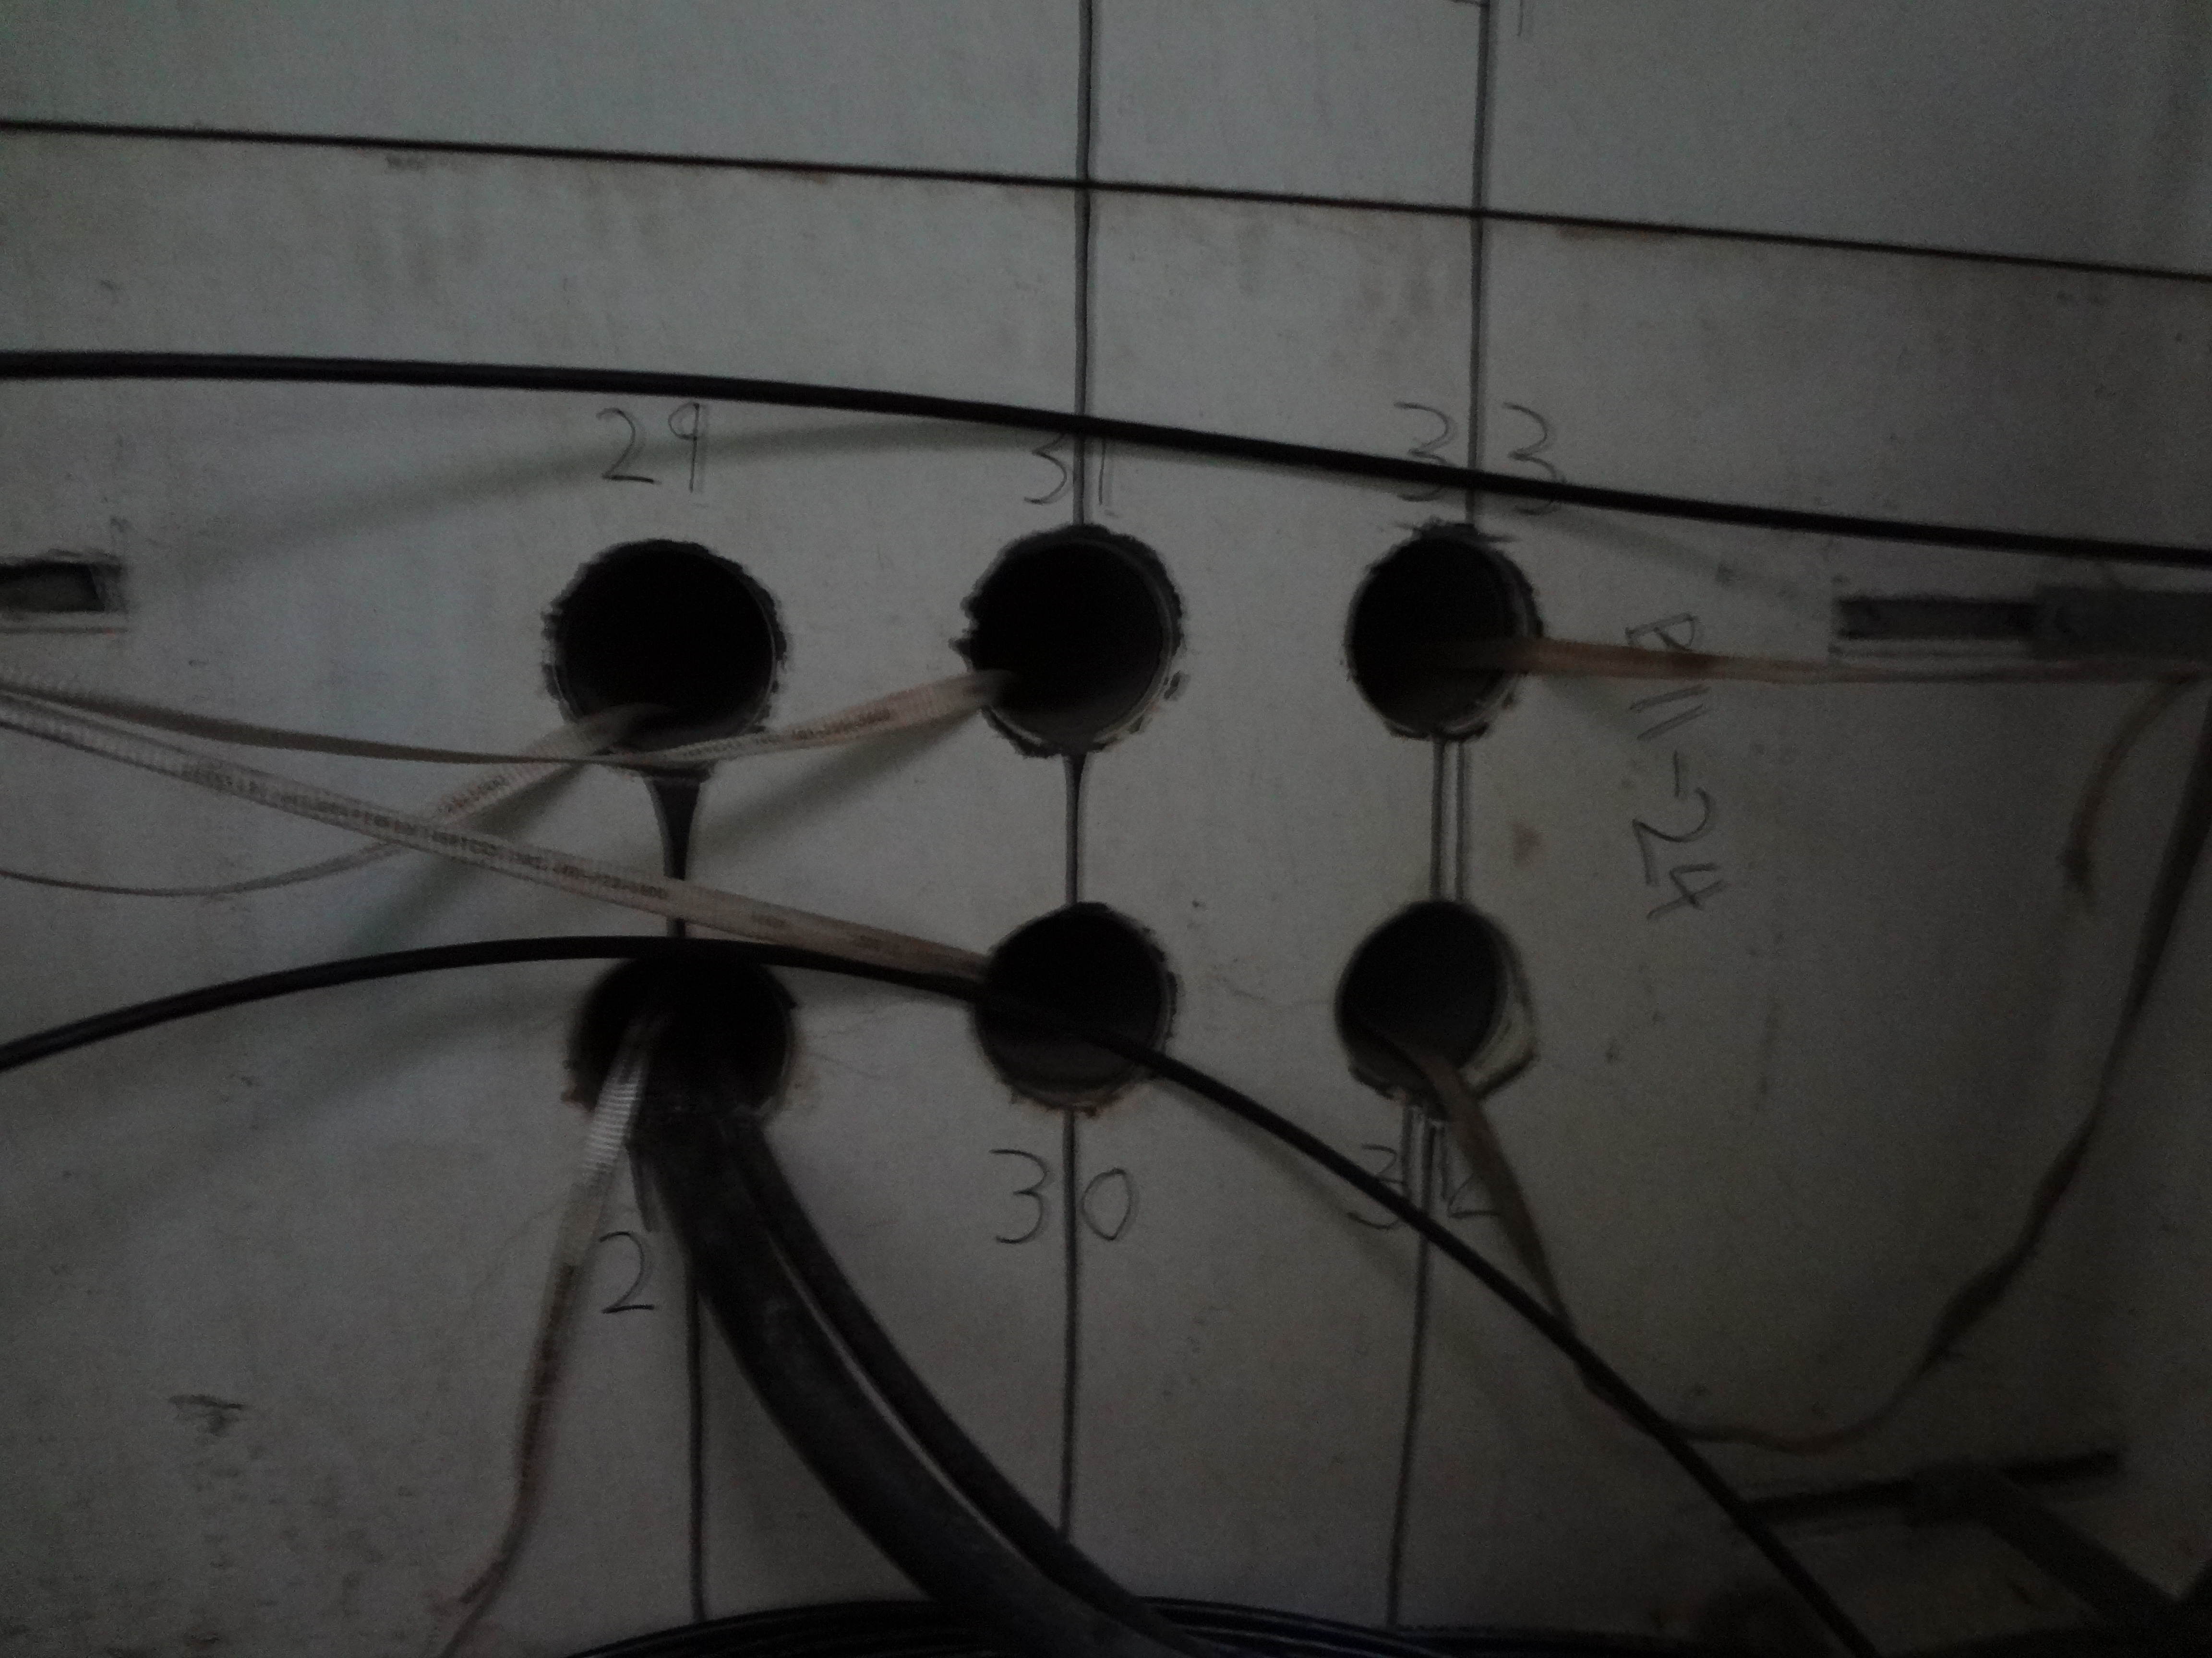
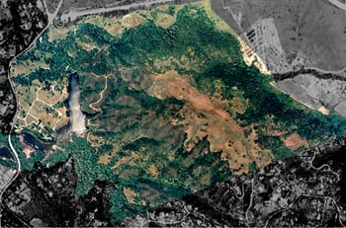
Stanford DAS Array-1
DAS Array parameters
2 x 2.45 km fiber-optic cable
2 x 305 channels
~8 m sensor spacing
7 m gauge length
Continuous recording
0-25 Hz digital recording
OptaSense DAS (ODH 3.1)
Jasper Ridge Station
(JRSC in BDSN-USGS)
3C broad-band seismometer
3C long-period seismometer
~4 miles from DAS Array-1
Web-accessible data

Slide 12
“Typical” data recorded by Array-1
Noise for interferometry
EQ in East Bay M 3.5
Traffic noise (car, buses, …)

Slide 13
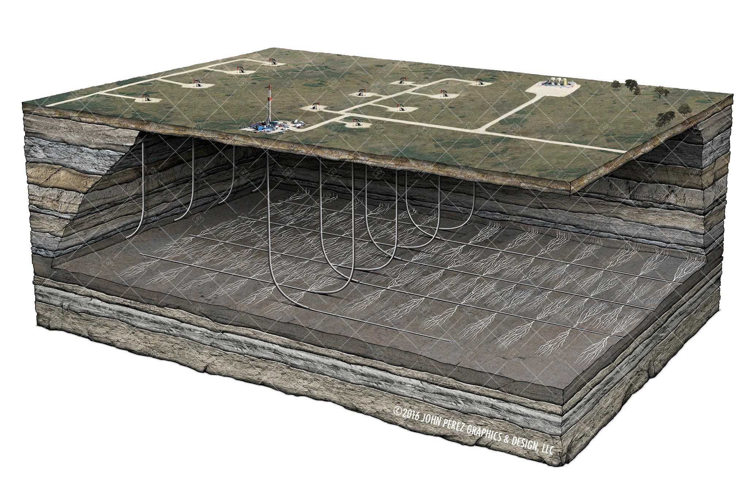
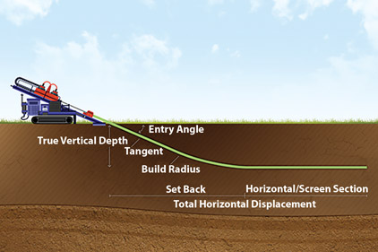
Passive reservoir monitoring
Microseismic
P & S waves
Sensitivity & freq. response
Localization ⬄ kinematics
Source mechanism ⬄ polarity
Angular sensitivity of DAS
Kuvshinov (Geo. Prosp., 2015)
Time-lapse interferometry
Surface waves (.2-2Hz)
Subsurface changes at 0-300 m
Daily changes are observable
Valhall Δ=2010-2004
de Ridder and Biondi (GRL, 2013)

Slide 14
Passive reservoir monitoring
Microseismic
P & S waves
Sensitivity & freq. response
Localization ⬄ kinematics
Source mechanism ⬄ polarity
Angular sensitivity of DAS
Kuvshinov (Geo. Prosp., 2015)
Time-lapse interferometry
Surface waves (.2-2Hz)
Subsurface changes at 0-300 m
Daily changes are observable
Valhall Δ=2010-2004
de Ridder and Biondi (GRL, 2013)

Slide 15
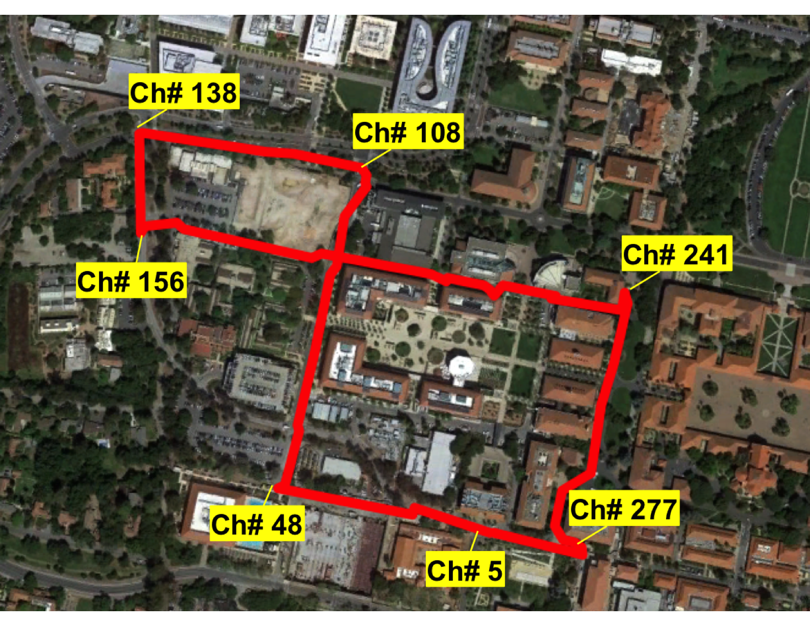
Magnitude 1.0
Distance 14.4 km
Depth -0.3 km
Repeatable recording? - Quarry Blast - Sept 14
Broadband JRSC-Z
EQ
N
N
Notes:
Best place to start demonstrating that a velocity inversion method is attractive is showing its application on Marmousi, or the deep water variation of Marmousi
that you see displayed on the screen.
This is the “true” model, and …

Slide 16
Magnitude 1.3
Distance 14.05 km
Depth -0.3 km
Yes, signal is repeatable! - Quarry Blast – Nov 4
Broadband JRSC-Z
EQ
N
N
Notes:
Best place to start demonstrating that a velocity inversion method is attractive is showing its application on Marmousi, or the deep water variation of Marmousi
that you see displayed on the screen.
This is the “true” model, and …

Slide 17
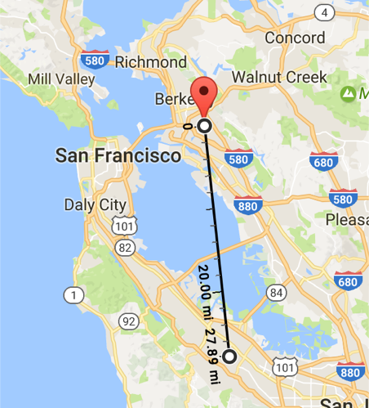
Are P-waves kinematics reliable? Yes!
Piedmont EQ M 3.5
Envelope of DAS data
vs.
Broadband JRSC-Z
Distance 42 km
Depth 4 km
11:48 pm
EQ
N
N
Notes:
Best place to start demonstrating that a velocity inversion method is attractive is showing its application on Marmousi, or the deep water variation of Marmousi
that you see displayed on the screen.
This is the “true” model, and …

Slide 18
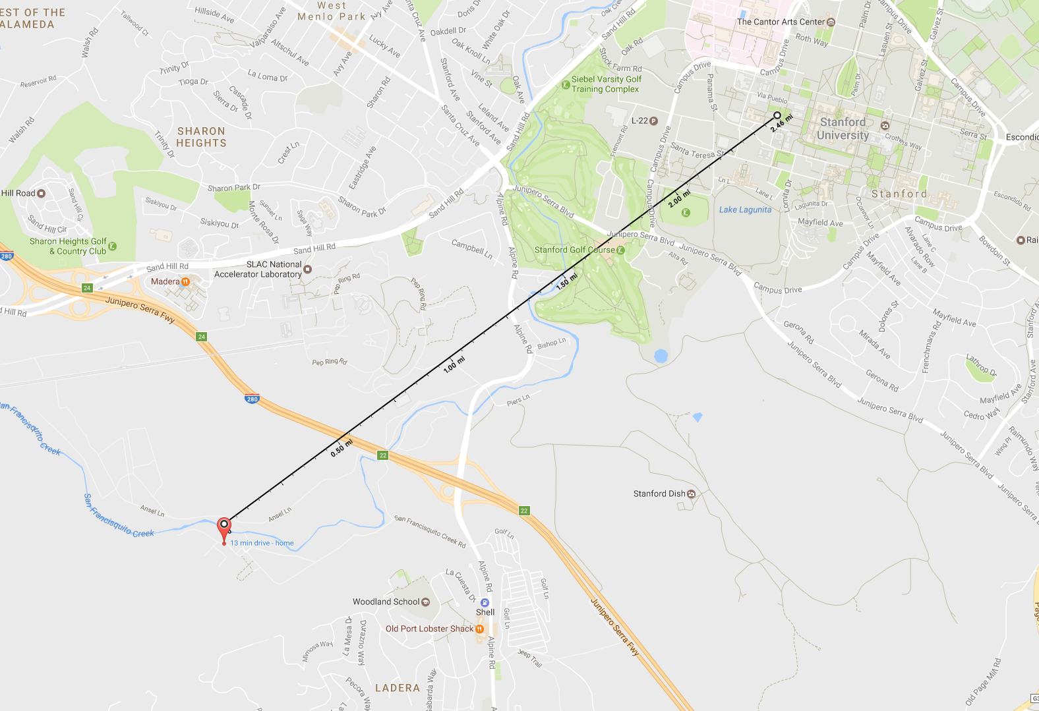
P-waves kinematics: Another example
Ladera EQ M 2.0
Envelope of DAS data
vs.
Broadband JRSC-Z
Distance 3.8 km
Depth 4.2 km
2:59 pm
EQ
N
N
Notes:
Best place to start demonstrating that a velocity inversion method is attractive is showing its application on Marmousi, or the deep water variation of Marmousi
that you see displayed on the screen.
This is the “true” model, and …

Slide 19
S-waves kinematics: They look good too!
Ladera EQ M 2.0
Envelope of DAS data
vs.
Broadband JRSC-Z
Distance 3.8 km
Depth 4.2 km
2:59 pm
EQ
N
N
Notes:
Best place to start demonstrating that a velocity inversion method is attractive is showing its application on Marmousi, or the deep water variation of Marmousi
that you see displayed on the screen.
This is the “true” model, and …

Slide 20
S-waves kinematics: They look good too!
Ladera EQ M 2.0
Envelope of DAS data
vs.
Broadband JRSC-N
Distance 3.8 km
Depth 4.2 km
2:59 pm
EQ
N
N
Notes:
Best place to start demonstrating that a velocity inversion method is attractive is showing its application on Marmousi, or the deep water variation of Marmousi
that you see displayed on the screen.
This is the “true” model, and …

Slide 21
Are P-waves waveforms reliable?
Ladera EQ M 2.0
Envelope of DAS data
vs.
Broadband JRSC-Z
Distance 3.8 km
Depth 4.2 km
2:59 pm
EQ
N
N
Notes:
Best place to start demonstrating that a velocity inversion method is attractive is showing its application on Marmousi, or the deep water variation of Marmousi
that you see displayed on the screen.
This is the “true” model, and …

Slide 22
Are P-waves waveforms reliable?
Piedmont EQ M 3.5
DAS data
vs.
Broadband JRSC-N
Distance 42 km
Depth 4 km
11:48 pm
EQ
N
N
Notes:
Best place to start demonstrating that a velocity inversion method is attractive is showing its application on Marmousi, or the deep water variation of Marmousi
that you see displayed on the screen.
This is the “true” model, and …

Slide 23
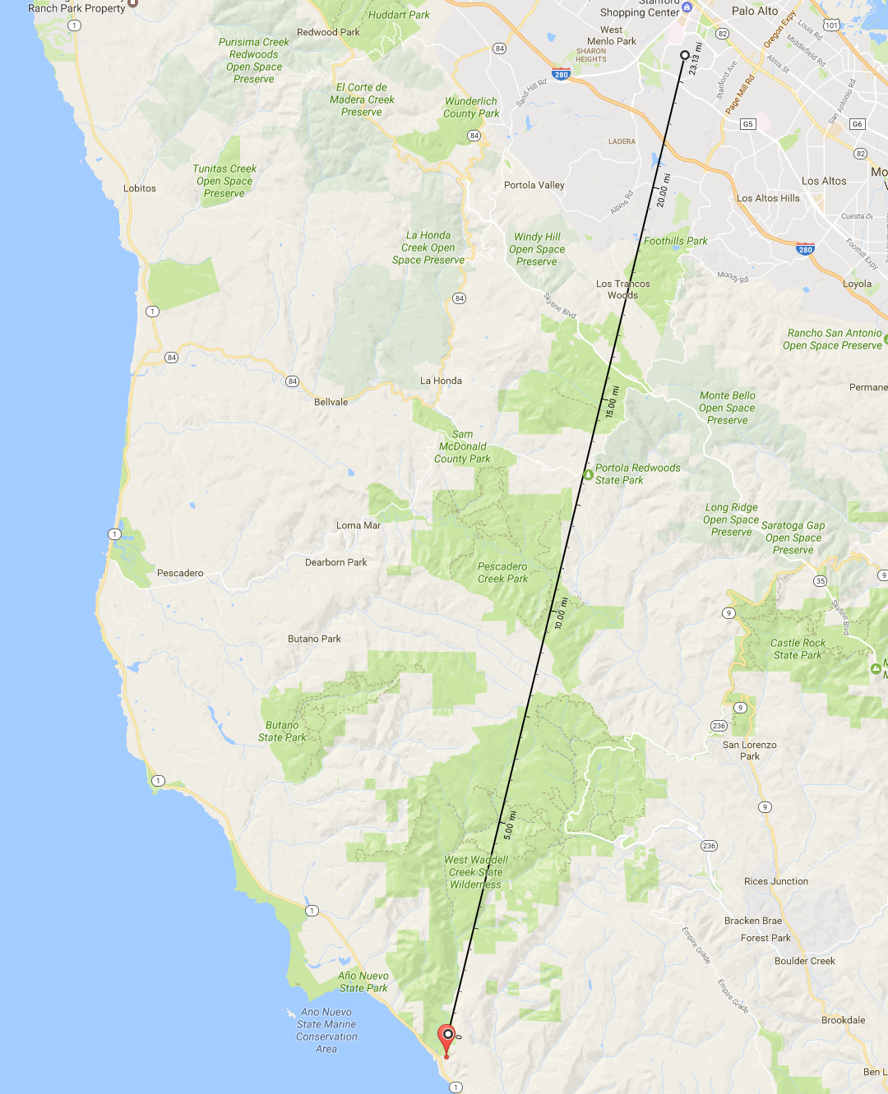
Are S-waves waveform reliable?
Bonny Doon EQ M 2.5
Original polarity
DAS data
vs.
Broadband JRSC-N
Distance 37.8 km
Depth 13.1 km
7:23 pm
EQ
N
N
Notes:
Best place to start demonstrating that a velocity inversion method is attractive is showing its application on Marmousi, or the deep water variation of Marmousi
that you see displayed on the screen.
This is the “true” model, and …

Slide 24
Are S-waves waveform reliable?
E-W
N-S
Bonny Doon EQ M 2.5
Original polarity
DAS data
vs.
Broadband JRSC-N
Distance 37.8 km
Depth 13.1 km
7:23 pm
EQ
N
N
Notes:
Best place to start demonstrating that a velocity inversion method is attractive is showing its application on Marmousi, or the deep water variation of Marmousi
that you see displayed on the screen.
This is the “true” model, and …

Slide 25
Yes, after phase correction
E-W
N-S
Bonny Doon EQ M 2.5
Polarity corrected DAS data
vs.
Broadband JRSC-N
Distance 37.8 km
Depth 13.1 km
7:23 pm
EQ
N
N
Notes:
Best place to start demonstrating that a velocity inversion method is attractive is showing its application on Marmousi, or the deep water variation of Marmousi
that you see displayed on the screen.
This is the “true” model, and …

Slide 26
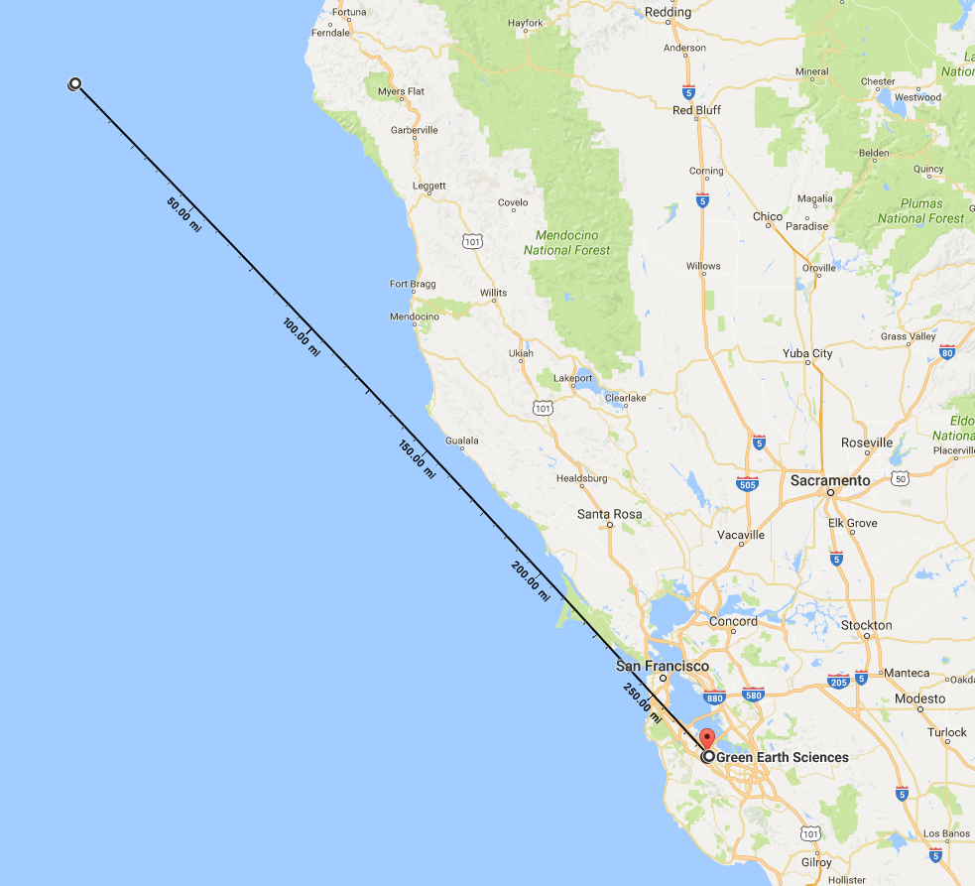
S-waves arrival from large and far EQ
Ferndale EQ M 5.6
Polarity corrected DAS data
vs.
Broadband JRSC-N
Distance 443 km
Depth 28.6 km
7:23 pm
EQ
N
N
Notes:
Best place to start demonstrating that a velocity inversion method is attractive is showing its application on Marmousi, or the deep water variation of Marmousi
that you see displayed on the screen.
This is the “true” model, and …

Slide 27
Surface-waves arrival from large and far EQ
Ferndale EQ M 5.6
Polarity corrected DAS data
vs.
Broadband JRSC-N
Distance 443 km
Depth 28.6 km
7:23 pm
EQ
N
N
Notes:
Best place to start demonstrating that a velocity inversion method is attractive is showing its application on Marmousi, or the deep water variation of Marmousi
that you see displayed on the screen.
This is the “true” model, and …

Slide 28
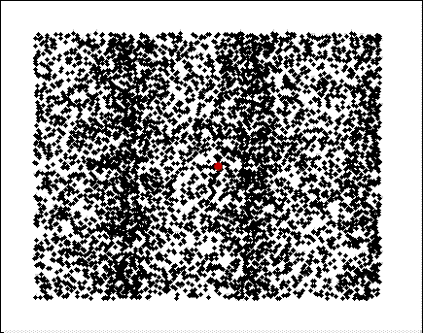
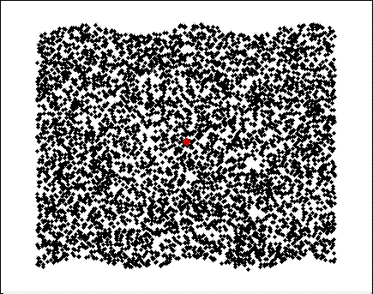
Why do we need to apply a phase shift?
P waves – cos²(θ)
S waves – sin(2θ)
Fiber
direction
θ
Propagation
direction
Animations courtesy of https://www.physics.byu.edu/research/acoustics/animationsWave.aspx
Notes:
Best place to start demonstrating that a velocity inversion method is attractive is showing its application on Marmousi, or the deep water variation of Marmousi
that you see displayed on the screen.
This is the “true” model, and …

Slide 29
Phase rotation around a smooth corner of array
Pawnee
Ferndale
EQ
N
EQ
N
Notes:
Best place to start demonstrating that a velocity inversion method is attractive is showing its application on Marmousi, or the deep water variation of Marmousi
that you see displayed on the screen.
This is the “true” model, and …

Slide 30
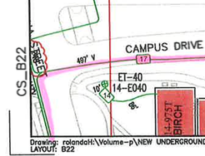
Phase rotation around a smooth corner of array
Pawnee
Ferndale
EQ
N
EQ
N
Notes:
Best place to start demonstrating that a velocity inversion method is attractive is showing its application on Marmousi, or the deep water variation of Marmousi
that you see displayed on the screen.
This is the “true” model, and …

Slide 31
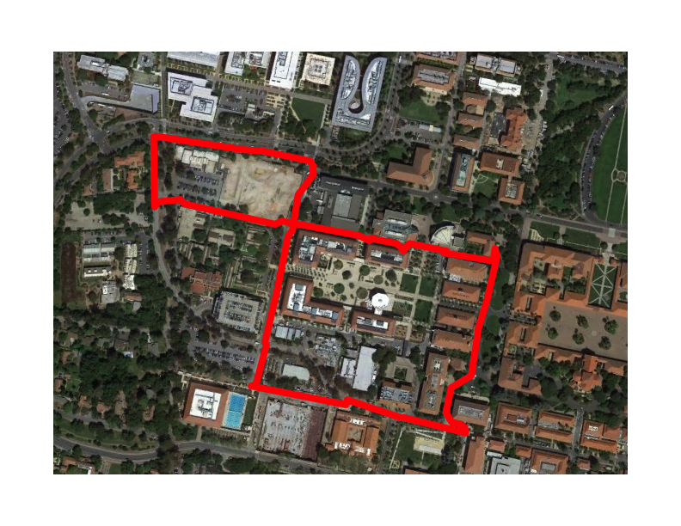
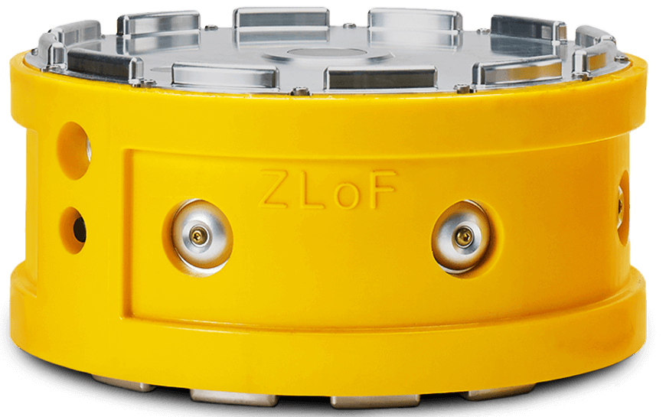
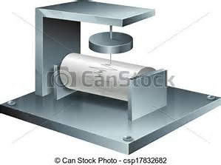
What’s next?
Analyze data we recently recorded with an active seismic survey with conventional 3C geophones along DAS array
  ~100 Fairfield Zland 3C
  Betsy gun source
  Objective #1: Compare with DAS recordings
  Objective #2: Image fault underneath Earth Sciences Mitchell Building
Install 2-3 broadband seismometers in manholes
Notes:
Best place to start demonstrating that a velocity inversion method is attractive is showing its application on Marmousi, or the deep water variation of Marmousi
that you see displayed on the screen.
This is the “true” model, and …

Slide 32
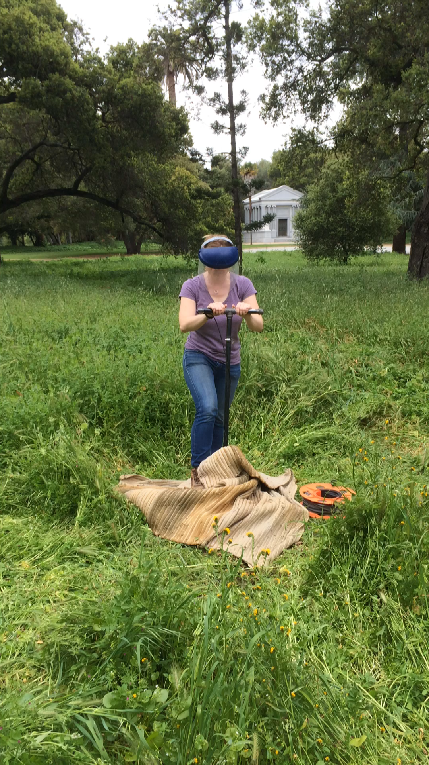
What’s next?
Analyze data we recently recorded with an active seismic survey with conventional 3C geophones along DAS array
  ~100 Fairfield Zland 3C
  Betsy gun source
  Objective #1: Compare with DAS recordings
  Objective #2: Image fault underneath Earth Sciences Mitchell Building
Install 2-3 broadband seismometers in manholes
Notes:
Best place to start demonstrating that a velocity inversion method is attractive is showing its application on Marmousi, or the deep water variation of Marmousi
that you see displayed on the screen.
This is the “true” model, and …

Slide 33
Conclusions
  We can continuously listen to, and hear it well, the Earth by cost-effective DAS arrays with fibers laid in PVC conduits.
  Kinematic and waveform information can be recovered from DAS data for:
    Event localization
    Source mechanism analysis (??)
  DAS array data need new signal processing methods and customized algorithms for real-time processing and event extraction.
Notes:
Best place to start demonstrating that a velocity inversion method is attractive is showing its application on Marmousi, or the deep water variation of Marmousi
that you see displayed on the screen.
This is the “true” model, and …

Slide 34
Acknowledgments
  OptaSense for DAS equipment loan.
  Bob Clapp and numerous other SEPers for help.
  Stanford’s Fiber Telecom Team for logistics and patience.
  Stanford Center for Computational Earth and Environmental Science for computational support.
  “Stanford Earth” IT for hosting OptaSense equipment.
Notes:
Best place to start demonstrating that a velocity inversion method is attractive is showing its application on Marmousi, or the deep water variation of Marmousi
that you see displayed on the screen.
This is the “true” model, and …

Slide 35
Can we use interferometry with DAS array? Yes
Channel 100
Channel 50
Cross-coherency on 0.2-7.0 Hz data
Velocity ~500 m/s
48 hours of recording (6 nights)
Cross-coherency on 0.2-5.0 Hz data
Velocity ~650 m/s
48 hours of recording (6 nights)
Velocity decreases with frequency
Notes:
Best place to start demonstrating that a velocity inversion method is attractive is showing its application on Marmousi, or the deep water variation of Marmousi
that you see displayed on the screen.
This is the “true” model, and …

Slide 36
Passive reservoir monitoring
Microseismic
P & S waves
Sensitivity & freq. response
Localization ⬄ kinematics
Source mechanism ⬄ polarity
Angular sensitivity of DAS
Kuvshinov (Geo. Prosp., 2015)
Time-lapse interferometry
Surface waves (.2-2Hz)
Subsurface changes at 0-300 m
Daily changes are observable
Valhall Δ=2010-2004
de Ridder and Biondi (GRL, 2013)

Slide 37
Going around a smooth corner
N
3
3
3
2
3
4
5
6
1
7
0
Pawnee
Ferndale
EQ
EQ
N
N
Notes:
Best place to start demonstrating that a velocity inversion method is attractive is showing its application on Marmousi, or the deep water variation of Marmousi
that you see displayed on the screen.
This is the “true” model, and …

Slide 38
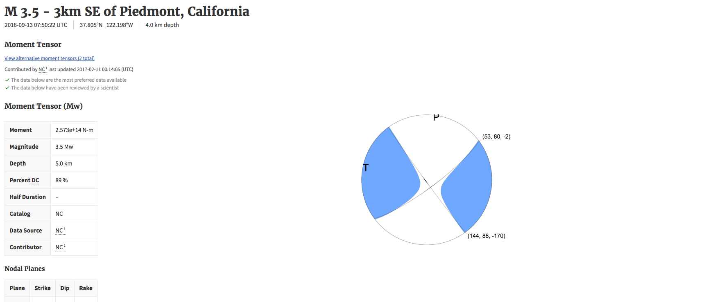
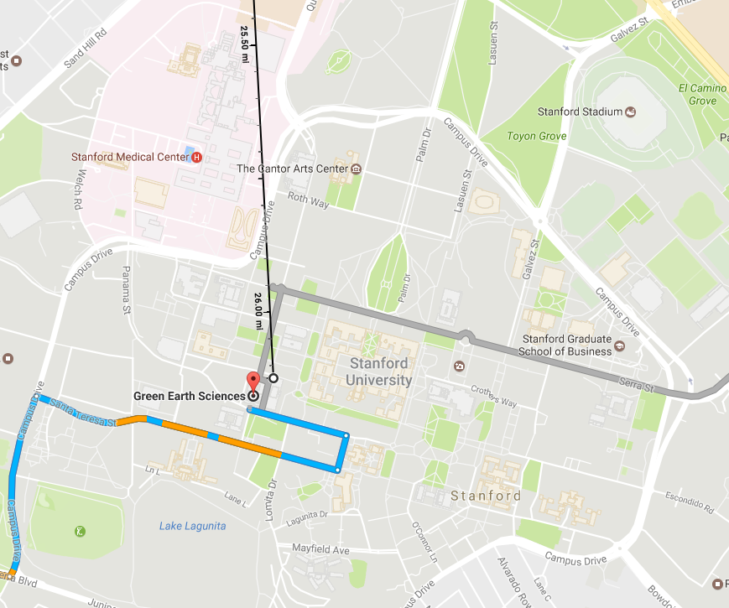
N
Piedmont EQ
0
1
2
3
4
5
6
7
3
2
4
5
6
1
7
0
EQ
Distance 26 miles
Depth 4 km
11:48 pm
N
Notes:
Best place to start demonstrating that a velocity inversion method is attractive is showing its application on Marmousi, or the deep water variation of Marmousi
that you see displayed on the screen.
This is the “true” model, and …

Slide 39
Distance 26 miles
Depth 4 km
11:48 pm
N
Piedmont EQ
0
1
2
3
4
5
6
7
3
2
4
5
6
1
7
Band-passed
0
EQ
N
Notes:
Best place to start demonstrating that a velocity inversion method is attractive is showing its application on Marmousi, or the deep water variation of Marmousi
that you see displayed on the screen.
This is the “true” model, and …

Slide 40
Distance 26 miles
Depth 4 km
11:48 pm
N
Piedmont EQ
3
2
4
5
1,030 m/s – 3 Hz
6
1
7
Windowed
0
EQ
N
Notes:
Best place to start demonstrating that a velocity inversion method is attractive is showing its application on Marmousi, or the deep water variation of Marmousi
that you see displayed on the screen.
This is the “true” model, and …

