Slide 1

The search for P-waves at Forties
Z-Z
P-P
Jason P. Chang
SEP Annual Meeting
April 18, 2017
Galveston, TX
Stanford
Exploration
Project

Slide 2
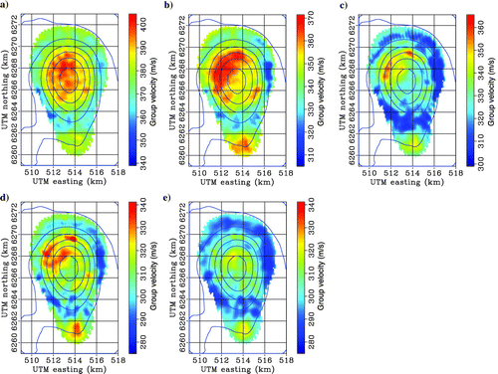
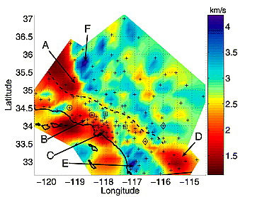
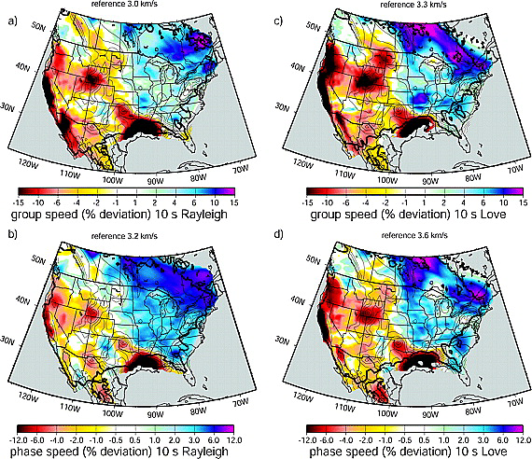
Surface-wave extraction from ambient noise
Marine
Land
Sabra, et al. (2005)
de Ridder and Biondi (2015)
Chang, et al. (2016)
de Ridder and Dellinger (2011)
Bensen, et al. (2008)

Slide 3
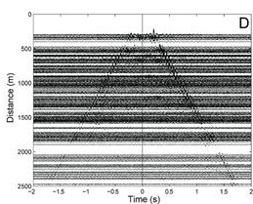
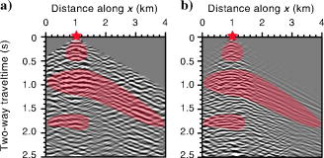
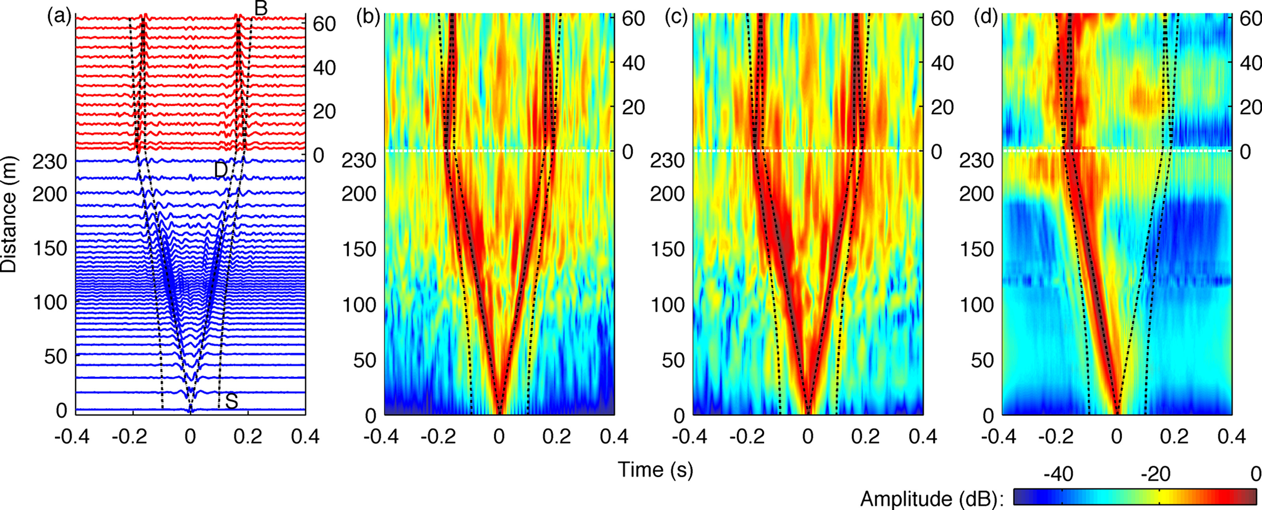
Body-wave extraction from ambient noise
Marine
Land
Mordret et al. (2013)
Draganov et al. (2009)
Brooks and Gerstoft (2009)
Nakata, et al. (2015)

Slide 4
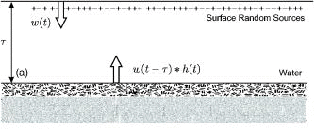
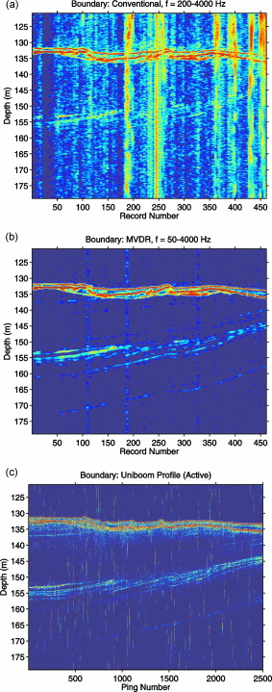
Passive fathometry
Harness energy from breaking waves at the sea surface
Gerstoft et al. (2008)
Correlate up- and down-going energy to obtain shallow reflection image
Siderius et al. (2010)

Slide 5
Outline
Apache Forties continuous data set
Seismic interferometry
Passive fathometry
Summary

Slide 6
Apache Forties
Bravo
Ocean-bottom node survey
  4C nodes
  Coil shooting
Three platforms
Goal: image gas pockets below and near platform
Source
Node

Slide 7
Bravo survey
Bravo
Spatial information
  Number of nodes: 52
  Average node spacing: 50 m
  Array max offset: 400 m
  Water depth: 120 m
Temporal information
  Recording duration: 4 days
  Sampling rate: 2 ms
Source
Node

Slide 8
Spectrogram—full recording

Slide 9
Spectrogram—kept recordings

Slide 10
Outline
Apache Forties continuous data set
Seismic interferometry
Passive fathometry
Summary

Slide 11
Ambient noise cross-correlation
E,N,Z,H recordings
30 min windows, 50% overlap
Calculate cross-coherence
Stack
Virtual source gathers

Slide 12
Ambient noise cross-correlation
E,N,Z,H recordings
30 min windows, 50% overlap
Calculate cross-coherence
Stack
Virtual source gathers

Slide 13
Ambient noise cross-correlation
E,N,Z,H recordings
30 min windows, 50% overlap
Calculate cross-coherence
Stack
Virtual source gathers

Slide 14
Correlations 40-80 Hz (by offset)
P-P
Z-Z

Slide 15
Correlations 40-80 Hz (by offset)
P-P

Slide 16
Correlations 40-80 Hz (by offset)
P-P
Linear event moving away from the platform

Slide 17
Correlations 40-80 Hz (by offset)
P-P
Linear event moving away from the platform
Linear event moving toward the platform

Slide 18
Correlations 40-80 Hz (by offset)
Z-Z

Slide 19
Correlations 40-80 Hz (by offset)
Z-Z
Fast linear event moving away from the platform

Slide 20
Correlations 40-80 Hz (by offset)
Z-Z
Fast linear event moving away from the platform
Fast linear event moving away from the platform

Slide 21
Ambient noise cross-correlation
E,N,Z,H recordings
30 min windows, 50% overlap
Calculate cross-coherence
Stack
Virtual source gathers

Slide 22
Ambient noise cross-correlation
E,N,Z,H recordings
30 min windows, 50% overlap
Calculate cross-coherence
Stack
Phase-weighted stack
Virtual source gathers

Slide 23
Phase-weighted stack
Notes:
p(t) = \frac{1}{N} \sum^{N}_{j=1} s_j(t) \left| \frac{1}{N} \sum^{N}_{k=1} \text{exp}\left[ i \Phi_k(t) \right]\right|^v

Slide 24
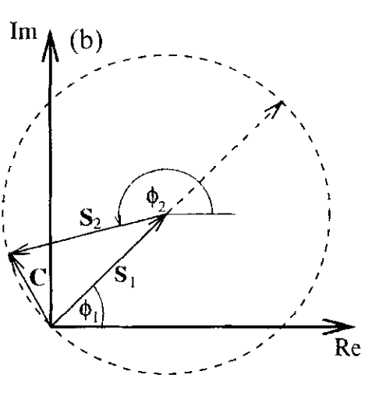
Phase-weighted stack
Phase stack
Schimmel and Paulssen (1997)
Coherent instantaneous phase weighted toward 1
Incoherent instantaneous phase weighted toward 0
Notes:
p(t) = \frac{1}{N} \sum^{N}_{j=1} s_j(t) \left| \frac{1}{N} \sum^{N}_{k=1} \text{exp}\left[ i \Phi_k(t) \right]\right|^v

Slide 25
Phase-weighted stack
Phase stack
Linear stack
Notes:
p(t) = \frac{1}{N} \sum^{N}_{j=1} s_j(t) \left| \frac{1}{N} \sum^{N}_{k=1} \text{exp}\left[ i \Phi_k(t) \right]\right|^v

Slide 26
Correlations 40-80 Hz (by offset)
P-P
Linear stack
Z-Z

Slide 27
Correlations 40-80 Hz (by offset)
P-P
Phase-weighted stack
Z-Z

Slide 28
Correlations 40-80 Hz (by offset)
Linear stack
P-P
Linear event moving away from the platform
Linear event moving toward the platform

Slide 29
Correlations 40-80 Hz (by offset)
Phase-weighted stack
P-P
Linear event moving away from the platform
Fast linear event moving away from the platform
Linear event moving toward the platform

Slide 30
Tau-p transform
P-P
Linear event moving away from the platform
Fast linear event moving away from the platform
Linear event moving toward the platform

Slide 31
Tau-p transform
P-P
Linear event moving away from the platform – 1500 m/s, 0 s
Fast linear event moving away from the platform
Linear event moving toward the platform

Slide 32
Tau-p transform
P-P
Linear event moving away from the platform – 1500 m/s, 0 s
Fast linear event moving away from the platform – 3000 m/s, 0 s
Linear event moving toward the platform

Slide 33
Tau-p transform
P-P
Linear event moving away from the platform – 1500 m/s, 0 s
Fast linear event moving away from the platform – 3000 m/s, 0 s
Linear event moving toward the platform – 1500 m/s, 0 s

Slide 34
Correlations 40-80 Hz (by offset)
Linear stack
Z-Z
Fast linear event moving away from the platform
Fast linear event moving away from the platform

Slide 35
Correlations 40-80 Hz (by offset)
Phase-weighted stack
Z-Z
Fast linear event moving away from the platform
Fast linear event moving away from the platform

Slide 36
Tau-p transform
Z-Z
Fast linear event moving away from the platform
Fast linear event moving away from the platform

Slide 37
Tau-p transform
Z-Z
Fast linear event moving away from the platform
Fast linear event moving away from the platform – 3000 m/s, 0 s

Slide 38
Tau-p transform
Z-Z
Fast linear event moving away from the platform – 3000 m/s, 0.15 s
Fast linear event moving away from the platform – 3000 m/s, 0 s

Slide 39
Three events
P-P
Velocity: 1500 m/s
Intercept time: 0 s
Direction: toward and away from platform
Component: P-P
2) Velocity: 3000 m/s
Intercept time: 0 s
Direction: away from platform
Components: P-P, Z-Z
3) Velocity: 3000 m/s
Intercept time: 0.15 s
Direction: away from platform
Component: Z-Z
Z-Z

Slide 40
Three events
P-P
Velocity: 1500 m/s
Intercept time: 0 s
Direction: toward and away from platform
Component: P-P
2) Velocity: 3000 m/s
Intercept time: 0 s
Direction: away from platform
Components: P-P, Z-Z
3) Velocity: 3000 m/s
Intercept time: 0.15 s
Direction: away from platform
Component: Z-Z
Z-Z

Slide 41
Three events
P-P
Velocity: 1500 m/s
Intercept time: 0 s
Direction: toward and away from platform
Component: P-P
2) Velocity: 3000 m/s
Intercept time: 0 s
Direction: away from platform
Components: P-P, Z-Z
3) Velocity: 3000 m/s
Intercept time: 0.15 s
Direction: away from platform
Component: Z-Z
Z-Z

Slide 42
Three events
P-P
Velocity: 1500 m/s
Intercept time: 0 s
Direction: toward and away from platform
Component: P-P
2) Velocity: 3000 m/s
Intercept time: 0 s
Direction: away from platform
Components: P-P, Z-Z
3) Velocity: 3000 m/s
Intercept time: 0.15 s
Direction: away from platform
Component: Z-Z
Z-Z

Slide 43
Three events
P-P
Velocity: 1500 m/s
Intercept time: 0 s
Direction: toward and away from platform
Component: P-P
2) Velocity: 3000 m/s
Intercept time: 0 s
Direction: away from platform
Components: P-P, Z-Z
3) Velocity: 3000 m/s
Intercept time: 0.15 s
Direction: away from platform
Component: Z-Z
Z-Z

Slide 44
Three “line” gathers
N-S
E-W
NE-SW

Slide 45
N-S line (P-P)

Slide 46
N-S line (P-P)

Slide 47
N-S line (P-P)
Propagating from north to south

Slide 48
N-S line (P-P)
Propagating from north to south

Slide 49
N-S line (P-P) – LMO (1500 m/s)
Propagating from north to south
Moving at 1500 m/s

Slide 50
N-S line (P-P)

Slide 51
N-S line (P-P)

Slide 52
N-S line (P-P)
Platform location

Slide 53
N-S line (P-P)
Platform location
Propagating from the platform

Slide 54
N-S line (P-P) – LMO (3000 m/s)
Platform location
Propagating from the platform
Moving at 3000 m/s

Slide 55
N-S line (Z-Z)
Platform location

Slide 56
N-S line (Z-Z)
Platform location
Propagating from the platform

Slide 57
N-S line (Z-Z) – LMO (3000 m/s)
Platform location
Propagating from the platform
Moving at 3000 m/s

Slide 58
N-S line
Original
LMO 3000 m/s
Z-Z
LMO 1500 m/s
P-P

Slide 59
E-W line
Original
LMO 3000 m/s
Z-Z
LMO 1500 m/s
P-P

Slide 60
NE-SW line
Original
LMO 3000 m/s
Z-Z
LMO 1500 m/s
P-P

Slide 61
Three events
P-P
Velocity: 1500 m/s
Intercept time: 0 s
Direction: toward and away from platform
Component: P-P
2) Velocity: 3000 m/s
Intercept time: 0 s
Direction: away from platform
Components: P-P, Z-Z
3) Velocity: 3000 m/s
Intercept time: 0.15 s
Direction: away from platform
Component: Z-Z
Z-Z

Slide 62
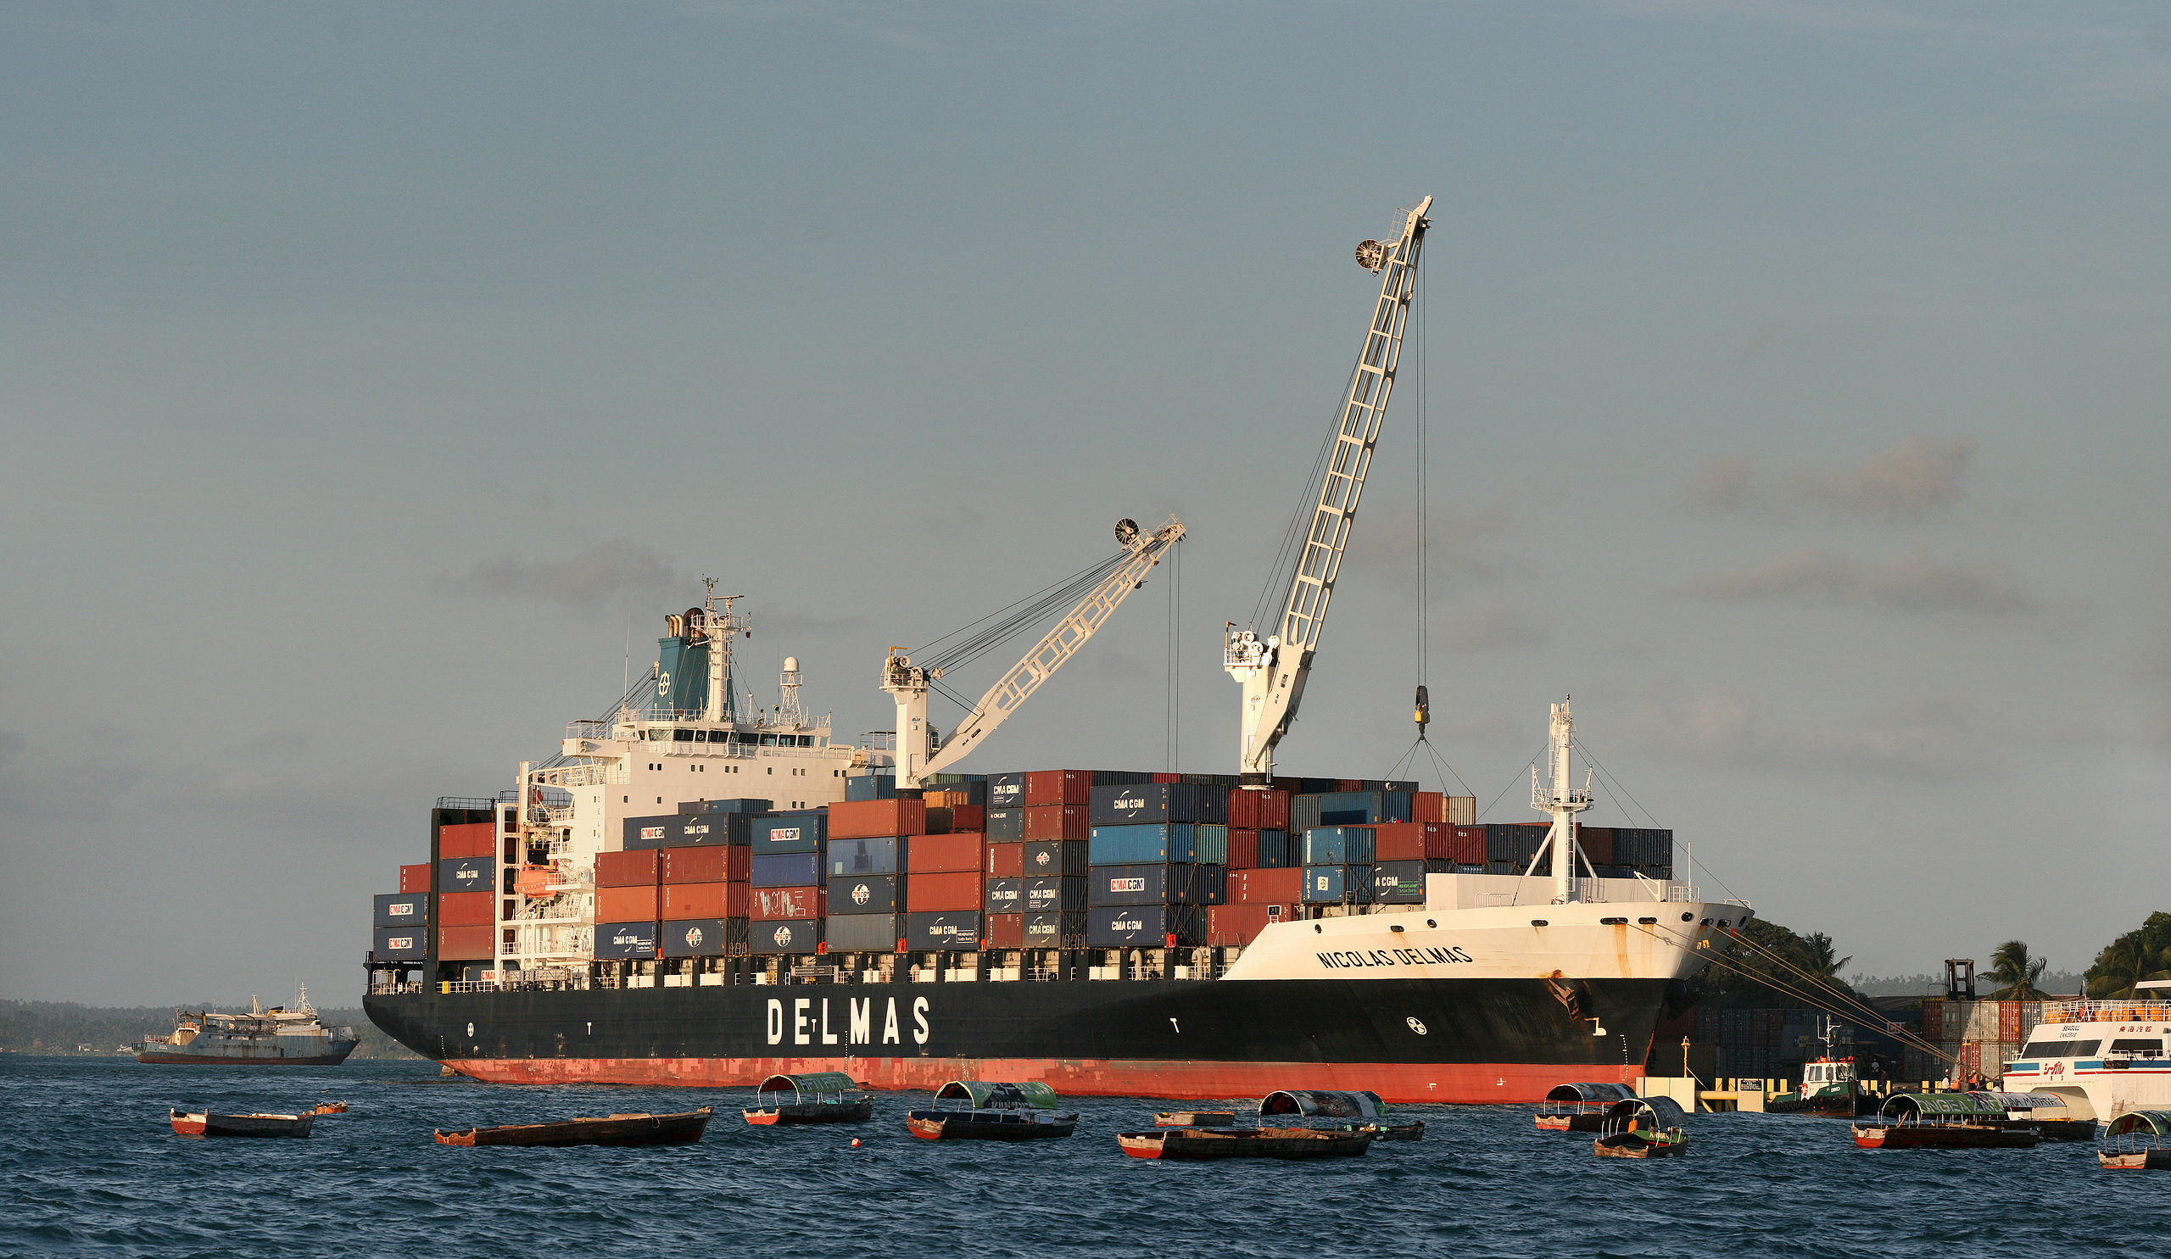
Three events
Velocity: 1500 m/s
Intercept time: 0 s
Source: from the northeast (horizontally traveling)
Component: P-P
2) Velocity: 3000 m/s
Intercept time: 0 s
Direction: away from platform
Components: P-P, Z-Z
3) Velocity: 3000 m/s
Intercept time: 0.15 s
Direction: away from platform
Component: Z-Z

Slide 63
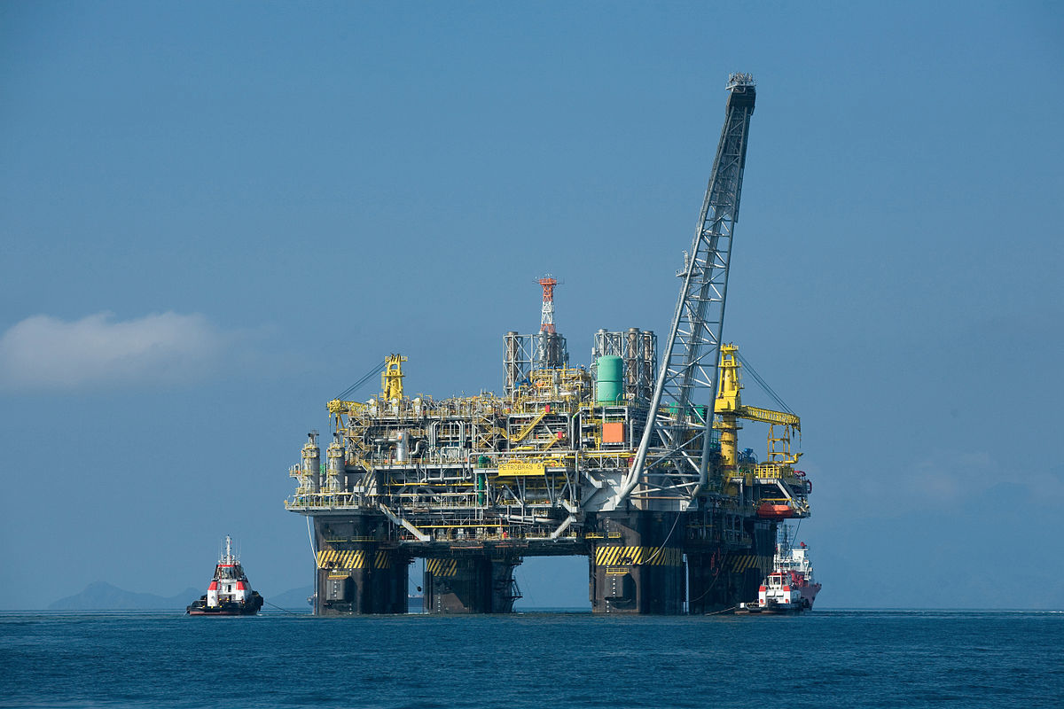
Three events
Velocity: 1500 m/s
Intercept time: 0 s
Source: from the northeast (horizontally traveling)
Component: P-P
2) Velocity: 3000 m/s
Intercept time: 0 s
Source: platform (some vertical propagation)
Components: P-P, Z-Z
3) Velocity: 3000 m/s
Intercept time: 0.15 s
Direction: away from platform
Component: Z-Z

Slide 64
Three events
Velocity: 1500 m/s
Intercept time: 0 s
Source: from the northeast (horizontally traveling)
Component: P-P
2) Velocity: 3000 m/s
Intercept time: 0 s
Source: platform (some vertical propagation)
Components: P-P, Z-Z
3) Velocity: 3000 m/s
Intercept time: 0.15 s
Source: platform (some vertical propagation, could be a multiple)
Component: Z-Z

Slide 65
Outline
Apache Forties continuous data set
Seismic interferometry
Passive fathometry
Summary

Slide 66
Passive fathometry
Harness energy from breaking waves at the sea surface
Gerstoft et al. (2008)
Correlate up- and down-going energy to obtain shallow reflection image
Siderius et al. (2010)

Slide 67
Passive fathometry workflow
30 min windows, 50% overlap
Perform up-down separation
Cross-correlate
Phase-weighted stack
Passive fathometer
Notes:
P_{\text{up}}(\omega) = \frac{1}{2}\left[P(\omega) + a(\omega) \rho c Z(\omega)\right]
P_{\text{down}}(\omega) = \frac{1}{2}\left[P(\omega) - a(\omega) \rho c Z(\omega)\right]

Slide 68
Passive fathometry workflow
30 min windows, 50% overlap
Perform up-down separation
Cross-correlate
Phase-weighted stack
Passive fathometer
Notes:
P_{\text{up}}(\omega) = \frac{1}{2}\left[P(\omega) + a(\omega) \rho c Z(\omega)\right]
P_{\text{down}}(\omega) = \frac{1}{2}\left[P(\omega) - a(\omega) \rho c Z(\omega)\right]

Slide 69
Passive fathometry geometry
Traditional
OBN
Adaptive beamforming
PZ summation

Slide 70
PZ summation (acoustic decomposition)

Slide 71
PZ summation (acoustic decomposition)
Simplifying assumption:
passive energy arrives at near-vertical incidence

Slide 72
PZ summation (acoustic decomposition)
Simplifying assumption:
passive energy arrives at near-vertical incidence

Slide 73
PZ summation (acoustic decomposition)
Simplifying assumption:
passive energy arrives at near-vertical incidence
Vertical slowness is just inverse of water velocity
Notes:
P_{\text{up}}(\omega) = \frac{1}{2}\left[P(\omega) + a(\omega) \rho c Z(\omega)\right]
P_{\text{down}}(\omega) = \frac{1}{2}\left[P(\omega) - a(\omega) \rho c Z(\omega)\right]

Slide 74
PZ summation (acoustic decomposition)
Simplifying assumption:
passive energy arrives at near-vertical incidence
Vertical slowness is just inverse of water velocity
Focus on near-offset reflections for estimating calibration coefficient (Biondi and Levin, 2014)
Notes:
P_{\text{up}}(\omega) = \frac{1}{2}\left[P(\omega) + a(\omega) \rho c Z(\omega)\right]
P_{\text{down}}(\omega) = \frac{1}{2}\left[P(\omega) - a(\omega) \rho c Z(\omega)\right]

Slide 75
Up-down separation
Up-going
Down-going

Slide 76
Passive fathometry for OBN
Simplifying assumption:
passive energy arrives at near-vertical incidence
Vertical slowness is just inverse of water velocity
Focus on near-offset reflections for estimating calibration coefficient (Biondi and Levin, 2014)
Notes:
P_{\text{up}}(\omega) = \frac{1}{2}\left[P(\omega) + a(\omega) \rho c Z(\omega)\right]
P_{\text{down}}(\omega) = \frac{1}{2}\left[P(\omega) - a(\omega) \rho c Z(\omega)\right]

Slide 77
Passive fathometry workflow
30 min windows, 50% overlap
Perform up-down separation
Cross-correlate
Phase-weighted stack
Passive fathometer

Slide 78
Passive fathometry (20-220 Hz)
Node 1
Node 2
Node 3
Node 4
Gain function t applied: damp 0 s event, enhance later events

Slide 79
Passive fathometry (20-220 Hz)
Node 1
Node 2
Node 3
Node 4
Water column multiples?
Gain function t applied: damp 0 s event, enhance later events

Slide 80
Passive fathometry (20-220 Hz)
Node 1
Node 2
Node 3
Node 4
Potential reflections?
Gain function t applied: damp 0 s event, enhance later events

Slide 81
Thoughts on passive fathometry
Potentially obtaining real events
  Water column multiples
  Subsurface reflections
Areas for improvement
  Exploiting array geometries
  Looking only at times of stormy weather

Slide 82
Outline
Apache Forties continuous data set
Seismic interferometry
Passive fathometry
Summary

Slide 83
Summary
Interferometry
Phase-weighted stack improves SNR
Three events:
  Horizontally-propagating P-wave at water velocity from distant sources
  P-waves propagating with vertical component from platform region
Fathometry
Possible events
  Water-column multiple
  Subsurface reflections
Future work focused on determining whether these events are physical
Z-Z
H-H

Slide 84
Acknowledgments
Apache North Sea Limited for permission to show results
Biondo L. Biondi, Shuki Ronen, Stewart A. Levin, and Robert G. Clapp for useful discussions and help processing the data

Slide 85
Questions, comments, or suggestions?
Z-Z
H-H

